Slide 1
The Consumerization of IT - BYOD

Slide 2
BYOD
Eden Dahlstrom,
Director of Research EDUCAUSE
Stephen diFilipo,
Vice President and CIO,
Cecil College

Slide 3
BYOD

Slide 4
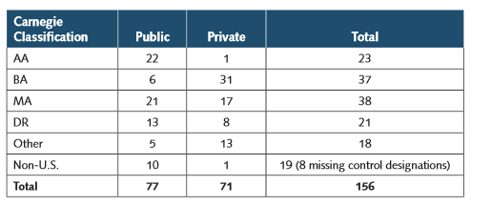
What Did ECAR Investigate?
Inside and Outside Industry Trends for BYO
IT Leader Interviews
Focus Groups
ECAR Survey
A thematic ECAR study of about the current trends, issues, and practices for BYOE in higher education.

Slide 5
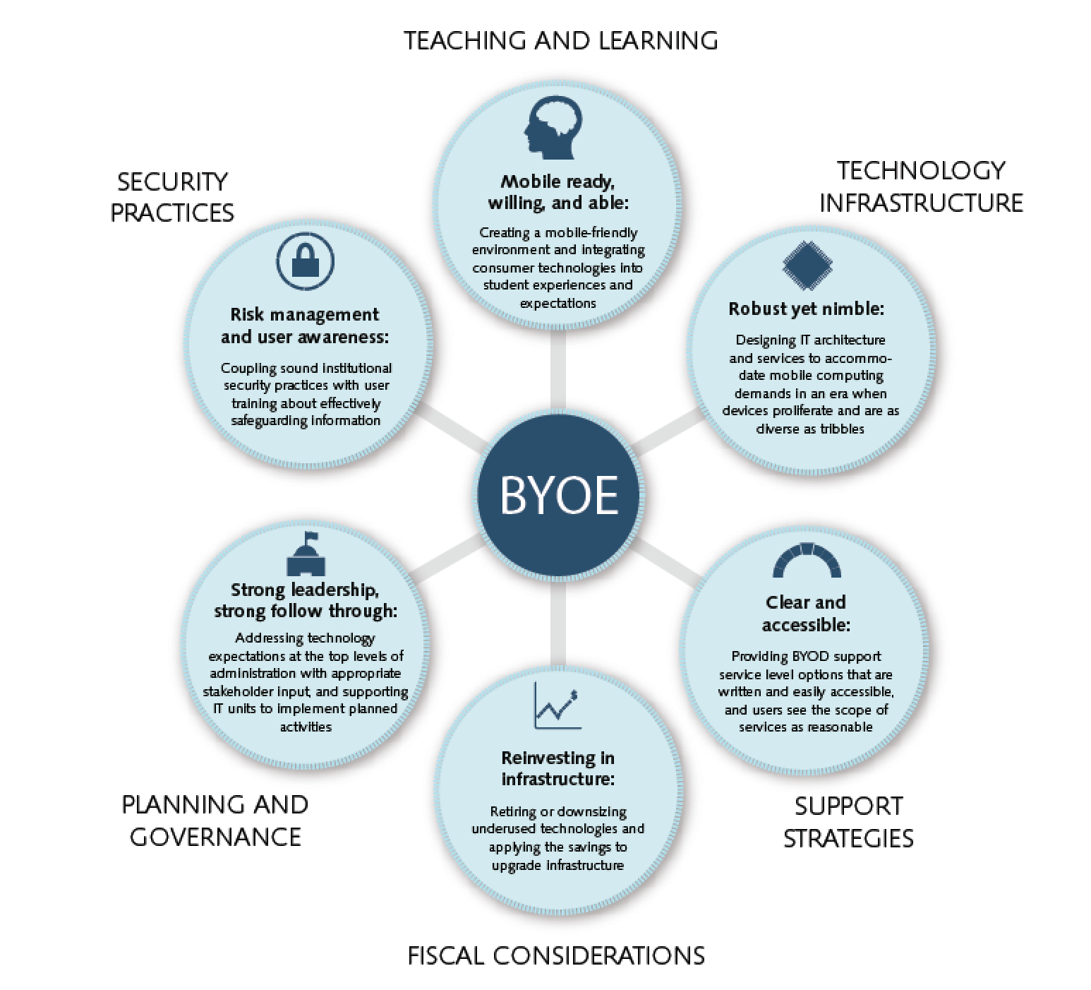
Our Framework

Slide 6
Poll Question 1:
What is the impact of BYOE on your campus?
Meh, we are taking it in stride –
OMG!, we are kind of freaking out about it –
Whatevs, it will work itself out –
945729
Pick your answer code
945730
945731
SMS Text: 37607 with [your answer code] as the message
Twitter: @Poll with [your answer code] as the Tweet
Direct Link: http://PollEv.com with [your answer code] in the box
Pick your response method

Slide 7
Results: What is the impact of BYOE on your campus?
103, on-demand responses at #EDU13

Slide 9
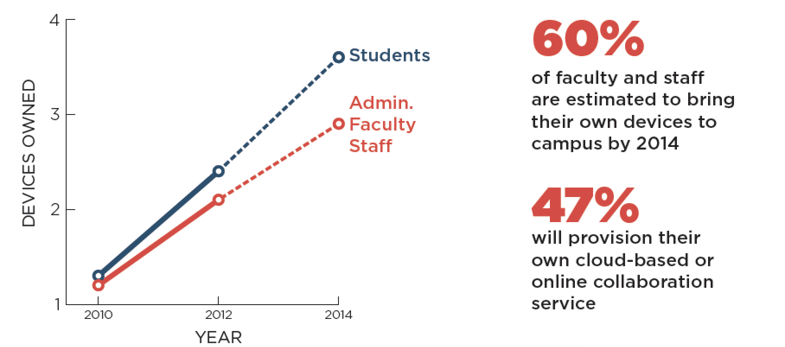
Device Proliferation Provides Opportunities and Challenges

Slide 10
Findings

Slide 11
What Matters Most
Planning Doesn’t Necessarily Precede Action for BYOE
A Solid Security Presence and Plan Can Adjust to Most BYOE Security Challenges
Cost Savings from BYO Can Be Elusive
Think of IT Infrastructure as “Middleware”
Support Strategies Will Need to Adapt to BYOE Environments
Implications for Teaching and Learning Excite IT Professionals the Most about BYO

Slide 12
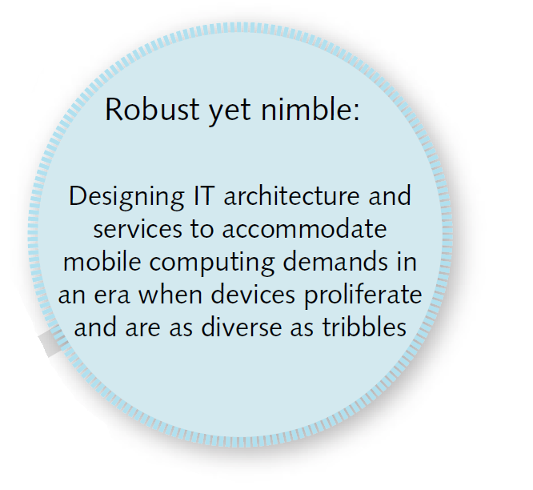
Technology Infrastructure

Slide 13
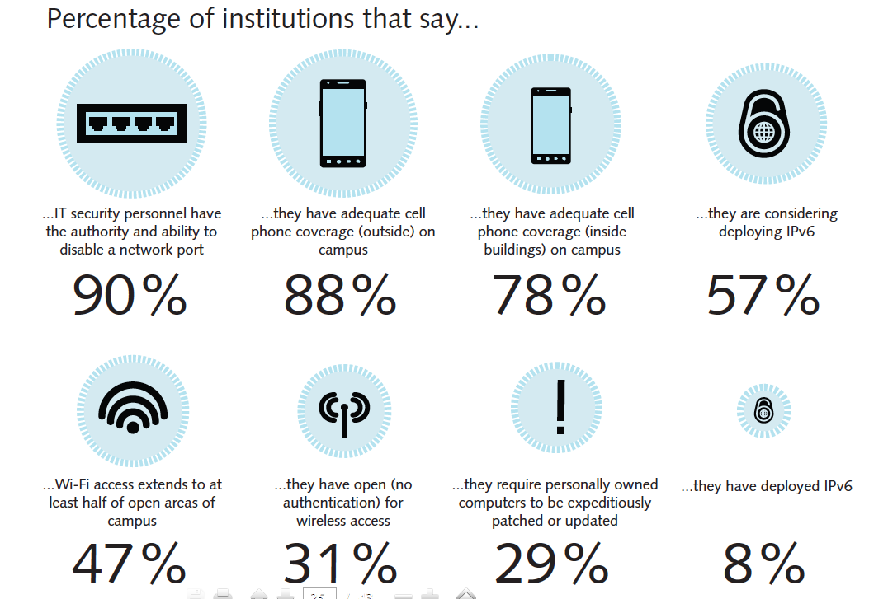
Current IT Practices that Relate to BYOE
Source:

Slide 14
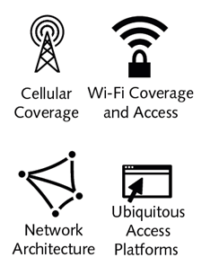
Ubiquitous and Frictionless Access
Including network Wi-Fi capabilities and open public Wi-Fi versus restricted network access
Including campus penetration of cellular coverage from main providers
Including bandwidth and Wi-Fi density ratios (i.e., number of devices per user)
Including access capabilities through device, apps, browsers, virtualized desktops, identify management tools, and cloud services

Slide 15
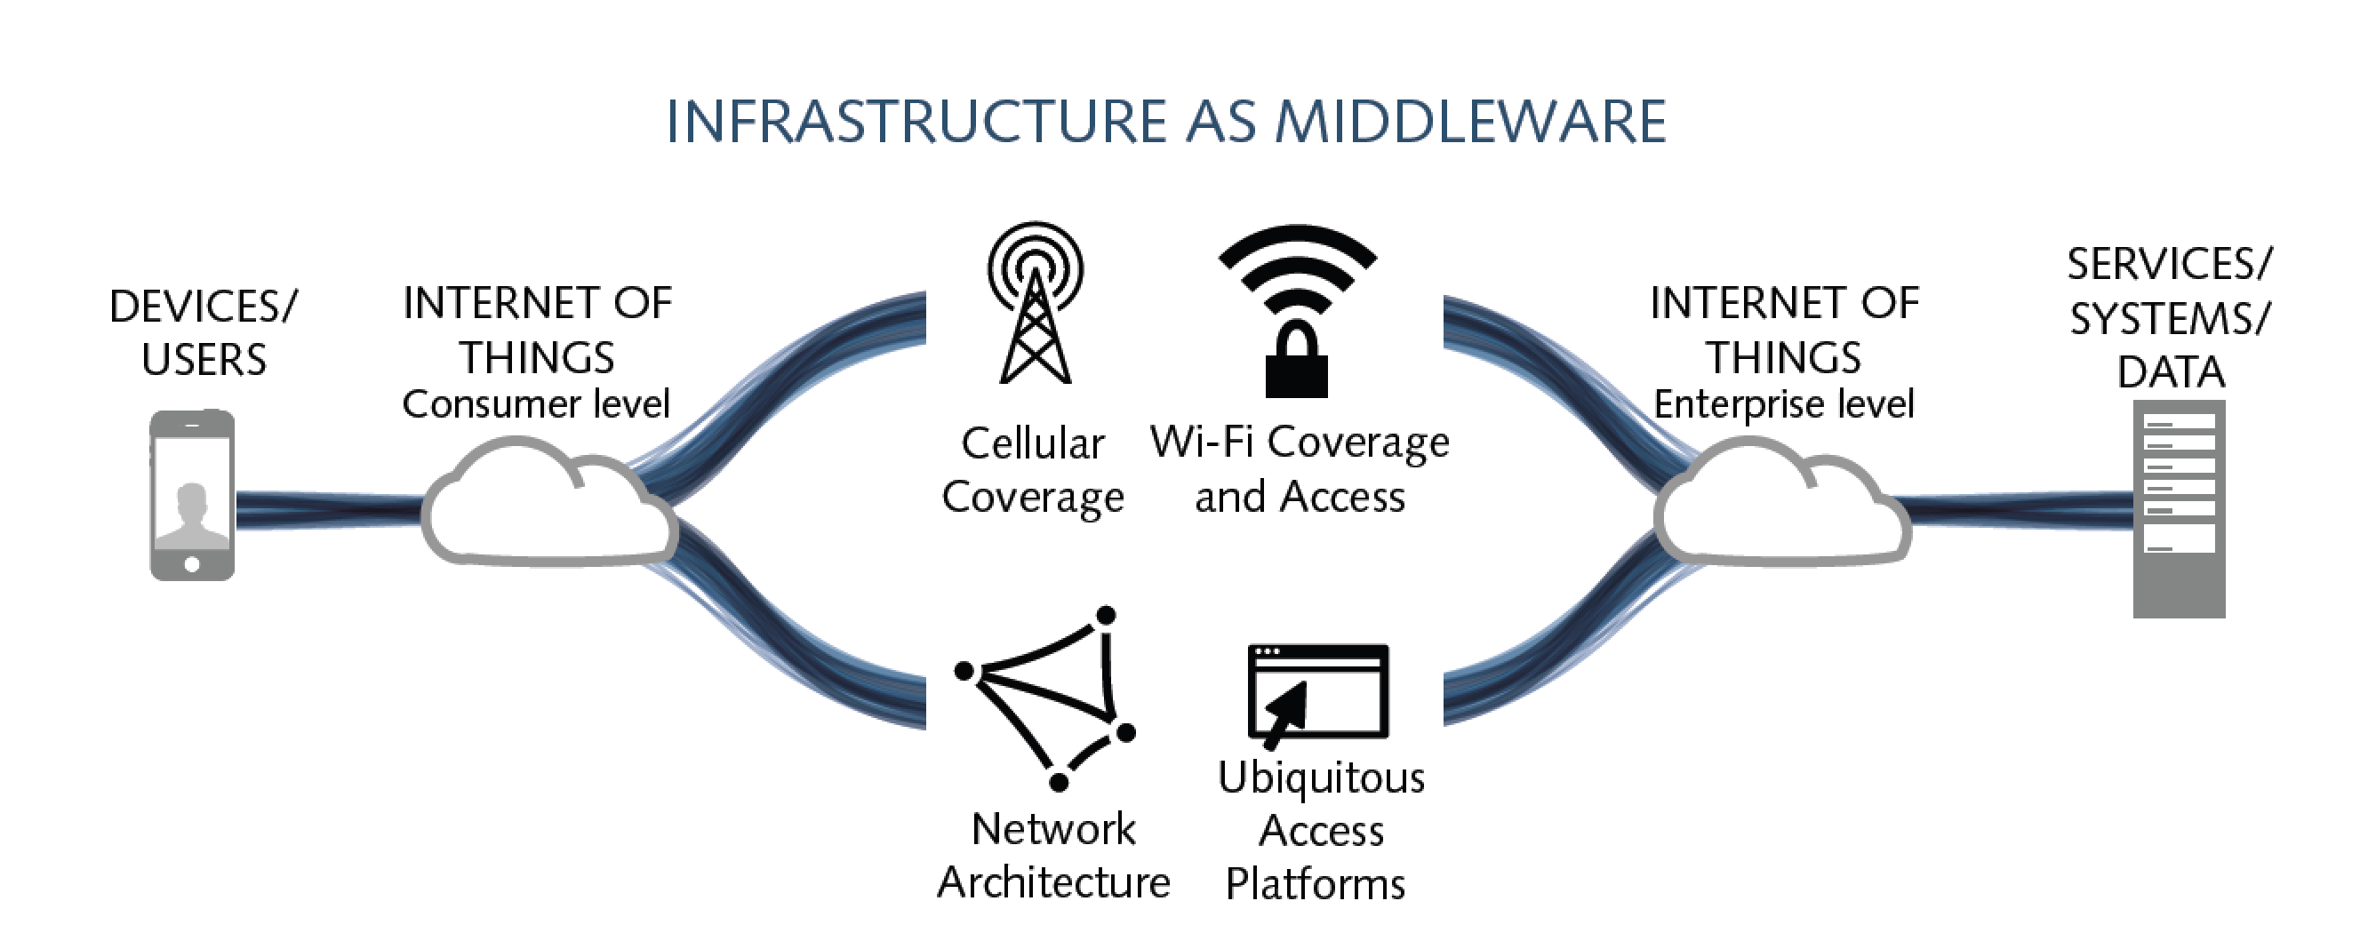
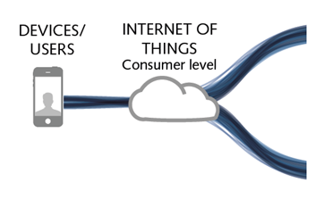
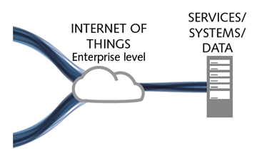
BYOE “Middleware”
The commodities that bridge users, their devices, and their consumer-level applications to the institution’s data.

Slide 16
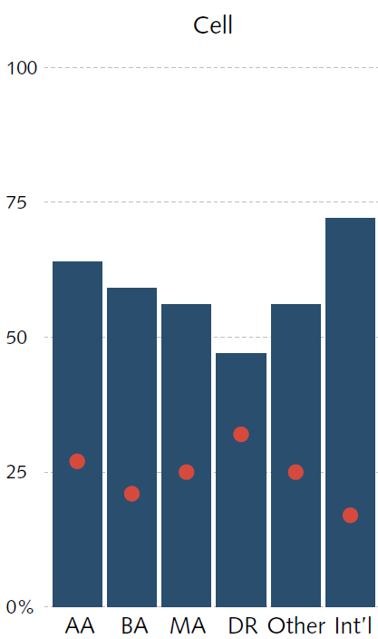
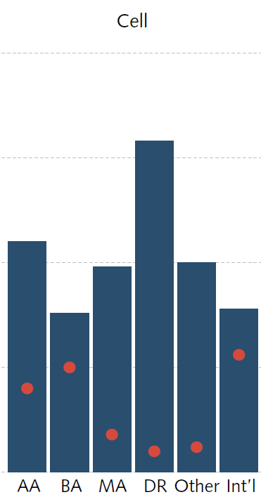
Infrastructure Adequacy and Upgrades
Present Adequacy of IT Infrastructure
Need to Upgrade IT Infrastructure
Though present accommodation of BYOE is adequate, most respondents expect infrastructure upgrades within two years for Wi-Fi and networks, in particular.
Have adequate coverage
Do not have adequate coverage
Need to upgrade
No need to upgrade
Cellular Service:
Adequate coverage is moderate
Plans to upgrade are (mostly) modest

Slide 17
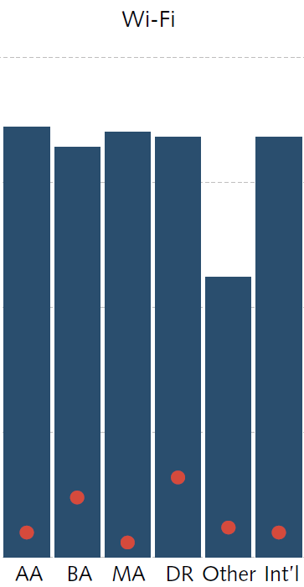
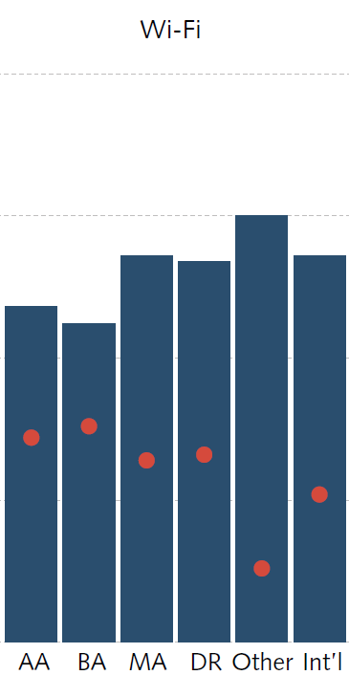
Infrastructure Adequacy and Upgrades
Present Adequacy of IT Infrastructure
Need to Upgrade IT Infrastructure
Need to upgrade
No need to upgrade
Have adequate coverage
Do not have adequate coverage
Wi-Fi Coverage:
Adequate coverage is moderate
Plans to upgrade are (mostly) robust

Slide 18
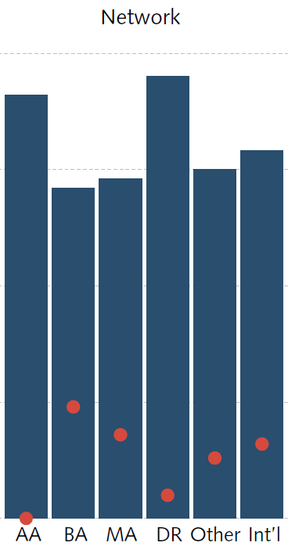
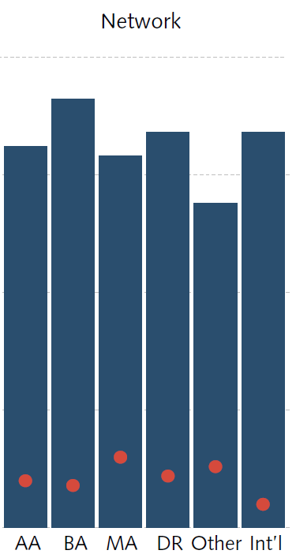
Infrastructure Adequacy and Upgrades
Present Adequacy of IT Infrastructure
Need to Upgrade IT Infrastructure
Networks:
Adequate coverage is robust
Plans to upgrade are robust
Have adequate coverage
Do not have adequate coverage
Need to upgrade
No need to upgrade

Slide 19
IT Infrastructure and the Student Experience
Ten challenges for using smartphones as learning tools.
34% slow network
34% inadequate battery
32% device usability issues
31% cost of data service
29% limited network access
25% cost of device
20% lack of apps
18% cost of apps
12% security/privacy concern
4% health concern

Slide 20
Priority for Improving IT Infrastructure

Slide 21
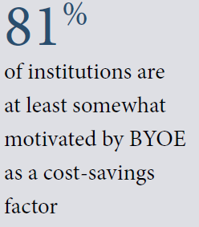
Infrastructure Upgrades and Budget

Slide 22
ECAR Recommends
Accepting that the cost to update/upgrade IT infrastructure can outweigh the cost savings from providing fewer institutionally provisioned devices and other technologies.
When retiring or downsizing underused technologies and applying the savings to upgrade infrastructure is a wise investment.
Invest in IT infrastructure “middleware” that is invisible, frictionless, and robust yet nimble in order to bridge the connection of users/devices and systems/services/data.

Slide 23
Poll Question 2:
What IT Infrastructure solutions are you seeking at your institution?
??
SMS Text: send a text to 37607 and include 955628 with your answer in the message
Twitter: Tweet @Poll and 955628 with your answer
Direct Link: Go to http://PollEv.com and include 955628 with your answer in the text box
Pick your response method

Slide 24
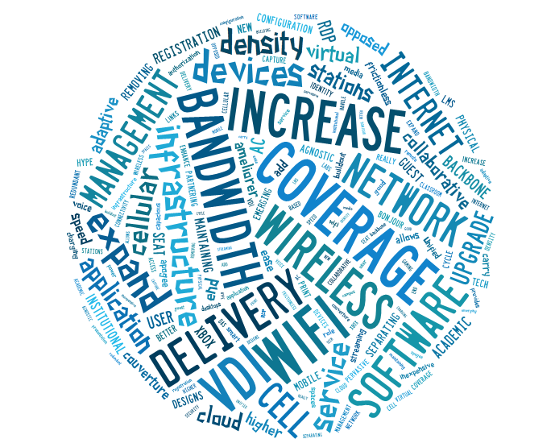
Results: What IT Infrastructure solutions are you seeking at your institution?
67, on-demand responses at #EDU13
Click chart below for access to raw poll results:

Slide 25
Notes:
http://www.polleverywhere.com/free_text_polls/g9cBZSGgjy6GqTf

Slide 26
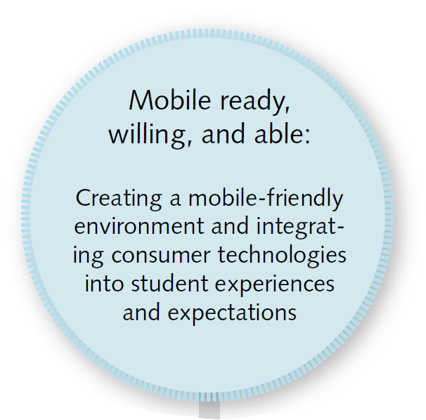
Teaching and Learning

Slide 27
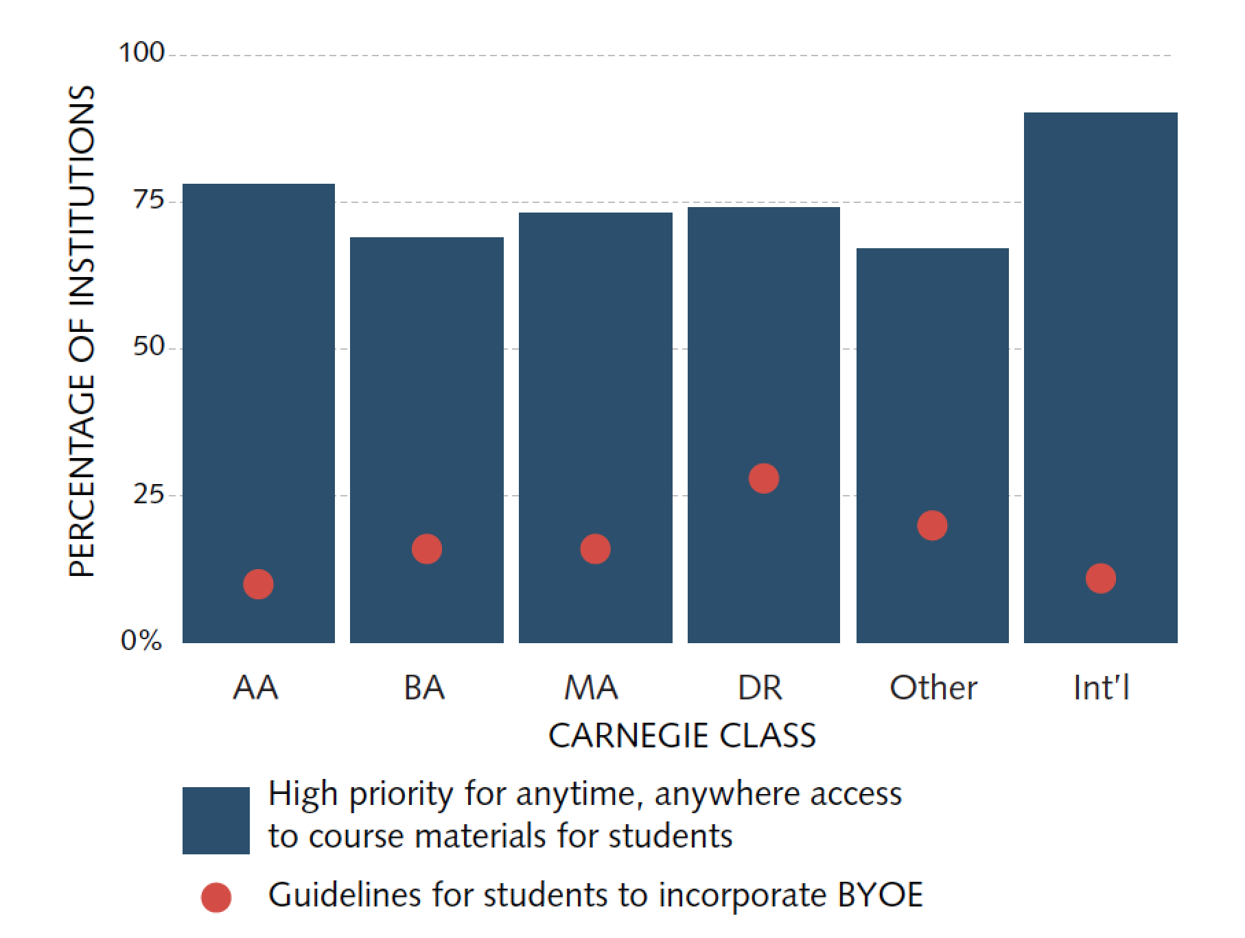
Facilitating Anytime, Anywhere Access is a Priority
Utilizing mobile technologies for T&L is a priority, but providing students guidance for how to do so is still rare.

Slide 28
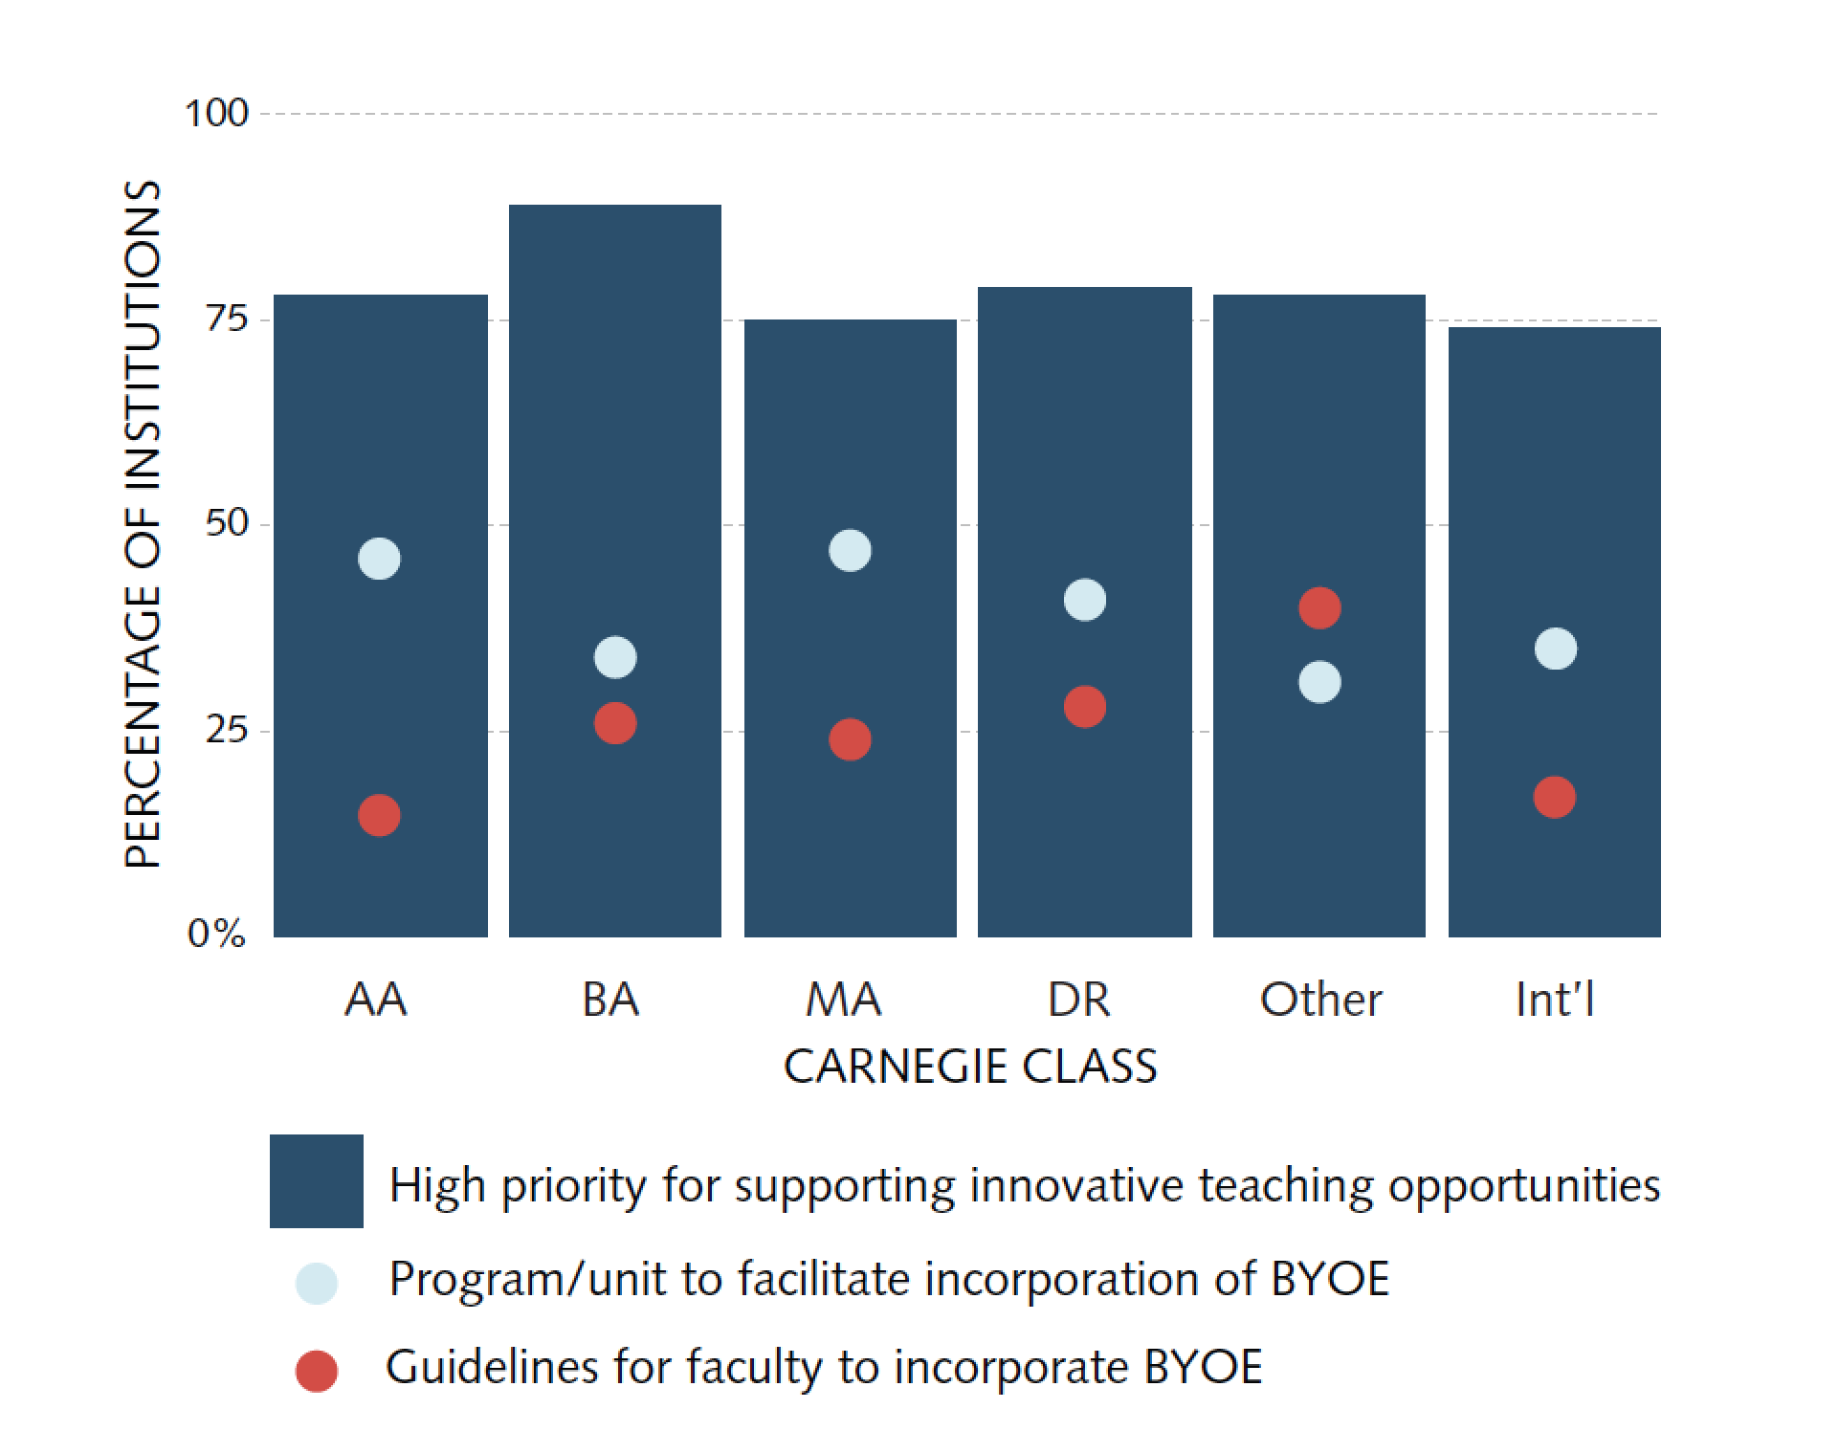
Supporting Innovative Teaching Opportunities is a Priority
Balancing academic freedom, professional development, and expectations for end-user experiences is important.

Slide 29
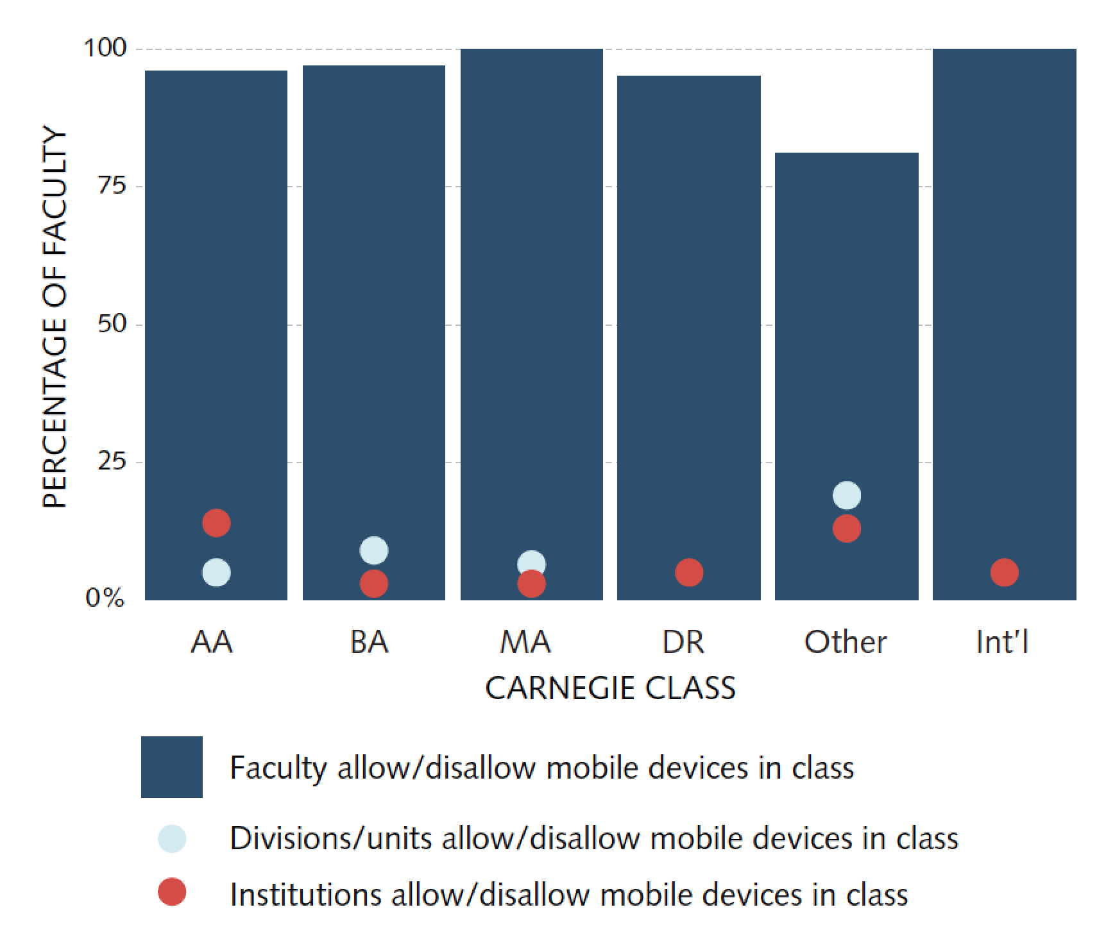
Authority for Allowing/Disallowing Mobile Devices in F2F Courses
How does this impact the student experience?

Slide 30
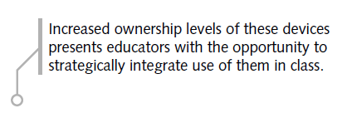
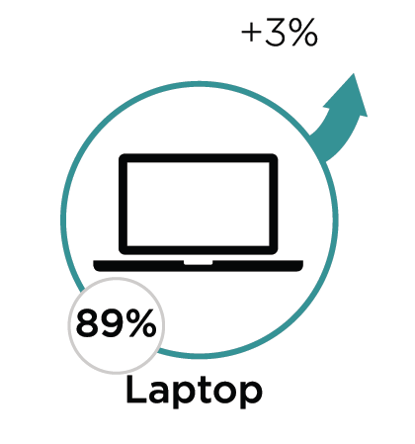
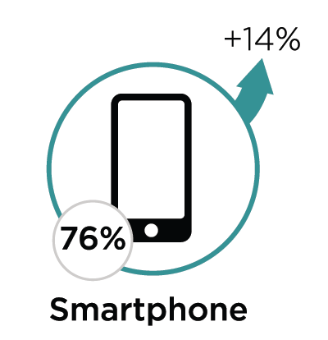
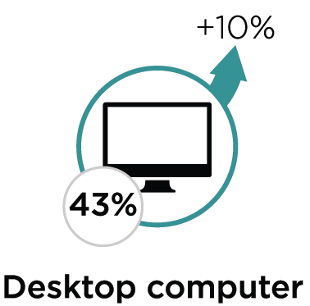
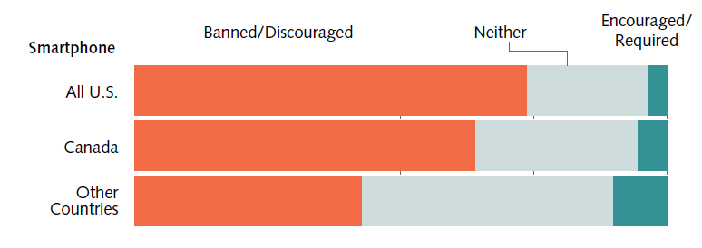
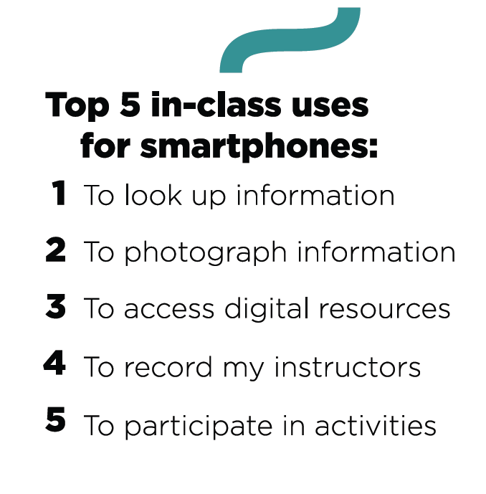
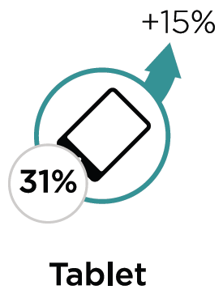
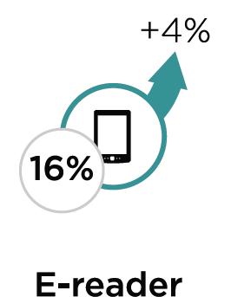
Students’ in-class BYOD Experience

Slide 31
ECAR Recommends
Be mobile ready, willing, and able with a mobile-friendly environment that meets student, faculty, and staff expectations.
Collaborate with other units to formalize systems for guiding students and faculty in incorporating mobile, networkable devices into the curriculum and pedagogy.
Consider the student perspective around BYOD policy and practices.
Provide faculty and students guidance about the ways in which to use mobile devices as learning tools.

Slide 32
Poll Question 3:
What are the greatest unrealized BYOE-related teaching and learning opportunities on your campus?
??
SMS Text: send a text to 37607 and include 955629 with your answer in the message
Twitter: Tweet @Poll and 955629 with your answer
Direct Link: Go to http://PollEv.com and include 955629 with your answer in the text box
Pick your response method

Slide 33
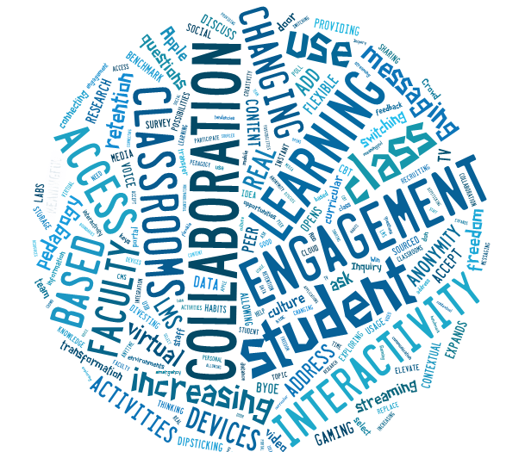
Results: What are the greatest unrealized BYOE-related teaching and learning opportunities on your campus?
53, on-demand responses at #EDU13
Click chart below for access to raw poll results:

Slide 34
Notes:
http://www.polleverywhere.com/free_text_polls/9xKFx5iSx33hvkZ

Slide 35
So Much More To Share…

Slide 36
…but Not Enough Time

Slide 37
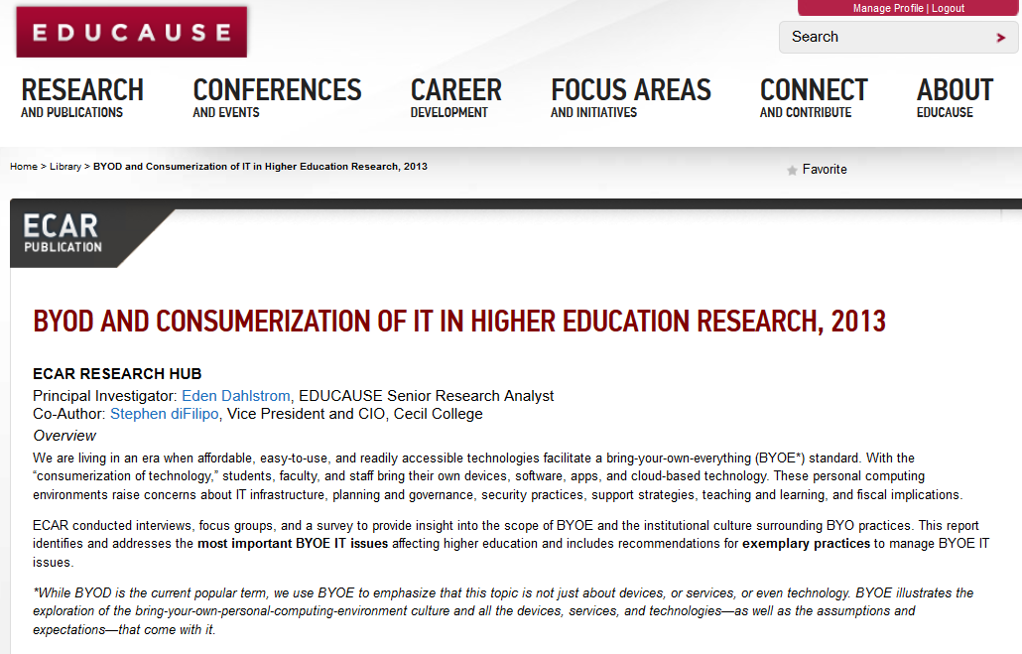
Visit the BYOD Research Hub
http://www.educause.edu/library/resources/byod-and-consumerization-it-higher-education-research-2013

Slide 38
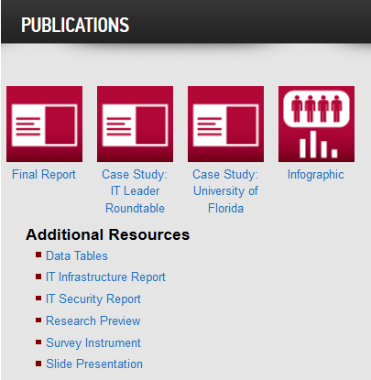
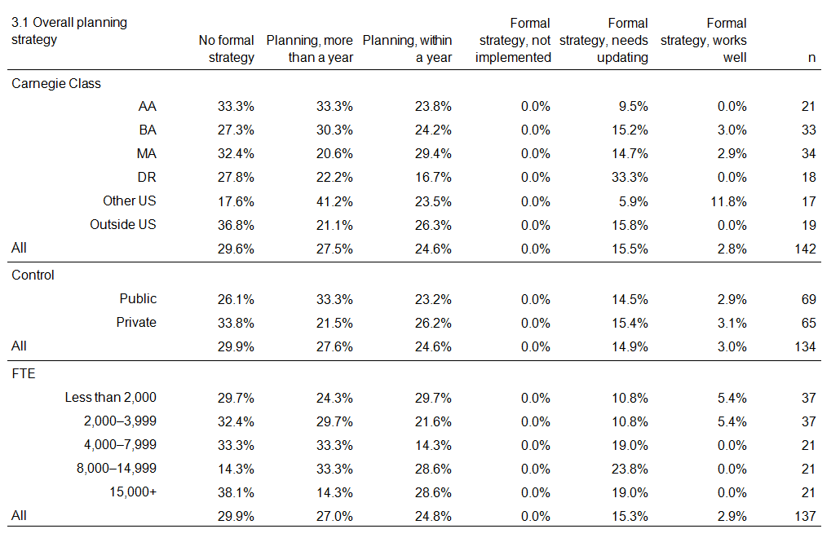
BYOD Research Products

Slide 39
Q&A

Slide 40
Contact Us; Follow Us
Eden Dahlstrom,
Director of Research at EDUCAUSE
edahlstrom@educause.edu
@DataDeeva
Stephen diFilipo,
VP/CIO at Cecil College
sdifilipo@gmail.com
@S_dF
www.educause.edu/ecar
Notes:
“…for the time being…MOOCs are not a threat to traditional higher education institutions or programs of study but instead are emerging as an alternative educational platform that can supplement and expand the market for higher education rather than supplant college/university experiences.”

