Slide 1


Slide 2
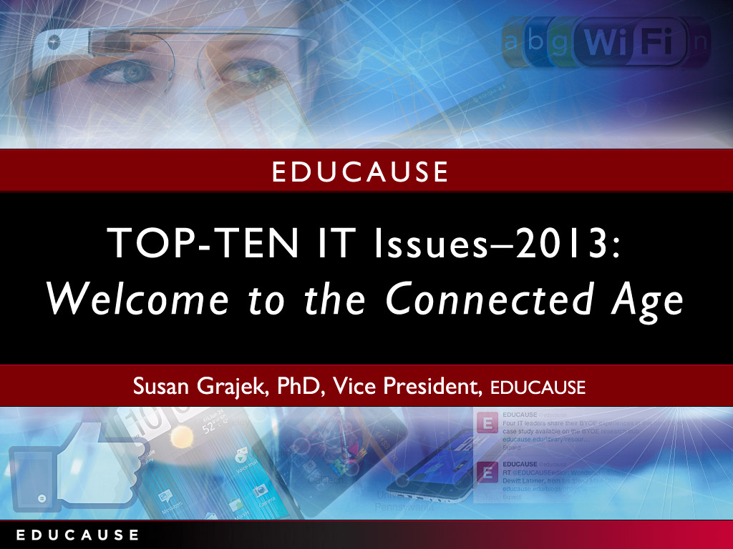

Slide 3


Slide 4


Slide 5
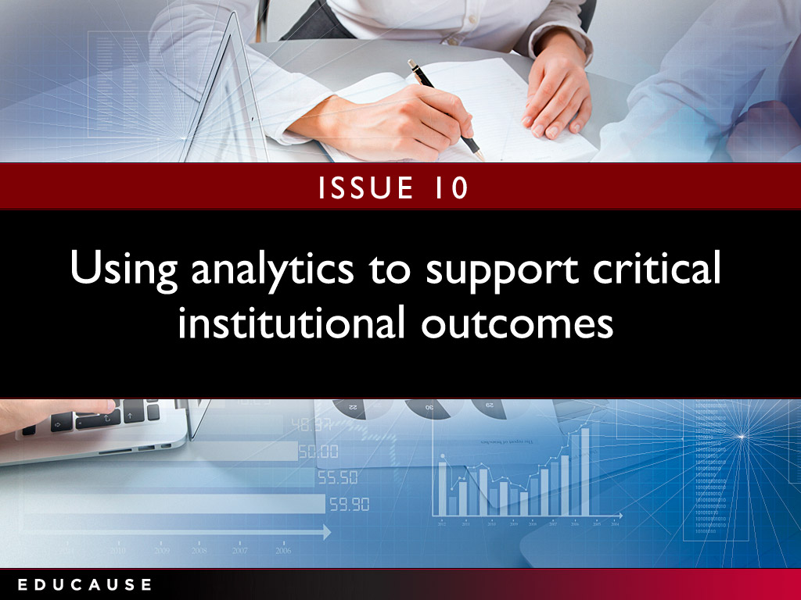

Slide 6
Using analytics to support critical institutional outcomes
Strategic questions to ask:
Do you have a culture of data-driven decision-making?
Does your institution view analytics as a strategic investment or as a new cost?
Do current data flows, definitions, and architectures need to be restructured and redefined to support institution-wide analytics?
Have you inventoried the skills and resources that could support analytics?
“The strength of data and analytics helps us understand our past and our current state and provides a glimpse of scenarios of the future based on that past and current state. ‘If you don’t know where you’re going, how will you know when you get there?’ ”
—CIO and Vice President
Notes:
Are the institution’s IT governance principles and structure widely understood?
Is the institution’s IT governance deemed effective? If not, how can IT leaders improve it?
What is the IT governance’s institutional realm of influence?
How does the institution’s IT governance structure adapt to new circumstances and issues such as the decentralization of information technology, new technologies, outsourcing, and cloud-based services?

Slide 7
Analytics: What we know
Source: ECAR Analytics Maturity Index, 2012

Slide 8


Slide 9
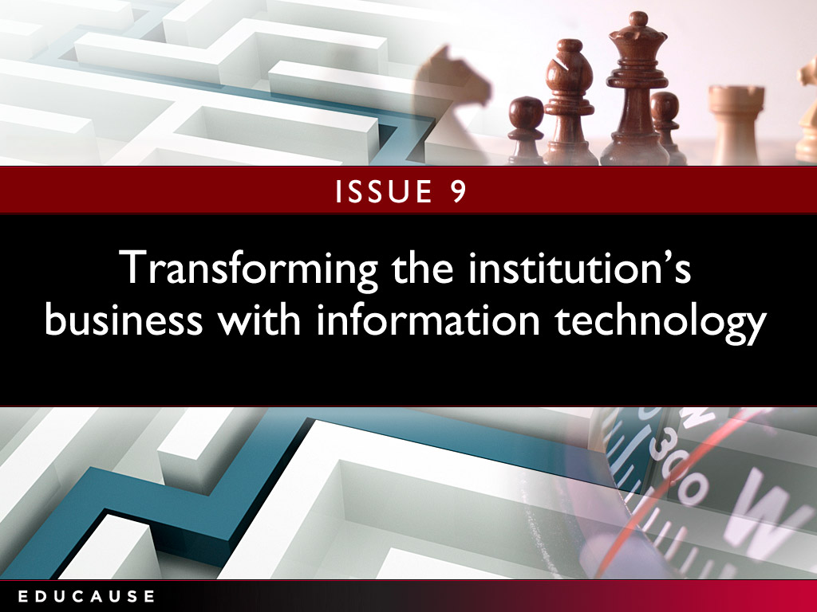

Slide 10
Transforming the institution's business with information technology
Strategic questions to ask:
How can innovation be encouraged in both the institution and the IT organization?
Is the organization willing to change business process or practice to garner effective and efficient use of its information technology?
Does the institutional funding model incentivize or undermine achieving the full benefits of business transformation?
“Higher education IT will need to change its mindset; it can’t provide everything in-house any more. We need to move from 'service provider' to 'solutions architect.' It’s an opportunity and a key challenge .”
—CIO
Notes:
What is the institution’s strategy for funding IT research infrastructure?
What is the balance between the central IT organization and decentralized IT support for the institution’s research mission?
What are the infrastructure, application, support, and staffing (levels and specialized roles) implications for central IT in supporting research?
What are the opportunities for cross-institutional collaborations? How do IT leaders evaluate the worth and risks of such collaborations? How do they foster participation and buy-in?

Slide 11
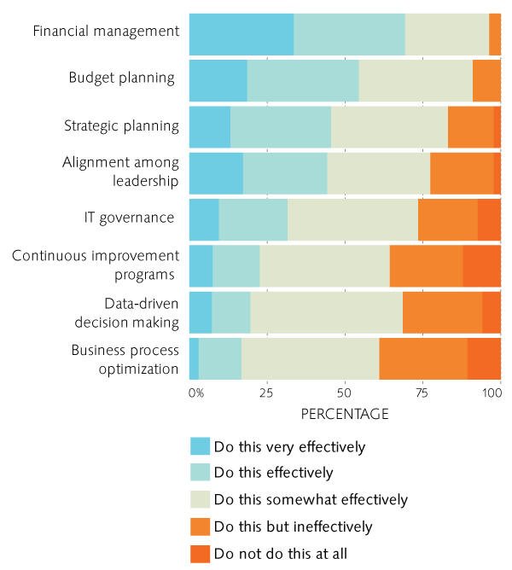
Transforming the institution's business with information technology: What we know
Need to develop stronger capabilities to support transformation
Financial capabilities are strongest; process transformation the weakest
Source: Assessing Your Fiscal Bandwidth: Current Practices for Measuring IT Costs in Higher Education, ECAR, May 2013
Notes:
Research computing: What we know

Slide 12
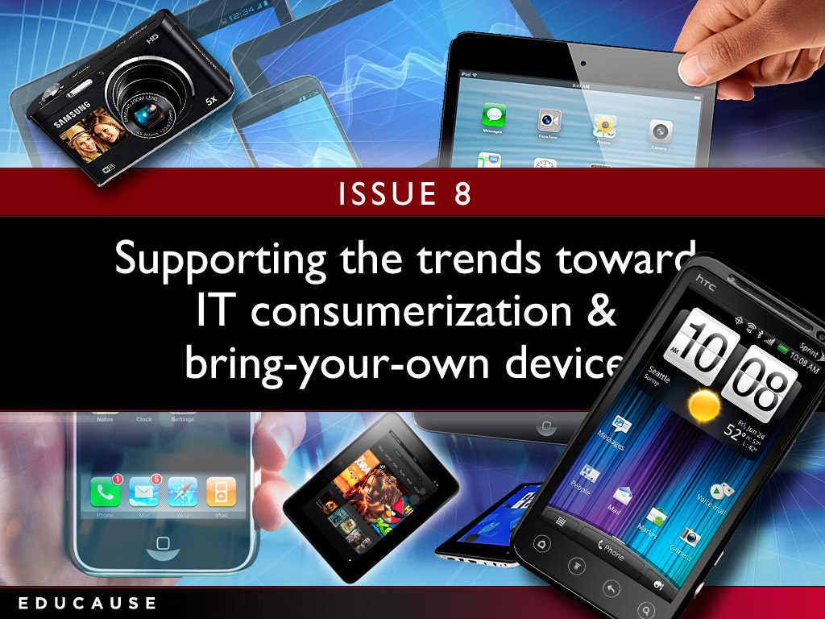

Slide 13


Slide 14
Supporting the trends toward IT consumerization and BYOD
Strategic questions to ask:
Do you have appropriate polices in place for data retention and storage, procurement, and data security?
Is it time to rethink providing employees with cell phones, tablets and other “personal” devices?
Do students still require institutionally-equipped computer labs?
How to minimize support time and expense in an increasingly diverse technology environment?
Should you provide services internally that are similar to existing external offerings?
“Students have already-established channels for acquiring and distributing information. To what level— if at all—do we want to accommodate those channels or drive all of the use into the university-sanctioned environment that we currently support?”
—Academic Technology Specialist
Notes:
Does the institution’s strategic plan include transformative objectives?
Is the IT organization viewed as a trusted partner in institutional transformation?
How can the institution support experimentation with technology to transform teaching and learning without unduly risking students’ learning outcomes?
Are the process reengineering and continuous improvement capabilities in place to enable transformative information technology?

Slide 15
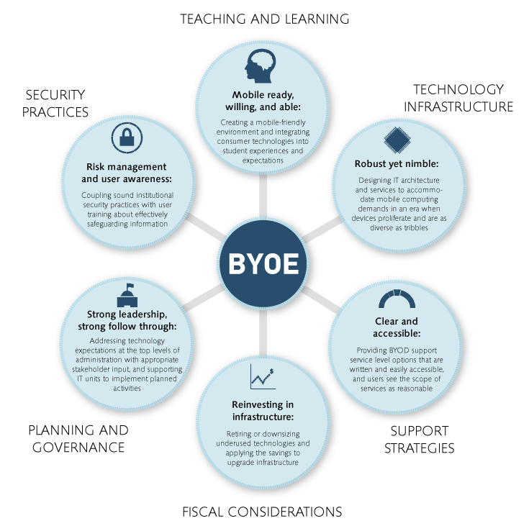
IT Consumerization and BYOD:
What we know
Source: The Consumerization of Technology and the Bring-Your-Own-Everything (BYOE) Era of Higher Education, ECAR, March 2013
Notes:
Research computing: What we know

Slide 16
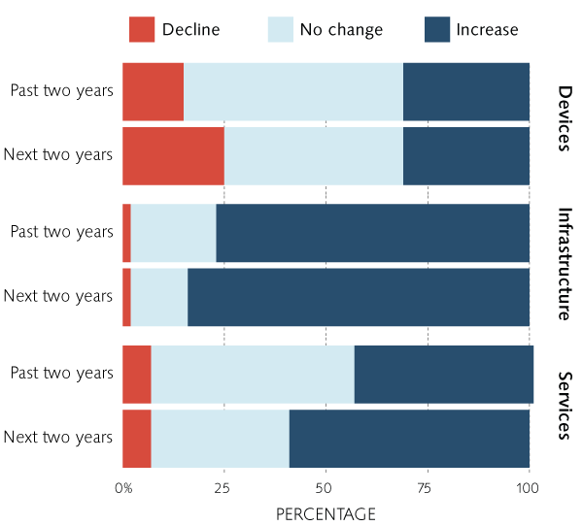
IT Consumerization and BYOD:
What we know
Financial Impact of BYO on IT Budgets
BYO more likely to increase than lower IT costs
Especially with infrastructure
Increased cost pressures for services and infrastructure, perhaps some relief with devices
Consistent results across all institutional types
Source: The Consumerization of Technology and the Bring-Your-Own-Everything (BYOE) Era of Higher Education, ECAR, March 2013
Notes:
Research computing: What we know

Slide 17
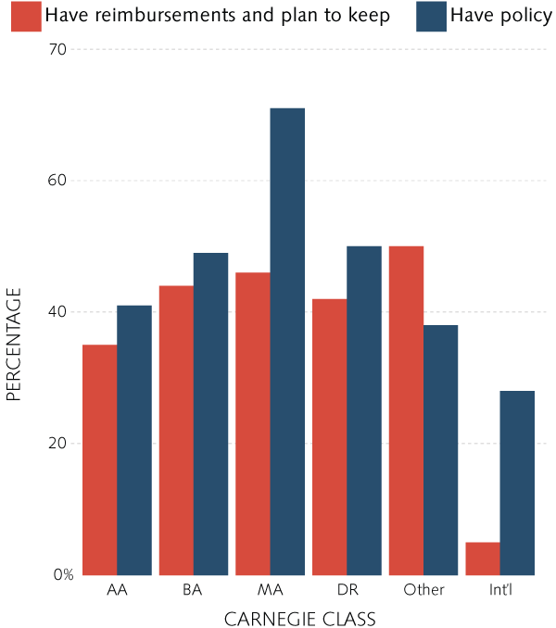
IT Consumerization and BYOD:
What we know
Prevalence of Employee Reimbursement Policies and Practices
About half of institutions have a policy to reimburse faculty and staff for personally-owned technologies
Policy reflects practice: only 20% of those without a policy reimburse
Very few plans to stop reimbursements
No patterns, consistency to reimbursement practices (what, when, who, how much)
Source: The Consumerization of Technology and the Bring-Your-Own-Everything (BYOE) Era of Higher Education, ECAR, March 2013
Notes:
Research computing: What we know

Slide 18
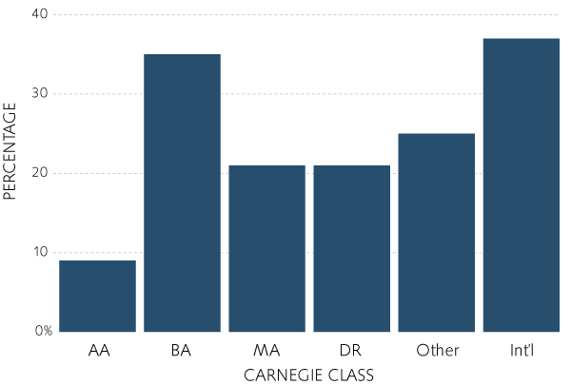
IT Consumerization and BYOD:
What we know
Few institutions plan to substantially reduce the number of student-accessible devices
Those who do will repurpose the spaces but retain their focus on students (lab, classroom, flexible learning space, hoteling space)
Plans to Reduce Institutionally Provisioned Student Devices (Labs, etc)
Source: The Consumerization of Technology and the Bring-Your-Own-Everything (BYOE) Era of Higher Education, ECAR, March 2013
Notes:
Research computing: What we know

Slide 19
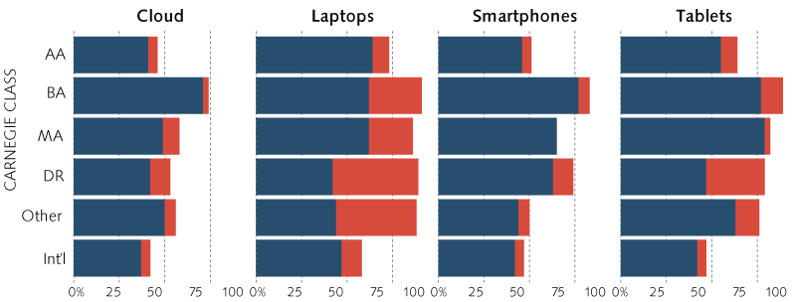
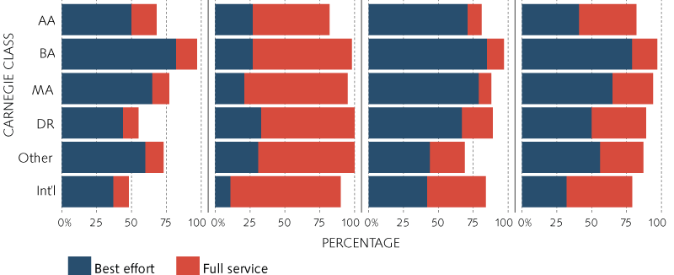
IT Consumerization and BYOD:
What we know
IT Support
IT Support for BYO is best effort rather than full
Highest service levels for laptops, with tablets second
For Students
For Faculty and staff
Source: The Consumerization of Technology and the Bring-Your-Own-Everything (BYOE) Era of Higher Education, ECAR, March 2013
Notes:
Research computing: What we know

Slide 20


Slide 21
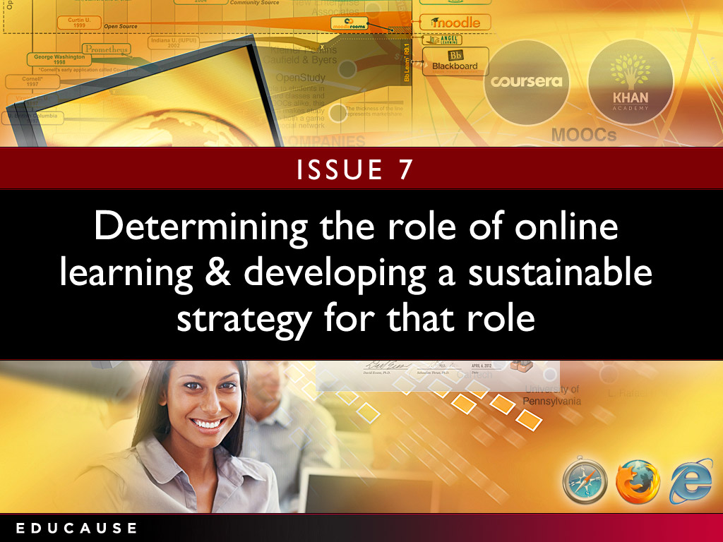

Slide 22
Determining the role of online learning and developing a sustainable strategy for that role
Strategic questions to ask:
Are faculty actively engaged in the discussion about online learning?
Do you have a strategy for online learning?
Do you provide the resources and incentives to create and deliver online learning?
What assessment techniques are in place?
“The role of online learning as a sustainable strategy for postsecondary institutions rests a good deal with the ability of faculty to adjust to new ways of instructing learners.”
—Associate Dean, Distance Learning
Notes:
How can IT leaders verify they are doing the very best with available IT resources?
How can IT leaders create an institution-wide view of IT funding and expenditures? What relationships and partnerships will they need to cultivate? What business processes might need to be changed?
How can IT leaders interweave an IT funding component into broader, institutional initiatives to ensure IT is appropriately funded to deliver what is needed?

Slide 23
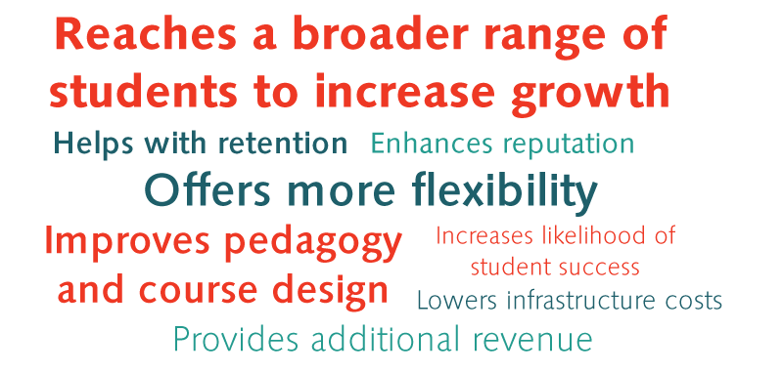
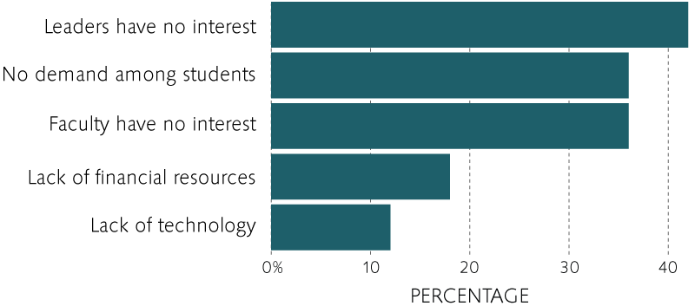
Online learning: What we know
Benefits of online learning
Reasons for not offering online courses
Source: The State of E-Learning in Higher Education: An Eye Toward Growth and Increased Access, ECAR, June 2013
Notes:
Distributed vs central IT. Varies greatly from instituiton to institution, range is about 50-50 to 100 (all central)
Run—optimize the execution of activities and processes already in place. Seek organizational growth through offering products and services faster and cheaper than the competition.
Grow—increase market reach, product and service offerings, expand market share, and so on. Seek organizational growth by taking market share from the competition (i.e., get a bigger piece of the pie).
Transform—innovate business processes and/or products and services in a completely new way, move into seemingly different markets, and so on. Seek organizational growth through new and different means.
As you can see, the RGT framework is similar in many ways to both Porter’s three generic strategies and a top-line versus bottom-line approach as follows:
Run overall cost leadership bottom line
Grow focus and differentiation top line
Transform (new) differentiation top line (when the focus is innovation)
Gartner
Run the business: This is an indicator of how much of the IT resource is consumed and focused on the continuing operation of the business. It includes all nondiscretionary expenses as part of the run-the-business cost. Examples include capital expenses for replacement of laptops at the end of their useful life, operating expenses for software maintenance contracts, operating expenses help desk outsourcing, infrastructure utility computing for human resources applications and software maintenance for regulatory software.
Grow the business: This is an indicator of how much of the IT resource is consumed and focused on developing and enhancing IT systems in support of business growth (typically organic growth). Discretionary investments are more likely to be included in the grow-the-business or transform-the-business cost. Examples include ERP upgrade project capital expenses to expand the capacity to include organic growth in software users, bandwidth capacity expansion project capital expenses to accommodate an organic forecast increase in customers using existing Internet applications, or software license upgrade for engineering software.
Transform the business: This is an indicator of how much of the IT resource is consumed and focused on implementing technology systems that enable the enterprise to enact new business models. This is very much a venture category, and would be represented by activities such as a brick-and-mortar retailer moving to online shopping, a traditional bank offering online banking (or moving into offering insurance services) or a commercial airline offering new freight services.

Slide 24
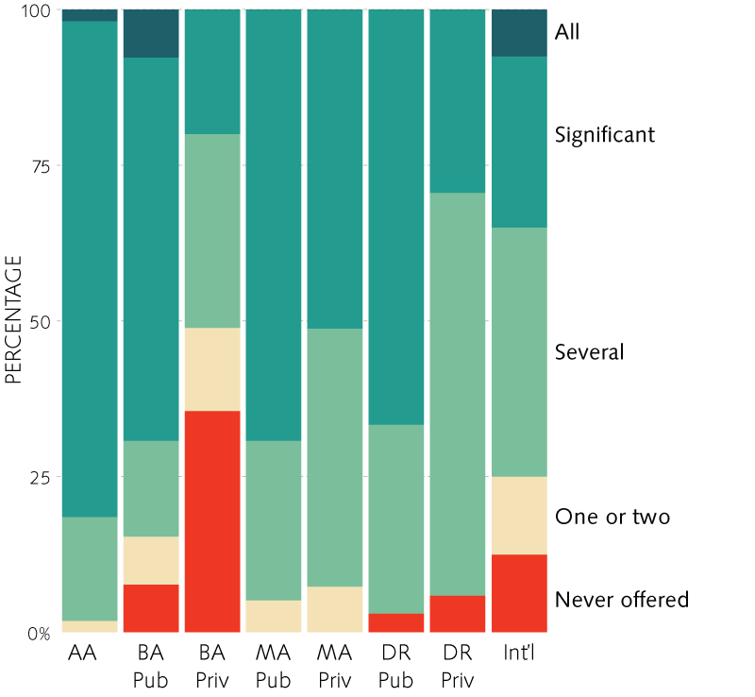
Online learning: What we know
Number of Online Courses Offered by Institutional Type
Private BA and private doctorals least likely to offer online courses
Community colleges most likely to offer online courses
Source: The State of E-Learning in Higher Education: An Eye Toward Growth and Increased Access, ECAR, June 2013
Notes:
Distributed vs central IT. Varies greatly from instituiton to institution, range is about 50-50 to 100 (all central)
Run—optimize the execution of activities and processes already in place. Seek organizational growth through offering products and services faster and cheaper than the competition.
Grow—increase market reach, product and service offerings, expand market share, and so on. Seek organizational growth by taking market share from the competition (i.e., get a bigger piece of the pie).
Transform—innovate business processes and/or products and services in a completely new way, move into seemingly different markets, and so on. Seek organizational growth through new and different means.
As you can see, the RGT framework is similar in many ways to both Porter’s three generic strategies and a top-line versus bottom-line approach as follows:
Run overall cost leadership bottom line
Grow focus and differentiation top line
Transform (new) differentiation top line (when the focus is innovation)
Gartner
Run the business: This is an indicator of how much of the IT resource is consumed and focused on the continuing operation of the business. It includes all nondiscretionary expenses as part of the run-the-business cost. Examples include capital expenses for replacement of laptops at the end of their useful life, operating expenses for software maintenance contracts, operating expenses help desk outsourcing, infrastructure utility computing for human resources applications and software maintenance for regulatory software.
Grow the business: This is an indicator of how much of the IT resource is consumed and focused on developing and enhancing IT systems in support of business growth (typically organic growth). Discretionary investments are more likely to be included in the grow-the-business or transform-the-business cost. Examples include ERP upgrade project capital expenses to expand the capacity to include organic growth in software users, bandwidth capacity expansion project capital expenses to accommodate an organic forecast increase in customers using existing Internet applications, or software license upgrade for engineering software.
Transform the business: This is an indicator of how much of the IT resource is consumed and focused on implementing technology systems that enable the enterprise to enact new business models. This is very much a venture category, and would be represented by activities such as a brick-and-mortar retailer moving to online shopping, a traditional bank offering online banking (or moving into offering insurance services) or a commercial airline offering new freight services.

Slide 25
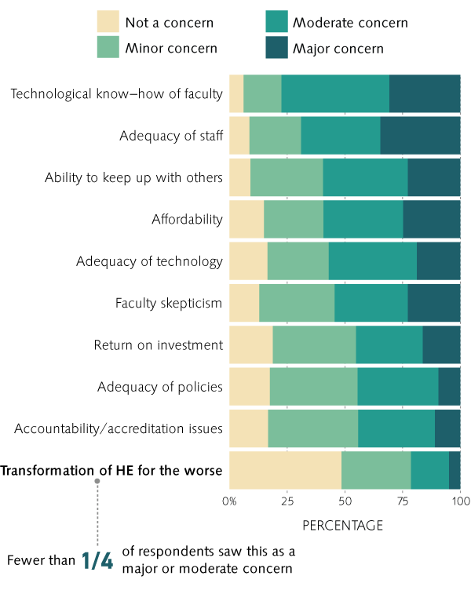
Online learning: What we know
Concerns about E-Learning Initiatives
Source: The State of E-Learning in Higher Education: An Eye Toward Growth and Increased Access, ECAR, June 2013
Notes:
Distributed vs central IT. Varies greatly from instituiton to institution, range is about 50-50 to 100 (all central)
Run—optimize the execution of activities and processes already in place. Seek organizational growth through offering products and services faster and cheaper than the competition.
Grow—increase market reach, product and service offerings, expand market share, and so on. Seek organizational growth by taking market share from the competition (i.e., get a bigger piece of the pie).
Transform—innovate business processes and/or products and services in a completely new way, move into seemingly different markets, and so on. Seek organizational growth through new and different means.
As you can see, the RGT framework is similar in many ways to both Porter’s three generic strategies and a top-line versus bottom-line approach as follows:
Run overall cost leadership bottom line
Grow focus and differentiation top line
Transform (new) differentiation top line (when the focus is innovation)
Gartner
Run the business: This is an indicator of how much of the IT resource is consumed and focused on the continuing operation of the business. It includes all nondiscretionary expenses as part of the run-the-business cost. Examples include capital expenses for replacement of laptops at the end of their useful life, operating expenses for software maintenance contracts, operating expenses help desk outsourcing, infrastructure utility computing for human resources applications and software maintenance for regulatory software.
Grow the business: This is an indicator of how much of the IT resource is consumed and focused on developing and enhancing IT systems in support of business growth (typically organic growth). Discretionary investments are more likely to be included in the grow-the-business or transform-the-business cost. Examples include ERP upgrade project capital expenses to expand the capacity to include organic growth in software users, bandwidth capacity expansion project capital expenses to accommodate an organic forecast increase in customers using existing Internet applications, or software license upgrade for engineering software.
Transform the business: This is an indicator of how much of the IT resource is consumed and focused on implementing technology systems that enable the enterprise to enact new business models. This is very much a venture category, and would be represented by activities such as a brick-and-mortar retailer moving to online shopping, a traditional bank offering online banking (or moving into offering insurance services) or a commercial airline offering new freight services.

Slide 26
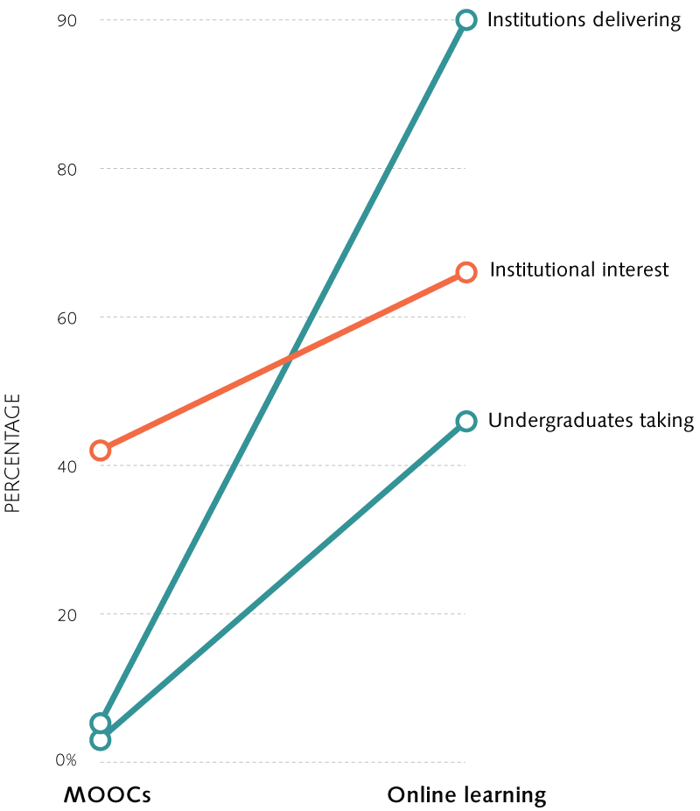
What about MOOCs?

Slide 27
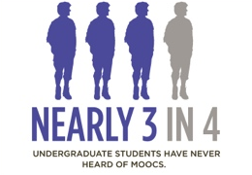
What about MOOCs?

Slide 28
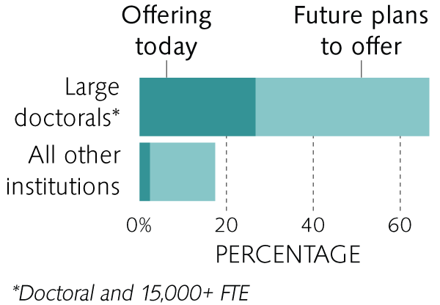
What about MOOCs?

Slide 29
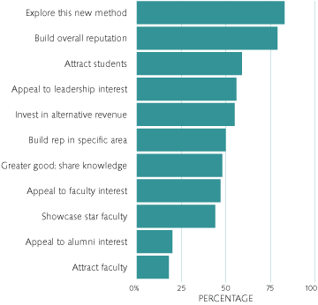
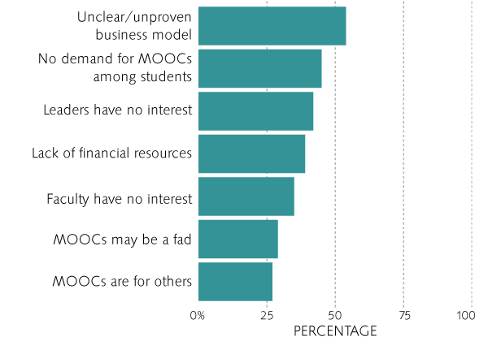
What about MOOCs?
Why institutions are doing MOOCs
Why institutions are not doing MOOCs

Slide 30
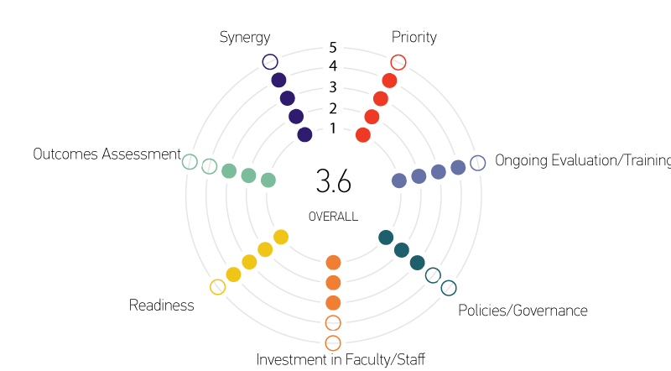
Online learning: What we know
E-Learning Maturity Index
Source: The State of E-Learning in Higher Education: An Eye Toward Growth and Increased Access, ECAR, June 2013
Notes:
Distributed vs central IT. Varies greatly from instituiton to institution, range is about 50-50 to 100 (all central)
Run—optimize the execution of activities and processes already in place. Seek organizational growth through offering products and services faster and cheaper than the competition.
Grow—increase market reach, product and service offerings, expand market share, and so on. Seek organizational growth by taking market share from the competition (i.e., get a bigger piece of the pie).
Transform—innovate business processes and/or products and services in a completely new way, move into seemingly different markets, and so on. Seek organizational growth through new and different means.
As you can see, the RGT framework is similar in many ways to both Porter’s three generic strategies and a top-line versus bottom-line approach as follows:
Run overall cost leadership bottom line
Grow focus and differentiation top line
Transform (new) differentiation top line (when the focus is innovation)
Gartner
Run the business: This is an indicator of how much of the IT resource is consumed and focused on the continuing operation of the business. It includes all nondiscretionary expenses as part of the run-the-business cost. Examples include capital expenses for replacement of laptops at the end of their useful life, operating expenses for software maintenance contracts, operating expenses help desk outsourcing, infrastructure utility computing for human resources applications and software maintenance for regulatory software.
Grow the business: This is an indicator of how much of the IT resource is consumed and focused on developing and enhancing IT systems in support of business growth (typically organic growth). Discretionary investments are more likely to be included in the grow-the-business or transform-the-business cost. Examples include ERP upgrade project capital expenses to expand the capacity to include organic growth in software users, bandwidth capacity expansion project capital expenses to accommodate an organic forecast increase in customers using existing Internet applications, or software license upgrade for engineering software.
Transform the business: This is an indicator of how much of the IT resource is consumed and focused on implementing technology systems that enable the enterprise to enact new business models. This is very much a venture category, and would be represented by activities such as a brick-and-mortar retailer moving to online shopping, a traditional bank offering online banking (or moving into offering insurance services) or a commercial airline offering new freight services.

Slide 31


Slide 32
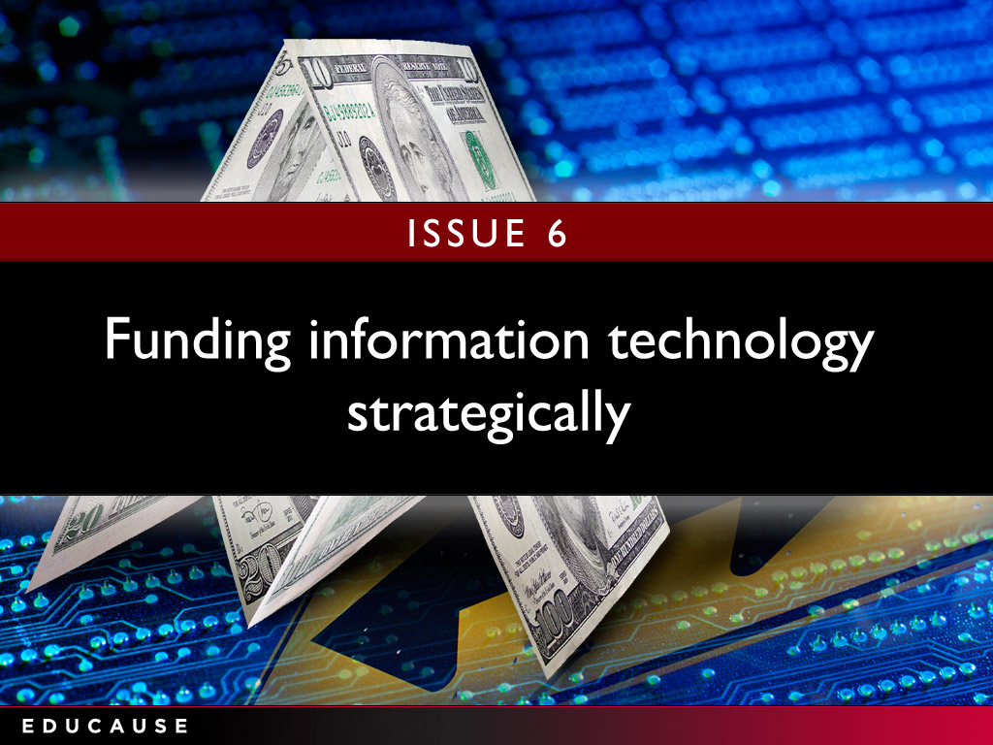

Slide 33
Funding information technology strategically
Strategic questions to ask:
Do you establish and manage IT investments using a transparent and inclusive governance process ?
Can you calculate the costs of its services to permit comparison with alternative sourcing options ?
Does the current distributed IT model need to be revisited to ensure the right balance between optimizing costs and service levels?
“Strategic investment in IT depends critically on having a strategic plan for campus IT. Too many campuses make investment decisions on the basis of chasing technology (e.g., devices) without determining where the institution should be heading.”
—President and Chief Executive Officer
Notes:
What strategic problems or issues can analytics help the institution address and what will be the institution’s initial focus?
What are the institution’s existing analytics capabilities and requirements for data, infrastructure, governance, and staffing?
What is the role of the IT organization?
What are the institution’s cultural issues around buy-in and adoption of analytics? How does analytics relate to accountability?

Slide 34
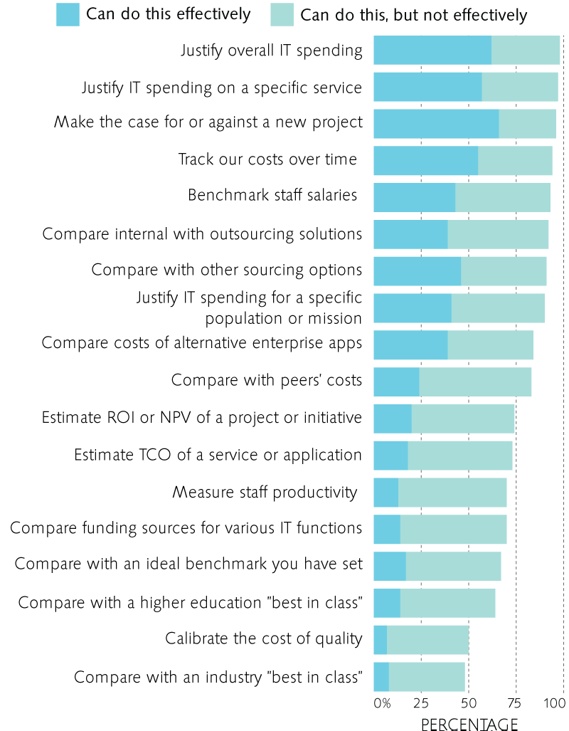
Funding information technology strategically: What we know
Effectiveness in Measuring the Cost of IT
Institutions that participate in the EDUCAUSE Core Data Service are more effective at benchmarking IT costs.
Source: Assessing Your Fiscal Bandwidth: Current Practices for Measuring IT Costs in Higher Education, ECAR, May 2013
Notes:
What strategic problems or issues can analytics help the institution address and what will be the institution’s initial focus?
What are the institution’s existing analytics capabilities and requirements for data, infrastructure, governance, and staffing?
What is the role of the IT organization?
What are the institution’s cultural issues around buy-in and adoption of analytics? How does analytics relate to accountability?

Slide 35
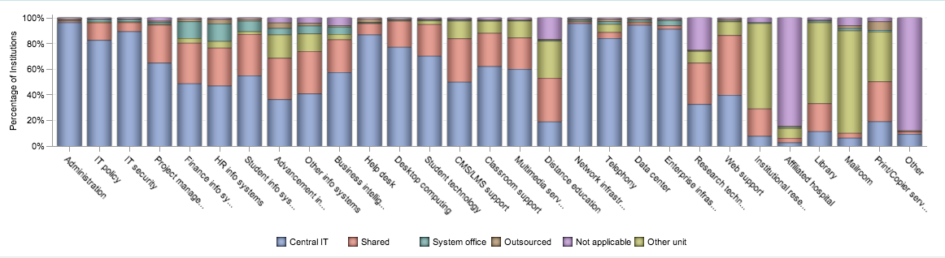
Funding information technology strategically: What we know
Distributed IT accounts for 29% of institutional IT costs.
Central IT comprises 3% of total institutional budget; all IT estimated to be 4% of institutional budget.
Responsibility for IT Functions
Source: 2012 EDUCAUSE Core Data Survey
Notes:
What strategic problems or issues can analytics help the institution address and what will be the institution’s initial focus?
What are the institution’s existing analytics capabilities and requirements for data, infrastructure, governance, and staffing?
What is the role of the IT organization?
What are the institution’s cultural issues around buy-in and adoption of analytics? How does analytics relate to accountability?

Slide 36
Funding information technology strategically: What we know
Source: 2012 EDUCAUSE Core Data Survey
Notes:
What strategic problems or issues can analytics help the institution address and what will be the institution’s initial focus?
What are the institution’s existing analytics capabilities and requirements for data, infrastructure, governance, and staffing?
What is the role of the IT organization?
What are the institution’s cultural issues around buy-in and adoption of analytics? How does analytics relate to accountability?

Slide 37
ERP
ERP projects seem expensive, but the median cost is .2% of the institution’s annual expenditures.

Slide 38


Slide 39
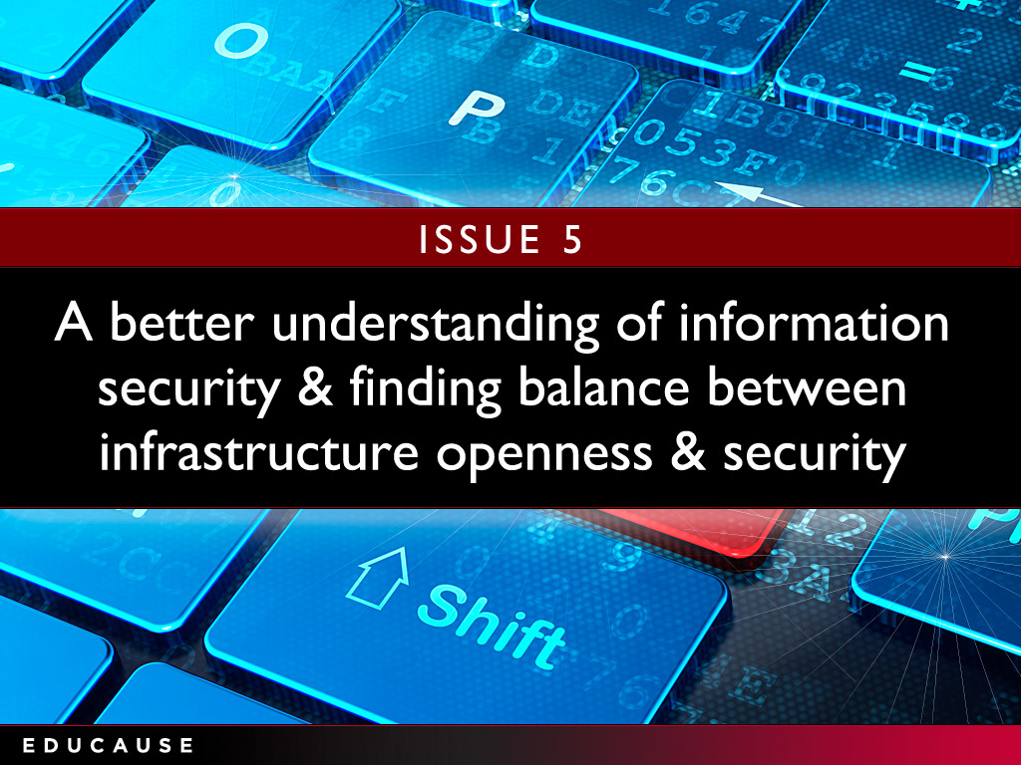

Slide 40
Facilitating a better understanding of information security and finding appropriate balance between infrastructure openness and security
“The now-pervasive nature of technology the use of social media compounds security issues. Maintaining the balance as perceived by those who are responsible for protecting institutional data and resources and those who use them often differs a great deal .”
— CIO
Strategic questions to ask:
Do you have a formal risk management process to identify and prioritize risks?
Do you have a dedicated ISO?
How to create a community of well-informed, vigilant users?
Notes:
Do the goals of the IT organization align with the institution’s strategic goals?
How can CIOs transform sidebar discussions about “technology” into a discussion about the tools, capabilities, and services the institution needs to be successful?
Do IT leaders possess the communications, strategic thinking, and negotiation skills to interact effectively with executive leadership?
Does the entire IT organization understand the nature of the many “businesses” at the institution well enough?

Slide 41
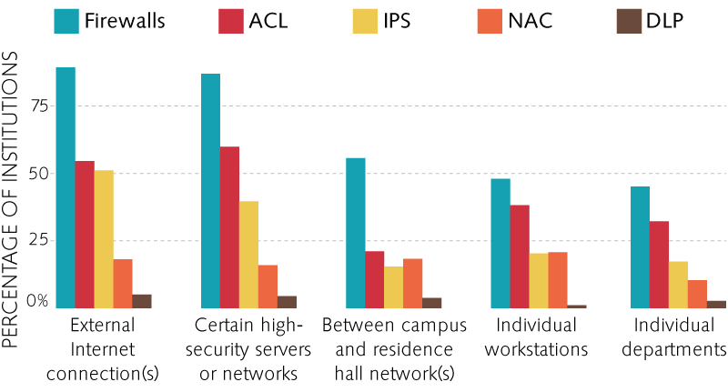
Information security: What we know
Access Control Lists
Intrusion Protection Systems
Network Access Control
Data Loss Prevention
Firewalls
Source: 2012 EDUCAUSE Core Data Survey
Notes:
Themes:
The future will not be as busy as the present
Move from tactics and technology to strategy
Multidimensional nature of the IT leadership role
Emergent role of innovation

Slide 42
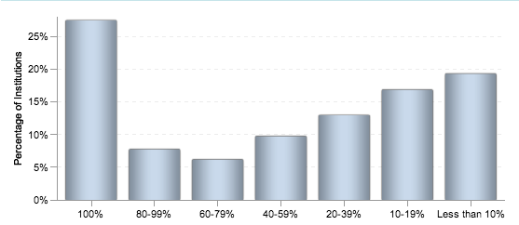
Information security: What we know
Only 27% of institutions have a dedicated ISO
Percent FTE of Information Security Officer
Source: 2012 EDUCAUSE Core Data Survey
Notes:
Themes:
The future will not be as busy as the present
Move from tactics and technology to strategy
Multidimensional nature of the IT leadership role
Emergent role of innovation

Slide 43
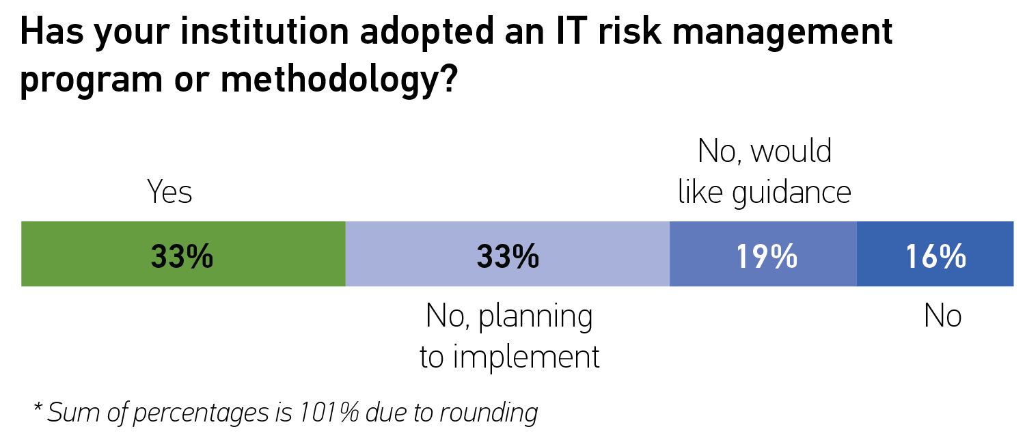
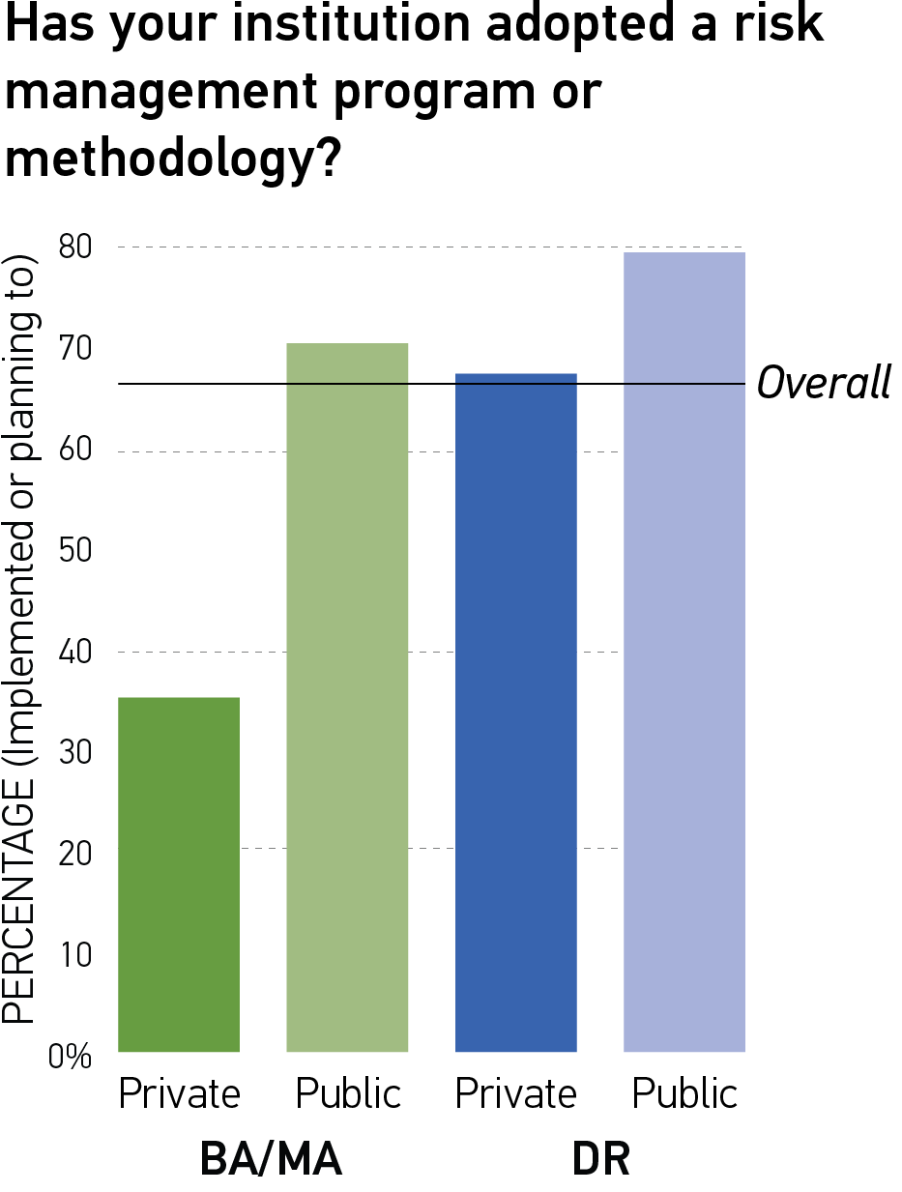
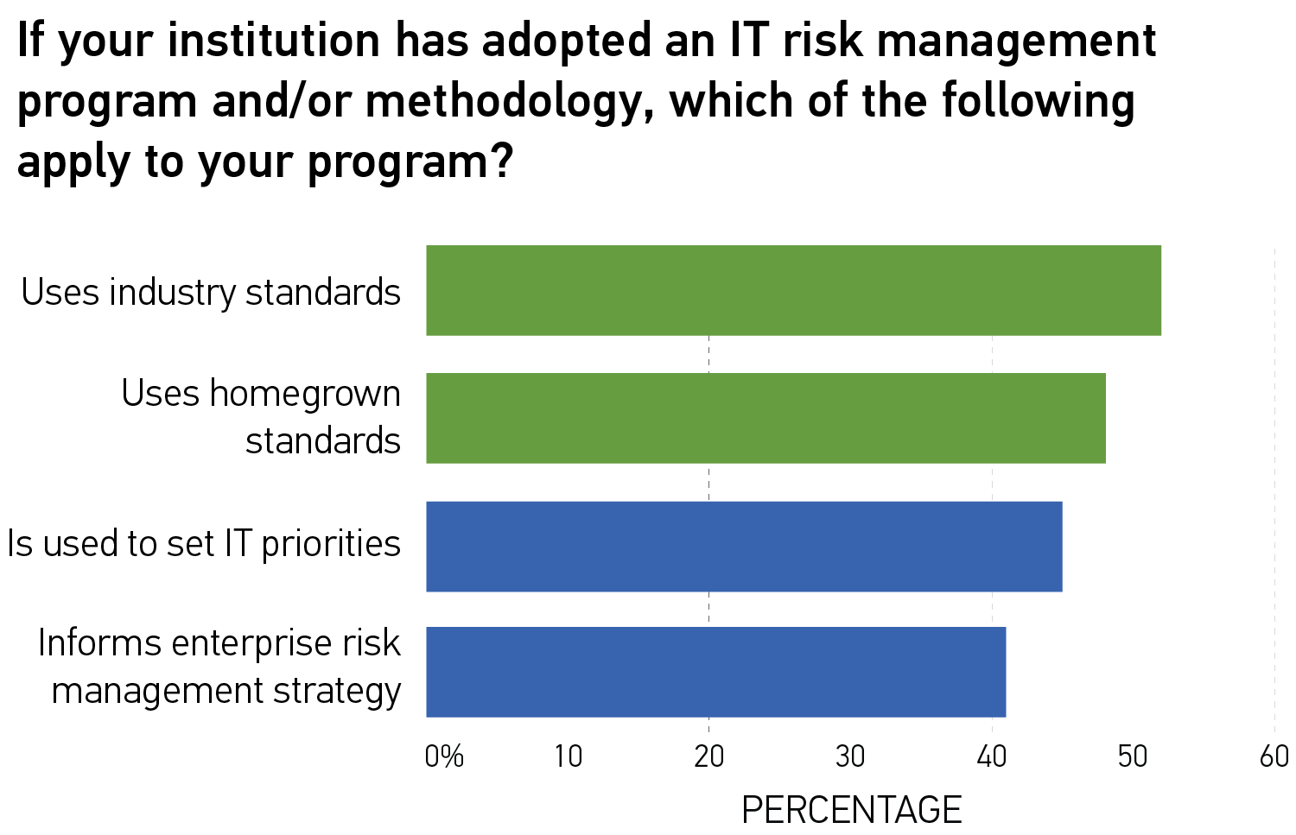
Information security: What we know
Source: ECAR Risk Management Research Bulletin, Paul Jeffries and Nadine Sterns, forthcoming 2013
Notes:
Themes:
The future will not be as busy as the present
Move from tactics and technology to strategy
Multidimensional nature of the IT leadership role
Emergent role of innovation

Slide 44


Slide 45
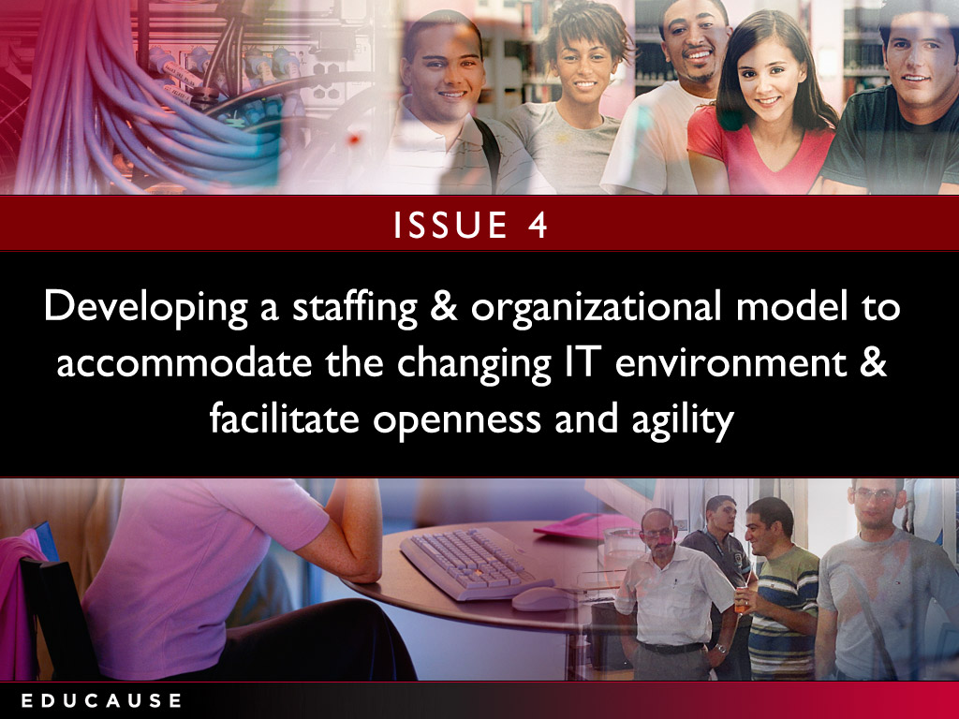

Slide 46
Developing a staffing and organizational model to accommodate the changing IT environment and facilitate openness and agility
Strategic questions to ask:
Does your sourcing strategy account for the impact on staff?
What are the current IT workforce’s capacity and capability gaps and strengths?
To what extent is the CIO’s ability to address staffing and organizational challenges limited or facilitated by the institutional culture as a whole?
“We don’t have the kind of flexibility or dynamic ability to adjust staffing in a way that aligns with our new mission. That is part of the conundrum.”
—Vice President of Information Technology and CIO
Notes:
What business processes could most benefit from greater operational efficiencies using IT?
Does the IT organization have strong-enough institutional partners and partnerships to define new processes and to champion and implement change?
What needed technology pieces (e.g., workflow, electronic forms, and digital signing) are in place now?
What are the institutional strategies, policies, and governance models to map out and redefine business processes?

Slide 47
Changing staffing and organizational models: What we know
Very high
Staff proficiency
High
Medium
Somewhat important
Important
Very important
Importance to job

Slide 48
Changing staffing and organizational models: What we know

Slide 49
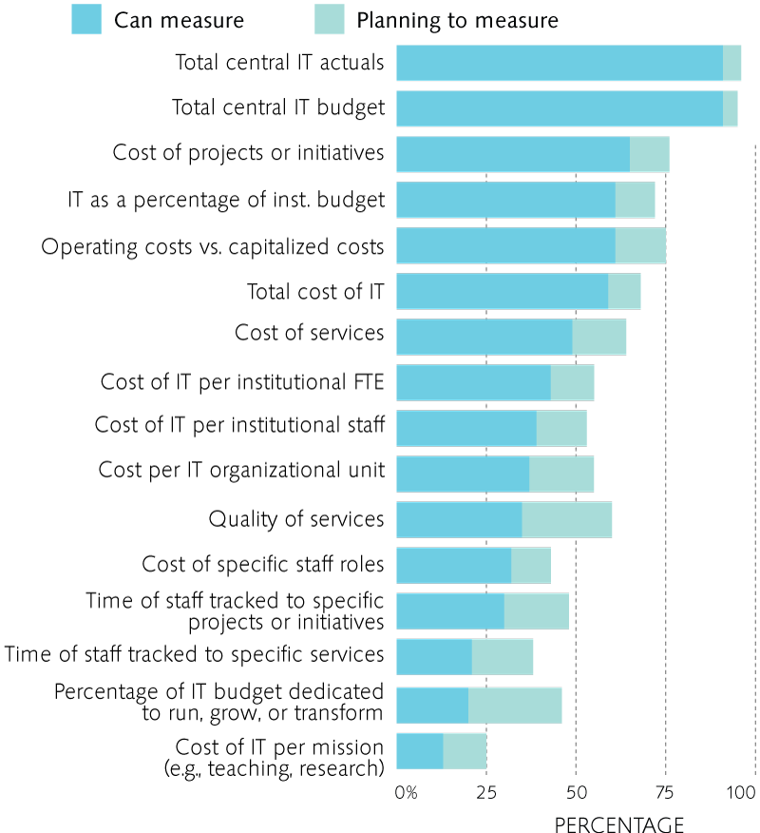
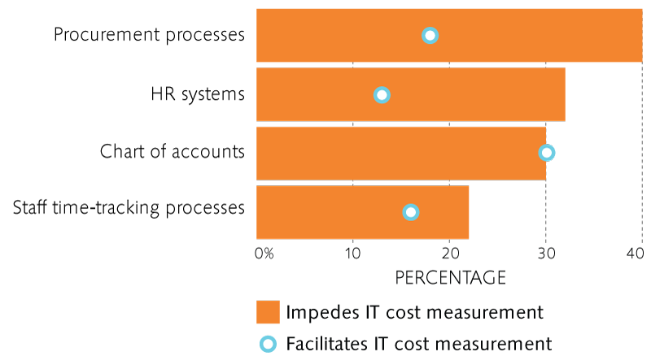
Changing staffing and organizational models: What we know
Do current practices enable or impede the IT organization?
Source: Assessing Your Fiscal Bandwidth: Current Practices for Measuring IT Costs in Higher Education, ECAR, May 2013
Notes:
Distributed vs central IT. Varies greatly from instituiton to institution, range is about 50-50 to 100 (all central)
Run—optimize the execution of activities and processes already in place. Seek organizational growth through offering products and services faster and cheaper than the competition.
Grow—increase market reach, product and service offerings, expand market share, and so on. Seek organizational growth by taking market share from the competition (i.e., get a bigger piece of the pie).
Transform—innovate business processes and/or products and services in a completely new way, move into seemingly different markets, and so on. Seek organizational growth through new and different means.
As you can see, the RGT framework is similar in many ways to both Porter’s three generic strategies and a top-line versus bottom-line approach as follows:
Run overall cost leadership bottom line
Grow focus and differentiation top line
Transform (new) differentiation top line (when the focus is innovation)
Gartner
Run the business: This is an indicator of how much of the IT resource is consumed and focused on the continuing operation of the business. It includes all nondiscretionary expenses as part of the run-the-business cost. Examples include capital expenses for replacement of laptops at the end of their useful life, operating expenses for software maintenance contracts, operating expenses help desk outsourcing, infrastructure utility computing for human resources applications and software maintenance for regulatory software.
Grow the business: This is an indicator of how much of the IT resource is consumed and focused on developing and enhancing IT systems in support of business growth (typically organic growth). Discretionary investments are more likely to be included in the grow-the-business or transform-the-business cost. Examples include ERP upgrade project capital expenses to expand the capacity to include organic growth in software users, bandwidth capacity expansion project capital expenses to accommodate an organic forecast increase in customers using existing Internet applications, or software license upgrade for engineering software.
Transform the business: This is an indicator of how much of the IT resource is consumed and focused on implementing technology systems that enable the enterprise to enact new business models. This is very much a venture category, and would be represented by activities such as a brick-and-mortar retailer moving to online shopping, a traditional bank offering online banking (or moving into offering insurance services) or a commercial airline offering new freight services.

Slide 50
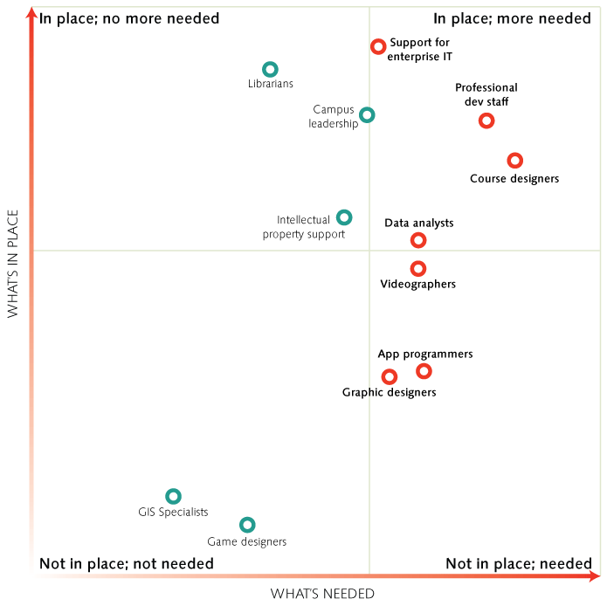
Changing staffing and organizational models: What we know
E-Learning Roles and Gap
Do current staff have the needed capacity and capabilities? E-learning as an example
Many staffing gaps in diverse areas
Source: The State of E-Learning in Higher Education: An Eye Toward Growth and Increased Access, ECAR, June 2013
Notes:
Distributed vs central IT. Varies greatly from instituiton to institution, range is about 50-50 to 100 (all central)
Run—optimize the execution of activities and processes already in place. Seek organizational growth through offering products and services faster and cheaper than the competition.
Grow—increase market reach, product and service offerings, expand market share, and so on. Seek organizational growth by taking market share from the competition (i.e., get a bigger piece of the pie).
Transform—innovate business processes and/or products and services in a completely new way, move into seemingly different markets, and so on. Seek organizational growth through new and different means.
As you can see, the RGT framework is similar in many ways to both Porter’s three generic strategies and a top-line versus bottom-line approach as follows:
Run overall cost leadership bottom line
Grow focus and differentiation top line
Transform (new) differentiation top line (when the focus is innovation)
Gartner
Run the business: This is an indicator of how much of the IT resource is consumed and focused on the continuing operation of the business. It includes all nondiscretionary expenses as part of the run-the-business cost. Examples include capital expenses for replacement of laptops at the end of their useful life, operating expenses for software maintenance contracts, operating expenses help desk outsourcing, infrastructure utility computing for human resources applications and software maintenance for regulatory software.
Grow the business: This is an indicator of how much of the IT resource is consumed and focused on developing and enhancing IT systems in support of business growth (typically organic growth). Discretionary investments are more likely to be included in the grow-the-business or transform-the-business cost. Examples include ERP upgrade project capital expenses to expand the capacity to include organic growth in software users, bandwidth capacity expansion project capital expenses to accommodate an organic forecast increase in customers using existing Internet applications, or software license upgrade for engineering software.
Transform the business: This is an indicator of how much of the IT resource is consumed and focused on implementing technology systems that enable the enterprise to enact new business models. This is very much a venture category, and would be represented by activities such as a brick-and-mortar retailer moving to online shopping, a traditional bank offering online banking (or moving into offering insurance services) or a commercial airline offering new freight services.

Slide 51


Slide 52
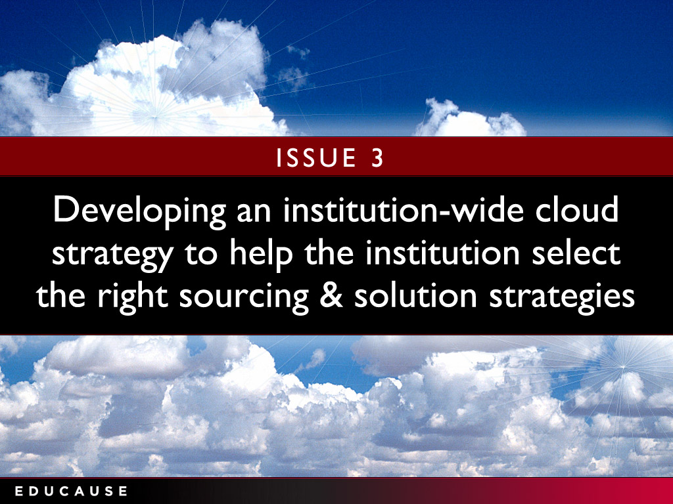

Slide 53
Developing an institution-wide cloud strategy to help the institution select the right sourcing and solution strategies
Strategic questions to ask:
What cloud services are already in use? Do you know?
Do you have the skills to evaluate, manage, and exit cloud services?
What are the data management and recovery strategies?
How to integrate cloud services into the enterprise architecture?
“ It is now much easier for business offices to sign up for cloud solutions and pay for them on a subscription basis. Free cloud offerings are compelling for many individual users. This is a real challenge for IT organizations that place a high value on control of the IT environment.”
—CIO and Vice President for Computing
Notes:
How will the cloud service add value to the institution?
What are the cost, security, support, and staffing implications?
How to secure end-users’ buy-in and adoption?
Has the ROI estimate adequately accounted for the financial, political, and organizational costs?
What are the vendor selection criteria?

Slide 54
Cloud computing: What we know
Decision Point | Type of decision | Issues | Actions to take
Sourcing IT | Business | Type of sourcing Business objective for sourcing | Consider range of sourcing options Explore demand aggregation opportunities
Managing Data | Risk | Data governance Risk management | Determine administrative, technical, physical safeguards Create the right contract provisions
Achieving Mission | Policy | Mission-relevant services | Determine core mission-relevant services and capabilities
Source: Demystifying the Cloud for Policymakers, Rodney Petersen, EDUCAUSE Review, January 23, 2013

Slide 55


Slide 56
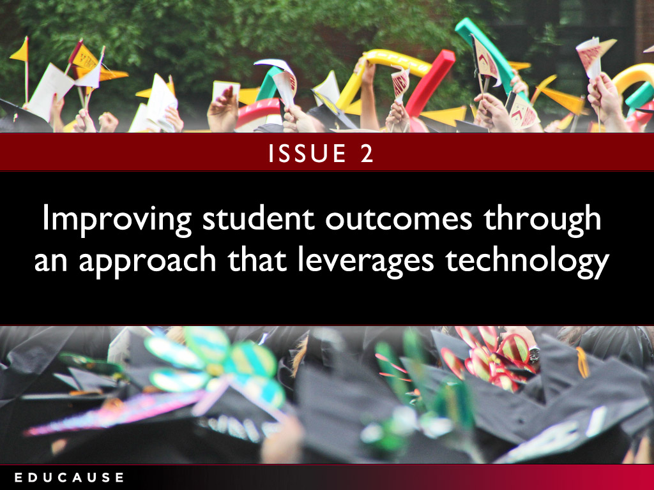

Slide 57
Improving student outcomes through an approach that leverages technology
Strategic questions to ask:
Do you use tools embedded in the LMS to track student learning?
Do faculty reward systems encourage or impede their use of instructional technology?
Do you provide adequate and timely instructional design assistance and services for students and faculty?
“It’s not enough to identify students at risk. To be successful, we need to ensure follow-through, so that students are provided the support they need in order to remediate problems and connect with the resources they need to succeed.”
—President
Notes:
What devices, operating systems, applications, and services fall under this umbrella?
What are the infrastructure implications, such as bandwidth and connectivity?
How does BYOD affect the IT organization’s support strategy?
What are the security implications?

Slide 58
Using technology to improve student outcomes: What we know
Most progress in past year with
E-textbooks
Mobile apps
Source: 2012 EDUCAUSE Core Data Survey
Notes:
Source:
Building a Flexible BYOD Program
To succeed at BYOD, organizations must have the flexibility to respond quickly as technologies evolve.
MITCH DAVIS
posted August 13, 2012 | Appears in the Summer 2012 issue of EdTech Magazine.
Know what's important to your users. A BYOD program can succeed only if users are happy, so find out what they want. In doing outreach with students, we found that printing from a tablet was at the top of the list. We then moved printers to spaces where students congregate. Now that we've put printers in more convenient locations, there's less need for students to run back to their dorms or apartments to print.
Support as many devices as possible. What's unique about mobility today is that everyone has access to a device, and they all want to join the conversation and share information. Don't stand in the way by restricting people to specific devices. Be there to educate, support and deliver service. Also be prepared to support all the main platforms, and deliver exceptional service to the ones that work best. Today, we have people across the IT organization doing research on the many different flavors of mobile devices.
Make the technology available to everyone. For a BYOD program to evolve, your stakeholders on campus need access to mobility tools, and not everyone can afford to buy them. That's why we offer free access to equipment through a loaner pool. In the past, users could obtain technology only through their department. Now, everyone has access to every type of mobile device, from tablets and MP3 players to projectors and portable video equipment. Having a loaner program also gives people an opportunity to try new technology before they buy it.
Be proactive, not reactive, when building a robust network. Start by creating a specific plan for delivering adequate wired and wireless bandwidth, including adding switches and access points where necessary. Effective BYOD requires a highly available network that never goes down. With the proper infrastructure and a financial model for funding upgrades in place, it's easier to more flexibly support new technologies as they evolve.
For example, the need for high-performance computing in classes has greatly expanded over the past three to five years. Students and faculty from the sociology, history and geology departments are now asking for access to major systems that store massive amounts of data — and they want access to that information on all of their devices. The IT staff must build a network that's robust and flexible enough so that when technology changes and users are ready to deploy new devices, the network is ready for them.
Keep IT staff engaged and well trained. Create a culture in which continuous learning among IT staff is encouraged and properly funded. It costs time and money to send people to classes, but without the proper training, the IT department will continue to implement old solutions, resist change and be unprepared for a fast-approaching future. The organizational disruption and technology failure that results will hinder everything, from academic research to fundraising.
Bottom-line financial managers may have a hard time understanding that IT skills and technology are a strategic advantage. The time-lost multiplier makes it easy to justify having an informed technology staff. Technology changes every three months. When the staff has limited skills, the group's ability to support innovative programs such as BYOD is diminished

Slide 59
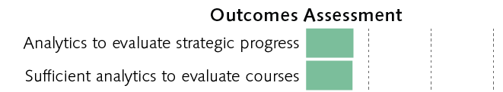
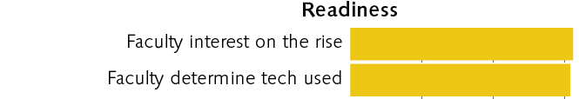
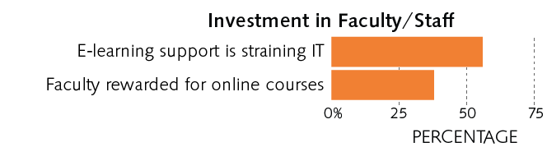
Online learning: What we know
E-Learning Maturity Index
Source: The State of E-Learning in Higher Education: An Eye Toward Growth and Increased Access, ECAR, June 2013
Notes:
Distributed vs central IT. Varies greatly from instituiton to institution, range is about 50-50 to 100 (all central)
Run—optimize the execution of activities and processes already in place. Seek organizational growth through offering products and services faster and cheaper than the competition.
Grow—increase market reach, product and service offerings, expand market share, and so on. Seek organizational growth by taking market share from the competition (i.e., get a bigger piece of the pie).
Transform—innovate business processes and/or products and services in a completely new way, move into seemingly different markets, and so on. Seek organizational growth through new and different means.
As you can see, the RGT framework is similar in many ways to both Porter’s three generic strategies and a top-line versus bottom-line approach as follows:
Run overall cost leadership bottom line
Grow focus and differentiation top line
Transform (new) differentiation top line (when the focus is innovation)
Gartner
Run the business: This is an indicator of how much of the IT resource is consumed and focused on the continuing operation of the business. It includes all nondiscretionary expenses as part of the run-the-business cost. Examples include capital expenses for replacement of laptops at the end of their useful life, operating expenses for software maintenance contracts, operating expenses help desk outsourcing, infrastructure utility computing for human resources applications and software maintenance for regulatory software.
Grow the business: This is an indicator of how much of the IT resource is consumed and focused on developing and enhancing IT systems in support of business growth (typically organic growth). Discretionary investments are more likely to be included in the grow-the-business or transform-the-business cost. Examples include ERP upgrade project capital expenses to expand the capacity to include organic growth in software users, bandwidth capacity expansion project capital expenses to accommodate an organic forecast increase in customers using existing Internet applications, or software license upgrade for engineering software.
Transform the business: This is an indicator of how much of the IT resource is consumed and focused on implementing technology systems that enable the enterprise to enact new business models. This is very much a venture category, and would be represented by activities such as a brick-and-mortar retailer moving to online shopping, a traditional bank offering online banking (or moving into offering insurance services) or a commercial airline offering new freight services.

Slide 60


Slide 61
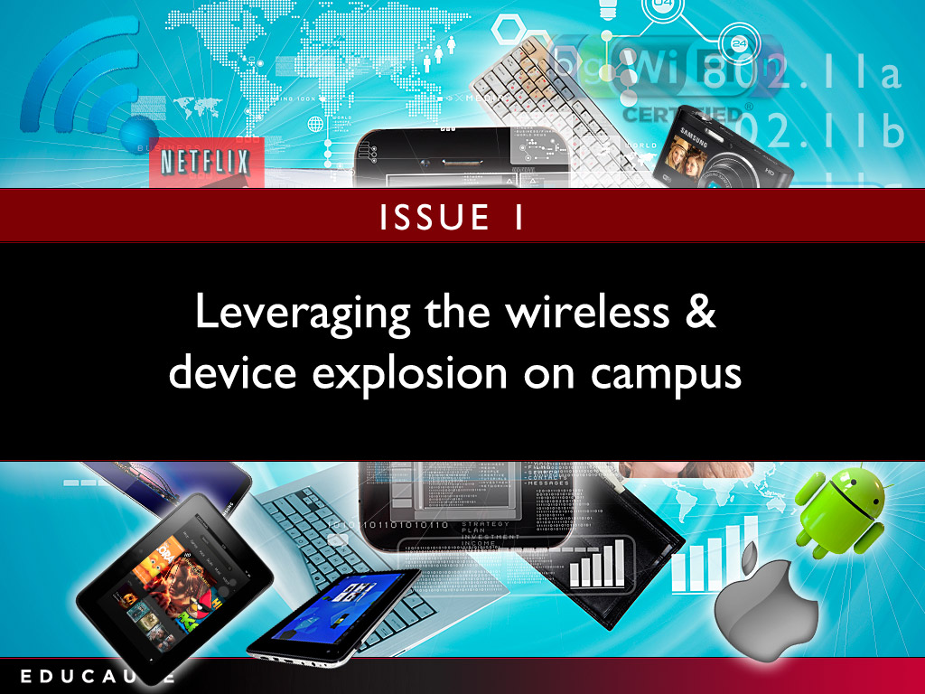

Slide 62
Leveraging the wireless and device explosion on campus
Strategic questions IT is asking
Do you have adequate wireless access and Internet bandwidth to address wireless device density?
Are the institutional applications and web resources mobile-accessible?
Have you considered the security implications of pervasive access to institutional resources and data?
“Students are carrying a cell phone—many with two—a tablet, and a laptop, and they may be also using a campus device at the same time. Not only are we faced with providing bandwidth to handle all these devices but we are challenged by the pure density of devices on campus.”
—Associate Vice Chancellor, Technology Services
Notes:
What non-technical skills are required?
Do we need entirely new roles?
What is our professional development strategy to close these gaps?
How to balance professional development with ongoing workloads?

Slide 63
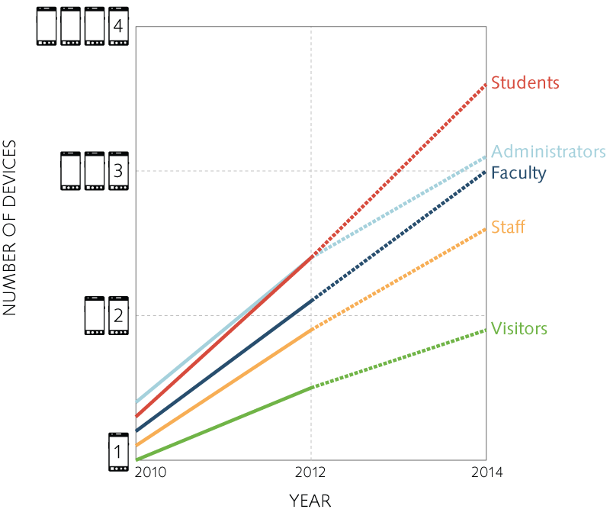
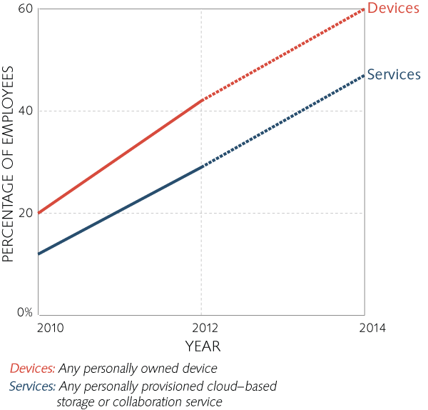
The wireless and device explosion:
What we know
This trend is not abating
Number of devices owned
Faculty and staff use of personal devices or environments for work-related purposes
Source: The Consumerization of Technology and the Bring-Your-Own-Everything (BYOE) Era of Higher Education, ECAR, March 2013
Notes:
What non-technical skills are required?
Do we need entirely new roles?
What is our professional development strategy to close these gaps?
How to balance professional development with ongoing workloads?

Slide 64
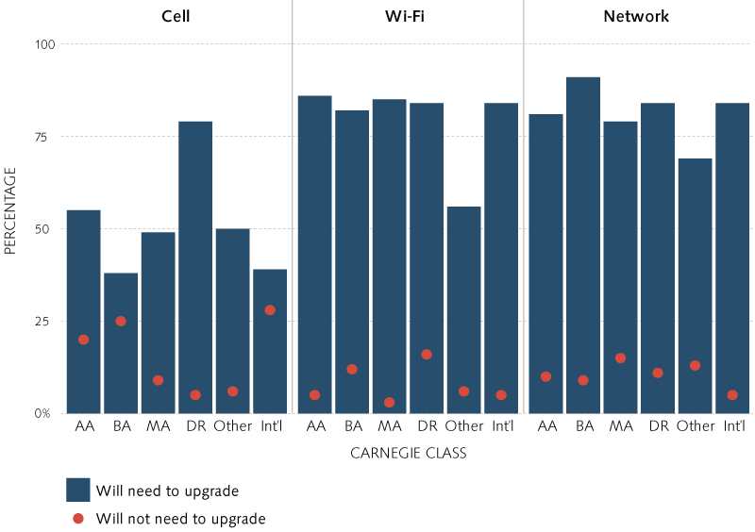
The wireless and device explosion:
What we know
Widespread need to upgrade networks
Source: The Consumerization of Technology and the Bring-Your-Own-Everything (BYOE) Era of Higher Education, ECAR, March 2013
Notes:
What non-technical skills are required?
Do we need entirely new roles?
What is our professional development strategy to close these gaps?
How to balance professional development with ongoing workloads?

Slide 65
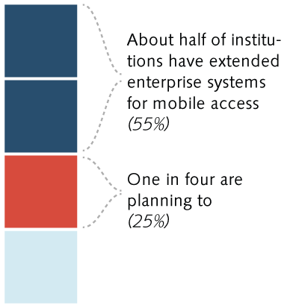
The wireless and device explosion:
What we know
Mobile as an ERP platform
Source: The Consumerization of Technology and the Bring-Your-Own-Everything (BYOE) Era of Higher Education, ECAR, March 2013
Notes:
What non-technical skills are required?
Do we need entirely new roles?
What is our professional development strategy to close these gaps?
How to balance professional development with ongoing workloads?

Slide 67
Top 10 IT Issues 2013
  Leveraging the wireless and device explosion on campus
  Improving student outcomes through an approach that leverages technology
  Developing an institution-wide cloud strategy to help the institution select the right sourcing and solution strategies*
  Developing a staffing and organizational model to accommodate the changing IT environment and facilitate openness and agility
  Facilitating a better understanding of information security and finding appropriate balance between infrastructure openness and security
  Funding information technology strategically*
  Determining the role of online learning and developing a sustainable strategy for that role
  Supporting the trends toward IT consumerization and bring-your-own device*
  Transforming the institution's business with information technology*
  Using analytics to support critical institutional outcomes*
*Also on 2012 list

Slide 68
Thank you!
Susan Grajek, sgrajek@educause.edu

