Slide 1
A Leading Change Culture That Works
Sherri Parker
Dean of Instructional and Learning Resources
@sherri_parker
#LeadChangedu13

Slide 2
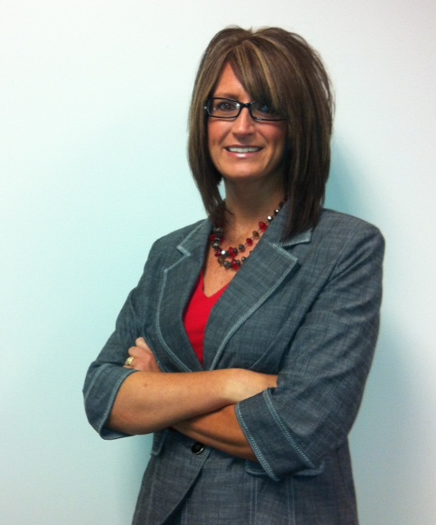
About Me
Dean of Instructional & Learning Resources
Jan 2012
Libraries + Instructional Development
15 Librarians, 8 Instructional Developers
19 years in Higher Ed
Library Sys Integration & Admin, Personnel Management, Web Development, $1.2M library budget
2013 Leading Change Institute Fellow
DePauw University 1994-2012
Notes:
LCI (Formerly Frye Leadership Institute) – Opportunity to focus on challenges that face higher education. Goal is to prepare and develop next generation leaders of libraries and information services to inspire, advocate, and advance change to benefit higher education. Heard from leaders such as the CEO for Educause, Molly Brand, President American Council on Education, Judith Eaton, President for Council for Higher Education Accreditation, Richard Culatta, Deputy Director for the US Office of Educational Technology.

Slide 3
About Harrison College
Career college since 1902 serving 5,000+ students
AS, BS, MA, Certificates
Business
Health Sciences
Veterinary Technology
Information Technology
Criminal Justice
The Chef’s Academy (Indy, NC)
13 campuses – mostly IN, also OH & NC

Slide 4
About Harrison Students
Full-time employed or unemployed
Un-traditional family status
30% traditional college age
Seeking AS - 18-35 years – 86% female
Seeking AS & BS - 25-44 years – 75% female
First generation college students
BS & MA degrees – 25-44 years – 50% male

Slide 5
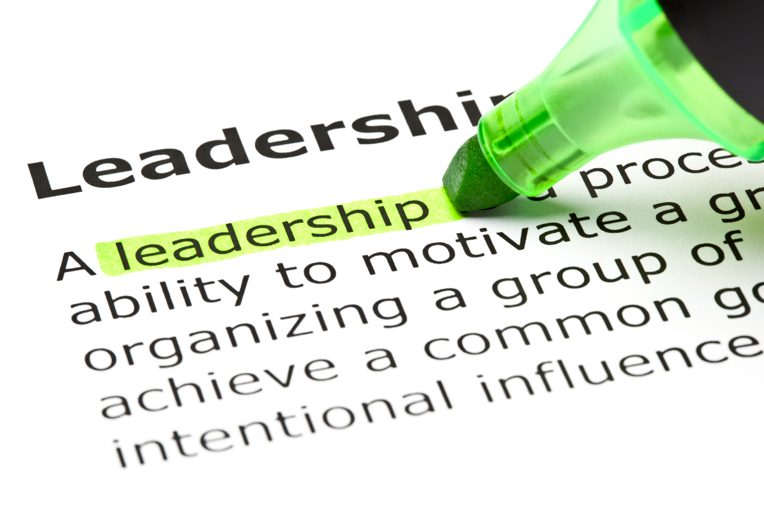
Presentation Objectives
Identify key leadership principles
Define distributed leadership
Describe competency-based performance evaluation process
Recognize and pinpoint new ways to integrate leadership into your workplace
#LeadChangedu13

Slide 6
Stand Up Poll
You think your institution currently practices and embraces distributed leadership
You feel your current employee performance review process is effective
You know that your department’s goals are clearly aligned with your institution’s strategic plan for 2013-14
Notes:
Goal = 6 min.

Slide 7
Explore Principles
Leadership
Increase your Influence
#LeadChangedu13
Notes:
As we begin to explore leadership today, I encourage you to focus on How you can Increase Your Influence. So much about leadership boils down to this overarching theme and the importance of relationship building.

Slide 8
5 Principles of Leadership
Focus on the situation, issue, or behavior, not on the person
Maintain the self-confidence and self-esteem of others
Maintain constructive relationships
Take initiative to make things better
Lead by example
#LeadChangedu13
Notes:
10:30.
1. How do we avoid letting personality differences keep us from dealing with a problem?We should broaden our perspective. In order to increase your influence, it is important to remain objective. As a leader, you should also avoid putting others on the defensive. We can also benefit by concentrating on the big picture and considering others’ points of view with an open mind.

Slide 9
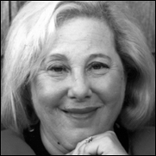
Rosabeth Moss Kanter
Holds the Ernest L. Arbuckle Professorship at Harvard Business School, where she specializes in strategy, innovation, and leadership for change.
On Twitter and in the Workplace, It's Power to the Connectors. November 16, 2009
http://www.hbs.edu/faculty/Pages/profile.aspx?facId=6486
#LeadChangedu13
Notes:
Repeatedly name in the top 50 most powerful women in the world.

Slide 10
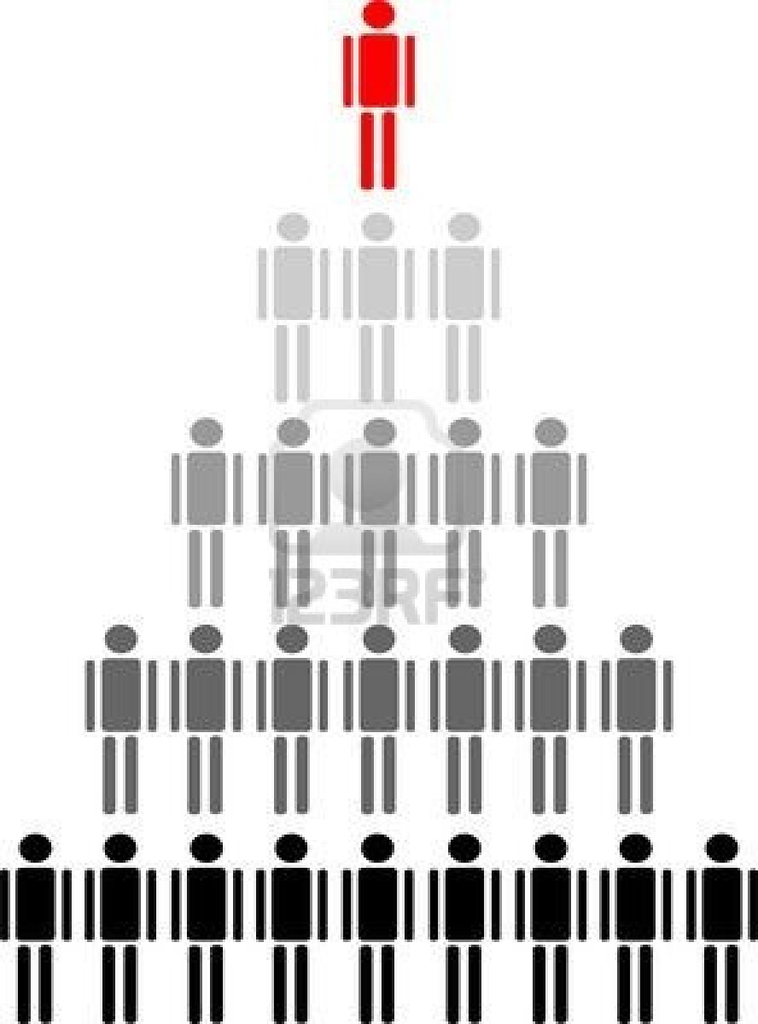
“Society of Organizations”
Formal hierarchies with clear reporting relationships give people their position and power.
Focus:
Top-down approach, managers provide directional leadership
America - 20th Century
People Hierarchy Royalty Free Cliparts, Vectors, And Stock ...
www.123rf.com

Slide 11
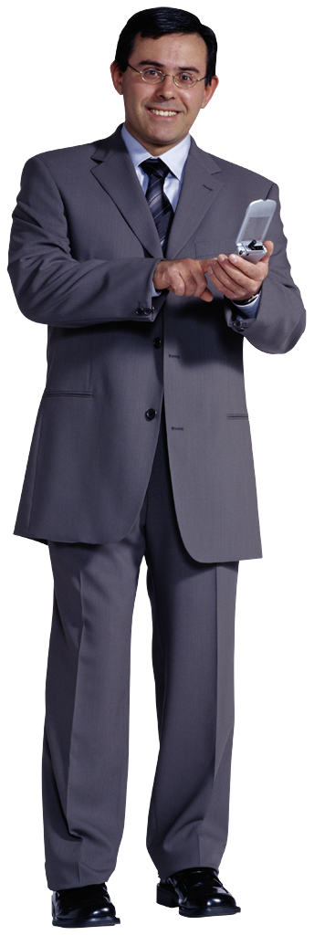
Distributed Leadership
Collective and inclusive philosophy
Shared responsibility
Collaboration
Focus:
Horizontal approach, multi-directional responsibilities
21st Century
#LeadChangedu13

Slide 12
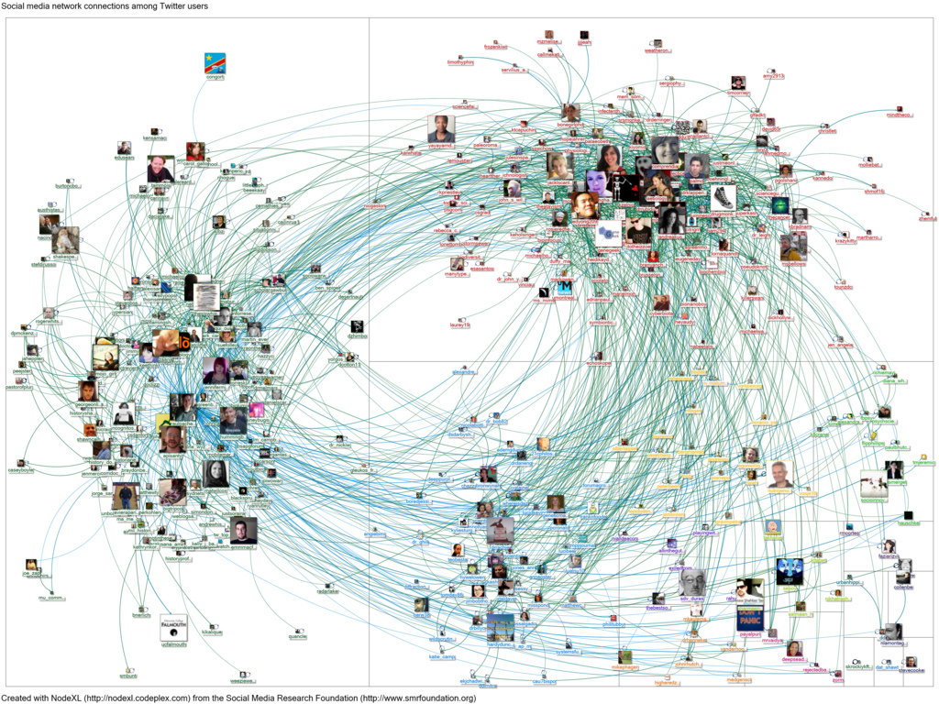
“Society of Networks”
Power and influence
self-organizing networks
21st Century

Slide 13
Circles of Influence
Replace chains of command
Changes nature of career success
21st Century

Slide 14
R. Kanter – Defines Distributed Leadership
Power goes to the “connectors”
those who actively seek relationships
and then serve as bridges between and among groups.
#LeadChangedu13

Slide 15
R. Kanter
Increased emphasis on horizontal relationships as the center of action
in order to focus on serving customers.
#LeadChangedu13

Slide 16
Society of Networks
Fewer people act as power holders monopolizing information or decision-making
even within organizations.
#LeadChangedu13

Slide 17
R. Kanter - Distributed Leadership
Spanning boundaries
grows relationships
increasing your influence.
#LeadChangedu13

Slide 18
A Leading Change Culture that Works
Great culture, highly professional
Support and promote faith, family, health, work
Highly collaborative cross-functionally
Status equality
Mission centered with clear focus on serving students in everything we do
Ideas welcomed and seriously heard
Accountability
Competency-based assessment
#LeadChangedu13

Slide 19
Competency-based Performance Assessment
10 competencies – choose 5
Leadership
one shared by every employee
#LeadChangedu13

Slide 20
10 Competencies at Harrison College
Leadership (all)
Adaptability (management)
Talent Development (management)
Alignment
Collaboration
Communication
Professional and Technical Expertise
Results Orientation
Service Orientation/Client Focus
Resilience
Notes:
2:26 – total now = say 33 minutes.

Slide 21
Leadership at Harrison College
The ability to make things happen by encouraging and channeling the contributions of others;
#LeadChangedu13

Slide 22
Leadership at Harrison College
taking a stand on and addressing important issues;
Houston, we have a problem
#LeadChangedu13

Slide 23
Leadership at Harrison College
acting as a catalyst for change and continuous improvement;
#LeadChangedu13

Slide 24
Leadership at Harrison College
developing viable partnerships and networks of people.
Notes:
10:55 – 30 minutes total is goal!

Slide 25
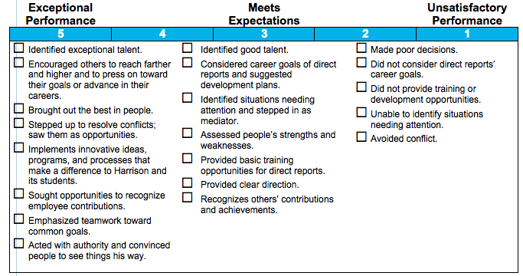
Competency-based Assessment
Leadership
Notes:
10:55 – 30 minutes total is goal!

Slide 26
Choose 5
Leadership (all)
Adaptability (management)
Talent Development (management)
Alignment
Collaboration
Communication
Professional and Technical Expertise
Results Orientation
Service Orientation/Client Focus
Resilience
Notes:
2:26 – total now = say 33 minutes.

Slide 27
8-Minute Brainstorm
Divide into groups
If adopted a competency-based assessment model:
Top 5 benefits of adopting the model
Top 5 concerns if the model were to be adopted
If adopted a distributed leadership model:
Top 5 benefits of adopting the model
Top 5 concerns if the model were to be adopted
#LeadChangedu13

Slide 28
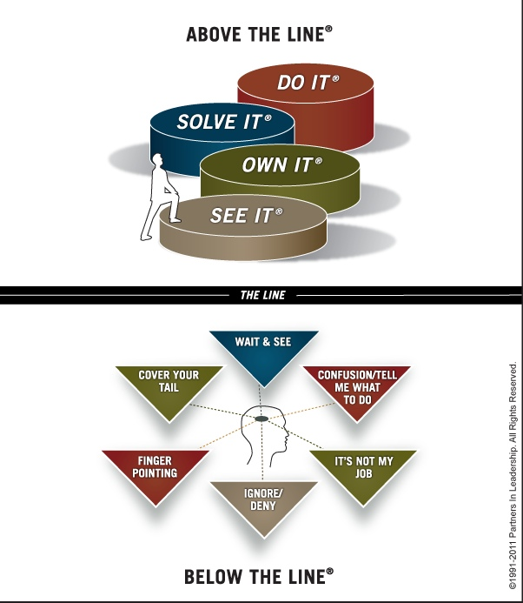
Item for Your Tool Belt
STEPS TO ACCOUNTABILITY®
Roger Connors, CEO, Partners of Leadership
The Oz Principle
http://www.ozprinciple.com/self/steps-to-accountability/
Notes:
Roger Connors created the Steps to Accountability Chart – describes this concept in his NY best seller, “The Oz Principle”.

Slide 29
Item for Your Tool Belt
15Five – great alignment/communication tool
What’s going well in your role? Any big wins this week?
What challenges are you facing? How are you going to fix and where do you need help?
How are you feeling? What are you doing to build morale and performance?
Good idea - what one thing will make the biggest improvement in your job, your team, or the organization?
#LeadChangedu13

Slide 30
A Leading Change Culture that Works
THANK YOU!
Questions?
Sherri Parker
Dean of Instructional and Learning Resources
Harrison College
sherri.parker@harrison.edu 317-447-6085

Slide 31
Cited Sources
123RF Royalty Free Stock Photos. (3 August 2013). Retrieved from http://us.123rf.com/400wm/400/400/costa1980/costa19800609/costa1980060900029/547570-people-hierarchy.jpg.
15Five. (3 August 2013). Retrieved from 15Five.com.
Diaz, J. 20 November 2012. Harrison College Fall Leadership Conference Presentation.
Kanter, Rosabeth Moss. 2009 November 16. On Twitter and in the Workplace, It’s Power to the connectors. Harvard Business Review. Retrieved from http://blogs.hbr.org/kanter/2009/11/power-to-the-connectors.html
Harvard Business School. Faculty & Research. (3 August 2013). Rosabeth M. Kanter. Retrieved from http://www.hbs.edu/faculty/Pages/profile.aspx?facId=6486.
Harrison College. 2013 August 1. Harrison Competencies.
Partnership in Leadership. (3 August 2013). Steps to Accountability. Retrieved from http://www.ozprinciple.com/self/steps-to-accountability/.
Social Media Research Foundation. (3 August 2013). Social Media Connectors Among Social Media Users. Retrieved from http://farm8.staticflickr.com/7003/6704337077_ef78832961_b.jpg.

