Slide 1
Look Ma! No Paper Textbooks!
Creatively and Collaboratively Advancing Our e-Content Future

Slide 2
Contents
Internet2/EDUCAUSE eText Pilots: Understanding What Higher Education Needs from E-Textbooks (Susan Grajek)
Campus Perspective: University of Wisconsin Madison (Bruce Maas)
Campus Perspective: Cornell University (Clare van den Blink)
Internet2 e-Content Initiative (Dana Voss)

Slide 3
Internet2/EDUCAUSE eText Pilots: Understanding What Higher Education Needs from E-Textbooks

Slide 4
2012-2013 Internet2/EDUCAUSE eText Pilot Program
More than 50 college & university participants
Over 25,000 students
Thousands of undergraduate and graduate courses
Courseload, CourseSmart, McGraw-Hill and many other Publishers
Notes:
PILOT GOALS
To continue to advance the higher education community’s understanding of online materials, and what is necessary for them to attain and surpass the effectiveness, accessibility, economy, and other relevant outcomes associated with traditional textbooks, and
To explore innovative business models, terms, and conditions that make access to digital educational materials more flexible, economical, efficient, and simple for institutions and publishers alike.ge with publishers, e-reader platforms, and various licensing models without having to commit to the long-term contracts or exclusivity common in today’s market.

Slide 5
Fall 2012 Pilot structure
20 institutions, Internet2, EDUCAUSE, McGraw-Hill, and Courseload
Notes:
Twenty colleges and universities collaborated with Internet2, EDUCAUSE, the publisher McGraw Hill, and the e-textbook platform provider Courseload to deliver free digital versions of textbooks to over 5,000 students and faculty in 393 undergraduate and graduate courses with a median class size of 28. The pilot shed light not just on the usability of McGraw-Hill textbooks in Courseload, but more broadly on the value of digital materials in higher education at this time.
The pilot included two partially overlapping studies: A “baseline”study that focused broadly on usability, adoption, and impact as well as a study whose specific target was the impact of e-textbooks on teaching and learning. Four institutions participated in both studies. In addition to the quantitative and qualitative data from the baseline and teaching and learning studies, student and faculty e-textbook usage data were provided by Courseload for each course. Table 1 summarizes the data sources.
Table 1
Data Sources
Baseline study
Teaching and Learning study
Usage data
17 institutions
5,388 students
99 faculty
7 institutions
1,752 students
45 faculty surveyed plus additional faculty interviewed
393 courses
Student survey
Faculty survey or interviews or focus groups
Student survey
Faculty survey (n=45 from 4 institutions) or interviews or focus groups
Counts of students’ page views and features used by course
Counts of faculty and TA (combined) page views and features used by course

Slide 6
Fall 2012 Pilot structure, continued
Each institution paid a $20,000 fee to Internet2 to participate in the pilot, and
No institutions passed those costs on to students or faculty.
Digital versions of McGraw-Hill textbooks were provided at no cost to all students, faculty, and teaching assistants in the 393 pilot courses.
Access to the e-textbooks expired at the end of the pilot.

Slide 7
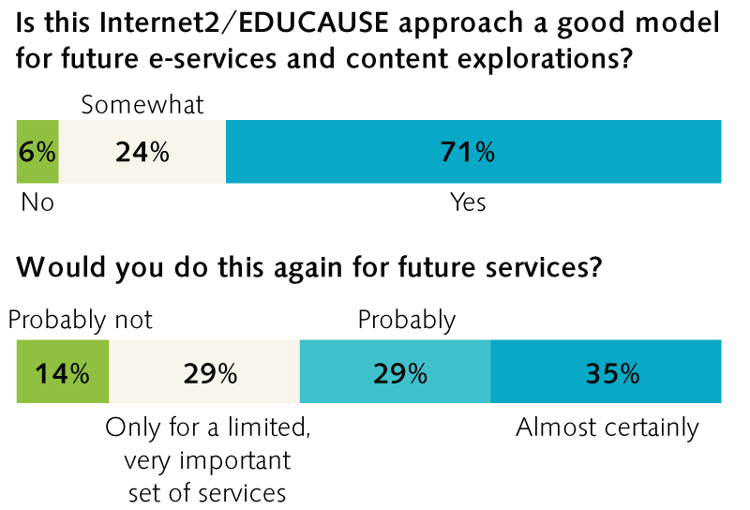
Evaluation of the pilot’s approach

Slide 8
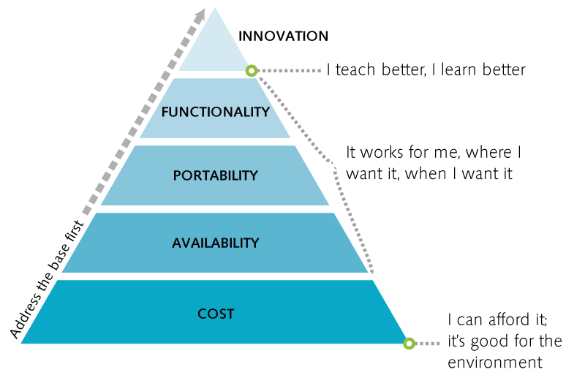
What students and faculty value in e-textbooks

Slide 9
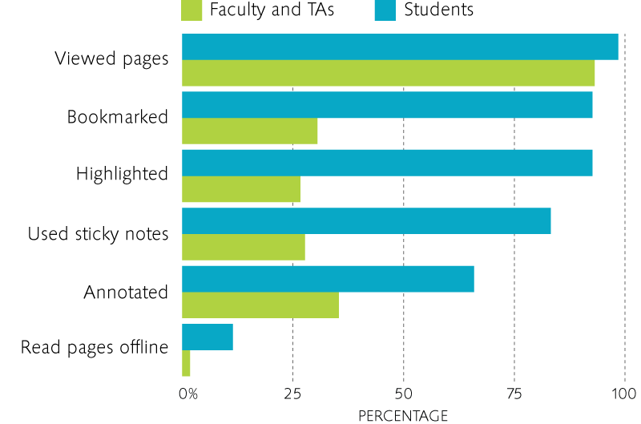
E-textbook feature usage by course
Use of e-textbooks
Faculty and students in every course viewed the e-textbooks
Students: 160 pages
Faculty & TAs: 30 pages
Source: Courseload usage data, n=~393 courses
Notes:
Faculty and students in every course viewed the e-textbooks. Very few e-textbook pages were viewed offline. According to the Courseload usage data, students viewed a median of 160 pages; faculty or teaching assistants 30 pages. The e-textbooks also enabled students and faculty to add bookmarks, highlights, sticky notes, and annotations. Students in almost all courses (96%) used at least one of these features; faculty, including teaching assistants, used at least one feature in 57% of courses. Each specific feature was used by faculty or treaching assistants in only 27%-35% of courses. Students were most likely to bookmark or highlight and least likely to annotate their e-textbooks.

Slide 10
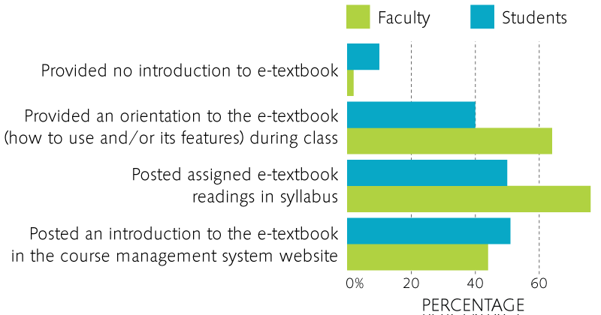
In general fewer than half of faculty incorporated the e-textbooks into their teaching
How instructors used e-textbooks
Sources: Faculty teaching and learning survey, n=45 and
Student teaching and learning survey, n=~1752
Notes:
in general fewer than half of faculty incorporated the e-textbooks into their teaching. See Chart 10. This low adoption was not apparently related to a challenging interface: Most faculty found the e-textbooks easy to learn and use. Only 11% had complaints; many of the complaints were about the need to change course materials or having insufficient time to prepare.
Only about 40% of instructors in the teaching and learning study reported adding annotations or highlights to the e-textbook or encouraging their students to use those or note sharing features of the e-text. Therefore it’s not surprising that so few students found useful their instructors’ highlights or annotations (31%) or the material the instructor added to the e-text (30%). In fact, if all instructors had themselves used annotations and/or highlights, it is possible that almost three-quarters of students might have found them useful. About half of instructors incorporated the e-textbooks into assignments, projects, or class discussions and less than 20% into group or team activities. (It’s unknown how many of the courses had group or team activities, though.)
When faculty were asked to describe how they changed their teaching as a result of using an e-textbook, they mentioned having more time to discuss different approaches to the material or emphasize the most salient parts of the text. Some were pleased to assume that all students now had access to their textbooks, because so many had previously opted not to purchase costly paper textbooks. Others experienced e-textbook as a complication because students disliked using them or were less likely to have the text in class.

Slide 11
E-textbook adherents and detractors
Students
Faculty
Source: student survey, n=~5388
Source: faculty teaching and learning survey, n=~29
Notes:
Individual students were classified as negative, neutral or positive about e-textbooks based on their patterns of responses to 11 baseline survey questions about the impact of e-textbooks. The three groups had equal numbers of students
The questions were: Compared to paper textbooks, e-textbooks (1) Helped me to better understand the ideas and concepts taught in this course, (2) Allowed me to better organize and structure my learning, (3) Increased engagement with course content, (4) Offered greater flexibility to learn the way I want, (5) Helped me interact and collaborate more with classmates, (6) Made my study time more efficient, and (7) Allowed me to interact more with my professor. (8) Using eTexts has become part of my learning routine. (9) I read more of the assigned material than I would have if it were a paper textbook. (10) I highlighted and/or annotated more than I normally do with paper textbooks. (11) I learned more from using the eText with highlighting and/or annotations (mine and others) compared to what I normally learn from paper textbooks.
Based on their comments, we were able to rate 36 faculty teaching and learning survey respondents’ attitudes towards e-textbooks as negative, neutral, or positive. Almost half of faculty were adherents (44%), one-third detractors (33%) and the remainder (22%) were neutral.

Slide 12
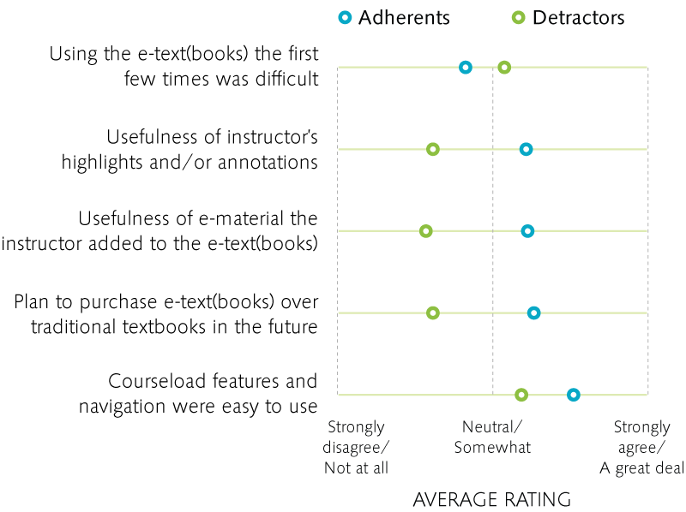
Differences between student e-textbook adherents and detractors
Source: student survey, n=~5388
Notes:
Adherents were more likely to plan to purchase e-texts over paper texts in the future.
Adherents were also more likely to have found the instructors highlights, annotations, and other additions to the e-text useful. They also had less initial trouble using the e-textbook.

Slide 13
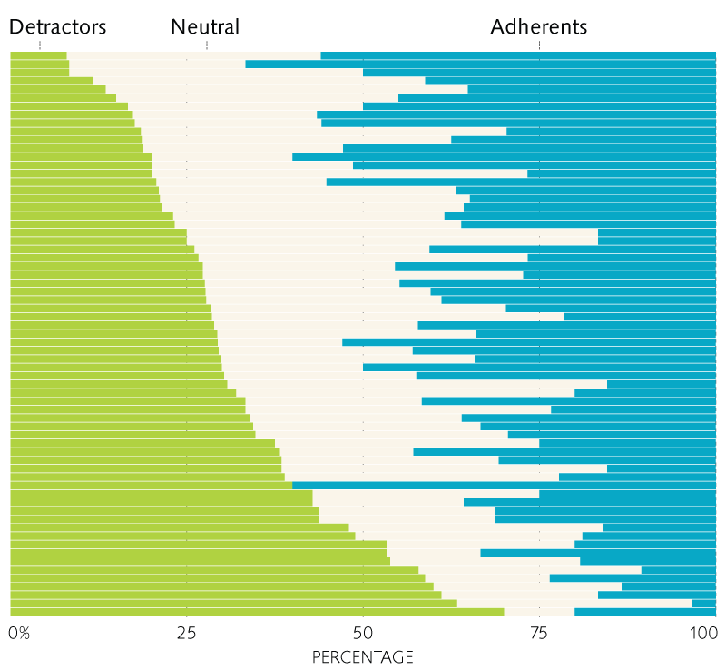
Students’ support of e-textbooks varies by course
Source: student survey, n=~5388
Notes:
We found that some courses had more than their share of adherents and some had more than their share of detractors. This plus the pattern of responses suggests that instructors’ adoption of e-textbooks is a key influencer of students’ experiences.

Slide 14
Conclusions
The pilot shows the path forward: Address faculty and students’ fundamental motivations:
Today’s course materials are too expensive
The environment factors into cost calculations.
They want choice: Choice of platform (including print), choice of place of access (including offline), choice of sourcing their textbooks.
They see digital course materials as the way of the future.
Need to be available on contemporary and emergent devices and interfaces.
Requirements are shaped by their experiences as consumers at least as much by their experiences using institutional applications.
They are here to teach and learn, and most welcome opportunities to be more effective. They need support to do this.

Slide 15
Conclusions, continued
Rather than focus on reformulating an existing model of publisher-provided content for electronic media, we might be wiser to expand our explorations to new forms of content and new models of content delivery
While IT clearly has a role to play to support, deliver, and help design new methods of providing digital course materials, it must collaborate and co-lead with many other groups.
Any explorations in the area of digital course materials must not just involve, it must empower and incentivize faculty

Slide 16
Campus Perspective: University of Wisconsin Madison

Slide 17
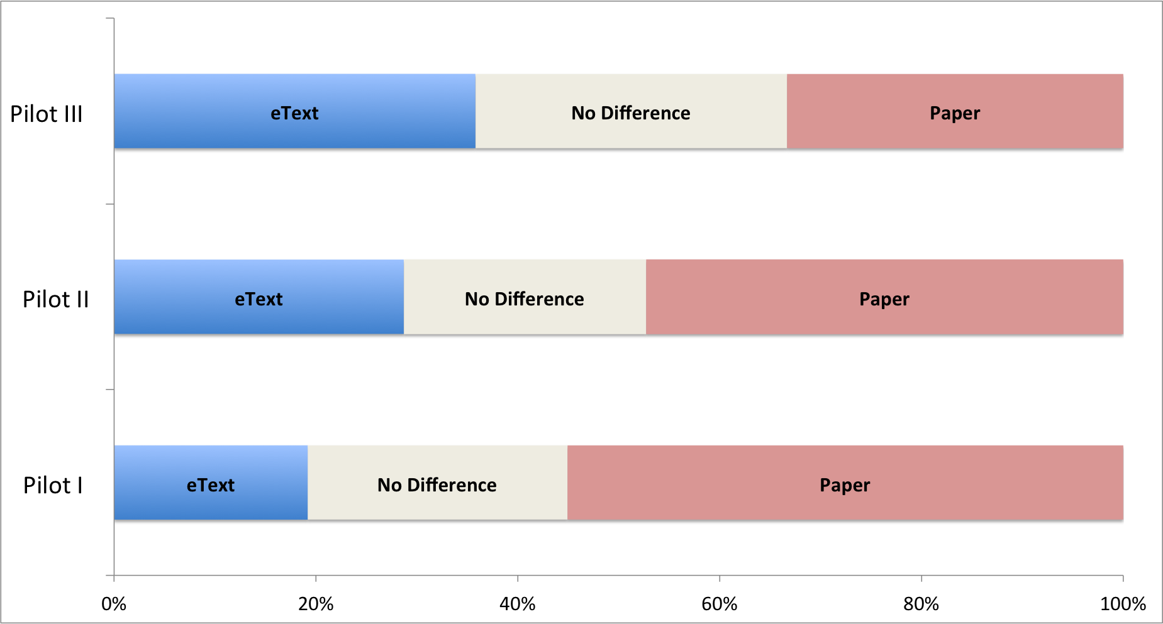
Student experience: paper or eText?
Overall, do eTexts or paper textbooks provide you with a better learning experience?
Notes:
In the first pilots, students preferred paper but in Pilot III, students appear to be divided equally between paper, eTexts, and no preference.
These results could be explained by
a shift towards digital/away from paper in the general student population over time
Pilot III selected for students who were more open to eTexts
Student experience in Pilot III with multiple eTexts resulted in increased preference for eTexts
Pilot I, N=416, spring 2012, Courseload
Pilot II, N=416, fall 2012, Courseload
Pilot III, N=81, spring 2013, CourseSmart

Slide 18
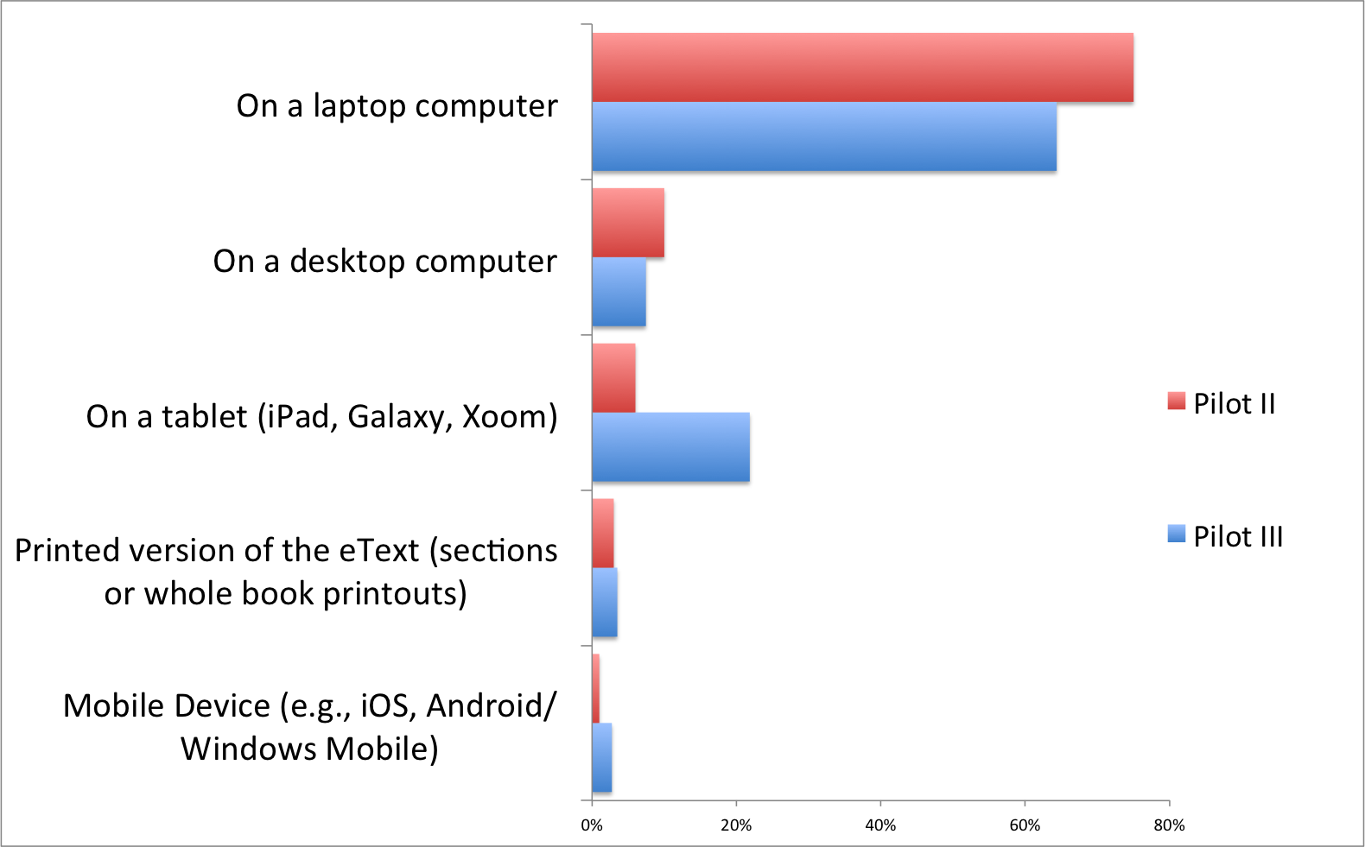
Use of eTexts on Devices
Increased use on tablets
Notes:
Overall, Wisconsin students have tended to use eTexts primarily on laptops but we did see an increase in the amount of time students in Pilot III spent using them on tablets.

Slide 19
Which features do students value?
Notes:
Some items in the word cloud are things students liked about CourseSmart (searching, offline access)
Some are things students wanted but did not have in CourseSmart (reliable offline access, instructor notes, better highlighting)

Slide 20
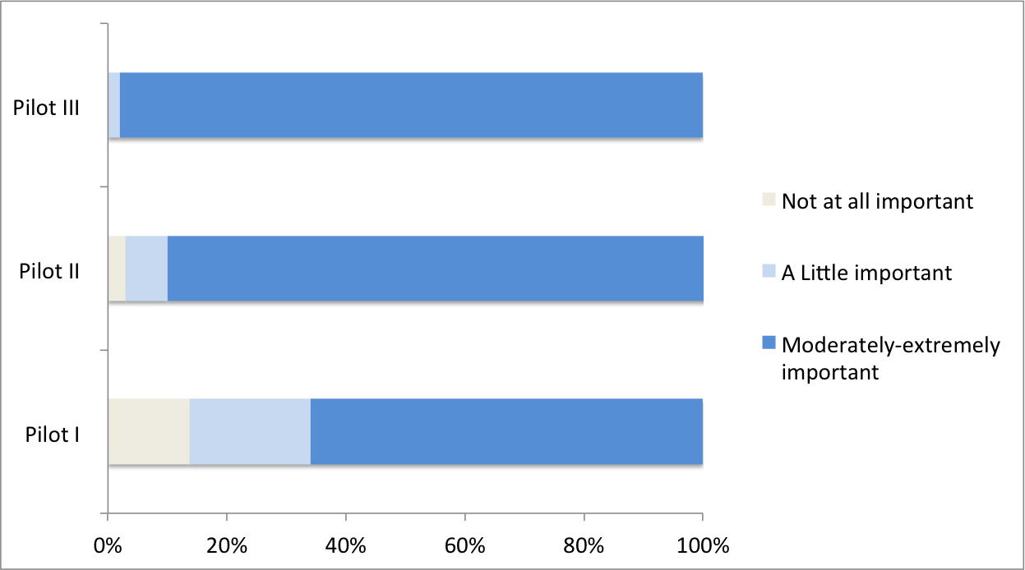
Importance of Low Price
How important is it that an eText costs less than a used or rented traditional paper textbook?
Notes:
Consistently, low cost of eTexts is a key factor for students
It is interesting that students in Pilot III, who were more positive about eTexts (versus Pilot I and II students) feel the most strongly about this.
Pilot III students say eTexts should be cheap because:
- Paper is more tangible
eTexts are a work in progress— need to improve readability, mobile apps, navigation
eTexts should be more interactive than the ones they used in the pilot (video, roll-over glossaries, quizzes inline with readings, etc)

Slide 21
Monetary value of eTexts
How much would you pay for a . . .
 | Pilot II (N=392) | Pilot III (N=80)
NEW paper copy of the textbook used? | $118.52 | $109.49
USED paper copy of the textbook used? | $71.22 | $64.74
A copy of the eText used? | $43.37 | $47.04
Consistently, students say eText is worth about one third of a new paper textbook.

Slide 22
Campus Perspective: Cornell University

Slide 23
McGraw-Hill eTextbooks
Add- comments, annotations, etc.
Integration & eText platform
Book store
CoursePacks
Library Electronic course reserves (ARES)
Instructor Materials
23

Slide 24
Mixed feedback from students
“I highlighted using the eTextbook. Easy to go back to the page I last left off on.”
“The ebook is inconvenient because I want to be able to print and highlights things, and I couldn’t with it.”
Notes:
Confounding factors----
Variability of ebook quality may impact this. Publishers not investing in the new medium….
How faculty introduced students to the eTextbook and reader features impacted their perceptions and use.
Because faculty did not use the enhanced features students saw little benefit.
When faculty did use the features, students felt a value added (VT).

Slide 25
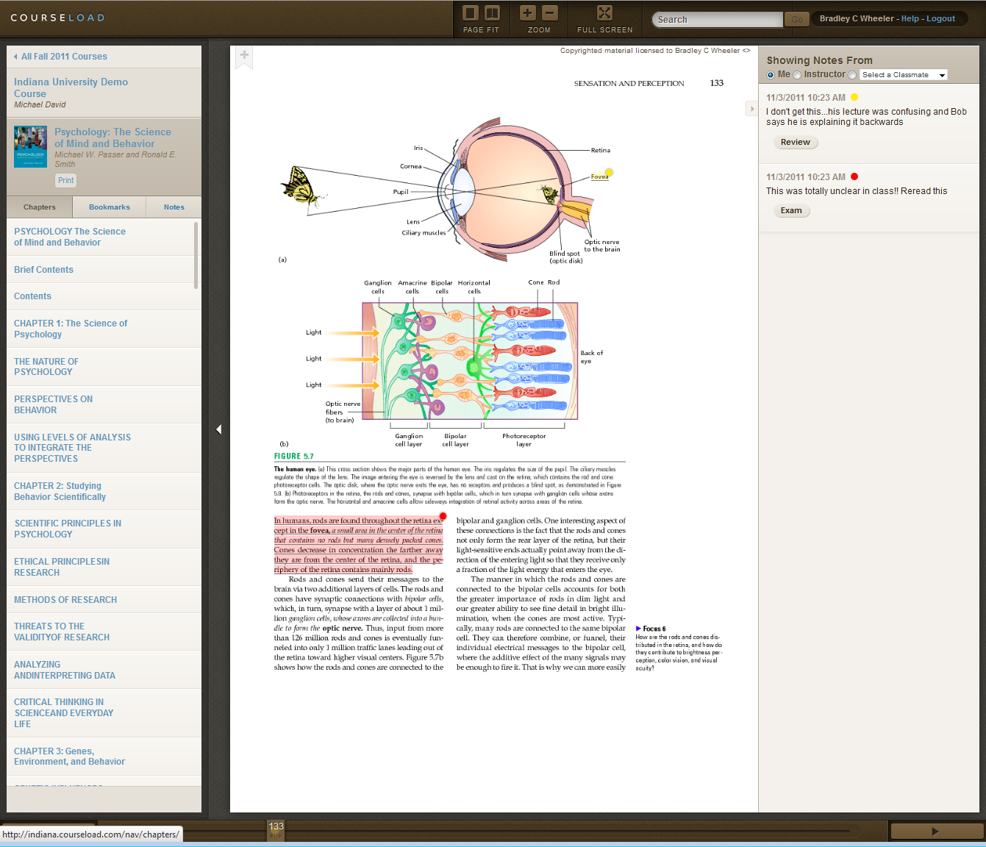
Full-text search
Annotations
Textual notes or links from a student, study group, or professor
Highlighting
Shared notes
Students who annotated more reported learning more..

Slide 26
Students were more likely
to purchase an eTextbook in the future
if it was INTEGRAL to the course.
“If we are to use eTexts, our instructors need to make them a central focus of the course…”
–Cornell student

Slide 27
Cornell Faculty Perspectives

Slide 28
Cornell Faculty Perspectives
“I think eTexts can support learning.”
Faculty plan on using eTexts for courses in the future.
Research Cited:
convenience, flexibility and the technology’s
Potential
“It’s a good direction to proceed”
“the move to eTextbooks is INEVITABLE”
Notes:
----- Meeting Notes (8/15/13 13:07) -----

Slide 29
Cornell University Outcomes
FACULTY
See value
Want eTextbook option
CORNELL STORE & ACADEMIC TECHNOLOGIES
want to implement a single integrated eTextbook platform

Slide 30
Moving from Pilot to Service….
Faculty
Store
IT
ALL want it….
BARRIERS = OLD MODELS

Slide 31
When she’s in college, which will she prefer?

Slide 32
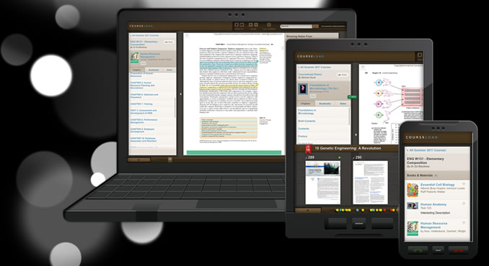
How can we leverage this new medium ?
Move educational content from a book to an engaging and collaborative experience?
Influence its evolution?
Work with new educational formats?

Slide 33
Internet2 e-Content Initiative eText clock is ticking!

Slide 34
e-Content Internet2 NET+ Initiative: Move from Pilot to Campus Service
34 – © 2013 Internet2
Notes:
Net+ initiative was kicked off in Spring 2013
Major Publishers were approached

Slide 35
Guiding Principles
Affordability for Students/Pricing Predictability
Flexible Business Models for Institutions
All Students Pay (ASP) and individual Students Pays (ISP) models
Accessibility
all components (text, navigation, notes/bookmarks/questions) are equivalent or as near-equivalent as possible for students using assistive technologies
Preference and Choice
Instructors: textbooks of choice, OER
Students: device, length of access
Library models: e-Reserves, options for students with limited means
Notes:
Instructors: freedom to choose the textbooks that best meet their teaching needs; access to full catalogs; flexibility to create custom e-textbooks; Support/leverage open eTextbook adoption/creation
Students: options for format, device, length of access

Slide 36
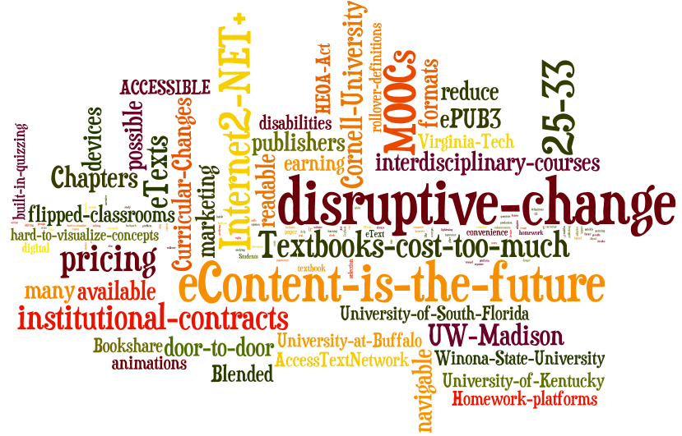
eText Clock is Ticking: www.cio.wisc.edu
Notes:
This will generally cover the points in Bruce’s blog:
http://www.cio.wisc.edu/etext-clock-is-ticking-for-textbook-publishers.aspx
eTexts are the future. However our most recent pilot (a year later) suggests that the ability to access multiple textbooks on a laptop or tablet adds a quantum leap of convenience that is shifting student opinion toward digital.
Curricular changes at universities will make e-content more important. Blended learning, flipped classrooms, the availability of content in MOOCs all reduce the focus on traditional lectures.
More granular textbook content is a better fit with many university courses. Instructors often want students to buy and read individual textbook chapters for a class. Instructors create topical, interdisciplinary courses on the fly—too quickly for the textbook market to adapt to their needs with a single textbook.
Institutional eText contracts will eventually help instructors with textbook selection (and encourage adoption of publisher eTexts). Textbook selection will always be up to the instructor, however institutional contracts would allow the university to provide instructors with a list of available eTexts (along with pricing) from publishers well in advance of student registration.
Digital textbooks can and should be so much more than paperless facsimiles of traditional textbooks. Students and instructors see the future of digital textbooks as much more interactive than a paper text could ever be.
Textbooks must be accessible for all students. Print textbooks are a barrier to students with many types of disabilities. But digital textbooks have the potential to break down those barriers significantly. While some human effort will likely always be needed to make graphic and video content accessible, textbooks in the ePUB3 standard would represent a large advance towards the goal of “born accessible” books.
eTexts should be readable and navigable on all devices and available in as many formats as possible. Copyright protections are preventing students from accessing their textbooks in the most useable forms and this is an unnecessary restriction, considering higher education’s successful track record educating students about digital piracy.
Textbooks cost too much. Students list “low cost of eTexts” as their number one strength. In our pilots, students consistently rated the maximum monetary value of an eText at about 25-33% of the actual publisher’s list price for a new paper version of the textbook.
The real danger to the publishing industry. I realize that the publishing industry is going through a period of disruptive change, and there is great uncertainty within the industry about the best ways to proceed. Members of the industry need to understand, however, that we will develop other approaches to digital course content if they fail to listen to the concerns above, and work with higher ed as partners. The higher education institutions that are part of Internet2 have clearly signaled our interest by working in partnership with the Internet2 NET+ service. My guess is that if the industry does not get its act together within the year, they will see significant additional threats to their business emerge. Innovation is constant, and the best bet is to embrace it. Higher ed is still willing to have dialogue, but the clock is clearly ticking.

