Slide 1
How Arizona State University Moves Data Faster
Kristin Kennedy
Arizona State University
Jason Morales
Microsoft
Patrick LeBlanc
Microsoft

Slide 2
About ASU

Slide 3
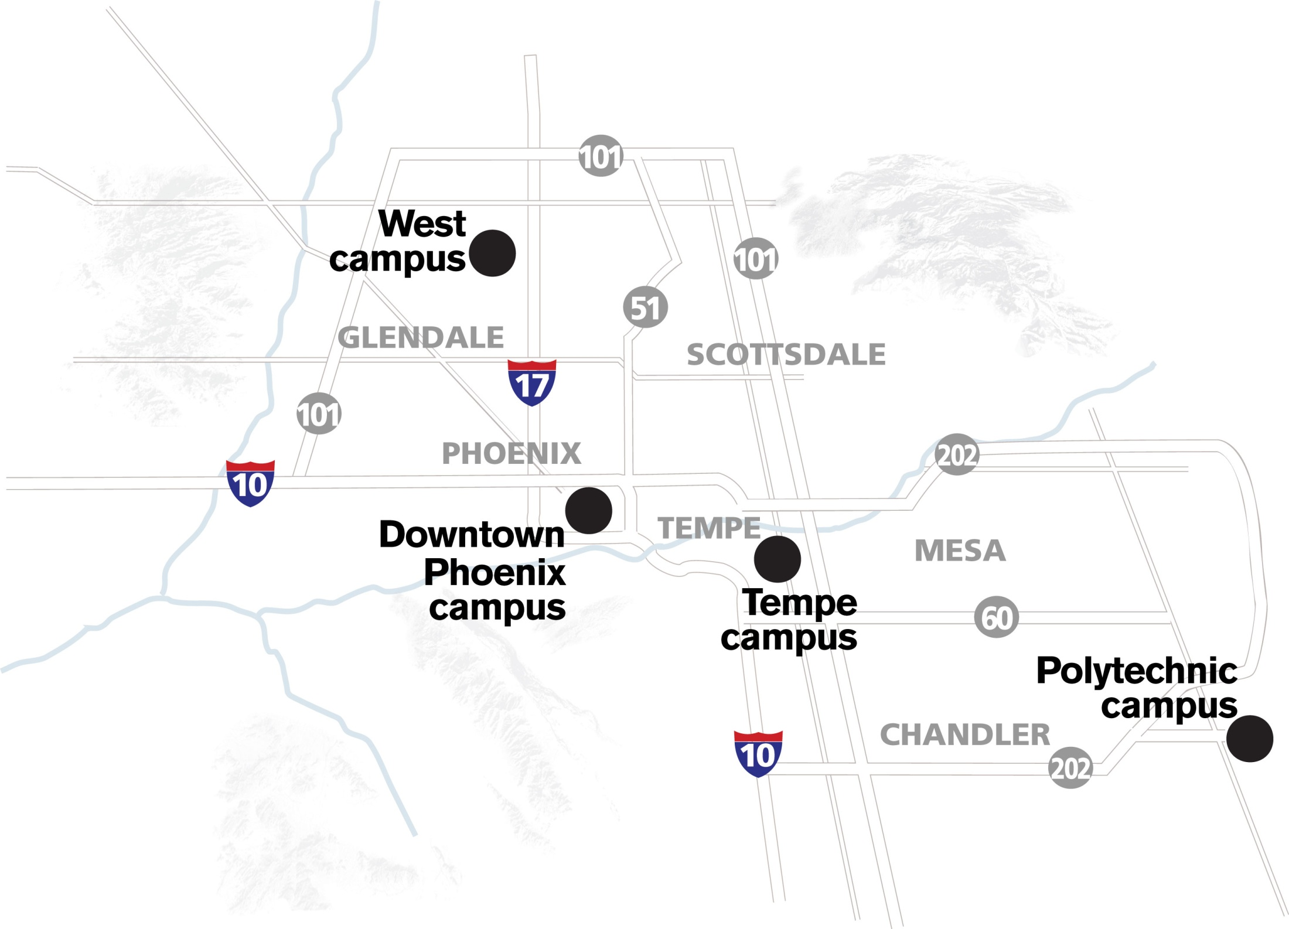

Slide 4
Fall Enrollments

Slide 5
ASU

Slide 6
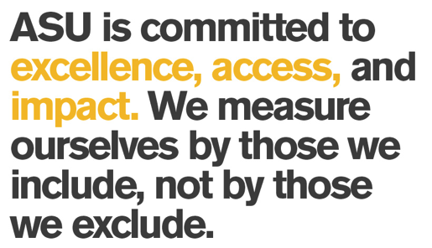
ASU

Slide 7
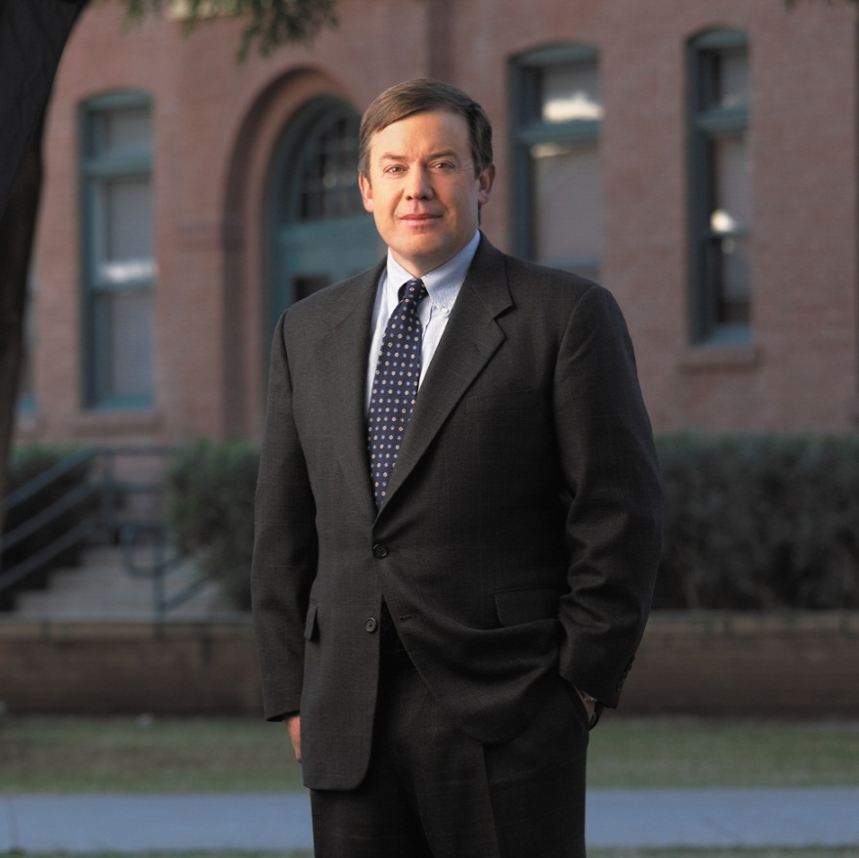
No More Excuses
“Without analytics, we can't understand what's going on, we can't understand the complexity of what we're trying to do, and we can't measure our progress. We needed tools to help us make better decisions—about everything. How should we design academic advising? How should we design individual courses? How should we design the overall pedagogical structure of the institution? Every facet of the institution requires robust analytics.” Dr. Michael Crow
http://www.educause.edu/ero/article/no-more-excuses-michael-m-crow-analytics

Slide 8
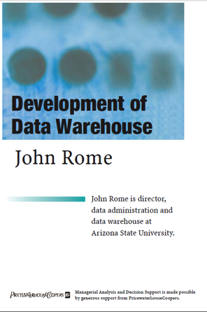
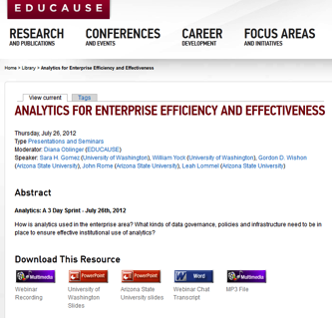
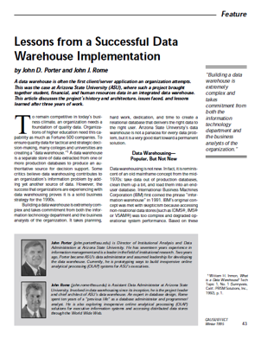
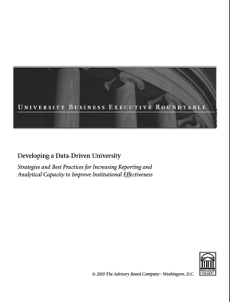
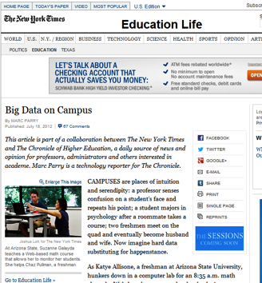
ASU Leader in BI

Slide 9
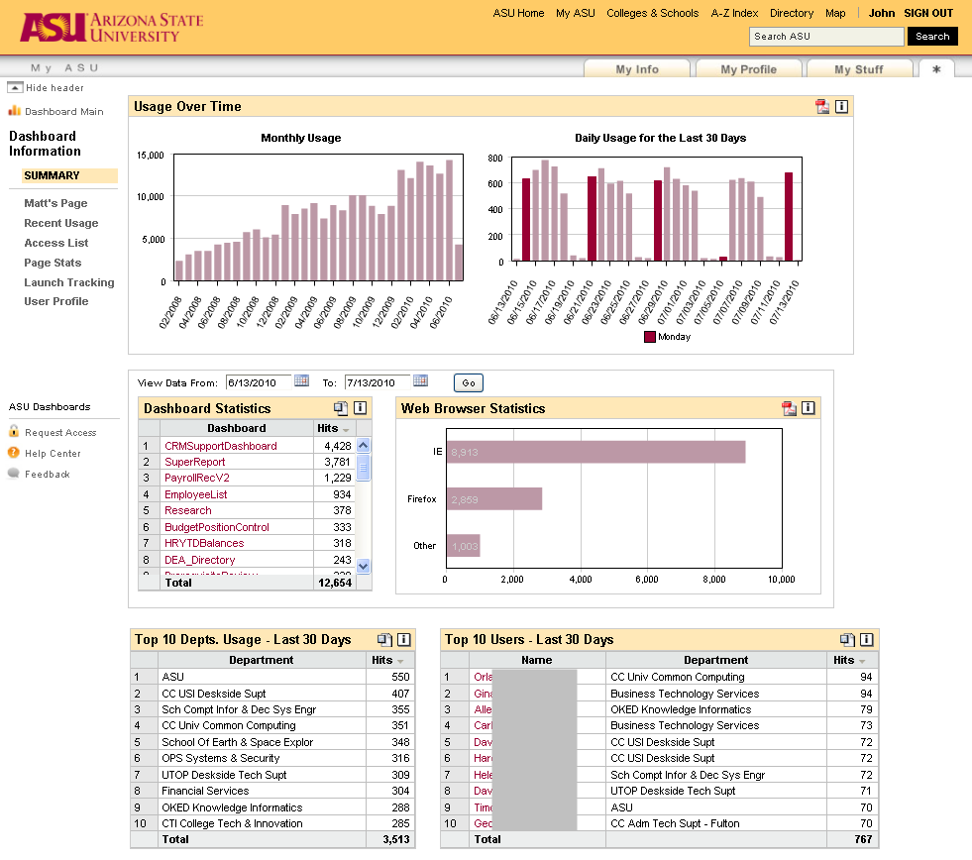
ASU’s Dashboards are Featured in Book
ASU’s Dashboards are Featured in Chapter of this Book

Slide 10
BI @ ASU
Data Warehouse Team
ETL (Data Stage)
ODS
EDW
My Reports
Self Service Query Building
Hyperion Interactive Reporting
Dashboards
Web Based
Corda Centerview 4.0

Slide 11
Org Chart
AVP Development
ETL and Data Integration
Reporting and Analytics
Program Manager
Manager Data Warehouse
ETL Developers (6)
Student Workers (4)
Support and Training (2)
BI Developers (3)
Analysts (2)
Student Worker (1)

Slide 12
Why Change Toolsets?

Slide 13
Tools End of Life

Slide 14
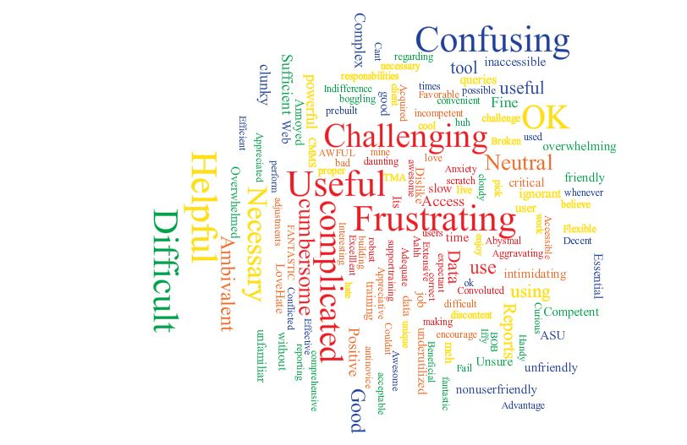
Internal Feelings

Slide 15
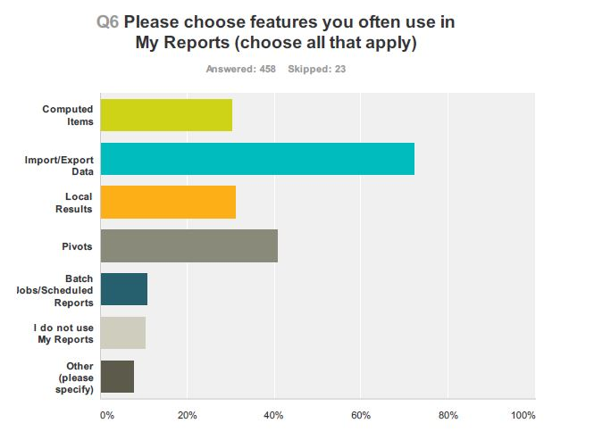
Use of My Reports

Slide 16
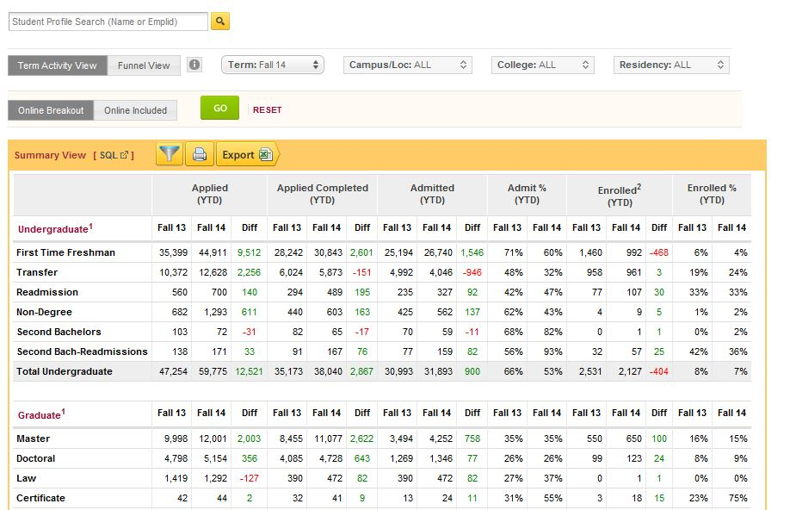
Dashboard Feature

Slide 17
Tools We Considered
Microsoft
IBM Cognos
OBIEE
Tableau

Slide 18
Microsoft BI
We already owned it
We don’t have a dimensional data warehouse
User familiarity with the tools

Slide 19
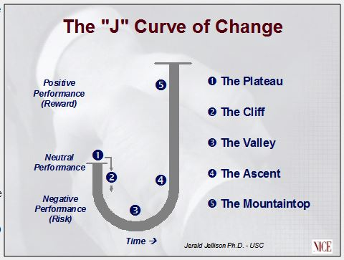
Change is Hard

Slide 20
More than a New Toolset
Vision:
To provide an accessible, easy to use, centralized Web-based reporting method that facilitates efficient and rapid access to analysis of University data to enhance data-driven decisions.
Objectives:
Increase Self Service so that all users can access University Data when they need to without any impediments to deeper analysis and access.
New toolset will be widely adopted by the University with a broader audience of higher level University Executives.
Maintain High level of established Customer Service.
Create user friendly access to metadata information about University Data that is accessible within the new reporting system.

Slide 21
Before
BI Team
My Reports
Dashboards

Slide 22
After
Analytics
Support & Training
Developers
Analysts

Slide 23
Self Service

Slide 24
Self Service
“Information workers must become more self-sufficient by having a BI environment that is more usable and more consumable. It is these two themes—usability and consumability—that play crucial roles in a fully functioning selfservice business intelligence (SS BI) environment.”
http://tdwi.org/articles/2011/11/09/research-excerpt-introduction-to-self-service-business-intelligence.aspx

Slide 25
My Reports = Self Service
Visual Query Building Tool
Access to Data from around the University
Pre-Built Reports
Batch Jobs

Slide 26
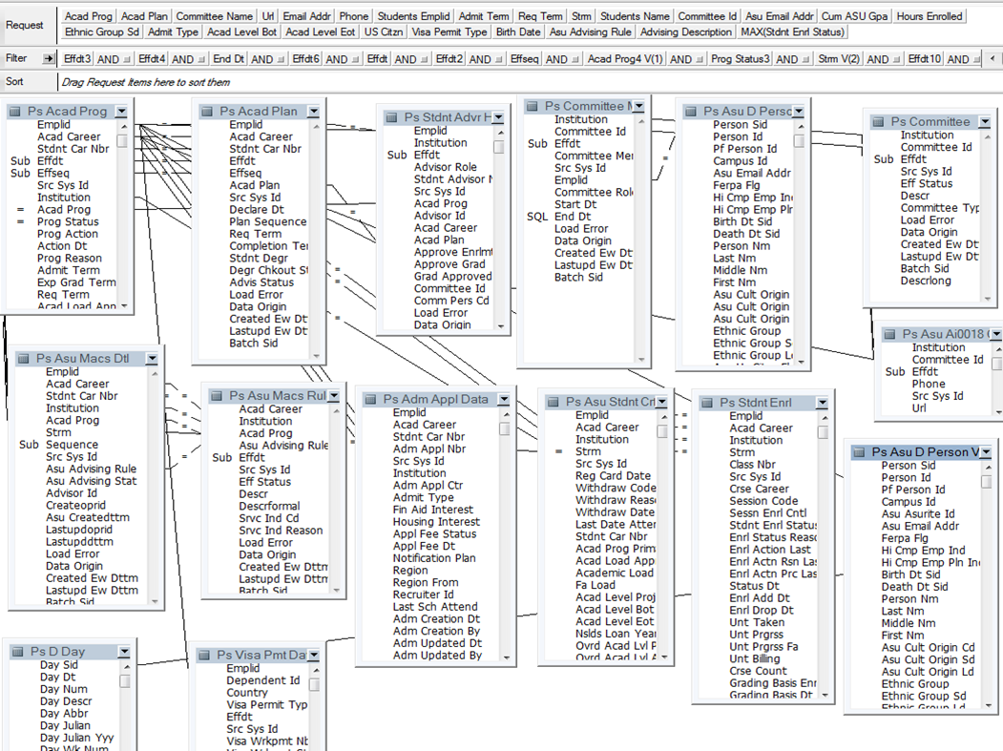
My Reports

Slide 27
Usability?

Slide 28
Two Approaches?
Centralized IT Development
Dashboards
De-Centralized User Development
My Reports

Slide 29
Dashboards
Coded by BI Developers
Parameters as defined ahead of time only
Why Export?

Slide 30
Dashboards

Slide 31
Managed Self Service
Hybrid approach that centralizes the complexities but allows for de-centralized data exploration

Slide 32
Microsoft BI
Data Models – Analysis Services Tabular - PowerPivot
Interactivity – PowerView, Performance Point, Reporting Services, Excel Services

Slide 33
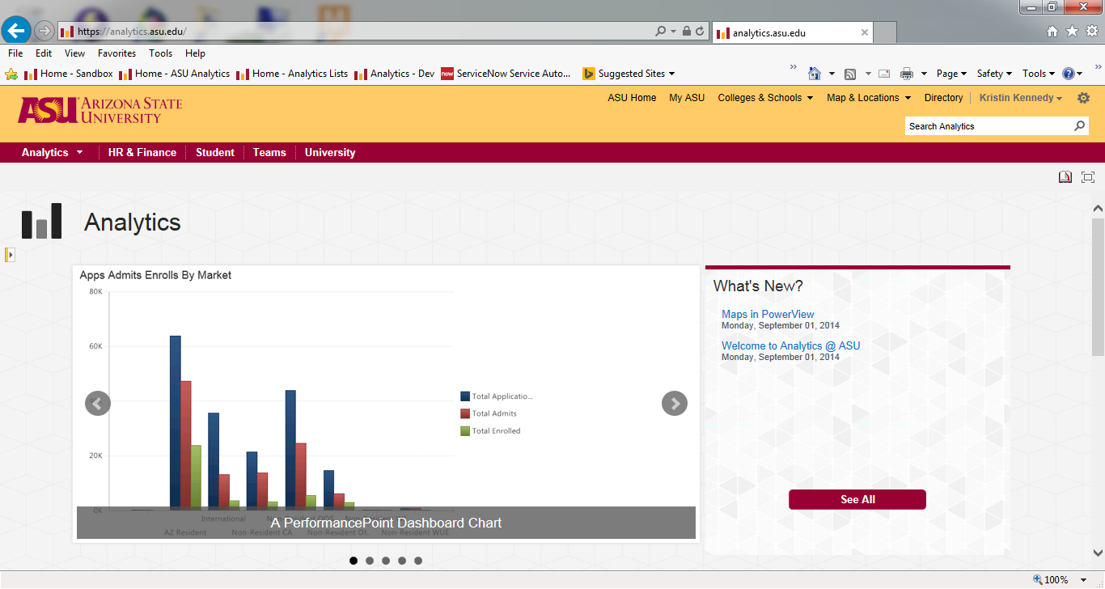
Microsoft BI

Slide 34
Benefits
Data Warehouse is not Star Schema – Dimensional Model
Allows for Different Skill sets
Power Users can still build content
Agile

Slide 35
Widely Adopted/Customer Service

Slide 36
What problem are we trying to solve?
How many enrollments do we have?
How many graduates do we have?
How many students came back?
Why are they leaving?
…

Slide 37
What problem are we trying to solve?
How we can make data available for whatever questions our users have?
How can we make the data easy to use for non techies?
How do we teach them how to fish?

Slide 38
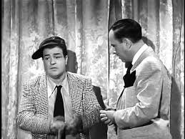
Answers to Questions

Slide 39
Don’t know what we don’t know

Slide 40
Reality
ASU Data Warehouse is 1.5TB
Took 1 year to build one flat “fact” table for Admissions
Conformed Dimensions/facts
User time commitment
ETL Time

Slide 41
Solution
PowerPivot
Quick/Agile
Less Rules
Results Oriented

Slide 42
Benefits
Great Ideas sometimes not widely adopted
Allows for Vetting of ideas
Measures Adoption and University Need before implementing

Slide 43
Won’t Solve All Problems
Start right away with PowerPivot/SSAS Tabular
For widely used or complex Dimensions/Facts, add to the Data Warehouse as appropriate

Slide 44
Metadata

Slide 45
Data Dictionary
Every time we meet with customers this is brought up
Why not a priority?
With limited resources, we focused more on making data available
Challenge to get this information from users

Slide 46
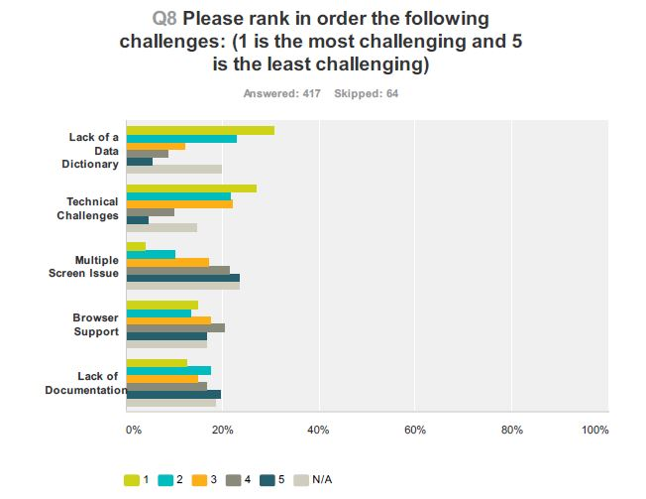
Survey Results

Slide 47
Survey Results

Slide 48
Data Governance
Newly formed group at University
Buy a product?
Project by itself
Needed something simple

Slide 49
SharePoint Tools
Business Connectivity Services (BCS)
SQL Server Database
Metadata Extracts from all sources
Oracle, SQL Server, Sybase, Models

Slide 50
Centralized Repository
Out of the box forms for easy data entry
Automated Integration of data
Import existing documentation in one centralized place
Google Spreadsheets all over

Slide 51
Flexible
If purchase a product later, can import data collected
Distributes work between Data Warehouse, Analytics and Subject Matter Experts

Slide 52
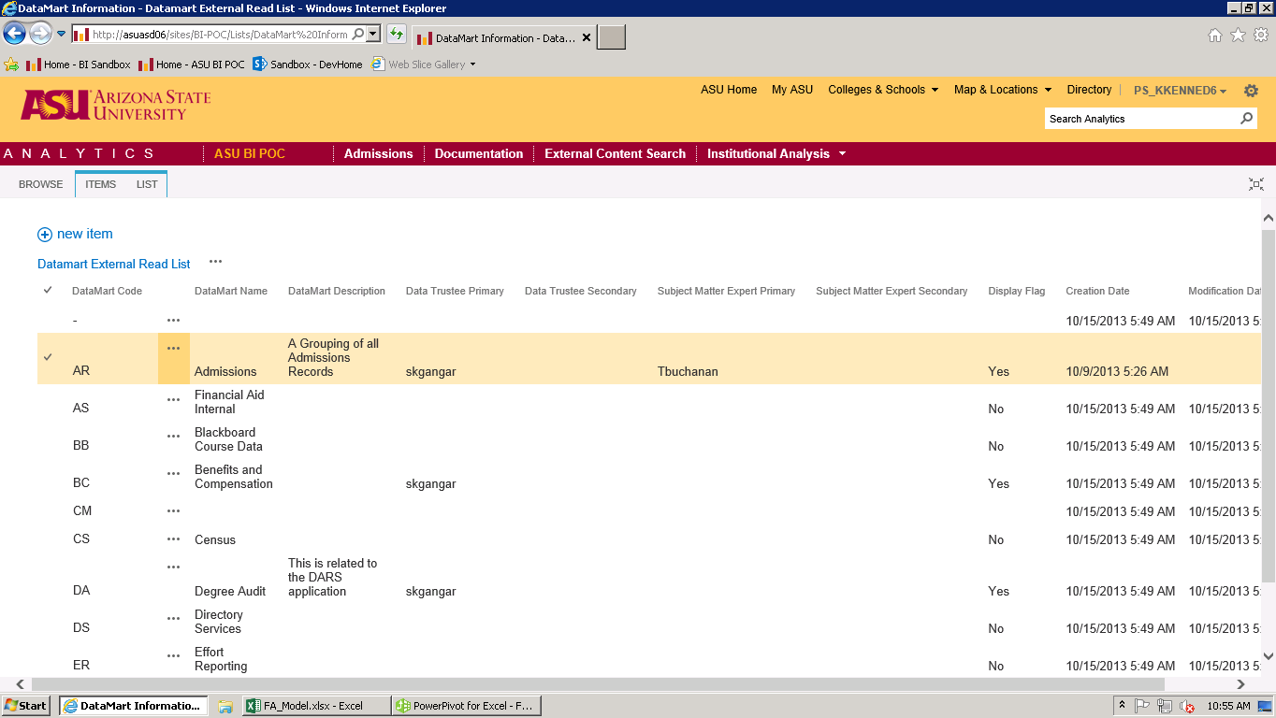
Out of the Box

Slide 53
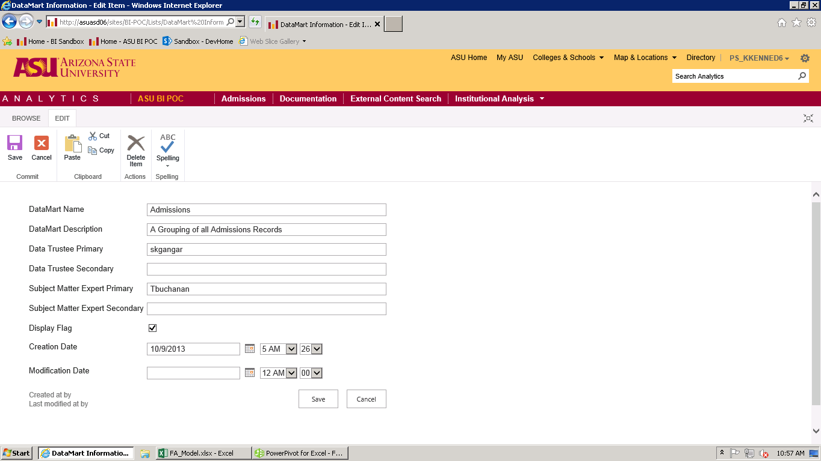
Out of the Box

Slide 54
Reportable
By having the data in a centralized database, can now report in any way we want
Models will be included as well

Slide 55
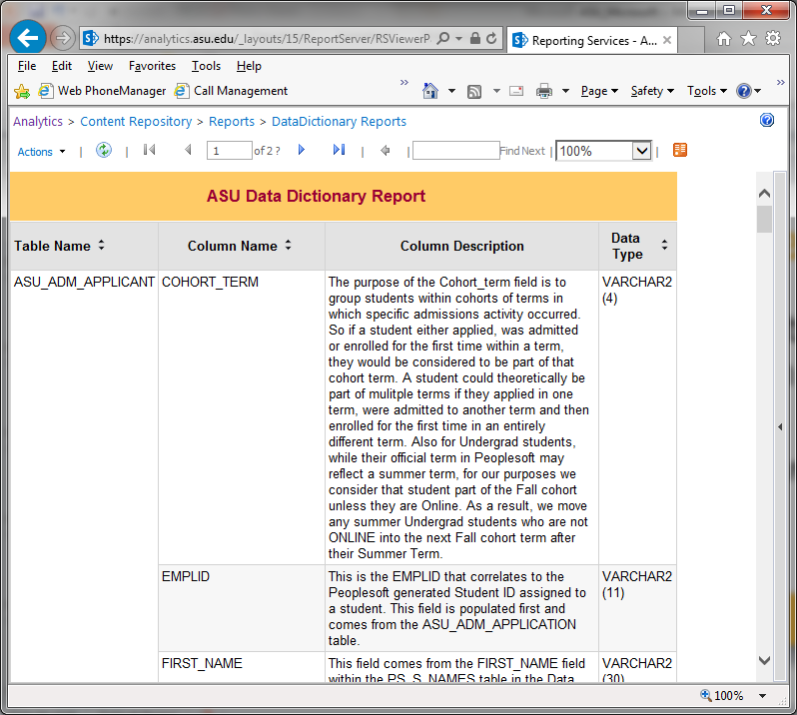
Reportable

Slide 56
Microsoft Implementation

Slide 57
Tools
SharePoint 2013
Performance Point
Excel Services
PowerView
SQL Server 2012
Analysis Services Multidimensional (SSAS)
Analysis Services Tabular (SSAS)
Analysis Services for PowerPivot
SQL Server Integration Services (SSIS)
SQL Server Reporting Services (SSRS)

Slide 58
Tools
Office 2013
Excel
PowerPivot
PowerView
Report Builder 3.0

Slide 59
Environment
Hosted by vendor that hosts our Data Warehouse
Entire Environment
Interacts with ASU Active Directory

Slide 60
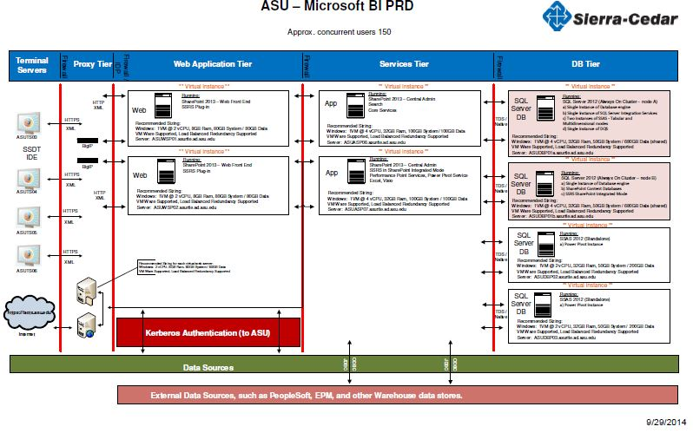
Environment

Slide 61
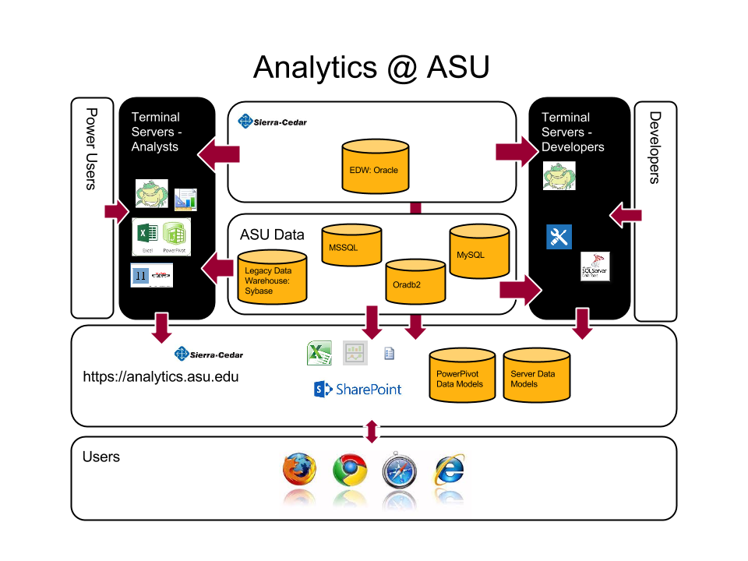
Environment

Slide 62
Timeline
December 2012 - Decision Made
July 2013 – Proof of Concept Environment Released
August 2013 – Began working on Authentication
November 2013 – allowed Power Users/Analysts Access to Terminal Servers

Slide 63
Timeline
November 2013 – Began having “Open” sessions getting users familiar with Model building tools
April 2014 – Production Environment Functional
October 2014 – Anticipate first “Site” released

Slide 64
Lessons Learned
Prepare for the 5 stages of grief if changing toolsets
Do not call things POC
Start on/Push for Authentication first
Start early on Licensing – more complicated with third party

Slide 65
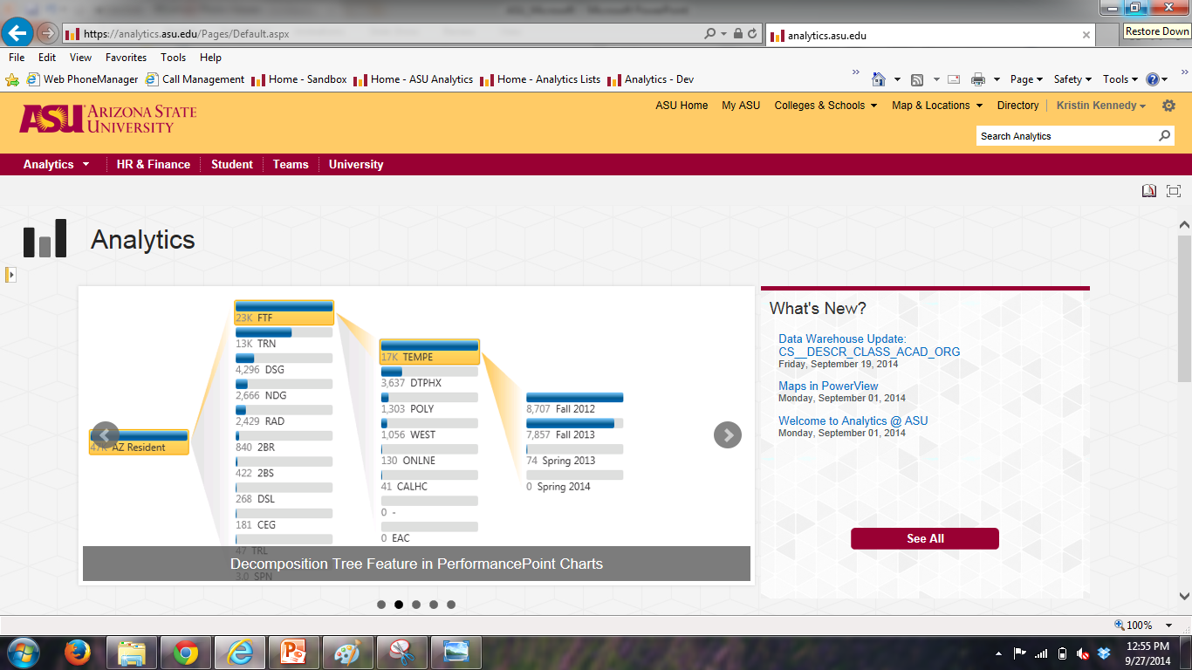
Live Demo

Slide 66
Example of All Tools
http://youtu.be/QFncM9P2Ykw
9 minute video showing example of each tool with Academic Data.

Slide 67
Questions?
Kristin.kennedy.1@asu.edu
Jason.morales@microsoft.com
Pleblanc@microsoft.com

