Slide 1
Disaster Recovery Constituent Group
George F. Claffey Jr.

Slide 2
What Elements Compromise DR/BCP
Security (both Physical and Technological)
Equipment (Servers, Storage, and Network)
Information (Customer Data, Log Files, archives)
Business Processes or Business Rules
Communications

Slide 3
Recent Changes to our Understanding of Disaster Recovery are a result of…
Storms (Andrew / Katrina)
9/11
Regulatory Compliance
Pandemic
Increasing number of International students
Growth in DR requirements
  (Some universities are like small cities)

Slide 4
New Problems, New Solutions
DR in a cloud
VMware / Virtualization
Virtual desktops
Commercialization / commoditization of Data center

Slide 5
Common Problems In
Existing/Static DR Plans
The plan does not encompass all of a campuses current technological services and/or it becomes outdated
  Servers or Storage have changed
  Versions of Software or patches have been applied
  Personnel have changed
  Networks or network addresses have changed
  Security or the network devices have changed
  Storage has change Again

Slide 6
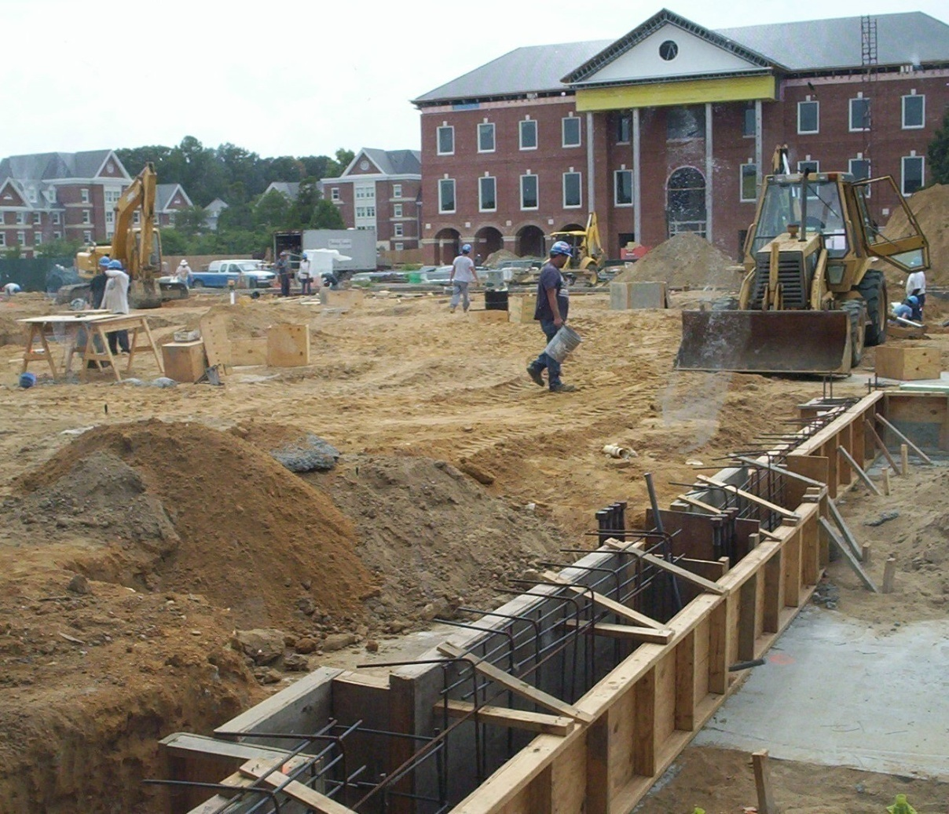
We Need a Strong Foundation
Ingredients for
A strong DR Foundation
Executive Support
Cabinet / Stakeholder Support
Information Technology Staff
Faculty Support
Facilities Support
Budget

Slide 7
What Impacts RTO
Number of Systems
Amount of Storage Required
Number of Restoration Devices (HD, Tape, etc.)
Personnel Available (skills required/shared)
Equipment availability (cold site, warm site, hot site, 1-800-IBM)

Slide 8
Questions for Discussion
How has the rise of virtualization impacted our DR?
How has internet backup (DRaaS), Box, etc. changed our strategies?
How do we integrate DR with existing change control procedures
Connect with Project Management Offices or Key application stakeholders
How do we or what strategies use to document current and changes in business processes

Slide 9
Help Us Improve and Grow
Thank you for participating
in today’s session.
We’re very interested in your feedback. Please take
a minute to fill out the session evaluation found within
the conference mobile app, or the online agenda.

