Slide 1
Financing IT’s Next Generation Opportunities:
Discussing the Options
Michele Norin, University of Arizona, Chairperson
James Estrada, Central Connecticut State University

Slide 2
Historical Patterns for Financing IT @ CCSU

Slide 3
IT Funding Sources
Activity | Funding Sources | Timing of Funds
Staffing | Institution – State, Tuition, General Fund Chargeback to Depts IT Student Fees | Annual; Permanent
Day-to-Day Support for Operations, Software, Licenses, & Contracts | Institution – State, Tuition, General Fund Chargeback to Depts IT Student Fees Grants Special Project Funds | Annual; Permanent; Sometimes One-time Funds
Construction | Institution – State Bonding, Donor Programs, Campus General Fund | One-time Funds
Infrastructure, Equipment, & Software. | Institution – State Bonding, Campus General Fund End-of-Year Funds | Annual; Permanent; End-of-Year; One-time funds.

Slide 4
IT Funding Sources
Activity | Funding Sources | Timing of Funds
Staffing | Institution – State, Tuition, General Fund Chargeback to Depts IT Student Fees | Annual; Permanent
Day-to-Day Support for Operations, Software, Licenses, & Contracts Cloud?? | Institution – State, Tuition, General Fund Chargeback to Depts IT Student Fees Grants Special Project Funds | Annual; Permanent; Sometimes One-time Funds
Construction | Institution – State Bonding, Donor Programs, Campus General Fund | One-time Funds
Infrastructure, Equipment, & Software. | Institution – State Bonding, Campus General Fund End-of-Year Funds | Annual; Permanent; End-of-Year; One-time funds.

Slide 5
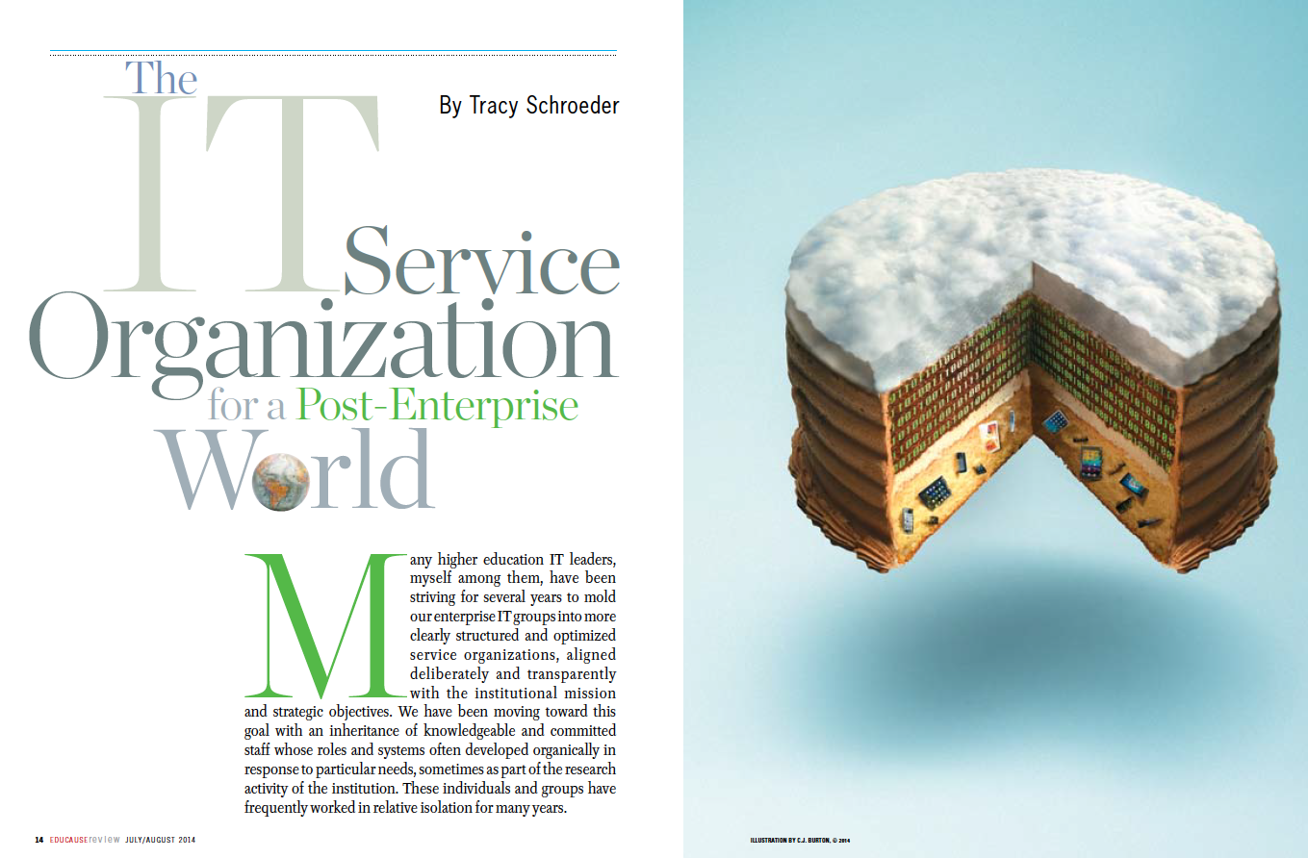
EDUCAUSE REVIEW JULY/AUGUST 2014, Page 14
Notes:
What Do Colleges and Universities Need from IT Organizations Today?
High-quality, cost-effective Utility Services;
A next-generation Security Infrastructure that enables institutions to more efficiently share resources and protect data;
Value-added process Reengineering and Data Analysis capabilities;
Innovative visions for the future of teaching, learning, and research.
What Will the IT Organization of the Future Look Like?
To meet the needs of colleges and universities in the post-enterprise world IT organizations will need to:
expand and develop new capabilities in ITSM, cloud services architecture and supporting infrastructure, IAM, process analysis and reengineering, institutional and big data analytics, and leading
identify areas where they can streamline. In many cases, staff will need to shift roles from one area to another, gaining new skills and responsibilities

Slide 6
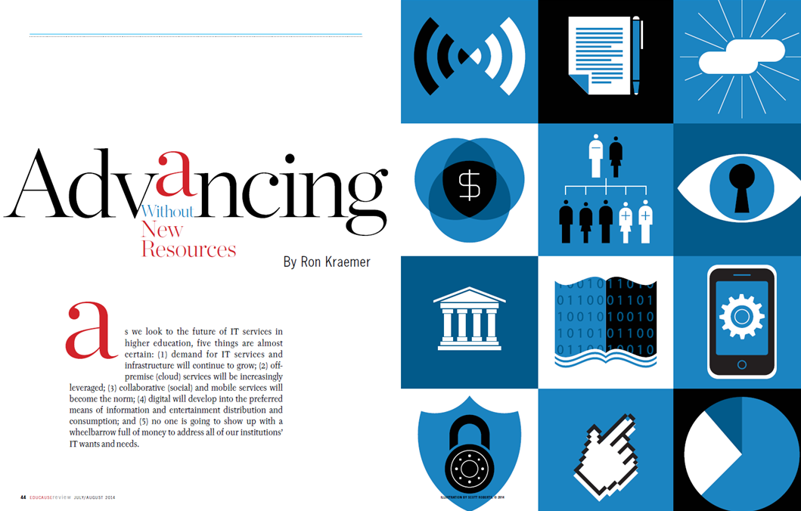
Advancing Without New Resources
Data Center
Application Integration /Realignment
Service Aggregation /Management
Organizational Structure
Messaging/ Communications
Software & Service Licensing
Apps Development
Administrative Support
Enterprise Resource Planning (ERP)
Platform
EDUCAUSE REVIEW JULY/AUGUST 2014, Page 44
Notes:
Top 10 Campus Needs
Teaching & Learning Support
Emerging Services
Staff Readiness
Analytics
Identity Management
Mobile
Digital Production
Information & Infrastructure
Legal
Security

Slide 7
The Future of Administrative IT
Notes:
Key Findings
1. Value Proposition:
A. Operational efficiency and effectiveness
B. Strategic asset for improving mission performance
2. Maximize value:
A. Clarify administrative costs and their drivers
B. Minimize customization in services and systems
C. Establish an institutional strategy for analytics
Share knowledge within and between institutions
3. The IT Community’s Message:
A. The status quo is unsustainable—all of higher education has to work together to realize the potential of administrative IT to reduce costs and advance the institutional mission.

Slide 8
Group Discussion
Part 1: What are the IT Funding challenges facing your campus?
Part 2: What could we do differently?

Slide 9
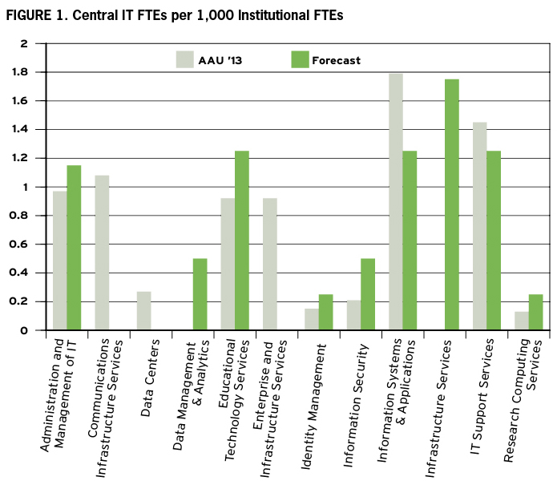
The IT Service Organization for a Post-Enterprise World
EDUCAUSE REVIEW JULY/AUGUST 2014, Page 14
Notes:
There are significant changes forecasted for traditional IT areas such as “Communications Infrastructure Services,” “Data Services,” and “Enterprise Infrastructure Services.” Some of the forecasted areas (the green columns) will represent entirely new types of services (e.g. cloud computing and/or Saas).

