Slide 1
Implementing Scale
for Core Commodity Services
through the Cloud and Collaboration

Slide 2
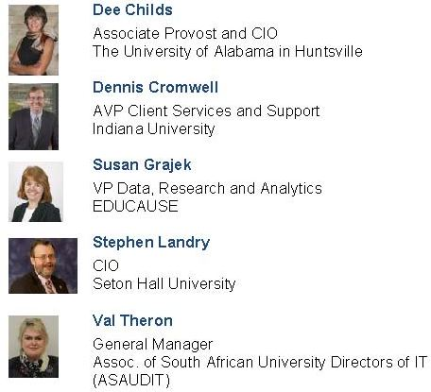
Facilitators

Slide 3
Implementing Scale for Core Commodity Services through the Cloud and Collaboration
Lightning Round: IaaS at Seton Hall University
Stephen G. Landry, CIO

Slide 4
IT Services
Trust
Trust
Edge
Leverage
Edge
The Extended IT Team

Slide 5
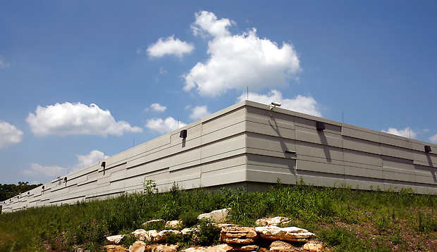
IU Bloomington Data Center (2009)

Slide 6
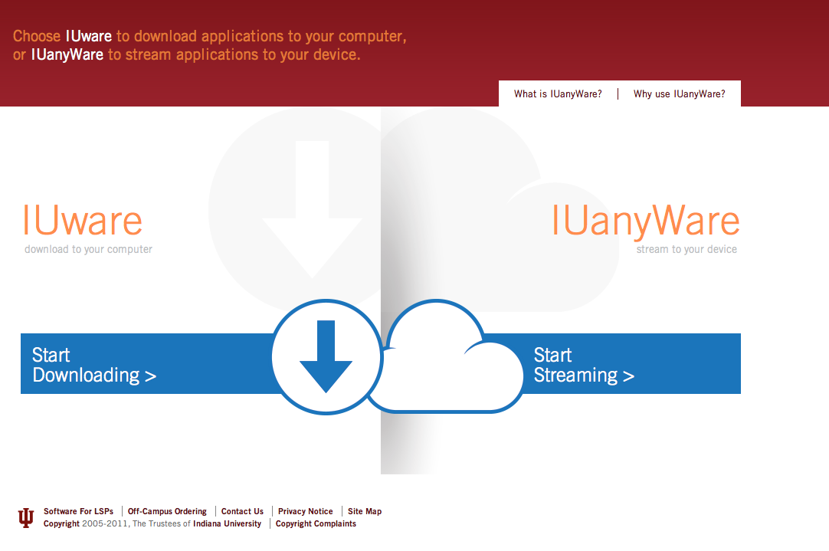

Slide 7
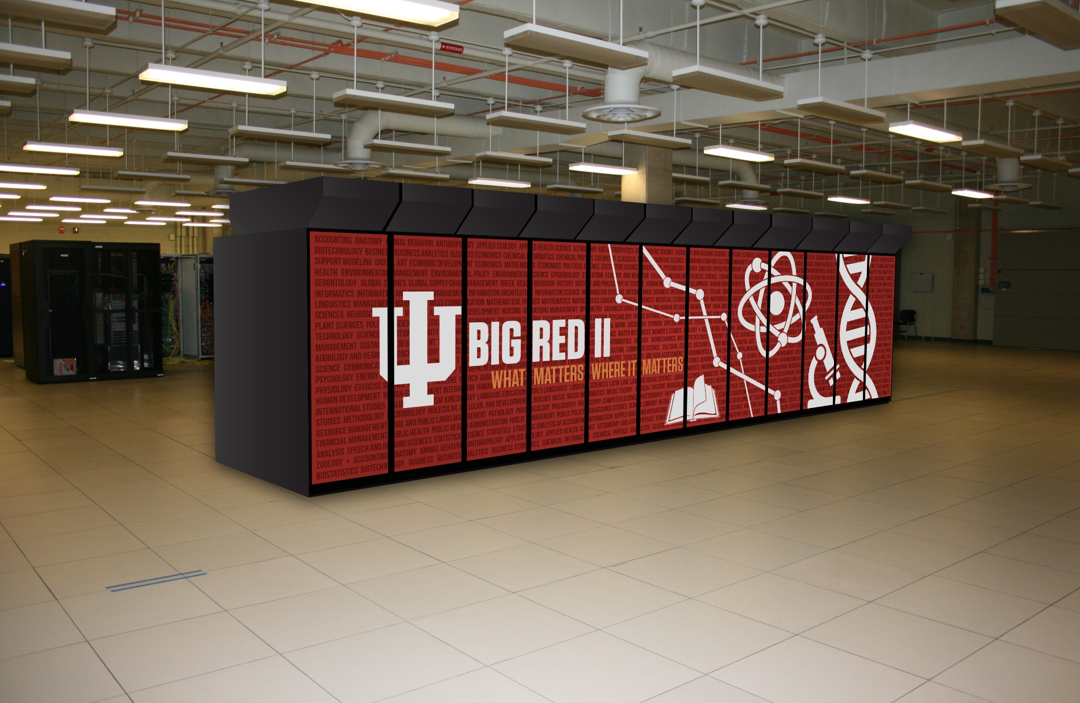
Big Red II Supercomputing

Slide 8
Daily Support and Design Services to > 700 IU Classrooms

Slide 9
Lightning Round:
Stephen Landry: Infrastructure-as-a-Service (IaaS) at Seton Hall University (SHU)
Seton Hall University
Mid-sized, private, Catholic affiliated
Suburban campus 15 miles from NYC
5,500 undergrad / 4,300 grad students
470 faculty
Ubiquitous computing campus – all undergrads receive University-issued convertible laptop/tablet computer

Slide 10
Lightning Round: IaaS at SHU (Cont.)
Question: If you were starting a new college from the ground up, would your plans include an on site data center?

Slide 11
Lightning Round: IaaS at SHU (Cont.)
SHU is no longer hosting on site:
Learning System (Bb, SaaS, 2004)
Student Email (O365, SaaS, 2009)
Help Desk System (S-Now, SaaS, 2009)
Prospect Inquiries (SalesForce, SaaS, 2009)
Web Site (PaperThin/AWS, IaaS, 2012)
Payment Gateway (TouchNet, SaaS, 2013)
Active Directory / ADFS (AWS, IaaS, 2013)
Identity Management (Okta, IMaaS, 2014)
Library Catalog (OCLC, SaaS, 2014)
Medical Records (Medicat, SaaS, 2014)
ETC …

Slide 12
Lightning Round: IaaS at SHU (Cont.)
Why wouldn’t a campus move it’s IT services to the cloud?
Operating vs. Capital Expense
Lack of appropriate services (e.g., databases, vendor support)
Maturity of cloud vendors
Ownership of data and ability to migrate data between services (i.e.,import/export)
Security
Security
Security … ETC, ETC, ETC …

Slide 13
Lightning Round: IaaS at SHU (Cont.)
But, e.g., Amazon Web Services (AWS) is moving at “cloud speed”:
Highly secure (every security cert conceivable)
High availability
Dropping prices
Offerings include SQL, Oracle, HPC
Near effortless deployment & upgrades
VPC securely integrates with existing DC
Backups, snapshots, multi-zone replication, VTL
One hour SLA available
Integration with S-NOW, Splunk, etc.
Gartner leader for vision, ability to execute

Slide 14
Lightning Round: IaaS at SHU (Cont.)
SHU’s Cloud Strategy:
“Cloud First” moving forward: All new server deployments will be in AWS
Move faculty and employee email to Office 365 by end of 2015
Migrate all simple standalone servers to AWS by end of 2015
Plan migration of Oracle and SQL databases to AWS

Slide 15
Discussion Topics
What are the primary areas that make sense for cloud or collaborative services?
DR, PaaS, IaaS, VoiP, analytics, Identity Management, NOC, LMS……
What are the primary risks (perceived or real?)
Security, cost, loss of control, lack of staff skillsets, job security…..
What is one thing you can do NEXT WEEK to start the conversation on your campus and/or continue the conversation with EDUCAUSE colleagues?

Slide 16
Help Us Improve and Grow
Thank you for participating
in today’s session.
We’re very interested in your feedback. Please take
a minute to fill out the session evaluation found within
the conference mobile app, or the online agenda.

