Slide 1
Envisioning the Future CIO:
Building a Recipe for Success

Slide 2
Speakers
Nigel Cunningham, Deputy Director Finance and Information Services, University of Ulster
Kathy Gates, Chief Information Officer, University of Mississippi
Thad Lurie, Chief Operating Officer, EDUCAUSE
Notes:
General overview of the group’s inception, purpose, and a summary of the progress and deliverables/report
What are the audience’s perceptions on IT leadership and professional development?
Ice-breaking: a couple statements and ask for a show of hands
Thought-provoking; lay foundation of discussion
Provide opportunity for straw poll of audience; gauge audience experience
My university leadership has a good understanding of my role in the organization
It is important that the CIO comes from a technical background

Slide 3
My university leadership has a good understanding of my role in the organization.

Slide 4
It is important that the CIO comes from a technical background.

Slide 5
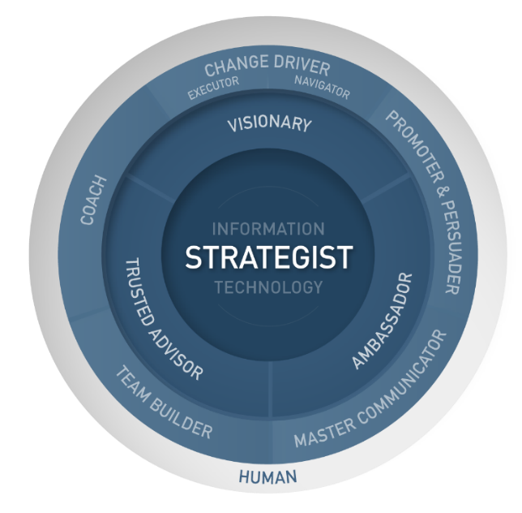
Roles
What does a successful CIO of the future look like?
Notes:
What does a successful CIO of the future look like?
First ask audience to respond to statements
Is the CIO role evolving as one cohesive role or fragmenting?
What % of time (targeted at aspiring CIOs) do you spend on managing things vs. leading people to get your objectives met/work accomplished? This may be another facet of operational ,control costs and ‘keep the lights on’ versus strategic role of driving business transformation

Slide 6
Is the CIO role evolving as one cohesive role or fragmenting?

Slide 7
My job gives me enough time to lead strategic change vs. managing and “Keeping the lights on.”

Slide 8
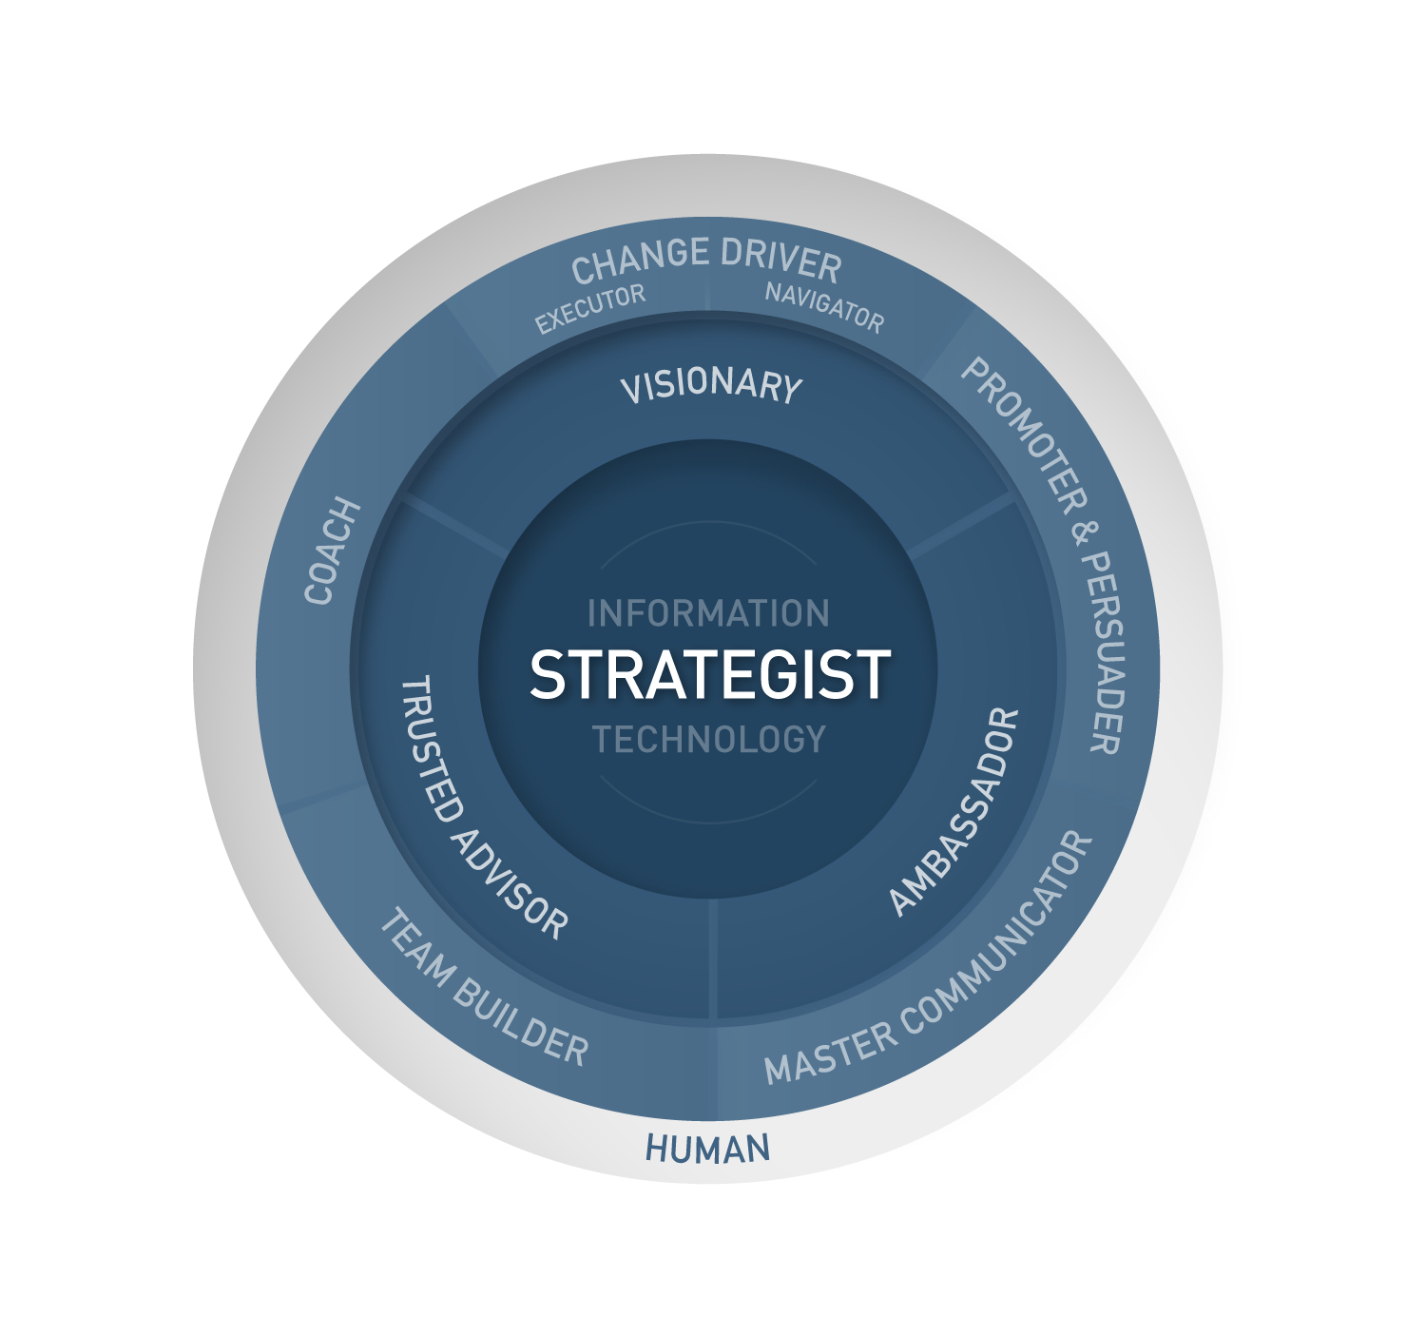
Roles
Notes:
Process
Cover briefly or discuss how these roles emerged
Overview of the model –
Inner ring –
Strategist: IT has a role to play in every part of the institution, so the IT leader takes a more holistic view than other executive-level roles. To be an effective strategist, the IT leader must understand the organization, provide Information System and Technology leadership and bring to life transformation across the organization.
Enabling Roles - These roles take time to develop, and are perhaps the most difficult to achieve. That said, they are also the most valuable roles that an IT leader plays.
Visionary –
Definition: the Visionary is a figurehead and thought leader for the institution. They scan the horizon for emerging trends and themes and act as a sponge for ideas and innovation.
Ambassador
Definition: our Ambassador promotes a positive image of IS. Through their contextual understanding, the IT leader is aware of political sensitivities and maintains a broad and even-handed view.
Trusted Advisor
Definition: Builds and maintains relationships with senior management and colleagues from across the organization. Colleagues trust the IT leader to use their critical thinking skills and good judgement to offer sound advice.
Discrete roles- whereas the enabling roles are typically ones that a successful CIO will consistently--and simultaneously--play, discrete roles may only be needed at specific times. Many of these roles stem and relate to the overarching roles.
Change Driver
Definition: the IT leader uses their courage and resilience to overcome barriers and deliver the desired organizational transformation. The Navigator steers a course, the Executor makes it happen.
Promoter & Persuader
Definition: Influences a wide variety of stakeholders and convinces them that the solution/process/technology is correct to gain their support from the outset.
Master Communicator
Definition: Translates the benefits of an IT solution, process, or technology for a non-technical audience, as well as adapts their message for different audiences.
Team Builder
Definition: Molds consensus and inspires people from across the organization to work toward a common goal.
Coach
Definition: Serves as a coach for executive-level colleagues, problem-owners and stakeholders, and for their IT team to help others understand the strategic role IT can play and the impact of technology, and to nurture talent.
Anchor Role:
Human-
Definition: The CIO should be be authentic, accessible, and keep a work/life balance. Remember that it’s a marathon and not a sprint!

Slide 9
Core attributes
In order for the CIO to perform all these roles, they require the following core attributes:
Strong communication skills
Critical thinking and good judgment
Credibility
Influencing and persuading key stakeholders
Building and maintaining relationships
Understands the business of the university
Thought leadership – promotes a clear vision for IS/IT
Ability to structure complex situations
Notes:
Overview of process of how we arrived at these overarching characteristics/skills/attributes
One of the guiding aims of this working group was to identify the most significant gaps in required skills and abilities for existing and emerging CIOs.
In order to do this by looking at the various roles a CIO plays and identifying the characteristics/skills/attributes needed to fulfil those roles successfully. We found that there were some attributes that appeared again and again. And we concluded that they were fundamental for a CIO to work within an institution to maximum effect.
Lead into next section
Pose questions - what’s stopping existing CIOs from playing all of these roles? Are aspiring CIOS equipped with the right skills to make the step up?

Slide 10
Barriers to Success
Within my personal control to change
Requiring change in my environment
Notes:
Ask participants to identify barriers and put them into two sets:
Within my personal control to change,
Requiring change in my environment.
Use slides #11 & #12 as examples
Once you have two lists, with audience input the group can brainstorm on strategies for addressing these barriers.

Slide 11
The biggest gap for aspiring CIOs is in the soft-skill area to deal with the more strategic and nuanced nature of the university leadership & executive-level settings.

Slide 12
At my institution, IT is seen as a service (vs. a strategic player).

Slide 13
A Recipe for Success
Operationally focused
Technically skilled
Experience of managing a team
Pipeline
Notes:
A successful CIO is the “cake” and our professional development action items are the “recipe” for making the cake.
Brief overview of typical characteristics/skills of Aspiring CIOs (see graphic on right of slide)
Use strategies identified to derive a list of specific “action items” that form the pipeline
Use examples of slide #15 to aid discussion

Slide 14
What should the pipeline look like?
Notes:
Ask the audience for input

Slide 15
What should the pipeline look like?
Some of our ideas:
Mentoring programs
Self awareness model with 360 feedback
A broad higher education orientation
Interpersonal skills assessment and development
Critical thinking training (online or third party)
Leadership and management fundamentals
Notes:
(Mark Askren suggestions)
The components of a professional development structure could be handled through an association such as EDUCAUSE or Jisc, by a campus HR organization, through one or more third-party firms, or through a combination. As an example the association(s) could provide best practices frameworks for mentoring, 360 surveys, and possibly other areas to be overseen and conducted locally by HR departments on campus.
Components with suggested links to roles:
Mentoring program with a flexible structure that would include personal career goal setting and coaching as to how to build a personal network (framework from association, locally managed by HR) Coach, change driver, human
Self awareness module with 360 feedback survey with guidance as to how to interpret and act on the results (framework from association, locally managed by HR) Master communicator, promoter/persuader, trusted advisor, human, team builder
A broad Higher Education orientation e.g. ‘learning the academic and administrative business of the university” including a panel of senior leaders discussing their key initiatives and risks that they’re focused on as well as speaking to what they’re looking for in terms of a CIO. This could be digitized with an annual refresh. Paired with a specific local face-to-face campus orientation followup after people complete the boarder digitized version perhaps as part of the mentoring program (broad overview designed and created by association, framework provided to local HR and CIOs to implement the local component with campus leaders) Trusted advisor, strategist, visionary, change driver
Interpersonal skills assessment and development including public speaking, how to influence peers and build consensus, emotional intelligence (perhaps a hybrid curriculum developed and licensed by a third-party but some face-to-face is needed with individual assessment and coaching). Master communicator, promoter/persuader, ambassador, human, team builder
Critical thinking component discussing the types of decisions that weill need to be made as they take on larger roles, case studies to learn how to approach vague and complex situations (could be done online by an association or third party) Strategist, visionary, trusted advisor, change driver
Leadership and management fundamentals including recruiting, retention, accountability, what motivates people, Myers-Briggs or similar, leadership by example, budget fundamentals and some type of brief overview of relevant legal issues and risk management (could be done online or hybrid by an association or third party) Change Driver, trusted advisor, visionary, team builder

