Slide 1
2014 CIO Constituent Group Meeting

Slide 2
Welcome
Your host: Theresa Rowe, Oakland University
Watch this space: educause.edu/e14cio
Join your colleagues in Community Spaces:
CIO Lounge W208A-C
Community and Collaboration Lounge W207AB
Join the conversation on the list all year - http://www.educause.edu/discuss/constituent-groups-about-information-technology-management-and-leadership/cio-constituent-group

Slide 3
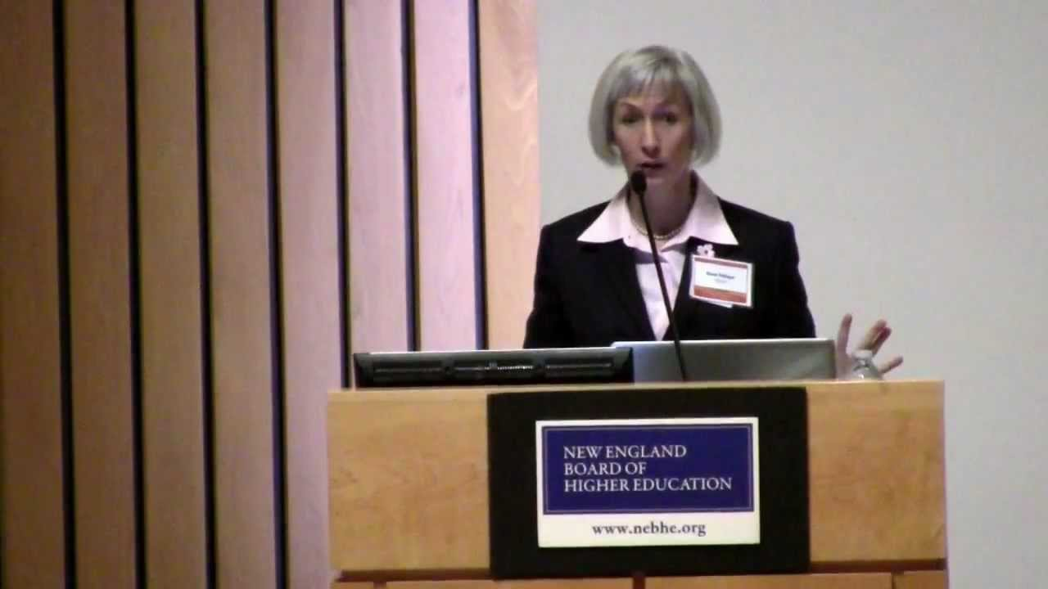
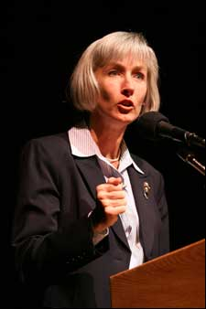
Farewell words from:
Diana Oblinger
President and CEO, Educause
Notes:
Dr. Diana Oblinger joined Educause in 2004 as a vice president, and was named president in 2008. I am sharing a view pictures that capture how we will remember Diana’s leadership, a strong and thoughtful voice for education, and for the contributions that information technology can contribute to the educational mission. Please let me introduce Diana Oblinger for a few farewell remarks.

Slide 4
Today’s Agenda
Free flow conversation
Engage in the topics that interest you

Slide 5
Invitation
The Educause Board of Directors and the Search Committee for the next President and CEO of Educause invite your comments
Tuesday, 9/30, 1:30 – 2:30
Room W108A
Notes:
Debbie Allison is here to answer questions. The search process is underway so like any search process we can’t, and won’t, get into specifics of where we are at. We need to protect the integrity and confidentiality of the search at this point in time. Still, we want to take advantage of having some many insightful colleagues at the same place. We have two specific things we will focus the discussion on.
what do you fee are the highest priorities of experience for the next President and CEO
what do you feel should be the future leadership agenda (time permitting)

Slide 6
Hot Topics: Transitions in Leadership
Surviving campus leadership changes
Partnership between IT leadership and institutional leadership
Transitioning to a new job or a new campus
Staffing and organizational models facilitating openness and agility
Changing funding models
Notes:
Surviving campus leadership changes and Transitioning to a new job or a new campus generated discussion on our CIO list and in our community. We will face these challenges at some point in our careers, becoming new CIOs or changing to a CIO job at a new campus. We can share strategies that will help us find success. Along with that is successfully reacting to change around us when campus leadership changes; how do we make the case for our IT investment to new leadership? That involves establishing a Partnership between IT leadership and institutional leadership to develop a collective understanding of what information technology can deliver. Developing an IT Staffing and organizational model to accommodate the changing IT environment and facilitate openness and agility is key to doing everything else on this list. Supportive funding models are needed to sustain core services, support innovation, and facilitate growth.

Slide 7
Hot Topics: Transitions in Technology
Wireless network and device explosion
Technology demands in new buildings
Changing sourcing strategies for technologies and services
Risk management and information security practices
Enterprise IT architecture
Notes:
What are we doing with technology? Addressing access demand and the Wireless and device explosion was a frequent discussion item among CIOs this year. We are actively talking about sourcing technologies and services at scale to reduce costs (via cloud, greater centralization of institutional IT services and systems, cross-institutional collaborations, and so forth), and also what kind of review and governance structure is needed. We are implementing Risk management and information security practices to protect institutional IT resources/data and respond to regulatory compliance mandates. We need enterprise IT architecture that can respond to changing conditions and new opportunities.

Slide 8
Hot Topics: Transitions and the Educational Mission
Improving student outcomes
Assisting faculty with instructional integration of IT
Using analytics to drive critical institutional outcomes
Determining role and strategy for online learning
Notes:
More on our list: Improving student outcomes through an institutional approach that strategically leverages technology – what can we contribute to this effort? How do we organize and provide services to assist faculty with the Instructional integration of IT, as Educause survey results suggest is desirable? Determining the role of Online learning role and strategy (and developing a strategy for that role) is an active discussion on many campuses. We often started online learning as an outgrowth of distance education models, and much of the growth occurred as individual faculty members decided to move random courses online. Our campuses are moving to thoughtful program development, and analysis of target audience. Strategies are evolving.

Slide 9
Discussion Question
What questions do you have?
What strategies can you share?

Slide 10
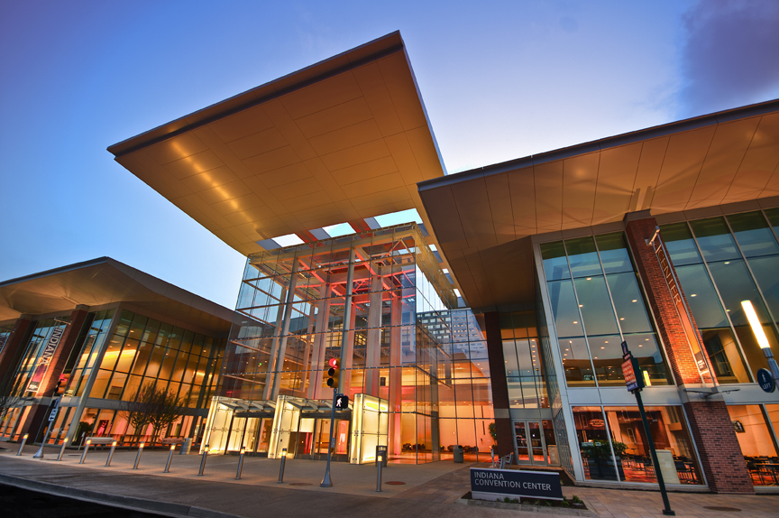
See You Next Year
EDUCAUSE 2015 October 27–30, 2015 Indianapolis, Indiana, and Online

Slide 11
Help Us Improve and Grow
Thank you for participating
in today’s session.
We’re very interested in your feedback. Please take
a minute to fill out the session evaluation found within
the conference mobile app, or the online agenda.

