Slide 1

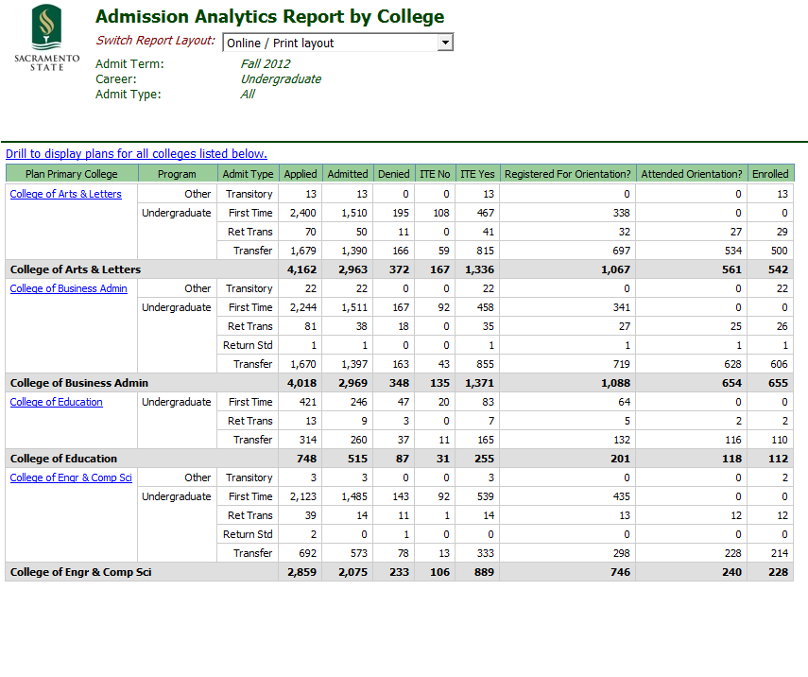
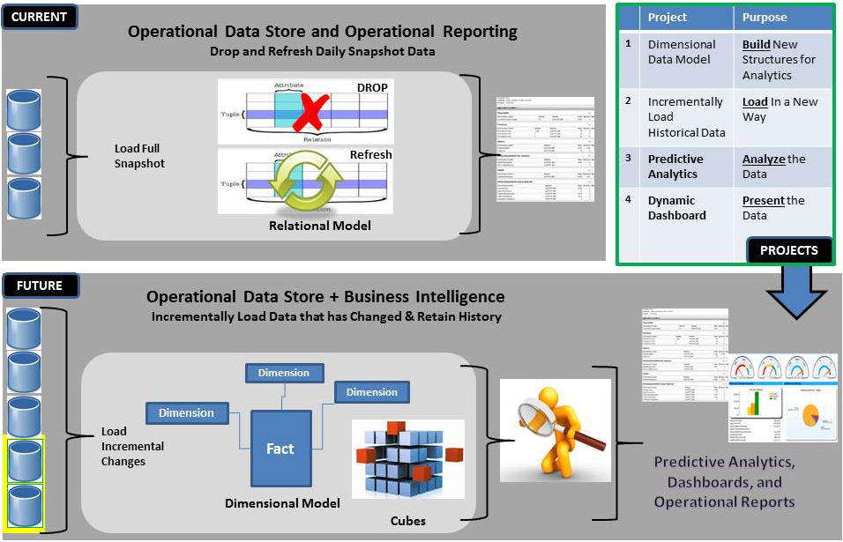
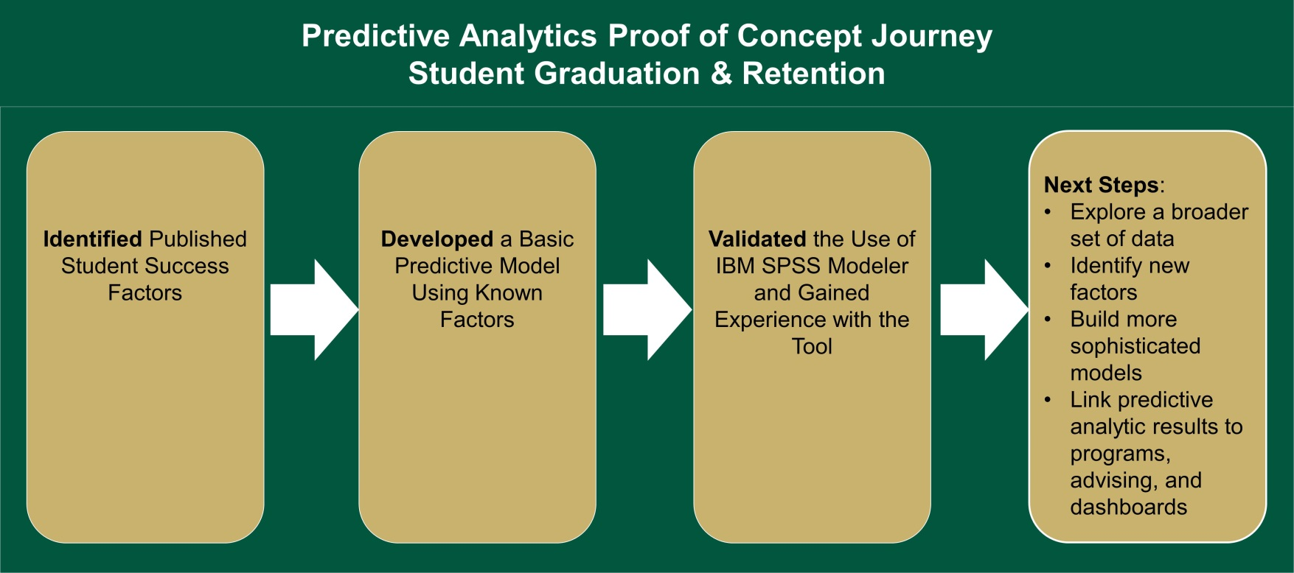
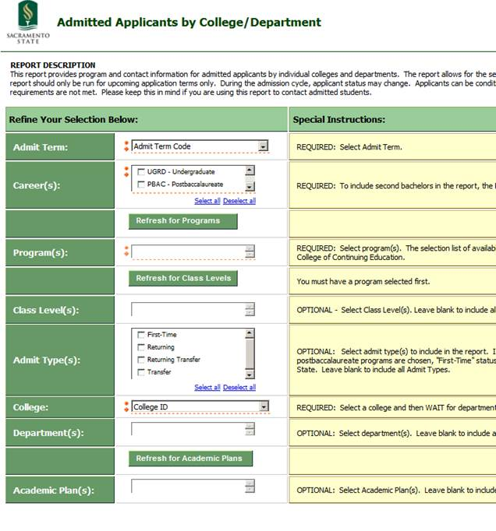
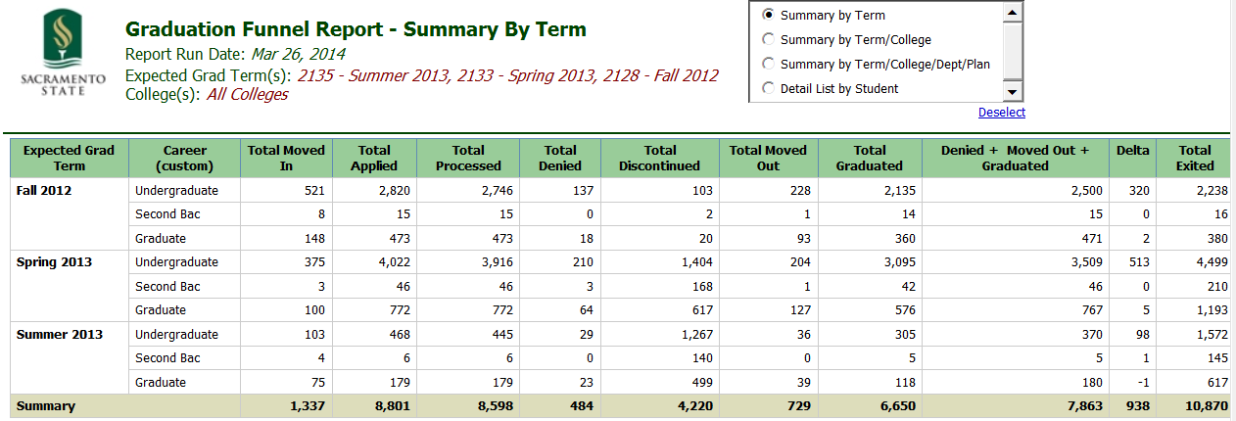
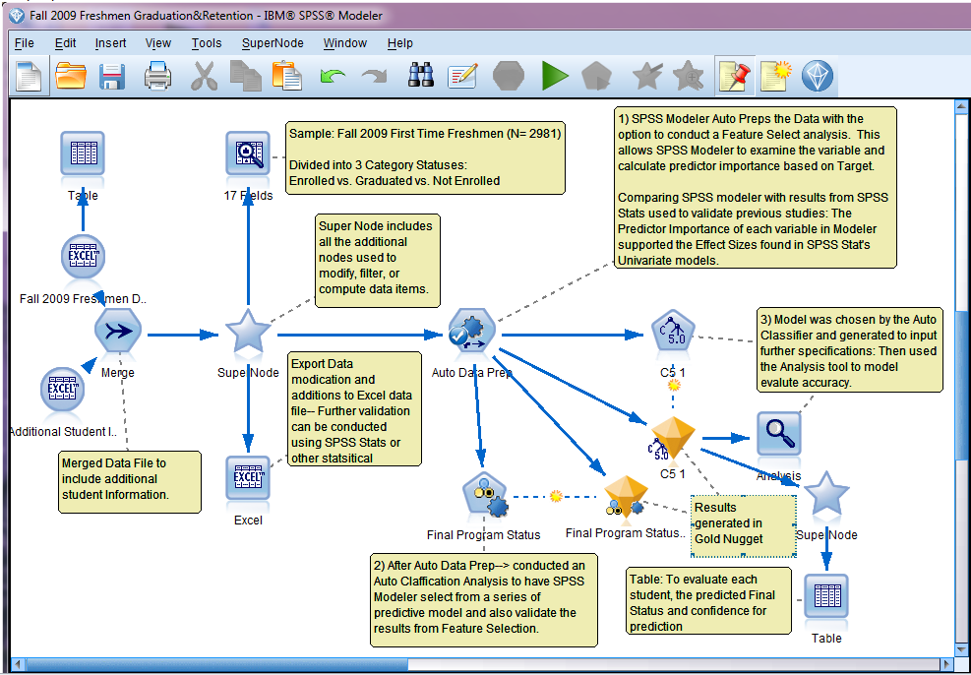
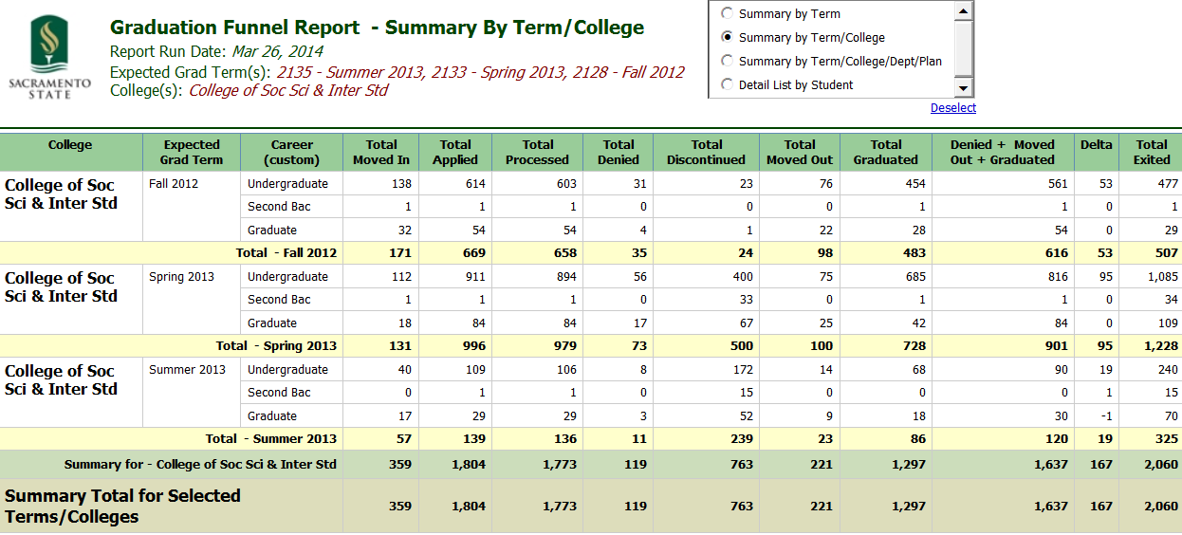
Using Data to Manage Enrollment and Graduation
Greg Siino and Helen Norris
California State University, Sacramento and Chapman University
Introduction
Solution
Report Options
Next Steps
California State University, Sacramento
One of the larger campuses in the 23-campus California State University system
Approximately 23,600 FTE comprised of approximately 29,000 students, mostly undergraduate
Approximately 60% of newly-enrolled undergraduate students are transfer students
“Non-traditional” students – working adults with families; first generation college
Admissions Analytics By College
Architecture Changes for Data Mining & Analytics
Admissions Analytics Reporting
  Aggregate Counts for the progressive funnel of Admissions Activity
  Timing: used by campus from Application through Matriculation
  Online or Export options
  Flexible Summary Total Options
  Graduate (PostBac) and Undergraduate perspectives
  Campus, College or Department Level perspectives through drills
Data Prep is key
Build data models for analytics
Model both input data and output data
Track accuracy of predictive trends and effectiveness of intervention programs
Add data sources
Enrollment Challenges
Changing enrollment targets
Impacted programs
Budget challenges
Data needs at campus/college/department level
Predictive Analytics: Proof of Concept
Admissions Analytics Filtering
Graduation Funnel Report By Term/College
Technical Environment
CSU uses the PeopleSoft suite for Student Administration, Finance, and HR
In 2008, Sac State implemented a self-service Data Warehouse using the Cognos tool
Data Marts include Finance, Student, Advance, and HR
Moved focus to student reporting in Fall 2009
Sophisticated security model for student data
About 500 users across campus
Approximately 20,000+ reports are run monthly
Collaborative approach to report development
Initial report rollout focused on operational reports
These examples represent operational reports used throughout the academic year rather than point-in-time Census data.

