Slide 1
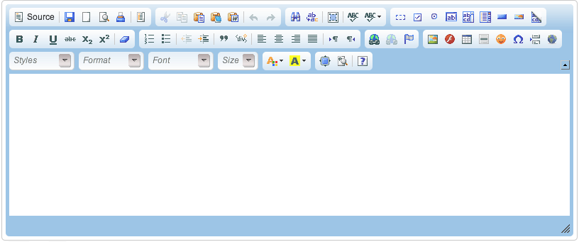
Widening the web
Poster by Bruce Darby, University of Edinburgh
How to make web applications accessible for everyone
1
3
Our overarching principles*:
Our overarching principles:
Readable.
Keyboard navigable.
Works with assistive software.
Unique object labels.
Correct tab sequence.
Customisable.
1. Readable.
Provide text alternatives for non-text content.
Ensure that the colour contrast ratio between text/labels/buttons and the background complies with the minimum specified in WCAG 2.0
2. Keyboard navigation. Must be able to navigate and operate the software by using the keyboard alone.
3. Assistive software. The user interface must provide information to assistive technology.
4. Unique object labels. Every interface object should have a unique label. This label must be in the correct position, be meaningful and readable.
5. Correct tab sequence. The sequence of tab key presses should be logical for the use of the application.
6. Customisable. The software should be able to be customised to an individual’s preference by the user. At a minimum the software should allow the font size, font colour and background colour, to be changed.
The sheer volume of guidelines is overwhelming
2
Never been done
before!
But it can be broken down into bite size chunks
(And web applications are all about functionality not just content)
*Principles for our web application. Your project might need different ones.
4
Accessibility
Technical constraints
6
So our developers chose accessible components from the very beginning
With our overarching principles we can introduce accessibility early. Before the project has
even started….
Usability
Developer Job Description
Essential:
HTML
CSS
JavaScript
Training & support
On tabbing into the editor the screen reader announces “Rich text editor, editor1, press ALT 0 for help.”
Accessibility
WAI-ARIA
WCAG 2.0…
5
At the start of the project we can bring accessibility to the table
So simple – but so brilliant
WCAG 2.0 and Section 508
compliance
Resources
Book
Podcast
Video
Automated accessibility tests:
WAVE from WebAIM
http://wave.webaim.org/
A Web for Everyone
Designing Accessible User Experiences
by Sarah Horton & Whitney Quesenbery
A Podcast for Everyone
http://bit.ly/podcast-for-everyone
Highly recommended:
Episode 2: Easy Checks (March 20, 2014)
Demo of CKEditor being used with a screen reader and keyboard:
http://bit.ly/accessible-ckeditor

