Slide 1
New Technology Service Models for Community Engagement
Dr. Bob Goeman – IT Director, Community Engagement Center, bgoeman@unomaha.edu
Mr. Matt Morton – Chief Information Security Officer, mmorton@unomaha.edu

Slide 2
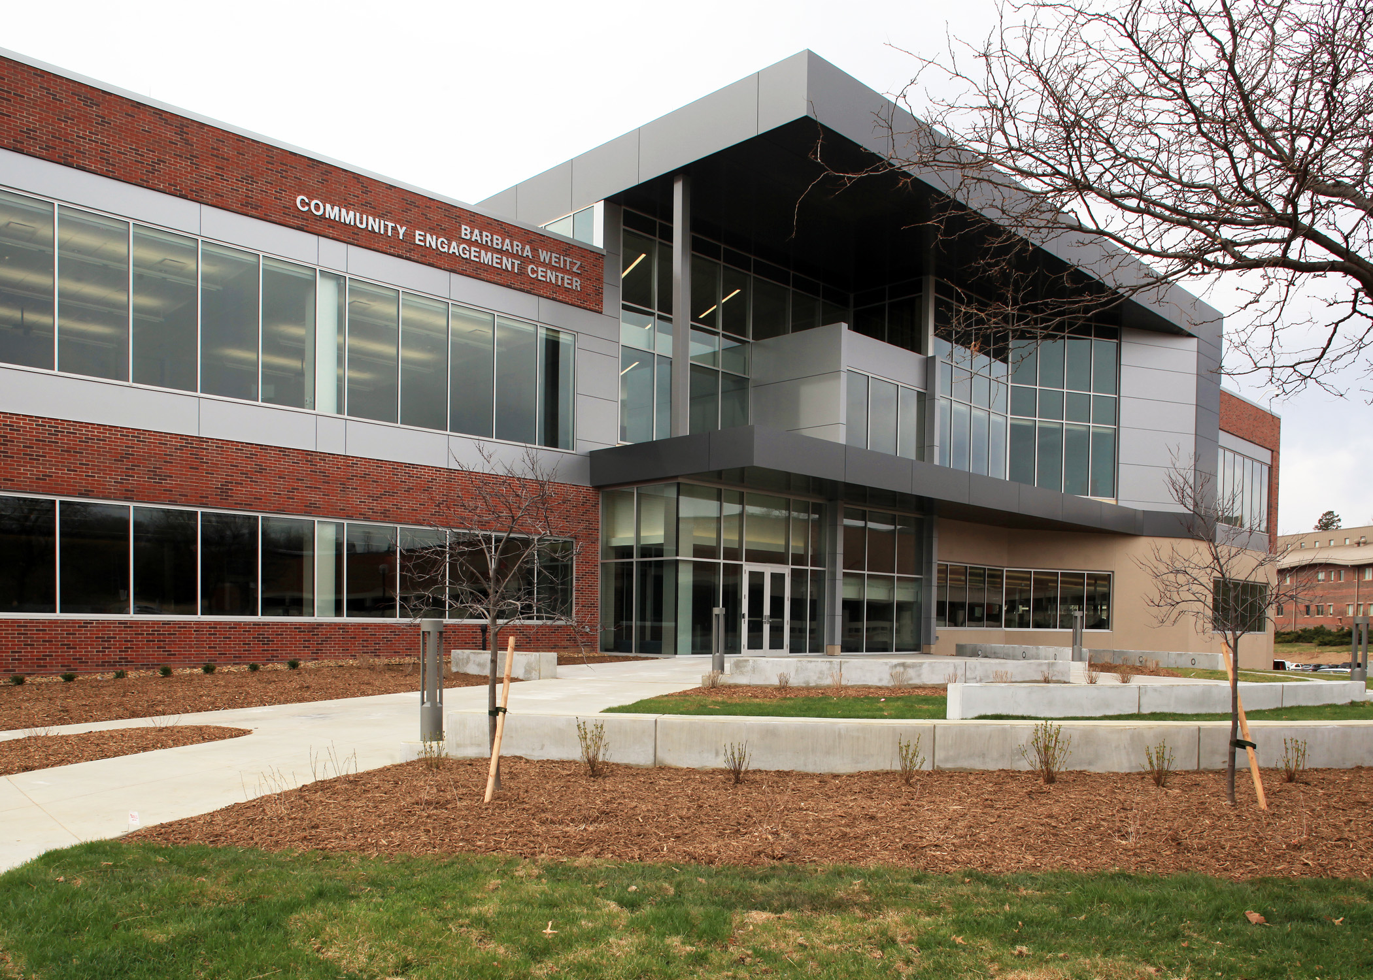
Front Door to campus
Signature outreach
Community spaces and events
Extend campus resources to community

Slide 3
What is University of Nebraska Omaha
Strategic Priority Areas Include:
UNO Student Population
Student-centered
Academic excellence
Engagement with urban, regional, national and global communities
15,395 total student body
12,705 undergraduate students
2,690 graduate students
41 states represented
More than 1,700 international students representing 121 countries

Slide 4
Who are the UNO Partners?
UNO Anchors
UNO Partners
Buffett Early Childhood Institute (BECI)
Service Learning Academy (SLA)
The Collaborative
William Brennan Institute for Labor Studies
MaverickPR
Office of Latino/Latin American Studies (OLLAS)
Sigma Phi Epsilon
The Social Media Lab for Research and Engagement
Spirituality, Public Health and Religious Studies (SPHRS)
Support and Training for the Evaluation of Programs (STEPS)
Sustainability Organizations
Volunteer Program Assessment – University of Nebraska at Omaha

Slide 5
Who are Community Partners?
Partner organizations represent great variety and bring unique perspectives on community issues, expertise and commitment to shared values.
A Time To Heal
Inclusive Communities
Metro Area Continuum of Care for the Homeless (MACCH)
Nebraska Shakespeare
Nebraska Watershed Network
Nebraskans for Civic Reform
Omaha by Design
The Omaha Community Foundation (OCF)
Omaha Public Library
Queer Nebraska Youth Networks
Wellness Council of the Midlands (WELCOM)
WhyArts? Inc.

Slide 6
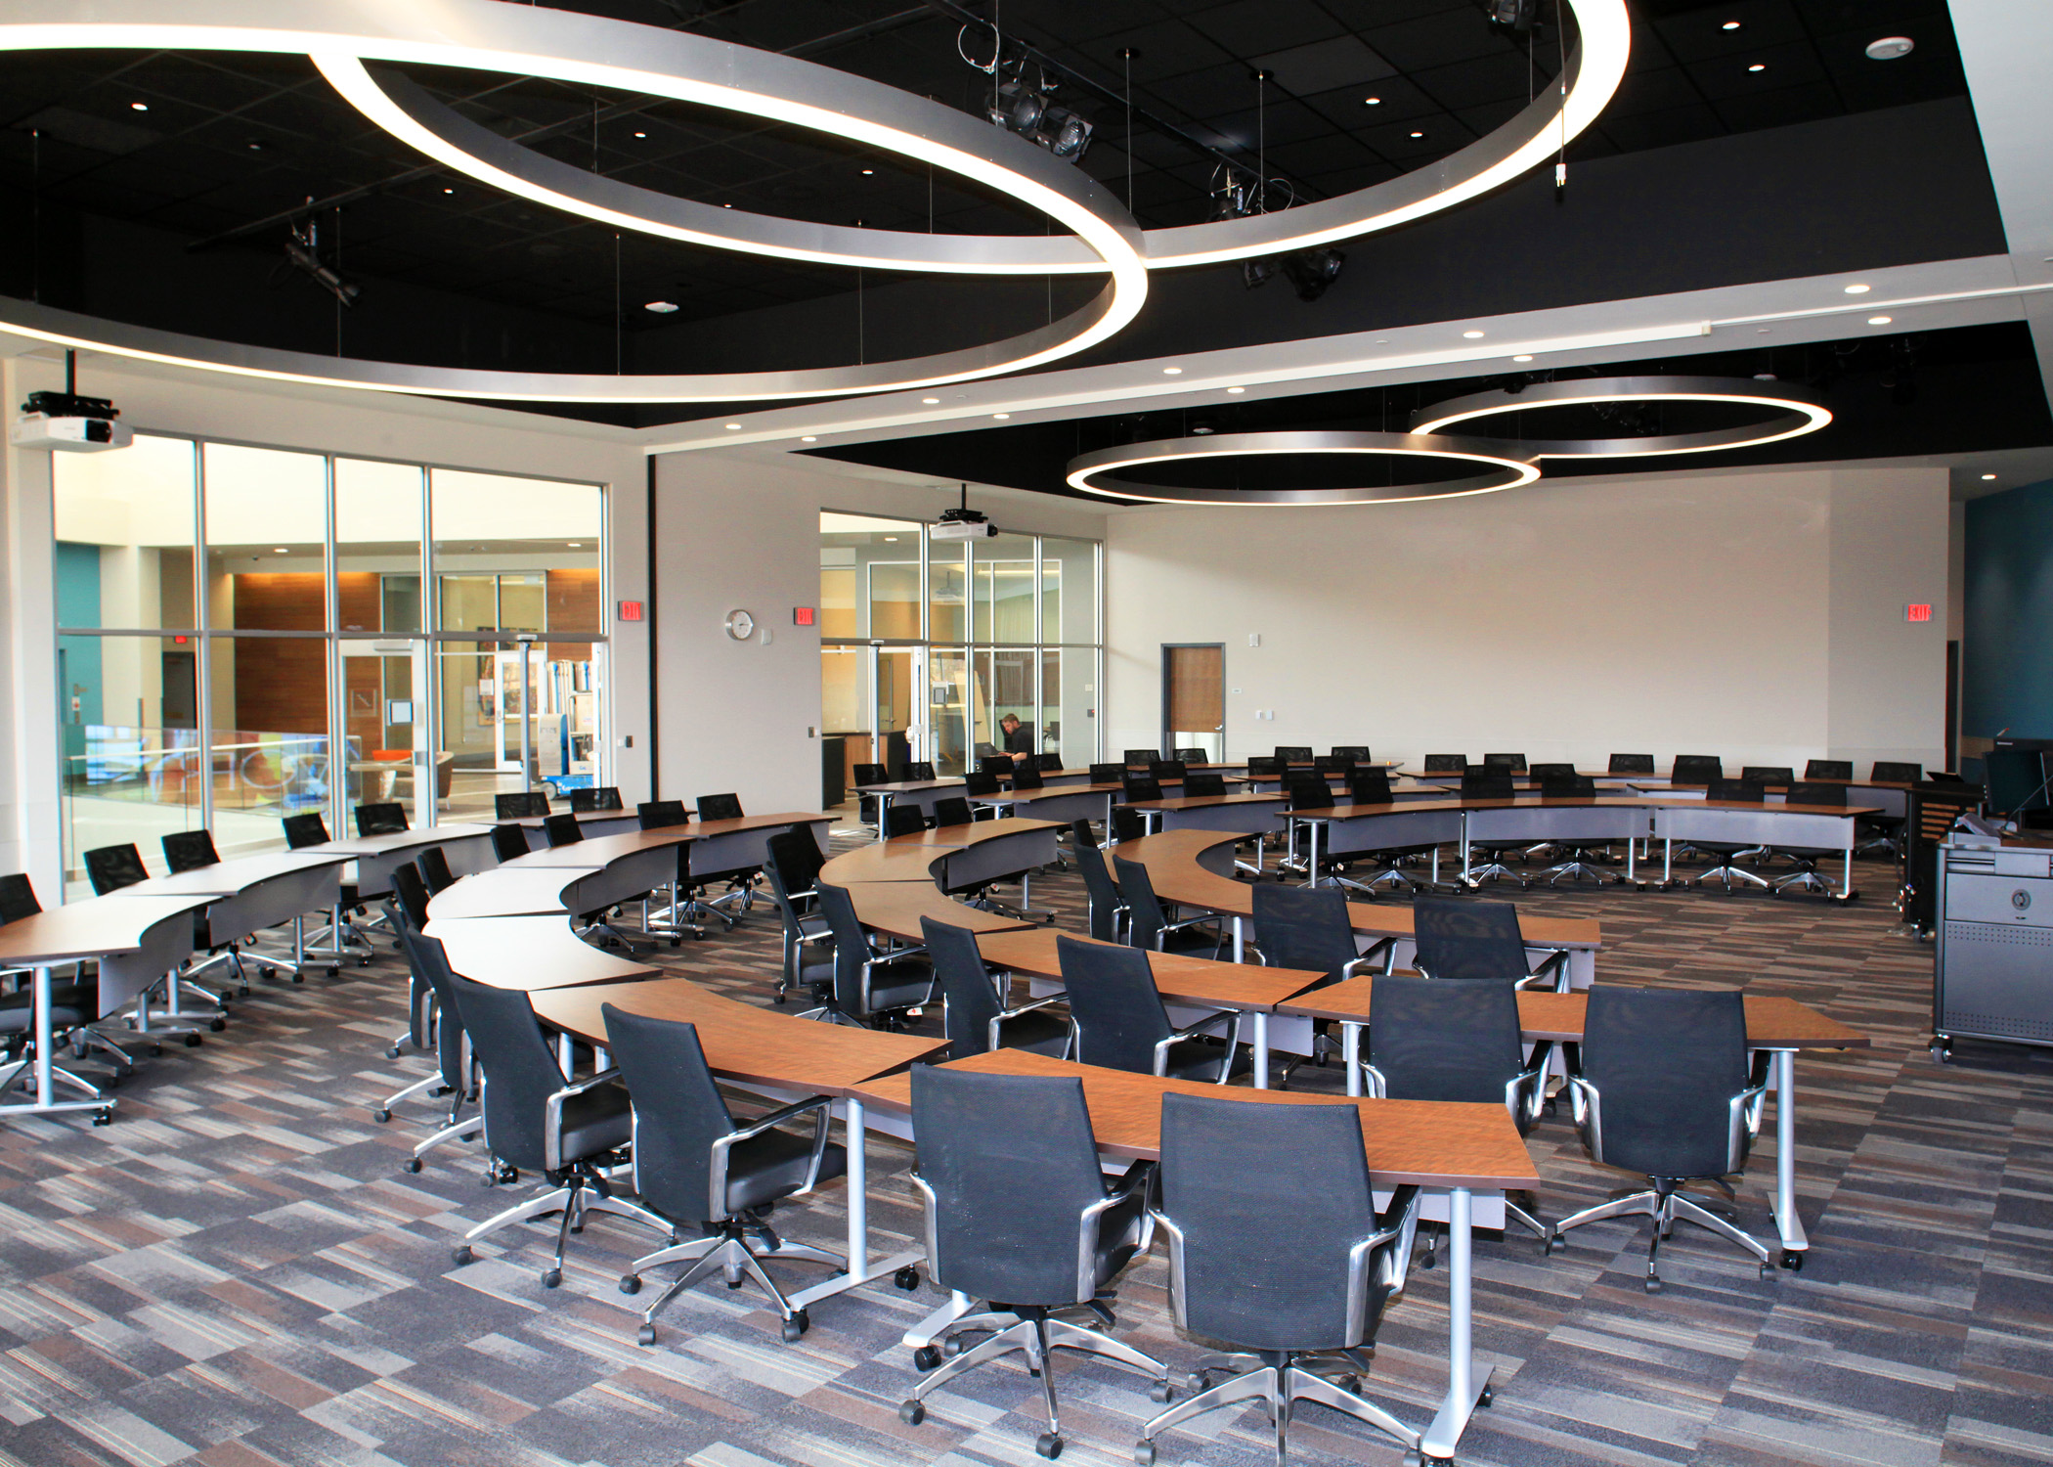
Barbara Weitz Community Engagement Center
***It is the only stand alone, comprehensive, engagement-specific university facility in the country.
Non-profit spaces that allow engagement through:
Webinars
Workshops
Press releases
Fundraiser kickoffs
Lunch and learn opportunities

Slide 7
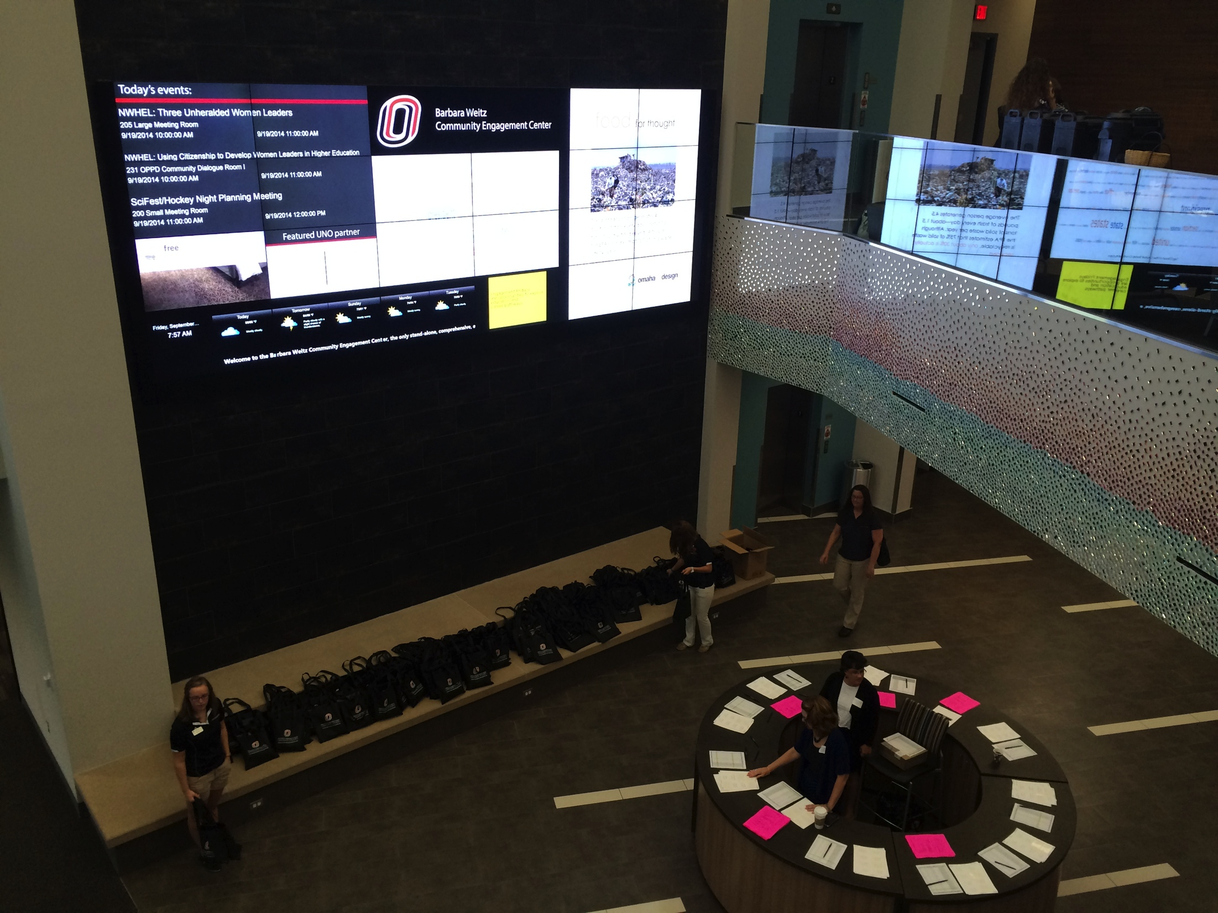
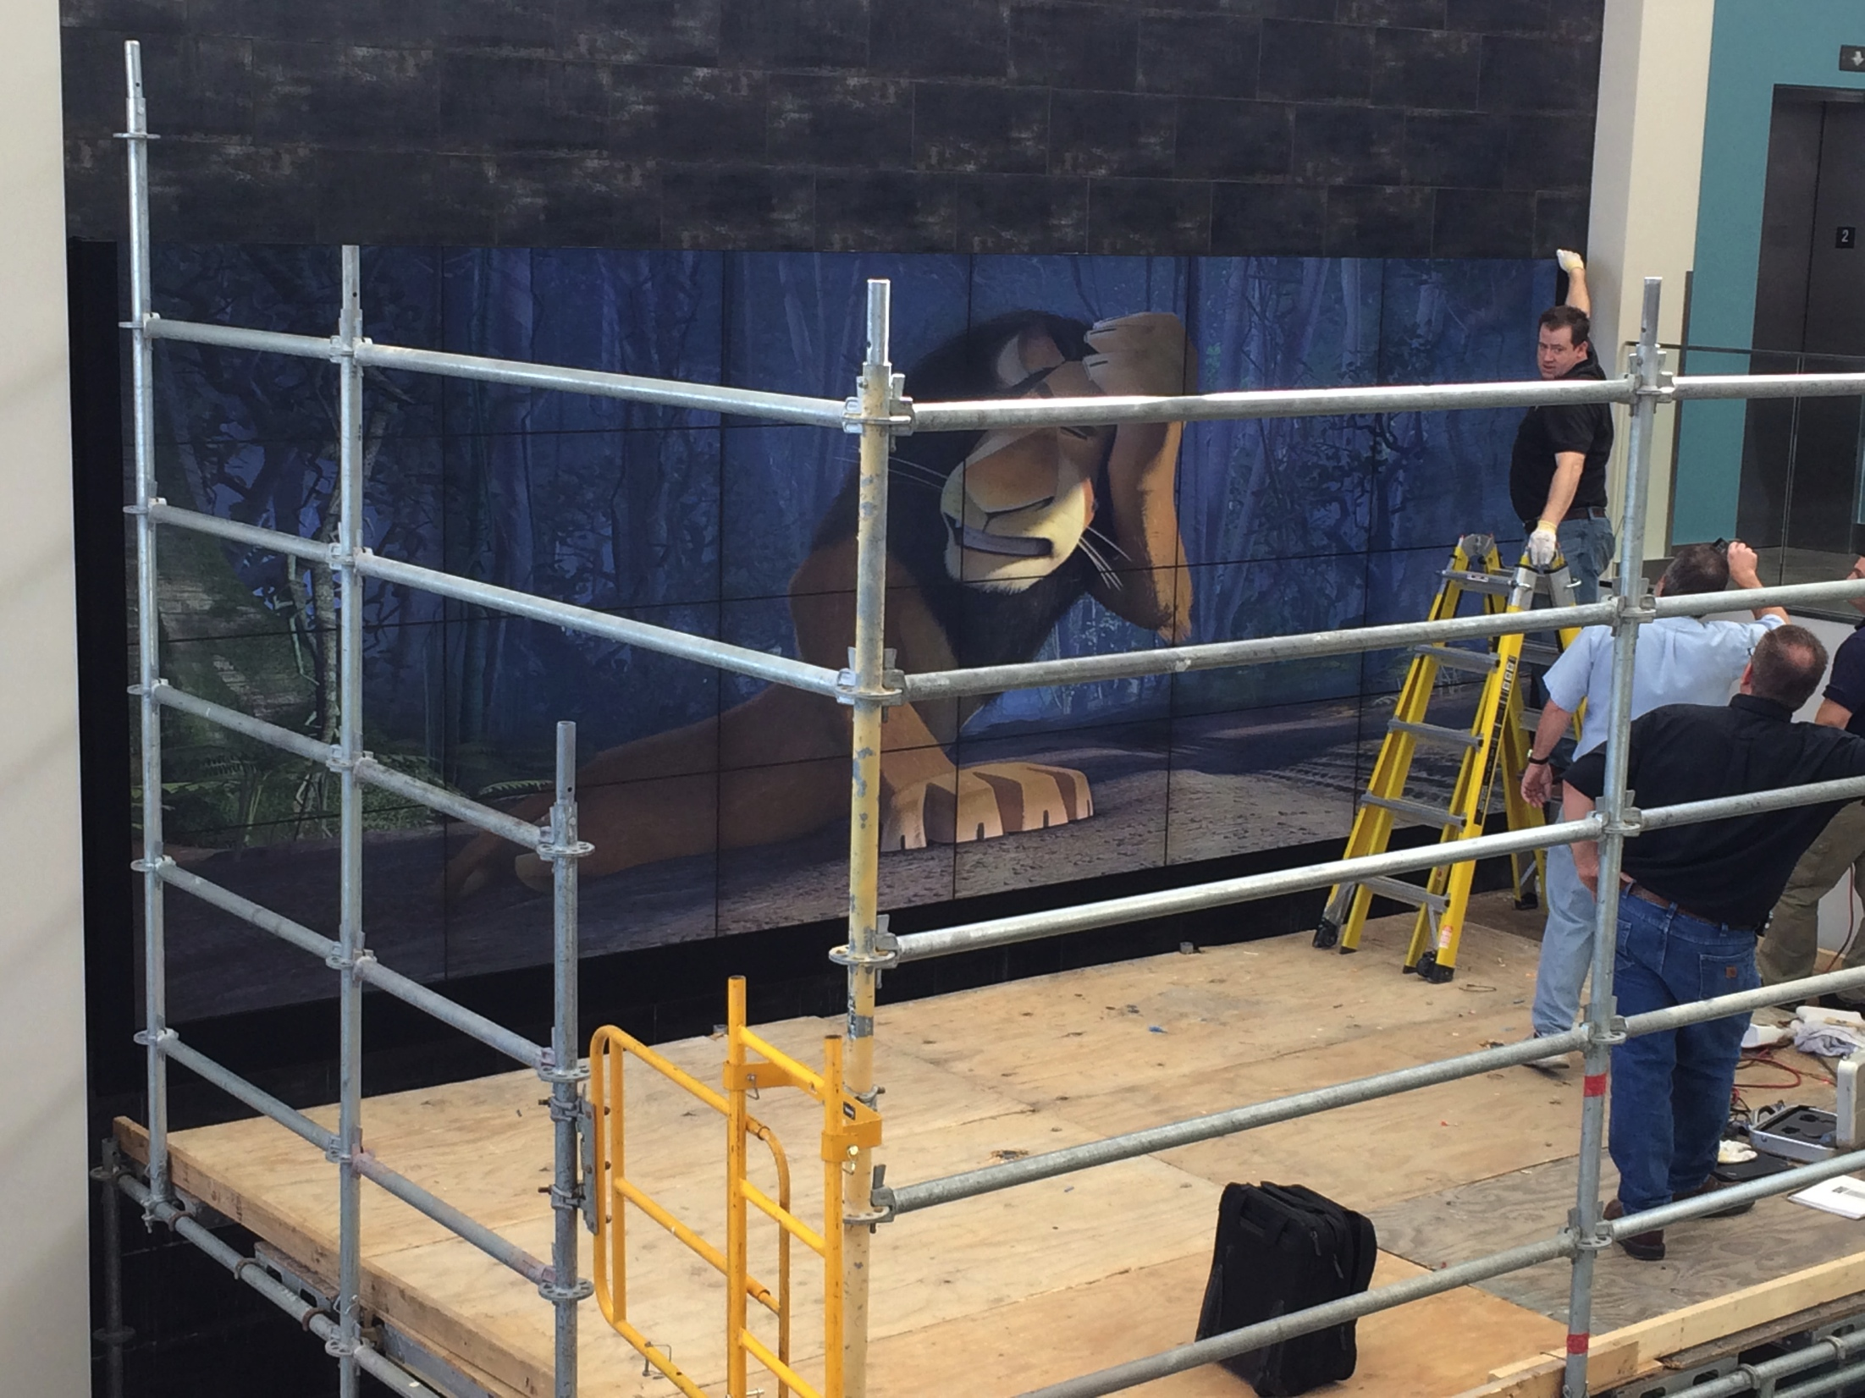
Video Wall
Showcase ongoing activities
Advertise future events and opportunities
Show large scale presentations
Feature partners from both on campus and non-profit partners

Slide 8
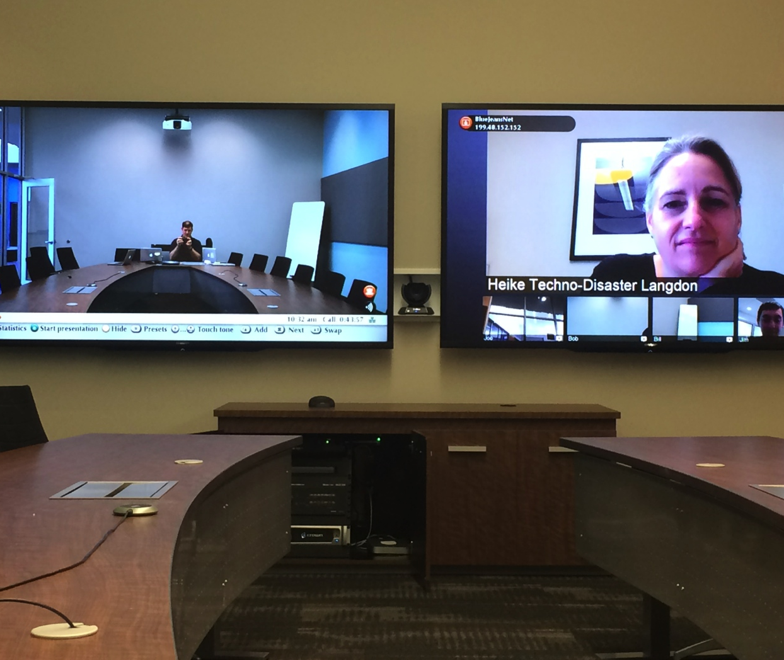
Meeting / Video Conferencing spaces

Slide 9
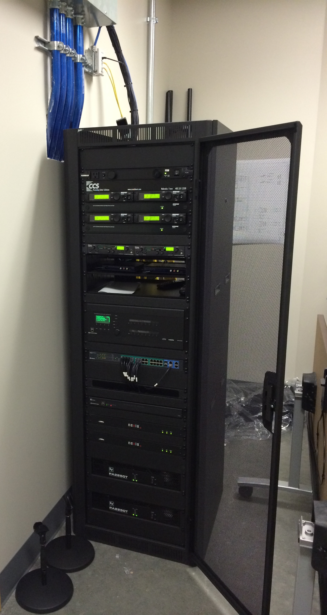
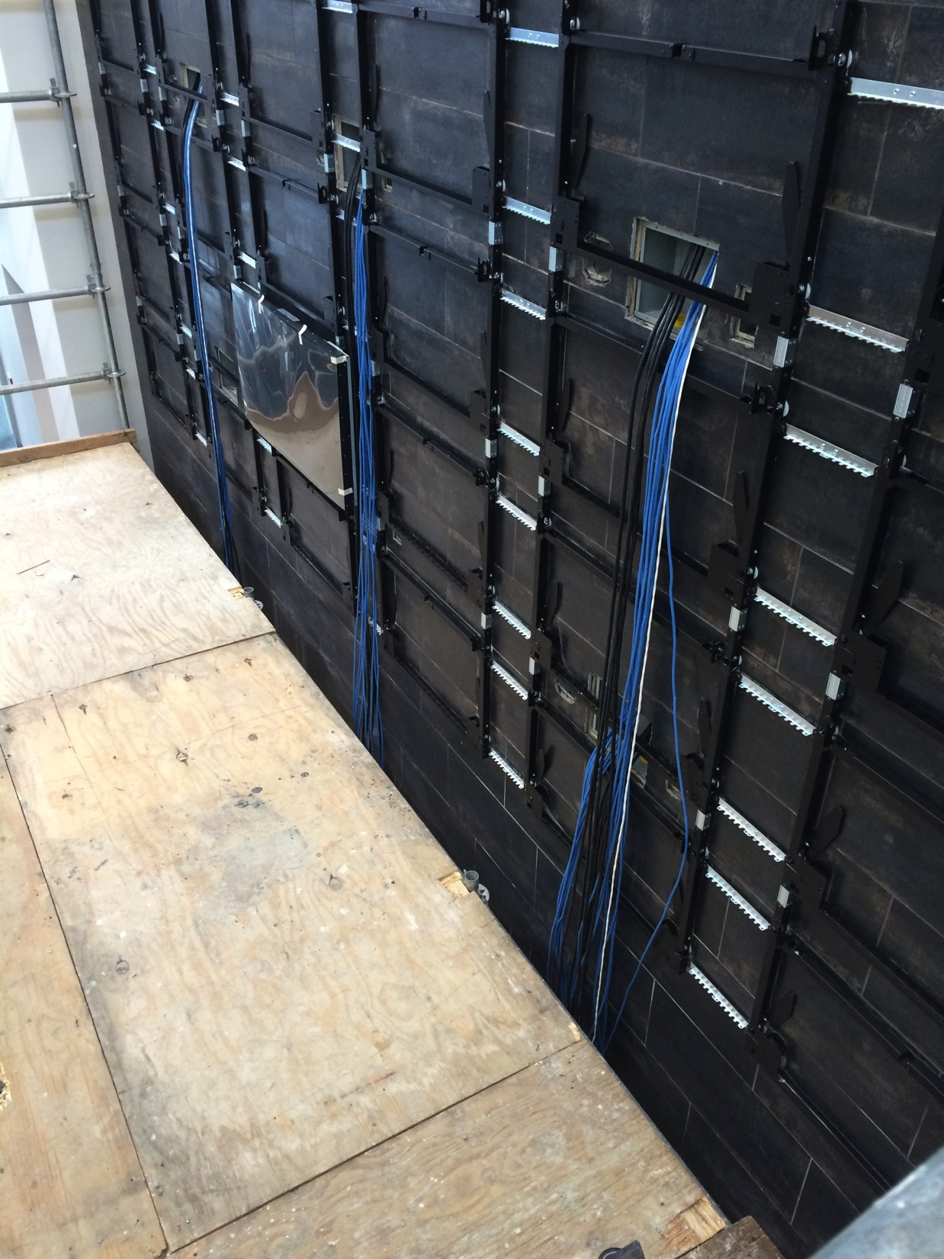
Digital Support Models
Support services integrated into environment
Focus on customer service
Develop strategies within organizational unit
Desire to be plugged into process right away

Slide 10
Digital Support Model Drivers
Need for Direct support in Colleges/Business Units
Under supported
Difficulty keeping technical staff
Less path for advancement or skill growth
Need to do direct security awareness training
Need to build better relationships with end user
University
College of Business Model
Centralized
Local
More
Less
Economy of Scale
Equilibrium

Slide 11
Technical Consultant Model
Provides direct support within business unit
Analyses the potential benefit of technology
Develops proposals for pilot projects
Basic project management
Develops and overseeing implementation plans
Experienced in developing and implementing technology plans (SMB)
Needs “soft” skills as well as technology skills.
Strong leadership potential

Slide 12
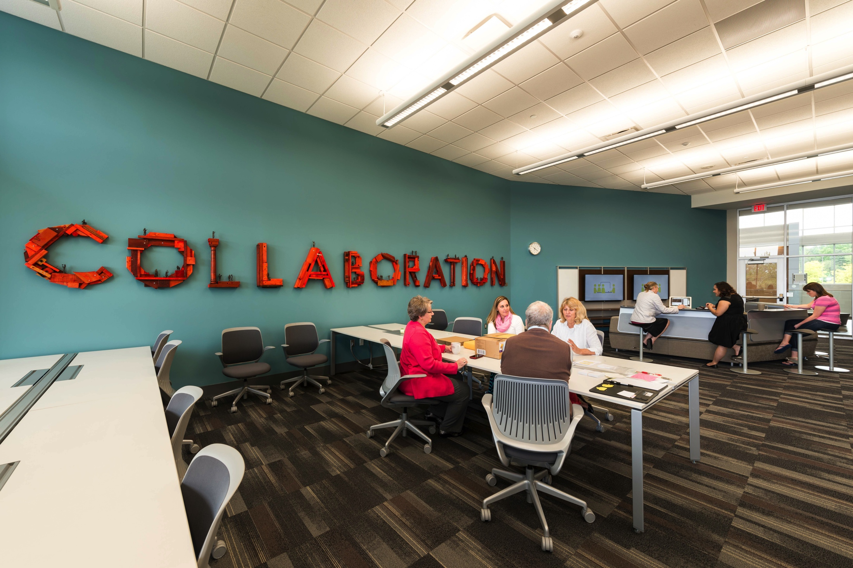
Digital Support Model Benefits
Helps in implementation of changes or new initiatives
Direct hands training with end users
Directly involved in technology planning for building, units and long term use of technology (future goal)
Able to be part of discussion of technology purchases prior to acquisition

Slide 13
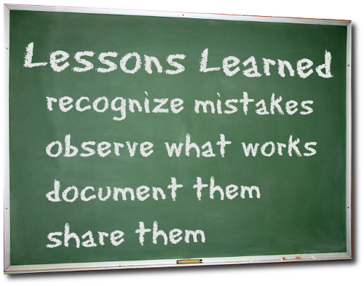
Lessons Learned
Can be difficult finding the “right” person for the role
Loss of specific knowledge for unit if tech leaves
Developing “equilibrium” point
Managing multiple MOU’s

Slide 14
Digital Support Model Implementation
Athletics
IT Support in department
Event IT support
Support Services, Enrollment Management & Student Services
Support of end users
Planning migration of servers/systems
Community Engagement Center
End user support
Support of community partners

Slide 15
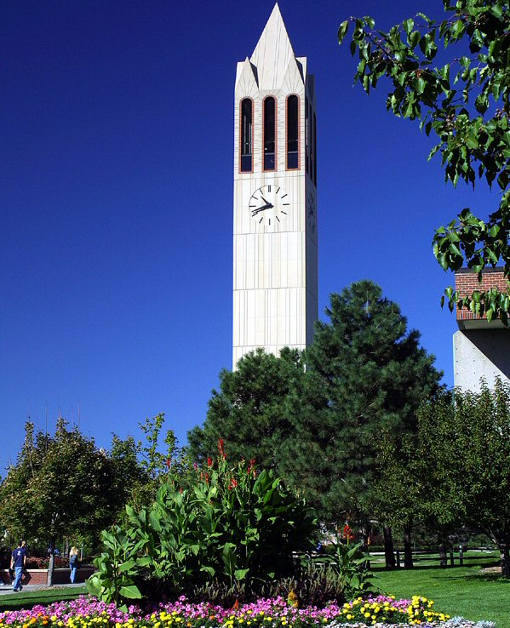
References
Leadership in the New Business Environment – Joe Topinka, Redwing Shoes CIO 2013
One Size Does Not Fit All: Two Models for Support and Training, Ellen Ramsey, Sue Ellen Breeden, Gene Roche, and Susan T. Evans. Educause Quarterly, No. 3 2001
The CIO Paradox, Martha Heller. Why Everyone in an Enterprise Can – and Should -- Be a Leader http://knowledge. wharton.upenn.edu/article.cfm? articleid=893 The McKinsey Quarterly

Slide 16
Help Us Improve and Grow
Thank you for participating
in today’s session.
We’re very interested in your feedback. Please take
a minute to fill out the session evaluation found within
the conference mobile app, or the online agenda.
Dr. Bob Goeman – IT Director, Community Engagement Center, bgoeman@unomaha.edu
Mr. Matt Morton – Chief Information Security Officer, mmorton@unomaha.edu

