Slide 1
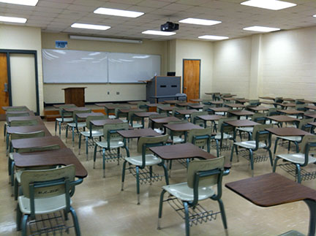
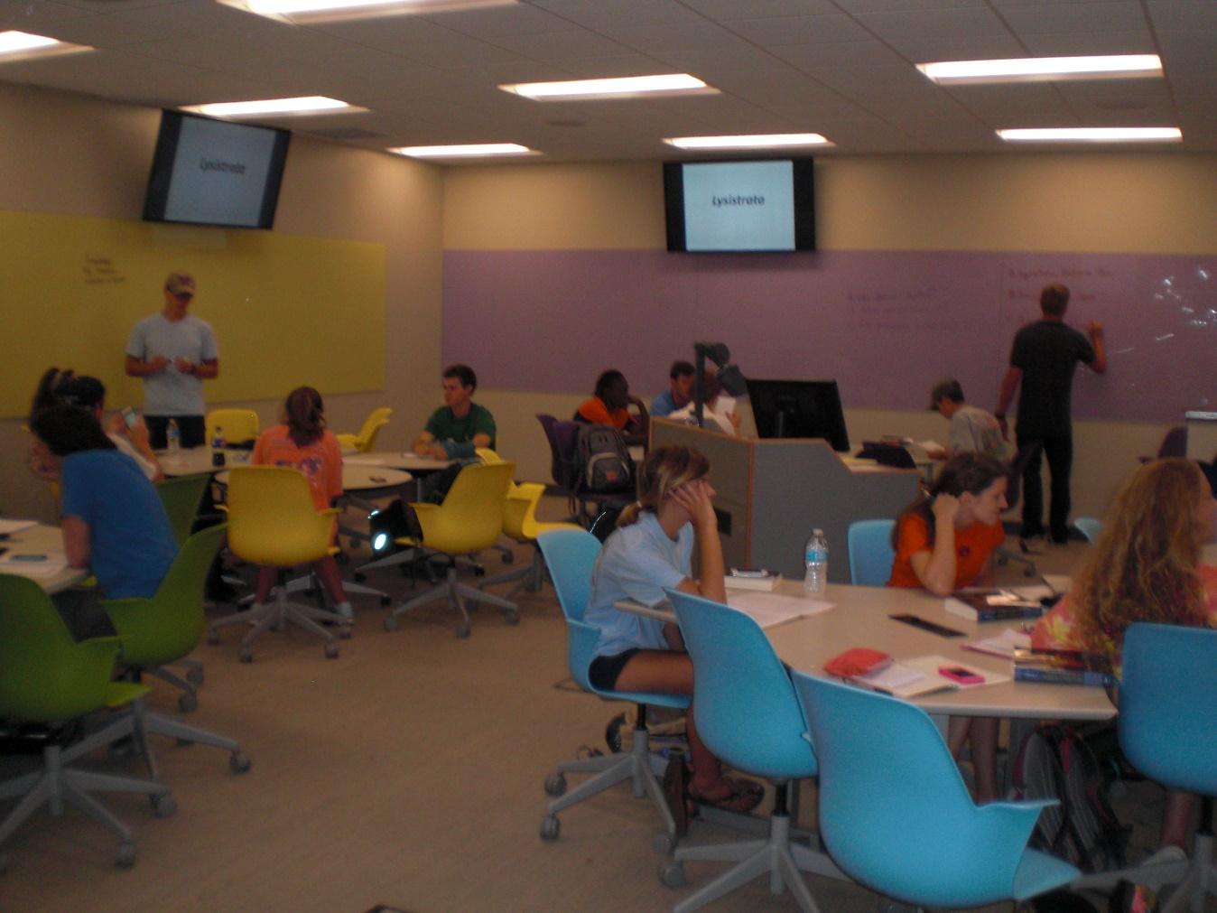
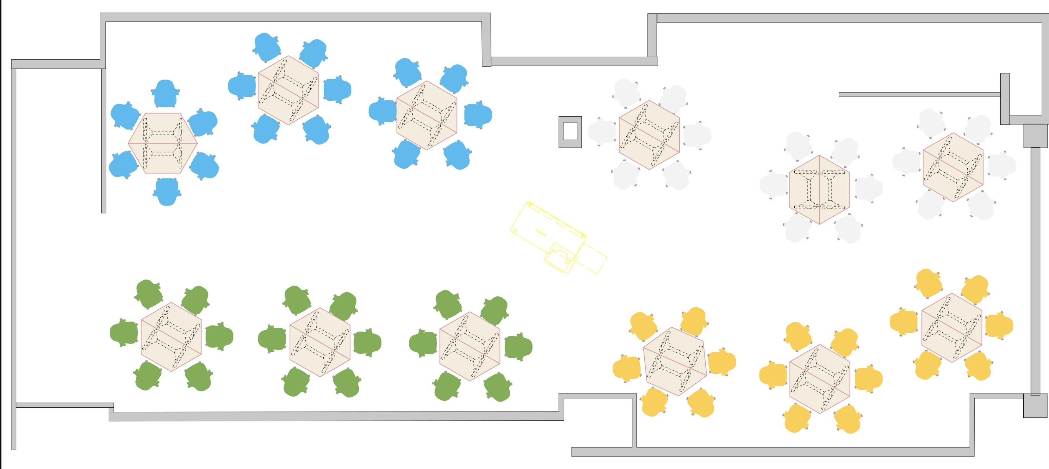
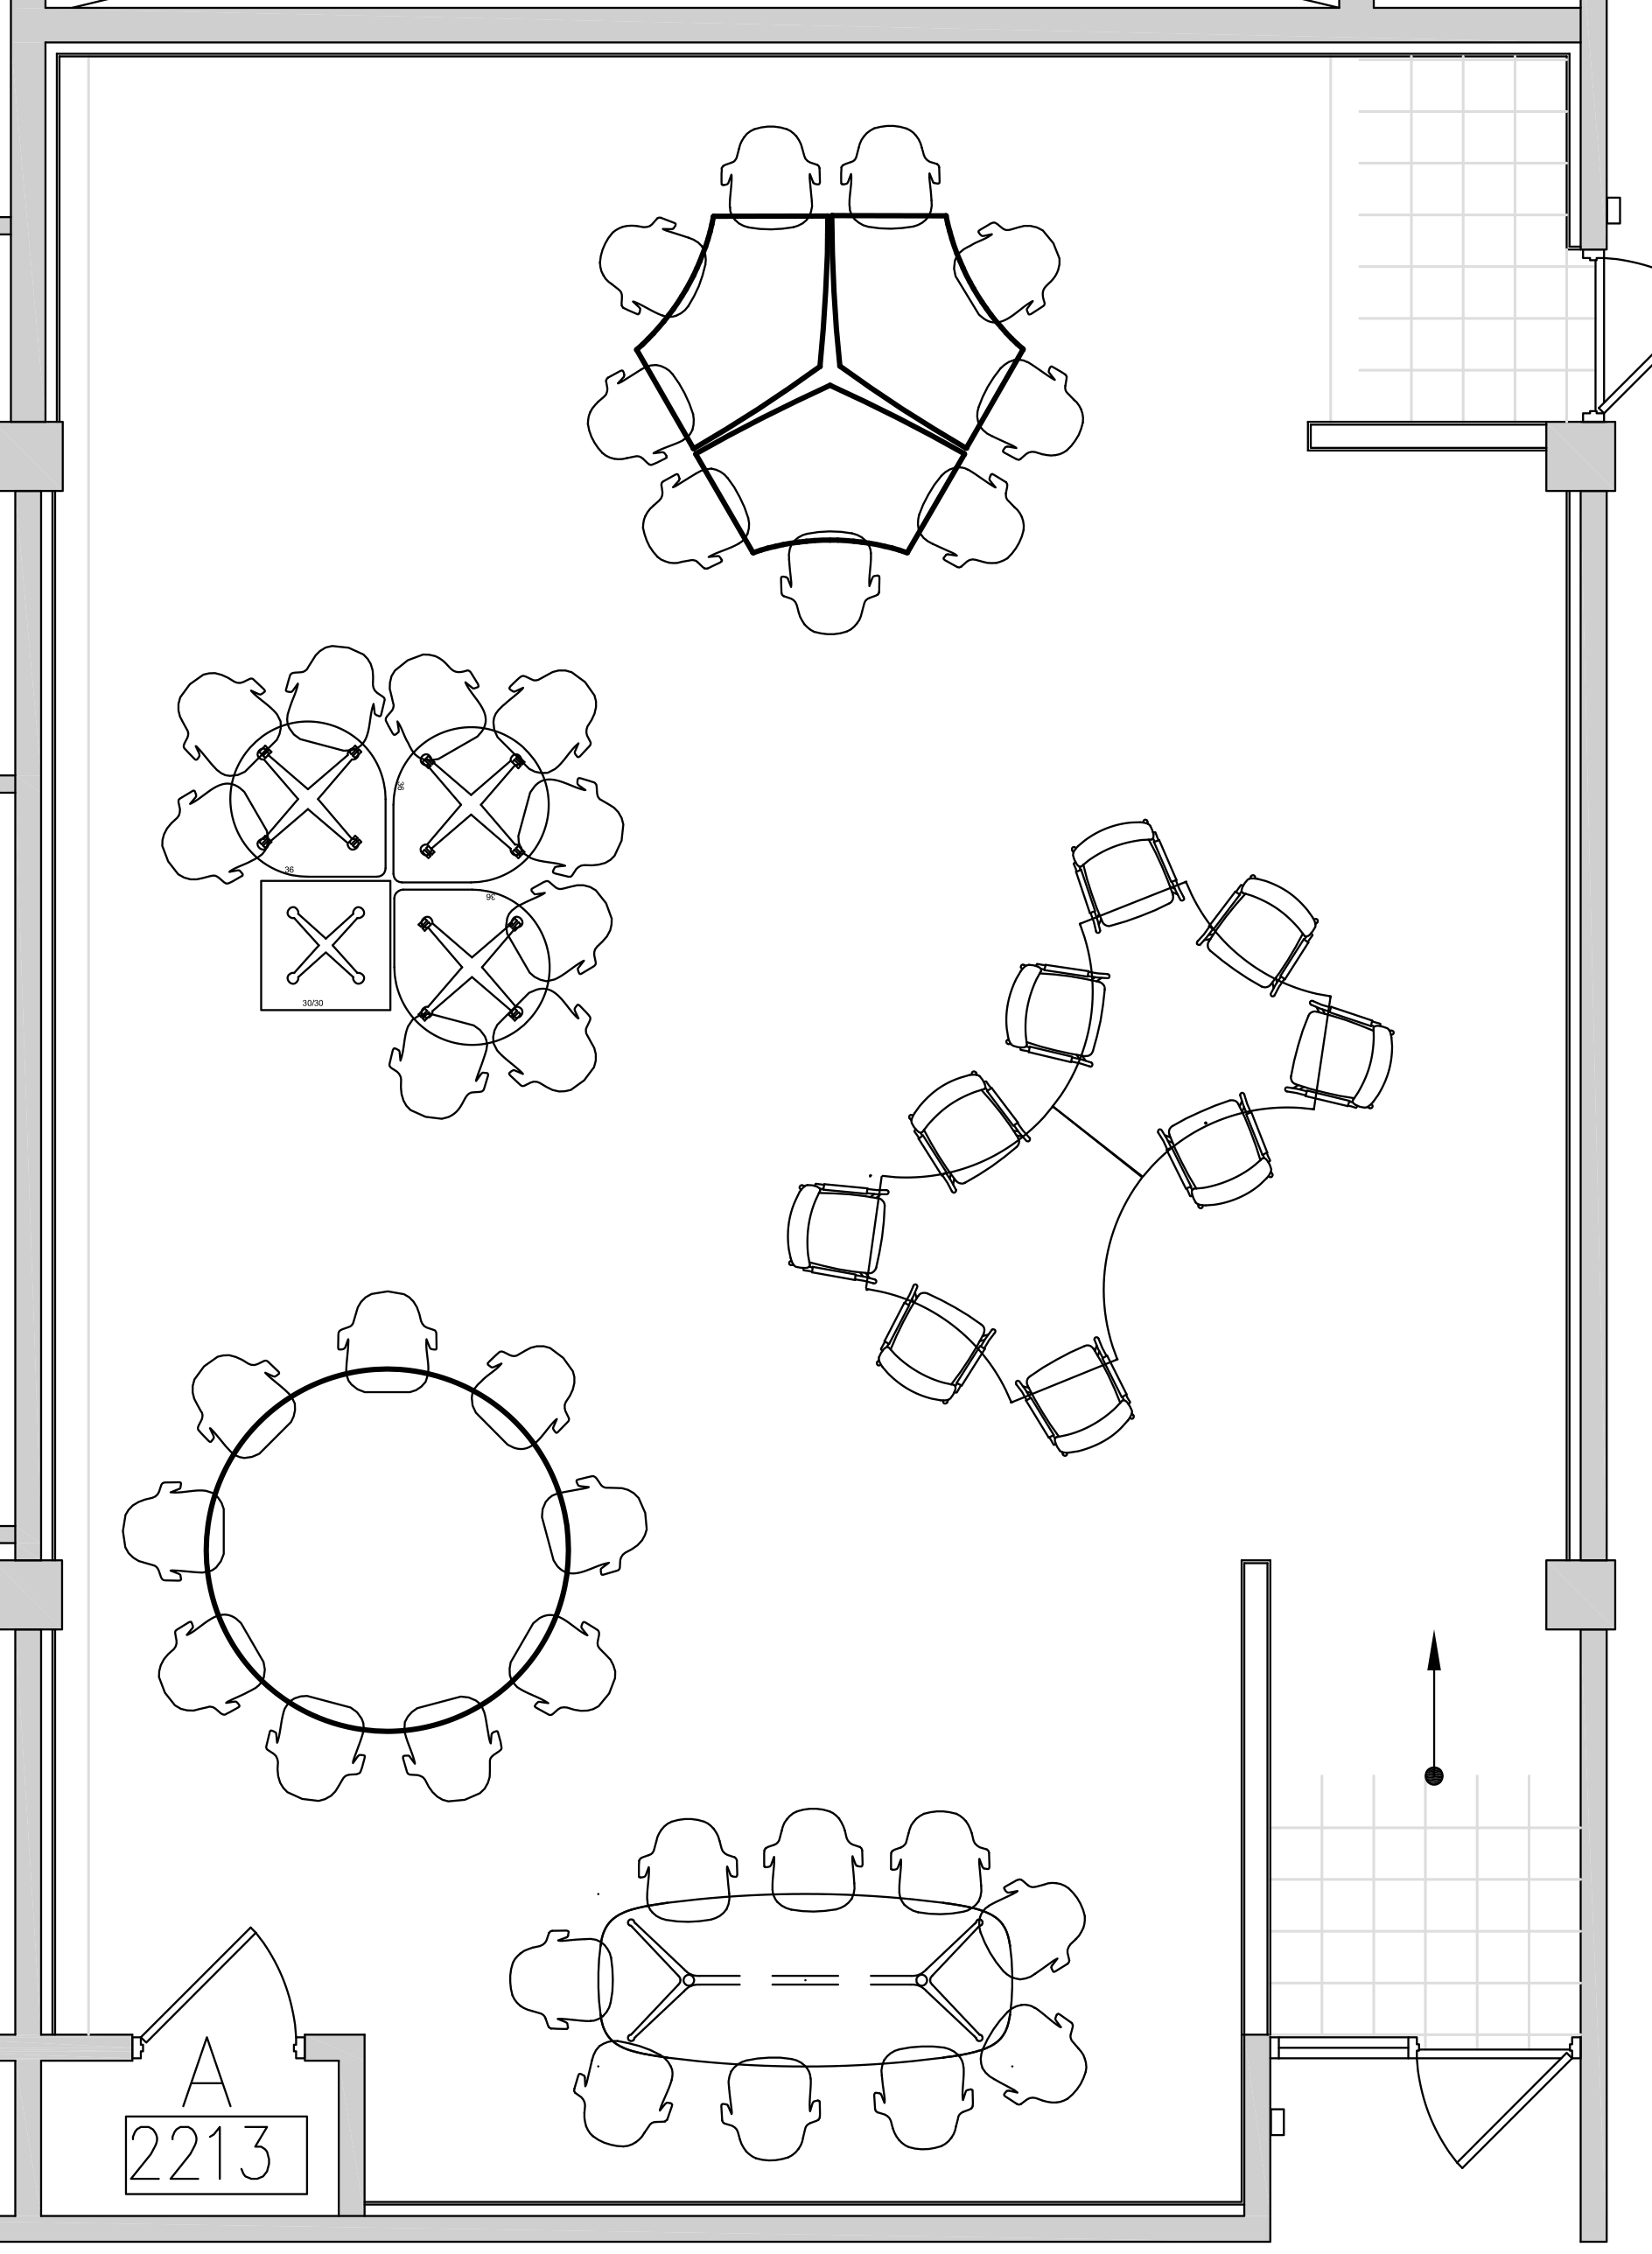
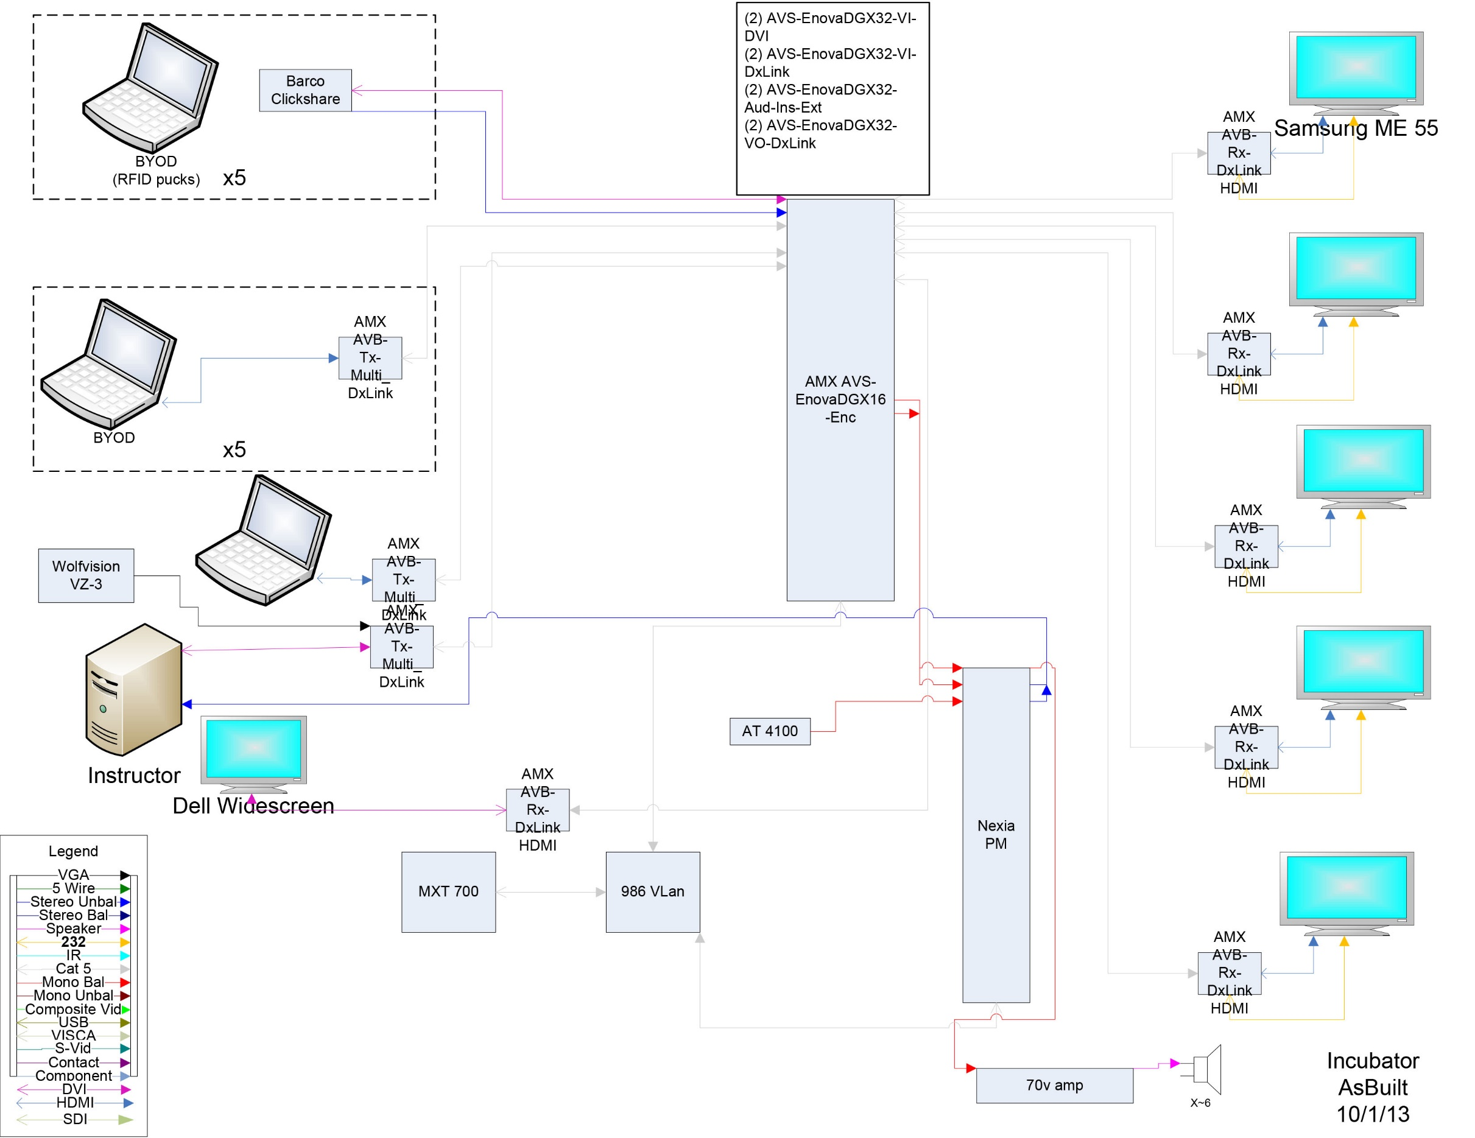
Discussion Question
Things You May Not Think of When Designing a 21st-Century Classroom
Renovate existing spaces Choose spaces carefully (ugly means less used but more expensive) Start planning as early as possible to find the right window for the redesign (most likely over the summer)
Cast a Wide Web of Communication: Faculty, Students, Administrators, Faculty Development, multiple branches of central/distributed IT, multiple branches of facilities, custodial staff, building manager, public relations
Regular communications to everyone during and after renovation, including bi-weekly facilities meetings and photos of progress
Translation Buy In Communication
Implementation Faculty Development Details
Assessment
Vision University Strategic Plan Research on Teaching and Learning
Strategic Goal: The university will redefine its role in the development of eLearning programs (including distance education), meeting the needs of current and new Auburn students in ways that are consistent with the university's academic standards.
Strategic Commitment: Develop a state-of-the-art classroom facility and technology-enhanced laboratories to support innovative teaching and research.
Central Classroom Facilities on the horizon
Construction Details: Floor box design for cable management Color coded cables Detailed instructions for room use for faculty and students Hands-on help for faculty and students as long as it takes Signage for traffic flow Complexity of electrical wiring
Research: STEM Research on Active Learning; eg 2013 PNAS study (http://www.pnas.org/content/111/23/8410.full.pdf+html) Other suggestions at http://www.auburn.edu/easl
Faculty Support: As early as possible (at least one term before teaching) workshops that model active learning student involvement focus on collaboration, student expectations, assignments hands-on support at beginning of term in class regular meetings for reflection throughout term (faculty cohort)
Feedback: Student surveys at end of term Faculty surveys at end of term Midterms SGIF (Small Group Instructional Feedback Students love the colors, furniture, professional feel
Dr. Wiebke Kuhn, IT Manager, College of Liberal Arts, Auburn University, with assistance from Daniel Caldwell, IT Specialist, Office of Information Technology, Auburn University, 2014

