Slide 1
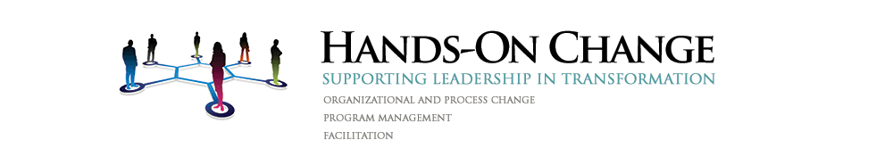
Change Literacy in
Higher Education
Jim Russell
CIO, Manhattanville College
&
Victoria Khazan, Principal
| September 29, 2014
(formerly, Organizational Transformation and Effectiveness, CUNY)

Slide 2

Completion of today’s seminar qualifies you for an official EDUCAUSE badge:
After the seminar and before Oct. 21:
Visit credly.com/claim
Enter code
2014-EDUCAUSE-11P
Follow the prompts to
provide a reflection on how you will apply knowledge from this seminar

Slide 3






After you submit your reflection:
EDUCAUSE staff will review your submission
Look for an email when
it has been approved
Then share your badge on professional and social networks or your own site, blog or résumé

Slide 4
AGENDA
Change Assessments
Organizational Assessments
Mitigation Plans
About this session

Slide 5
OVERVIEW
Change Management at CUNY has developed a holistic approach for higher education entities engaging in sustained change, whether from new technologies or outside mandates. The protocols include evaluating the scope and scale of change efforts, gauging potential impacts, and creating tailored protocols and structures to prepare organizations to successfully execute change initiatives.

Slide 6
Session Goals & Outcomes
Participants will benefit from change management lessons learned during the largest ERP implementation in higher education to date. We will share both best practices and stumbling blocks during the roll out this most complex change initiative, and covey the kind of governance, project structure, roles, skills and communications are required to drive change. We will discuss the norms of driving change and what is unique to higher education, including complex hierarchies and politics as well as early indicators of success and danger.
Outcomes: Understand how to approach and estimate change readiness from the smallest department to the largest organization. Apply our real-life lessons, multi-disciplinary tools and best practices to develop an actionable road map for implementing your change initiative.

Slide 7
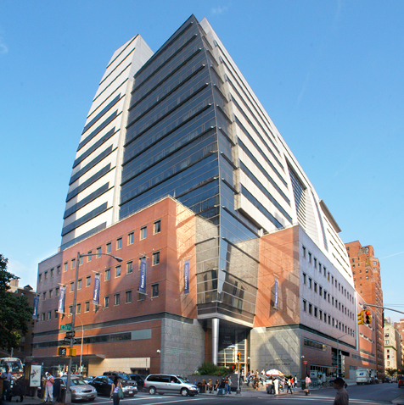
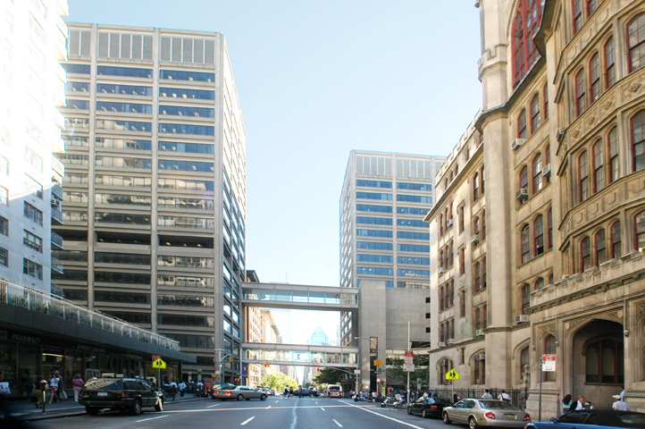
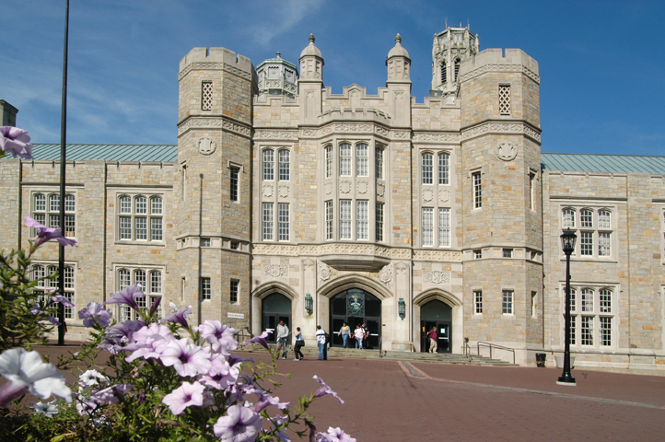
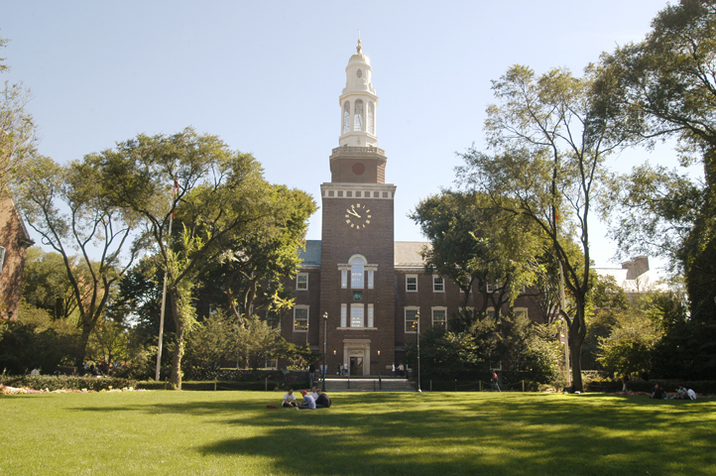
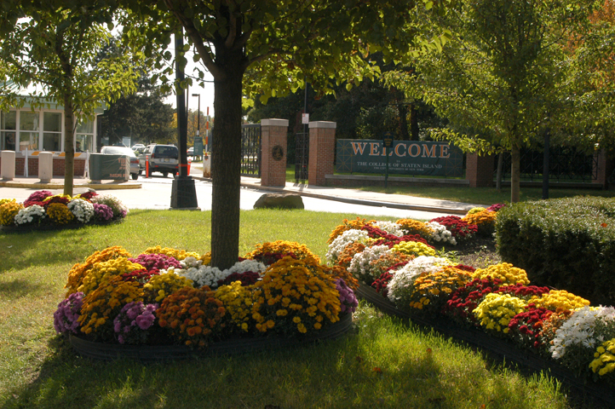
WHAT IS CUNY?

Slide 8
WHAT IS CUNY
CUNY is the largest urban public university in the United States:
24 Institutions
>262,000 degree-seeking students
>257,000 continuing education students
>7,000 full-time faculty
>10,000 part-time faculty
1,000 continuing education teachers
>35,000 total employees
1,400 academic programs
200+ associate and baccalaureate degree majors
100+ graduate degree programs
280+ buildings on 23 million square feet of space
641+ acres

Slide 9
ERP IMPLEMENTATION – “CUNYfirst”
PeopleSoft (Oracle) 9.0
Unification of Finance, Human Capital Management (HR) and Campus Solutions (SIS)
Replaced 35 year old home grown legacy systems
Union environment
Both city and state oversight

Slide 10
What Made CUNYfirst Unique
Splintered Change Management
  Large scope made it clear that we needed more resources than practicable in a centralized team
  Existing University models in communications and training did not support massive change effort
  Wave approach
    By module
    Campus Solutions (Student Information) by schools
    A few “big bangs”

Slide 11
CHANGE MANAGEMENT FORMULA
Your Assessment of the
1. Change Impact (of your initiative on your organization)
+
2. Organizational Readiness(to absorb the disruption and mitigate the Risks of your initiative, whether internal or to customer)
MUST INFORM YOUR
3. Change Strategy Elements & Approach

Slide 12
Change Impact + Org. Readiness/Risk = Change Strategy
Change Impact Assessment:
  Stakeholder Assessment: Number of stakeholders? Who are they? How profoundly are they Impacted? (CUNY – High)
  Change Saturation : what percentage of org? how broad? How deep? Impact on customer? (CUNY – High)
  Change Complexity: what portion of individual’s daily lives, work processes , communications , job location will be disrupted? Other simultaneous changes? (CUNY - High)
+
Organizational Readiness Assessment:
  Sponsor Assessment : Sponsor/Leadership engagement and change competency (ideal High)
  Information Penetration Assessment: Does the Org have /utilize an established communications infrastructure, (e.g., townhalls, workshops, printed/online/intranet) to drive messaging effectively through the organization. (ideal High)
  Organization’s Change Maturity Assessment: Has the org gone through significant change efforts and has it formalized and/or institutionalized the change process? Have they been through a positive or negative change experience? (This drives the level of “hands-on” support the change team will have to provide) (Ideal: High)
    =
Change Strategy Roadmap (Building up Change Infrastructure and Tools):
  ADKAR Exercise - Where are we with Awareness and Desire at this stage?
Visible Sponsorship Network and Impactful Ubiquitous Business Case (look to Sponsor Assessment) – Burning Platform
Sustainable Governance structure is established (look to Change Saturation and Sponsor Assessment)
Project Management Infrastructure centrally and PM skills are taught (look to Org Change Maturity assessment)
Formalize the Change Team or task force and its role: /skill/reach/relevance (All Assessments)
Change Management Tools and Initiatives (business process assessment, key changes, Feedback mechanism (CRI), benchmarking, townhalls, brainstorming sessions)
Communication Strategy (look to Information Penetration Assessment)
Training Needs and Strategy (look to Change impact Assessment and Org. Change Maturity assessment)
Notes:
Questions To Set up the Change Strategy Roadmap Exercise:
1. Introduction to ADKAR. Where are we with Awareness and Desire?
2. Review the Change and OD tools listed
3. Based on the results from your Assessment work, which of these tools do you think you will need? Can you prioritize them in order of importance?
4. What kind of change management resources do you think you’ll need to implement these effectively? Over what period of time?
5. Which of these would you like to discuss in depth?

Slide 13
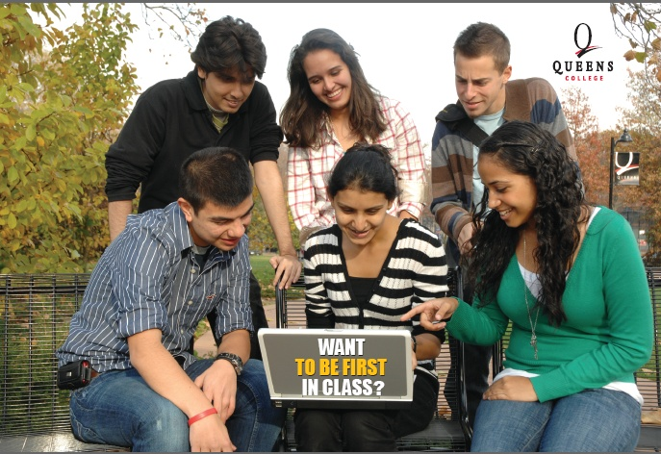
Change Assessment

Slide 14
I. Change impact assessment
  Stakeholder Assessment (WHO?): Number of stakeholders? Who are they? How profoundly are they Impacted? (CUNY – High)
  Change Saturation (HOW MUCH?) : what percentage of org? how broad? How deep? Impact on customer? (CUNY – High)
  Change Complexity: what portion of individual’s daily lives, work processes , communications , job location will be disrupted? Other simultaneous changes? (CUNY - High)

Slide 15
Exercise I.
Impact Assessment: Stakeholder Assessment
List Stakeholder Groups
__________________________________
__________________________________
__________________________________
___________________________________
___________________________________
Rate each stakeholder group’s impact level
1-Low to 5 High
Notes:
Instructions: Use either your own project or the CUNYfirst Case study.
“You’ve been provided the CUNY case study. Given what you’ve read and heard about CUNYfirst project, complete the Stakeholder Assessment by:
Listing the key stakeholders and
Rating how each group will be affected by CUNYfirst
E.g. 1 – little or no impact to 5. profound impact affecting all workflows, business processes.
Lessons Learned: Point out that stakeholder assessment should assess more than “impact” on the stakeholder group. E.g., Faculty may have scored a 2-3 impact score, but they are a powerful group with outsided influence, which needs to be managed and mitigated.”

Slide 16
Exercise 2.
Impact Assessment: Change Saturation
What percentage (approx.) of the organization is affected by the change?
_____________________________________________
How deeply will this change affect the stakeholder groups? What are the potential implications to other groups, or processes? e.g. customers, regulatory, etc.
______________________________________________
Are there other simultaneous changes?
_______________________________________________
Notes:
We are trying to stimulate thinking of impact beyond stakeholders to other groups and processes.

Slide 17
Six characteristics of Change
Characteristic of Change | Impact on Change Process
Is it Simple? -to understand? Do? | More of …. Less of…
Is it Compatible? -with what your people are used to? | More of …. Less of…
Is it Better? -do people see advantages to changing? | More of …. Less of…
Is it Painful? -will it change relationships? How people spend their time? What they do? | More of …. Less of…
Is it Divisible? -implemented all at once or one at a time? | More of …. Less of…
Who will feel it most acutely? | More of …. Less of…

Slide 18
Exercise 3.
Impact Assessment: Change Complexity
How large and complex is the organization/ or the impacted parts? Or Are there only a few stakeholders and can they be reached easily?_____________________________
Are there multiple organizations? silos? What are they? ___________________________
Is it centralized or decentralized? Are there multiple hierarchies? Competing priorities?
________________________________________

Slide 19
Key Changes
Business Process Documentation
Key Changes review
  Simple: GL
  Complex: Faculty workload

Slide 20
Possible Case Study (20 minutes)
Groups of about 10
  Select a facilitator
  Select a scribe
Use the form to identify stake holders involved in this policy change, the change saturation and the change complexity
  Consider the different types of social media sites likely to be found at a college (department, school, research center, initiative, individual,…) Are the changes the same for each and will the requirements vary?

Slide 21
Organizational Readiness/Risk Assessment

Slide 22
II. Organizational Readiness Assessment
  Sponsor Assessment : Sponsor/Leadership engagement and change competency (ideal High)
  Information Penetration Assessment: Does the Org have / utilize an established communications infrastructure, (e.g., townhalls, workshops, printed/online/intranet) to drive messaging effectively through the organization. (ideal High)
  Organization’s Change Maturity Assessment: Has the org gone through significant change efforts and has it institutionalized the process? Have they been a positive or negative experience? (This drives the level of “hands-on” support the change team will have to provide) (Ideal: High)

Slide 23
Sample sponsor Assessment Diagram
President
A2
Provost
B1
Students
B3
SVP Administration
A2
CIO
A3
Student affairs
B2
Asst. Provost
A2
Dir. Faculty
B2
Dir Admissions
A2
Registrar
B3
Faculty Council
B3
Adjunct Faculty Council
B3
Dir. Fac. Advisors
A1
Dir. Admiss./Enroll
A.2
Bursar
A3
Fin.Aid
A3
Dir. IT
A3
Testing
B.3

Slide 24
Exercise 4.
Readiness Assessment: Sponsor Assessment
This Assessment evaluates each individual based on
  His/her outlook relative to the change effort and
  His / her competence in change management**
  Please follow these steps, to complete the diagram:
For Each individual,
  Assign A if the manager is involved and supports the change
  Assign B, if he / she is either neutral or opposes it
Then….
  Assign a number (1, 2, or 3), for that person’s Change Competency
    Level 1 = experienced and competent in change management
    Level 2 = limited experience and skills in change management
    Level 3 = little knowledge or skills in change management
  3. Color the diagram (green, yellow, red) based on these Rules
Director of FA
A1
A1 = Green = supports the change and has demonstrated a high-level of competency
A2 = Yellow = supports the change and has demonstrated a moderate level of competency
B1, B2, B3, A3 = Red = either opposed or not engaged in the change OR has demonstrated a low level of sponsor competency
Director of Admissions
A2
Red/Resistance
Red/Sponsor Skill

Slide 25
Exercise 4. Instructions Continued: sponsor Assessment
Group Exercise:
  Group A – will work on CUNYfirst Sponsor Assessment to be led by one Facilitator
  Group B – might work on a volunteer project and work through a Sponsor Assessment with assistance from a Facilitator
Groups can use red, yellow and green post-its on flip charts or blank sheets of paper to create their diagrams
Notes:
Need post-Its

Slide 26
Exercise 4. Sponsor Assessment Diagram
President
A2
Provost
B1
Students
B3
SVP Administration
A2
CIO
A3
Student affairs
B2
Asst. Provost
A2
Dir. Faculty
B2
Dir Admissions
A2
Registrar
B3
Faculty Council
B3
Adjunct Faculty Council
B3
Dir. Fac. Advisors
A1
Dir. Admiss./Enroll
A.2
Bursar
A3
Fin.Aid
A3
Dir. IT
A3
Testing
B.3

Slide 27
Exercise 5
Readiness Assess.: Info Penetration Assessment
Does the Org have or utilize an established communications infrastructure, (e.g., townhalls, workshops, printed/online/intranet) to drive messaging effectively through the organization?
How easy/difficult will it be to control the messaging to each group of stakeholders?
What kind of communication tools and network would make sense for the project?
Rate and rate the As-Is Communication Infrastructure
(1- Ad- Hoc/Immature to 5- Established Communication channels and strategy)
Answer:
How would your rate your Information Penetration (1 thru 5?)
What would be required to effectively drive communication?
__________________________________________________________________
______________________________________________________________________

Slide 28
Exercise 6
Readiness Assess.: Change Maturity Assessment
Has the org gone through significant change efforts?
Has it been through a positive or negative change experience?
Has the organization formalized and/or institutionalized the change? (creating a PMO, educating/formalizing change management through certifications, continuous improvement/six sigma efforts, other)
Rate the organization on a Change Maturity Scale
(1 – Ad-hoc processes to 5 – institutionalized change and improvement efforts)
_______________________________________________
*If the org has been through a failed or particularly painful change effort, consider lowering the rating.

Slide 29
Break

Slide 30
Prosci's Five Tenets of Change Management
We change for a reason
Organizational change requires individual change
Organizational outcomes are the collective result of individual change
Change management is an enabling framework for managing the people side of change
We apply change management to realize the benefits and desired outcomes of change.

Slide 31
Organizational Change: One Person at a Time
“ADKAR” is a model that helps break down Change. It consists of 5 phases Awareness, Desire, Knowledge, Ability, Reinforcement.
The ADKAR model is based on two premises, which are sometimes overlooked:
  It is people who change, not organizations.
  Successful change occurs when individual change matches the stages of organizational change.
You cannot manage change at an organizational level until you know how to manage change with a single individual.
Jeff Hiatt, President and founder of Prosci and author of
ADKAR: A Model for Change in Business, Government and Our Community

Slide 32

The ADKAR Model:
Some building blocks of successful change
Awareness |  | of the need for change
Desire |  | to participate and support the change
Knowledge |  | on how to change
Ability |  | to implement required skills and behaviors
Reinforcement |  | to sustain the change
ADKAR describes the traditional phases that an individual will go through when faced with change

Slide 33
Engagement Roadmap to Implement a Change Effort
Full Adoption
5. Continuously monitor and manage group and Individual competency
Stage 5
4. I/we have the ability to implement.
Stage 4
3. I/We have a plan to Implement.
Stakeholder:
C
Road to Full Adoption
Stage 3
2. I/We know the design & what changes for us.
Stakeholder: B
Phases of a Project: 1.Bus. Need, 2.Design, 3&4.Implementation, 5.Monitoring & Control
Stage 2
1. I/We understand Business Need)
Stage 1
Stakeholder: A
(A)wareness
(D)esire
(K)nowledge
(A)bility
(R)einforcement
Strategy
Communication
by mgt about clear
goals and benefits
Make goals relevant to local context
What’s already being done? What are Gaps? changes?
Facilitate group
workshops/discuss.
Determine gaps in resources and skills. Plans to fix.
Develop group and
individual goals
and execution plans
Use tools to measure
Progress and adoption
Sample Actions to Drive Adoption of Change Along (ADKAR) Change Curve

Slide 34
The ADKAR Model
Awareness: of Context; of the Need; of the Why? and….
Awareness of what happens if we don’t?
Why is that?
  Because loss avoidance is stronger than focus on a gain or opportunity
Some Tools
Stakeholder Analysis
Communication Strategy/ per stakeholder
Engagement Platforms:
  Leadership Town Halls
  Announcements
  Newsletters
  Workshops, briefings
  Team meetings
Some Stumbling Blocks:
No buy-in or disbelief from Top
No cascade of information
Expectations
Relevance
Notes:
Pull Q&A from book…

Slide 35
The ADKAR Model
Desire to support the change is Emotional.
  Personal motivation to support the change
  Organizational drivers to support the change
This is the time to capture both: hearts and minds! And…
Begin working on Change resistance:
Make it personal – address personal concerns
Link Change to what people care about
Understand their mental models (for example….)
Notes:
Pull Q&A from book…

Slide 36
The ADKAR Model
Desire Development Strategies:
Connect to your people on the cognitive and emotional levels.
Understand what matters to them, fears, hopes, anxiety.
Allow time for feedback and venting.
Acknowledge the change. Acknowledge the difficulty. But lead consistently toward desired objectives.
Leverage opinion leaders, coach managers, feedback loops and respond to concerns to ensure people are heard and valued.
Communication –
  State change in Concrete terms, not abstract. Show when you can!
  Appeal to the entire brain (left and right) with story-telling, imagery, personal accounts, real world analogies. No numbers, charts, graphs
  Keep in mind “Change Saturation”

Slide 37
The ADKAR Model
Knowledge on how to change.
  Knowledge, skills and behaviors required during and after the change
  Building knowledge usually centers around
  Actively supporting knowledge building and knowledge - transfer should still be driven from the top (or HQ) and reinforced locally by managers.
    What does this look like?
    How is it supported centrally and locally?
  At this stage, we must forge strong connections between concepts (new vision, values) with actions (new organization, new processes, new behavior, new relationships.)
Notes:
Pull Q&A from book…

Slide 38
The ADKAR Model
Ability to implement new skills.
  This is about ability to navigate new processes and systems
    Many of which may not yet be finalized, which may produce a frustrating experience.
    This is the stage where business solutions are designed (new processes, systems and organizational structure).
  Barriers that may inhibit ability to implementing the change:
  Training – adequate and timely
  Alignment and Communications between departments
    open channels of communication to find the optimal process
  Tools: regular meetings, trouble shooting sessions, user group sessions on best practices, good project management.
***Middle Management take on the brunt of the burden in this stage and should be able to translate strategy into actions and driving changes in process and behavior.
Notes:
Pull Q&A from book…

Slide 39
The ADKAR Model
Reinforcement to sustain the change.
  Mechanisms to keep the change in place
    Recognition, rewards, incentives, successes
    Process optimization and best practices
    Rethinking role and responsibilities in the department
    Focus on desired behaviors: e.g. analytical, process focused, collaborative, customer oriented, etc.
Notes:
Pull Q&A from book…

Slide 40
*“A&D” Before “K&A”
Awareness & Desire
• Why? Why now?
• What if we don’t?
• What’s In It For Me?
Knowledge & Ability
What are we actually going to do?
How will we do it?
“A good portion of what we expect from this project depends on
adoption and usage.”
Notes:
If we want ROI, we need to drive adoption and usage. That means we need to:
1)apply a structured approach,
2) scale and customize our strategy, and
3) integrate CM plans and activities into the overall project plan.”
What portion of YOUR project depends on employees adopting, embracing and utilizing the change?

Slide 41
III. Change Roadmap: Infrastructure and Tools
Visible Sponsorship Network and Impactful Ubiquitous Business Case (look to Sponsor Assessment) – Burning Platform
Sustainable Governance structure is established (look to Change Saturation and Sponsor Assessment)
Project Management Infrastructure centrally and PM skills are taught (look to Org Change Maturity assessment)
Formalize the Change Team or task force and its role: /skill/reach/relevance (All Assessments)
Change Management Tools and Initiatives (business process assessment, key changes, Feedback mechanism (CRI), benchmarking, townhalls, brainstorming sessions)
Communication Strategy (look to Information Penetration Assessment)
Training Needs and Strategy (look to Change impact Assessment and Org. Change Maturity assessment)
Notes:
The community should identify from this list the tools or strategies that they have either struggled with or are new to them.

Slide 42
III. Change Roadmap:
Infrastructure and Tools Questions
Where are you with Awareness and Desire in your project?
Review the Change Infrastructure and Tools listed. Based on the results from your Assessment work, which of these tools do you think you will need? Can you prioritize them in order of importance?
What kind of change management resources do you think you’ll need to implement these effectively? Over what period of time?
Which of these Infrastructure Elements or Tools would you like to discuss in depth? Other?

Slide 43
What is Change Literacy?
Change literacy is the awareness of the tools and processes available to help an organization and its people navigate/execute change initiatives in the least painful and most effective way possible. As it develops toward change fluency it also allows leaders and managers to identify or develop new tools and processes.

Slide 44
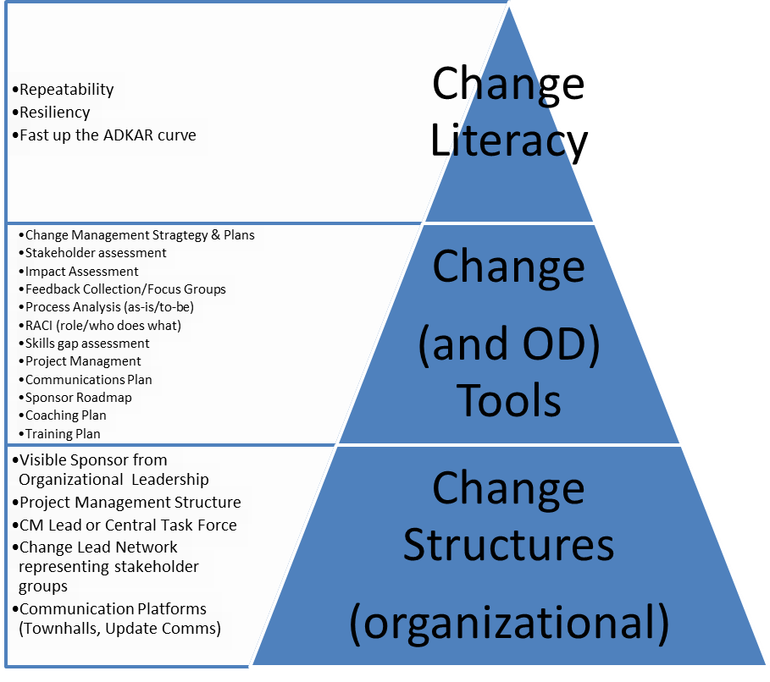

Slide 45
Takeaways: Success Factors for Change Management
Hands-on/tactical
Supported when maturity is low
Access to the right people up and down the chain

Slide 46

“Knowing what to do with a toon is easy.
It’s getting them to do it that’s hard.”
Ender, Ender’s Game, Orson Scott Card

Slide 47
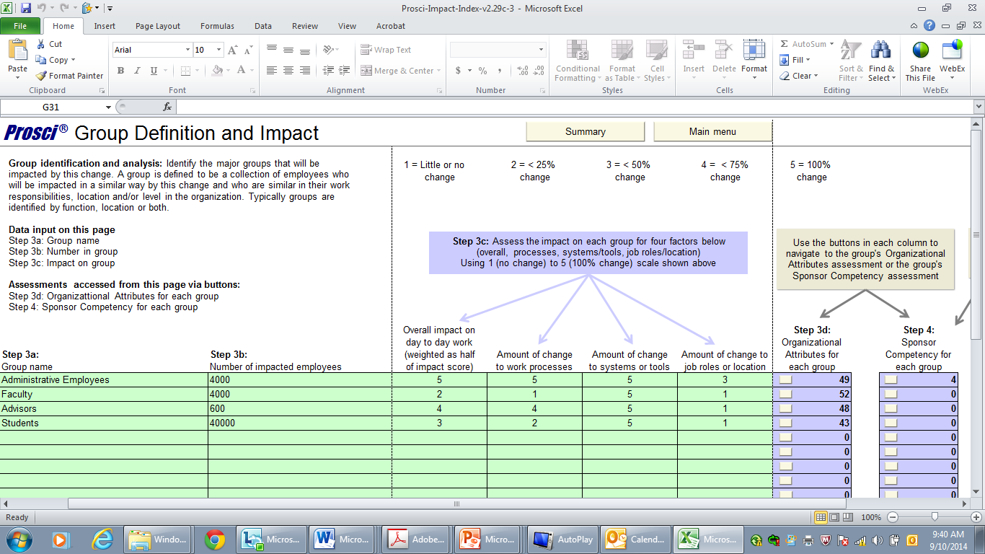

Slide 48
Try Drawing this next time…
Campus Security
Uniform Change
Database Upgrade
ERP
Purely People
Purely People
Purely People
Purely Technical
ROI source
from this
project
Purely Technical
Purely Technical

Slide 49
Kotter’s 8 steps of leading change
Establishing a Sense of Urgency
Creating the Guiding Coalition
Developing a Change Vision
Communicating the Vision for Buy-in
Empowering Broad-based Action
Generating Short-term Wins
Never Letting Up
Incorporating Changes into the Culture
Source: http://www.kotterinternational.com/our-principles/changesteps

Slide 50
Kotter, eight reasons why change initiatives fail:
Too much complexity
Failure to building coalition and support
Not understanding the need for a clear vision
Failure to clearly communicate the vision
Permitting roadblocks and resistance to change
Not planning for short-term results, and not achieving them
Declaring victory too soon
Failure to institutionalize changes in organizational culture
Source: http://www.kotterinternational.com/

Slide 51
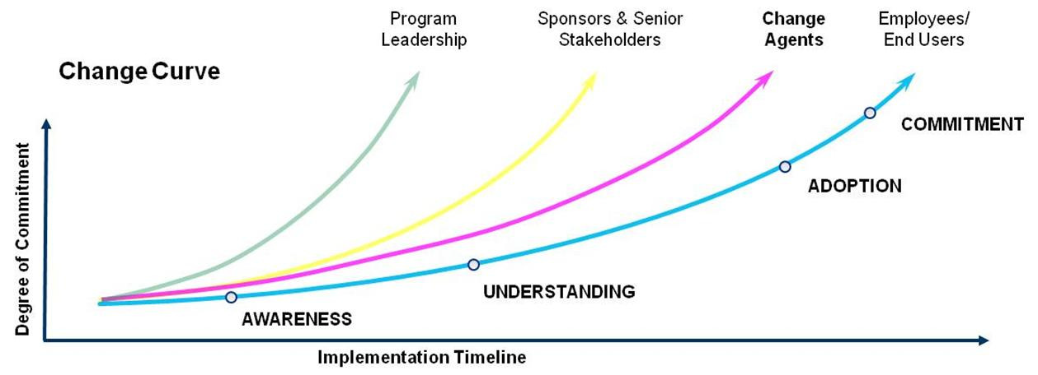
Change Agents help bridge the gap between leadership and employees. They mobilize impacted employees through clear and consistent information and materials.
Moving Up the Change Curve
Change Agents need to move up the change curve before the broader employee/end user groups to help drive the change effort and bring remaining users to desired levels.
Change Agents help identify resistance characteristics. This is critical to understanding and planning of future efforts.
Lack of Motivation – need for transformation unclear or no personal sense of urgency
Big Picture Not Understood – is only a partial understanding about what is changing
Perceived Loss of Personal Control – impacted individuals have little or no involvement
Loss of Stability – high levels of uncertainty regarding the future expectations of jobs, roles, and required skills
Inadequate Communications – communications are untimely, outdated or unfocused, and provide few details and little direction
Expectations Not Met – expectations about communications and personal interactions unmet.

Slide 52
Change Activites

Slide 53
Completion of today’s seminar qualifies you for an official EDUCAUSE badge:
After the seminar and before Oct. 21:
Visit credly.com/claim
Enter code
2014-EDUCAUSE-11P
Follow the prompts to
provide a reflection on how you will apply knowledge from this seminar

Slide 54
After you submit your reflection:
EDUCAUSE staff will review your submission
Look for an email when
it has been approved
Then share your badge on professional and social networks or your own site, blog or résumé

Slide 55
THANK YOU
Victoria Khazan
victoria.khazan@handsonchange.com
Tel. 201-396-8638
Jim Russell,
CIO, Manhattanville College
jim.russell@mville.edu

Slide 56
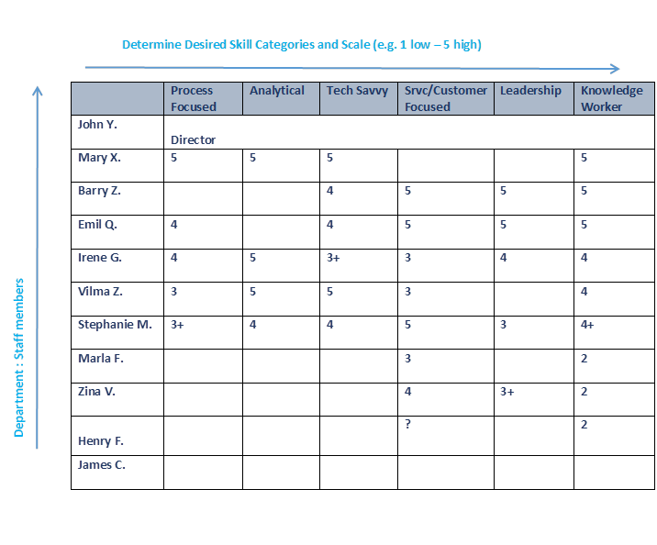
Change Management: Skills Assessment

Slide 57
RACI is an Acronym
: RESPONSIBLE
: ACCOUNTABLE
: CONSULTED
: INFORMED

Slide 58
EXAMPLE: Hiring a New Controller - Interview
People
CONTROL
DIR HR
RECRUIT.
Spec.
TRAINING
Spec.
COMP
BENEFITS
Activities
Set Recruitment Policy
A
R
I
I
Advertise job
I
I
Screen CVs
C
A/R
R
R
I
Interview
A
I
R
Negotiate Comp
Induction Training
Review Comp & Ben
Sign off :

Slide 59
RESISTANCE IS HUMAN
“If you want to make enemies, try to change something” Woodrow Wilson
Loss of Stability/ Comfort in the Current State
Fear of the Unknown
Threat to Personal Status
What Else?

Slide 60
How Organizations Create Resistance
INDIVIDUAL’S PERSPECTIVE | ORGANIZATION’S PERSPECTIVE
“I heard things are changing. I wonder what that means for me?” | We cannot say anything until we’ve finalized the plan.
“I’ve been here a long time, why can’t they ask ME what I think?” | We can’t let the managers know because then everyone will know. And we’re not ready for that.
“If they take away my office/title/people, I will leave or retire!” | We can’t afford the disruption because we need to maintain the level of service.
“I know my new manager is looking to reorganize and she hasn’t made eye contact with me in a week!” | Hold off on having staff meetings until we have this plan of action ready to go.
“What’s the flavor of the week this week? It’ll pass.” | We need everyone’s complete commitment to make this work!
“Wow that meeting told me absolutely nothing about what’s going to happen to me or my group!!! What disrespect!” | That town hall was a great way to lay out our strategy and goals. It got everyone on board!
Building Blocks of Resistance
No awareness of the reason to change
What else?
Haven’t made the decision to engage
Change is a passing thing. Won’t be sustained
Fear that they don’t have knowledge/ ability to succeed
What else?

Slide 61
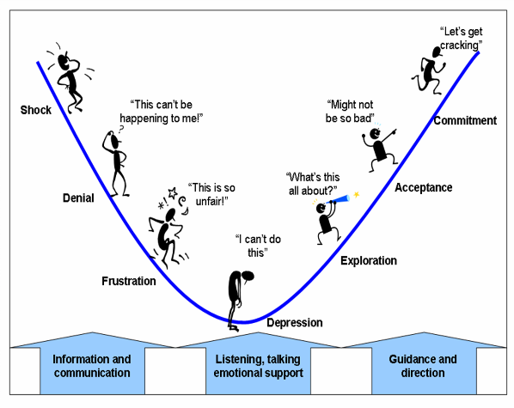
Individual’s “Valley of Despair”

Slide 62
Change Management: Components
Build Governance Structure
Build Leadership Team(s)
Build Project Teams
Build Change Management Team(s)
Build Stakeholder Map(s)
Build Impact Map or Heat Map(s)
Build Risk Map(s)
Build Communication Strategy
Build Implementation Roadmap
Build Change Literacy
Build Alignment

Slide 63
Change Impact + Org. Readiness/Risk = Change Strategy
Change Scope or Change Impact Assessment (I produce 1-5 scale for each of these) 3 to 4 on each team 30-40 minutes:
  WHO Stakeholder Assessment: Number of stakeholders? Who are they? How profoundly are they Impacted? (CUNY – High)
  HOW MUCH Change Saturation : what percentage of org? how broad? How deep? Impact on customer? (CUNY – High)
  WHAT Change Complexity: what portion of individual’s daily lives, work processes , communications , job location will be disrupted? Other simultaneous changes? (CUNY - High)
+
Organizational Readiness Assessment:
  Sponsor Assessment : Sponsor/Leadership engagement and change competency (ideal High) We give them to chat and our experience 15 minutes
  Information Penetration Assessment: Does the Org have /utilize an established communications infrastructure, (e.g., townhalls, workshops, printed/online/intranet) to drive messaging effectively through the organization. (ideal High)
  Organization’s Change Maturity Assessment: Has the org gone through significant change efforts and has it institutionalized the process? Have they been a positive or negative experience? (This drives the level of “hands-on” support the change team will have to provide) (Ideal: High)
  ---------------------BREAK-----------------------------------------------------------
  OPTIONAL: ADKAR - Where are we with Awareness and Desire at this stage? (High) Survey
=
Change Strategy (Organizational Infrastructure and Tools): Have someone prioritize
Create a Visible Sponsorship Network and Impactful Ubiquitous Business Case (sponsor assessment) Champions, Visible Burning Platform
Ensure a Sustainable Governance structure is established (Change Saturation and sponsor assessment)
If needed, establish a Project Management Infrastructure centrally and PM skills are taught (Org Change Maturity assessment)
Professionalize and Formalize the Change Team or task force and its role: /skill/reach/relevance (All Assessments)
Introduce Change Management Tools and Initiatives (business process assessment, benchmarking, townhalls, brainstorming sessions) CRI
Develop a Communication Strategy (Information Penetration Assessment)
Develop Training needs and strategy (Change impact Assessment and Org. Change Maturity assessment)

