Slide 1
Implementing IT Accessibility on Your Campus: Sharing Strategies That Succeed
Notes:
Welcome
Speakers:
Greg Kraus, IT Accessibility Coordinator, NC State University
Cheryl Pruitt, Director, Accessible Technology Initiative, Cal State University (CSUN)
Sue Cullen, Program Manager, Universal Design Center, Cal State Northridge (CSUN)
Alen Davoudian, IT Consultant, Web Developer CSUN

Slide 2
Presenters
  Greg Kraus
    IT Accessibility Coordinator, North Carolina State University
Cheryl Pruitt
  Director, Accessible Technology Initiative,
  California State University (CSUN)
Sue Cullen, Program Manager, Universal Design Center (UDC)
  California State Northridge (CSUN)
Alen Davoudian
IT Consultant, UDC, Web Developer CSUN

Slide 3
Agenda
Introductions
  Organization health status in one word
Accessibility Policies
Building Institutional Support
Supporting Web Developer & Content Creators
Procurement
Captioning
Instructional Materials

Slide 4
Introduction

Slide 5
What Do We Mean By IT Accessibility?
We mean creating an IT environment where
  An individual can access and acquire the same information, engage in the same interactions and enjoy the same services that the device/technology offers non-disabled individuals with substantially the equivalent ease of use

Slide 6
Universities must provide…
...an environment for all participants that is
  Timely
  Equally effective
  Equally integrated
…reasonable accommodations to qualified students with disabilities

Slide 7
What to do about it?
Not everything has to be accessible, but it has to be equally effective
Accessible
Accommodation

Slide 8
An Example

Slide 9
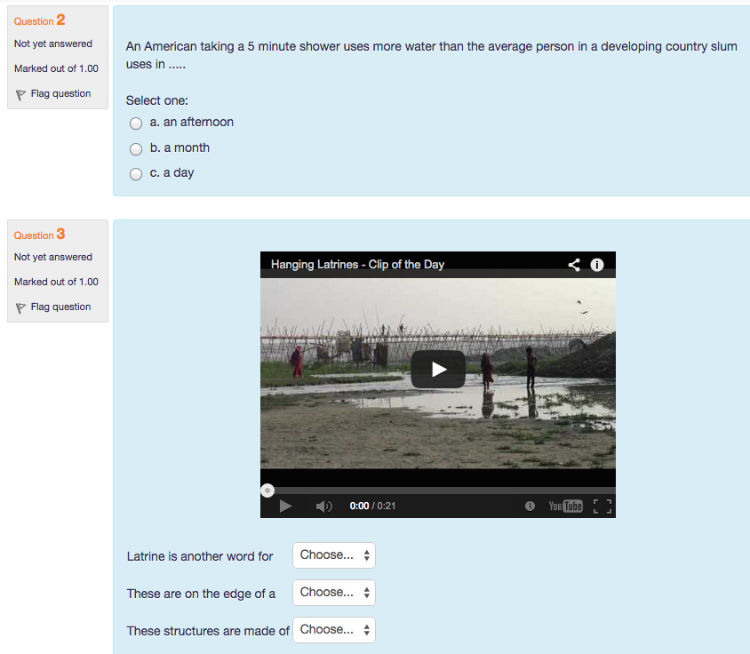
Notes:
Quiz in LMS that cannot be read with a screen reader
Must have an assistant
Equally integrated?
Same ease of use?
Some might say – “Well, I just won’t count that for you, so don’t worry about it”

Slide 10
Moving from Accessibility to Universal Design
The design of products and environments to be usable by all people, to the greatest extent possible, without the need for adaptation or specialized design.
  Definition of Universal Design, Ron Mace, NCSU
Eliminating as many barriers as possible for as many people as possible

Slide 11
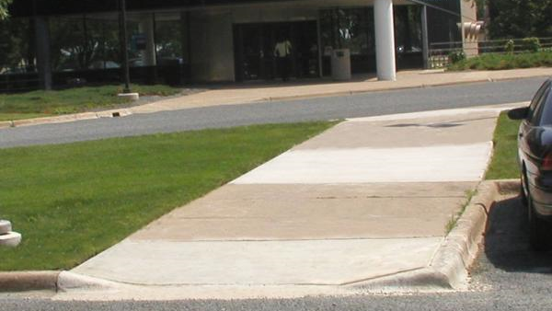
Curb Cuts

Slide 12
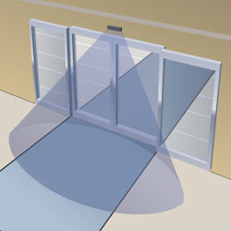
Automatically Opening Doors

Slide 13
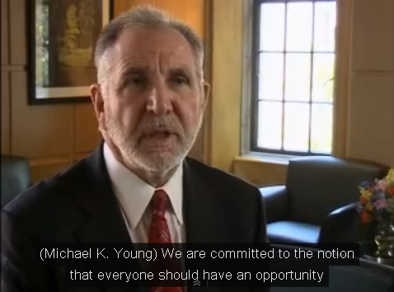
Captioning

Slide 14
Whose Responsibility Is It?
Web Developers
Faculty
Content Creators
Upper Administration
Purchasing
IT
Disability Services
Training Groups

Slide 15
Accessibility Policy

Slide 16
Why a Policy?
An accessibility policy
  Focus a campus’ attention on the issues
  Define how the institution will go about meeting those requirements

Slide 17
Helps avoid questions like
Why does this have to be accessible?
When do I have to make it accessible?
Does this particular resource have to be accessible?

Slide 18
Scope of the Policy
Web Accessibility
Information Technology (IT) Accessibility
Information and Communication Technology (ICT) Accessibility
Electronic and Information Technology (EIT) Accessibility

Slide 19
Anatomy of the Policy
State the institution’s commitment to accessibility
What standard will define “accessible”
The scope of what must be accessible
Timelines for implementing
Prioritizing implementation
Exclusions to the standard
A regular review process for maintaining accessibility
A grievance and remedy procedure
Required language on Web sites
Resources available to campus
Effective dates

Slide 20
State the institution’s commitment to accessibility
State that you are committed to providing access to your educational services and programs

Slide 21
What standard will define “accessible”
Section 508?
WCAG 2 Level AA?

Slide 22
The scope of what must be accessible
Only educational materials?
Resources related to essential business and education needs
Publicly available content?

Slide 23
Timelines for implementing
Three types of content
  New development/refreshed content
  Current technology
  Legacy content

Slide 24
Prioritizing implementation
Where should efforts be expended first?
  Course content
  Public content

Slide 25
Exclusions to the standard
NOT exceptions to the policy, but exceptions from the standard
“When compliance is not technically possible or may require extraordinary measures due to the nature of the information and the intent of the resource”
Define an exception process

Slide 26
A regular review process for maintaining accessibility
How often do people need to check their content?
Do they need to report their findings to someone?

Slide 27
A grievance and remedy procedure
Define a process for when end users encounter barriers to using specific content
Who do they contact?
What process will be followed to address the problem?

Slide 28
Required language on Web sites
Will you require specific language to be on all appropriate resources?
  Where to get help when you encounter problems
  Resources for further help
Notes:
http://accessibility.ncsu.edu

Slide 29
Resources available to campus
What resources are available to campus in order to help follow this policy?

Slide 30
Effective dates
For new policies, are there deadlines for when current content must be checked for accessibility and problems addressed?

Slide 31
Moving your institution towards accessibility…
Cultural change
+
Institution-wide effort
=
Really BIG Job
Notes:
Cultural change involves changing the way the people think about their jobs – how to create, build, buy, and adopt products and services that universally serve the greatest number of people regardless of how they interact with that product.
Institution-wide effort – integrating accessibility into all the campus business processes – looking at how the campus is doing things now and what needs to done to make accessibility part of the everyday work – not a bolt-on or after thought
At the CSU we realized that the institution-wide effort would require a continuous process improvement approach
Strong Executive Support at each of our campuses there is an ATI Sponsor at the VP level who oversees the campus ATI implementation

Slide 32
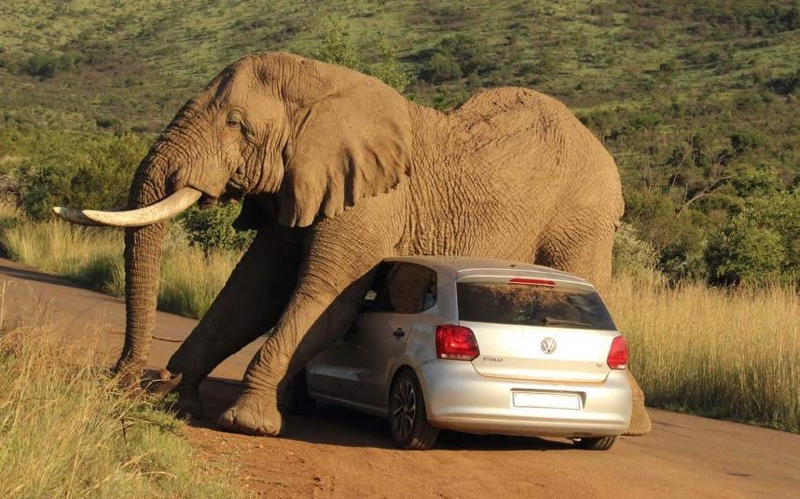

CSU Accessibility Policy 2007 – 2009
Notes:
Executive Order 926 – General Policy January 1, 2005 - The California State University Policy on Disability Support and Accommodations – what campuses need to
Coded Memo’s operational documents – how and when to do it
First substantive: Coded Memo 2007 Responsibilities, Plans, Timelines, split the implementation effort into 3 priority area Web, Procurement, and IM and articulated goals for each area
Problems included Vague responsibilities and unrealistic timelines
No one had experience with this type of implementation so it was not clear how large the implementation would be (institution-wide) or how to proceed with the implementation
Campuses were confused –unsure how to proceed to accomplish the goals – short timelines became a de-motivating factor – not nearly enough resources were available
Lots of checklist and training attempts without any business processes in place to support the effort
So we need to change things -
Graphic from: https://www.google.com/search?q=elephant&client=firefox-a&rls=org.mozilla:en-US:official&channel=sb&biw=924&bih=394&source=lnms&tbm=isch&sa=X&ei=khEjVJjlB6uxigK0zYDQAg&ved=0CAYQ_AUoAQ#facrc=_&imgdii=_&imgrc=pXHP976AcuWn4M%253A%3BCzxkJtQI1mVsdM%3Bhttp%253A%252F%252Fi1.mirror.co.uk%252Fincoming%252Farticle3997600.ece%252Falternates%252Fs2197%252FAn-elephant-relieves-an-itch-on-a-small.jpg%3Bhttp%253A%252F%252Fwww.mirror.co.uk%252Fnews%252Fweird-news%252Fhilarious-moment-elephant-uses-car-3997679%3B2197%3B1463

Slide 33
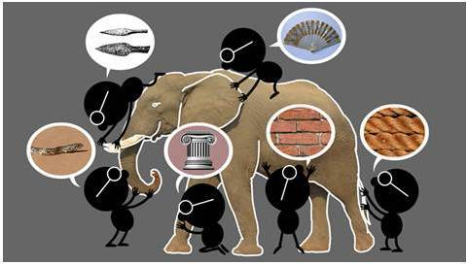
Developing New Policy
Notes:
Elephant and people figures: https://infocus.emc.com/wp-content/uploads/2012/04/ChoongPicElephant.jpg
Brought CSU Stakeholders together in late 2009 and 2010 to put forth a new policy that campus could actually accomplish. Campus implementation experiences informed the group as to how the huge accessibility problem could be broken down into manageable pieces. These discussions lead to the development of the CSU ATI Framework which we will discuss in a moment
The CSU 2013 Policy

Slide 34
CSU ATI Framework: Policy (Strategies/Goals & Success Indicators)/Priorities
Continuous Process Improvement with
Strong Executive Support
Work the Campus Plan
Measure Progress
Make a Campus Plan
Notes:
The CSU implements this framework by utilizing our strategies (outlined in the Coded Memo), applying continuous process improvement guided by the goals and success indicators. There is strong Executive support which is one of keys to success. Each year our campuses follow this implementation cycle
Planning – Each campus establishes a plan based on priorities such as impact and capacity to guide their work on Success Indicators. Implementation activities for each year are chosen based on impact.
Working the Plan - the ATI System team organizes projects to address specific high impact Success Indicators. These projects are collaborative efforts across our campuses that produce deliverables that can be adopted and adapted by individual campus’. Each campus works on their own projects and adopts systemwide deliverables as needed.
Measuring Progress - ATI Annual Reports that cover all the goals and success Indictors measured by status level are submitted by each campus. Systemwide Aggregate reports are compiled from the individual campus reports.
We have seen improvement each year and we have been able to determine where campuses are experiencing difficulties. One of the areas that our campuses were experiencing problems was in the procurement of accessible products.
The systemwide audit office also now includes ATI in the auditable areas for CSU Campuses. They use the Goals/Success Indicators/Status levels as part of the audit process – campuses are required to show proof of progress. Audit also verifies that each campus is updating the campus plan.
CSU policy, assessment tools, and links to web resources are located at: http://ati.calstate.edu/mod/book/view.php?id=331&chapterid=39

Slide 35


Activities to collaborate and share ideas
Notes:
Graphic from: http://www.natcom.org/uploadedImages/CommunicationCurrents_Articles/Volume_7/Lshutterstock_46799458.jpg

Slide 36

Accessibility
Planning and Process
Template
Activity: Planning Template Overview
Agenda sections will include:
  Speaker presentation of issues and potential solutions
  Questions to consider – group discussion
  Planning Templates and discussion - handouts
Notes:
Sue

Slide 37
Accessibility
Planning and Process
Template
How to use the templates
  Planning template provides a common framework for documenting progress toward achieving goals. Data contained in these documents are to help:
  (1) record institutional improvement (what is going well)
  (2) identify challenging areas
  (3) Document possible solutions and resources to implement those solutions
  (4) develop a shared institutional definition of measurements of success

Slide 38
Accessibility
Planning and Process
Template
Areas of discussion
  Policy
  (2) Web
  (3) Procurement
  (4) Instructional Materials (e.g. documents,
  multi-media)

Slide 39
Status Levels
Status Level: a description that indicates how the Status Level is defined.
If the organization has undertaken several actions related to a Success Indicator, select a Status Level that best reflects overall progress.
Use the Status Level Definition as a reference while completing the Status column.
Notes:
If it is easier, use a level of measurement such as 1-5

Slide 40
Status Levels | Description for Procedures | Description for Documentation | Description for Resources
Not Started | No action has been taken yet. | No documentation has yet been generated. | No resources have yet been allocated.
Initiated | The campus has an ad hoc or developing practice. Procedures, if in place, are generally ad hoc. | Documentation is generally absent. | Resources have been tentatively identified but not yet allocated.
Defined | The campus has a common practice. Procedures, if in place, are consistent but informal. | Documentation, if present, is in working draft. | Resources have been firmly identified but not yet allocated.
Established | The campus has a standard practice. Procedures are consistent and formal. | Documentation is complete and fully reflects the standard practice. | Resources have been both identified and allocated.
Managed | The campus has a mature practice. Procedures are also in place to track and capture success indicators (milestones and measures of success). | Documentation is complete and fully reflects the standard practice. | Resources have been both identified and allocated.
Optimized | The campus has a mature practice. In addition, procedures are in place to conduct regular administrative reviews of success indicators to gauge effectiveness and implement improvements. | Documentation is continually revised to reflect the managed practice. Periodic administrative review of documentation is conducted. | Resources have been both identified and allocated. Periodic administrative review of resource allocations is conducted
Notes:
For these definitions: key is -- level of defined procedures, documentation, resource allocation and administrative review
Initiated: ad hoc – documentation is missing- resource tentatively identified not allocated
Defined: informal procedures which may be consistent- drafting documentation
Established: standard practice- procedures consistent and formal-documentation reflects this – resources have been allocated
Managed: practice is matured and success indicators tracked – measurable success
Optimized: all of the above plus procedures in place for administrative review of success indicators for improvements as needed- documentation continually reviewed by administrators

Slide 41

Building
Institutional
Support
Notes:
Institutional support must be seen as a shared responsibility. If not, accessibility will continue to be addressed as a separate but not equal situation
Changing the habits of individuals in their everyday work habits and responsibility is key
Graphic Credit: http://www.naccho.org/topics/infrastructure/CHAIP/chachip-online-resource-center.cfm

Slide 42
To build institutional support and support cultural change
Consider:
What is going well in your institution?
What could be improved?
What resources, key roles and business processes could be defined or improved?
Notes:
As we consider how to support cultural change you may think about the questions listed on the slide.

Slide 43


Technology should be usable to everyone regardless of their individual characteristics.
Notes:
UDC @CSUN

Slide 44
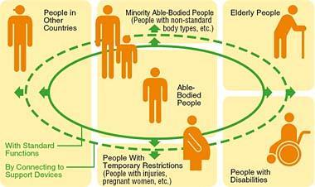
Universal Design
Intentional approach to design
Anticipates a variety of needs
Broadens usability to public
Is more economical
Respects human diversity
Notes:
*
Image is of concentric circles with a able body person in the center and those with various disabilities or differences are in the outer circles.
Their is a person of average ability in the center, as that is often the audience for whom things are designed. Further from the center are images of a person in a wheelchair, a pregnant woman, an elderly person with a cane, individuals with significantly different body types, and people from other countries. The image emphasizes that there are many types of users to consider and that we should not just design for the most common user or we will leave many out.
10-18-09

Slide 45
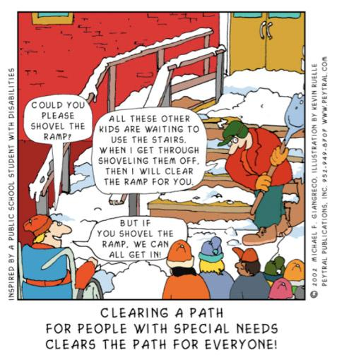
Notes:
This comic depicts a person shoveling snow off steps leading to a school entrance. A person in a wheelchair is asking that the ramp be cleared of snow. The custodial person responds that he needs to finish clearing the steps first so the other people may enter. The peson in the wheelchair points out that if the ramp were to be cleared, they could all access the building.
This is an excellent example of changing the way we make decisions in our everyday work lives that support access.

Slide 46

There is only one way to do things.
Notes:
Of course there is only one way to correctly move through a maze. Therefore there is only one way to do things. Right? We are challenged on a continual basis to create, purchase, promote or support new and interesting technologies, web sites, print materials, movies, animation etc. Do you find there is only one technology to use to meet a need? Institutions must define their business needs and discover which technology best meets those needs and consider whichi is also the most useable to everyone. This involves defining the intended function of the technology and what are the diverse needs of those individuals who will be using it. Will today’s session give you the special magic combination to move through the maze? The goal is to provide tools which will help provide parameters in which to work as policy and business processes are developed.

Slide 47
Finding your way through the maze of design and user interface
Compliant and Usable Technology
Design/Evaluate/Repeat
Notes:
This is a graphic of a maze, meant to explain how you will find your way through the maze of business needs to innovate, design elements and interface issues. There are three dots which will move through the maze, the first flies through staying within the walls of the maze and correctly exits. The exit is defined as Compliant and Useable Technology. The second gets struck behind a wall, the third creatively hops the walls of the maze and exits successfully.

Slide 48
Executive Level Sponsors
Vice Presidents
Associate VPs
Deans
CIOs
ADA Officer
508 Officer
Directors
Executive
Level
Support
Notes:
Develop a strategy to keep key administrators involved and informed. Top down while also working bottom up can move things along.

Slide 49
Campus
Governance
Campus Wide Disabilities Issues Board
Accessible Technology Initiative Steering Committee
Web/Training Coordinators
Procurement Process/Training
Instructional Materials/ Training
Notes:
Without clear direction even the best intentions can cause confusion and wasted time and effort. Clearly defined goals for each committee or working group will help prevent unnecessary duplication of work and misunderstanding of the policy and intended outcomes.

Slide 50
1) Web Environment:
URL Identification
2)
Technical Support
Role Clarification
3)
Division/Dept Content Creators Reporting Needs
4) Paraprofessional Student Support Liaisons
5) Paraprofessional Web Developer
6)
Accessibility UD Web Dev/System Administrator
7)
Coding Solutions Provided
Accessibility Web Audits
Notes:
Build structure business processes to support the intended business goals. If the goal is to have an accessible web environment then accessment is essential to track progress. Providing training and tools of support are needed as well.

Slide 51
Benefits of using
Universally Designed Technology
With proper structure of a web page the user can change the presentation of the page to meet their needs.
Proper structure and coding allows users to choose how they navigate a web page.
Technology should require the least amount of effort for the users. Don’t assume they will all engage the technology in the same way.
Proper use of structural helps authors edit and navigate large documents.
Notes:
With proper structure users can:
Change the color of the page is they have trouble seeing the assigned design colors e.g. color blind or prone to migraines
Navigation based on links only, headers only etc
Navigate to what they need when they need it without having to know your institution already
In documents is helps with large document edits

Slide 52
Evaluation Protocols for Compliance & Usability Testing
Level I
Level II
Level III
Review VPAT information for confusing or unclear remarks and explanation resulting in significant barriers.
If egregious issues found, conduct manual testing to validate claims or lack of accuracy based on Impact considerations.
Share VPAT back to the vendor with additional UDC comments.
Consider Campus or System Wide Impact of the product.
Recommendations and resources provided.
Concurrently: Run Compliance Sheriff (C.S.) level IV scan based on appropriate check points. Use as a guide for manual checking.
Complex web navigation pages (all previously listed criteria plus keyboard accessibility, tables, CSS, navigation, scripting and Assistive Technology testing ).
Basic web page (link & semantic requirements, tab order and images)
Web form applications (form fields labels, input mask, error handling)
Limited criteria validation based on application type
Examples:
As needed provide actual coding or work around for end user.
Concurrently: Run C.S. level IV scan with manual testing.
Detailed recommendations and resources provided.
Applications have coding that requires additional research and reiterative testing of coding solutions validation.
Criteria validation based on CSU ATI Requirements and full UDC Testing Guide implementation.
Comprehensive testing (all previously listed criteria plus usability testing )
Notes:
For free or purchased technology we have a structure evaluation process.
Defining the business need is left to the buyer or users of the technology we advise on the impact of a lack of usability
I: Simple VPAT review if available – share info back with vendor
II: Targeted criteria review- Form: use form construct criteria, Basic web page: Links, Header Structure, Complex: include tables, CSS scripting
III: Comprehensive testing based on CSU ATI Criteria (based on 508 and WCAG 2.0) Reiterative testing and coding solutions given and validated, Detailed recommendations given

Slide 53
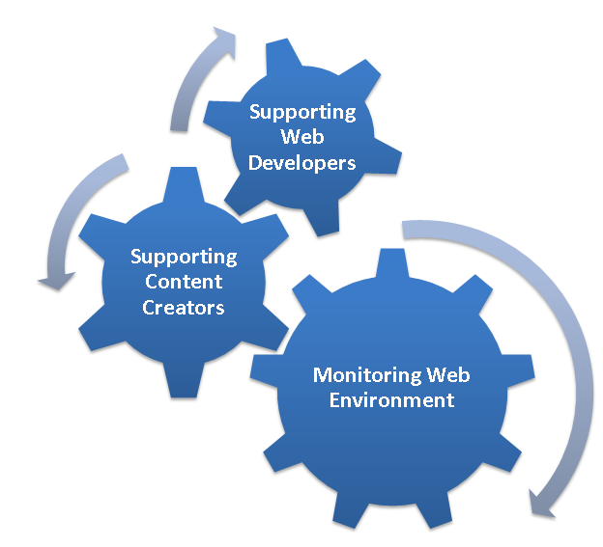
Creating Accessible
Web Pages and Applications
Notes:
three components of creating accessible web pages and applications that are in close collaboration to develop accessible content:
Supporting web developers
Supporting content creators
Monitoring web pages

Slide 54
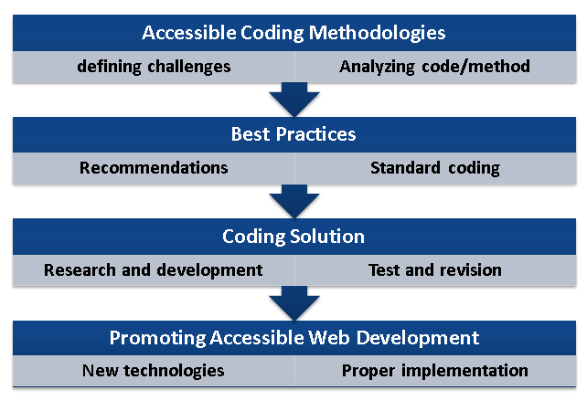
Supporting Web Developers
Notes:
our distinct procedures to support web developers are:
Accessible coding methodologies
Best Practices
Coding Solutions
Promoting accessible web development

Slide 55
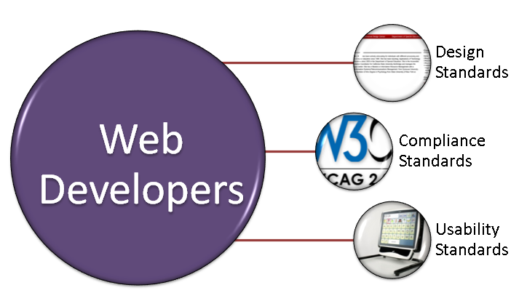
Supporting Web Developers
Integrate compliance standard skills into the everyday work habits and expectation of employees.

Slide 56
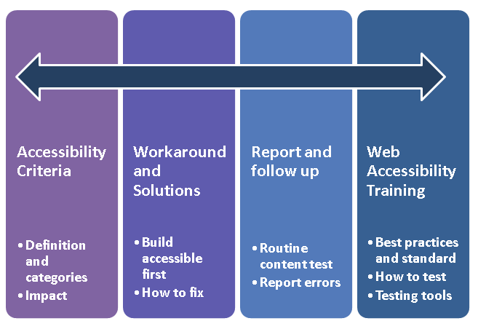
Supporting Content Creators
Notes:
Four interconnected procedures to support content creators understanding accessibility and creating accessible content.

Slide 57
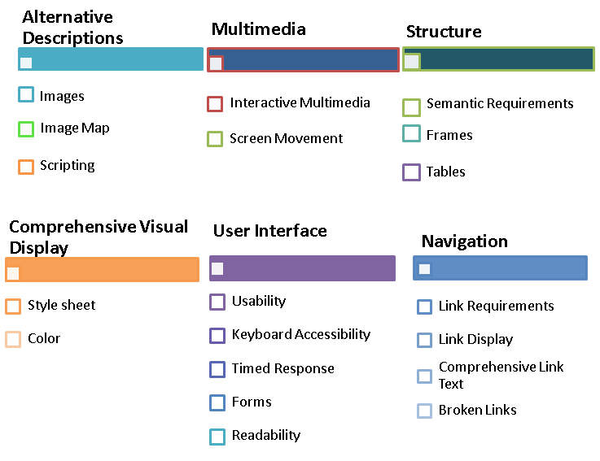
UDC Evaluation Categories
Section 508/WCAG 2.0 U.D. Principles
Notes:
6 evaluation categories that are used for conducting a manual test and reporting accessibility and usability errors
Categories are built upon the characteristics of components being tested within a web page, for example, tables, frames and headings are used to organize content and create a structure for the web page, therefore they are grouped under “Structure” category.
Alternative Descriptions
Diagram showing the topics of Images, Image Map, and Scripting are under the Alternative Descriptions section of UDC evaluation categories
Multimedia
Diagram showing the topics of Interactive Multimedia and Screen Movment are under the Multimedia section of UDC evaluation categories
Structure
Diagram showing the topics ofSemantic Requirements, Frames, and Tables are under the Structure section of UDC evaluation categories
Comprehensive Visual Display
Diagram showing the topics ofVisual Readability, Style Sheets, and Color are under the Comprehensive Visual Display section of UDC evaluation categories
User Interface
Diagram showing the topics of Navigation, Keyboard Accessibility, Times Response, and Forms are under the User Interface section of UDC evaluation categories
Navigation
Diagram showing the topic of Link Requirements is under the Navigation section of UDC evaluation categories

Slide 58
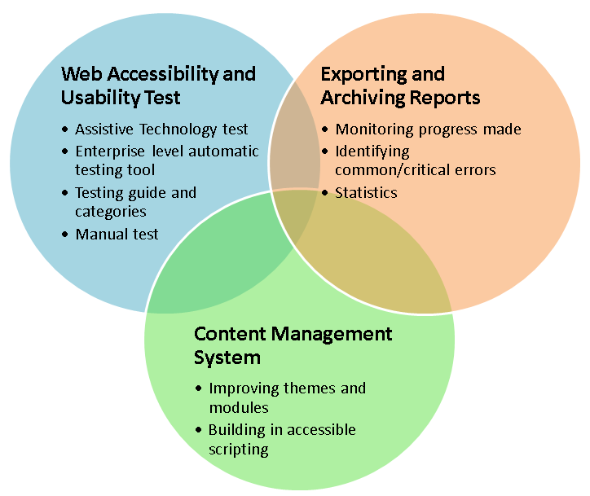
Monitoring Web Environment
Notes:
Three main components of monitoring web environments.
Web accessibility and Usability Testing
Exporting and archiving reports
Content management system and accessibility improvement

Slide 59



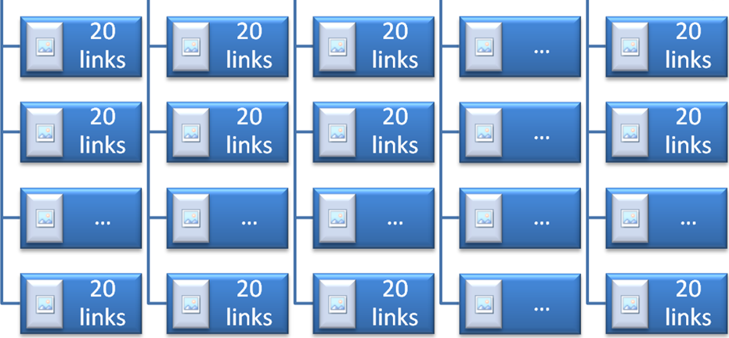
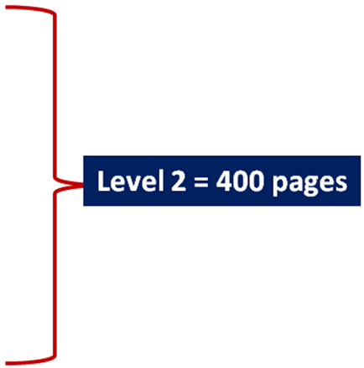
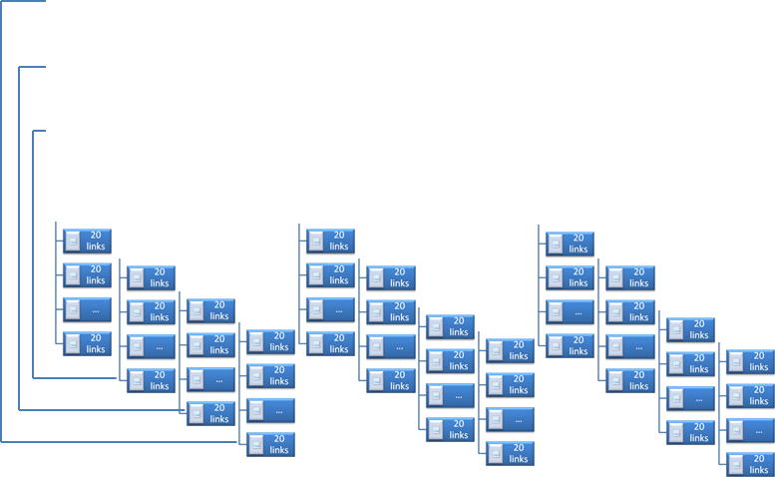
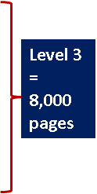
Enterprise Level Automatic Testing Tool

Slide 60
Procurement

Slide 61
Building an Accessible Procurement Process
Strong sustainable Executive Level support
Documented procurement procedures
Defined staffing roles and responsibilities
Equally Effective Alternate Access Planning
Training
Outreach
Notes:
What does it take to implement a procurement process that considers accessibility for each IT purchase or adoption?
The areas listed on the slide all play an important role in building that process.
A multi-year project, based on the Goals and Success indicators, where several stakeholders from multiple campuses came together to recommend a standardized process that each CSU campus could adapt or adapt to improve the business processes that support purchasing accessible products. In the next few slides we will look at the steps that the group identified, roles and responsibilities, and templates that can be used to implement the process.

Slide 62
Accessible Procurement Process Steps
Gather Information
Review Information
Review Product
Place Order
Notes:
View the CSU procurement process at: http://teachingcommons.cdl.edu/access/procurement_process/
Each step has a set of procedures, responsible parties, and templates.

Slide 63
Accessible Procurement Roles and Responsibilities
ATI Designee or Other Designee(s)
Purchase Requester
Administrative Support Staff
Buyer
Vendor
Information Technology Support Staff
Disability Services Staff
Executive Sponsor
Notes:
Shared responsibility

Slide 64
Step 1 – Gather Information
Responsible Person | Consultation | Input(s) | Output(s)
Purchase Requester | ATI Designee, IT Staff | Blank Pre-Purchase Information Form | Completed Pre-Purchase Information Form
Purchase Requester | ATI Designee, Vendor | VPAT request to Vendor | Completed VPAT(s)
Purchase Requester | ATI Designee | Completed Pre-Purchase Information Form and VPAT(s) | Submit documentation to ATI Designee

Slide 65
Step 2 - Review Information
Responsible Person | Consultation | Input(s) | Output(s)
ATI Designee | Purchase Requester | Completed Pre-Purchase Information Form and vendor VPAT | Accessibility documentation has been reviewed. Forms are incomplete - return to Purchase Requester; Forms are complete continue
ATI Designee | Purchase Requester, IT Staff | EIT Review Form Template | Initiated EIT Review Form including impact level and review type

Slide 66
Step 3 - Review Product
Responsible Person | Consultation | Input(s) | Output(s)
ATI Designee | Purchase Requester | Initiated EIT Review form; Complete accessibility documentation | Completed Accessibility Review
ATI Designee | Vendor | Request Accessibility Roadmap from Vendor | Completed Accessibility Roadmap
ATI Designee | Disability Services Office Staff, Purchase Requester, IT Staff | EEAAP Guidelines and Template | Completed EEAAP
ATI Designee | Purchase Requester | Completed EIT Review, Accessibility Roadmap, and EEAAP | Completed EIT Review Form including Review Summary and Recommendations

Slide 67
Step 4 - Place Order
Responsible Person | Consultation | Input(s) | Output(s)
Administrative Support staff | Purchase Requester | EIT Summary and Recommendations and purchase requisition form | Submit the purchase requisition with all documentation
Purchasing Department Buyer | ATI Designee, Purchase Requester | Completed Purchase Requisition with documentation; Buyer EIT Checklist | Completed Buyer EIT Checklist and order placed with Vendor
ATI Designee | Purchase Requester | Completed EIT Review, Accessibility Roadmap, and EEAAP | Completed EIT Review Form including Review Summary and Recommendations

Slide 68
Contract Language – General Provisions
Americans With Disabilities Act (ADA)
Contractor warrants that it complies with California and federal disabilities laws and regulations. (Americans with Disabilities Act of 1990,42 U.S.C. 12101 et seq). Contractor hereby warrants the products or services it will provide under this Contract comply with the accessibility requirements of Section 508 of the Rehabilitation Act of 1973, as amended (29 U.S.C. 794d), and its implementing regulations set forth at Title 36, Code of Federal Regulations, Part 1194. Contractor agrees to promptly respond to and resolve any complaint regarding accessibility of its products or services. Contractor further agrees to indemnify and hold harmless CSU from any claims arising out of Contractor’s failure to comply with the aforesaid requirements. Failure to comply with these requirements shall constitute a material breach of this Contract.
Notes:
This language is included in the General Provisions which should be included in the contract for IT purchases. The language was specified in our systemwide policy –executive order 926

Slide 69
Accessible Procurement Process: Next Steps
Proof-of-Concept implementation at California State University Fresno.
Implement the Accessible Procurement Process workflow in a computer module for our systemwide Common Financial System.

Slide 70
Captioning

Slide 71
Benefits of Captioning
People with hearing impairments
Noisy environment
Non-native language speakers
Dr. Who
Multi-modal learning
Searchable transcripts
Notes:
470 miles deep

Slide 72
What technically do we mean?
Transcript
Synchronize the transcript with the video

Slide 73
Transcript
This is an overview of NC State's Accessibility Website Scanning Service. My name is Greg Kraus, the IT Accessibility Coordinator. If you want to access the service, just go to the URL go.ncsu.edu/accessibility-scan. So what does this do? This service scans the publicly available websites on NC State's campus. It can't scan password protected sites and it doesn't do a very good job evaluating web applications. If you want to evaluate either of those types of items for accessibility there are other

Slide 74
Caption File
1
00:00:00,450 --> 00:00:04,700
Greg Kraus: This is an overview of NC State's
Accessibility Website Scanning Service. My
2
00:00:04,700 --> 00:00:09,820
name is Greg Kraus, the IT Accessibility Coordinator.
If you want to access the service, just go
3
00:00:09,820 --> 00:00:16,820
to the URL go.ncsu.edu/accessibility-scan.
So what does this do?

Slide 75
The Finished Product
https://www.youtube.com/watch?v=29kwPw0EO5I

Slide 76
But don’t forget…
…the accessible media player

Slide 77
Types of Content To Be Captioned
Screencasts
Movies
Recorded lectures
Classroom capture
Online synchronous meetings/classes
Notes:
http://accessibility.ncsu.edu/multimedia/

Slide 78
Costs
$2.00-$2.50/minute
$120-$150/hour
Classroom Capture: $8000/course
Live Online Class: $120/class session

Slide 79
Who Pays For It?
Creator of the video?
Department?
Disability Services?
Provost?
Different between course related content and non-course related content?

Slide 80
Do You Have To Caption Everything?

Slide 81
Models of Creating Captions
Create them yourself
Use in-house staff (students)
Use in-house staff (CART providers)
Outsource

Slide 82
Models for Funding
ADA Coordinator’s Office
College/Department
Distance Education
Grants
Notes:
http://accessibility.ncsu.edu/multimedia/

Slide 83
Supporting Faculty

Slide 84
Accessible:
Text documents
Slide presentations
PDF
Multi-media
Interactive materials
Web

Slide 85
Accessible Instructional Materials – Faculty
Multi-pronged problem that needs several solutions for different faculty audiences
  On-demand web tutorials and reference materials
    Young faculty who already know how to use technology
  Face-to-Face trainings
    Interested faculty who need extra help using technology in general
  Full-service document remediation and conversion
    Especially older faculty

Slide 86

A Campus Solution - offering an array of services
Accessible Instructional Materials Center
California State University, Long Beach
Notes:
http://www.csulb.edu/divisions/students/aim/
The AIM center brings together Accessible Instructional Materials services for faculty – offering self-paced tutorials, small group trainings, and full conversion services. Faculty may send materials for conversion or drop in for training. The center has been open for about 1 year and has been slowly building capacity. The Provost includes information about the AIM center in a monthly communication to faculty. The center also conducts tours for campus executives and academic departments.
The AIM Center does all alternate media conversion including all the e-reserves for the library each semester. They also provide work stations and a study area for students with disabilities.

Slide 87

Instructional Materials:
Proper structure saves time and money
Notes:
Graphic from: http://www.suitqaisdiaries.com/wp-content/uploads/2013/08/keep-calm-and-save-money-39.png

Slide 88
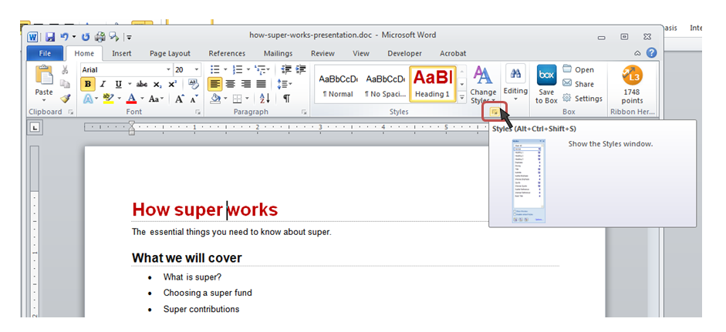
Use Styles and Formatting

Slide 89
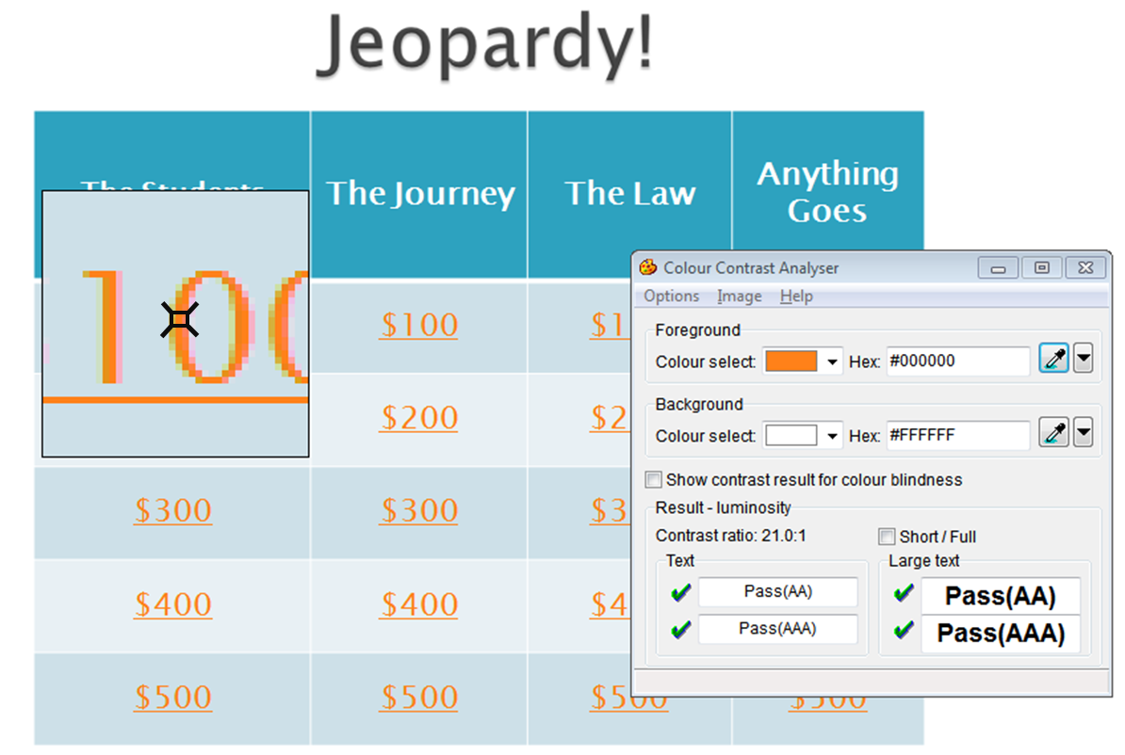
Color Contrast

Slide 90
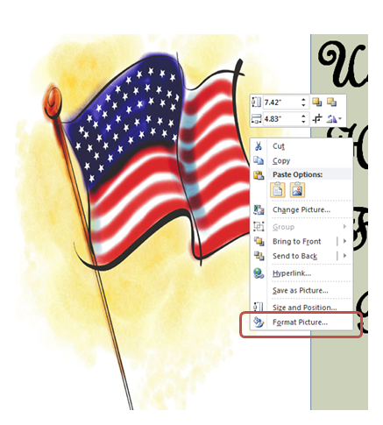
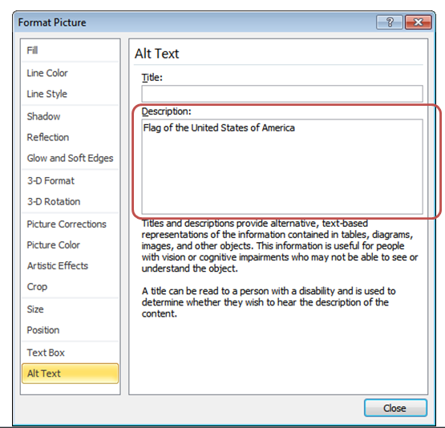
Images

Slide 91
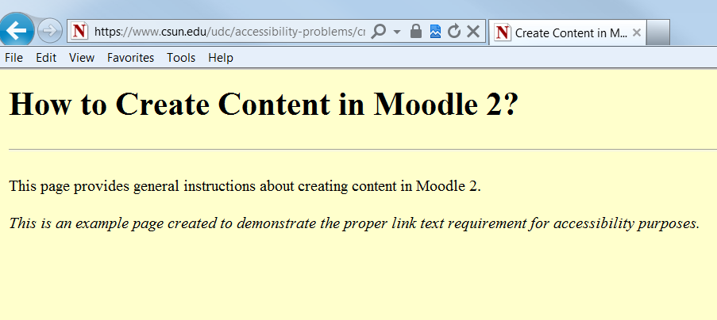
Well Labeled Links
Incorrect:
Faculty can preview and create course content for summer and fall courses. info
Correct:
Faculty can preview and create course content for summer and fall courses by reading more information about Creating Content in Moodle 2.
Notes:
"Auditory users" -- people who are blind, have difficulty seeing, or who are using devices with small or no displays -- are unable to scan the page quickly with their eyes. To get an overview of a page or to quickly find a link, these users will often tab from one link to the next or review a list of available links on a page.
Therefore, include introductory information in the first link, then distinguishing information in the links that follow.
This will provide context information for users reading them in sequence.

Slide 92
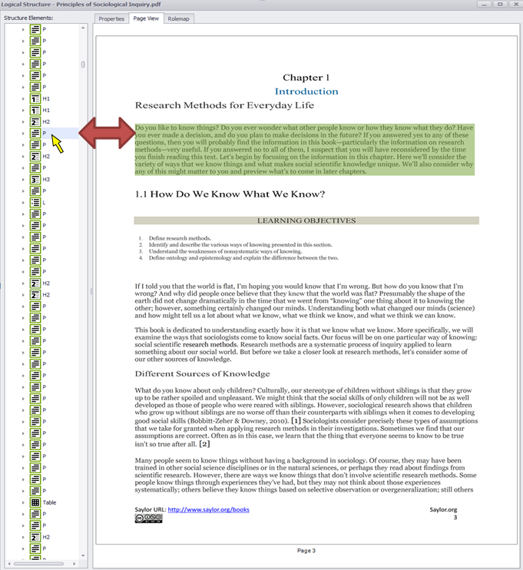
PDF
Reading order
Alternative Text
Structured Tables
Color Contrast
Labeled form elements

Slide 93
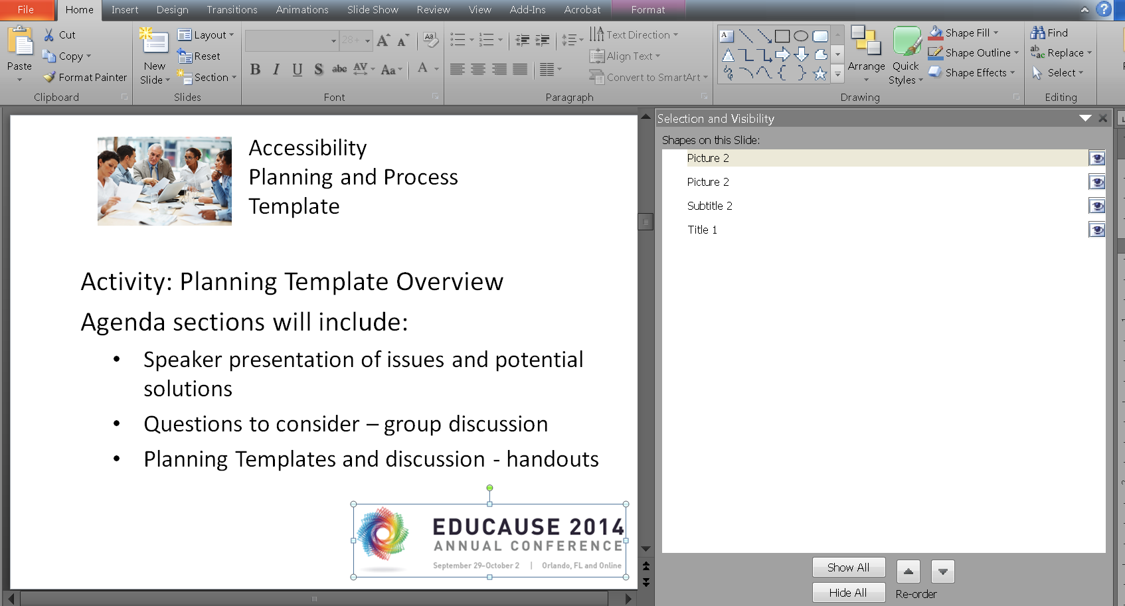
Power Point Reading Order

Slide 94
Wrap Up

