Slide 1
Application Sprawl is Sucking the Wind Out of Your Sails
David Koehler
Bob Carozzoni
Cornell University

Slide 2
Copyright
This presentation leaves copyright of the content to the presenter. Unless otherwise noted in the materials, uploaded content carries the Creative Commons Attribution-NonCommercial-ShareAlike license, which grants usage to the general public with the stipulated criteria.

Slide 3

Cornell Facts
Founded in 1865 by Ezra Cornell
Located in Ithaca, New York
Member of the Ivy League
Land Grant Institution of New York State
19,000 Students in 7 UG and 4 Grad Colleges

Slide 4

Cornell Challenges
Great Recession of 2008-2009 Brought Big Budget Reductions
Bain Consulting Recommended Reductions in Spending on Applications
Estimated $28M Run Rate Needed to Be Reduced by $6M
Lead to Application Streamlining Initiative in 2011

Slide 5

Discussion Questions
How many attendees have measured the value
of their application portfolio?
How many are considering it?

Slide 6
Application Streamlining at Cornell
http://www.cio.cornell.edu/planning-governance/it-projects/administrative-streamlining-initiatives/application-streamlining-asi

Slide 7

Application Streamlining Goals
Application Streamlining allows the synchronization of IT priorities with business priorities.
Applications will be managed as key assets of the institution.
Total cost of ownership of Cornell application portfolio will be reduced

Slide 8
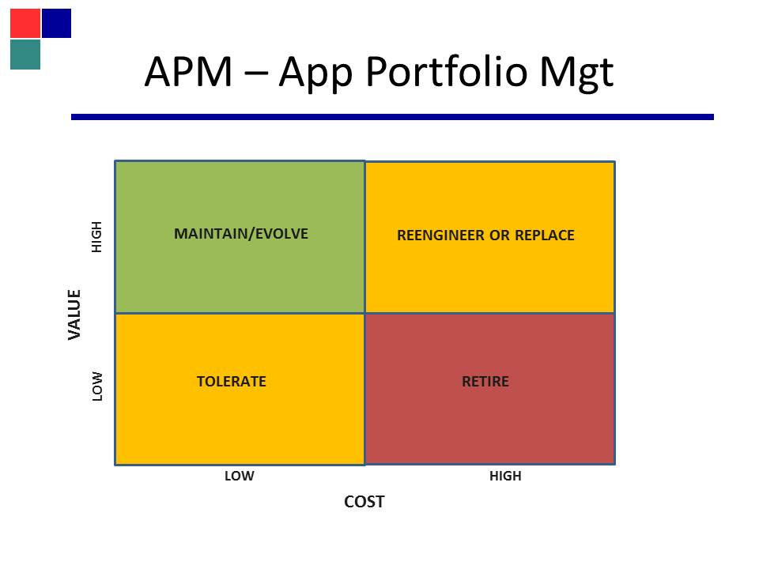
Functional Purpose
1

Slide 9

Application Streamlining
Phase I – Unit Inventory and Recommendations
Phase II – Consolidation
Phase III – Alternate Sourcing (Cloud)

Slide 10
Phase I Pilot
Staff from Administrative Unit (3), Academic Unit (2) and Central IT (4)
Needed to Develop Methodology
Compute Total Cost
Calculate Business Value
Normalize (0-100)
Develop Reports
What’s an Application?
Completed in Four Months

Slide 11
Phase I Pilot
Calculation of Business Value
Converting Qualitative to Quantitative
Uniqueness, Risk, Campus Impact, Utility,
Data of Record, Strategic Importance
Forced Choice Methodology
Captured in Spreadsheet

Slide 12
Uniqueness: Is there another known application that could be used in place of this application? | There is no known commercial or internal to Cornell application that provides similar functionality (i.e. totally unique in function) | 10
 | There is no known internal to Cornell application that provides similar functionality (commercial may) | 10
 | There is an internal to Cornell application that would meet business needs with modifications | 5
 | There is an internal to Cornell application that would meet business need with business process modifications | 3
 | There are other internal to Cornell applications that would meet business needs as delivered. | 0
Risk: Is this application necessary to meet regulatory requirements or minimize institutional risk? | Application mitigates major legal/security/liability issues | 20
 | Application mitigates policy issues | 15
 | Application mitigates business process risk | 10
 | Application designed to prevent human errors | 5
 | Application does not address regulatory requirements or institutional risk | 0
Campus Impact: How much do other systems or business functions depend upon data that is created by this application? | Required to provide data to enterprise-level business functions | 15
 | Required to provide data to unit-level business functions | 10
 | Required to provide data to other department-level business functions | 5
 | Does not provide data to other systems or business functions | 0
Data of Record: Does this application capture or support University Data of Record? | Application IS the data of record for a given entity | 15
 | Application EXTENDS the Data of Record (i.e. IS the Data or Record for a small # of fields) | 10
 | Application SHOWS the data of record | 5
 | Application captures or modifies but does NOT feed back the data of record | 0
Utility | The application automates a business process that is Complex _(7)___ Moderate _(4)__ Simple _(0)___ | 0
 | The application meets business requirements Fully _(6)___ Partially _(3)___ Barely or not at all _(0)___ | 0
 | Ease of use: High _(7)___ Med _(3)___ Low _(0)____ | 0
 | Total Utility Score | 0
Strategy: Does this application support the goals and mission of your unit, department, or individuals within. | Application directly supports the academic mission of an academic unit | 20
 | Application directly supports the strategic goal of an administrative unit | 20
 | Application directly supports departmental goal | 10
 | Application directly supports faculty/staff goal | 5

Slide 13
Business Value Spreadsheet
Risk: Is this application necessary to meet regulatory requirements or minimize institutional risk? | Application mitigates major legal/security/liability issues | 20
 | Application mitigates policy issues | 15
 | Application mitigates business process risk | 10
 | Application designed to prevent human errors | 5
 | Application does not address regulatory requirements or institutional risk | 0

Slide 14
Discussion Question
Would a Pilot Project Be Valuable at Your Institution?

Slide 15
Phase I Campus Rollout
Determined Sponsors and Technical Leaders
Business Analysts to Interview Business Users
Technology Managers Determined Cost Spreadsheets
Used Seasoned Project Manager to Drive Process
Completed 28 Units in 6 Months

Slide 16
ASI Unit Process
1. Identity Sponsor, IT Lead and Business Analyst
for Unit Team
2. Unit Team begin meetings with ASI Core Team
3A. IT Lead Begins Application Inventory
3b. Sponsor, sends kickoff email to business owners
4a. Business Owners for each app identified
and contacted
4b. BA conducts business owner interviews
5a. Cost data gathered and entered
5b. Business Value data gathered and entered
6. Data Analysis
7. Report and Recommendations issued

Slide 17
Statistics from Phase I
Consolidated Numbers
Units = 28
Applications in inventory = 1159
Applications Scored = 702 (61% of inventory)
Applications Not Scored (below threshold) = 373 (32%)
Applications Unscored (no score reported) = 84 (7%)
Consolidated Averages
BV Score = 69.8
Cost Score = 22.0
BV/Cost Ratio = 3.5

Slide 18
Ratio Chart Sample (CALS)

Slide 19
Functional Purpose
1

Slide 20

Phase I – Success
Complete Application Inventory
Sponsors understood value proposition
Unit Action Plans Created
Some units discontinued applications
Some units upgraded technology
Unintended Benefit
Sharing of applications across colleges

Slide 21
Discussion Question
Would your Senior Finance Staff Find This Effort Valuable?
Would the Reports be Useful?
Questions from the Floor?

Slide 22
Phase II – Application Consolidation
Search Inventories by Functional Purpose
Survey Participants
Likely Matches
Value of Consolidation
Score Candidates
Cost Savings
Motivated Units
Alignment with IT Strategic Plan
Alignment with Business Strategy

Slide 23
Consolidation Framework
Short Title | Initial Thinking | HIGH COST SAVINGS | Motivated Units with the capacity to engage | Consideration of existing IT strategy ("Fluffy Test") eg. SOA | Consideration of existing/desired business strategy | Total | Status
Document Management | Sorely needed. Big bang for big buck. Lots of energy around campus for this | 5.47 | 5.67 | 7.22 | 7.83 | 26.19 | Discovery ongoing
Archival Solutions (for historical data) | Possible Candidate, probably not low hanging fruit, but should be evaluated as possible. | 4.00 | 4.56 | 5.69 | 6.69 | 20.94 | Discovery pending completion of Doc Mgmt
Project Management | Effort tracking, Task Management, simple WBS, capture of effort against work (Simple is good) | 3.78 | 4.11 | 5.94 | 6.11 | 19.94 | Unanet, MS Project Server
Lab Management Tools | Lots of them, with lots of overlap. | 3.00 | 4.40 | 5.80 | 6.67 | 19.87 | Clare van den Blink leading group
CRM System/Event Management (ILR willing to share theirs)/Membership Management/Dues Collection | CRM/Membership Management/Event Management seem similar. Consider collapsing. | 2.06 | 3.82 | 4.47 | 5.59 | 15.94 | Discovery scheduled
Access Control Tools/Key Access | Should consolidate on a COTS version (Weill) | 2.00 | 2.71 | 5.21 | 5.21 | 15.14 | Weill hall solution
Survey Tools | We already feel like we have an offering, need to come up with a way to get folks to consider turning off their versions/methods | 2.27 | 2.67 | 4.87 | 5.20 | 15.00 | Qualtrics, SRI
ELM (Electronic Learning Management) | Good candidate. Could easily show savings. | 1.69 | 2.41 | 4.18 | 5.18 | 13.45 | Discovery ongoing; led by HR with PPM involvement

Slide 24
Recommended Consolidation Projects
Document Management
Archival Storage
Customer Relationship Management (CRM)

Slide 25
Additional Recommendations
Survey Tools
Learning Management
Project Management
Lab Management
Access Control

Slide 26
ASI Critical Success Factors
Enlist the Support of Business Unit Leaders
Engage Business Analysts for Interviews
Use Peer Pressure to Get Units to Finish

Slide 27
Discussion Question
Would You Be Able to Enlist Sponsors from Each of Your Major Units?

Slide 28
ASI Phase III - Outsourcing
Team Formed
  CALS
  Facilities
Pilot Project Planning
  Methodology for Success
  Sample Projects for Cloud-Sourcing
  Sample Projects for Component Deployment

Slide 29
Examine Application. Use expert judgment on the likely entry location into the flowchart below
Chosen Application
Work with CIT Cloud Unit
Y
SaaS?
N
Y
PaaS?
N
Y
IaaS?
N
Y
Functional Decomposition
Composite App?
N
Develop Framework
No Change
Find/Create Components
Assemble Application

Slide 30
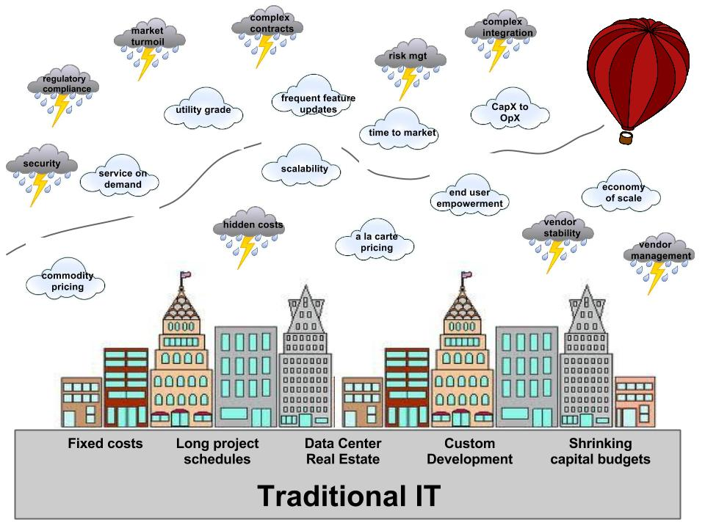
Cornell Cloud Advisory Service
“Charting a course for silver linings!”
Notes:
A competency center for cloud computing, offered as a free service to those on campus doing cloud computing.

Slide 31
Extend cloud competence beyond IT
Audit
Procurement
Legal
Security
Policy
Accessibility
Compliance
Risk management
Notes:
Consumer Culture: Cloud gives end-users more opportunity to work directly with commercial service providers bypassing central IT and it's mature processes for managing risk (audit, procurement, legal, security, policy, DR, accessibility, compliance) . The result could be increased risk and over consumption of services (resulting in an increase in the institution's total IT spending)

Slide 32
Join me tomorrow…
Wednesday, October 1, 2014 2:40pm-3:30pm
Meeting Room W305A/B
Cloud, crowd, and outsourcing will eat your lunch—unless you adapt.
Learn how IT leaders can embrace the inevitable dominance of cloud (and other forms of outsourcing) and survive to become an engine of IT transformation and business value.

Slide 33
Help Us Improve and Grow
Thank you for participating
in today’s session.
We’re very interested in your feedback. Please take
a minute to fill out the session evaluation found within
the conference mobile app, or the online agenda.

