Slide 1
The Evidence toward Impact:
The Maricopa Millions OER Project
Dr. Lisa Young
Scottsdale CC
Paul Golisch
Paradise Valley CC
Phoenix, AZ
PollEv.com/pvcc
Notes:
Professor Golisch goes to visit Dr. Young.

Slide 2
Many students do not
buy textbooks
Photo by Jupiterimages - Getty Royalty-Free License http://www.gettyimages.com/Corporate/LicenseAgreements.aspx
Created with Haiku Deck
Notes:
Prof. Golisch: Dr. Young, many of my students are not buying the textbook for my class. I read an article in U.S. News and World Report that said this is a problem at many colleges and universities.

Slide 3
http://www.usnews.com/news/articles/2014/01/28/report-high-textbook-prices-have-college-students-struggling
Notes:
Prof. Golisch: Here is an excerpt from the article. I didn’t realize how much of an issue this has become. Do you know how much students pay for textbooks annually?

Slide 4
Notes:
On average, how much money do full-time college students spend on textbooks each year? https://www.polleverywhere.com/multiple_choice_polls/vANaS6gdXdWcDoA#!/my/polls

Slide 5
Maricopa Community Colleges
Notes:
Prof. Golisch: Wow … textbooks cost almost half as much as the tuition? What can we do to help the students afford their college education?

Slide 6
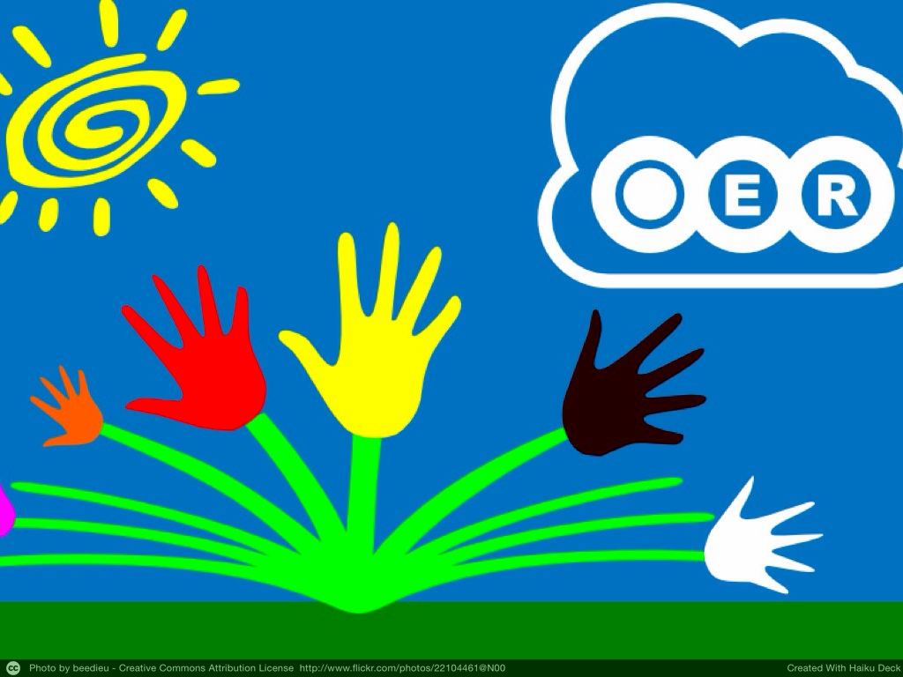
Notes:
Dr. Young: Open Educational Resources
Prof. Golisch: Open what?

Slide 7
Notes:
Which of the following best describes your experience in regard to Open Educational Resources (OER)? https://www.polleverywhere.com/multiple_choice_polls/51cEKanfbiSyPrG#!/my/polls

Slide 8
Notes:
Prof. Golisch: Looks expensive. Isn’t that why publishers pay textbook authors so much?

Slide 9
Notes:
What % of publisher textbook costs goes to the author? https://www.polleverywhere.com/multiple_choice_polls/9WnswGDwHtl4gpD#!/my/polls

Slide 10
http://www.sdsubookstore.com/Bookstore/Textbooks/PricingPolicy/WheretheNewTextbookDollarGoes/tabid/143/Default.aspx
Notes:
Prof. Golisch: You still need funding to produce these Open Educational …

Slide 11
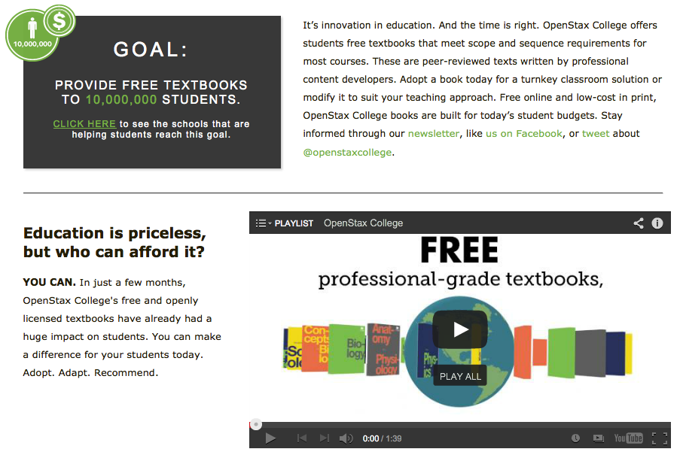
OER Example: OpenStax College
openstaxcollege.org
Notes:
Prof. Golisch: Textbooks are great, but what about faculty resources, exam banks, and online assessments?

Slide 12
OER Example: MyOpenMath
myopenmath.com
Notes:
Prof. Golisch: This looks similar to MyMathLab and WebAssign. Is anyone using this MyOpenMath program?

Slide 13
Notes:
How much money did Scottsdale Community College math students save in one year due to OER usage? https://www.polleverywhere.com/multiple_choice_polls/jswj5x9TrS4Zzsm

Slide 14
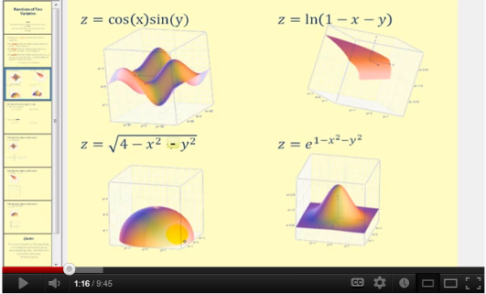
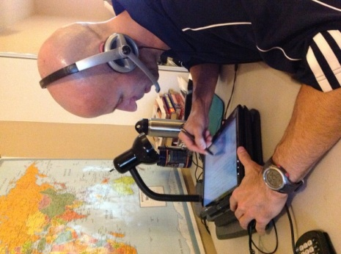
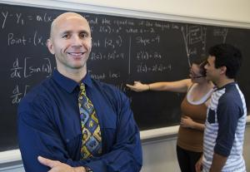
3600+ Math Videos Covering Arithmetic Through Calculus and Beyond
30,000+ subscribers
15.5 million total views
Prof. James Sousa
Notes:
This James Sousa is impressive, but how many other people are that dedicated to the OER cause?

Slide 15
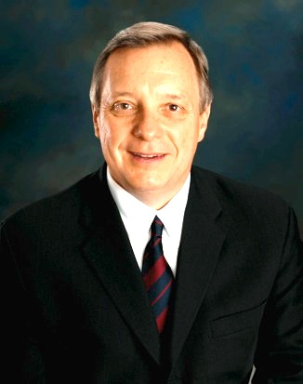
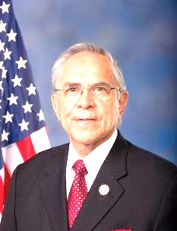
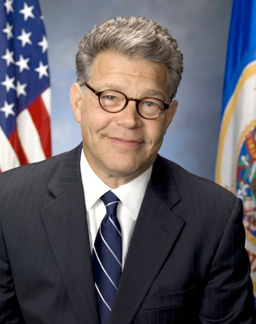
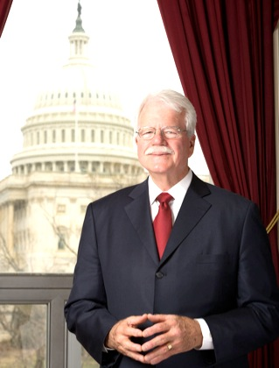
The Affordable College Textbook Act
S. 1704 (Durbin-Franken)
H.R. 3538 (Hinojosa-Miller)
Creates a grant program to support pilot programs at colleges and universities
Ensures that materials created will be freely and easily accessible to the public
Requires entities who receive funds to complete a report on the program effectiveness
Requires the Government Accountability Office to provide an updated report on the price trends of college textbooks
Sen. Dick Durbin (IL)
Rep. Rubén Hinojosa (TX)
You can go to www.sparc.arl.org to help support it
Sen. Al Franken (MN)
http://www.ecs.org/clearinghouse/01/14/37/11437.pdf
Rep. George Miller (CA)
Notes:
Prof. Golisch: All of this is nice, but how does it apply to me. I don’t want to teach with some turnkey course from some grant funded professor I don’t even know. What about Academic Freedom?

Slide 16
The 4 Rs of OER
Revise
Reuse
Remix
The 5th R
Retain
Retain – the right to make, own, and control copies of the content
Redistribute
Notes:
Prof. Golisch: Sounds like a lot of work. Is anyone (besides Scottsdale’s math department) actually doing this?

Slide 17
The National OER Scene
Members in CCCOER
Some Notable OER Projects
Senators and Congressmen sponsoring the Affordable College Textbook Act
Notes:
Prof. Golisch: Hey, I see a star in Arizona. Do we have a notable OER project? How did that get started?

Slide 18
Math
Scottsdale CC
Phoenix College
Paradise Valley CC
English
Psychology
Geography
Notes:
Prof. Golisch: That’s great, but what has the impact been in the Maricopa Community College District?

Slide 19
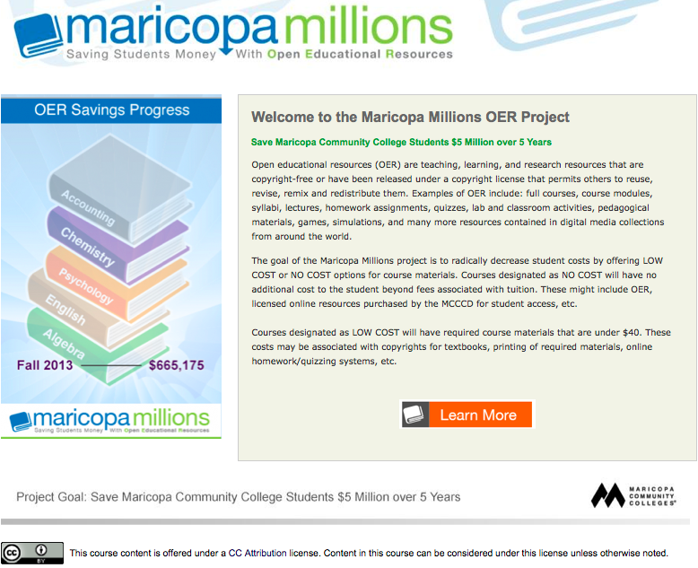
Spring 2014 ----------------- $1,483,175
($818,000)
Notes:
Prof. Golisch: Almost 1.5 million in one year. You may have to update that project goal. How are you calculating these savings?

Slide 20
20 students per class
$100 per student
Notes:
Prof. Golisch: So, tell me more about this project you are working on?

Slide 21
Library Faculty
Notes:
Prof. Golisch: A committee and a strategic plan … great, but how is this plan being put into action?

Slide 22
Photo by JD Hancock - Creative Commons Attribution License https://www.flickr.com/photos/83346641@N00
Created with Haiku Deck
Notes:
Prof. Golisch: Is this project really worth it? Have projects at other colleges resulted in some serious savings for students?

Slide 23
Notes:
Approximately how much money has been saved worldwide through the adoption of OER in higher education? https://www.polleverywhere.com/multiple_choice_polls/r3TxrhuDvaUP6jP

Slide 24
Photo by Gideon Burton - Creative Commons Attribution-ShareAlike License https://www.flickr.com/photos/33895652@N04
Created with Haiku Deck

Slide 25
MOOCs vs. OERs
MOOC – Massive Open Online Course | OER – Open Educational Resources
Free tuition | Same tuition as other courses at the college
Textbook may or may not be free | Textbook is free or very inexpensive
Huge enrollment (thousands) | Same enrollment limit as other courses at the college
Online | Online, Hybrid, Face to Face
Very little faculty/student interaction (Groundskeeper) | Significant faculty/student interaction (Coach)
Less than 10% complete with passing grade. | Similar success rates as comparable non-OER courses.
Notes:
Prof. Golisch: That MOOC success rate looks pretty bad. I guess that’s what our colleague meant when she tweeted “MOOC is the bling. OER is the thing.” What are the students saying about OER?

Slide 26
Impact on Deciding in Which Course to Enroll
Student Comment -
Notes:
Prof. Golisch: It sounds like the students in these classes appreciate the OER materials and saving some money. However, that is just one class. Have larger groups been surveyed?

Slide 27
Scottsdale Community College
Survey of Math Students - Fall 2012
score.scottsdalecc.edu
sccmath.wordpress.com
Only 6.3% would not recommend the open materials to their classmates
Notes:
Prof. Golisch: That data looks pretty good, but I’d like to hear some quotes directly from the students.

Slide 28
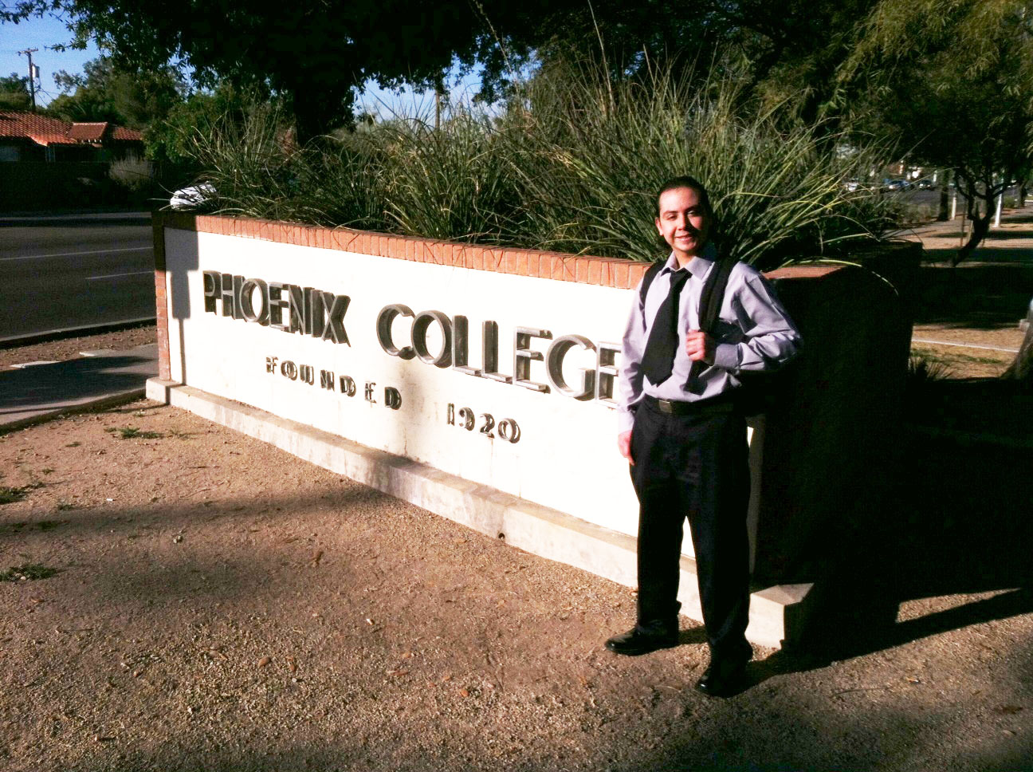
Manuel Ordoñez
Major: Business
“Open Educational Resources allow everyone
in class to have all the materials on day one.”
Notes:
Prof. Golisch: Having the materials on the first day is very important. Any other thoughts from students?

Slide 29
Student OER Interviews
Notes:
Prof. Golisch: So how do the students find these OER courses so they can enroll?

Slide 30
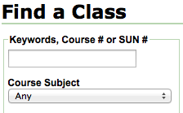
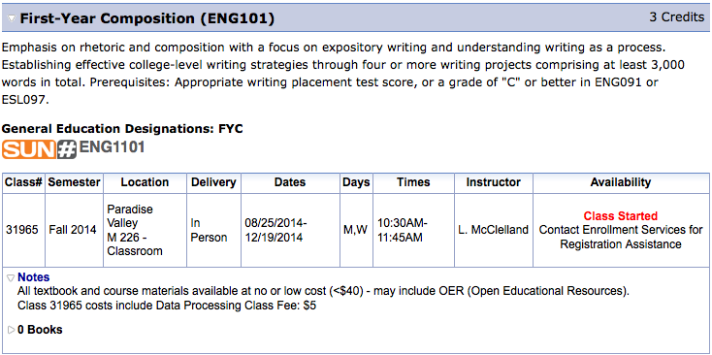
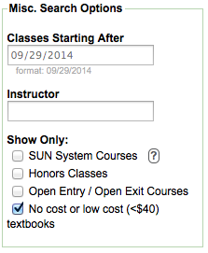
classes.sis.maricopa.edu
Notes:
Prof. Golisch: Wow, that’s great. Is there an OER option for all of the high enrollment courses in Maricopa?

Slide 31
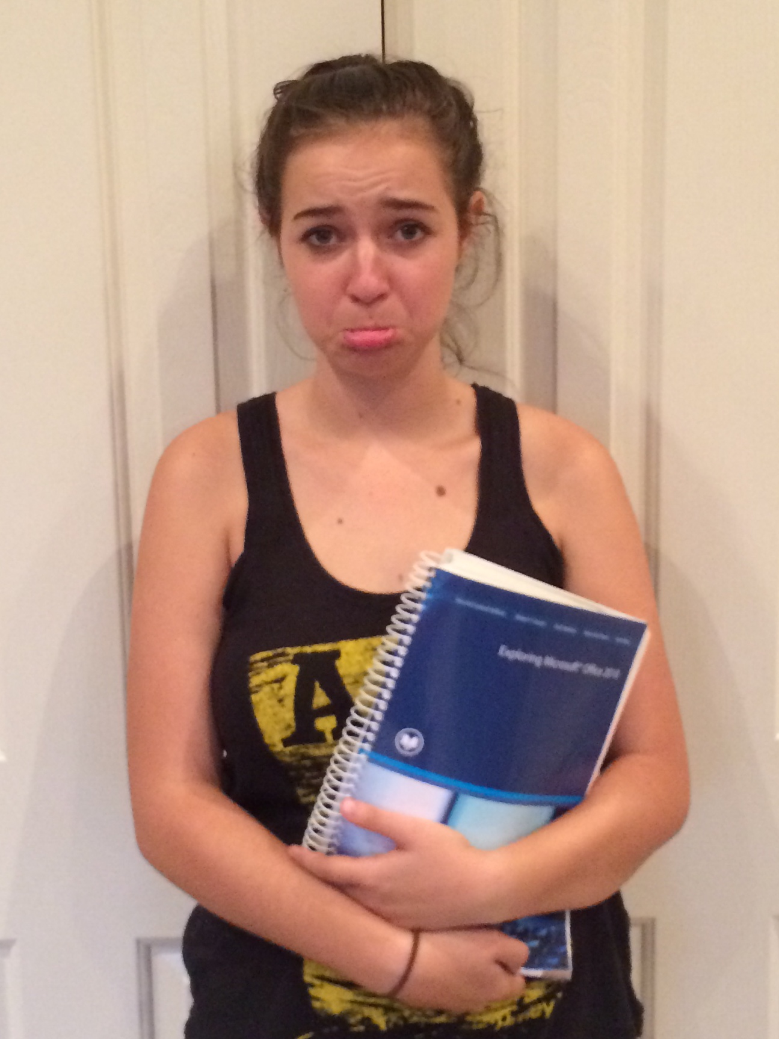
Aren’t you leading
a project to
increase the use of free textbooks?
Why was my book so expensive?
Dad?
$185
Update: The price of CIS 105 textbooks in MCCCD has dropped significantly since Paul’s daughter took this class last year.
Notes:
Prof. Golisch: So, if OER materials can be just as effective as publisher materials, why don’t more people use them?

Slide 32
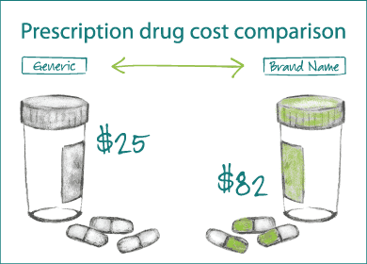
OER vs. Publisher Materials Analogy
http://sexualhealthblog.wordpress.com/2013/01/31/generic-drugs-vs-branded-one/comment-page-1/
Notes:
Prof. Golisch: I’d like to know a little more about OER and how I can get started. Where should I start?

Slide 33
Questions??

