Slide 1
Campus Experience with Internet2 NET+ Cloud Service for Data Storage and Collaboration (Box)
Bob Flynn, Indiana University
Nichole Kosier, University of California, Merced
Laurie H. Sherrod, Clemson University
Candie Halstead, California State University, San Marcos
MaryBeth Stuenkel, University of Michigan-Ann Arbor

Slide 2

Photo by jackharrybill - Creative Commons Attribution-NonCommercial-ShareAlike License http://www.flickr.com/photos/67603778@N00
Created with Haiku Deck

Slide 3

Photo by Noah J Katz - Creative Commons Attribution-NonCommercial-ShareAlike License http://www.flickr.com/photos/41502943@N03
Created with Haiku Deck

Slide 4

Indiana University
8 Campuses, 115K students, 20K faculty/staff
2nd Largest Med School in US
Box @ IU
April 2012 Rollout
Box HED Advisory Board
75,000+ users
70TB stored
Bob Flynn
Manager, IT Community Partnerships
Box Service Owner

Slide 5
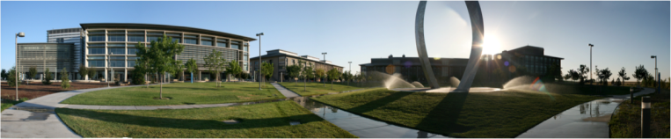
UC Merced – Opened in 2005
    Public Research University/ Newest campus in UC system
    Students: 6268 Faculty: 400 Staff: 900
Box at UC Merced – Since Nov. 2013
    70% of clients use Box (5258)
  Nichole Kosier
    Box Service Manager/Implementation Project Manager
it.ucmerced.edu/BoxService

Slide 6





Clemson Box
9,412 of 25,000 seats
  20,000 students
  5,000 faculty/staff
Two years (one year pilot)
Support Page:
http://tinyurl.com/clemsonbox
Homegrown tool to provision class/group folders
Laurie Holleman Sherrod
BA/MAT Clemson/Citadel
Student Training Coordinator
Box Admin, Support, Training
Notes:
Editorial Guidelines on Bullets:
1. Vertical lists are best introduced by a grammatically complete sentence followed by a colon. No periods
are required at the end of entries unless at least one entry is a complete sentence, in which case a period
is necessary at the end of each entry.
Example: A university can be judged by three measures:
· The quality of its students
· The quality of it faculty
· The quality of its infrastructure
2. If a list completes the sentence that introduces it, items begin with lowercase letters, commas or semicolons
(if individual items contain commas) are used to separate each item, and the last item ends with a period.
Note that the introductory clause does not end with a colon.
Example: A university can be judged by
· the quality of its students,
· the quality of its faculty,
· the quality of its infrastructure.
3. Avoid mixing sentence and nonsentence items in a bulleted list.
6

Slide 7

“CSUSM”
Founded in 1989
Located in North San Diego County
13,000 Students; 1,450 Faculty and Staff
Began Box Implementation in 2013
1,260 Migrated Box Accounts
Candie Halstead
Coordinator, User Support Services
Inherited Project Management of Box 6 Months into Implementation

Slide 8

University of Michigan
University of Michigan
  Research university, founded in 1817 as
  the Catholepistemiad, or University of Michigania
  Ann Arbor campus
  19 schools and colleges
  43,710 students
  6,768 faculty
  13,715 staff
  Total research expenditures exceed $1.3 billion / year
  Flint and Dearborn campuses
Box at Michigan
  Using Box since early 2012
  ~47,000 Box accounts; 66 TB + data stored
  box.it.umich.edu/info
MaryBeth Stuenkel
  IT Program Manager
  M+Box Service Owner
Notes:
“Catholepistemiad,” an academy of universal knowledge

Slide 9

Photo by Todd Ryburn - Creative Commons Attribution License http://www.flickr.com/photos/38882101@N03
Created with Haiku Deck
Notes:
Bob - getting ready to pre-provision to everyone; lots of email aliases
MB - does auto-deprovisioning

Slide 10

Photo by kennymatic - Creative Commons Attribution License http://www.flickr.com/photos/99472898@N00
Created with Haiku Deck
Notes:
MB - ticket metrics
Candie - transitioning new users/how much one-on-one help was needed
Nicole - departmental training and outreach, average .25 FTE (for 5000+ users)

Slide 11
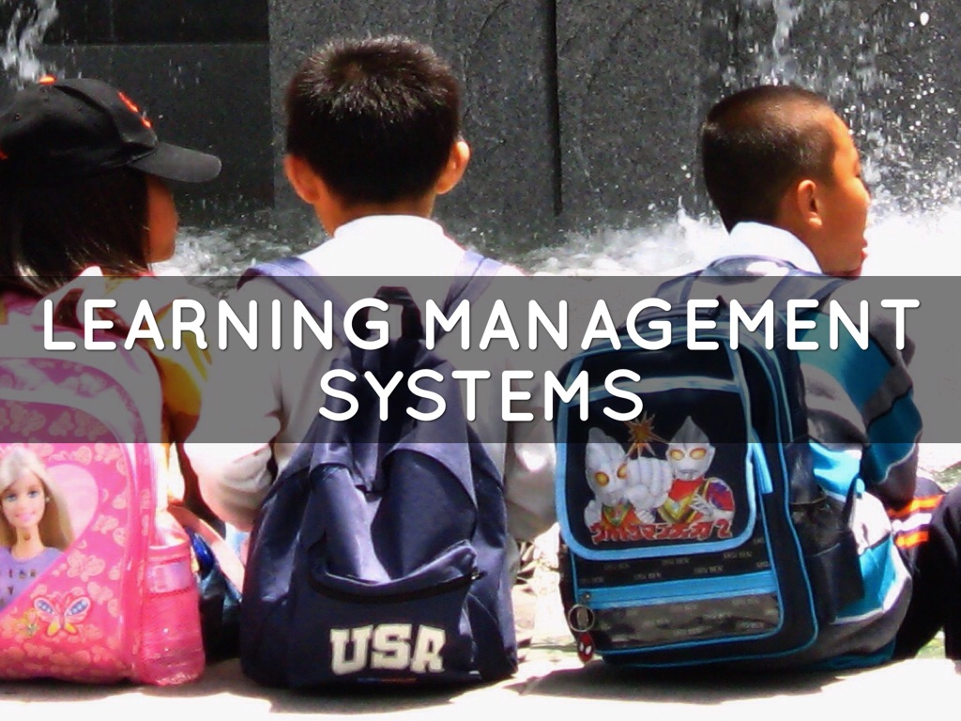
Photo by ewar woowar - Creative Commons Attribution-NonCommercial-ShareAlike License http://www.flickr.com/photos/84004549@N00
Created with Haiku Deck
Notes:
Bob - working with Canvas
Laurie - using Blackboard - professors have option of Box folder for each class

Slide 12

Photo by y3rdua - Creative Commons Attribution-NonCommercial-ShareAlike License http://www.flickr.com/photos/36189452@N00
Created with Haiku Deck
Notes:
MB - just signed BAA, communicating with campus

Slide 13

Photo by pennuja - Creative Commons Attribution License http://www.flickr.com/photos/22749993@N08
Created with Haiku Deck

Slide 14
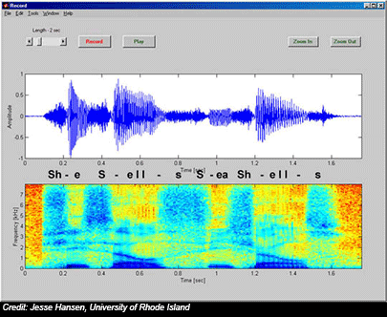

The world in your classroom
Features
External collaborators
Owner’s enterprise rules and quota
Single-sourcing content
Internal collaborators
Audio preview for training and testing
New life for old media
Features
Preview-only permission
Video preview
Access audit

Slide 15
Box Use Cases
Departmental storage migrated from local server
Purchasing approval process workflow

Slide 16


Clemson Use Cases
Security Camera
Printing Services
Notes:
Editorial Guidelines on Bullets:
1. Vertical lists are best introduced by a grammatically complete sentence followed by a colon. No periods
are required at the end of entries unless at least one entry is a complete sentence, in which case a period
is necessary at the end of each entry.
Example: A university can be judged by three measures:
· The quality of its students
· The quality of it faculty
· The quality of its infrastructure
2. If a list completes the sentence that introduces it, items begin with lowercase letters, commas or semicolons
(if individual items contain commas) are used to separate each item, and the last item ends with a period.
Note that the introductory clause does not end with a colon.
Example: A university can be judged by
· the quality of its students,
· the quality of its faculty,
· the quality of its infrastructure.
3. Avoid mixing sentence and nonsentence items in a bulleted list.
16

Slide 17
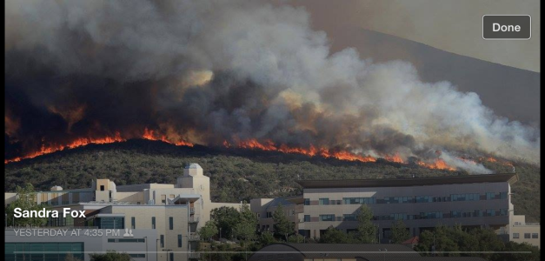
USE CASES
HR Conducts faculty searches via Box. Files are shared between HR and the hiring department and committee members.
Biology faculty member is in the Brazilian Rainforest gathering final data for a new textbook. He and his publisher collaborate via Box.
CSUSM
May 2014

Slide 18


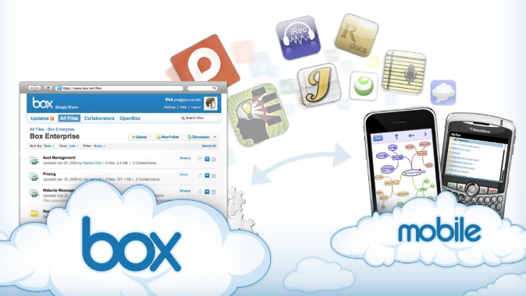

University of Michigan
Class Role Playing
Students record video with smart phones, upload to M+Box
Files shared with instructor and classmates
Resume Books
Book of student resumes created as PDF with hyperlinked index
Open web access makes books available immediately on request
Eliminate cost of printing and distribution
Features
Large files and quota for video
Upload from mobile device
Collaboration between students and instructor and each other
Features
Large file size
Immediate availability from anywhere
File access stats provide analytics
student

Slide 19

Photo by Frosted Peppercorn - Creative Commons Attribution-NonCommercial-ShareAlike License http://www.flickr.com/photos/93472573@N00
Created with Haiku Deck
Notes:
MB - service accounts from day one
Bob - folders and relationships
Candie - don't change the project manager in the middle of the project

Slide 20

Photo by Domiriel - Creative Commons Attribution-NonCommercial License http://www.flickr.com/photos/17274350@N00
Created with Haiku Deck
Notes:
Bob - Great relationship with I2 and Box

Slide 21

Photo by an untrained eye - Creative Commons Attribution-NonCommercial License http://www.flickr.com/photos/26312642@N00
Created with Haiku Deck

Slide 22
Box Use Cases
Departmental storage migrated from local server
Purchasing approval process workflow
Lectures available for students via LMS Sakai
Service Learning Projects

Slide 23

Clemson Use Cases
Security Camera
Basketball
Notes:
Editorial Guidelines on Bullets:
1. Vertical lists are best introduced by a grammatically complete sentence followed by a colon. No periods
are required at the end of entries unless at least one entry is a complete sentence, in which case a period
is necessary at the end of each entry.
Example: A university can be judged by three measures:
· The quality of its students
· The quality of it faculty
· The quality of its infrastructure
2. If a list completes the sentence that introduces it, items begin with lowercase letters, commas or semicolons
(if individual items contain commas) are used to separate each item, and the last item ends with a period.
Note that the introductory clause does not end with a colon.
Example: A university can be judged by
· the quality of its students,
· the quality of its faculty,
· the quality of its infrastructure.
3. Avoid mixing sentence and nonsentence items in a bulleted list.
23

Slide 24

Clemson Use Cases
Printing Services
Blackboard Overflow

Slide 25


University of Michigan
Contest Submissions
Files uploaded to M+Box from anyone, anywhere
Committee of people at U-M and outside reviews files
Staff track review process
Team Projects
Students create folder for classwork, shared with instructor
Instructor creates folders for teamwork, assigns students as
collaborators
Instructors and students collaborate and comment on files
Features
Large files and quota
Receive and share files outside of U-M
File access stats enables tracking progress
Features
Large files and quota
Flexible collaboration
Commenting allows discussion of classwork
Access anywhere

Slide 26

University of Michigan
Class Role Playing
Students record video with smart phones, upload to M+Box
Files shared with instructor and classmates
Software Distribution
Store software in folders
Permit appropriate customers to download
Features
Large files and quota for video
Upload from mobile device
Collaboration between students and instructor and each other
Features
Large quota and file size
Instant availability of uploaded files
Validate receipt of files through access stats
student

Slide 27

University of Michigan
Resume Books
Book of student resumes created as PDF with hyperlinked index
Open web access makes books available immediately on request
Eliminate cost of printing and distribution
Reference Materials
Store files in M+Box, link from Intranet
New versions immediately available
No web expertise required
Features
Large file size
Immediate availability from anywhere
File access stats provide analytics
Features
Ability to update in place
Electronic distribution saves time
On-demand access to latest information

