Slide 1

Welcome! This session features polling.
For the best experience:
Install the Poll Everywhere app on your mobile device
Choose “I’m Participating”
Enter “budesktop” in the “join a presentation” field.
Texting and Tweets will also be response options.
Desktop Support
How to Reduce Cost while
Maintaining Client Satisfaction
Featuring Boston University’s
IT Help Center

Slide 2
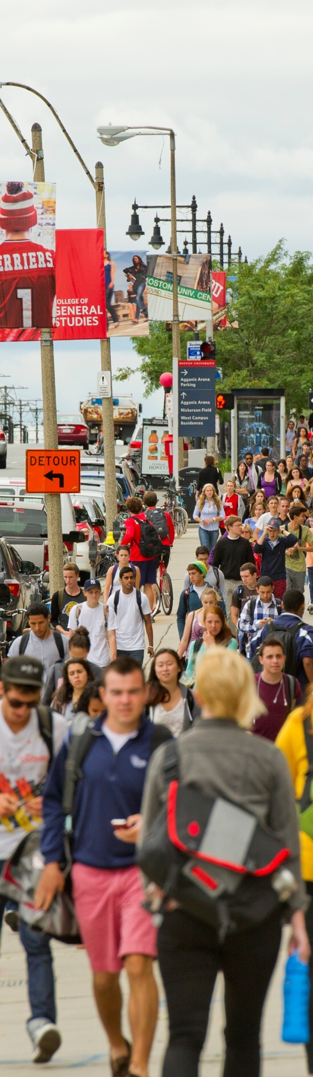
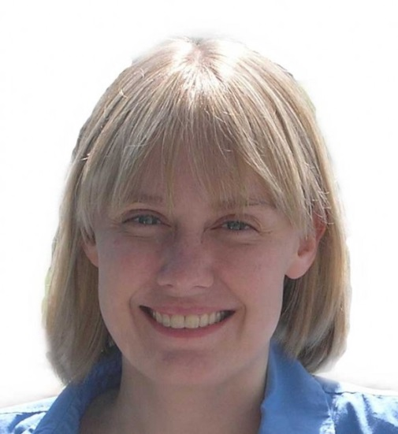
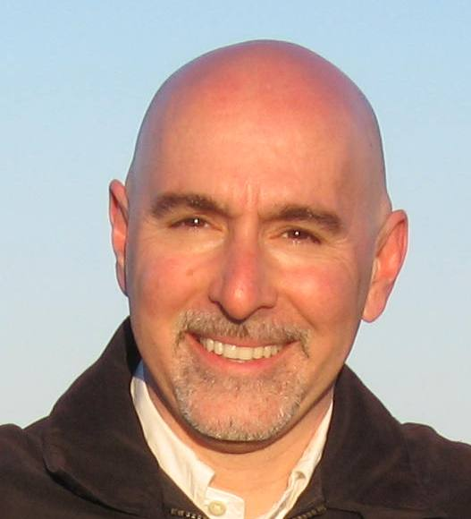
Jill Beckman
Assistant Director,
Desktop Services
Stacy Gianoulis
Executive Director,
IT Help Center
Notes:
Current structure for the IT Help Center, Boston University’s client-facing department for its central IT organization.
Jill and Stacy are the session presenters.
**Photo Credit**
Campus banners along Comm. Ave.
Photo by Cydney Scott

Slide 3


?
LET’S GET STARTED!
?
Notes:
Has your boss ever presented you with a seemingly impossible task?

Slide 4

Notes:
And when you’re told the timeframe for the task, it’s incredibly aggressive?
**Photo Credit**
© Ocusfocus | Dreamstime.com

Slide 5
!
!!!
Notes:
In January 2013, that’s what happened. We were tasked with implementing a cost savings initiative by reducing desktop support staff. This needed to be done by the end of the fiscal year, so we had essentially five months to complete an assessment and reorganization of desktop support on campus.
This task was a follow up to activity that had begun in 2009, when a working group was assembled and a consultant review conducted of desktop support services at Boston University. Five broad directives resulted from the investigation, and since 2009, BU’s IS&T and local technology support organizations, called IT Partners, had been working toward these objectives.
Our President announced that he wanted to focus specially on reducing the cost of desktop support at BU’s Management Conference on 11/26/2012. At the time no one knew how this announcement would impact our teams, but we all knew changes were imminent. This session details the process taken by Stacy and Jill once they were assigned in January to implement these changes before July 1. The targeted go-live date was June 1, 2013.
BU chose to be upfront and transparent with the community about these changes. While the honesty was appreciated, this meant staff currently providing desktop support to our community had to work for the first half of the year without knowing if they would still be employed in July. This made the situation even trickier, and meant we needed to be very good about change management….and communication.

Slide 6

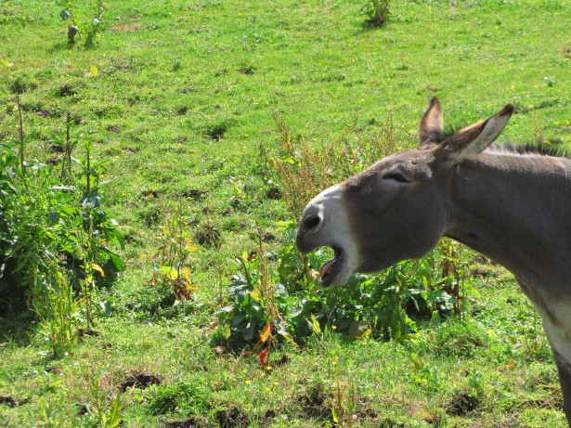
COMMUNICATION
Notes:
Communication is crucial for something like this. Confusing messages can be counterproductive and can result in extra work.
**Photo Credit**
Cry of the Donkey by WEYENBERGH JACKY
http://www.publicdomainpictures.net/view-image.php?image=45663&picture=cry-of-the-donkey
Added white frame
Animal by George Hodan
http://www.publicdomainpictures.net/view-image.php?image=68417&picture=animal
Added circular frame

Slide 7
IN WHAT ORDER
WHAT
WHO
HOW
Notes:
It matters who is sending out the communication, what medium is used (e-mail, speech, etc.), how things are worded, and the order in which you inform different audiences and/or people.

Slide 8
Apples are shiny.
Notes:
As a fun experiment, session attendees voted on the meaning of this sentence.

Slide 9
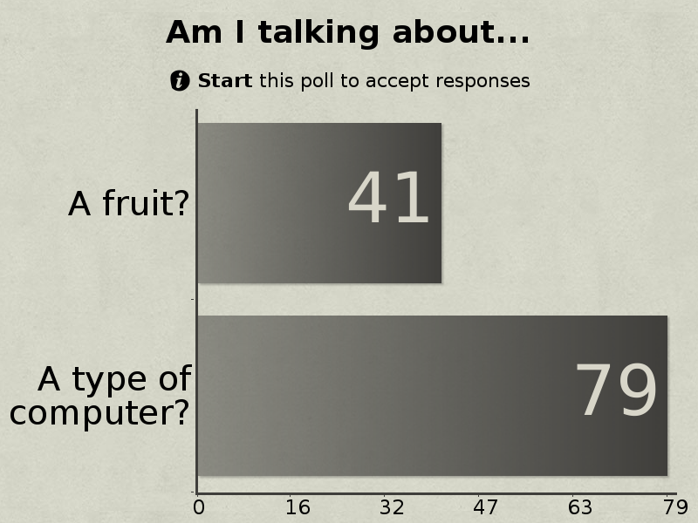

Notes:
Here are the poll results.
The mixed answers show that it is very possible for many people to see and hear the same thing but walk away with different conclusions.
In this case, more context would have made the sentence clearer. ;)

Slide 10
Colleagues,
I write to update you on the Desktop Support efficiency review and next steps…
We will strive to move the service level for desktop and laptop machines to a standard where there are at least 225 machines per FTE professional.
We will propose alternative support models for units with support efficiencies below this standard.
In all cases of staff reductions, we will work together to identify alternate positions at BU for which the staff member may be qualified…
Notes:
Here is an example of a message sent to potentially impacted staff.
This message is a good example of how we shared information with our community. Unfortunately, the e-mail list this message was sent to had not been kept completely up to date, allowing us to exhibit for you how important the order of informing your audience can be. The next slides explain.

Slide 11
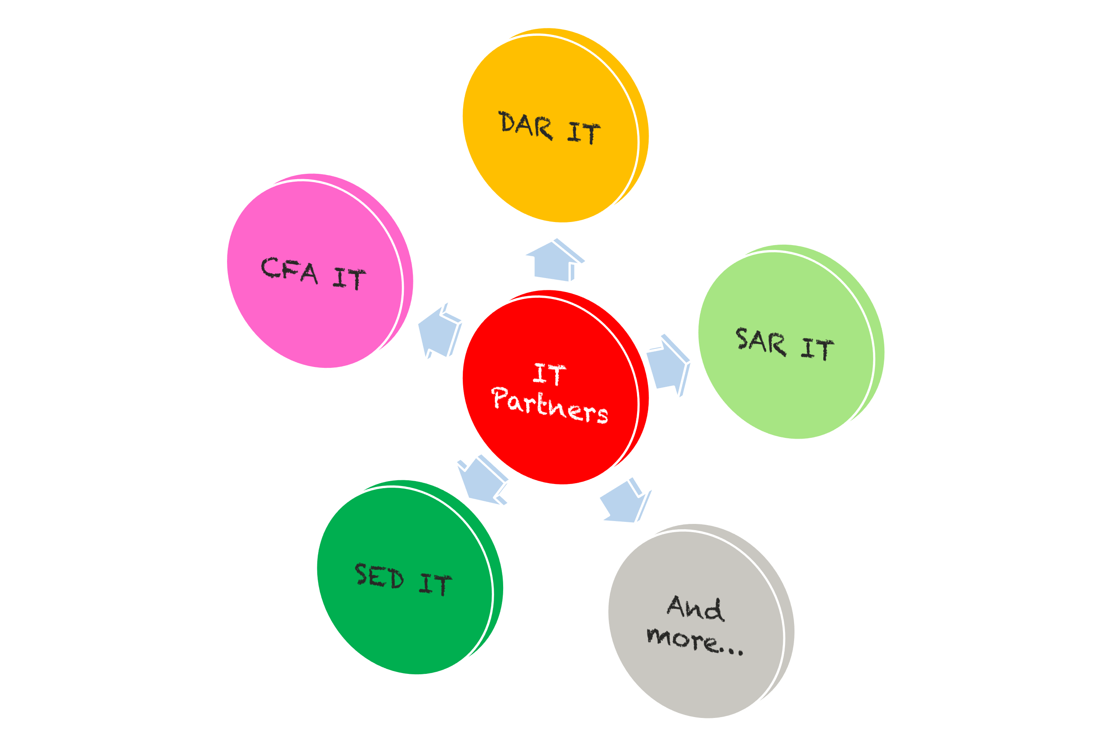
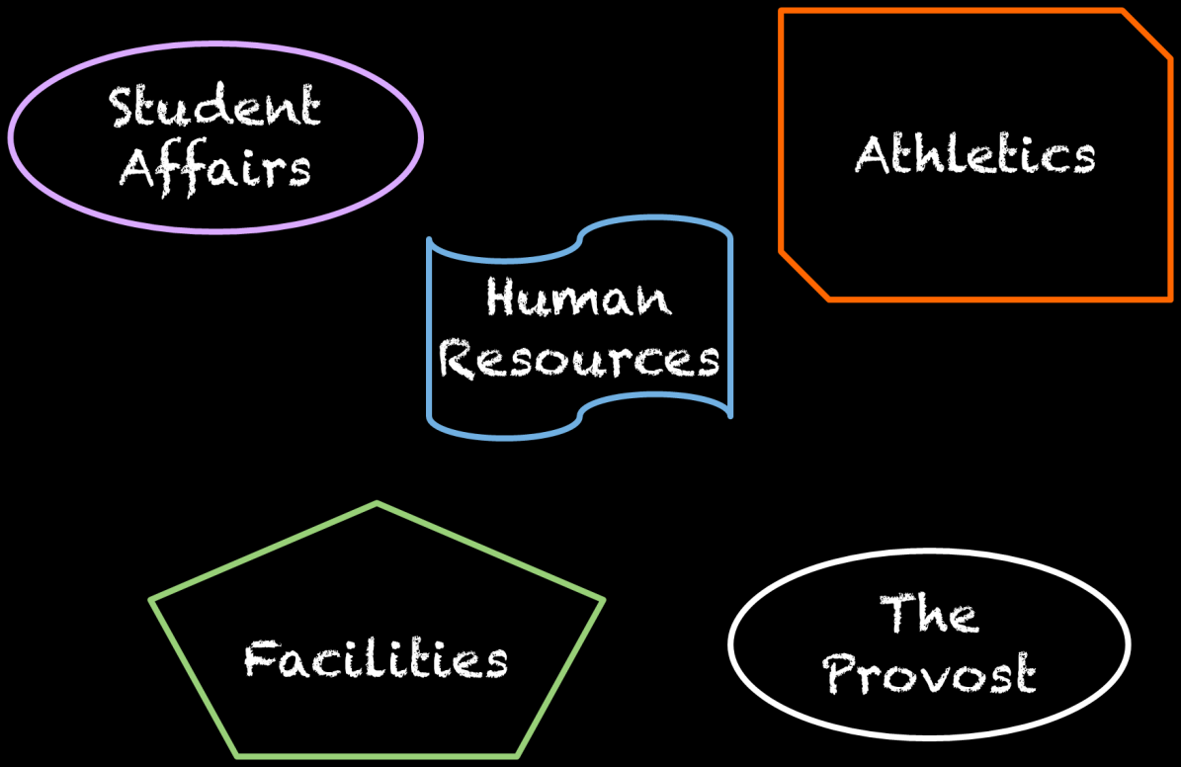
IS&T
Notes:
At the time, Boston University faculty and staff received their desktop support in a variety of different ways. Our central IT group, IS&T, provided support to some sites. The departments on the left are some examples of the sites we supported. Other distributed teams, called IT Partners, were dedicated and funded by one school or department, and examples are shown on the right.
The message being sent to impacted staff was intended to provide an update to our IT Partners. Since some employees had moved from an IT Partner team to the central desktop team, they were still on the mailing list for our IT Partners, and received the communication. The result was that a portion of the central desktop team received information about our efficiency review before others, causing confusion and concern.
The lesson here is – keep your mailing lists up to date! Who finds out about what when can matter.

Slide 12

CURRENT STATE
Notes:
How did we decide what to do next?
First, we assessed our current state. We looked at different benchmarks, such as machines per FTE and clients per FTE, to try and determine whether there were efficiencies to be gained. We also talked to peer institutions for recommendations.
**Photo Credit**
© Pryzmat | Dreamstime.com - Wild West Photo

Slide 13
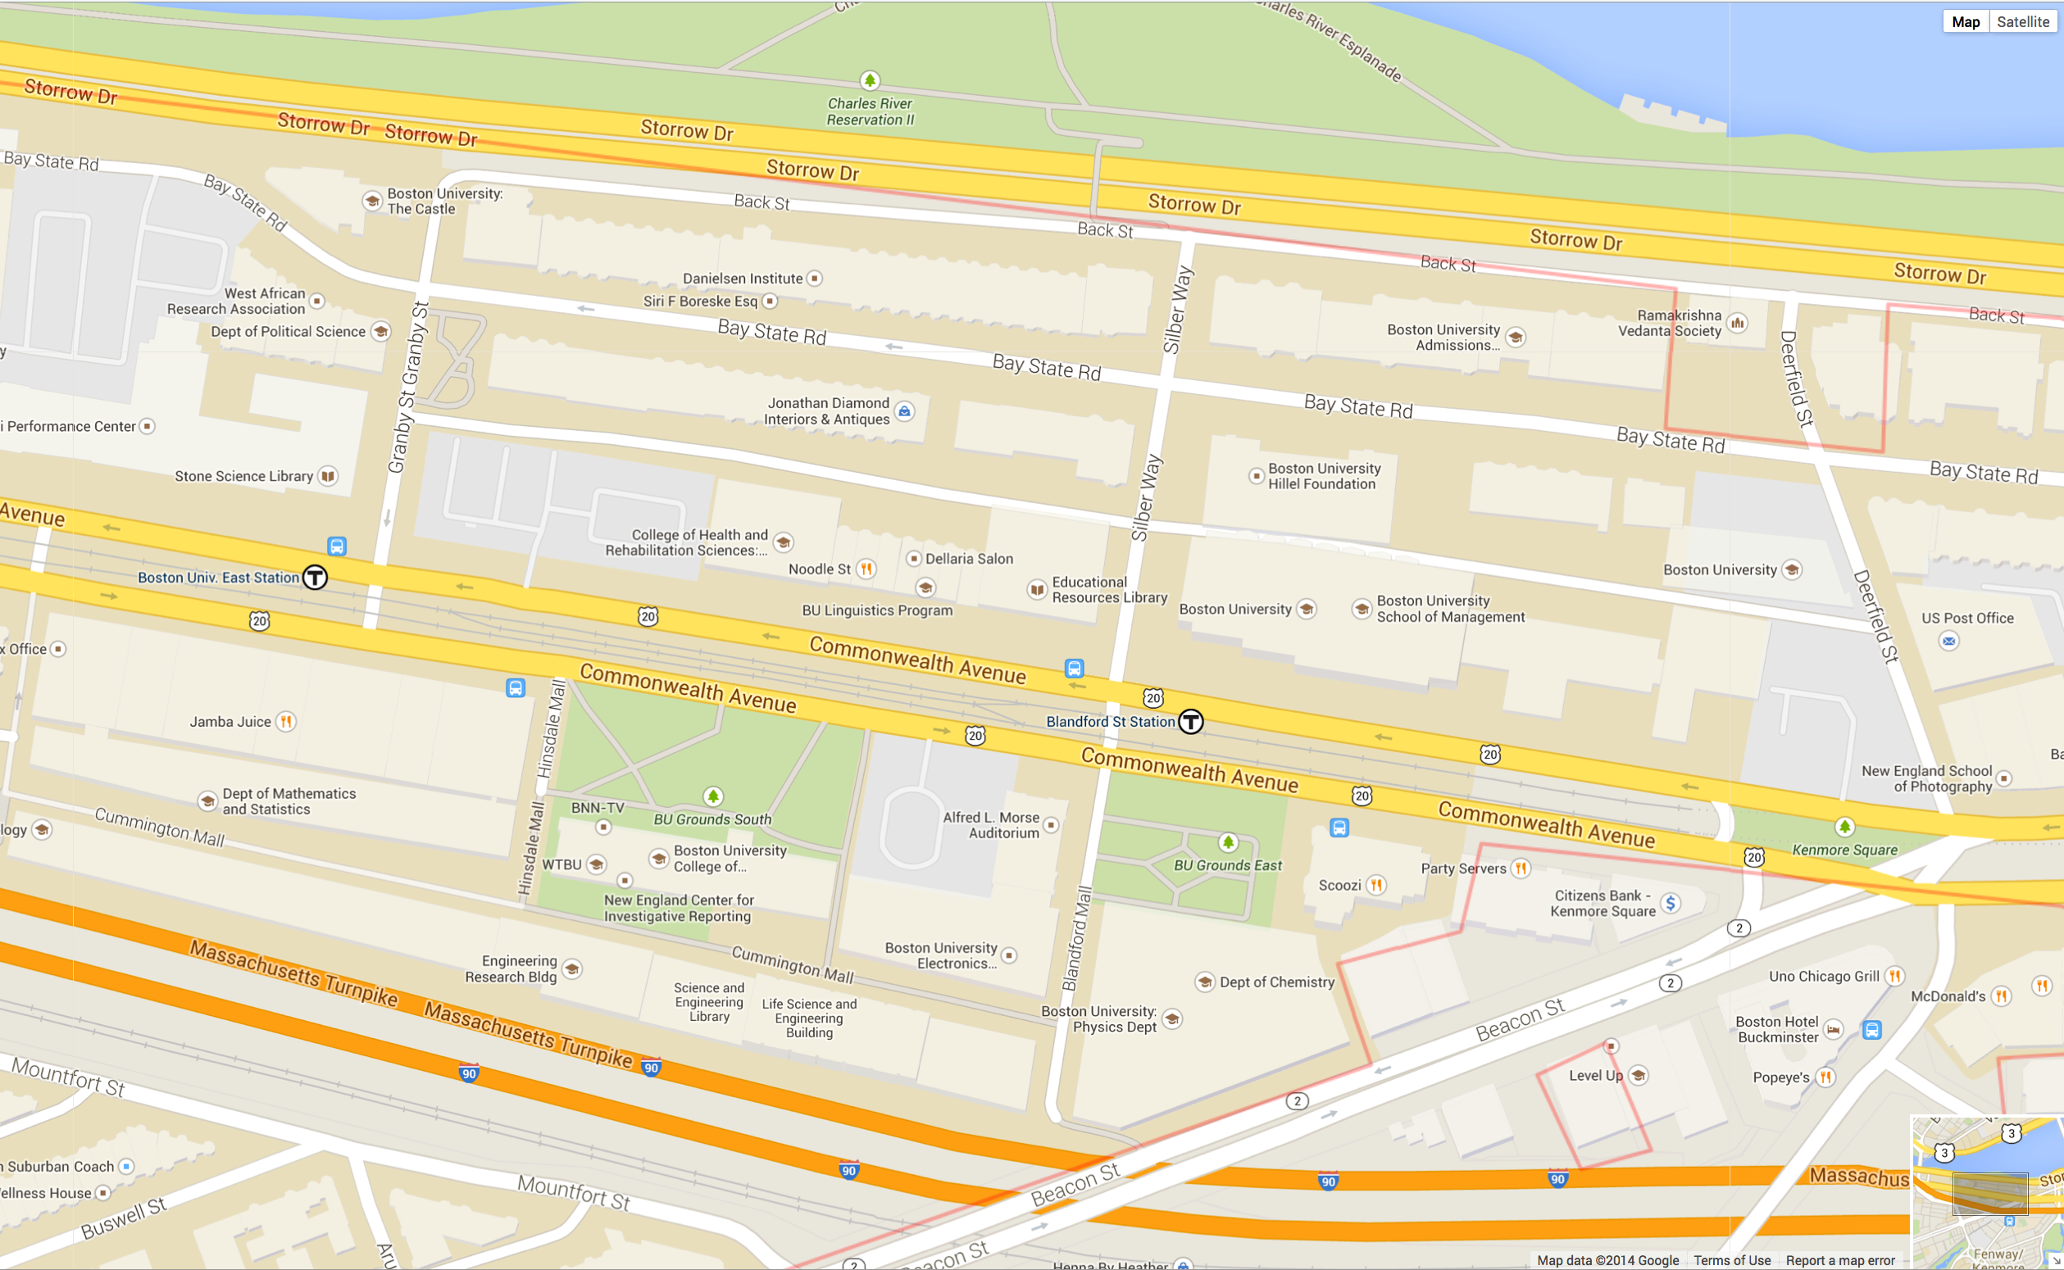


Right next door!
ONE
Building!
LEGEND
SAR IT
DAR IT
SMG IT
SED IT
Central Desktop
Notes:
This slide shows a portion of the BU campus and the distribution of IT staff.
Just in this photo, there were five different IT teams. In one building alone, there existed ten IT support staff, and two more were situated right next door. But the different teams did not collaborate or work together, and in fact the folks in brown were dedicated to a single floor.
**Photo Credit**
http://www.stockvault.net/photo/133222/vintage-chalkboard

Slide 14
What is Clustering?
A centralization strategy that preserves the concept of locally situated staff, who are grouped into physical zones for:
teamwork
cross-training
efficiency
Notes:
Therefore, we decided to use a strategy called clustering to reorganize desktop support staff. We did this because we wished to preserve locally situated staff, which was important to our community.

Slide 15
LEGEND
SAR IT
DAR IT
SMG IT
SED IT
Central Desktop
New Team!
Notes:
This slide shows before clustering and after clustering for that same portion of campus.
For best results, use slideshow mode to view the animations.

Slide 16
Increases the value add of the local interactions that are so important to our community’s culture.
Enables smaller organizational units and management who can also carry out meaningful relationship management duties with clients.
Notes:
Additional information about the benefits of clustering.

Slide 17
Assistant Director, Desktop Services
East Cluster
Central Cluster
West Cluster
Manager
Manager
Manager
Lead
Lead
Lead
Lead
Lead
DSS 1
DSS 2
DSS 3
DSS 4
DSS 5
DSS 6
DSS 7
DSS 8
DSS 9
DSS 10
DSS 11
DSS 12
DSS 13
DSS 1
DSS 2
DSS 3
DSS 4
DSS 5
DSS 6
DSS 7
DSS 1
DSS 2
DSS 3
DSS 4
DSS 5
DSS 6
DSS 7
Notes:
Here is the team we created after analyzing the data. We created three geographic clusters – East, Central, and West – which align with the long and narrow layout of the BU campus.

Slide 18
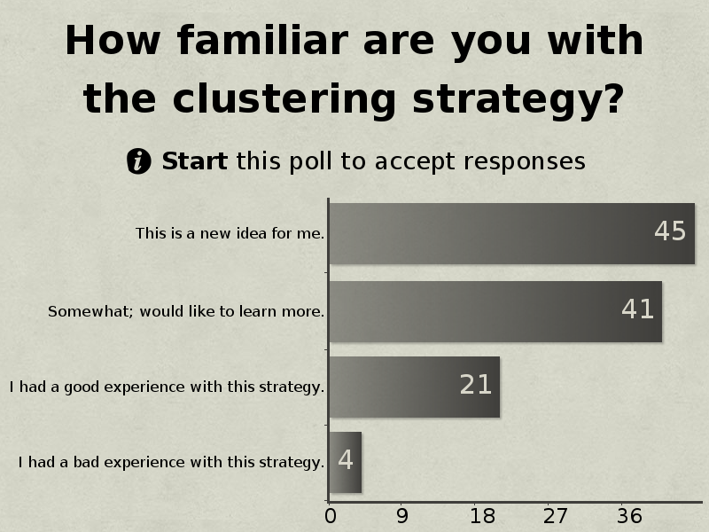
Notes:
This is how familiar session attendees were with the clustering strategy.

Slide 19


STAKEHOLDERS
Notes:
To be successful, we had to get the buy-in of our schools and departments. After all, they were giving up positions for this initiative. We had executive sponsorship but not a mandate. The success of our initiative would depend on the schools and departments being our allies and advocates.
Therefore, we formed a Stakeholders group. The stakeholders represented their business unit and were mainly Assistant Deans and Assistant VPs.
We met with them regularly, created a SharePoint site to share documents and status. We also had individual meetings with the stakeholders, and we asked for stakeholder volunteers to be on the interview teams for the management positions. This was incredibly helpful, and the stakeholders appreciated being part of the interview teams.
**Photo Credit**
http://www.canstockphoto.com
Close Up of Tent Stake Wrapped With Rope – kisbear
Sharp Wooden Spikes - surpasspro

Slide 20
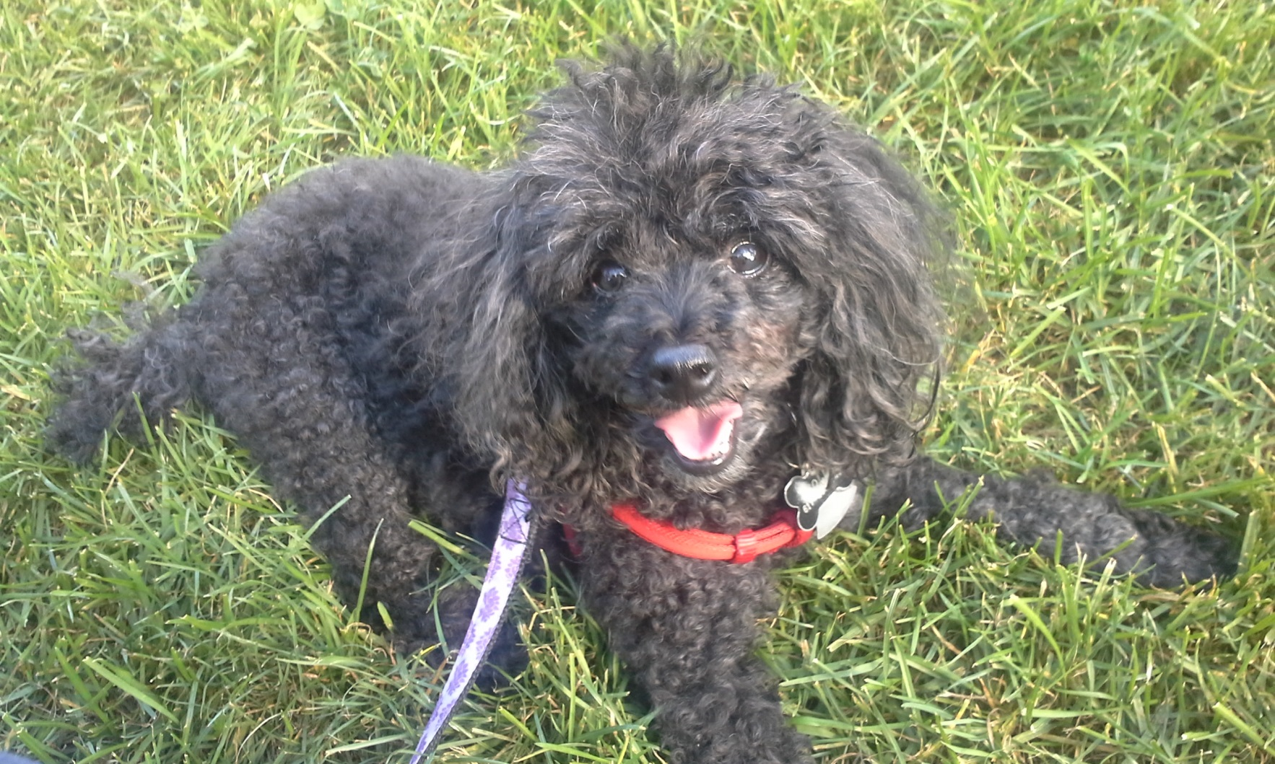
A POSITIVE OUTLOOK
Notes:
In order to effectively communicate and gain the trust of those impacted by these changes, we put together a list of reasons why this initiative is beneficial for stakeholders, clients, and even impacted staff.
**Photo Credit**
Photo taken by Jill Beckman – “Molly”

Slide 21
Be Positive!
Increase collaboration between IT teams and stakeholders
Give schools and departments a “translator” for navigating IS&T services
Notes:
High level benefits for stakeholders.
These two benefits were the most requested as we began our process, and the most highly lauded after the initiative was complete.

Slide 22
Be Positive!
One IT = Simpler for Clients
Team coverage = Clients can always get support
Clustering = Clients see friendly faces
Notes:
Tangible benefits for clients.
One IT: The idea behind this is that clients no longer need to know when they should contact central IT vs. their local IT support. Once a phone call is made or an e-mail is submitted, we now handle the rest!

Slide 23
Be Positive!
Career Enrichment = New things to Learn
Tiered structure = Room to Grow
Technical Track
I, II, III, Sr.
Management Track
Lead, Manager, Assistant Director
Notes:
Benefits for impacted staff.
The tiered structure opens up the possibility of promotions for desktop support staff that previously were on a one-man team. This allows you to reward deserving employees and keep talented individuals in your organization. Otherwise, staff must look elsewhere for professional growth.

Slide 24
Be Positive!
IT management = Mentors for team
One Team = Colleagues can collaborate and solve problems together
Improved Communication leads to standardization and efficient support!
Notes:
More benefits for staff and community.
IT management = Previously, IT staff often reported to someone in finance or HR. This meant supervisors could not always assist with solutions to roadblocks, because IT was not their field. Now, with the new model, desktop support staff report to IT supervisors.
We find that our team now is providing proactive support and standardizing how things are done: if an issue is identified by one team member, the solution will be implemented across all supported schools and departments to ensure other clients will not run into the same issue.

Slide 25

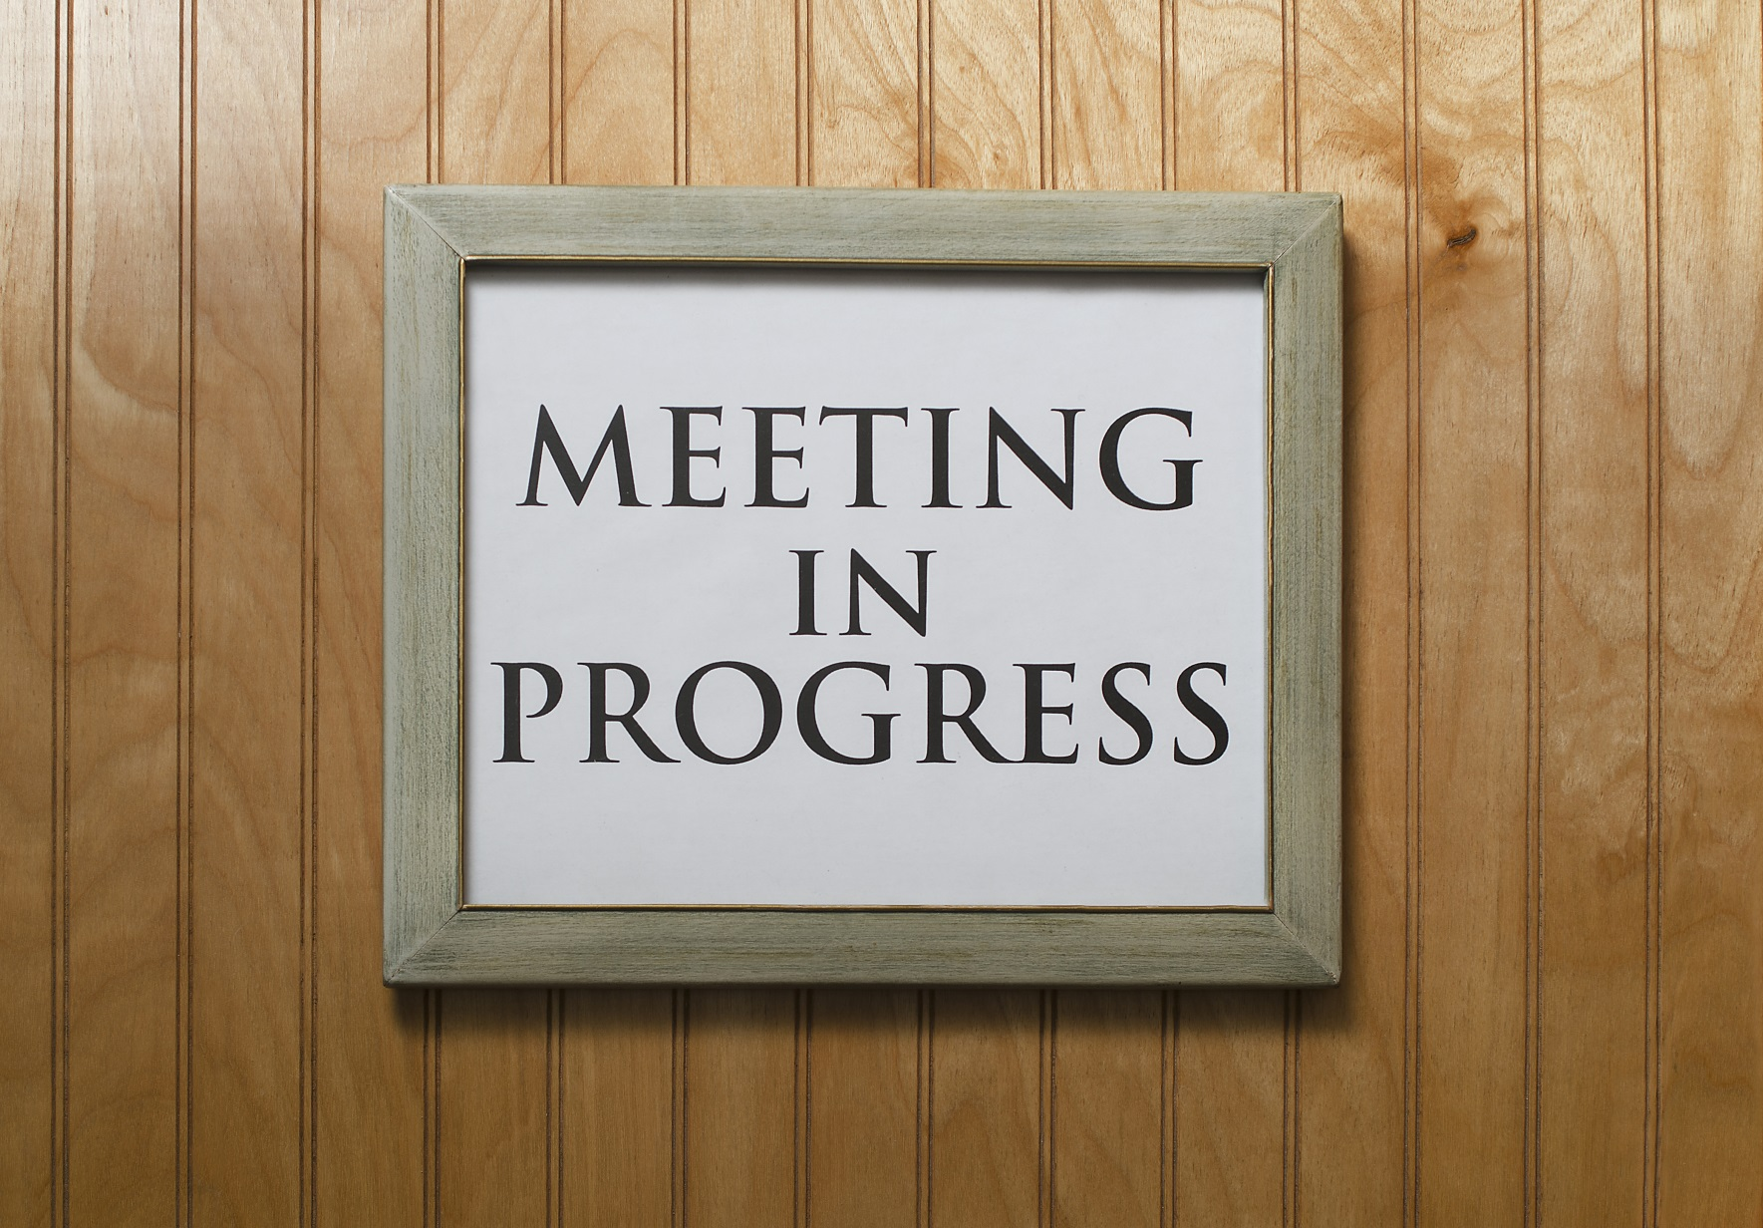
COMMUNICATING WITH STAFF
Notes:
It was important to keep the lines of communication open with impacted staff, as keeping the ship afloat while worrying about the future wasn’t easy. We had many check-ins and meetings, often after hours, listening to the needs and concerns of the central desktop support team. Our CIO also put together a great presentation and spoke to all impacted staff, answering their questions and clearly illustrating our process and goals. This went a long way towards allowing folks to feel that they weren’t in this alone.
**Photo Credit**
Business People World by Karen Arnold
http://www.publicdomainpictures.net/view-image.php?image=74743&picture=business-people-word
Put in circular frame
© Kentannenbaum | Dreamstime.com - Meeting In Progress Sign Photo

Slide 26

Desktop Support Clustering Initiative
Frequently Asked Questions
What if I lose my job? Will assistance be offered?
Who will decide where staff will be placed?
What if I am not interested in a position?
Will seniority factor into the hiring decisions?
Notes:
We also worked with Human Resources to create an FAQ to provide as a reference to potentially impacted staff.

Slide 27
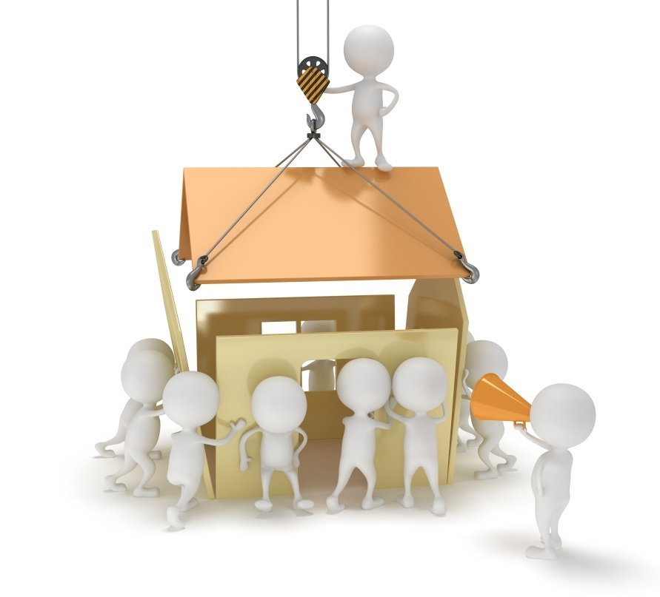

BUILDING THE TEAM
Notes:
Now it was time to put the team together. How did we build the team?
-First we hired the management team. As mentioned, our stakeholders participated in the interviews and were the decision-makers for the choices. Applicants were limited to in-scope positions/staff, to minimize job loss.
For the rest of the team, they were not required to reapply. Staff were placed based on their yearly performance evaluations and an assessment form that was filled out by each supervisor. Some examples of the assessment form can be seen in the next slides. We are happy to provide the form if you are interested.
We did our best to keep relocations to a minimum, so that when we went live, many schools and departments were still being supported by the same friendly faces as before the restructuring.
**Photo Credit**
© Newbi1 | Dreamstime.com - 3D People Build A House Photo
© Alphaspirit | Dreamstime.com - Build New Business Photo

Slide 28
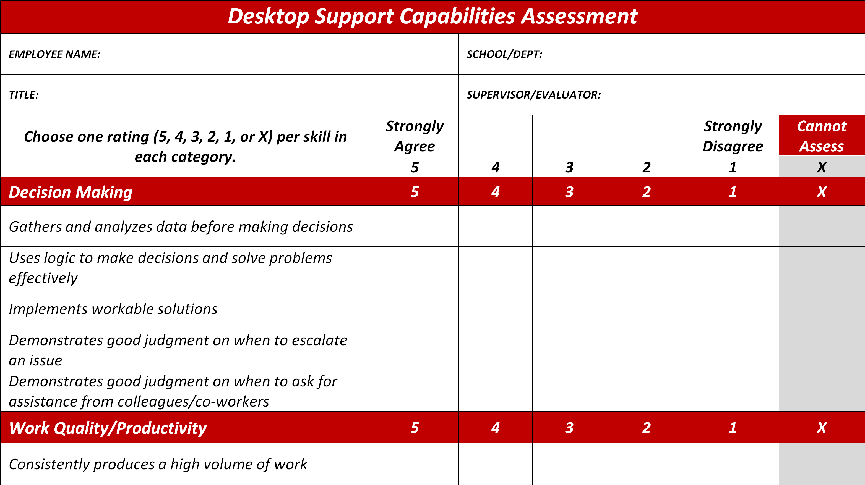

Slide 29
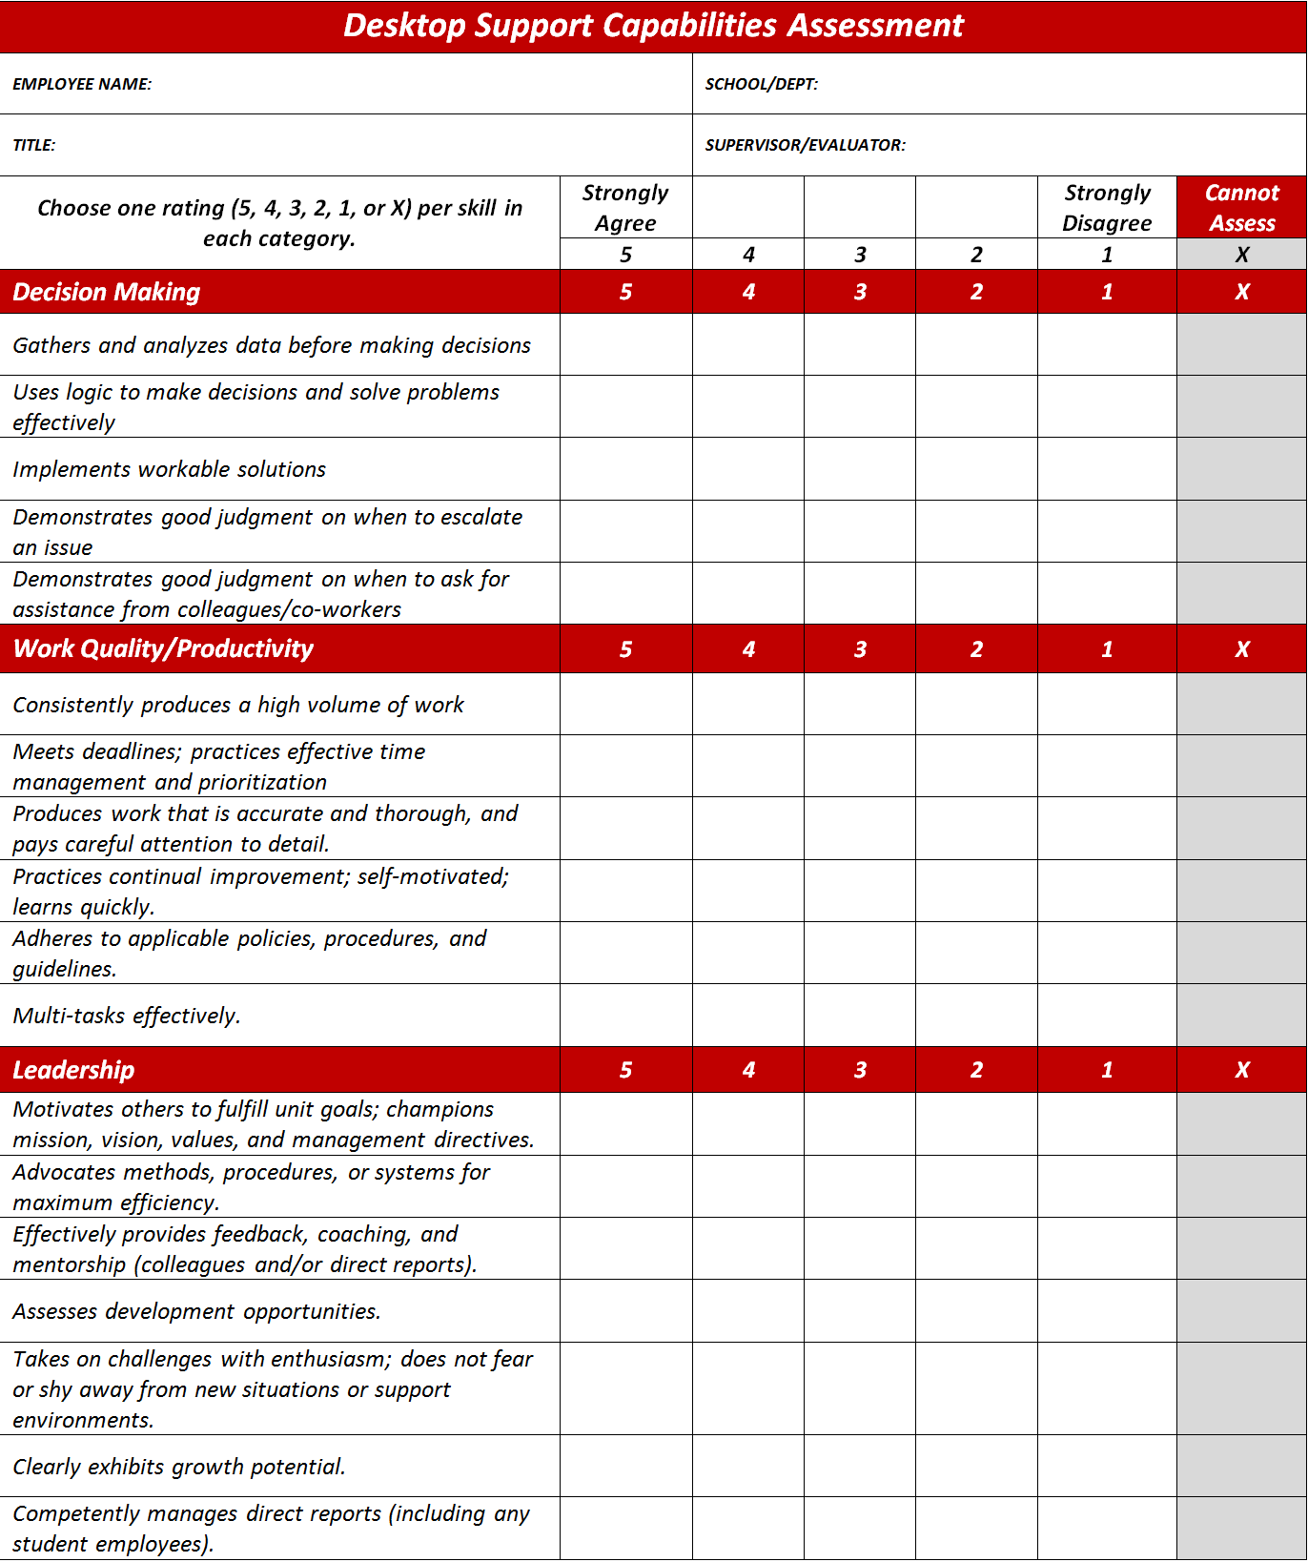
Soft Skills
Good judgment
Leadership
Communication
Discretion
Technical Skills
Active Directory
Mobile devices
Mac Operating Systems
Certifications

Slide 30


Almost there…
GO-LIVE PREP
Notes:
Now that the team was built, how did we notify everyone of the upcoming changes?
Communication was so important that we created a mini project plan just to schedule and manage the notifications about go-live expectations.
**Photo Credit**
© Flynt | Dreamstime.com

Slide 31
[Central]
Christian/Jill/
Brent/Jared
  Meet with Doug
  Meet with Rob
  Meet with Emily
  Meet with Darryl
  Meet with Tim
Christian/Jill
  Meet with Tracy
  Meet with Mike
[West]
Jill/Kyle
  Meet with Matt
  Meet with Ron
  Meet with Joe
Jill/Kyle/John
  Meet with Jason & Greg
  Meet with Carmella
  Meet with Josh
David/Kyle
  Meet with Mike
[East]
Jill/Mark
/Barbara/Mike
  Meet with Denise
  Meet with Dan
  Meet with Deb
  Meet with Greg
  Meet with Phil
  Meet with Ali & Dris
  Meet with Greg & Teri
Jill/Mark
  Meet with Jorge, Joe, and Paul
Notes:
We created a new 36-person team.
This meant a lot of meetings to let folks meet their supervisors and be informed about where they would be located.
This is just a snapshot of some of the meetings that were held. The order of each meeting was planned carefully, because many in-scope staff members worked closely together, and anxiety would be raised if acquaintances were not notified on the same day. With a campus that is long and narrow, we also had to consider the locations of our meetings.

Slide 32
BUA: BU Academy
CFA: College of Fine Arts
CGS: College of General Studies
DAR: Development and Alumni Relations
FIN: Office of the Senior Vice President Chief Financial Officer & Treasurer
LAW: School of Law
SAR: Sargent College of Health and Rehabilitation Sciences
SED: School of Education
SMG: School of Management
SSW: School of Social Work
BUPD: Boston University Police Department
STH: School of Theology
MATH: Dept. of Math & Statistics
MUG: The Libraries
Notes:
Altogether, 14 schools and departments were directly impacted by this change.
To ease the transition, we created custom messages to each community, setting expectations for how support should be requested after the transition.
This was a lot of work, but went a long way towards easing any potential anxiety about the change. When we went live, it was almost a non-event. Many people did not even notice!

Slide 33
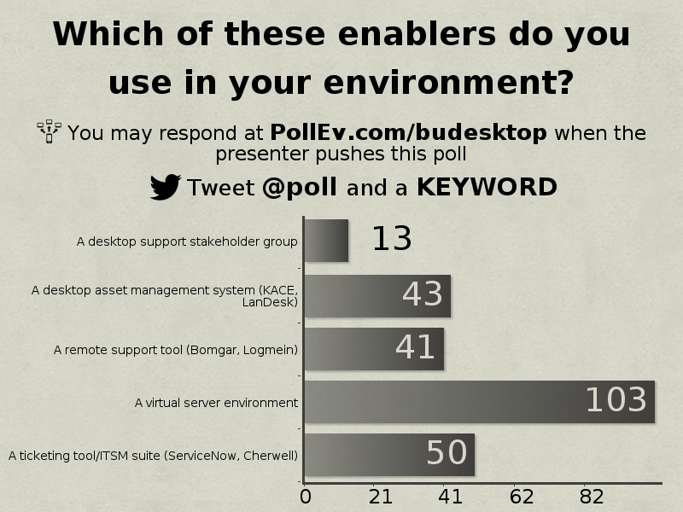

Notes:
Essentially, we were being asked to support the same number of people and systems with 10 less FTEs which is about 20% less staff.
We implemented some new processes and tools to make this happen. We called these “enablers.” Some of these enablers were already in place, and were either expanded or leveraged on a greater scale. Others came to be because of our initiative.
Here you can see which enablers are in use by session attendees.

Slide 34
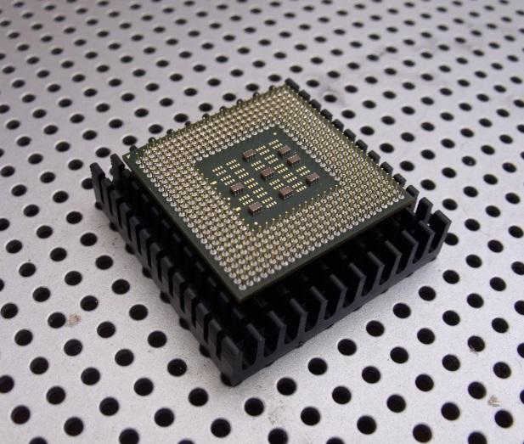

SERVER VIRTUALIZATION
Notes:
When talking to other schools, having a virtual server environment was the top recommendation for an enabler to desktop reorganization? This might seem counterintuitive, so….why is that?
Every school and college that transitioned to receive desktop support from the new team had its own servers. File servers were very common. Others had print servers or servers that were hosting applications and/or databases. These servers were being maintained by desktop support staff and in most cases server administration was not their area of expertise. Also, most of these schools and departments could not afford state of the art equipment and a climate controlled data center. This means the servers were hosting business critical data applications, but were at high risk for failure. In fact….
**Photo Credit**
Computer Chip by john kovacich
http://www.publicdomainpictures.net/view-image.php?image=18630&picture=computer-chip
Put in circular frame
© Elgris29 | Dreamstime.com - Hosting And Server Room Photo

Slide 35
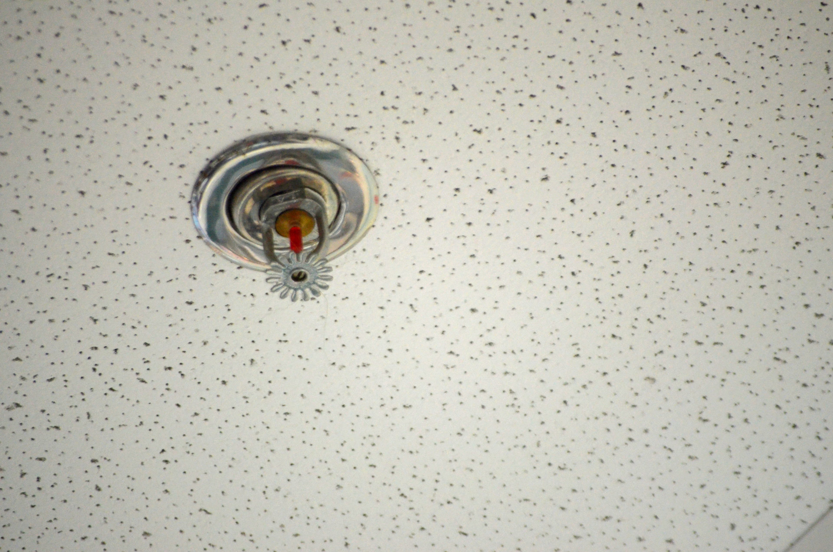
Notes:
Most of the servers we inherited were NOT being backed up at all, and were sitting under leaky pipes or sprinkler heads!
If you have a virtual server environment, and not only can you improve your stakeholders’ desktop support, but you can also take their high risk servers and put them in a secure environment supported by server administrators, and back them up…this is a very powerful and compelling picture, and a great benefit for your clients.
**Photo Credit**
Fire Sprinkler Head by Peter Griffin
http://www.publicdomainpictures.net/view-image.php?image=31715&picture=fire-sprinkler-head

Slide 36


REMOTE SUPPORT
Notes:
As part of this initiative, we upgraded our remote support tool and adopted Bomgar. Why was this so important?
Two reasons:
Bomgar was a much improved tool, and was a morale booster for staff. They were happy about its adoption.
Bomgar allowed us to move more desktop support to our enterprise service desk, and also assisted with distributing support calls more evenly across the new desktop support team. Bomgar helped us facilitate this cultural change. Rather than telling clients that they had to call a central service desk instead of their trusted desktop support person, we explained that Billy or Adam or Donna now had help, and that when their embedded desktop person is unavailable or helping someone else, they now have the ability to call a number to get someone that can see their screen and help them through their issue. The session will be documented which will allow for local desktop support follow up, if needed.
Focusing on the positive and explaining to clients what they are really getting with new tools and processes is crucial for success. “Don’t call Billy” is a negative message for clients and stakeholders. But saying “Billy has help” or “Billy isn’t alone anymore” is a positive message that is much more easily implemented with an effective remote support tool.
**Photo Credit**
Images from www.bomgar.com

Slide 37
MEASURING OUR RESULTS
Notes:
Well, we made it. It wasn’t easy! But over a year later, we have happy clients and a high performing team.
To wrap up, we’d like to share some metrics, and then we’d be happy to answer any questions.

Slide 38
~$750,000
in Savings
Reduced 10
Desktop Support Positions
Notes:
Overall, we saved BU ~$750,000 annually, and we eliminated 10 desktop support positions. We leveraged three vacant positions and relocated staff when possible to minimize job loss.

Slide 39
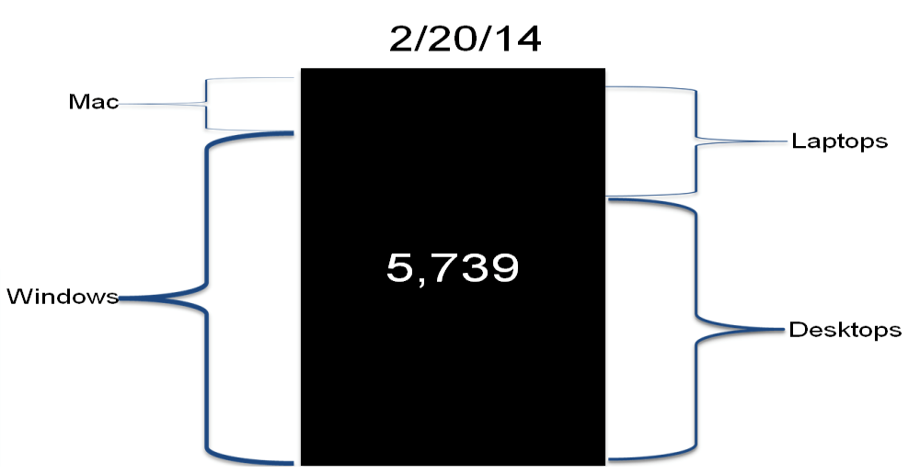
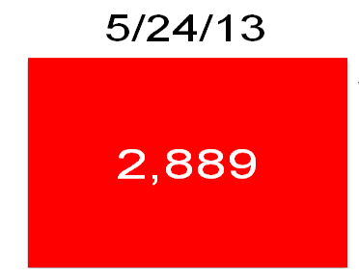
Assets Supported by Desktop Services
~98% increase
Pre-DSCI: 5/24/13
Post-DSCI: 2/20/14
Notes:
This slide shows the increase in desktop and laptop assets supported by the IS&T central desktop support team, Desktop Services. It does not include mobile devices (phones, tablets, etc.) or peripherals (printers, scanners, etc.)
Keep in mind that these assets are only BU-owned assets as we do not put our KACE agent on personally owned computers. BU does not always supply adjunct faculty, postdocs, and staff with BU-owned assets. However IT absolutely will support personally owned devices, so this is only a piece of the picture.

Slide 40
Desktop Services Ticket Volume
Ticket Increase = 108%
= Incidents
= Service Requests
Notes:
A team of 25 desktop support specialists handled 12,056 tickets in FY’13. A team of 36 desktop support specialists handled 25,028 tickets in FY’14 – which is an increase in volume of 108%.
In contrast, the increase in FTEs to the central desktop support team was an increase of 44%.
It is important to note that tickets are only a % of a desktop support staff member’s time. Most team members are also resourced on projects and assisting with relationship management. Many also assist with maintaining and supporting enterprise shared services like our desktop asset management system, KACE, and often work change windows to implement RFCs. None of this activity is captured in this ticket volume.

Slide 41
Service Desk Ticket Volume
Ticket Increase = 78%
= Incidents
= Service Requests
Notes:
Our Service Desk was already an enterprise service desk before the DSCI. This means that the clients receiving desktop support in the field by the new central desktop team had already been somewhat leveraging our Service Desk.
Nevertheless, ticket volume went up by 78%! This is a pretty big jump, and indicates two things:
We successfully migrated some desktop support tickets to our Service Desk
The DSCI ended up being somewhat of an advertising campaign. It is likely more folks used the enterprise Service Desk because they learned of it through the DSCI.

Slide 42
“Since the clustering, we have received a lot of good feedback from Faculty and Staff in regards to improved service. We now don't have to hope for our IT person to be available to solve an immediate need, only send an email to IThelp and know that there is a group of people out there supporting us.”
    - Kevin, School of Theology Client Representative
Notes:
The next slides are some quotes from our Stakeholders, all of whom currently are members of the Desktop Support Stakeholder Group.

Slide 43
“The service the law school receives from Desktop Services is very good. We also benefit from having IS&T staff in place who are familiar with issues in other schools and colleges, and who have existing relationships with central IS&T colleagues…We would not have been able to successfully manage the [building renovation] project without being able to occasionally leverage the support of additional Desktop Services staff. Thanks for the extraordinary effort this past year!”
    - Liz, School of Law Client Representative

Slide 44
“As spread out and decentralized as our department has become, with the addition of Sourcing & Procurement and Sponsored Programs specifically, the clustering initiative, in my opinion, has enhanced our Desktop Support platform.”
    - David, Finance (VPFA) Client Representative

Slide 45
“The Desktop Services Clustering Initiative has provided a broader base of support for the Libraries and more closely linked the Libraries' technology support to existing and emerging IS&T initiatives.”
    - Jack, BU Libraries Client Representative

