Slide 1
Building Institutional Capacity for Learning Analytics
Linda L. Baer Ellen Wagner
Linda Jorn Bruce Maas
Michael Mathews

Slide 2
Challenge: How do you find the student at risk?
http://www.youthareawesome.com/wp-content/uploads/2010/10/wheres-waldo1.jpg

Slide 3
Challenge: How do you find the student at risk?
http://www.youthareawesome.com/wp-content/uploads/2010/10/wheres-waldo1.jpg

Slide 4
Characteristics
Technology, Processes and Practices
Skills and Values
Leadership
Culture
Investment

Slide 5
Stages of Student Success Analytics
Static Reporting – Getting Started with Analytics
Dynamic Analysis/Intervention – Accelerating the Progress of Analytics
Optimization – Transforming/Optimizing/Leveraging Analytics

Slide 6
Stages of Student Success Analytics
Characteristics | Stage I Getting Started with Analytics | Stage II Accelerating the Progress of Analytics | Stage III Transforming/Optimizing/ Leveraging Analytics
Technology, Processes and Practices | Basic ERP, LMS, Report Writing Tools First Ventures into Analytics Tools and Applications, Pilot Projects /Dept Solutions | Combination of ERP, LMS, Analytics Applications, CRM, Advising) First-Generation Predictive Analytics | Sophisticated Data Warehouses with Analytics, Embedded Predictive Analytics, Leading to More Advanced Practices
Skills and Values | Power Users Provide Reports | Analytics Spread More Broadly – Concept of Analytics for the Masses | Pervasive Data, Information, and Analytics Engages Everyone from Front-Line Knowledge Worker to Executives
Leadership | Leadership Focuses on Data and Reporting | Leadership to Encourage Evidence-Based Decision Making | Strong, Consistent Leadership, Analytics is a Strategic Practice , Student Success an Inst. Imperative
Culture | Culture of Reporting | Culture of Evidence-Based Decision Making Reflected in Behaviors | Culture of Performance Measurement and Improvement
Number of Institutions in this Category | 3,000+ | Approximately 800-900 | Approximately 40-60 Mostly For-Profits and Online Universities UMBC, UMUC are Among These
Linda L. Baer & Donald Norris 2014

Slide 7
What is Your Stage of Development of Student Success Analytics?
Characteristics | Stage I Getting Started with Analytics | Stage II Accelerating the Progress of Analytics | Stage III Transforming/Optimizing/ Leveraging Analytics
Technology, Processes and Practices
Skills and Values
Leadership
Culture
Investment

Slide 8
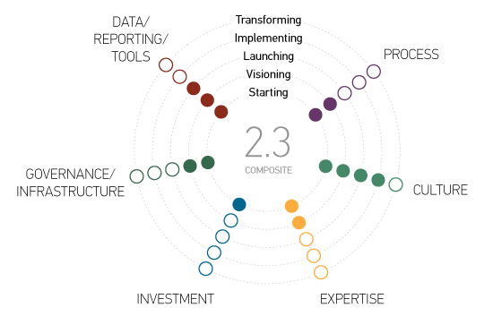
Analytics in Higher Education -- ECARndex
http://www.educause.edu/ecar/research-publications/ecar-analytics-maturity-index-higher-education

Slide 9
Linking Predictive Analytics to Prescriptions for Success Ellen Wagner Chief Strategy Officer, PAR Framework September 29, 2014 – Orlando FL @edwsonoma, ellen.wagner@parframework.org

Slide 10
From Hindsight to Foresight

Slide 11
Game-Changer: Common Data Definitions
PAR institutions jointly develop and agree to conform to a set of common data definitions for all variables in PAR data set.
The PAR Framework common data definitions work as a Rosetta Stone of student success.
PAR Framework team openly licensed and published the PAR common data definitions:https://community.datacookbook.com/public/institutions/par
“The PAR Framework project’s release of the Data Definitions as a Creative Commons license is a major step forward and a possible competitive advantage over commercial competitors…” (Lowhendahl, Education Hype Cycle, 2014. Gartner Research)

Slide 12
Predictive models reduce guesswork to find students at risk
Lift curves
30%

Slide 13
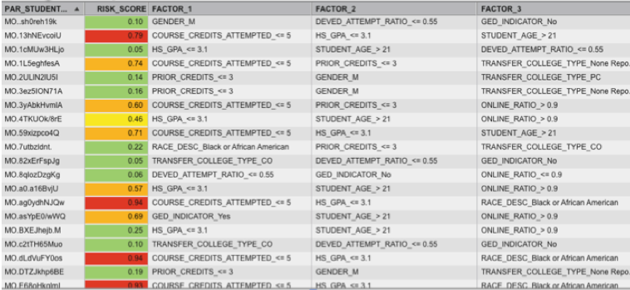
Actionable information identifies points for prescription
Anonymized ID
1st, 2nd and 3rd factors contributing to risk
Risk they will not be retained

Slide 14
Knowing what to do next: PAR Student Success Matrix (SSMx)
Research-based toolkit and application for applying and benchmarking student services and interventions
PREDICTORS/ TIME | CONNECTION | ENTRY | PROGRESS | COMPLETION
Learner Characteristics
Learner Behaviors
Fit/Learners Perceptions of Belonging
Other Learner Supports
Course/Program Characteristics
Instructor Behaviors/ Characteristics
Validated with 39 institutions
80+ known predictors
Ability to benchmark interventions
Publically available definitions, over 1,700 downloads since June 2013
https://par.datacookbook.com/public/institutions/par

Slide 15
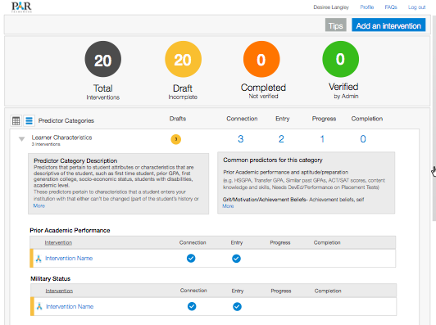
Applying interventions and measuring effectiveness
Student Success Matrix (SSM^{x}) Online
Mechanism for inventorying & categorizing student success interventions/ supports
enables cross institutional benchmarking
supports local and cross institutional cost/ benefit analyses.
Helping institutions target interventions efficiently
The right students
The right levels of interventions
The right modalities
The right timing
Online tools for inventorying and measuring student success programs

Slide 16
Applying Interventions at the greatest point of need/value
A fundamental objective for developing common frameworks for reviewing student interventions is so that the most effective interventions can be applied at the points of greatest need to effectively remediate risk.
PAR has paved the way for creating common understanding of student risk and common tools for diagnosing risk. The road to developing consistent and applied measurement to student impact of intervention will take time and vigilance.
Please visit http://parframework.org

Slide 17
University of Wisconsin – Madison: Building Organizational Capacity
Stage 1: Static
Stage 2: Dynamic
Stage 3: Optimization
D2L Student Success System Pilot
Educational Innovation: Learning Analytics Design Team
Pugliese’s (2010) Stages of Building Organizational Capacity for Student Success Analytics
Notes:
Pugliese’s (2010) Stages of Building Organizational Capacity for Student Success Analytics

Slide 18
University of Wisconsin – Madison: Building Organizational Capacity
Stage 1: Static
Stage 2: Dynamic
Stage 3: Optimization
1) Technology infrastructure, analytic tools and applications
2) Policies, processes, practices, and workflows
3) Values and skills
4) Culture and behavior
5) Leadership
Pugliese’s (2010) Stages of Building Organizational Capacity for Student Success Analytics
Notes:
Pugliese’s (2010) Stages of Building Organizational Capacity for Student Success Analytics

Slide 19
University of Wisconsin – Madison: Building Organizational Capacity
Stage 1: Static
Stage 2: Dynamic
Stage 3: Optimization
1) Technology infrastructure, analytic tools and applications
2) Policies, processes, practices, and workflows
3) Values and skills
4) Culture and behavior
5) Leadership
Pugliese’s (2010) Stages of Building Organizational Capacity for Student Success Analytics
Notes:
Pugliese’s (2010) Stages of Building Organizational Capacity for Student Success Analytics

Slide 20
University of Wisconsin – Madison: Building Organizational Capacity
Stage 1: Static
Stage 2: Dynamic
Stage 3: Optimization
1) Technology infrastructure, analytic tools and applications
2) Policies, processes, practices, and workflows
3) Values and skills
4) Culture and behavior
5) Leadership
Pugliese’s (2010) Stages of Building Organizational Capacity for Student Success Analytics
Notes:
Pugliese’s (2010) Stages of Building Organizational Capacity for Student Success Analytics

Slide 21
Improving Retention and Advancement
Education and Career Positioning System
Through the
WWW.EPS4.ME
Notes:
Imagine if the students, parents and employees could visualize their destiny in a graphical manner by accessing and analyzing all the data from the educational performance systems, degree pathways, bureau of labor statistics, personal needs, workforce trends, workforce pathway, and their own personal assessment data throughout their lifetime. If the data and ownership of this liberated data were available, it would be much like the GPS but called the EPS – Educational Positioning System, or Education and Career Positioning system which allows the journey toward a rewarding career more visual and realistic

Slide 22
Improving Retention and Advancement
Through
National Award Winning
Education and Career Positioning System
Shah Ardalan, Michael Mathews, Lois Becker

Slide 23
The Problem
The Problem
Students making informed decisions

Slide 24
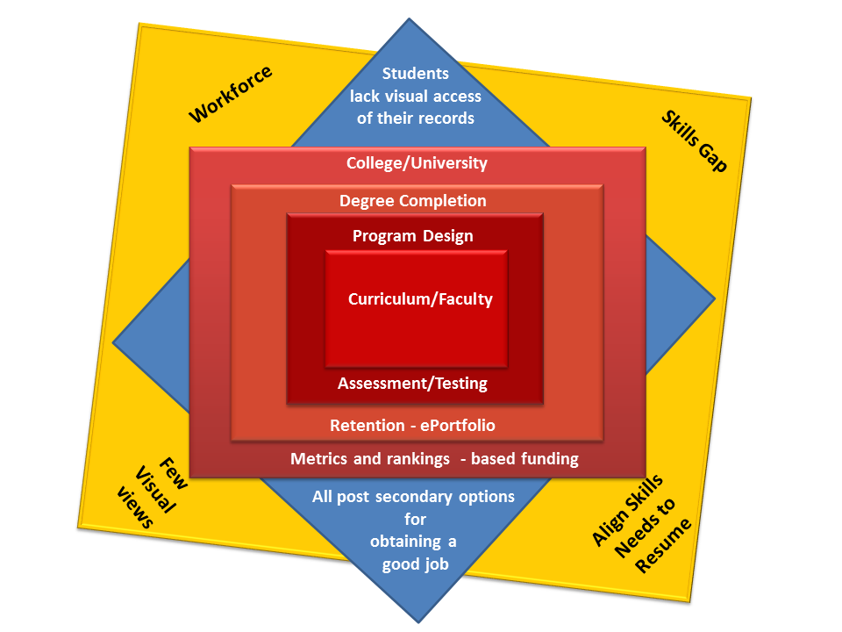
Consumers spoke and we listened…
An outside-in approach
Notes:
Figure 1.2 shows more descriptively where the potential skills-gap may start occurring. The reality of the modern economy is that the university and college environment is critical, but does not ultimately provide the pathway that bridges workers to the workforce. The missing element(s) is the access to all the data that makes up the complete characteristics and qualifications of the student. Considering the that less than 25% of students graduate from a single education provider, and that students can’t access their own educational records, the ability for students to identify their own growth patterns toward a good job or career are greatly diminished.

Slide 25
Outcomes
Students have full access to their personal data
Students make better choices on programs that tie to their values
Faculty can better know their students
Students better understand the expectations of each major
We provide better counseling to our students
Students succeed and persist to bachelors program
We have a program pipeline to better align projected programs and hiring
25% enrollment growth from K12 to College - first semester after
Attributed Increase in persistence by 5-10%

Slide 26
Integrated Implementation Method
Issued to all first year students attending orientation course.
Given to students and parents as a ‘talking point.’
Local high schools involved with implementation.
Faculty training and embracing of student self navigation
Advisors all trained on co-operation with parents and students
Instilled a ‘360 Degree’ cooperative spirit with faculty, students, parents, advisors, and executives.

Slide 28
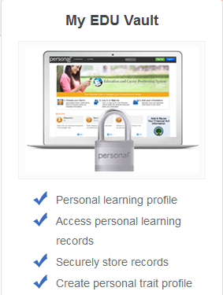
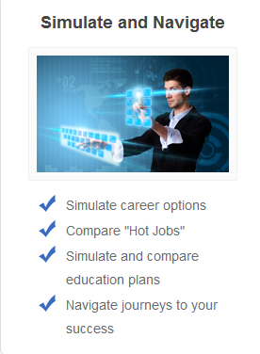
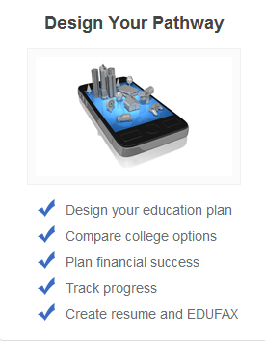
1
2
3
Notes:
1. My EDU Vault is an application where you can create your personal learning profile and securely store all your personal data and records.
2. Simulate and Navigate allows you to navigate through everything you need to know about colleges, majors, and careers.
3. Design Your Pathway lets you plan your finances and create you resume and EDUFAX.

Slide 29
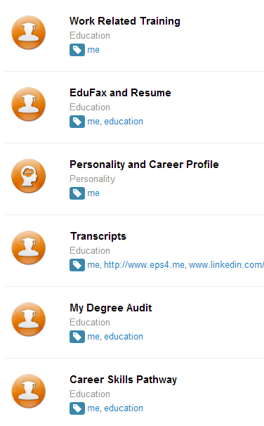
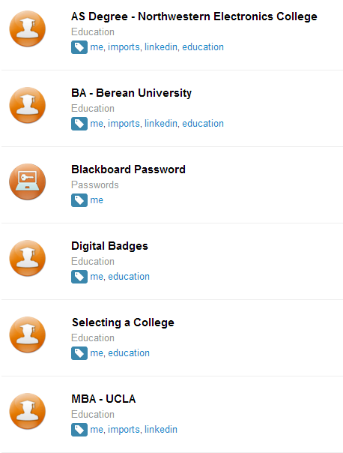

Slide 30
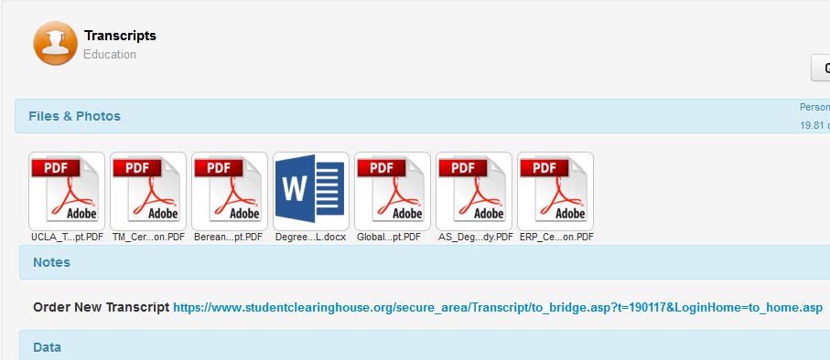
All Archived Transcripts for Michael Mathews
Link to order official transcript

Slide 31
Contact
Contacts
http://www.EPS4.ME
Michael.Mathews@Lonestar.edu

Slide 33
Questions
lindalbaer0508@gmail.com
Ellen.wagner@parframework.org
jorn@wisc.edu
Bruce.maas@cio.wisc.edu
michael.mathews@lonestar.edu

