Slide 1
IaaS with NET+: Campus Experiences on Deploying Cloud Infrastructure

Slide 2
Presenters & Panelists
Andrew Keating (Internet2)
  Director, NET+ Program Management
Mike Chapple (Notre Dame)
  Senior Director, IT Service Delivery
Jeff Reel (Penn State)
  Director, Strategic IT Programs
Chad Hyatt (U Alabama Huntsville)
  Director, Academic Technologies & Client Services

Slide 3
Internet2 NET+ Program
Background and Current Status

Slide 4
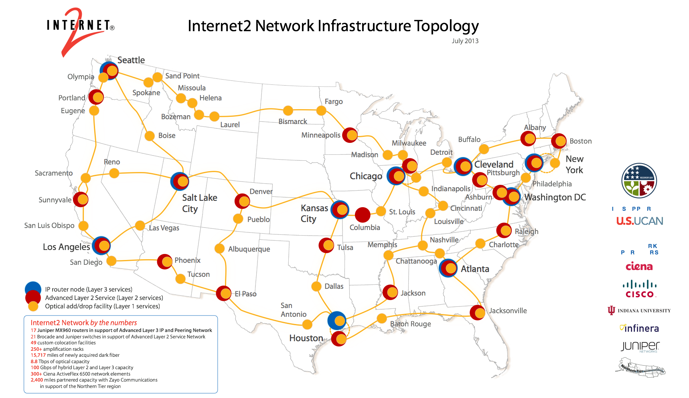
263 Universities
60 Corporations
70 Government agencies
38 Regional & state networks
65 International R&E networks
September 30, 2014 © 2013 Internet2
Notes:
Internet2 is building the next innovation platform
Internet2’s core mission is to be the “forward leaning leader” of the R&E community—to facilitate the next innovation platform and to keep our campuses “way out in front” of commodity offerings
Membership has expanded from 34 to 255+ universities, plus 150 leading industry, network and affiliate members—including government agencies and laboratories
Internet2 broader community has expanded to over 66,000 community anchor institutions across the U.S. and over 100 international networking partners representing over 50 countries

Slide 5

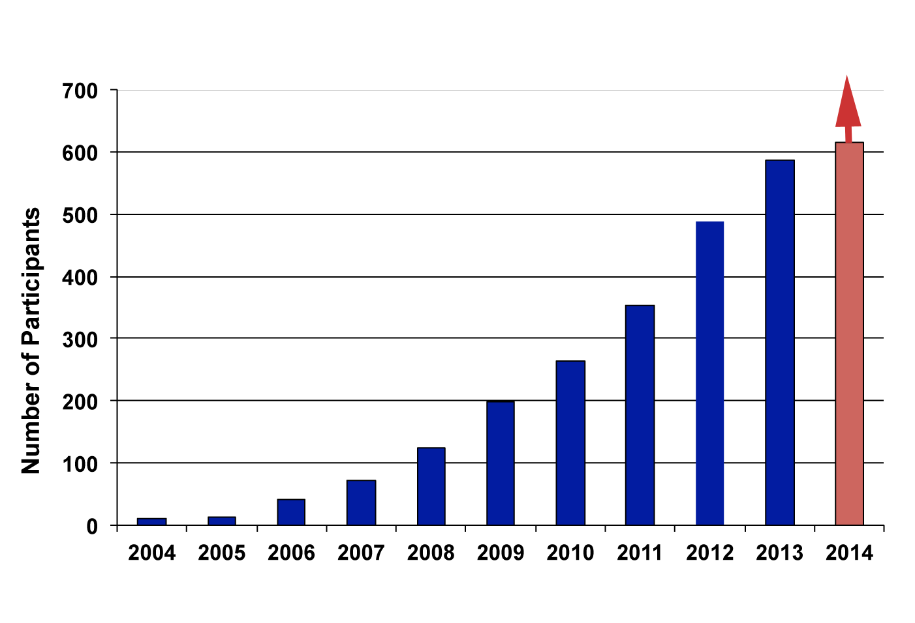
Foundation for Trust & Identity
15 425+
2 160+
0 2000+
7.8 million
Academic Participants
Sponsored Partners
Registered
Service Providers
Individuals served
by federated IdM

Slide 6
5th Generation of Computing
This Era of Computing is Still Nascent
1970s
Monolithic
1980s
Client-Server
1990s
The Web
2000s
Services Oriented Architectures
2009+
Cloud
Lessons From The Past *Still* Apply To The Future
Notes:
Look at history, we can say Cloud Computing is the 5th generation of computing, after monolithic, client-server, web, service-oriented architecture and now it’s cloud service.
----- Meeting Notes (4/4/14 10:40) -----
Steve: Fixup this slide to include ribbon

Slide 7
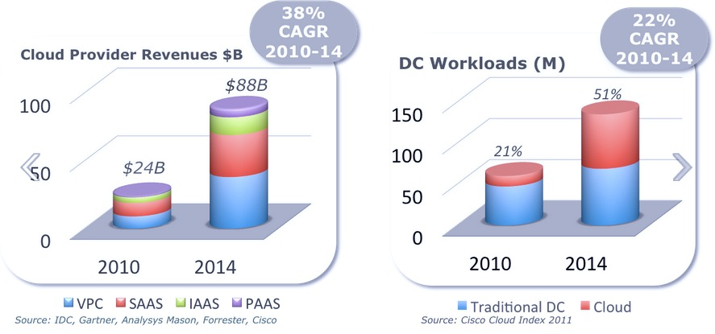
The Cloud Market is Growing…

Slide 8
NET+ Service Validation Components
Functional Assessment
  IT technical review of features / functionality
  Tune service for research and education community
Technical Integration
  Network: determine optimal connection and optimize service to use the Internet2 R&E network
  Identity: InCommon integration
Security and Compliance
  Security assessment: Cloud Controls Matrix
  FERPA, HIPAA, privacy, data handling
  Accessibility
Legal and Business
  Customized agreement developed from community contract templates
  Develop business model with leadership from sponsor campus purchasing office
  Define pricing and value proposition that all participating campuses approve
Deployment
  Documentation
  Use Cases
  Support Model

Slide 9




















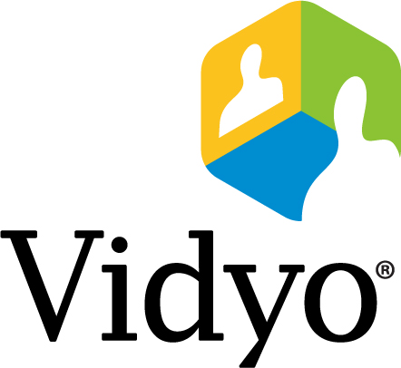




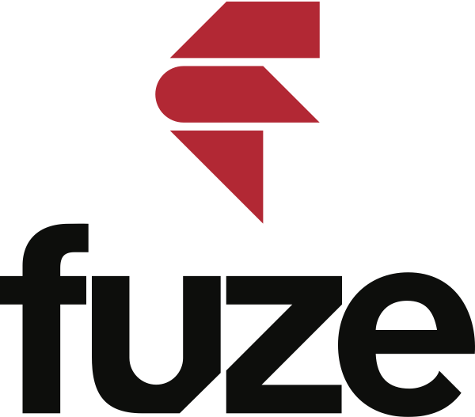











Growing Ecosystem of Cloud Services & Providers

Slide 10
Campus Perspectives

Slide 11

University of Notre Dame
Private research university located in South Bend, Indiana
~12,000 students and ~1,200 academic staff

Slide 12

Pennsylvania State University
Public research university with campuses across the state
~100,000 students and ~10,000 academic staff
"Penn state old main summer" by George Chriss - Own work. Licensed under Creative Commons Attribution 2.5 via Wikimedia Commons - http://commons.wikimedia.org/wiki/File:Penn_state_old_main_summer.jpg#mediaviewer/File:Penn_state_old_main_summer.jpg

Slide 13
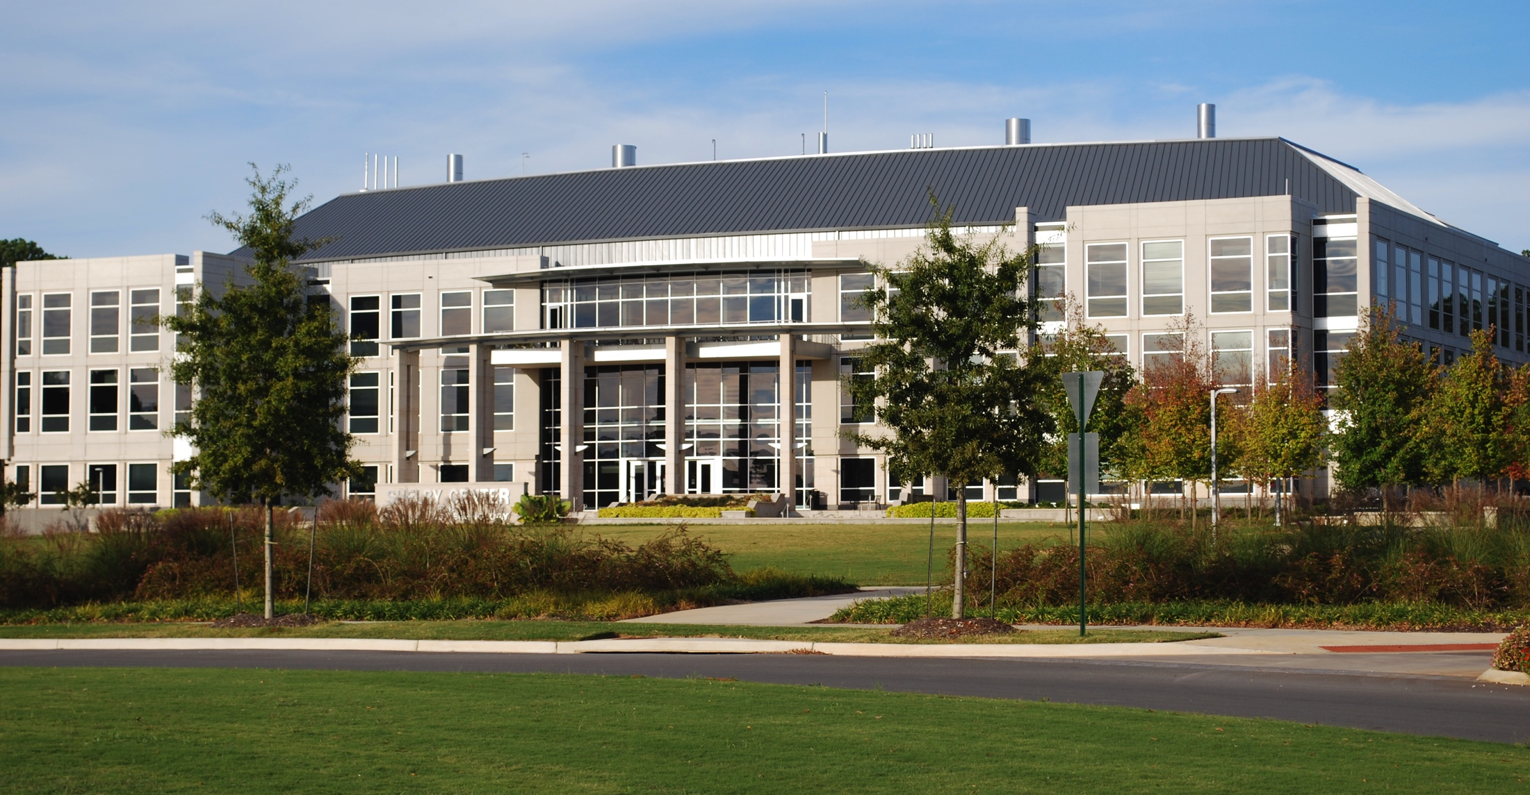
University of Alabama Huntsville
Public research university with 6 colleges, part of UA system
~8,000 students and <1,000 academic staff
"UAHShelbyCenter" by Anivron - Own work. Licensed under Creative Commons Attribution 3.0 via Wikimedia Commons - http://commons.wikimedia.org/wiki/File:UAHShelbyCenter.jpg#mediaviewer/File:UAHShelbyCenter.jpg

Slide 14
Discussion

Slide 15
Presenters & Panelists
Andrew Keating (Internet2)
  Director, NET+ Program Management
Mike Chapple (Notre Dame)
  Senior Director, IT Service Delivery
Jeff Reel (Penn State)
  Director, Strategic IT Programs
Chad Hyatt (U Alabama Huntsville)
  Director, Academic Technologies & Client Services
Notes:
What cloud service(s) has your institution deployed? What appealed to you about looking to the cloud for a solution with that service?
What are some of the challenges you and your team faced in moving infrastructure to the cloud? How did you overcome them?
Have there been benefits from cloud infrastructure… to your end users? …to the IT team? …to the institution?
Are there special considerations with a cloud infrastructure service that you might not have taken into account when considering on premise hardware? Or are the issues when evaluating and deploying a service still fundamentally the same, even if the location of the hardware or the operation of the service is different?
What is your overall cloud strategy? Are you looking to move additional services to the cloud? Why or why not?
Our community has unique requirements to consider when deploying cloud infrastructure. Can you speak to some of your requirements and how your recent or planned deployments were tailored to your campus needs?
Cloud services promise lower Total Cost of Ownership. Can you elaborate how this applies to your institution?

Slide 16
Help Us Improve and Grow
Thank you for participating
in today’s session.
We’re very interested in your feedback. Please take
a minute to fill out the session evaluation found within
the conference mobile app, or the online agenda.

