Slide 1

Using FLEXspace to Streamline Learning Space Design and Renovation
Notes:
Good Morning!
Hopefully everyone is well caffeinated, and thank you so much for joining us at this early hour to share our excitement about FLEXspace (the Flexible Learning Environments eXchange)

Slide 2


Presenting Core Team Members
Lisa Stephens
Senior Strategist, SUNY Academic Innovation
Joseph Moreau
Vice Chancellor, Technology-Foothill De Anza CC District
James Frazee
Senior Academic Technology Officer – San Diego State University
Megan Marler
Director, Strategic Services – ARTstor
Jim Young
Chief Learning Officer – SCUP
Flexible Learning Environments eXchange
  Flexible Learning Environments eXchange
Notes:
(Lisa)
I’m Lisa Stephens – It’s been my privilege to serve as the volunteer Project Manager = conductor of an amazing orchestra.
FLEXspace is now available as a production environment to enable faculty, technology integrators, and facilities designers to openly share media-rich examples of innovative learning spaces and best practices – Joe will be describing this more in a moment, and James and Megan will be providing a tour on how you can join this important collaboration that we believe can benefit everyone in higher education and beyond.
The goal of our presentation this morning is to provide you with actionable knowledge about this version of FLEXspace,
Demonstrate how each of the attributes for pedagogy, technology, and facilities supports this integrated solution
And share the roadmap for moving forward and the integration synergy with the ELI Learning Space Rating System.

Slide 3
Vision and Mission
Vision:
A comprehensive, searchable, open access, peer-reviewed learning space repository.
Mission:
Build a high performance community tool that shares learning environment data to save time, money and effort, and provide a source of best practice models.
  Flexible Learning Environments eXchange
Flexible Learning Environments eXchange
Notes:
(Lisa)
To unpack the FLEXspace vision and mission statement -
We are collectively creating a robust, highly searchable, open access learning space repository
once populated with a critical mass of records - institutions will have the option to submit records for voluntary peer review, and we have a team of people ready to begin work on rubrics as part of the next developmental phase.
Robust = highly reliable, (not an institutional member server – which is how we were led to ARTstor
Open Access = once you receive a free account in FLEXspace– you click through the terms of service, (e.g., don’t violate copyright)
Then you can be begin searching and uploading examples of learning environments from all over the world.
Highly Searchable – James and Megan will be demonstrating how to search and filter on the database attributes –
We have a business model that has been vetted by a number of external reviewers that we believe will enable institutions to use this at no, or very low cost, to showcase institutional points of pride
(Hand off to Joe)

Slide 4







Founding Partners & Sponsors
Herman Miller
Flexible Learning Environments eXchange
  Flexible Learning Environments eXchange
Notes:
(Lisa)
Although 5 of us are presenting today, we have 12 people on our core team, serving as an interim board – and have collaborated with well over 50 people to refine FLEXspace taxonomies from beta to production 1.0 this past year.
Most of the early collaborators were drawn from professional organizations and institutions listed here,
We’re thrilled to announce that Herman Miller is the first- of what we hope will be many - founding corporate sponsors to help with the start up phase.
Although the project began within SUNY, we now enjoy a unique, large-scale collaboration among founding institutional partners – with each one contributing a strategic strength to the project.
(hand off to Joe)

Slide 5
Community Value
Provide ROI examples of peer solutions
Decrease the facilities planning-to-construction time cycle
Encourage consistent terminology across stakeholder groups:
Facilities Planners
Architects
Faculty
Instructional Design & Support
Administration
Information Technologists
Flexible Learning Environments eXchange
  Flexible Learning Environments eXchange
Notes:
(Joe)
The key community value of FLEXspace is sharing best practices.
Tension between interests when building new spaces. (how many of you have experienced…)
Funding has declined for construction of new buildings, driving a need for renovation cycles to be more agile, and respond to increased demand for features to support digital content capture and display for flipped classroom, active learning, etc. \
We’re convinced that by creating three separate domains to gather information from the perspective of faculty, instructional technology support and facilities design and support expertise we’ll help promote a common understanding across the learning space eco-system.

Slide 6
Community Value
Demonstrate a variety of ways to capture and “flip” content
      Course Capture
      Tutorial Applications
      Developmental Education Modules
Encourage experimentation and adoption of emerging models:
      Maker Spaces & “Fab Labs”
      Active Learning Classrooms
      Support of Gaming, Simulation and Immersive Environments
Flexible Learning Environments eXchange
  Flexible Learning Environments eXchange
Notes:
(Joe)
The literature continues to support the value of making course content available in a number of ways
And part of the value of FLEXspace is that as we seek to better understand how to construct and support emerging models of learning environments, we can share our experience more broadly when designing Active Learning Classrooms, Maker Spaces and Simulation Spaces.
Clearly, the lines between built environments and digital classrooms are becoming increasingly blurred, and this project is intended to help us with those challenges.

Slide 7
Community Value
Integrated with other national efforts
  Learning Space Rating System: conceptual guidance in planning stages, post-occupancy evaluation
  FLEXspace: benchmarking database for design, post-occupancy evaluation
Cross link to other important resources:
  NCSU Scale-Up
  Learning Space Toolkit
  Journal of Learning Spaces
  FLEXspace Founding Organizational Websites
Flexible Learning Environments eXchange
  Flexible Learning Environments eXchange
Notes:
(Joe)
The Learning Space Rating System and FLEXspace have been under development for similar lengths of time, and are two sides of the same coin.
The teams behind both efforts are working very closely together on parallel, complimentary tracks.
We anticipate that with further peer review, over time the systems will become more tightly integrated
Also, the FLEXspace Environment seeks to be very comprehensive and inclusive. There are many fine efforts underway that provide details in particular knowledge areas; as the system grows, additional resources will be added.
(Toss to Jim Young)

Slide 8
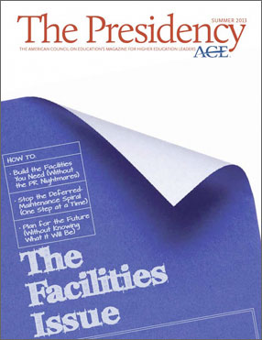
Community Value
“FLEXspace may be the most advanced in terms of inventorying space on multiple dimensions in a way that’s useful to both infrastructure planners and academic planners.”
“By the summer of 2014, campus leaders using FLEXspace will be able to plug into its interactive online database of innovative learning spaces.”
July 2013
American Council
on Education (ACE)
Flexible Learning Environments eXchange
  Flexible Learning Environments eXchange
Notes:
(Jim – flips quickly through 5 slides of good press)

Slide 9

Community Value
April 2014 Cover
Campus Technology Magazine
  Flexible Learning Environments eXchange
Notes:
(Jim)
Campus Technology Cover Story highlighted the synergy between LSRS and FLEXspace

Slide 10
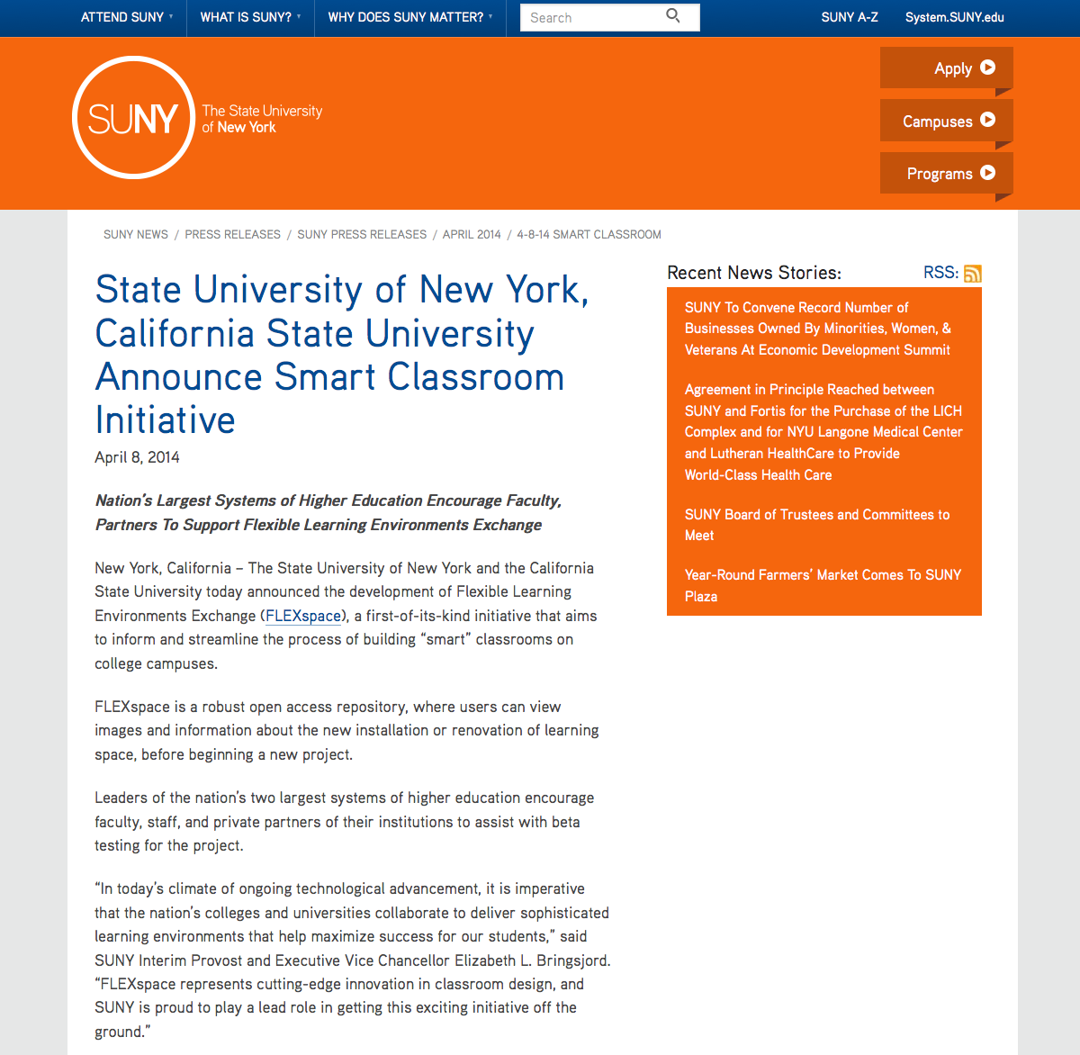
Community Value
April 8th SUNY-CSU
Joint Announcement Encouraging Adoption and Partnerships!
Flexible Learning Environments eXchange
  Flexible Learning Environments eXchange
Notes:
(Jim)
SUNY and Cal State System issued a joint announcement encouraging adoption and support of FLEXspace.

Slide 11
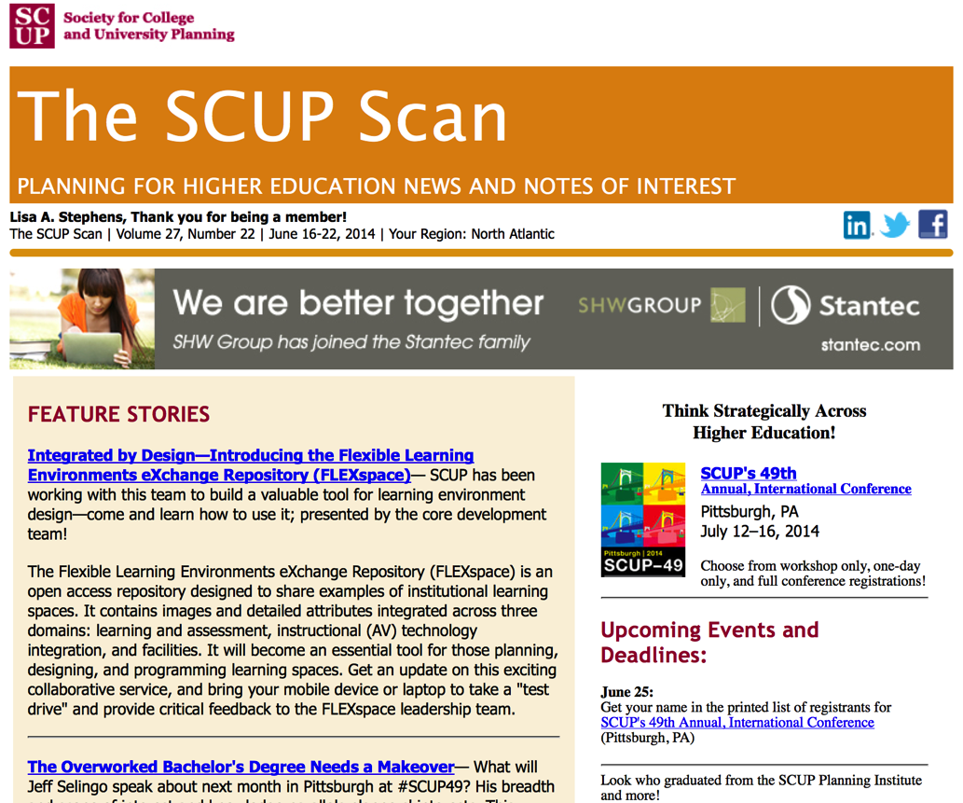
Community Value
June 2014
SCUP Scan
E-Newsletter
Flexible Learning Environments eXchange
  Flexible Learning Environments eXchange
Notes:
(Jim)
SCUP strongly supports both FLEXspace and the LSRS – have featured both in a number of publications to help drive data input/adoption

Slide 12
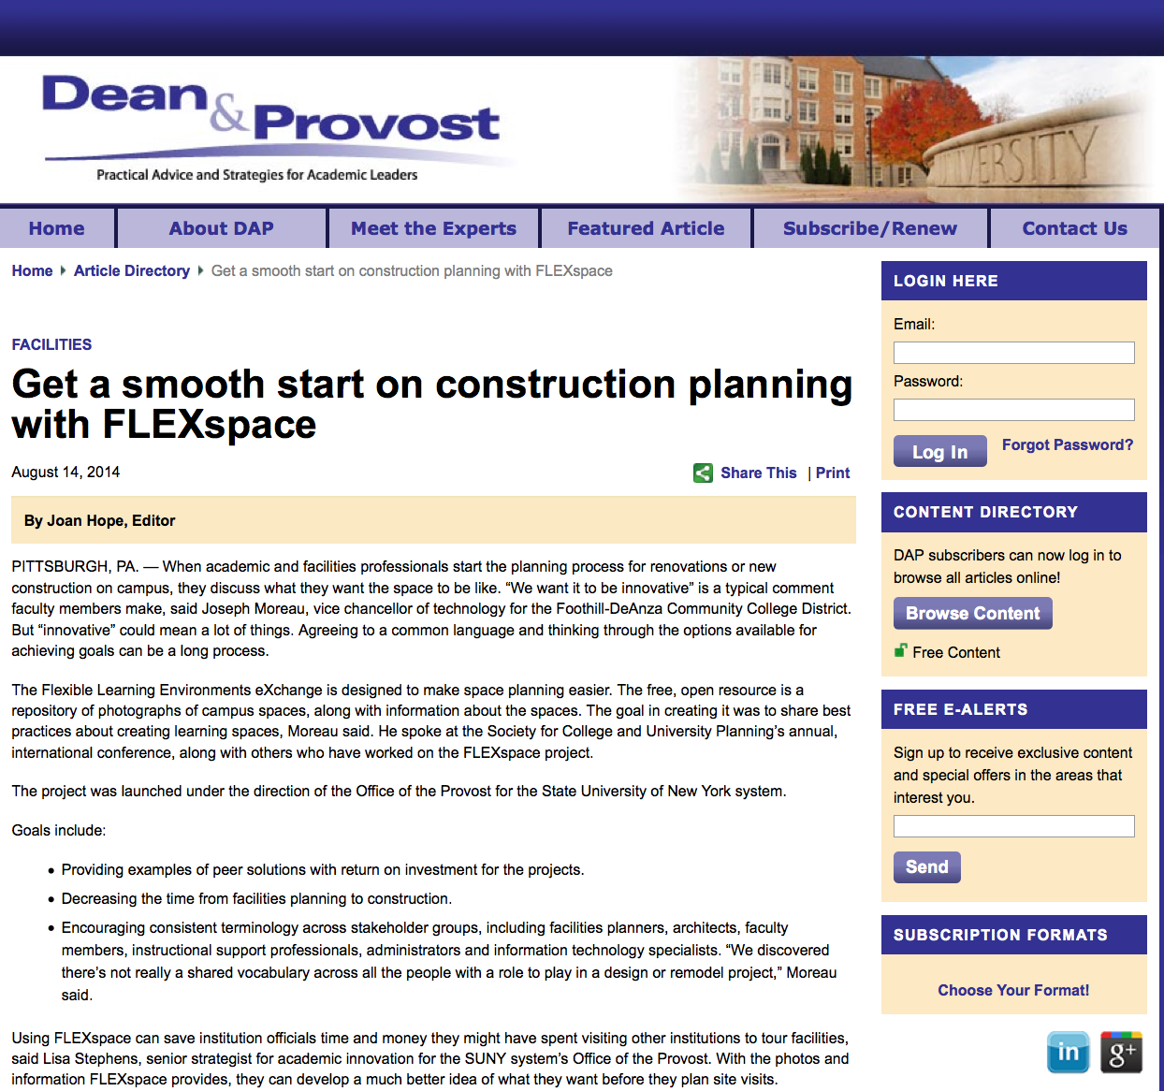
Community Value
August 2014
Dean & Provost
Magazine
Flexible Learning Environments eXchange
  Flexible Learning Environments eXchange
Notes:
(Jim)
Latest highlight article was released just last month in Dean and Provost Magazine
Toss to Lisa

Slide 13
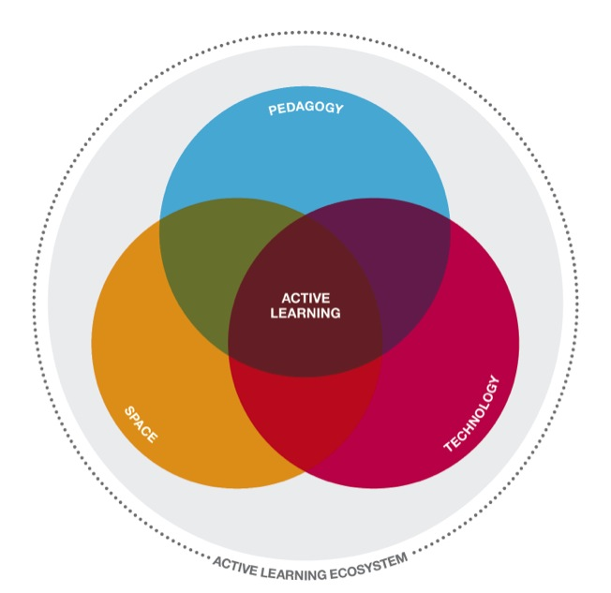
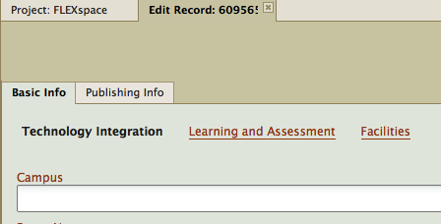
Taxonomy Development
Flexible Learning Environments eXchange
  Flexible Learning Environments eXchange
Notes:
(Lisa)
We know that active learning best occurs at the intersection of technology, pedagogy, and facilities – not necessarily in that order.
The FLEXspace taxonomies focus efforts in each of those worlds.
The goal was to create taxonomies that would enable people with average knowledge to populate attribute fields
Needed to find the balance between enough detail to facilitate good searches
Without requiring so much information that it became a time consuming burden.
The attribute fields reflect the active learning eco-system in each of the technology, learning and assessment and facilities taxonomies.

Slide 14
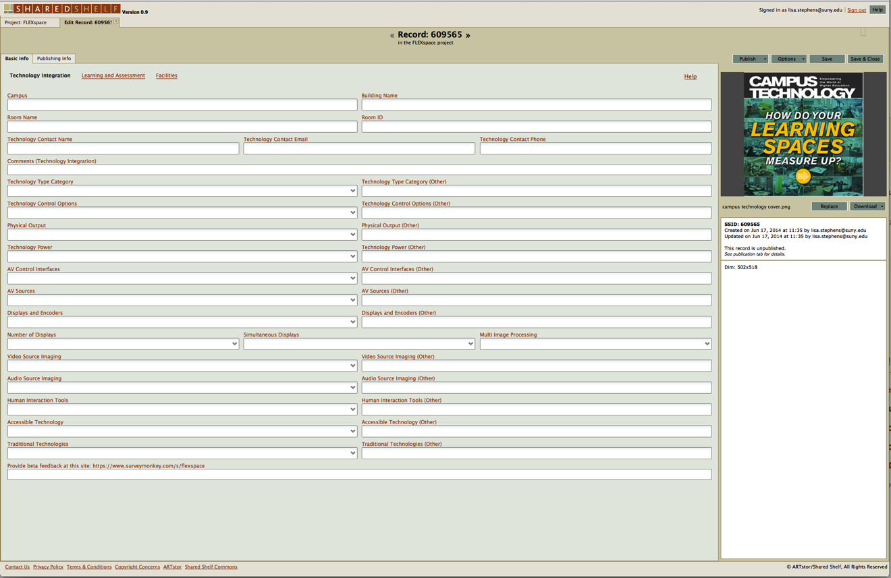
Taxonomy Development
Flexible Learning Environments eXchange
  Flexible Learning Environments eXchange
Notes:
(Lisa)
Don’t strain your eyes on this – the purpose is not to read the content in the fields,
But to show a screenshot of the entire amount of work in the Technology Taxonomy – the feedback received so far is that we met the goal of not being burdensome –
particularly since many of the fields have pull down menu choices.

Slide 15
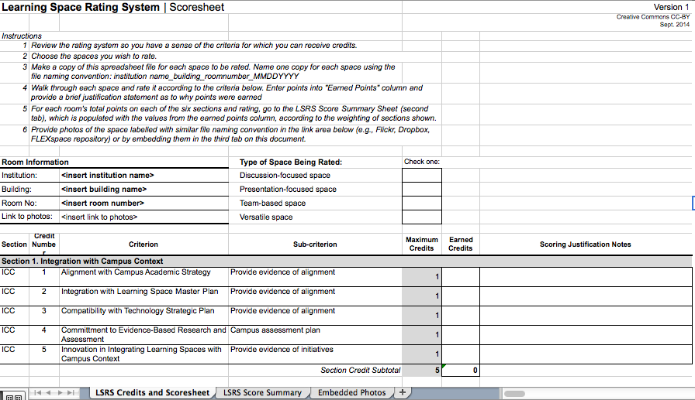
Synergy with LSRS
  Flexible Learning Environments eXchange
Flexible Learning Environments eXchange
Notes:
(Lisa)
the ELI Learning Space Rating System is modeled after the LEED rating system that awards credits for environmental sustainability
The concept is that certain classroom attributes should be awarded credit to reflect active learning features.
LSRS and FLEXspace are complimentary and non-redundant, and with your help, we expect that they will continue to converge moving forward.

Slide 16
Synergy with LSRS
Pre-Design
PD
SD
DD
CD
CA
POE
Assess
Assessment:
Learning
Effectiveness
Schematic
Design
FLEXspace/LSRS
Eco-System
Post-Occupancy
Evaluation
Design
Development
Construction
Admin
Construction
Docs
  Flexible Learning Environments eXchange
Flexible Learning Environments eXchange
Notes:
(Lisa)
When considering the entire built environment cycle, LSRS may be particularly useful in guiding the pre-design and schematic design phases, on the “input side” of planning, while FLEXspace can provide early benchmarking inspiration.
The detailed and comparative information in FLEXspace can be a resource in the design development and construction documents phase.
FLEXspace can help during the Construction Administration phase, for example when engaged in value engineering, and both systems will contribute later in evaluations post-occupancy.
Ultimately, both systems will work together to increase ROI in the design, build and assessment of spaces in a holistic, integrated manner.
The important point is that the primary use of the LSRS will likely be rating spaces in the post-occupancy phase, once a space is built and in order to compare spaces across a campus, so we need to recognize that. Rating spaces in a predesign phase will also be useful, for comparison later once renovated. Once a planning process using LSRS gets established at an institution, it may become more influential in the early stages of planning and design.
(toss to James and Megan for Demo Start)

Slide 17
Demonstration
Looking for “first impressions” – be honest!
Open Dialog – shout out questions are fine.
Do you have what you need to take this back and share with your colleagues?
Based on first impressions, how might we improve what you see?
  T
Flexible Learning Environments eXchange
  Flexible Learning Environments eXchange
Notes:
James starts with CSU project
Megan helps or jumps in with additional features.
(Have to leave time to talk about the Sustainability Roadmap – toss to Joe)

Slide 18

Sustainability Roadmap
Spring 2014 | Release 1.0 | Target 500 Complete Records
Ongoing | Build Community, Expand Sponsorship | Conferences & Demos Expand Web Toolkit & IAC
Summer 2015 | Release 2.0 | Peer Review Functionality Expand to Tiered Sponsorship
Summer 2016 | Release 2.X | Revise & Expand Business Plan: Business, K-12, 501[c]3’s
Summer 2017 | Release 3.0 | Mature Adoption Self-Sustaining via Sponsorship or Membership Model
Project Plan
Deliverables
Notes:
Joe

Slide 19
Current Stats
322 Total User Accounts
220 Unique .EDU Institutions
  US-212
  UK-15
  Canada-10
  Germany, Jamaica, Malaysia, Mexico, New Zealand, Singapore, South Africa, Sweden, UAE
Institutional Size
  Large – 18 Community College - 33
  Medium – 41 K-12 – 14
  Small – 22 JISC (UK) 12
  Very Small – 17 Other (inc. Library) 34
28 Vendors or Architectural Firms
  T
Notes:
Joe

Slide 20
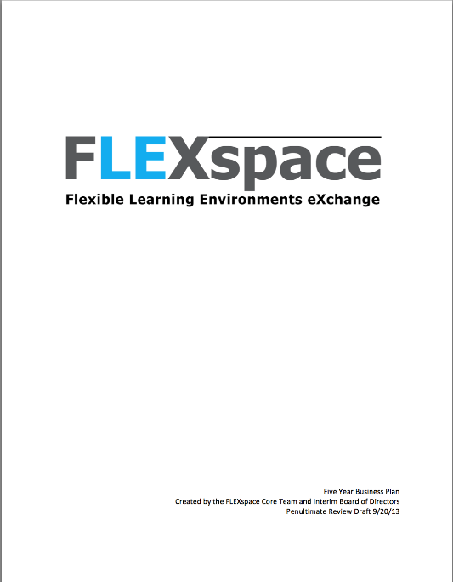
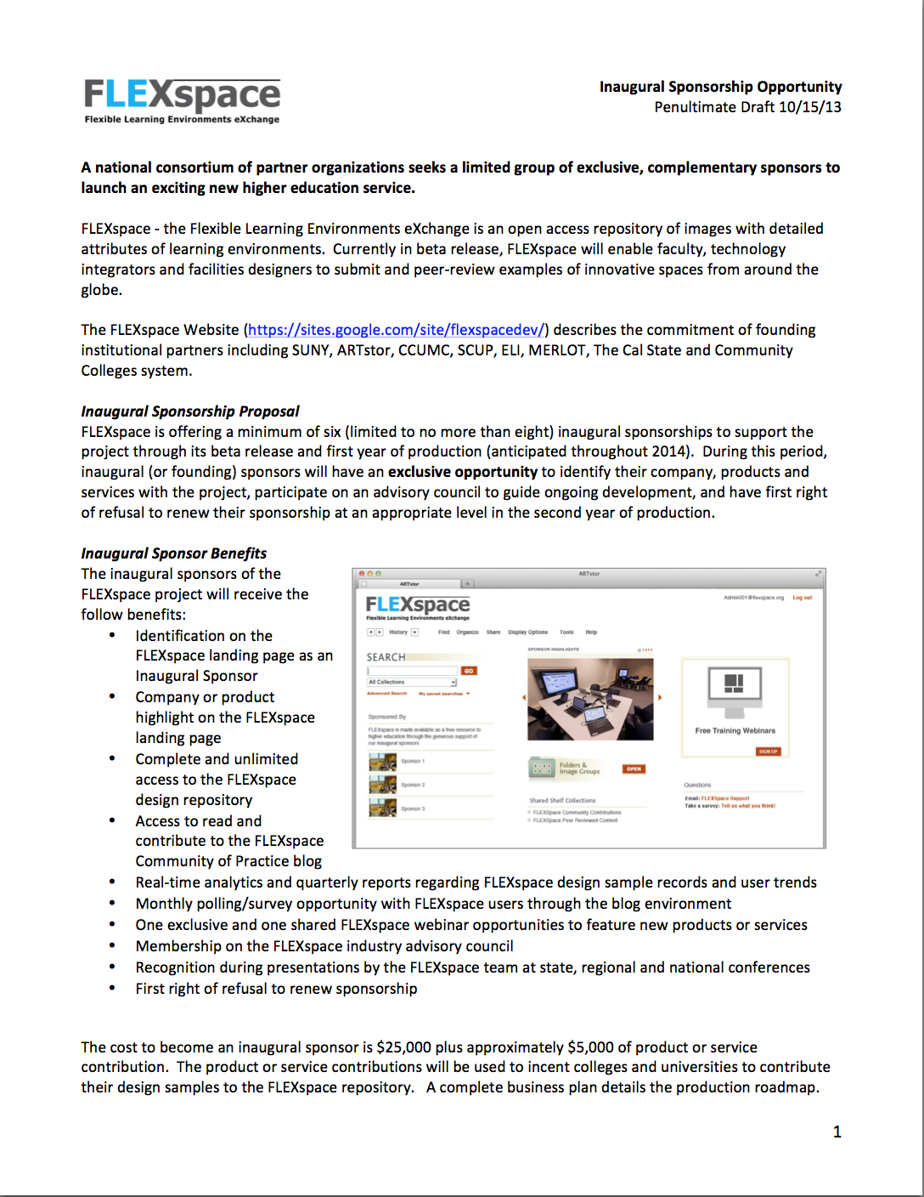
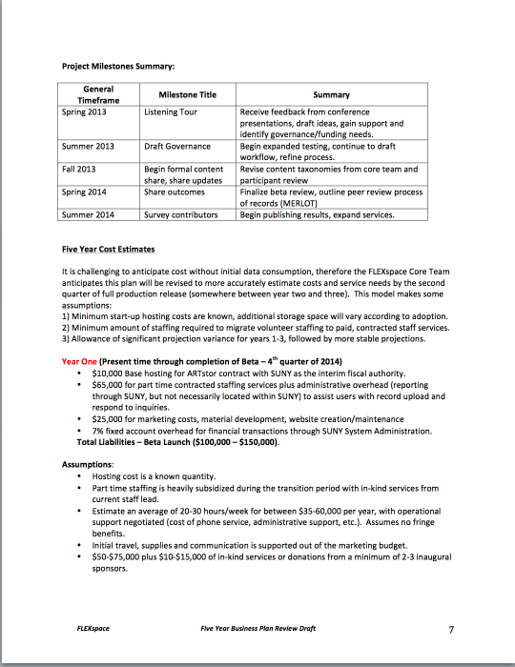
Sustainability Roadmap
Five Year
Business Plan
(2013-17)
Post-Inaugural Tiered Sponsorship Plan
Flexible Learning Environments eXchange
  Flexible Learning Environments eXchange
Notes:
Joe
Toss to Lisa to Wrap

Slide 21

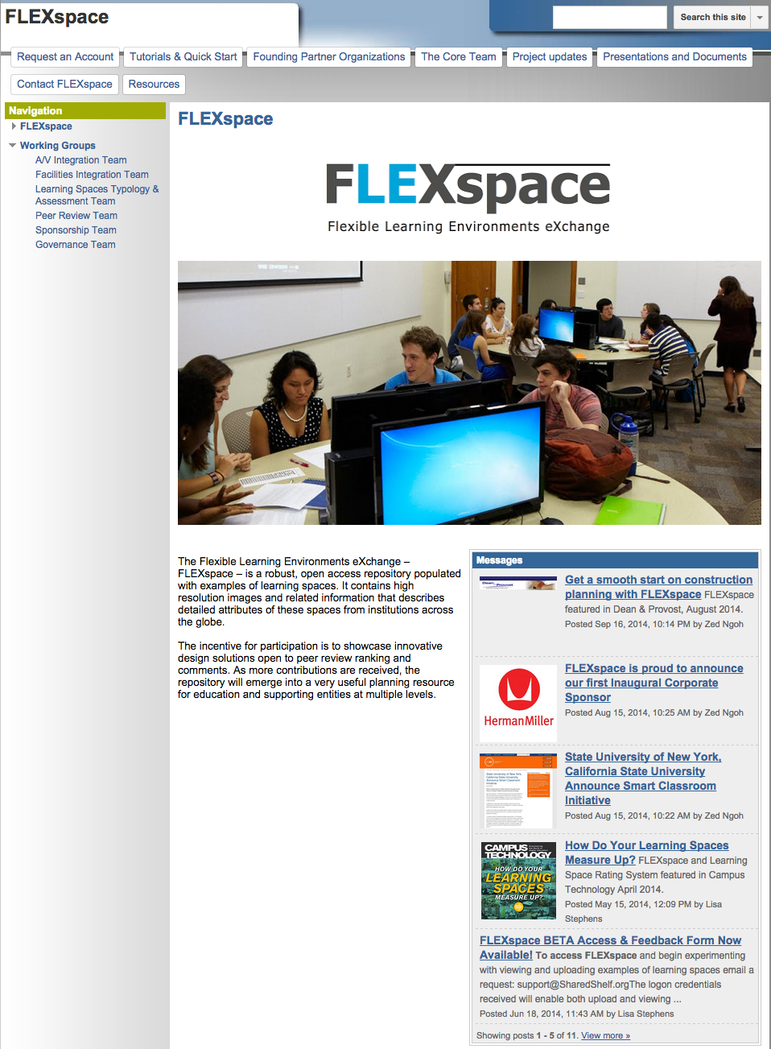

Project Website
FLEXspace.org
Domain Donated
Project Website
Core Team Contact
Founding Members/Sponsors
Account Request
Publications & Links
FLEXspace Repository Portal Access
Browse Collections
Contribute/Showcase Spaces
  Learning/Assessment
  Technology Integration
  Architecture/Facilities
Flexible Learning Environments eXchange
  Flexible Learning Environments eXchange
Notes:
(Lisa)
The vast majority of the project information is readily available on the flexspace.org website.
We’re very happy to now be able to say “FLEXspace.ORG” – our friends at the Adler Group generously released that domain name to our project.
Part of our roadmap is to migrate away from a Google Site into a more robust website.

Slide 22
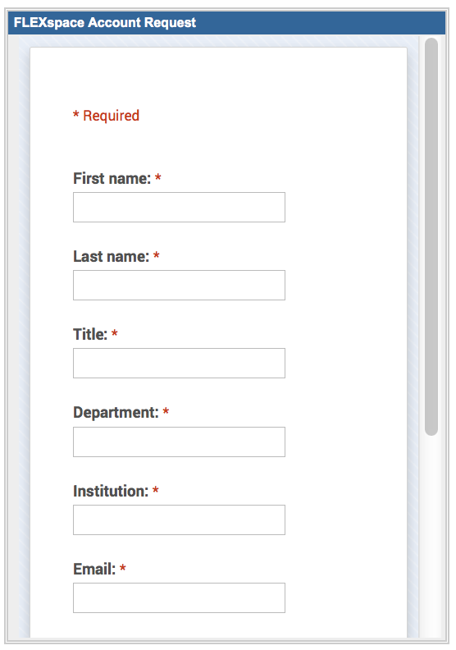
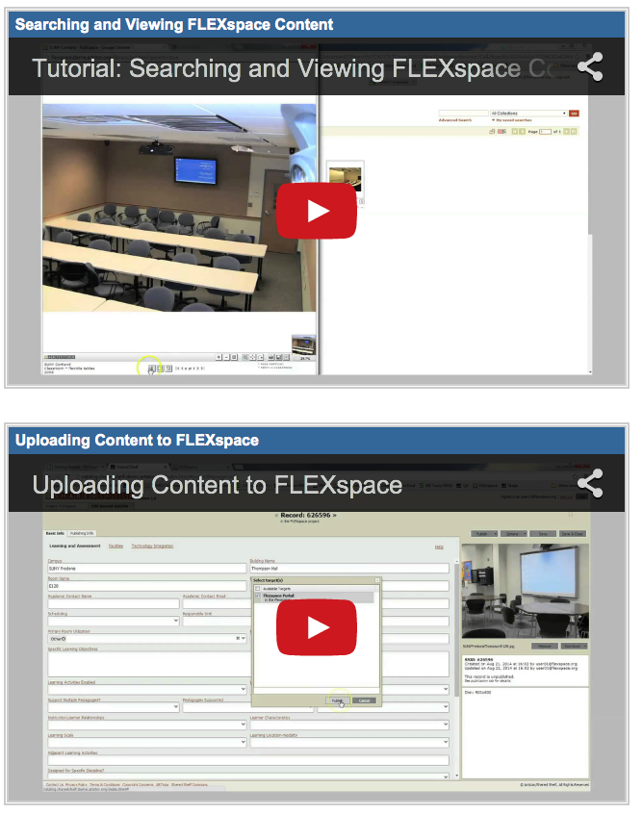
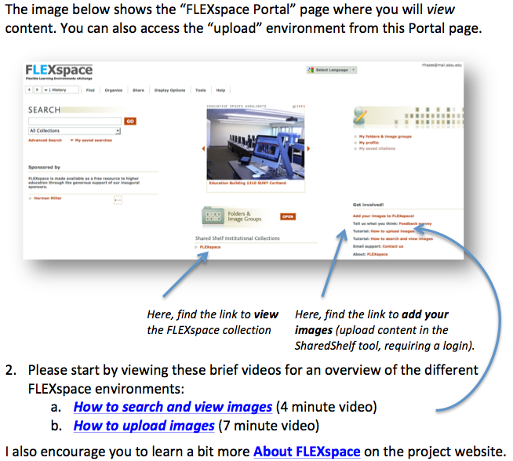
Project Website
Getting Started
Account Request
Agree to terms/conditions
Support Contact
FLEXspace Tutorials
How to Browse Content
How to Upload/Contribute
Quick Start Guide
Growing collection of tips
Flexible Learning Environments eXchange
  Flexible Learning Environments eXchange
Notes:
(Lisa)
The vast majority of the project information currently resides in on the flexspace.org website.
It serves as a common collection point for people to request accounts to get into the Shared Shelf system
And provides updates and links to other complimentary efforts.

Slide 23
Questions?
Lisa Stephens
Lisa.Stephens@suny.edu
Senior Strategist, SUNY Academic Innovation
Joe Moreau
moreaujoseph@fhda.edu
Vice Chancellor, Technology-Foothill De Anza CC District
Megan Marler
Megan.Marler@ARTstor.org
Director, Strategic Services – ARTstor
James Frazee
jfrazee@mail.sdsu.edu
Senior Academic Technology Officer – San Diego State University
Jim Young
james.young@scup.org
Chief Learning Officer - SCUP
  T
  Flexible Learning Environments eXchange
Notes:
Q&A – put up closer slide!

Slide 24
Help Us Improve & Grow
Thank you for participating
in today’s session.
We’re very interested in your feedback. Please take
a minute to fill out the session evaluation found within
the conference mobile app, or the online agenda.
Notes:
Thank you – please fill out an evaluation and tell us how we can improve this presentation to build out FLEXspace!

