Slide 1
The Browning Letters Project:
Preservation for Digital Humanities
Ian Graham
Pattie Orr
Darryl Stuhr
Wellesley College
Notes:
PATTIE:
Intro - read bios

Slide 2
The Browning Letters Project:
Preservation for Digital Humanities
Notes:
PATTIE:
Why would we want to do this?

Slide 3
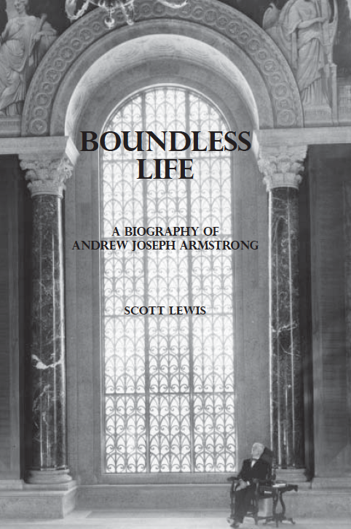
Armstrong
Browning Library
Notes:
PATTIE:

Slide 4
Baylor-Wellesley Connection
Timeline
1922
2007
2012
Notes:
PATTIE:
When did this project start?.
1922 — correspondence from Fannie Browning about the Wellesley Browning Collection
1930 — Armstrong’s desire for the courtship letters but Wellesley’s purchase of them
2007 — Wellesley
2011 — Wellesley donation and Project Meeting
2012 — First deadline — 2012 (575 courtship + 800 Baylor-owned letters)

Slide 5
Happy Valentine’s Day
2012
Notes:
PATTIE:
First Launch Valentine’s Day 2012
The original story from Feb. 12, 2012 appeared nationally and internationally in more than 400 outlets, like:
Washington Post, NY Times, LA Times, Boston Globe, Houston Chronicle, CBS News, ABC News, NPR
This was the beginning of other partnerships — Balliol, Harry Ransom Ctr.@ UT, Bodleian and Eton
————————————————————————————-
Darryl — NEXT SLIDE
————————————————————————————-

Slide 6
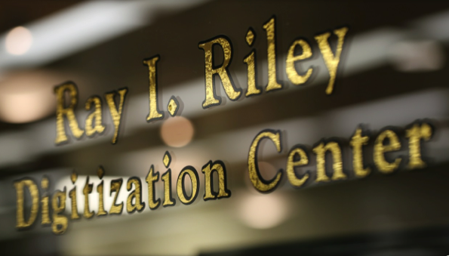
Ray I. Riley Digitization Center
Notes:
DARRYL:
Ray I. Riley Center — centralized

Slide 7
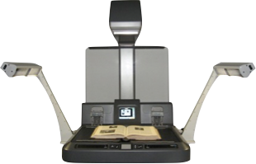
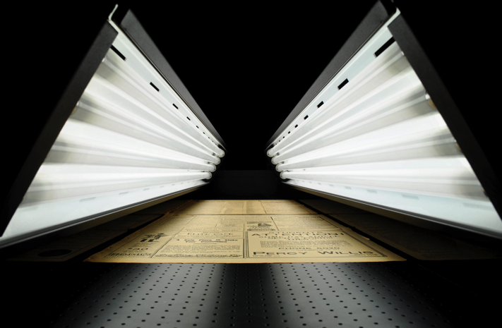
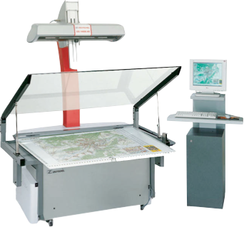
Ray I. Riley Digitization Center
Notes:
DARRYL:
Equipment

Slide 8
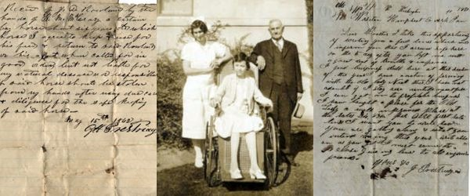
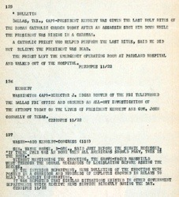
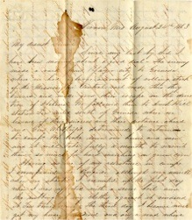
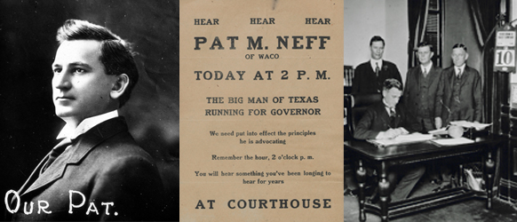
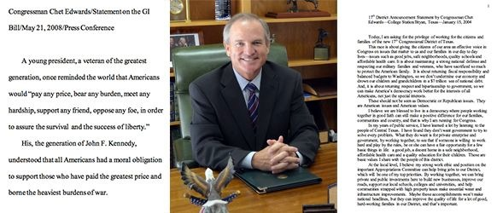
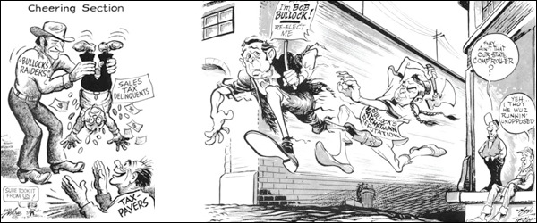
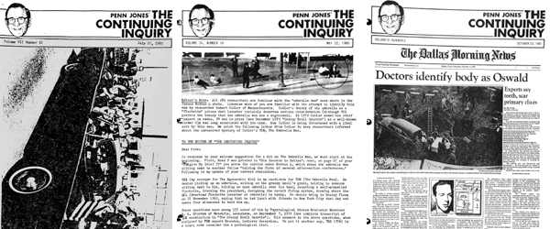
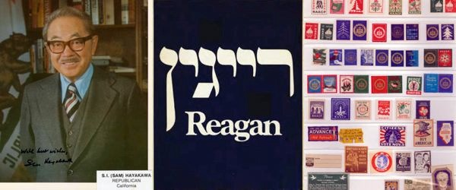
262,619
items online
Notes:
DARRYL: Our work
Maps, newspapers, audio records, cassettes, reel-to-reel tape, video tapes: U-Matic, Beta, VHS

Slide 9
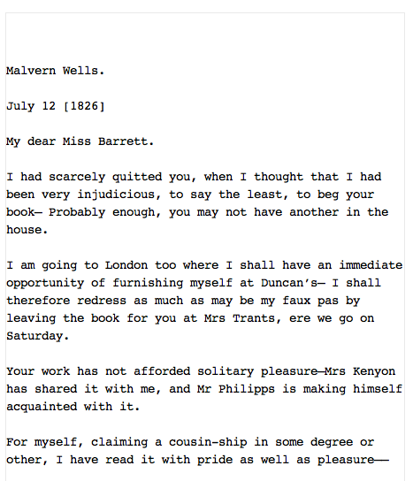
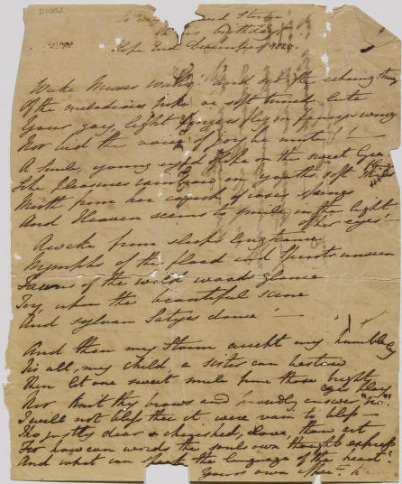
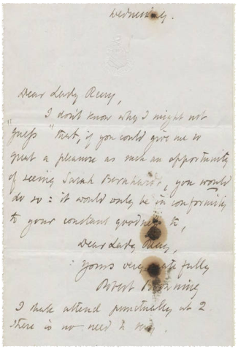
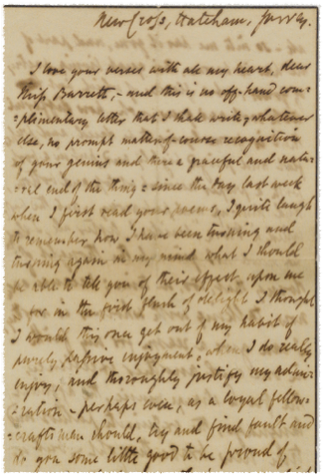
Project Phases
Phase 5
Phase 4
Phase 3
Phase 2
Phase 1
Notes:
DARRYL: Phases
1 — Wellesley Love letters @ Wellesley — sent to BU / At the same time BU…digitizing for 2012 Release
2 — Digitize ABL
3 — Digitize the remainder of Wellesley Letters at BU
4 — Add full text to all of the letters (#) by contracting with one of the premier Browning scholars has been our vendor for the full text transcriptions (both W and BU)
5 — Begin building partnerships — CURRENTLY: UT HRC, Balliol College

Slide 10
Digitization Progress
2/2012
2/2013
2/2014
Notes:
DARRYL: Digitization progress
Wellesley: 574 (around 800 BU letters at launch)
Baylor: 2,920
W@BU: 1,050

Slide 11
Project Statistics
1 TB
4,593 Letters
23,464
Letter pages & envelopes
1.9 Million
full-text words
Notes:
DARRYL: Stats

Slide 12
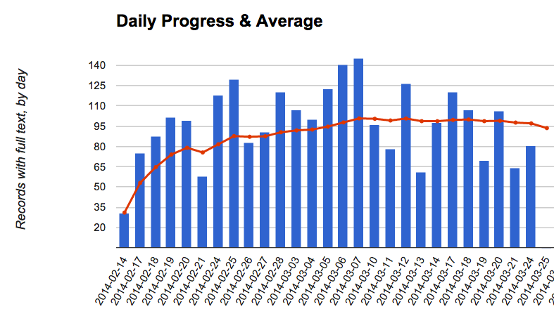
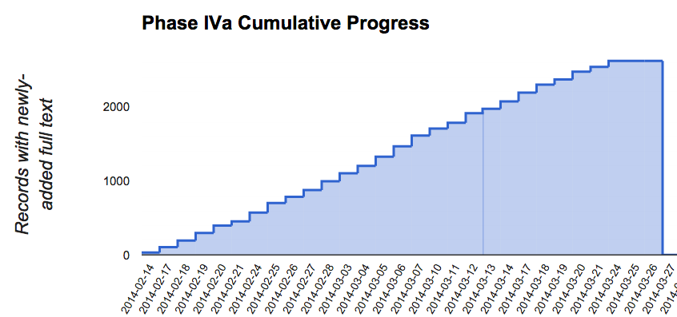
Tracking Project
Notes:
DARRYL: How we are tracking the project

Slide 13
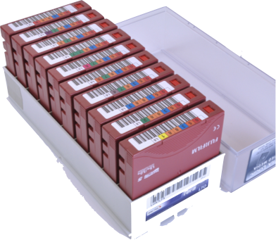
Digital Preservation
Riley Preservation Server
BU Data Center
LTO Tape
Texas Digital Library
DPN
Notes:
DARRYL: Digital preservation efforts

Slide 14
Partners
Balliol
Eton
Notes:
DARRYL: Our partners
BU and Wellesley first, soon after launch…
UT update - 313
Balliol update - 57 letters — half are digitized
When Balliol goes online, we feel the…
Bodleian = 48 / Eton = 458
——————————————-
876 letters

Slide 15
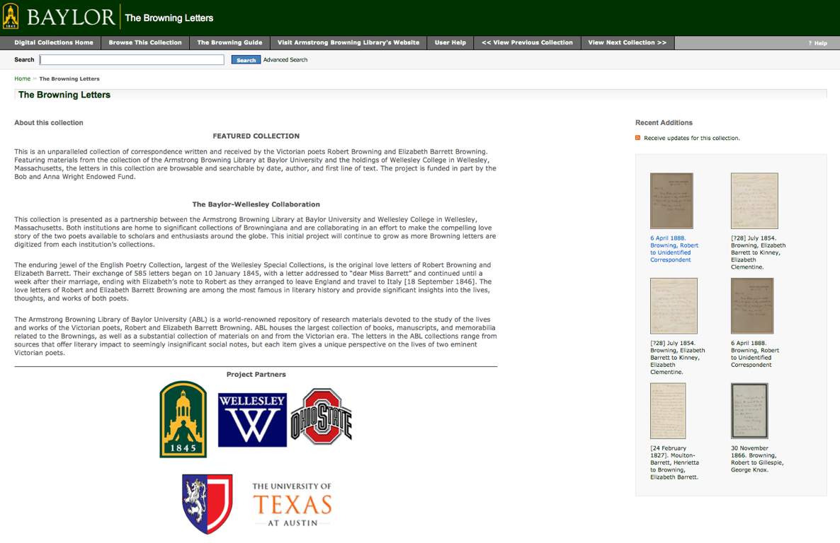
Notes:
DARRYL: The public face is through our DAMS — OCLC CONTENTdm

Slide 16
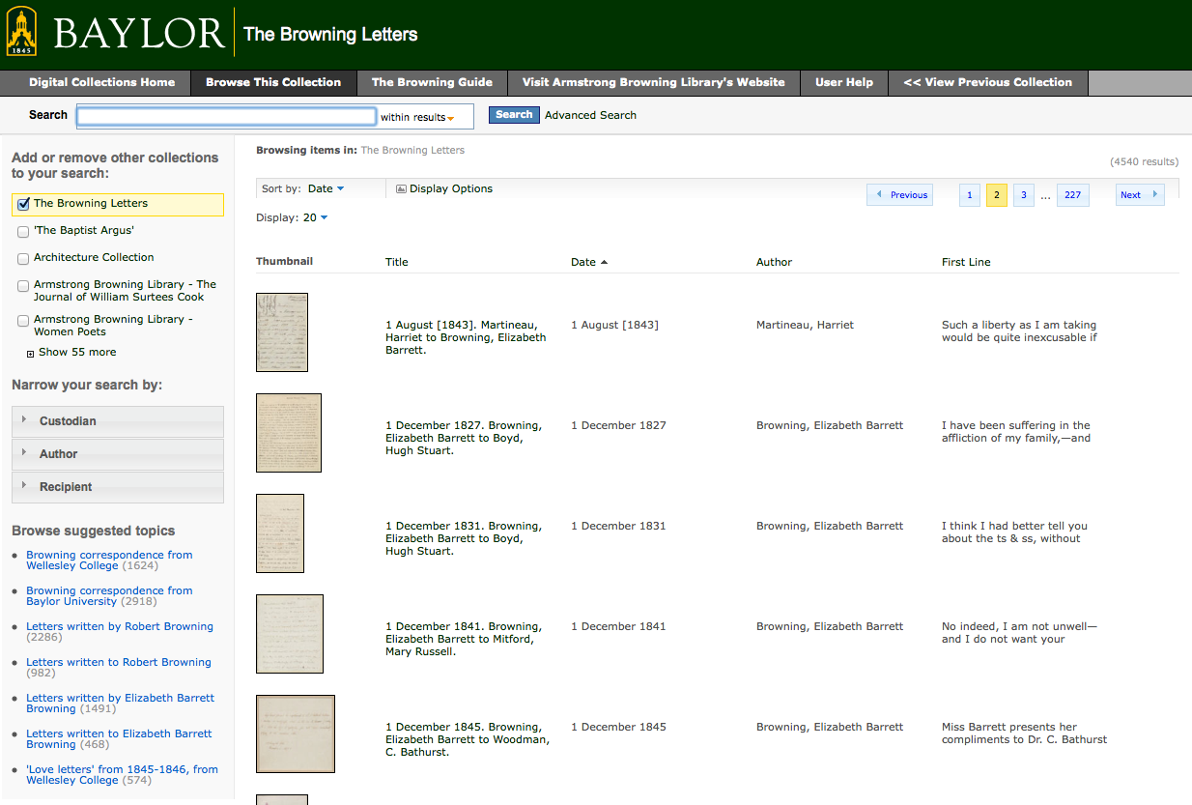
Notes:
DARRYL

Slide 17
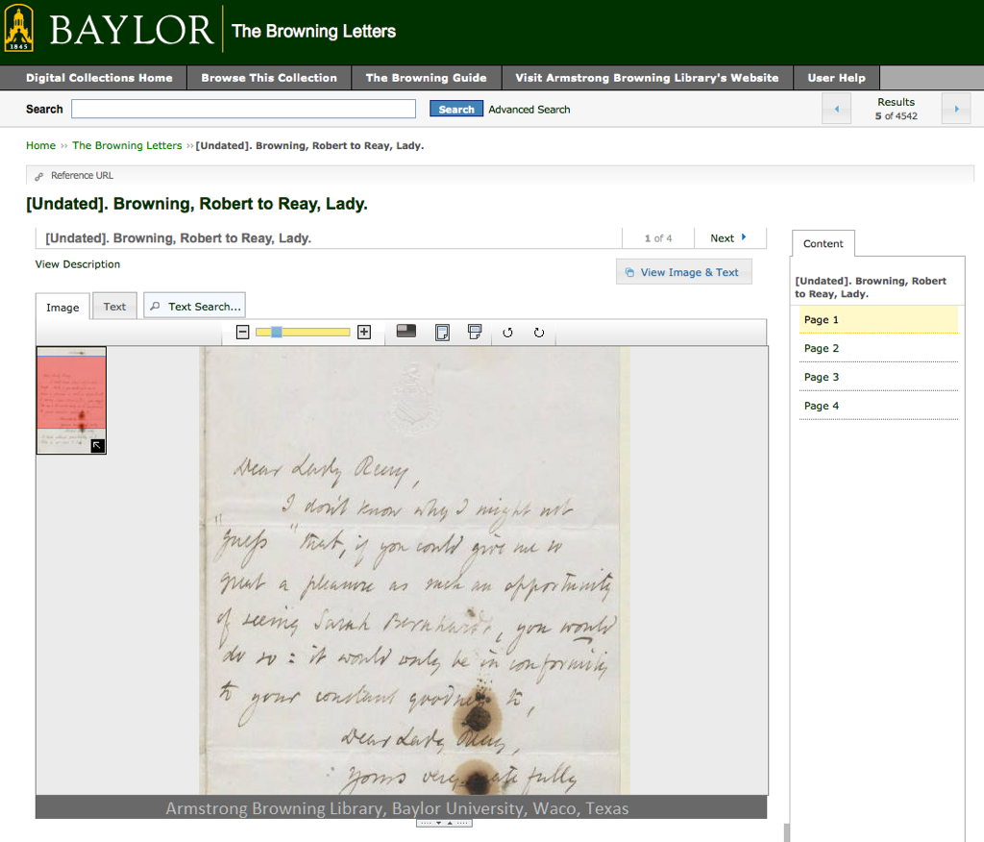
Notes:
DARRYL:

Slide 18
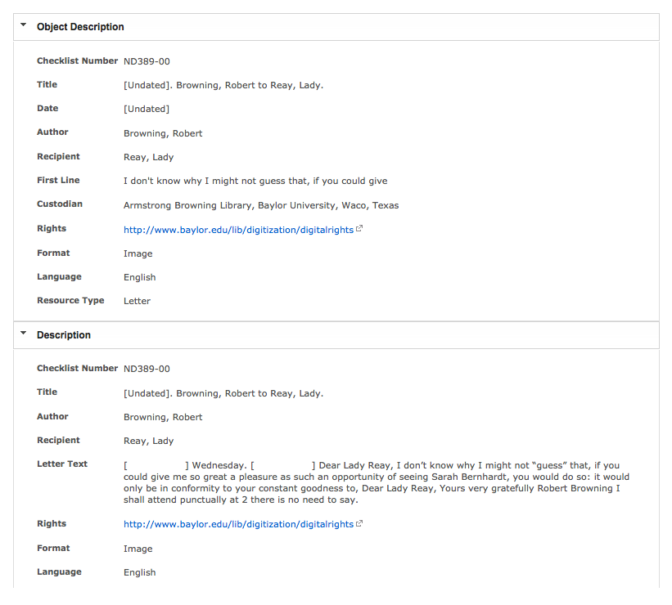
Notes:
DARRYL:

Slide 19
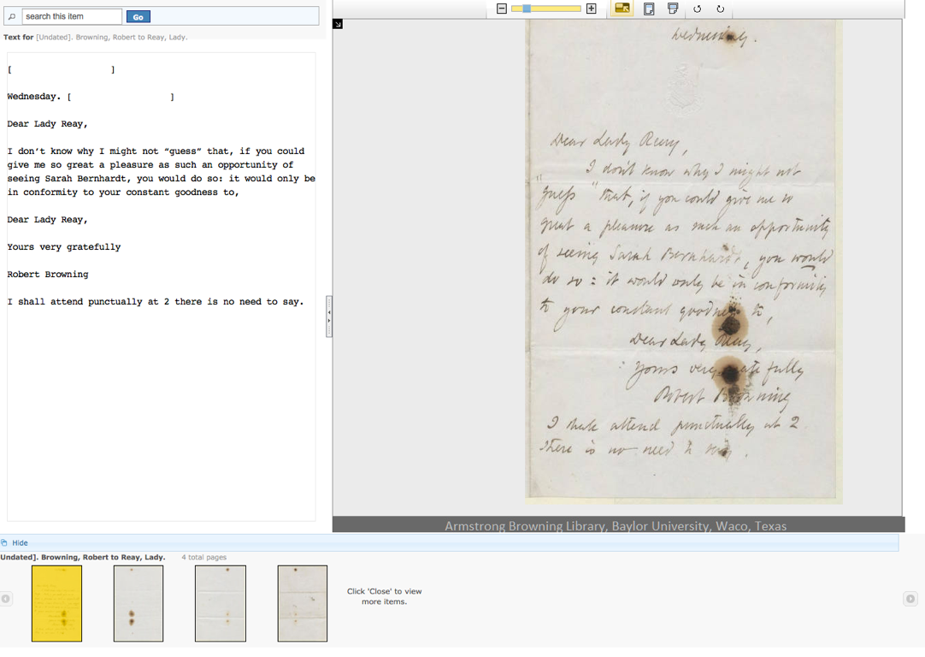
Notes:
DARRYL:

Slide 20
Digital Collection Access
Notes:
DARRYL:
————————————————————————————-
IAN — NEXT SLIDE
Handover

Slide 21
Notes:
IAN-

Slide 22
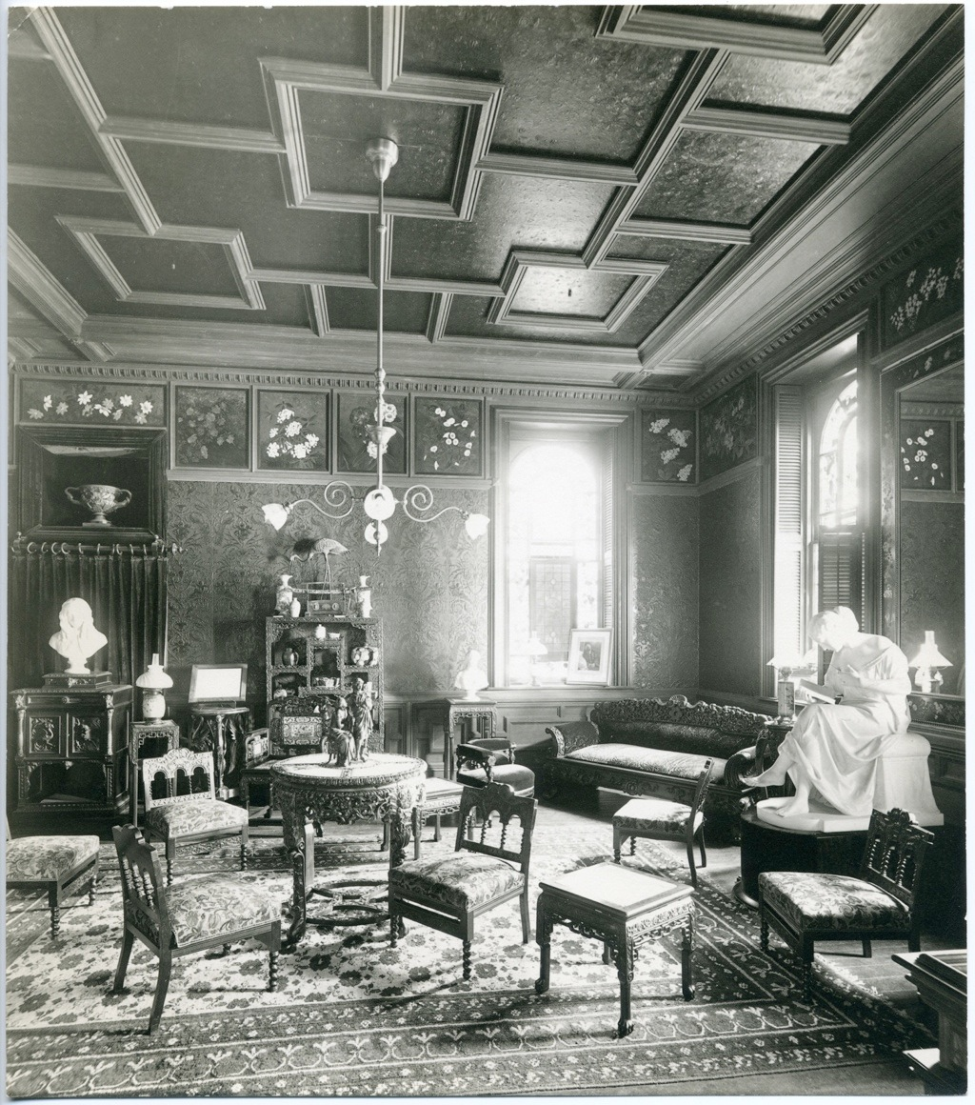
Notes:
IAN-

Slide 23
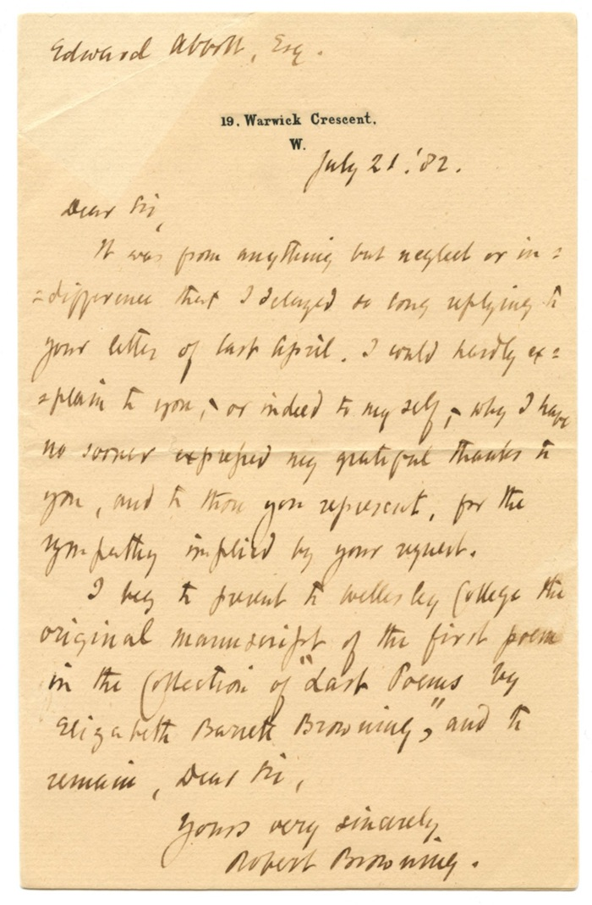
Notes:
IAN-

Slide 24
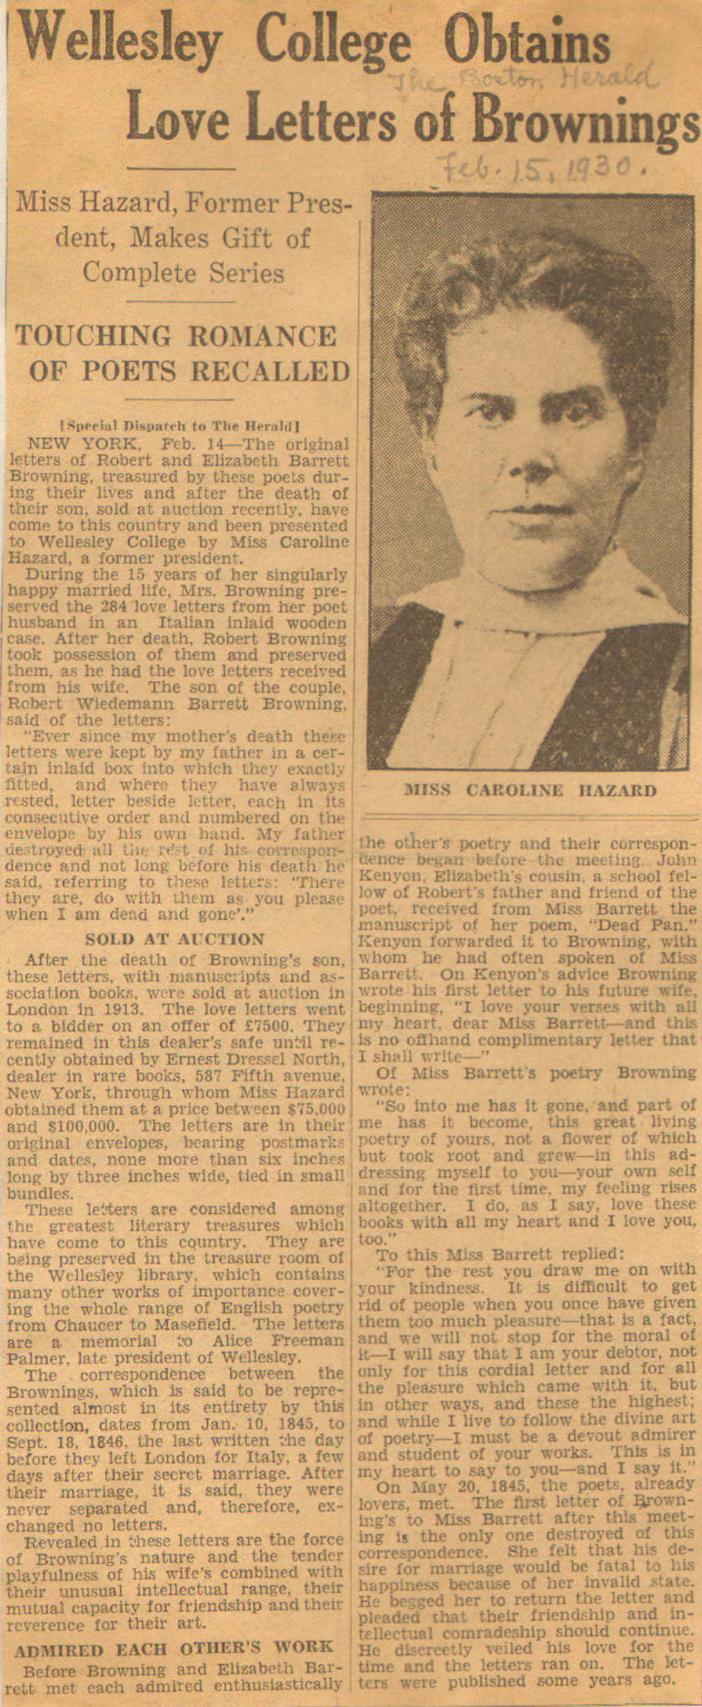
Notes:
IAN-

Slide 25
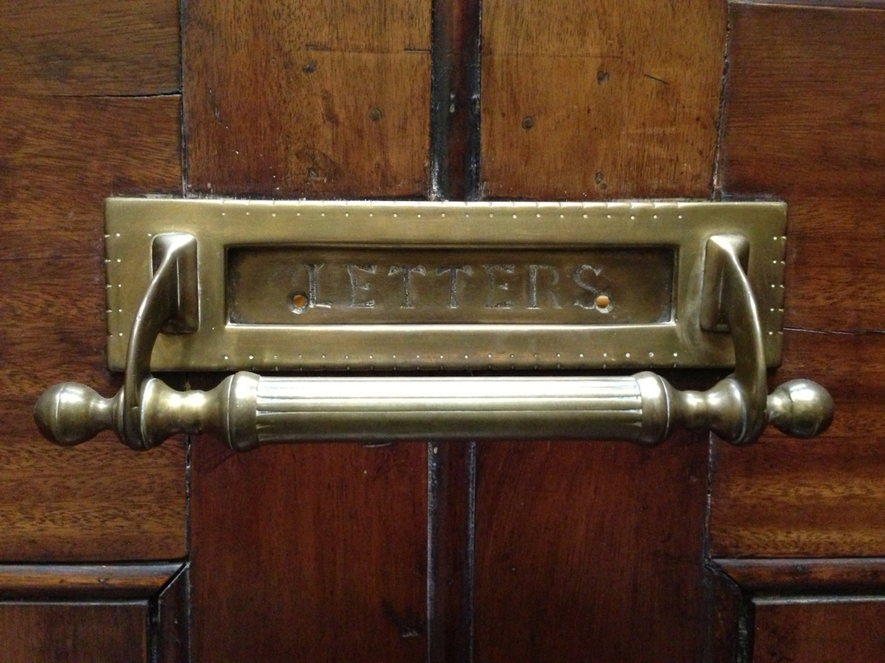
Notes:
IAN-

Slide 26
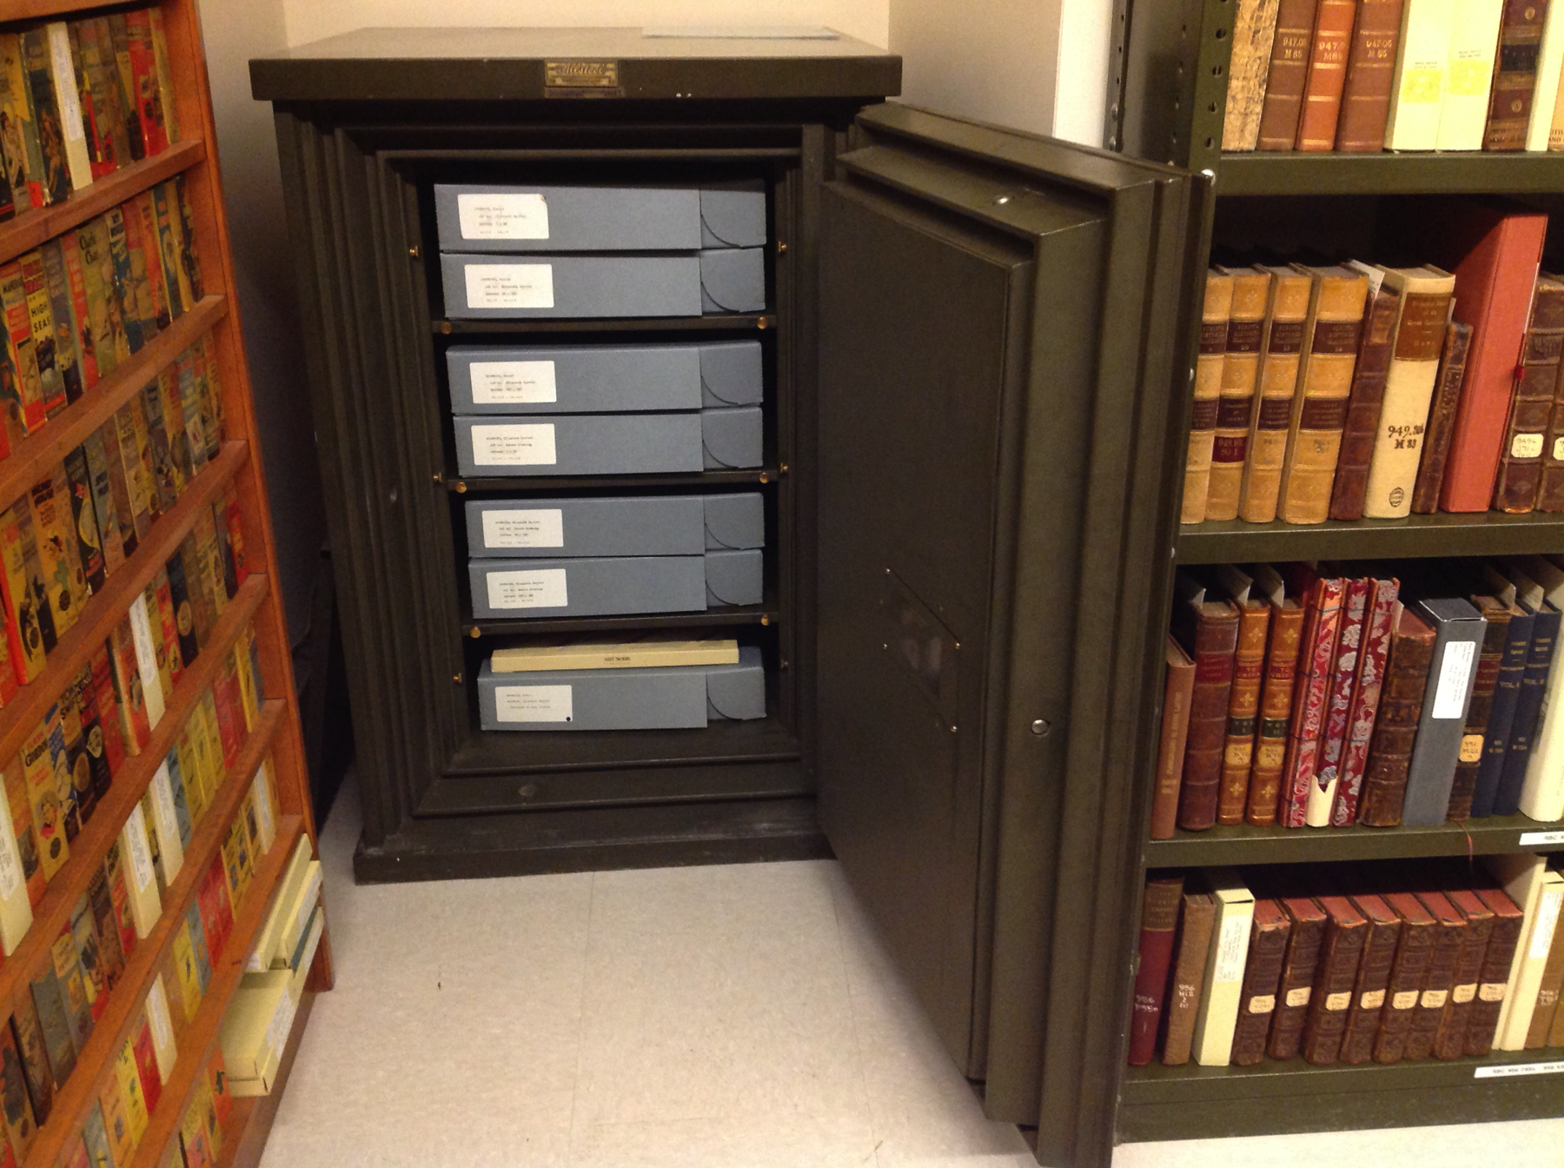
Notes:
IAN-

Slide 27
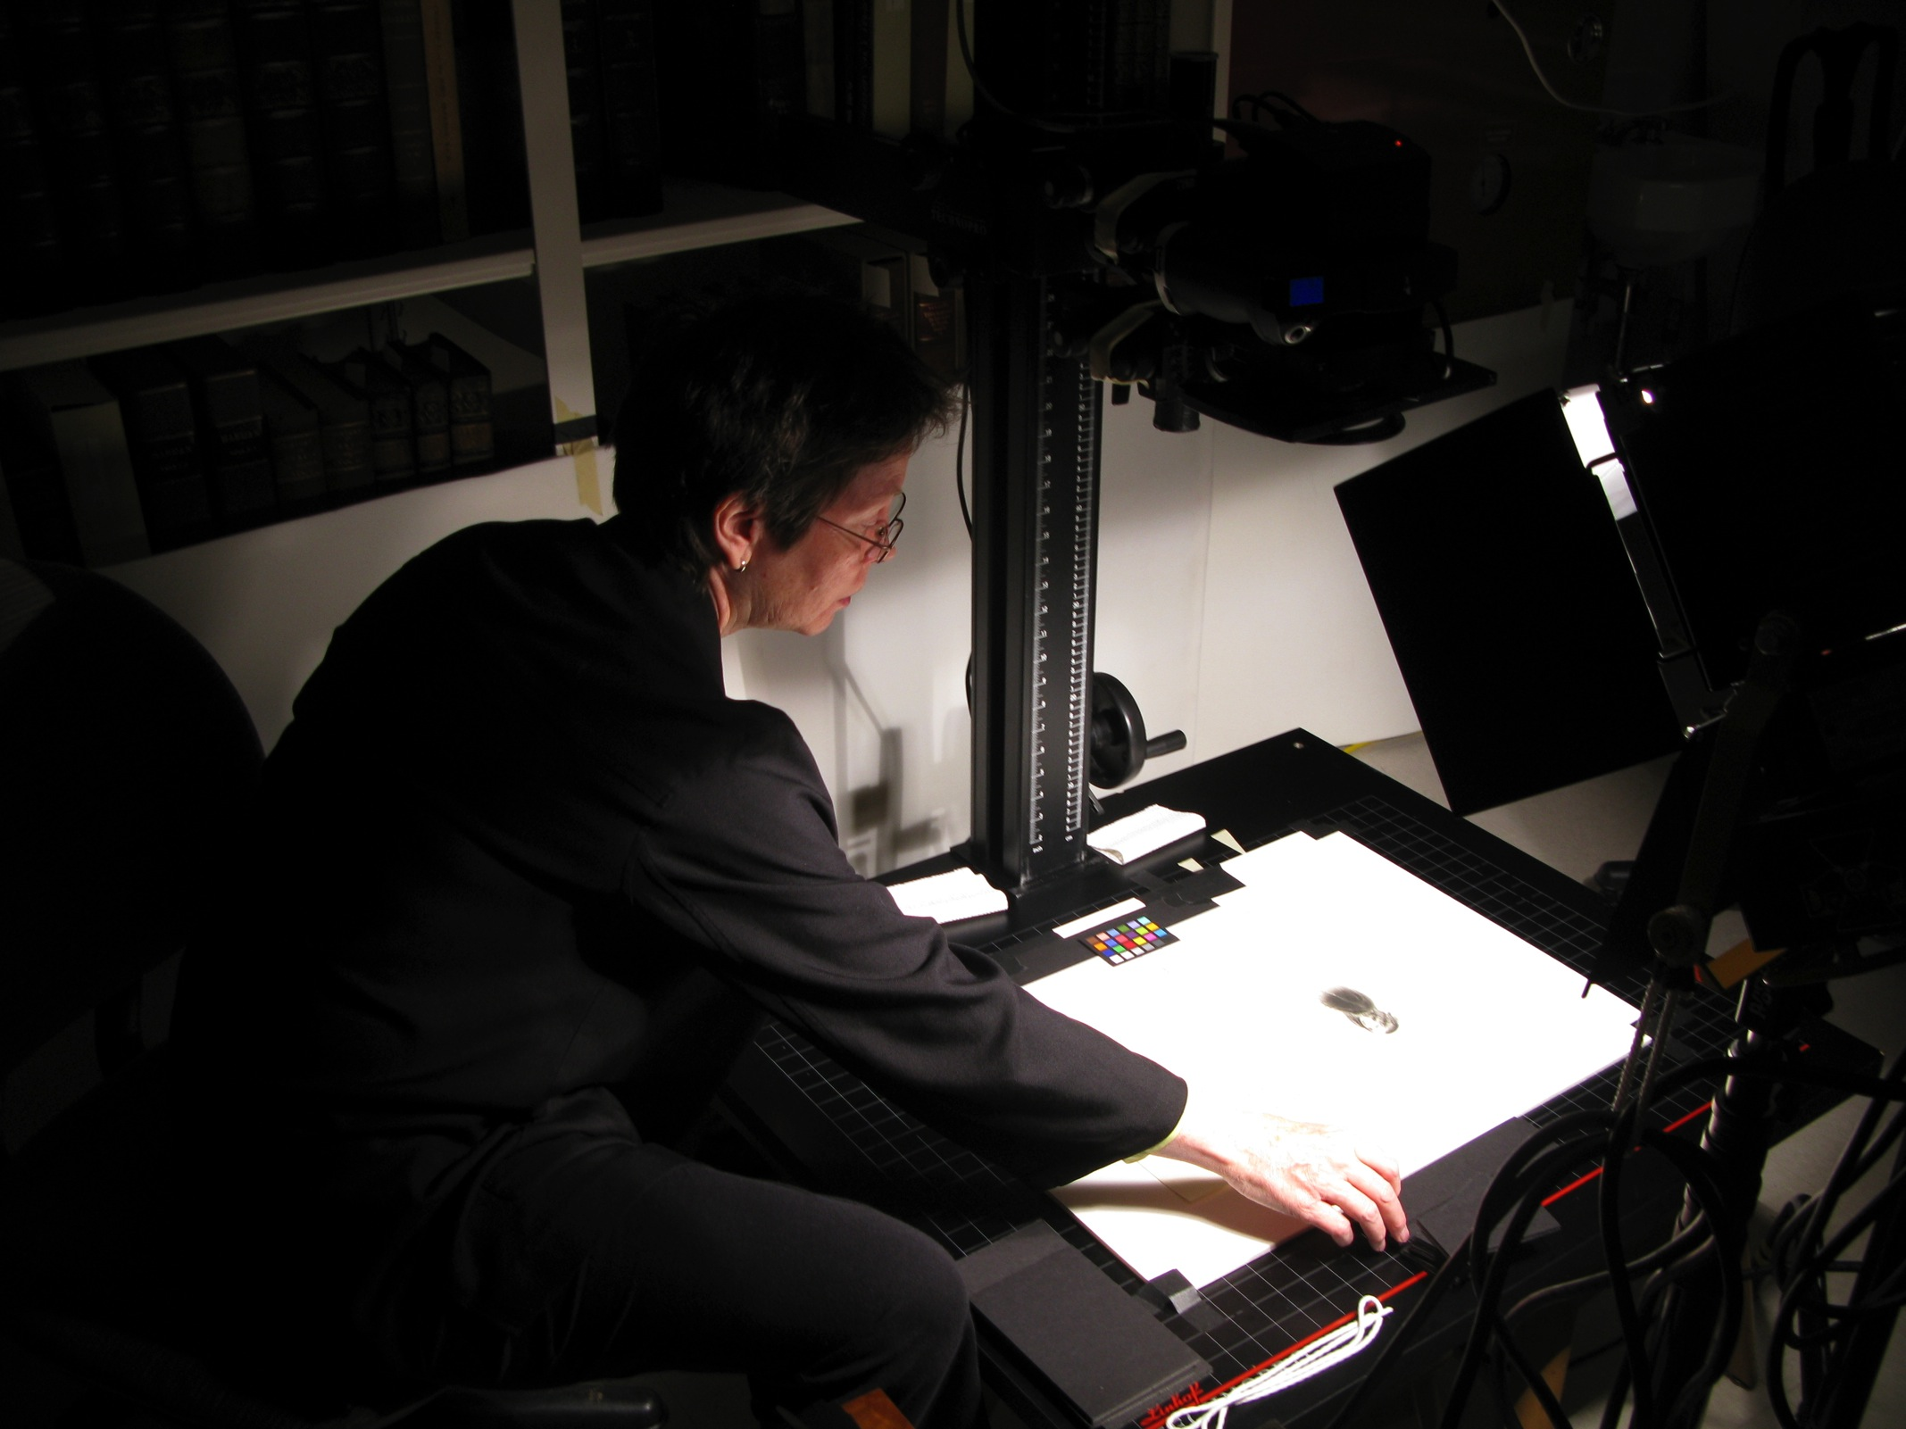
Notes:
IAN-

Slide 28
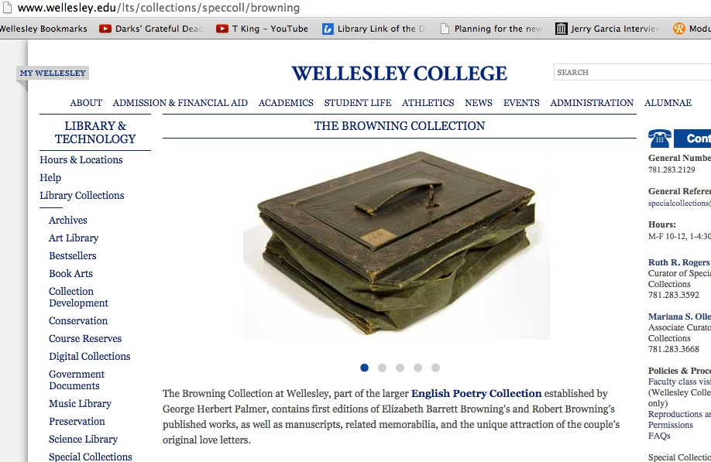
Notes:
IAN-

Slide 29
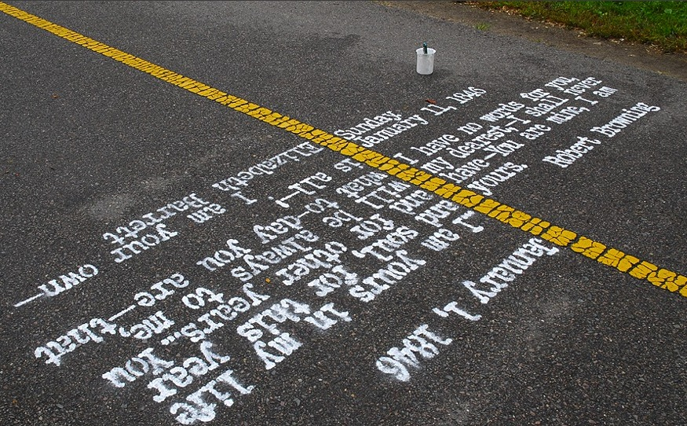
Notes:
IAN-

Slide 30
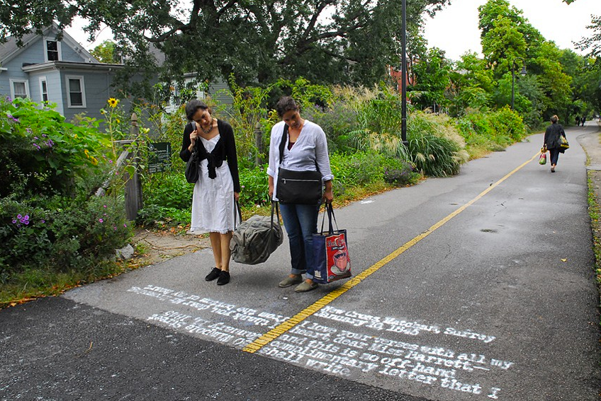
Notes:
IAN-
————————————————————————————-
PATTIE — NEXT SLIDE

Slide 31
Balliol
College
Notes:
IAN / PATTIE —

Slide 32
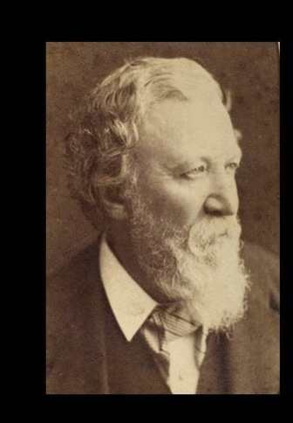
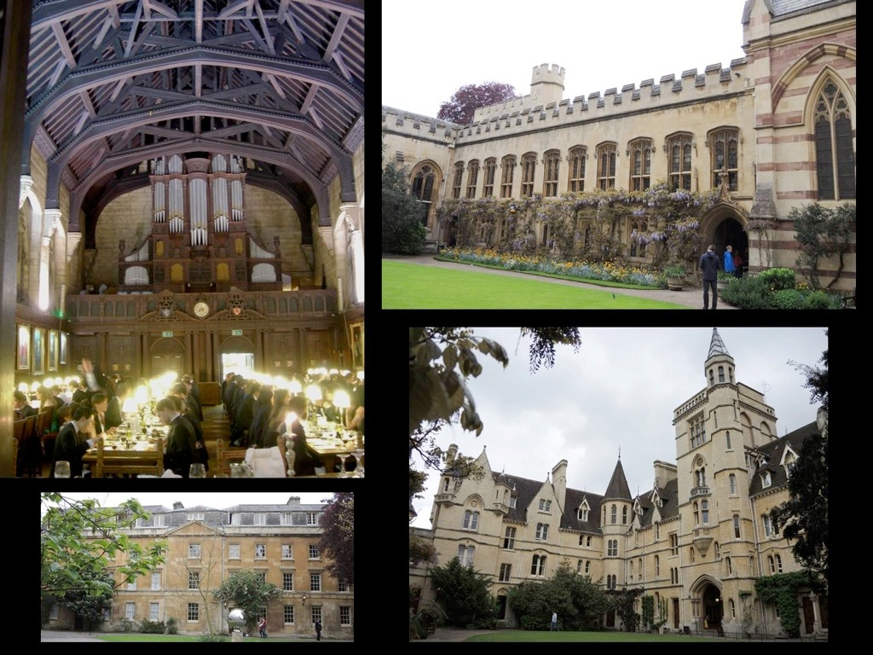
Notes:
PATTIE:
Balliol — Baylor Connection
When Elizabeth Barrett Browning died in 1861, Pen was 12, and his father was very concerned to make a fresh start in England for the two of them. A large part of this plan included a great desire on the senior Browning’s part to get Pen into Balliol College, the most academically serious at the time.
Several visits by Robert Browning, and was then made a senior member of the University with voting rights, Balliol’s first Honorary Fellow.
Browning was delighted by the fellowship as a mark of intellectual and social acceptance. This close connection continued, even when Pen, predictably, failed the Balliol entrance exam.

Slide 33
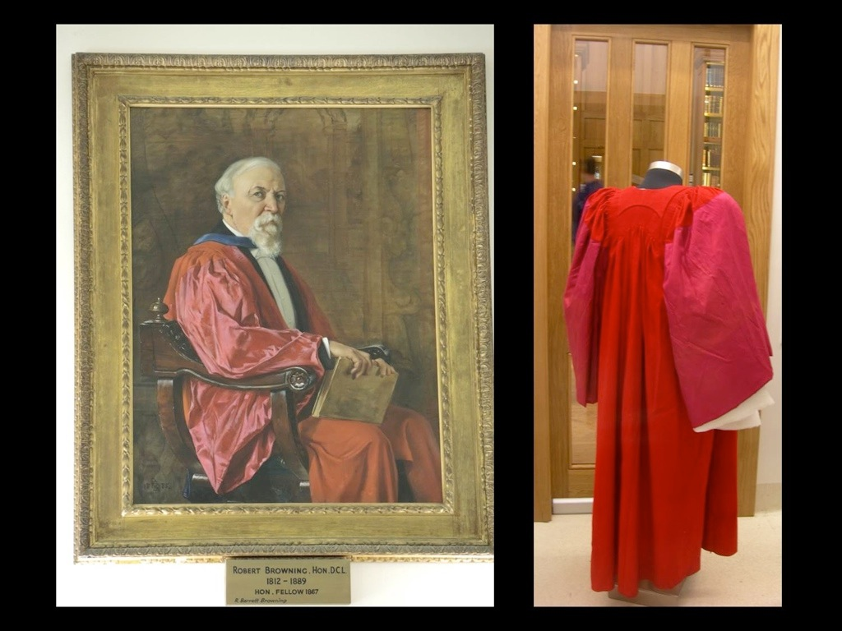
Notes:
PATTIE:
In 1882 Browning received an Honorary DCL. Pen painted a portrait of him in the DCL regalia and in 1885 Pen gave the portrait to Balliol, where it still hangs in the library. After Browning’s death, Pen presented the college with more of his effects including 6 volumes of holographic texts of poems.
Further acquisitions followed through the years.

Slide 34
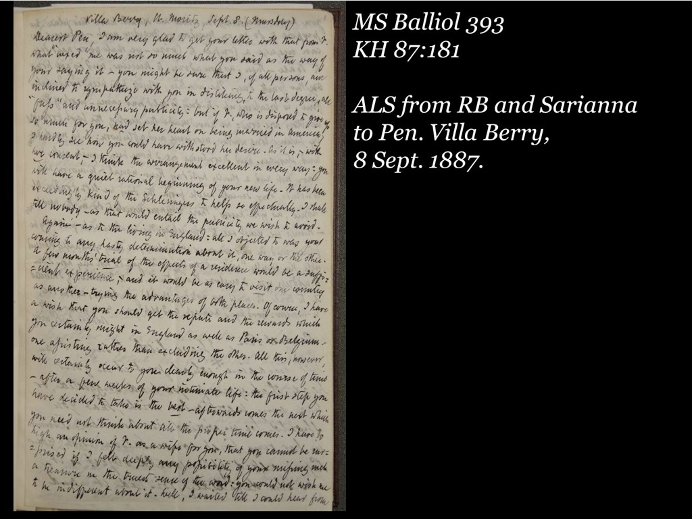
Notes:
PATTIE:
There are 53 letters at Balliol written between 1887 and 1889 and demonstrate the closeness of the Browning family. Many were written jointly by Browning and his sister Sarianna, and are addressed to Pen, his wife Fannie, and often Pen and Fannie together.
Balliol aims to become a digitization hub for the collections of Browning letters held by other Oxford colleges.

Slide 35
The Browning Letters Project:
Preservation for Digital Humanities
www.baylor.edu/library/browningletters

