Slide 1
The Return of the Odd Couple? Digital Literacy And The Learning Commons Curriculum
Cinthya Ippoliti, Head Teaching and Learning Services UMD Libraries
October 1st, 2014 EDUCAUSE

Slide 2
Outline
Background about our approach to digital literacy and the training series
Our content curriculum (v 1.0)
Our current curriculum (v 2.0)
Lessons Learned
Future Plans

Slide 3
Digital Literacy Overview
Why digital literacy @ UMD?
Gap in student learning
No place on campus where these skills are formally taught
Assignments and projects are expected to incorporate these elements
Competencies
Apply existing knowledge to generate new ideas, products, or processes using video, online tools and physical equipment
Create original works as a means of personal or group expression
Communicate information and ideas effectively to multiple audiences using a variety of media and formats
Locate, organize, analyze, evaluate, synthesize, and ethically use information from a variety of sources and media
Evaluate and select information sources and digital tools based on the appropriateness to specific tasks

Slide 4
Background On Badges
Badges are digital tokens that appear as icons or logos on a web page or other online context such as a Facebook page. They can be awarded by institutions, organizations, groups, or individuals, and typically signify accomplishments such as completion of a project, mastery of a skill, or marks of certain types of experience
Learners fulfill the specified criteria to earn the badge by attending classes, passing an exam or review, or completing other activities. The grantor verifies that the specifications have been met, and awards the badge

Slide 5
Assessment Of Learning With Badges
What learning should be recognized and how will it be assessed?
Assessment choices do affect student learning
At first, we focused on quizzes and external answers from students, we thought a high number of participants=success
Then, we focused on student products with rubrics/criteria as opposed to quizzes
Connection between motivation and badge design/function
Encourage learners to develop new skills and transfer them, not just earn a prize
Set goals and determine their own path
Build outside value for the badges
We hope to add peer not just “expert” (us) assessment and create a peer community so those who earned badges can help others

Slide 6
Some Things To Consider
Why do badges appeal to some learners but not others?
Does badging really engage students?
What is the institutional context for the badges-is there one?
How can you create a sense of community similar to that found in gaming?
How can you support and quantify learning outside of the classroom?

Slide 7
Quick Poll
How many of you are currently offering badges at your institutions?
If yes, please explain (via chat or raise hand)

Slide 8
Background
Terrapin Learning Commons (TLC) Workshop Series
Created in Fall of 2012 in response to need for citation management support
There was no one library department who “owned” it
Through this model we sought to expand the traditional notion of learning into other environments and explore digital badges as a way to recognize and validate student success outside the classroom
There is no other technology support on campus for students other than general assistance for email, our CMS, etc.
We began with Endnote Web
Expanded to include other citation management tools
Poster Printing

Slide 9
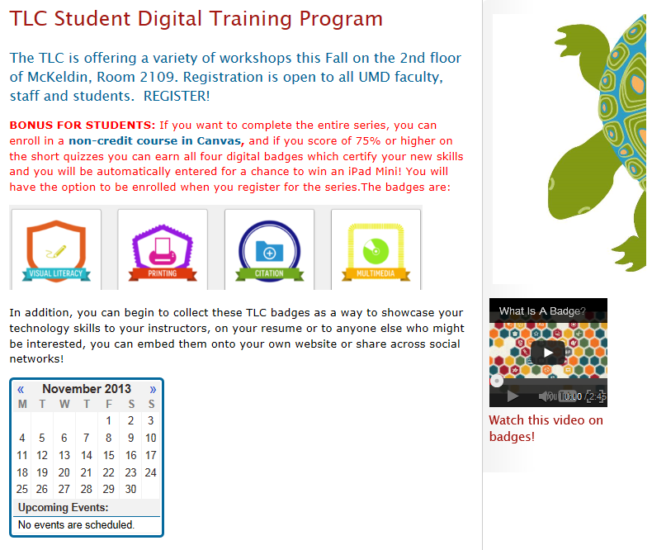
Past Workshops
Logistics
Advertisement through our monitors, Twitter, Student Advisory Group, Center for Teaching Excellence
Partners
Multimedia
Art/Architecture Library
Special Collections
Engineering Library
DSS (internal IT)

Slide 10
Workshop Statistics
Fall 2012
Endnote Web: 87 participants
Spring 2013
Zotero: 21 participants
Endnote Web: 25 participants
RefWorks: 11 participants
WorldCat UMD: 17 participants
Poster Printing: 41 participants
Fall 2013
Images/Primary Sources: 5 participants
Multimedia: 11 participants
Endnote Web and Zotero: 13 participants
3d and Poster Printing: 5 participants

Slide 11
Version 1.0:Logistics
Students attended in-person workshops under 4 main tracks: (selected based on expert interest and availability to teach)
Visual literacy/Primary Sources
Multimedia
Citation Management
Production: Poster and 3d Printing
Accessed a Canvas module which becomes available after the last workshop ended

Slide 12
Version 1.0: Learning Outcomes
Evaluate various citation management tools and select the most appropriate for their needs
Learn the basic features and functionality of Endnote Web, Zotero and Refworks
Learn how to create a 3D printed object (files, formats, etc.)
Learn how to create and print a poster using our large-format printer
Learn how to shoot and edit video footage utilizing a digital camera and our Adobe Final Cut Pro suite of tools
Find and ethically incorporate images into their projects
Explore primary resources and what our special collections have to offer

Slide 13
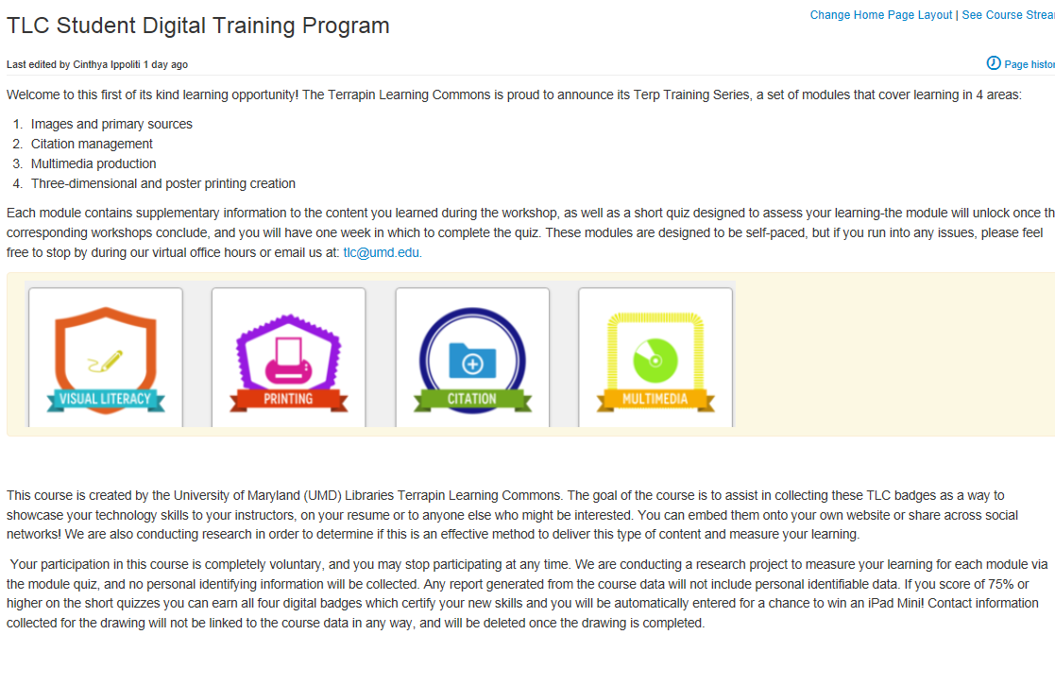
Version 1.0: Canvas Course

Slide 14
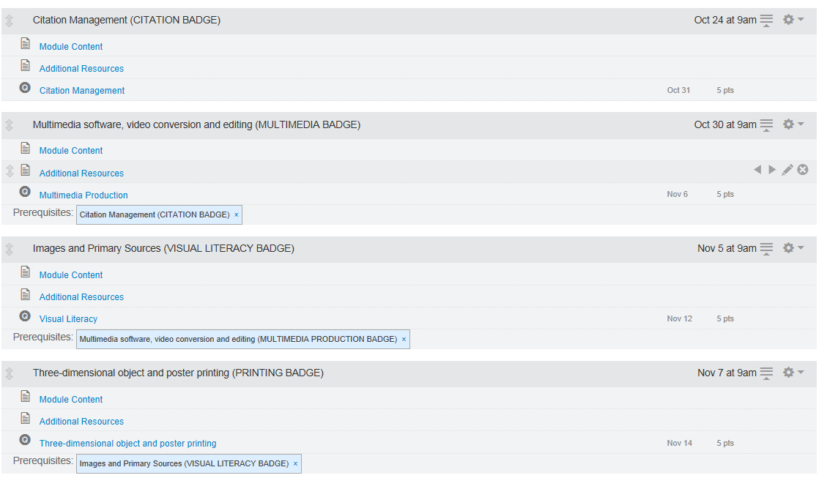
Version 1.0: Curriculum

Slide 15
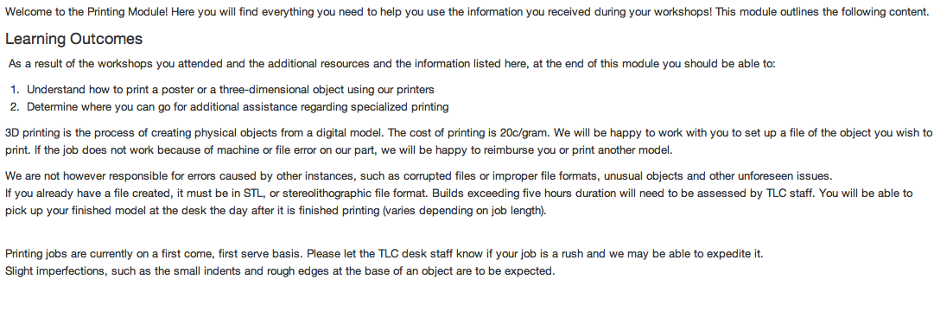
Version 1.0: Curriculum cont’d

Slide 16
Version 1.0: Canvas Course Statistics
5 people enrolled
2 took the entire series
Their average score at the end of the class was 91.7% and 97.5%
Opportunity to win an iPad was probably the main motivating factor
We then developed a version 1.5 where about 3-5 people attended each workshop and we did not offer the course
Biggest draw was when we had a class come in for Google Glass specifically

Slide 17
Questions?

Slide 18
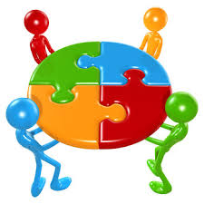
Activity #1
Your turn! Thinking a about digital literacy and badges for your own institutional context, define the challenge
Take 1 minute per point of view and brainstorm challenges-capture these or add them to the chat conversation
Process
Partnership
Innovation

Slide 19
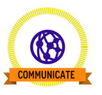
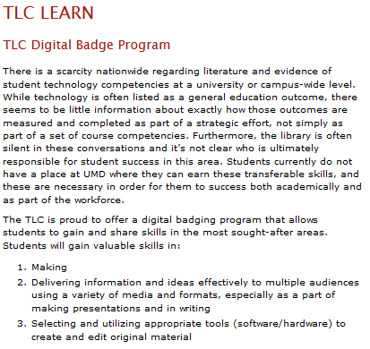
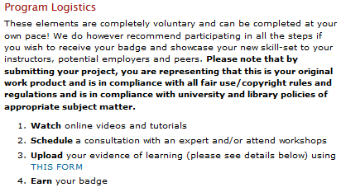
Version 2.0: Explore, Create, Learn, Engage

Slide 20
V 2.0: Learning Outcomes
Multimedia Production: The requirements address the following standards, performance indicators, and learning outcomes from the ACRL Visual Literacy Competency Standards for Higher Education
Standard One: The visually literate student determines the nature and extent of the visual materials needed.
Standard Two: The visually literate student finds and assesses needed images and visual media effectively and efficiently.
Standard Five: The visually literate student uses images and visual media effectively.
Standard Six: The visually literate student designs and creates meaningful images and visual media.
Standard Seven: The visually literate student understands many of the ethical, legal, social, and economic issues surrounding the creation and use of images and visual media, and accesses and uses visual materials ethically.

Slide 21
V 2.0: Learning Outcomes
Digital Communication:
Create effective online presentations utilizing various free web tools
Understand the basic elements of creating an effective presentation, including format, content, visual design:
Select appropriate images and visual media aligned with the presentation’s purpose
Integrate images into projects purposefully, considering meaning, aesthetic criteria, visual impact, and audience
Edit images as appropriate for quality, layout, and display (e.g., cropping, color, contrast)
Include textual information as needed to convey an image’s meaning (e.g., using captions, referencing figures in a text, incorporating keys or legends)
Adapt writing purpose, style, content and format to the appropriate digital context
Making:
Demonstrate an understanding of the different types of equipment in the MakerSpace
Utilize at least ONE of the types of equipment in the space to create a project
Identify what other fabrication locations on campus can offer and how to contact them

Slide 22
V 2.0: Online Content
Multimedia Production:
Lynda.com playlists. Sample playlist: http://www.lynda.com/SharedPlaylist/adfb4a51ccaf4577b3b061a985c83dcb?org=umd.edu
The Documentary Filmmakers’ Statement of Best Practices in Fair Use and the National Council of Teachers of English’s Code of Best Practices in Fair Use for Media Literacy Education
Sample videos and corresponding written descriptions accompanied by an explanation of how they satisfy the criteria for the basic video production digital badge
Makerspace Equipment:
http://lib.guides.umd.edu/tlcmake
Digital Communication:
http://umddc.tumblr.com/
FlipSnack.edu
Haiku Deck
Swipe.to

Slide 23
Version 2.0: In-person workshops & consultations
Multimedia Production
Shooting footage
Incorporating images/footage and sound effectively
Editing
Makerspace Consultations
3D printers and scanner
Google Glass
Creating effective presentations
Coming (soon)…Writing for social media
Blogs
Twitter

Slide 24
Version 2.0: Badge Details
Students have to upload actual evidence of their work: Multimedia
At least 30 seconds long
Contains at least five “shots” and either expository titles or a voiceover track
Saved as one of the following file types: .avi, .mp4, or .mov
Represents or communicates a concept, narrative, or argument; uses audiovisual means to represent data and information; or documents a person, place, or thing
Combines materials (video footage, images, audio tracks, text, etc.) created by the student with at least one example of an image, video clip, or audio clip created by someone else
All material created by someone other than the student is given attribution in citations and credit statements and used according to ethical and legal best practices
The video should be accompanied by a written description of the project which defines its purpose, audience, and environment (e.g. academic environment, open web); explains which tools were used to produce it; and reflects on its effectiveness.

Slide 25
Version 2.0: Badge Details
Students have to upload actual evidence of their work: Presentation
Upload a 1-3 minute presentation using the form on the topic of "How the TLC supports your learning" and consisting of the following elements
Must use one of these presentation tools:
FlipSnack.edu
Haiku Deck
Swipe.to
Content must be relevant to the theme
Visual design must contain at least 3-5 images or video elements. Color scheme, layout and overall design must be consistent with the guidelines mentioned above
All material created by someone other than the student is given attribution in citations and used according to ethical and legal best practices

Slide 26
Version 2.0: Badge Details
Students have to upload actual evidence of their work: Making
You must utilize at least ONE of the equipment types available (3D printer/scanner or Google Glass)
Utilize Google Glass to create a photo tour of the TLC: At least 5 photos and share with the TLC's Google + account adding comments to explain why you chose the images you did: teachingandlearningumd@gmail.com (TL McKeldin)
Your 3D printed object must be connected with UMD in some way-whether in color, shape or theme and it must either be a prototype or a working model. At this time, there are no size limitations
Students can upload evidence of criteria completion via
an online form: https://libumd.wufoo.com/forms/tlc-digital-badge-program/
They then receive the badge via email via Credly

Slide 27
Questions?

Slide 28
Activity #2
You are now creating solutions to the new challenge you’ve identified. Sketch a lot of ideas, this is the time for generating as many ideas as possible. Take 5 minutes and generate as many ideas as you can think of!
How might these new ideas support student learning differently?
How did they help you think about this issue in a different manner than before?

Slide 29
Some Lessons Learned
Our participant surveys revealed that scheduling was the number one detractor from attending
The numbers of attendees has decreased, while our workload has increased especially with this new curriculum
Interest in some things like poster printing is no longer high-presumably students know how to use the equipment
There is no disciplinary context for the content
How do we accommodate the just-in-time vs just-in-case needs. We are not used to a more flexible model…yet!

Slide 30
Future Plans
We are embedding a digital literacy module that can be then added into any program-we are in the beginning stages of planning to pilot with two sections of our mandatory The Student in the University course this Fall:
Combine elements of introduction to the university like time management, study skills, etc. with technology skills such as multimedia production and visual literacy
Digital certificate for the course
Compare learning in this course vs our out of classroom model and try to look at student cohort as well as individual data

Slide 31
Questions?
Cinthya Ippoliti: cippol1@umd.edu, 301-714-7224

