Slide 1
At the Crossroads: The Convergence of IT Service Management and Project Management in Higher Ed
Wednesday October 1, 2014
1:30 PM – 2:20 PM
Meeting Room W303

Slide 2


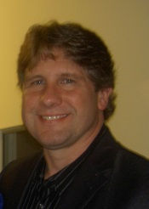
Speakers
Bob Black
Assistant Director, IT Process and Planning
Miami University (Ohio)
Thomas Dugas
Head of Planning and Project Management & Associate Director
Carnegie Mellon University
Clay Fulton
Senior Application System Analyst
Carnegie Mellon University

Slide 3
Agenda
Why use IT Service Management?
Project Portfolio Management defined
Service Life Cycle integration with Project Management Methodology
Discussion Activity
3

Slide 4





Shift to IT Service Management
(ITSM) approach
Focus on
Technology Components
Focus on Services that
Support the Business
Service Management is a set of specialized organizational capabilities for providing value to customers in the form of services.
The goal is to manage IT from a business perspective, focusing on the end-to-end services rather than technology silos.
*Credit VMWare

Slide 5
Why utilize a service-based approach?
Changing requirements – focus on desired business outcomes
Shifting technical environment (cloud, commodity providers, SaaS, etc.)
Responsibility for best use of resources
Clearer view of our services and dependencies
Increase transparency and collaboration

Slide 6
Things you can do to develop an ITSM focus
Adopt an IT industry-standard ITSM / ITIL framework for managing services
Develop processes (before implementing a tool)
Implement a shared divisional tool (ServiceNow) to implement the framework
  “ERP for IT”
Require increased accountability and responsibility from service owners

Slide 7
Project Portfolio Management Defined
Project Portfolio Management (PPM) is a framework used evaluate and prioritize projects in order to maximize their contributions to strategic goals.
Project Portfolio Management can help to manage resources and ensure alignment to division and campus objectives.
The PPM framework enables a focus on transparency and communications as active project efforts are centrally located in a single project repository

Slide 8
Where you may see this convergence
Service Lifecycle
  Projects Create Enhance, Change, or Retire Services
  Capacity Planning
  Change Management

Slide 9
Service Lifecycle vs. Project Lifecycle
If it doesn’t exists, create it
Content should be created here
Project to enhance service
Service Lifecycle
Project to create service
As part of continuous service improvement
Content should be reviewed and updated at each subsequent project
Project to retire service
Project to upgrade service
*Credit VMWare

Slide 10
Service Life Cycle integration with Project Management Methodology
Project Portfolio Management aligns with Service Management efforts as New Projects are developed through Continual Service Improvement activities throughout the entire Service Lifecycle.
*Credit VMWare

Slide 11
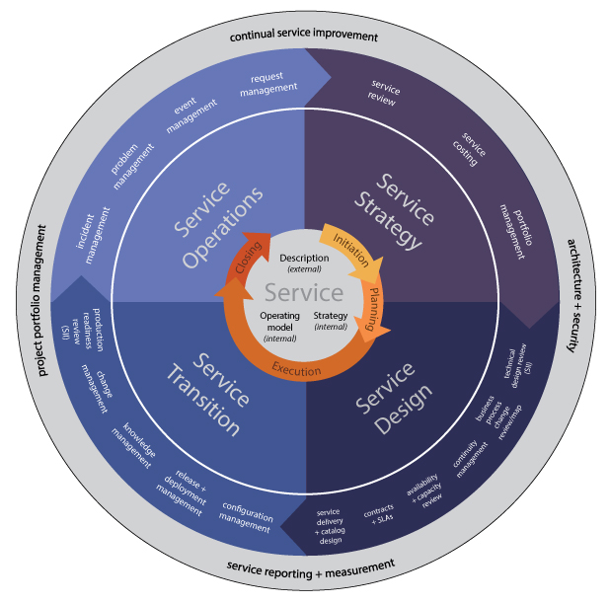
Another view of the Service Lifecycle
11

Slide 12
Human Resources Convergence
ITIL Service Design > Capacity Management
Definition: Helps organizations match their IT resources to business demands
Resource capacity management (RCM) (Personnel, System and Component)
Project Management > Resource Capacity Planning
Definition: Decisions about scheduling prioritized projects based on the availability of specialized resources
View resources by attributes such as departments, skills, and roles
Resource estimation, time tracking, compare estimates vs actuals.
Convergence of ITSM and PM
View resource workload across all work
By time-phase
Perform what-if analysis on resource workload and availability

Slide 13
The Change Management Perspective
ITSM
Strategy
Design
CSI
Transition
Operations
Change Management
RFC
Authorize for Design
Authorize for Build and Test
Authorize for Deployment
Review and Close
PMO
Portfolio Governance
Project Management
Change Control

Slide 14
Discussion Activity: Small Group
Clearly write your name and email address on one side of a notecard
Clearly write your response to the following statement on the other side:
Describe a practice that you have seen tried in your organization to bring service management and project management frameworks closer together.
Share your response with your neighbors

Slide 15
Discussion Activity: Whole Session
What major themes did you discover during your small group discussions?
What barriers prevent the integration of service management and project management practices?
Why might you wish to maintain separation between service management and project management practices?
If you could make one change to your organization regarding the convergence of service and project management, what would it be?

Slide 16
Discussion Activity: Follow-up
Please leave your note-card along with your business card on your table
We will collect them to:
  Compile and organize all the practices into “white paper” to share with you
  Your business card will help us to read your handwriting for your Name and Email Address ☺

Slide 17

17

Slide 18
Presenter Contact Information
Bob Black
Assistant Director, IT Process and Planning
Miami University, Oxford, OH
blackrw@miamioh.edu
Thomas Dugas
Head of Planning and Project Management & Associate Director
Carnegie Mellon University, Pittsburgh, PA
tdugas@andrew.cmu.edu
Clay Fulton
Senior Application System Analyst
Carnegie Mellon University, Pittsburgh, PA cfulton@andrew.cmu.edu
18

