Slide 1

IT Strategic Alignment
The Core of Strategic Planning
James Bradley, UT Arlington VP of IT & CIO
Erin Morgan, Director Strategy & Planning
Zinna Butcher, Communications Coordinator

Slide 2

Session Objectives
Develop Assessment Purpose Statement
Determine Composition of Assessment Teams
Outline Assessment Activities
Notes:
Jim
At the end of the session, we want you to have a clear idea of
why you should perform an assessment,
who should be on your teams, and
what activities your teams should perform.

Slide 3
Why are you considering an IT assessment?
Align to institutional goals 595416
Improve understanding of clients 595435
Evaluate organizational effectiveness 595436
Precursor to strategic planning 595437
Develop IT improvement plan 595438
All of the above 595439
Other – None of the above 595460
Notes:
Jim

Slide 4
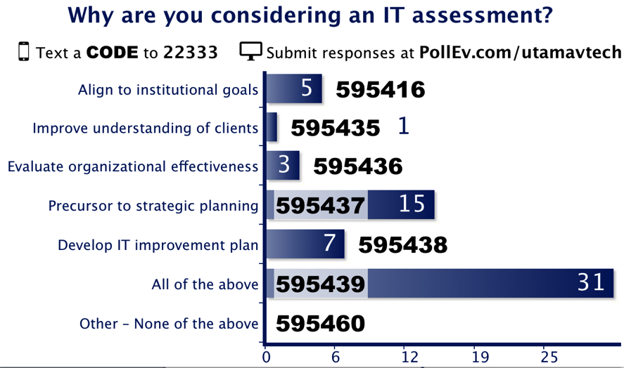

Slide 5
Purpose Statement
Notes:
Jim

Slide 6
University of Texas Arlington
Almost 40,000 Students
2,200 Faculty
Seventh fastest growing public research institution
Fifth most diverse university
Second largest member of The University of Texas System
One of six national universities named a “Next Generation University”
  Broad online course and program offerings
  Increased enrollment growth
  Emerging research presence
Notes:
Jim
Basic University background
New CIO and President

Slide 7
UT Arlington’s Purpose
Conduct an inventory and assessment of all IT resources and staff to achieve the following outcomes:
Design an organization optimized for service delivery
Establish collaborative campus relationships
Align human resource capability with organizational needs
Develop a strategic plan grounded in university goals
Notes:
Jim
Why did we perform an assessment and how did we use the findings?
Introduce Erin, Zinna, Deepika, and Nazneen

Slide 8
Brainstorm & Discussion (6 minutes)
What are your reasons for conducting an assessment of your IT organization?
  Use notecards to quickly jot ideas
  Generate your purpose statement
  Write one statement on the whiteboard to share with the room
Notes:
Jim or Erin

Slide 9
Shared Purpose Statement
Participant Feedback
Determine gaps and redundancies in IT services
To communicate the mission and purpose of IT to the organization
To enable better decision-making for project planning
Overarching goal of improving IT service with a focus on diverse and distributed user base
To understand the strengths and weaknesses of the organization & to ensure all weaknesses are addressed in a timely and professional manner
To Align our IT strategy with School Strategy
Determine which resources to keep and how we can support those resources

Slide 10
Shared Purpose Statement
Participant Feedback
To confirm alignment with organization and demonstrate value
Identify areas that could become shared services with other groups on campus
Identify current perceptions (strengths and weaknesses)
To ensure scarce resources are being utilized optimally

Slide 11
Assessment Teams

Slide 12
UT Arlington Assessment Teams
System Mapping
Customer Experience
Process Design
Benchmarking
Organization Structure
Asset Mapping
Create holistic view of the organization
Find mismatch of asset operation, ownership, and maintenance
Identify and evaluate performance to best practice
Map service delivery through the organization structure
Focus groups and surveys assess perceptions and satisfaction of customers
Evaluate process health
Notes:
Erin
System Mapping Team
Examined the transformation of inputs to service delivery
Benchmarking & Customer Experience
Fairly traditional execution of evaluation of who we should become and who we are now
Process Design
Identify core processes and review areas of variance and recommend improvements
Organization Structure
Create a view of how decisions are made and service is executed through the existing IT structure
Asset Mapping
Map assets to process and operations and look for mismatch between who pays and who operates and maintains

Slide 13
Team Attributes & Benefits
Attribute | Participants | Benefit
Cross-Functional | Representative from each IT team at various levels IT Stakeholders | Shared Ownership in the IT Improvement Journey
Inclusive | Academic Leadership Administrative Leadership & Staff Distributed IT Students | Amplified Stakeholder Voices
Diverse | Cross-Functional IT IT Stakeholders | Enlarged Perspective, Limited Myopic View
Notes:
Zinna
“Advocate”
STILL WORKING ON THIS PAGE
Cross-Functional
Shared Ownership in the IT Improvement Journey
people’s views of the IT organization are changing because they are now familiar with the IT organization and understand how committed the organization is to help campus succeed and to ensure the University’s goals are met.
result of the strategic alignment project, IT has a better understanding of the needs of the customers and University.
Inclusive
Diverse:

Slide 14
Assessment Team Composition
Systems Team (DNA for All Other Teams)
Benchmarking
Customer Experience
6 IT Representatives
Process Design
Organization Structure
Asset Mapping
6 IT Representatives
1 External IT Representative
1 Student Intern
8 IT Representatives
6 Customer Representatives
5 IT Representatives
6 IT Representatives
6 IT Representatives
4 Student Interns/Volunteers
1 Student Intern
2 Budget/Account Representatives
Notes:
Zinna: Summarize team composition. Emphasis the importance of having a collaborative team – Talking and it roles into the next slide
This is not just Senior Leadership
Students includes Marketing Student, Industrial & Organizational Psychology

Slide 15
Have you participated in an IT assessment?
Notes:
Zinna
Show of hands
Distribute folks around the room

Slide 16
Brainstorm & Discussion (7 minutes)
Are there missing assessment teams?
Are there missing roles?
  Use notecards to quickly jot ideas
  Compare teams and roles
  Discuss and pick unique teams and/or roles to add to the whiteboard and share with the room

Slide 17
Share Assessment Team Improvements
Participant Feedback
Missing roles:
Information Security
Human Resources
Library & Media Services
External Key Business Services
Faculty
Researchers
Missing Teams:
Executive Steering Committee
Project Team

Slide 18
Assessment Activities

Slide 19
UT Arlington’s 8 Assessment Activities
Map the IT system from inputs, through transformation processes, to delivery of services and products to end-users
Benchmark against best-in-class IT organization
Conduct surveys, analyze results, and provide recommendations
Conduct focus groups, analyze results, and provide recommendations
Analyze key IT business processes, evaluate the overall effectiveness, while identifying improvements
Map ad-hoc decision-making case studies to the organization structure
Map processes to the organization structure
Map assets (human and capital) to business requirements

Slide 20
Sample Team Methodology & Output

Slide 21
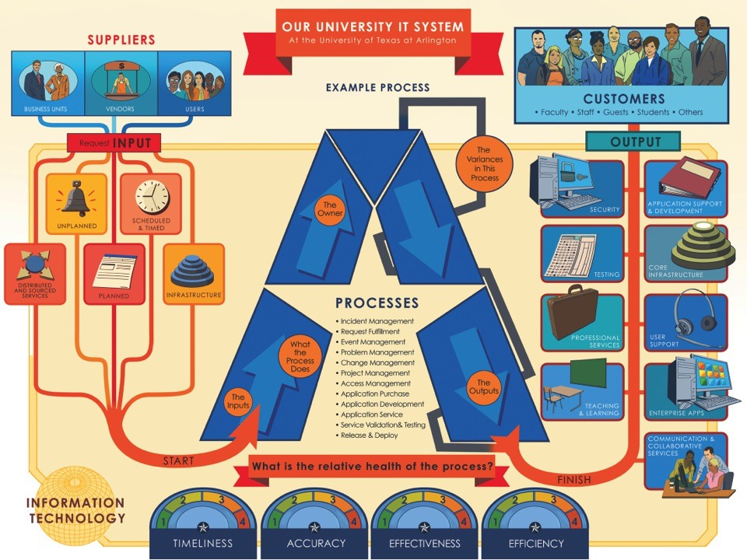
Notes:
Suppliers
Inputs
Processes
Outputs
Customers

Slide 22
Benchmark Team Interview Protocol
Questions focused on the following areas:
Context (history, challenges, key initiatives)
Current state (competitive edge and areas for improvement)
Organizational structure (how well it enables or disables)
Strategic orientation (connection to strategy)
Big bets (what changes had the greatest impact)
Measurement (how success is measured)

Slide 23
Focus Group Methodology
Focus group interviews
Standardized open-ended questions to minimize variability
Informal conversational questions to explore unanticipated responses
11 focus groups conducted over 2.5 weeks
98 people attended one hour sessions
Focus groups were scheduled as affinity groups (Deans, Chairs, etc.)
  55 staff, 36 faculty, and 7 students attended
  52 women and 46 men

Slide 24
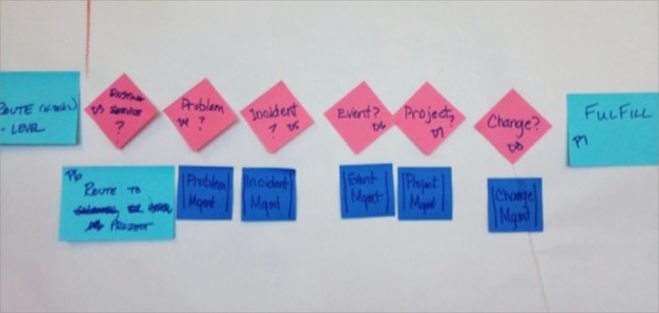
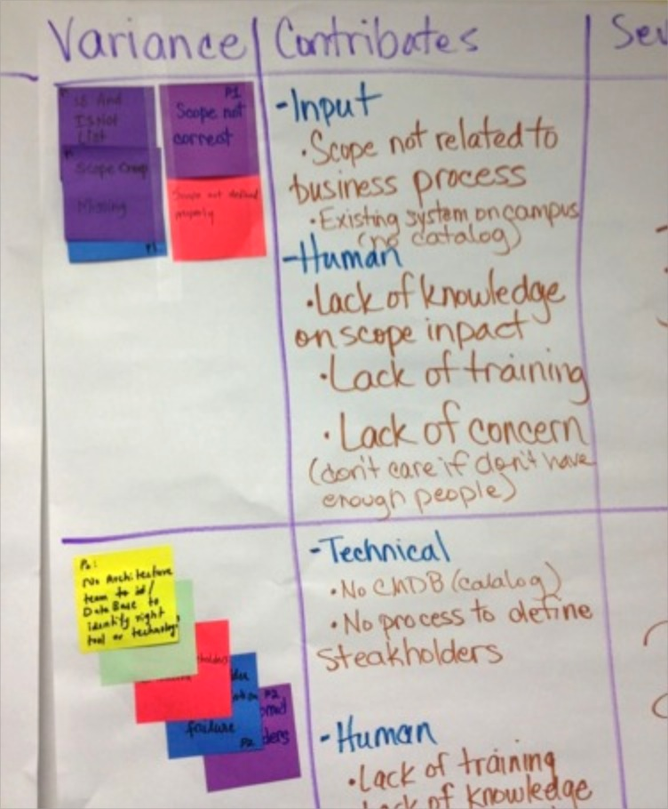
Process Team Variance Analysis

Slide 25
Organization Team Analysis
VP IT & CIO
Client Services
Operations & Systems
Operations
Network & Telecommunications Services
Network Services
Telecommunications
Enterprise Information Services
Desktop Services
Instructional Services
Service Desk
Business Collaboration
Application Services
Statistical Services
Application Development
Enterprise Production Services
Enterprise Business Intelligence
Enterprise Application Services
Systems
Office of the VP IT & CIO
Project Management Office
Financials
Procurement
Human Resources
Marketing & Communications
Risk Management
Executive Support

Slide 26
Sample Inputs to Strategic Plan

Slide 27
Implement Changes
Strategic Transformation Process
Align IT to University Strategy
 | Who are we now? | How do we transform? | Who do we want to be?
Structure | Unresponsive to opportunities Inadequately meets University objectives and complexities Silos slow service delivery | Build nimble, customer-centric organization and deploy missing elements of the IT organization | Customer-facing, service organization Engaged, collaborative communicator with our University
Process | Fails to collaborate with and limited engagement of IT stakeholders Highly transactional and one-size-fits-all processes and solutions Process immaturity and low efficacy Lack of effective measurements | Create collaborative governance Develop flexible and differentiated processes and standards Enhance IT transparency through effective measures and reporting | Broad, University-contributor who delivers transformative possibilities Provider of flexible, customer-centric standards Capable of telling our story with transparency and clarity
Support Systems | Providers of unreliable system Delivery of services over-overburdens certain parts of the organization Missing functions prevent us from providing for existing and emerging IT needs | Fortify Tier I infrastructure Leverage the cloud Deliver systems that support a Tier 1 research institute and promotes student success | Manager of highly-reliable systems Provider of on-demand sourcing partnerships capable of quickly meeting University needs Engine that creates efficiencies through automation
People | Unresponsive, slow, and resistant to change Insular, inward-focused, and limited awareness of new IT trends Outdated or misaligned skillsets | Say Yes! Build strong academic partnerships and national IT reputation Strengthen core skills and competencies | Agile, nimble, and responsive to customer needs, adapting to changes dynamically Partner with University units
Engage Feedback Loops
Strategic Planning
Review Metrics
Develop Operations Plan
Take Action
Notes:
Activities from each assessment team helped us to determine

Slide 28
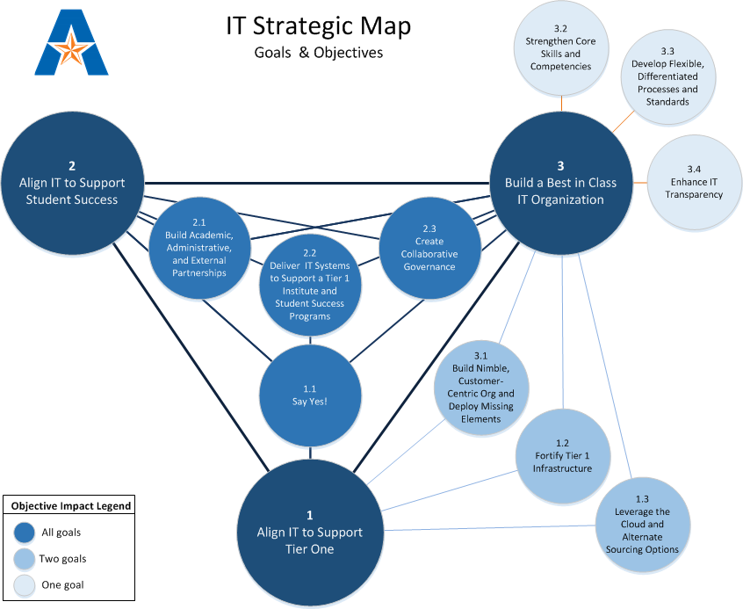

Slide 29
Brainstorm & Discussion (7 minutes)
Are there missing assessment activities?
  Use notecards to quickly jot ideas
  Compare activities
  Discuss and pick unique activities to add to the whiteboard and share with the room

Slide 30
Share Additional Assessment Activities
Participant Feedback
How well are we meeting customer needs
SWOT (Strength, Weaknesses, Opportunities, and Threats) Analyst
Skill Assessment
Current Tool Kits
Cross Check
Measurable Outcomes and Assessments
Good Change Strategy

Slide 31
Questions?

Slide 32
Resources
Contact us for information about our consultant partners for this project
See our full assessment report at http://www.uta.edu/oit/Integration_Report.pdf
Connect with us:
  Jim Bradley cio@uta.edu
  Zinna Butcher zinna@uta.edu
  Erin Morgan emorgan@uta.edu
Visit the Strategic Planning Constituent Group on Thursday at 9:10am in Meeting Room W308A/B
Join the Strategic Planning Constituent Group at http://www.educause.edu/discuss/all-discussion-groups

Slide 33
Help Us Improve and Grow
Thank you for participating
in today’s session.
What to keep?
What to improve?
Longer Session
(Pre-Conference)?
We’re very interested in your feedback. Please take
a minute to fill out the session evaluation found within
the conference mobile app, or the online agenda.
Notes:
What went well that you’d like us to continue in the future?
What could be improved?
Would you like a longer session?

