Slide 1
Alignment and Accountability:
Moving from the Strategic to the Operational
Craig Fowler and Anna McFadden
EDUCAUSE
October 1, 2014

Slide 2

Western Carolina University

Slide 3
From your experience …
Are there cases where strategic plans simply gather dust?
  Yes or No
Is you answered yes, what was the main reason why?
  lack of funding
  no accountability
  no metrics
  just an exercise to get a checkbox
  no commitment
Is you answered no, what was the main reason for success?
  well-funded
  Accountability Let’s use PollEverywhere!
  metrics
  commitment

Slide 4
Agenda – One University’s Experience
Leadership Philosophy
Strategic Planning
Communication
Objectives, Measurement, and Evaluation

Slide 5
Leadership Philosophy
Envision 5-10 years vs. where you want to be next
Strategy provides the framework for decision making
  Priorities, Goals, and Timing
    What we will say “no” to
  Culture (Triple P, Awards, Root Cause)
  Professional Development
  Organization structure and positions
It’s better to stretch ourselves with our goals than to set goals we know we can meet
Goals and objectives must be written down
If you can’t measure it, you won’t achieve it
Goals must be linked
  WCU 2020 Strategic Plan
  IT Strategic Plan
  IT Leadership Team Annual Objectives

Slide 6
Leadership Philosophy, cont’d.
There must be accountability
  Leadership focus
  Establish ownership
    Ownership is enhanced by engaging people in goal creation
  Define and document deliverables
  Set dates
  Measure progress
    Metrics
    Annual report
  Evaluate performance
Transparency -- Goals and objectives must be shared, communicated, and jointly owned
  Within IT
  Governance process
  Information Technology Council
Building and maintaining trusting relationships fosters understanding, adoption, and “forgiveness”

Slide 7
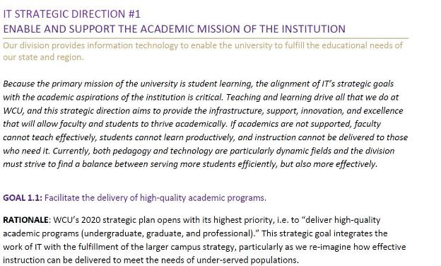

Cascading Strategic Planning
WCU completed its 2020 Strategic Plan in June 2012
IT completed its Strategic Plan in April 2013
  Committee Membership
  Vision, Mission, Guiding Principles, Core Values
  Eight Focus Groups
Moving from Strategic to Tactical
  IT leadership established 2013-2014 goals June 2013

Slide 8
WCU 2020 and IT Strategic Plans
2020 Strategic Directions
Fulfill the educational needs of the state and region
Enrich the total student experience
Enhance our external partnerships
Invest in our people
Invest in our core resources
Garner support for our vision
IT Strategic Directions
Enable and support the academic mission of the institution
Enhance university business processes
Improve the university’s technology foundation
Invest in our people
Invest in our core IT resources
Improve our service commitment
Enable a flexible and secure technology architecture

Slide 9
IT Strategy and Goals Communication
Discussions with IT Council
Discussions with IT staff
Brochure for each IT staff member
Poster placed in each IT department location
Information Technology Leadership Council Retreat
  “Theme for the Year”
Visits with Deans
DoIT News
Division Meetings
Microsoft Lync

Slide 10
Aligning IT’s Strategic Momentum (link)
IT 1-pager for 2013-2014
As of 06/24/2014
On track (2)
Warning (1)
Key issues (0)
1.676
1.735
1.666
Satisfaction with IT (34%)
Strategic Actions and Services
  Implement IT Communications Plan
  Develop Faculty Research technology needs plan and budget. Initiate initial projects.
  Investigate extended support options, including support hours, chat, and other approaches.
  Analysis of Help Desk offering certain training
  University wide software inventory
  Define and communicate strategic positioning of the Intranet and roadmap
Self Service IT
  Phase 1 self-help knowledge base (HD, TC, CFC)
  Automate My Cat PIN reset process
  Automate guest wireless request process
  Automate non-person account renewal process
  Automate guest systems access process
  Automate system availability dashboard web page
Wireless user experience improvement team
Telecom
  Implement organization transition
  Implement process automation and simplification
  Investigate cost reduction opportunities
  Develop voice roadmap / VoIP plan
Metrics
  85% Helpdesk First Contact Yield (FCY)
  95% satisfaction on tickets surveyed
  <7% incident ticket escalation
  <10% incidents exceeding resolution time
  15% reduction in desk-side visits
Improving IT (33%)
Strategic resource alignment
  Review resource allocation within IT and adjust to strengthen alignment with university and IT strategic objectives
  Expand business analysis capacity/capability
  Baseline IT staff percentage on projects. Target 15% by EOY.
  Define work intake process and priorities: incidents vs. service requests vs. work requests vs. projects at dept and team levels
Sustainable models
  Investigate and analyze moving to GA Banner Hosted Environment
  Systems capacity planning process
  Develop sustainable funding model for Telecom
  Define Strategic Technologies Planning process
  Assess and refresh network master plan
People Development
  Adopting our IT Core Values
  Map strategic goals & initiatives to needed professional development
  Define and implement specific cross-training objectives
  Maintain certifications
  5 Conference presentations and 3 published articles
  Management and performance management training
Disaster Recovery
  Data center backup capacity at 100%
  Web server failover
  Recovery site agreement
  Develop “to-be” disaster recovery design
  Test exercise
Administration
  Develop approach for budget distribution and accountability
  Develop S/W and H/W license maintenance tracking process/calendar and responsibilities
  Develop IT “work at home” policy: reqmts, stds, and expectations
  Develop and implement Off-Hours Coverage policy
  Formalize training request process
  Standardize recruitment process
Process Re-engineering for Apps development
Complete IT audit actions
PMO
  Implement TeamDynamixHE project management system
  Assessment of our PMO maturity using formal methodology
IT policies
  “One in, One out” PC replacement
  Use of generic ID’s
  Versions of software supported
  Data classification and handling
  Risk assessment and management
  External hosting / Cloud infrastructure policy and checklist
On-site benchmark visits with 2 univ: Apps&Sys, ITDS, Netwk
Projects (33%)
University Initiatives
  ENS Banner Opt-out
  Participate: Univ Strategic Master Plan
  Participate: Univ process improvement Task Force
  Participate: Physical Access Task Force
  Participate: Biltmore Park Strategic Plan
  Data Capabilities
  Develop a University Business Intelligence (BI) / Data Strategy
  Data warehouse intranet reporting: admissions, prog prioritization
  Digital Media
  Collaboration file sharing
  Video for CEAP and lecture capture
  Video for clinical capture
  Video recording policy
  Academic
  Grades First
  Foreign Language Assembly
  Strategic plan for LMS usage
  Blackboard enhanced functionality
  Classroom virtualization Phase 2
  Academic electronic docs and workflow
  CFC Instructional Tech Outcomes Assessment Plan
  Student Experience
  Recruitment Plus admissions replacement
  Scholarship tracking system
  Develop portal strategy
  Virtualization Strategy for student and faculty/staff use
  Networking
  Academic wireless expansion phase 2
  Residence hall wireless expansion phase 2
  Dual fiber paths for all buildings
  A) Wired network upgrade phase 1; B) Phase 2
  Identity Access Mgmt (IAM)
  Implement InCommon cross-institutions capability
  Dev business case and problem framework
  Develop high level architecture and proposed roadmap
Security
  Implement multifactor authentication
  ISO security framework Phase 2
  Vulnerability scanning follow through
  Develop annual security awareness training
Faculty / Staff email recommendation
Dev roadmap for eliminating apps on older technologies
GA mandates: Student data mart; e-Invoicing. +++
Intranet Phase 3
  Implement IT division intranet site
  Implement new intranet “homepage”
ITPF = 169
IT Performance Factor
Sum of (category averages*wgt %*100)
  A 175+
  B 155-175
  C 140-155
  D <140
Items in purple tie to 2020 or IT Strategic Plan initiatives

Slide 11
Examples from the IT One-Pager
Strategic Actions and Services
  Strategy linkages
    2020 Plan- 5.4.2
    IT Strategic Plan 1.3.1, 1.3.2, 3.2.3
  Develop faculty research technology needs plan and budget. Initiate initial projects.
    Establish IT team to review faculty needs already generated.
    Develop possible solutions and prioritize. Seek faculty feedback.
    Develop budget by February 1.
    Prioritize projects.
    Request initial projects

Slide 12
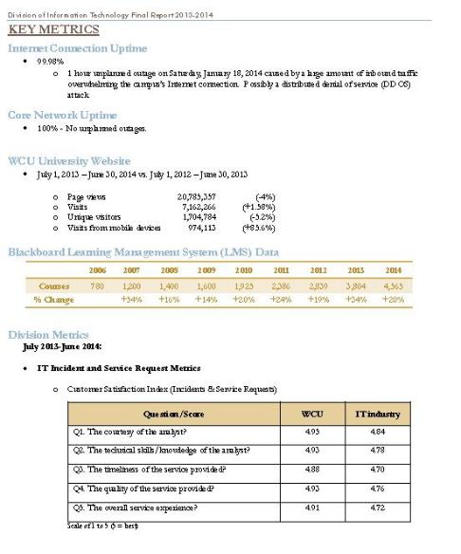
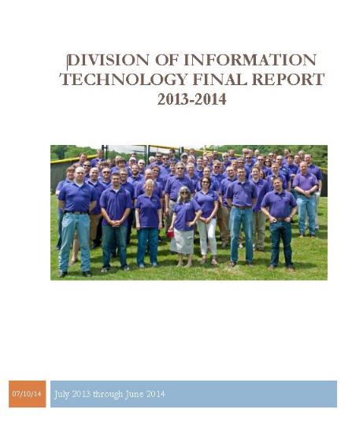
Another Example
Disaster Recovery
  Strategy linkages
    2020 Plan 5.4.4 IT Strategic Plan 3.3
  Data Center backup capacity at 100%
    Complete DC backup project, increasing backup capacity to 100% of DC.
  Web server failover
    Complete this project, allowing for un-interrupted WCU.edu services should an outage occur.
  Recovery site agreement
    Document an agreement with an offsite data center provider providing WCU the ability to re-locate limited computing infrastructure from the main campus should it be necessary.
  Develop “to-be” disaster recovery design
    Design an architecture providing the necessary technology solution fitting university business continuity needs.
  Test exercise
    Hold an annual DR tabletop exercise, similar to the new process developed for the 2013 drill
Board of Trustees Report- Metrics

Slide 13
Evaluation
IT Director
  Each IT Director has a One-pager for their department
  Status is reviewed quarterly
  Performance evaluation tied to achievement of annual objectives
  Leadership is evaluated not only on accomplishment but process
  Team member reviews tied to objectives
CIO
  IT One-pager is the annual objectives for the CIO
    Approved by Chancellor at beginning of fiscal year
  Chancellor reviews and discusses One-pager status quarterly
    There may be additions or removals
  Performance evaluation tied to achievement of objectives and additional expectations

Slide 14
Discussion
This is only one university’s experience
What have you seen as successful processes, approaches, or tools for moving from the strategic to the operational?

Slide 15
Contact Us
Craig Fowler cfowler@email.wcu.edu
Anna McFadden amcfadden@email.wcu.edu
Office of the CIO, Western Carolina University
828-227-7282

