Slide 1
Using Technology to Provide Shared Access to Valuable Online Learning Resources and Improve Teaching and Learning
Jonathon Sweetin M.S. of ED
Learning Solutions Services Manager
North Carolina Community College System

Slide 2
Overview
NCCCS Background
The Big Problem
What is the Virtual Learning Community?
Why was it needed?
Content Flow
The Next Problem
What is the NCLOR?
How is the NCLOR organized?
Content and Outcomes Big Picture
Demo VLC Contribution & LMS integration
Analytics and Reporting
Questions

Slide 3
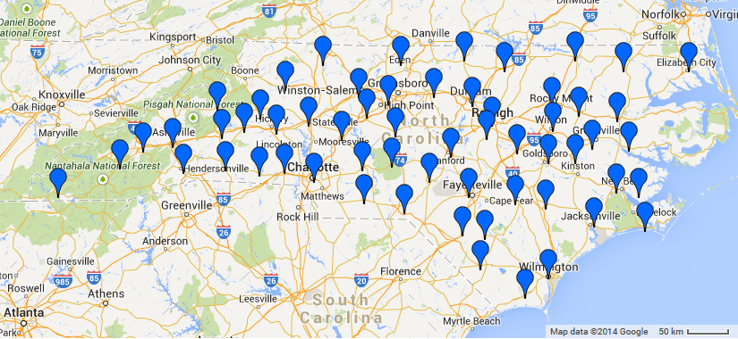
NCCCS Background
Created in the 1960’s
3rd largest system in the U.S.
58 colleges with 124 campuses
Over 1,800,000 enrollments (Cur for 13-14 AY)

Slide 4
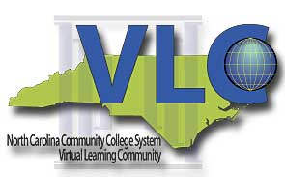
The Big Problem..
A lot of non-traditional students…juggling jobs, families, responsibilities… need better choices for obtaining a degree
Possible Solution…Distance Learning!
The Virtual Learning Community was created to centrally develop online courses/programs for all 58 colleges to share.

Slide 5
What is the Virtual Learning Community?
In short…it is shared content and course development
Established in 1998 through collaborative agreement of all 58 NCCCS college Presidents.
Developed centralized online courses since 1999.
SMEs work with (instructional designers) to create courses & learning objects for the Combined Course Library.
Creates quality courses in a template approach for faculty to customize for their college.
Provides distance learning resources, research, and best practices to support distance learning at the colleges.

Slide 6
Why was it needed…
Oh My!

Slide 7



College Information System & Learning Management Systems
Each college administers their own LMS but can host applications in many ways.

Slide 8
The Content Flow…
Virtual Learning Community
Content Development
Learning Management Systems
Moodle – Delivery Platform
College Information System (Ellucian)
Course Information from Combined Course Library
Blackboard - Delivery Platform

Slide 9


The Next Problem
The maintenance, versioning, and storage of the VLC content was getting unmanageable.
There was a missing piece to our content flow…

Slide 10
The Missing Piece…
Virtual Learning Community
Content Development
Learning Management Systems
Moodle – Delivery Platform
College Information System (Ellucian)
Course Information from Combined Course Library
Blackboard - Delivery Platform
NC Learning Object Repository (NCLOR)
EQUELLA 6.1

Slide 11
What is the NCLOR?
The North Carolina Learning Object Repository (NCLOR) is North Carolina’s K-14* online centralized searchable database that houses teaching and learning resources. NCLOR based on the Equella platform by Pearson.
The NCLOR…
serves as a centralized searchable database for resources.
helps eliminate the duplicative costs of content development and allows seamless integration with LMSs.
aids in distribution and management of collaborative/licensed content to many institutions.
has the ability to “tag” resources to any information needed. (i.e. outcomes)

Slide 12







Version/Maintenance Example
Bb College 1
VLC Developer
Bb College 2

Slide 13





Version/Maintenance Example
Bb College 1
Resources
Bb College 2
VLC Developer
Moodle College 1

Slide 14
How is the NCLOR organized?
Collection>Resource>Attachment…All organized by metadata schema “linked” to resource summary.
Metadata
VLC
Collection B
Collection C
Resource
Summary
Resource
Summary
Resource
Summary
Attachment
Attachment
Attachment

Slide 15
Content & Outcomes Big Picture
Align Content to Outcomes/Standards
Use SMEs and faculty to find and tag content to learning standards.
Adopt Content
Faculty find the aligned content that best fits their lesson plans/courses and adopt it in their LMS or face-to-face courses.
Improve Instructional Design
By improving the instructional design of the lesson plans/courses, we increase the likelihood of student success.
Using metadata in NCLOR, NCCCS can…

Slide 16
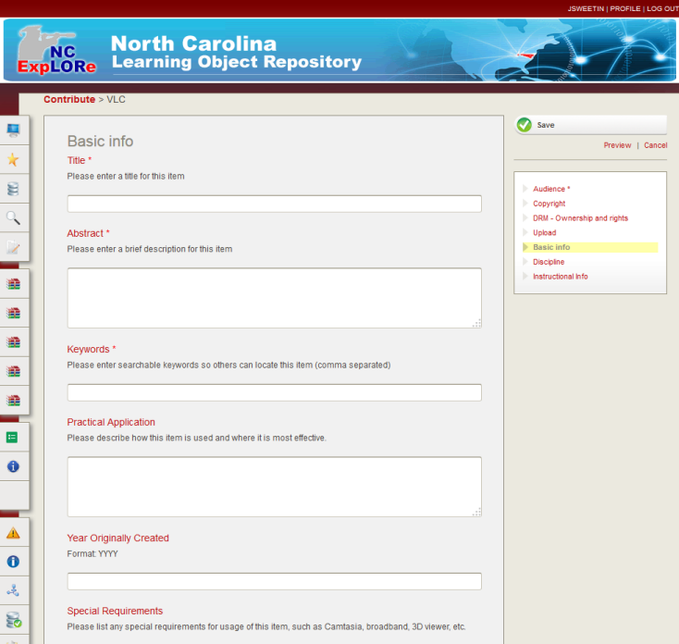
VLC Collection Demo
Collection Wizard

Slide 17
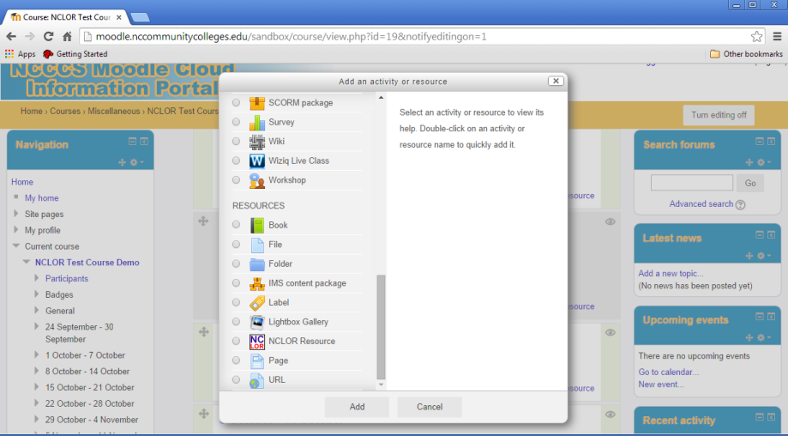
LMS Integration Demo
Moodle Resource Module

Slide 18

Analytics and Reporting
Equella = Custom Reporting
Example: NCLOR Resource/Collection/# of Views for Jan 2014
Rank | Resource Title | Collection Name | User Views
1 | Prokaryotic Cell Structure | VLC | 251
2 | Stained Elodea Slide | VM | 150
3 | Wisc-Online Arterial Blood Gas | OER | 137
4 | Binary Fission for Bacterial Reproduction | VLC | 130
5 | Ostomy Nursing Care | Higher Ed | 115
6 | Bacteria Shapes | VLC | 107
7 | QUOTE IT! | VLC | 106
8 | Piaget’s Sensorimotor Stage of Cognitive Development… | VLC | 95
9 | Gender Development: A Summary of Terms and Theories | VLC | 85
10 | Human Cheek Smear Slide | VM | 78
11 | Perfusion-DVT | NC-Net | 77
12 | CK-12 Chemistry : Chapter 1 Introduction to Chemistry | OER | 72
13 | Exterior Skull ID & Labeling | VLC | 72
14 | Restraint for the Veterinary Assistant | VLC | 72
15 | Wisc-Online Differentiating Acid-Base Disturbances | OER | 70

Slide 19
Questions?
Jonathon Sweetin
Email: sweetinj@nccommunitycolleges.edu
NCLOR Website: explorethelor.org

