Slide 1
To Scrum or Kanban: Is that the Question?
Candace Jones Senior Applications Manager University of California, Office of the President

Slide 2
Agenda
Introduction
Round 1: Basic Agile Principles
Round 2: Scrum
Round 3: Scrumban
Sample Project
How can I get started?

Slide 3
Introduction

Slide 4
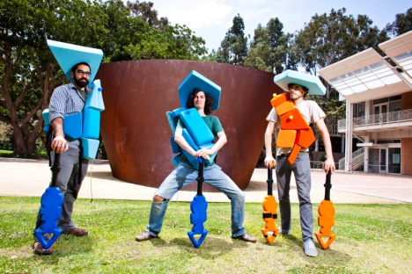
University of California
Ten campuses, five medical centers, and three
national laboratories
We serve 233,000 students and 190,000 employees
We have a budget of approximately 24 billion dollars
Office of the President – 1500 staff across 60
departments
Web and Application Services Undergraduate Admissions Systems
Over 80 custom PHP applications
Central Undergraduate Admissions Application
Drupal and Cascade Server
SharePoint

Slide 5
Discussion
PollEv.com/candacejones126

Slide 6
Basic Agile Principles

Slide 7
Agile Manifesto
We are uncovering better ways of developing software by doing it and helping others do it. Through this work we have come to value:
Individuals and interactions over processes and tools Working software over comprehensive documentation Customer collaboration over contract negotiation Responding to change over following a plan
That is, while there is value in the items on the right, we value the items on the left more.

Slide 8
Scrum versus Kanban
Scrum
Product owner, ScrumMaster, Team
Sprint planning, timeboxed sprints, sprint demo,
retrospectives
Set explicit policies
Kanban
No defined roles, less prescriptive
Visualize the workflow
Set work in progress limits

Slide 9
Scrum

Slide 10
President’s Postdoctoral Fellowship Program
Entire team attended training – Passed Certified
ScrumMaster test
Project already behind schedule before starting new
methodology
Team formed - sprint planning, estimates, daily stand-ups
Sprint demo one – delayed, conducted retrospective
$40,000 = 579 Hours
Overage = 413 hours or $35,000
Committed to finishing PPFP with Scrum

Slide 11
Down but not out!

Slide 12
What went wrong?
Candace Jones
Estimates inaccurate
Stand-ups too long (debating roadblocks)
Retrospectives quiet
Took on too large a project for first Scrum experience.

Slide 13
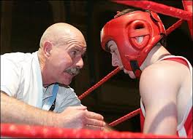
Round 3: Coaching / Scrumban

Slide 14
Retrospective / Coaching
Brought in Agile Coach to participate in Retrospective
Appreciated the planning in Scrum
Maintenance work never taken into account
Need one place to manage both
Need explicit policies to apply to work
Resource assignments needed to be adjusted
Okay to switch methodologies

Slide 15
Sample Project
RGPO Donation Form
Users stories
Project list
Kanban board
Quick demo

Slide 16
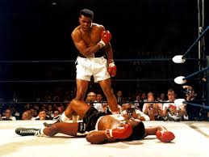

Slide 17
How do I get started?
Start small……take something that would take you less than 40 hours to complete and schedule it across a two week sprint.
This extra time will not place undue pressure for first project
It also will allow the team to feel a bit of success initially.
Chose a project that either you have a flexible customer – or is internally facing, to the unit.
Get training / coaching.

Slide 18
Discussion
PollEv.com/candacejones126

Slide 19
Help Us Improve and Grow
Thank you for participating
in today’s session.
We’re very interested in your feedback. Please take
a minute to fill out the session evaluation found within
the conference mobile app, or the online agenda.

