Slide 2
I Can See Clearly Now:
Gaining Insight Into Academic Processes Through Analytics
University of Mississippi
Susan Lukose / Chris Reichley

Slide 3




What are your favorite consumer apps with embedded analytics?
http://pollev.com/umanalytics

Slide 4
Student Ratings of Instruction: Sentiment Analysis Gold Mine

Slide 5
History of Student Ratings
Used broadly for more than 50 years.
Hot topic that is the subject of much research.
Digitized comments facilitate text mining.
Sentiment analysis of all kinds of narrative feedback is a big focus area right now.
  Movie reviews
  Product ratings

Slide 6
Student Ratings @ UM
Online process for 10+ years
DB contains 1M+ evaluations and
500K+ comments
Began text mining project in 2012
  Statistical analysis
  Sentiment analysis
Work resulted in a chapter in the 2013 Springer text, “Educational Data Mining”
Notes:
Discuss privacy of instructors and students.
At his point, this is an exploratory research project. The results are not used in production.

Slide 7
Methodology for Scoring Comments
Positive and negative sentiment is calculated across ten categories:
Organized | Clear
Helpful | Learning
Knowledgeable | General
Fair | Difficulty
Engaging | Accountability

Slide 8
Positive sentiment
Extremely knowledgeable on the subject, and ancient languages in general. Very driven and goal-oriented. He managed the class just as I assume he planned it to be conducted, making appropriate changes as necessary. I enjoy the concentation on translations...after all, that seems to be what it is all about.
Overall Sentiment Scores (Excluding Difficulty)
Total -- Positive: 7.516 Negative: 0.000
Normalized -- Positive: 100.000 Negative: 0.000
Category Scores
Organized: 1.000 (positive) 0.000 (negative)
Knowledgeable: 2.641 (positive) 0.000 (negative)
Engaging: 1.375 (positive) 0.000 (negative)
Learning: 1.250 (positive) 0.000 (negative)
General: 1.250 (positive) 0.000 (negative)

Slide 9
His accent sometimes makes it hard to take notes during lectures but he does a very good job of updating blackboard and keeping the notes available.
Overall Sentiment Scores (Excluding Difficulty)
Total -- Positive: 1.375 Negative: 0.800
Normalized -- Positive: 63.218 Negative: 36.782
Category Scores
Helpful: 1.375 (positive) 0.000 (negative)
Clear: 0.000 (positive) 0.800 (negative)
Mixed sentiment
Negative sentiment
The lecture could get pretty monotoned so sometimes it was hard to pay attention
Overall Sentiment Scores (Excluding Difficulty)
Total -- Positive: 0.000 Negative: 2.625
Normalized -- Positive: 0.000 Negative: 100.000
Category Scores
Engaging: 0.000 (positive) 2.625 (negative)

Slide 10
Variables of Interest from SIS
Student
  Age
  Gender
  Ethnicity
  Classification
  Overall GPA
  Grade in course
  Academic area
Instructor
  Age
  Gender
  Ethnicity
  Rank
Course
  Term when course was taught
  Campus where course was taught
  Time of day when course was taught
  Period within term when ratings were collected
  Section size
  Level
  Category (lecture, laboratory, studio, etc.)
  Delivery mode (online, interactive video, traditional)
  Academic area

Slide 11
Average Summary Sentiment by Overall GPA
Notes:
Objective of next three graphs is to show the kinds of questions that can be answered.

Slide 12
Normalized Sentiment by Category
Notes:
Many comments just say “Great” or “Awesome”. These would go into the General category.

Slide 13
Academic Areas with Most Sentiment in the Helpful Category

Slide 14
Applications
Current | Potential
Use results to develop themes for faculty workshops. | Provide summarized comments to department chairs.
Understand student perceptions about teaching. | Trigger administrative alerts for extremely negative comments, especially in the Accountability category.
Identify characteristics of great teachers. | Look for trends across courses to inform course planning process.

Slide 15
Academic Discipline

Slide 16
Academic Discipline @ UM
Workflow was created in 2006 to automate the process
Cases are initiated by instructors
If appealed by student, decision is made by committee
912 cases processed till now

Slide 17
Reports

Slide 19
Automated Attendance System

Slide 20
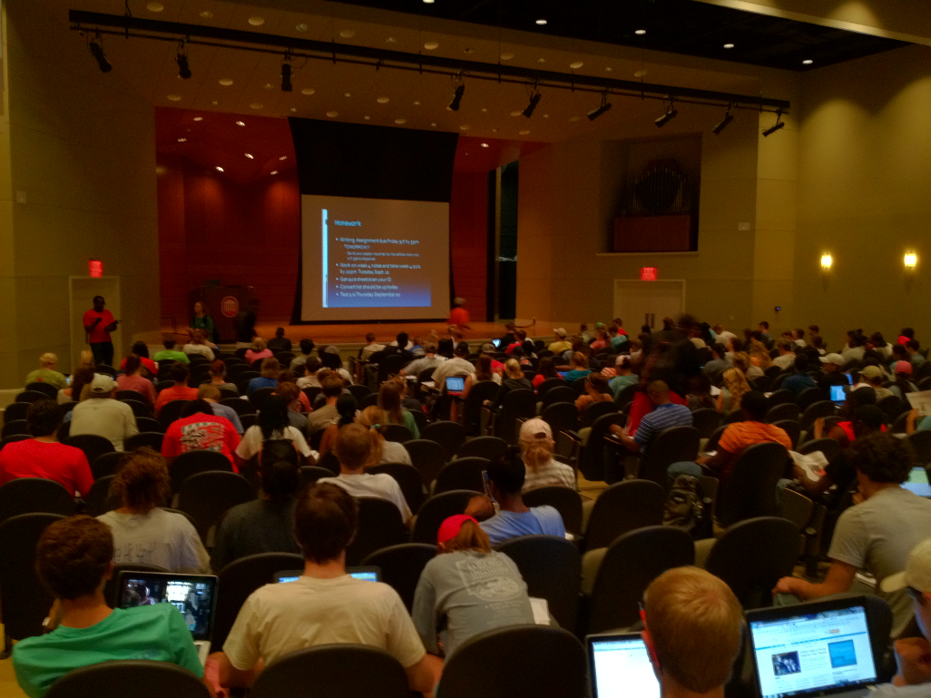
Automated Attendance
The Automated Attendance System was designed to support student retention efforts while lowering the burden placed on faculty members.
Factors
    Freshman Attendance
    Based Initiative (2001)
    Center for Student
    Success and First-Year
    Experience
    Record Enrollment
    Hybrid Courses
    Time Constraints

Slide 21
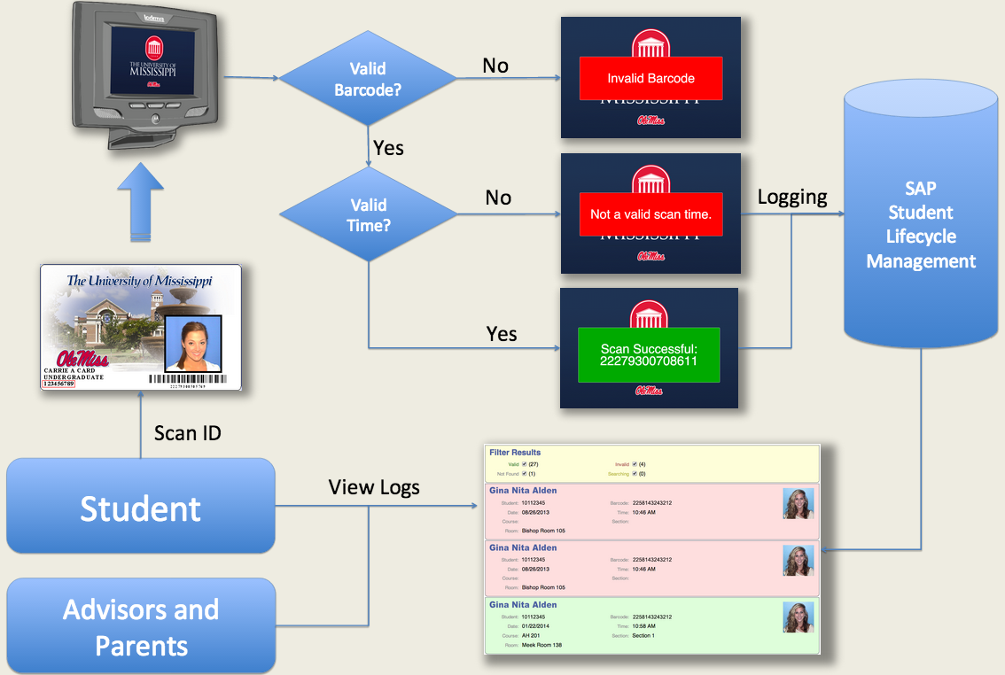

Slide 22
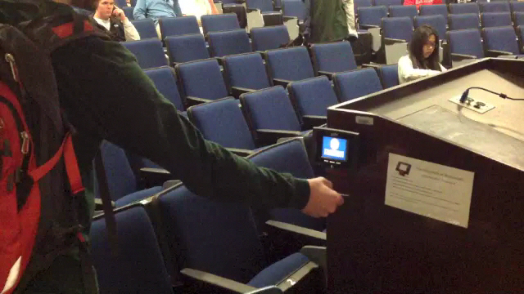
Automated Attendance Scanners

Slide 23

Attendance Data Statistics
Live Spring of 2013 (12 rooms)
Currently
54 Rooms
129 Scanners
~1,000 Classes
~1.3 Million Scans
~20k Bookings (current semester)

Slide 24
Bookings with Mid-Term Grade vs. Absences

Slide 25
Average Absences by Mid-Term Grade

Slide 26
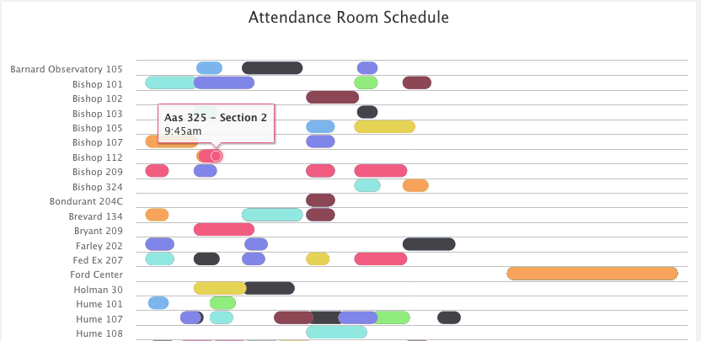
Attendance System

Slide 27
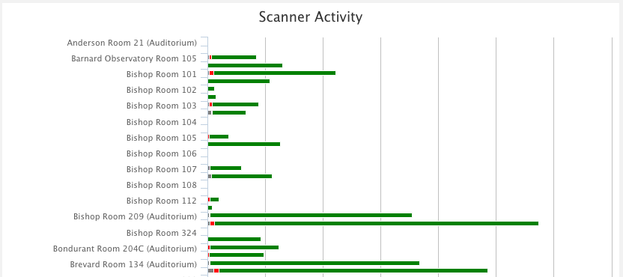
Attendance System

Slide 28
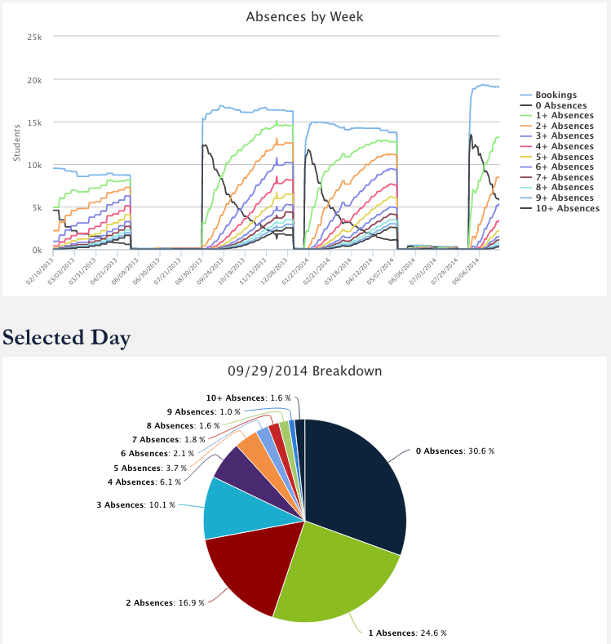
Attendance System

Slide 29
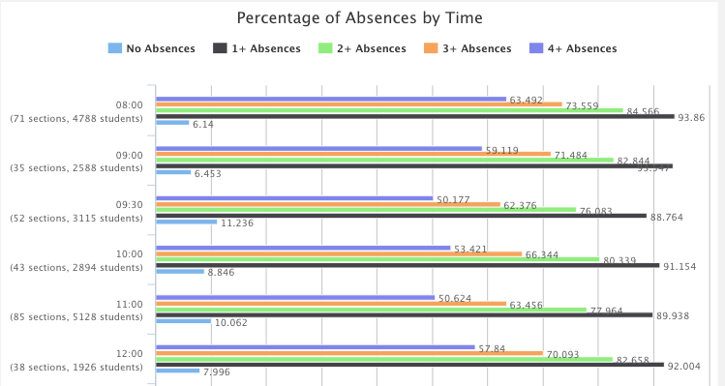
Attendance System
Time, Course, Room, Instructor, Class Time

Slide 30
What opportunities exist for further automation and analytics in higher education?
http://pollev.com/umanalytics

Slide 31
Questions / Discussion

