Slide 1
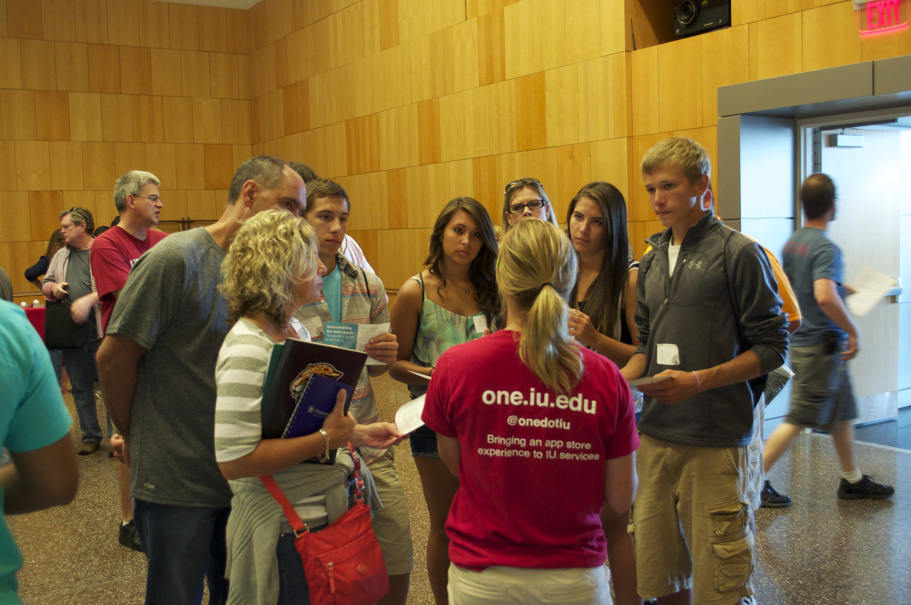
Reach out to students with proactive support
Notes:
Introductions – 2min
Cathy will facilitate
Each participant will introduce their role in general at IU

Slide 2
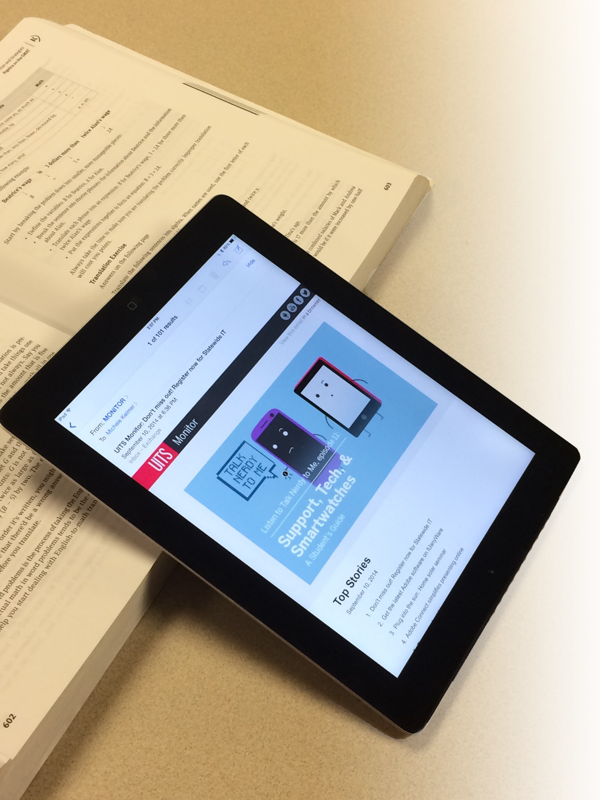
Email?
Social Network: Fractured
Print? Really
Now what?
Notes:
Cathy – 3min
(Image on this slide is the UITS Monitor)

Slide 3
UITS Student User Survey 2013
UITS can do a lot. I seem to know very little of it.
UITS doesn’t do a good job of informing people of the services available.
This survey is the first time I knew that these technologies existed.
Notes:
Cathy – 2min
-- these quotes are from the UITS User Survey student sections for 2013

Slide 4
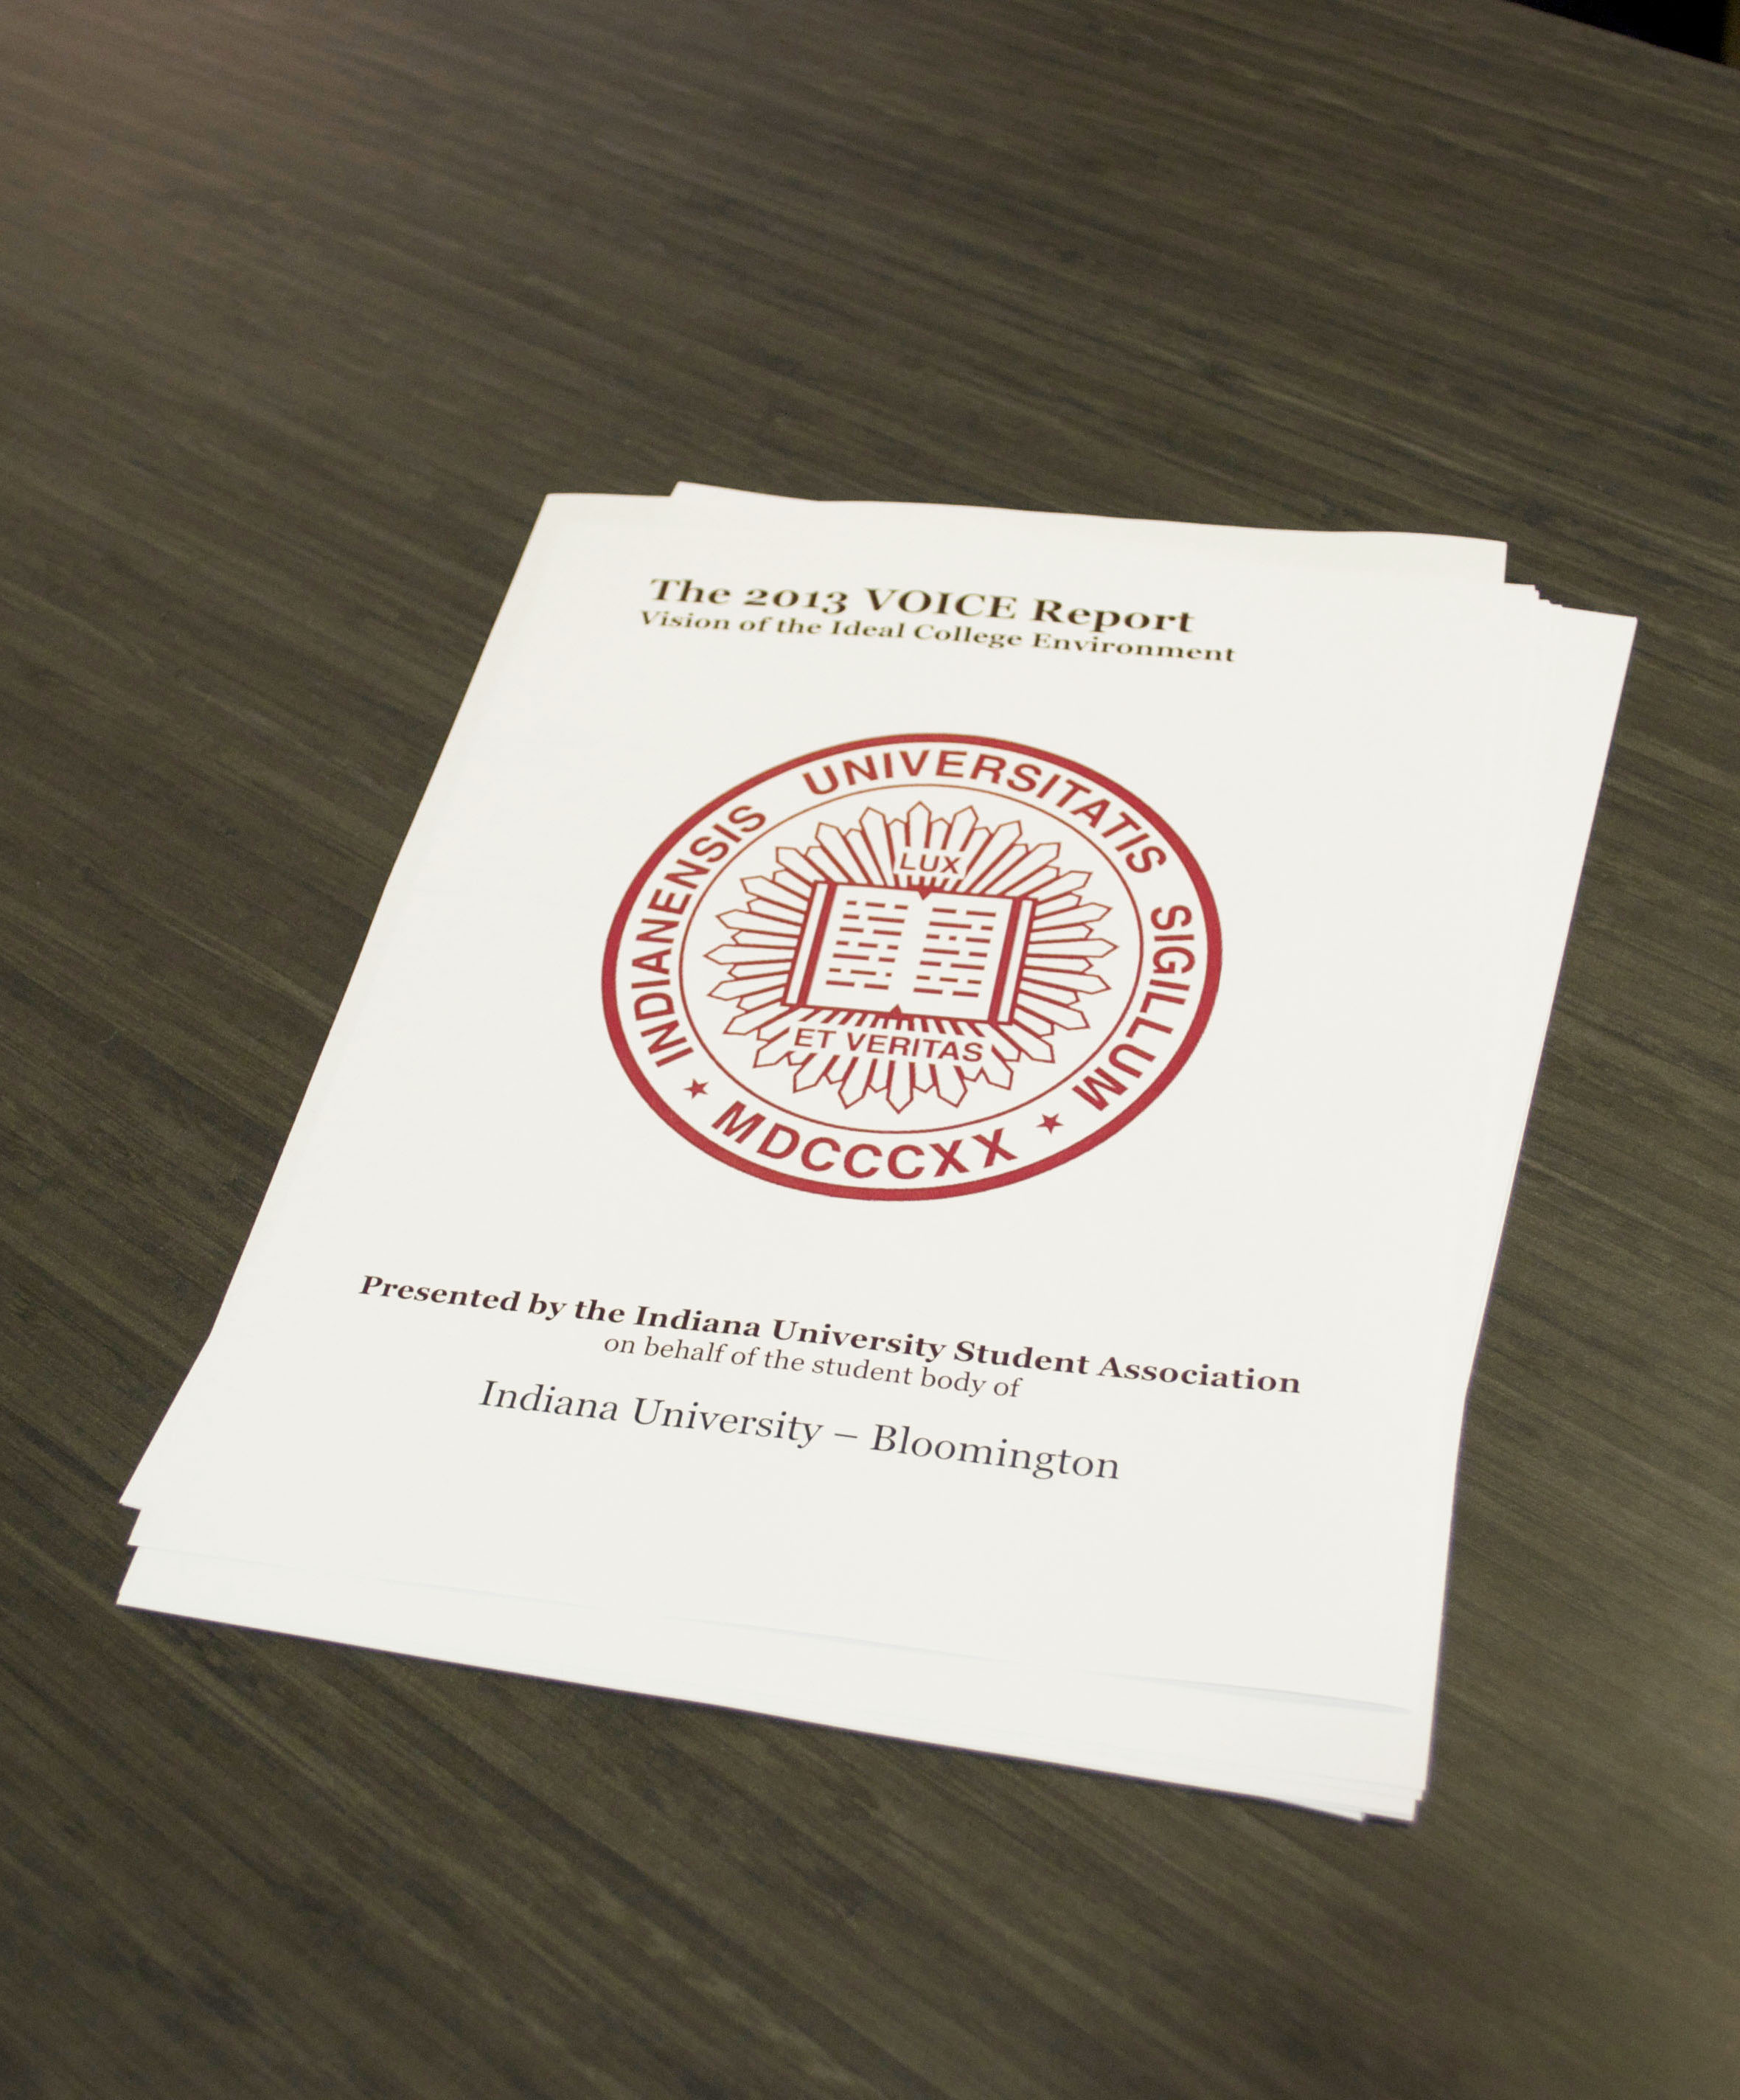
Student VOICE Report 2013
Top recommendation: Create an effective awareness strategy to inform students of the technological resources available on campus
Notes:
Cathy – 2min
Michele notes that students state they don’t want email, but face-to-face
Some notes:
VOICE REPORT:
Question: Do you regularly receive emails from UITS? (95% answered yes)
Reported reading rate:
Only 10 percent “read almost all of them”
42% read some of them
43% “I don’t read them”
VOICE REPORT:
Q15. How do you primarily find out about opportunities to join student organizations?
10.97% Presentations in class
30.91% Flyers/posters
8.97% Student Involvement Fair
31.70% Word of mouth
11.57% Chalk writing on ground
5.88% Other (please specify)

Slide 5
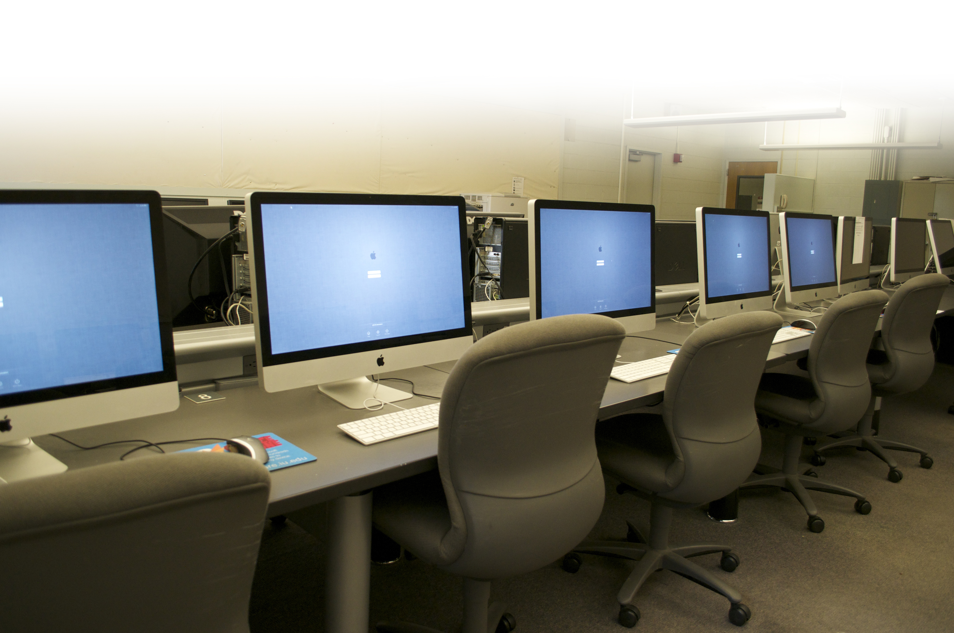
If your technology goes unnoticed…
Does it have value?
Notes:
Cathy – 2min

Slide 6
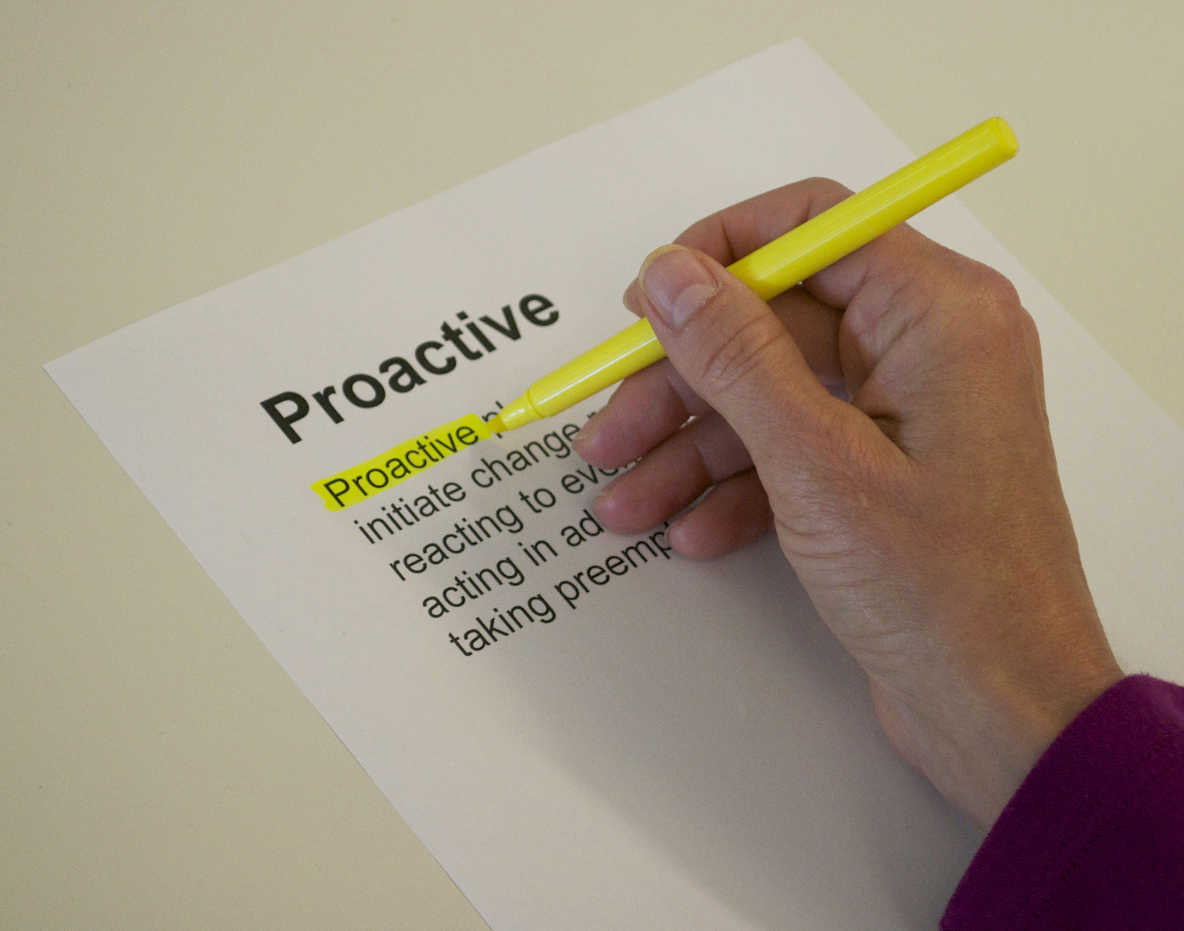
What is proactive support?
Notes:
Cathy – 4 min

Slide 7
Who is responsible for student outreach regarding technology at your institution?
Student outreach is handled ad hoc, pulling people to help as needed.
We have a dedicated group as part of our support team.
Our IT communications person or office handles it.
Other
Notes:
Michele: Survey – 1 minute

Slide 8
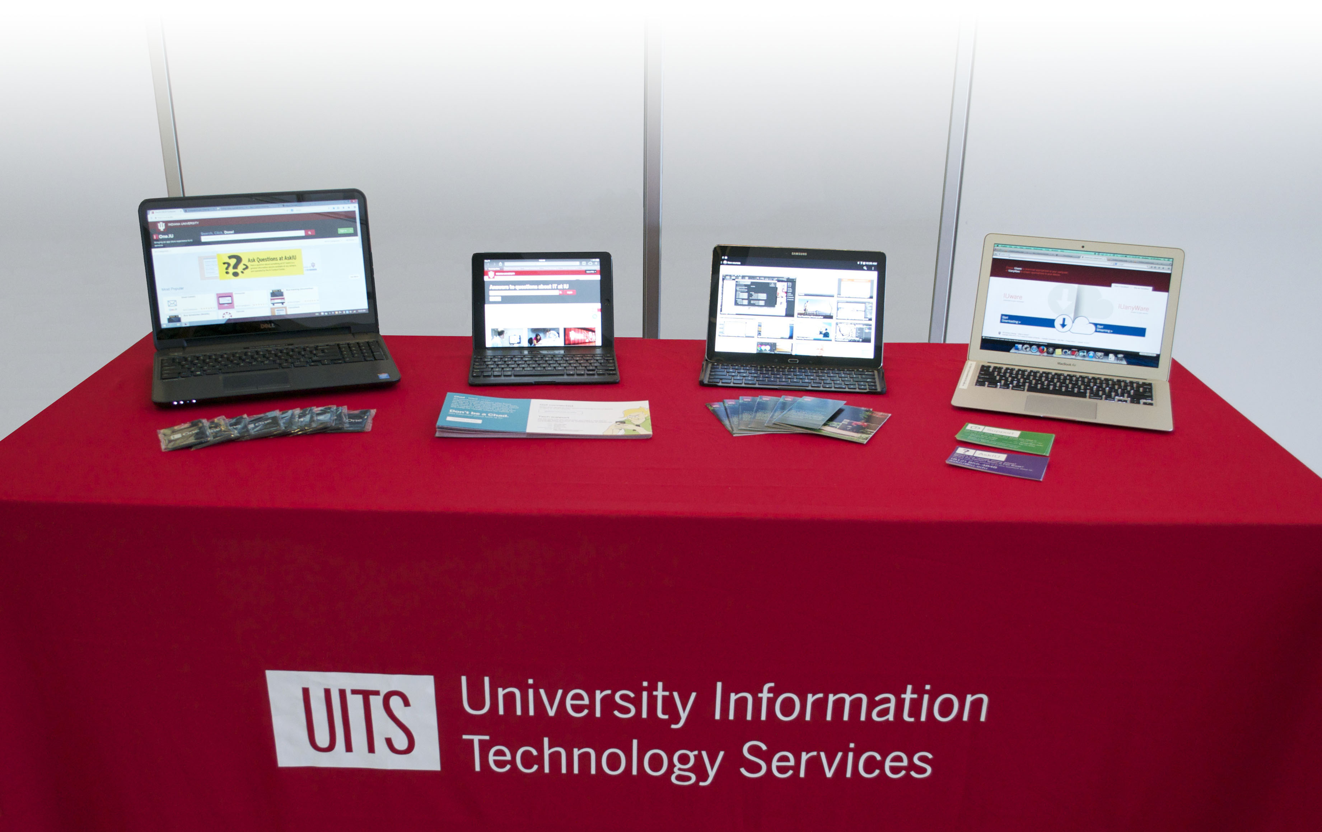
Pilot student outreach program
Purpose
Resources
Impact
Notes:
Michele 4min
(add purpose)
Emphasize the little resource and big IMPACT
Data driven
We didn’t have a baseline to know how many people it would be possible to reach during the pilot.
Purpose –
Our IT Communications Office focuses on raising awareness
We were charged with increasing adoption
Empowering People, IU’s Strategic Plan for IT
Action 47: Student Communication
IU should accelerate its communication programs that help students understand the potential and limitations of information technology, highlight new technologies and uses, promote effective and efficient use practices, and recommend practices for protecting intellectual privacy and property.
Action 43: Student Liaisons
IU should continue to establish and maintain ongoing, formal relationships with students and student groups who can serve as liaisons to the IT organization.
Initially we had a student org: Student IT Ambassadors
Form of proactive support
Started in fall 2013 as a pilot with backing from UITS leadership, specifically Sue Workman and Cathy O’Bryan
Resources for the pilot:
IUB – 3 staff, equipment
IUPUI – 3 staff (although we were not fully staffed for a semester), equipment
Technology – a couple of old laptops and an iPad at each campus and an iPad mini for each student hourly
A pop-up banner sign and a UITS-branded table cloth
T-shirts for the students
Giveaways were provided by the different services we promoted
Impact in first semester: more than 5400 contacts
Cathy’s advice of fail fast and move on
Adult Student Resources example

Slide 9
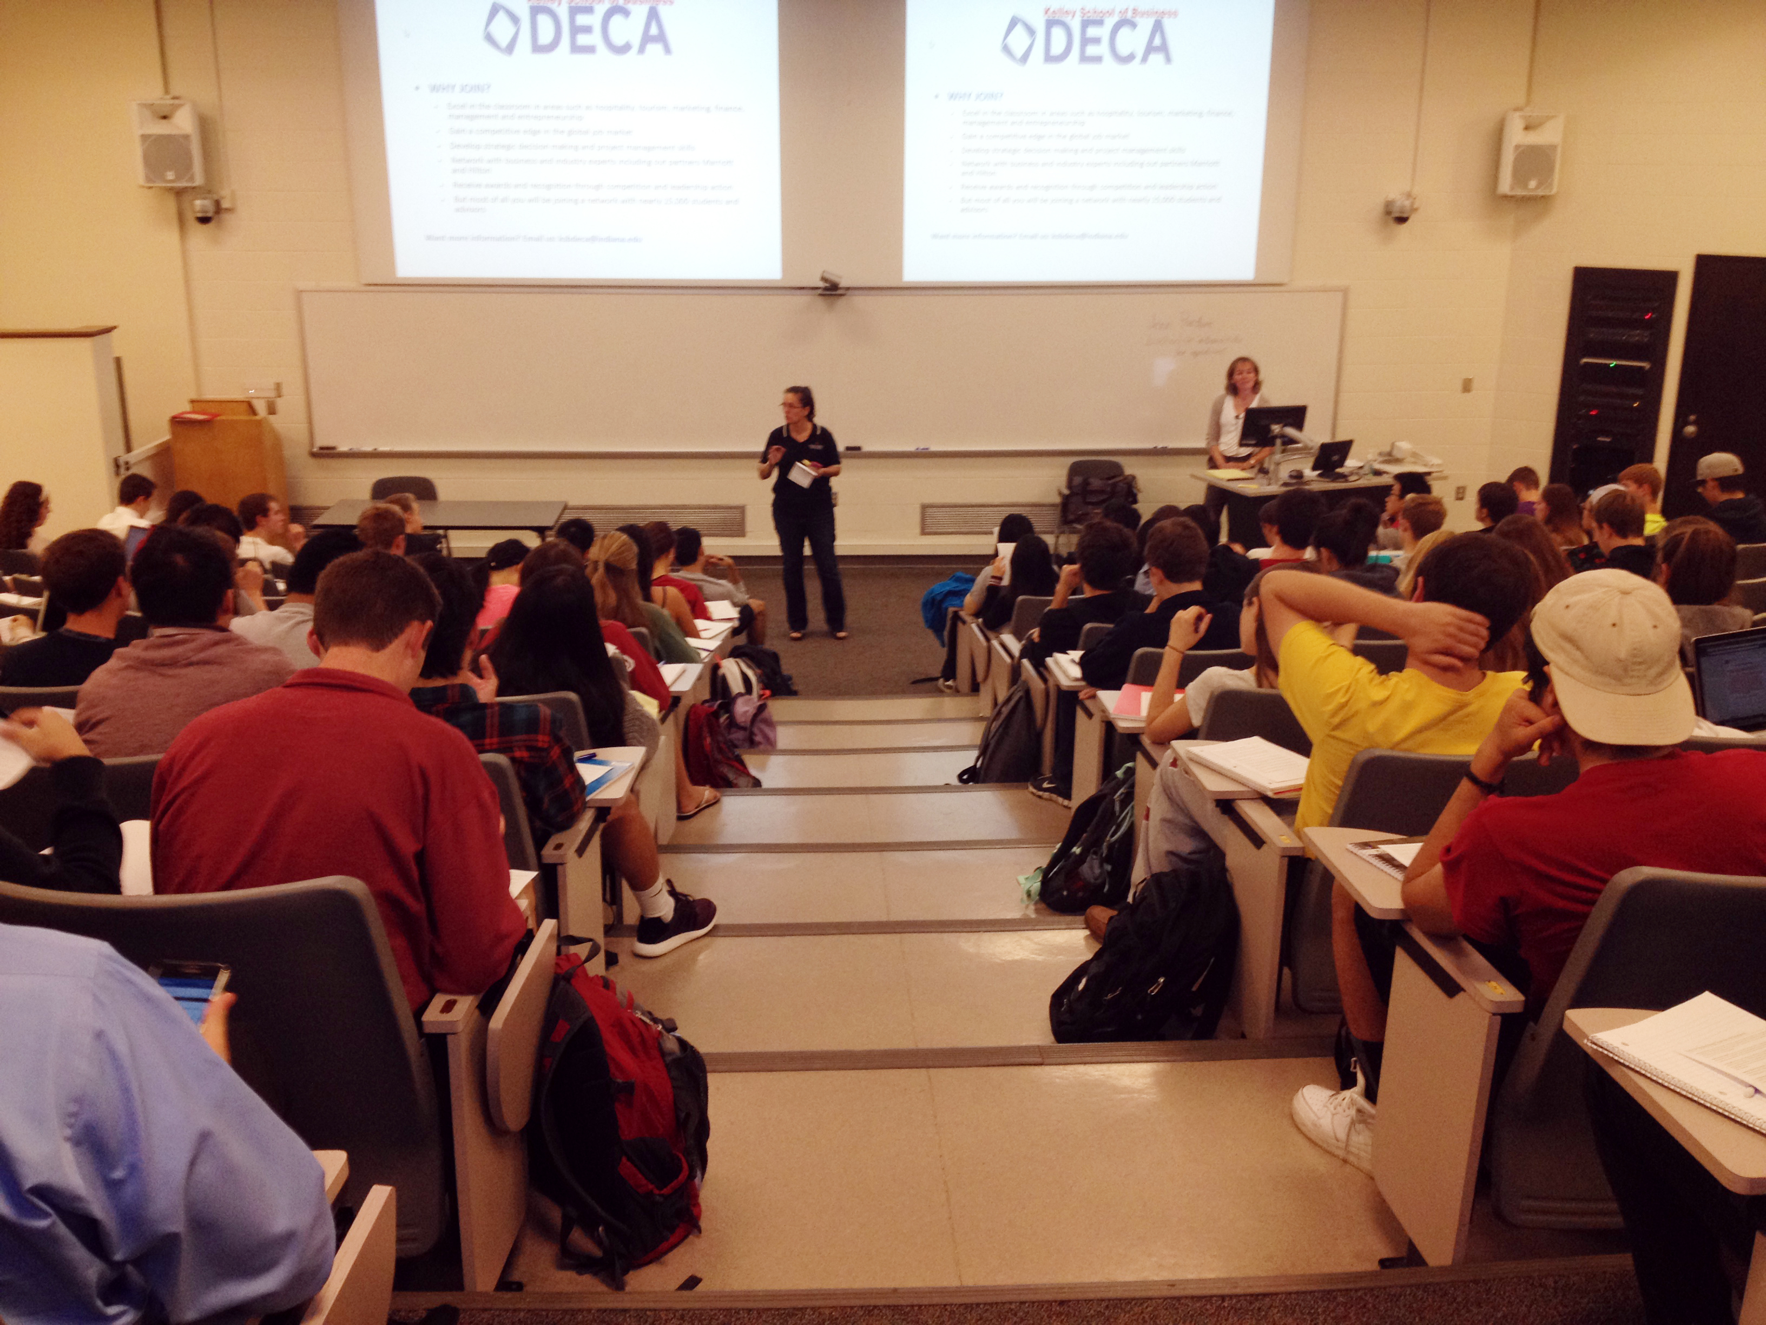
How?
Notes:
Michele – a few seconds
How???? Did we start? Build a base of potential opportunities to get in front of students.

Slide 10
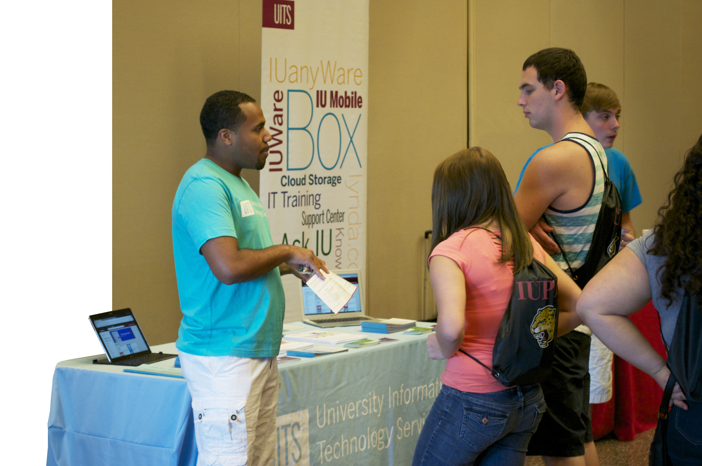
In the beginning…
Information tables
Classroom presentations
Online presentations
Notes:
Michele – 2min
Details on “events”… data driven
Info tables –
anywhere we could get permission
Our student staff would see other people tabling around campus and then ask them who to ask for permission to table
We tracked interactions, even by the half hour, to see what time frames and locations worked best
IT Managers Council assistance for classroom presentations connections
Classroom presentations
Range:
2 minutes (A100) x 140 students x 6
Or 30 students for an hour in a lab
The first one led to creating a Top 10 list that we could handout at our presentations
We arranged for drop-in presentations outside of class for faculty who simply didn’t have time to allot in class
Online presentations – thought this would be successful for adult students and in the winter and for study abroad
Even created slides for faculty to post before class (they could access them via Box)

Slide 11
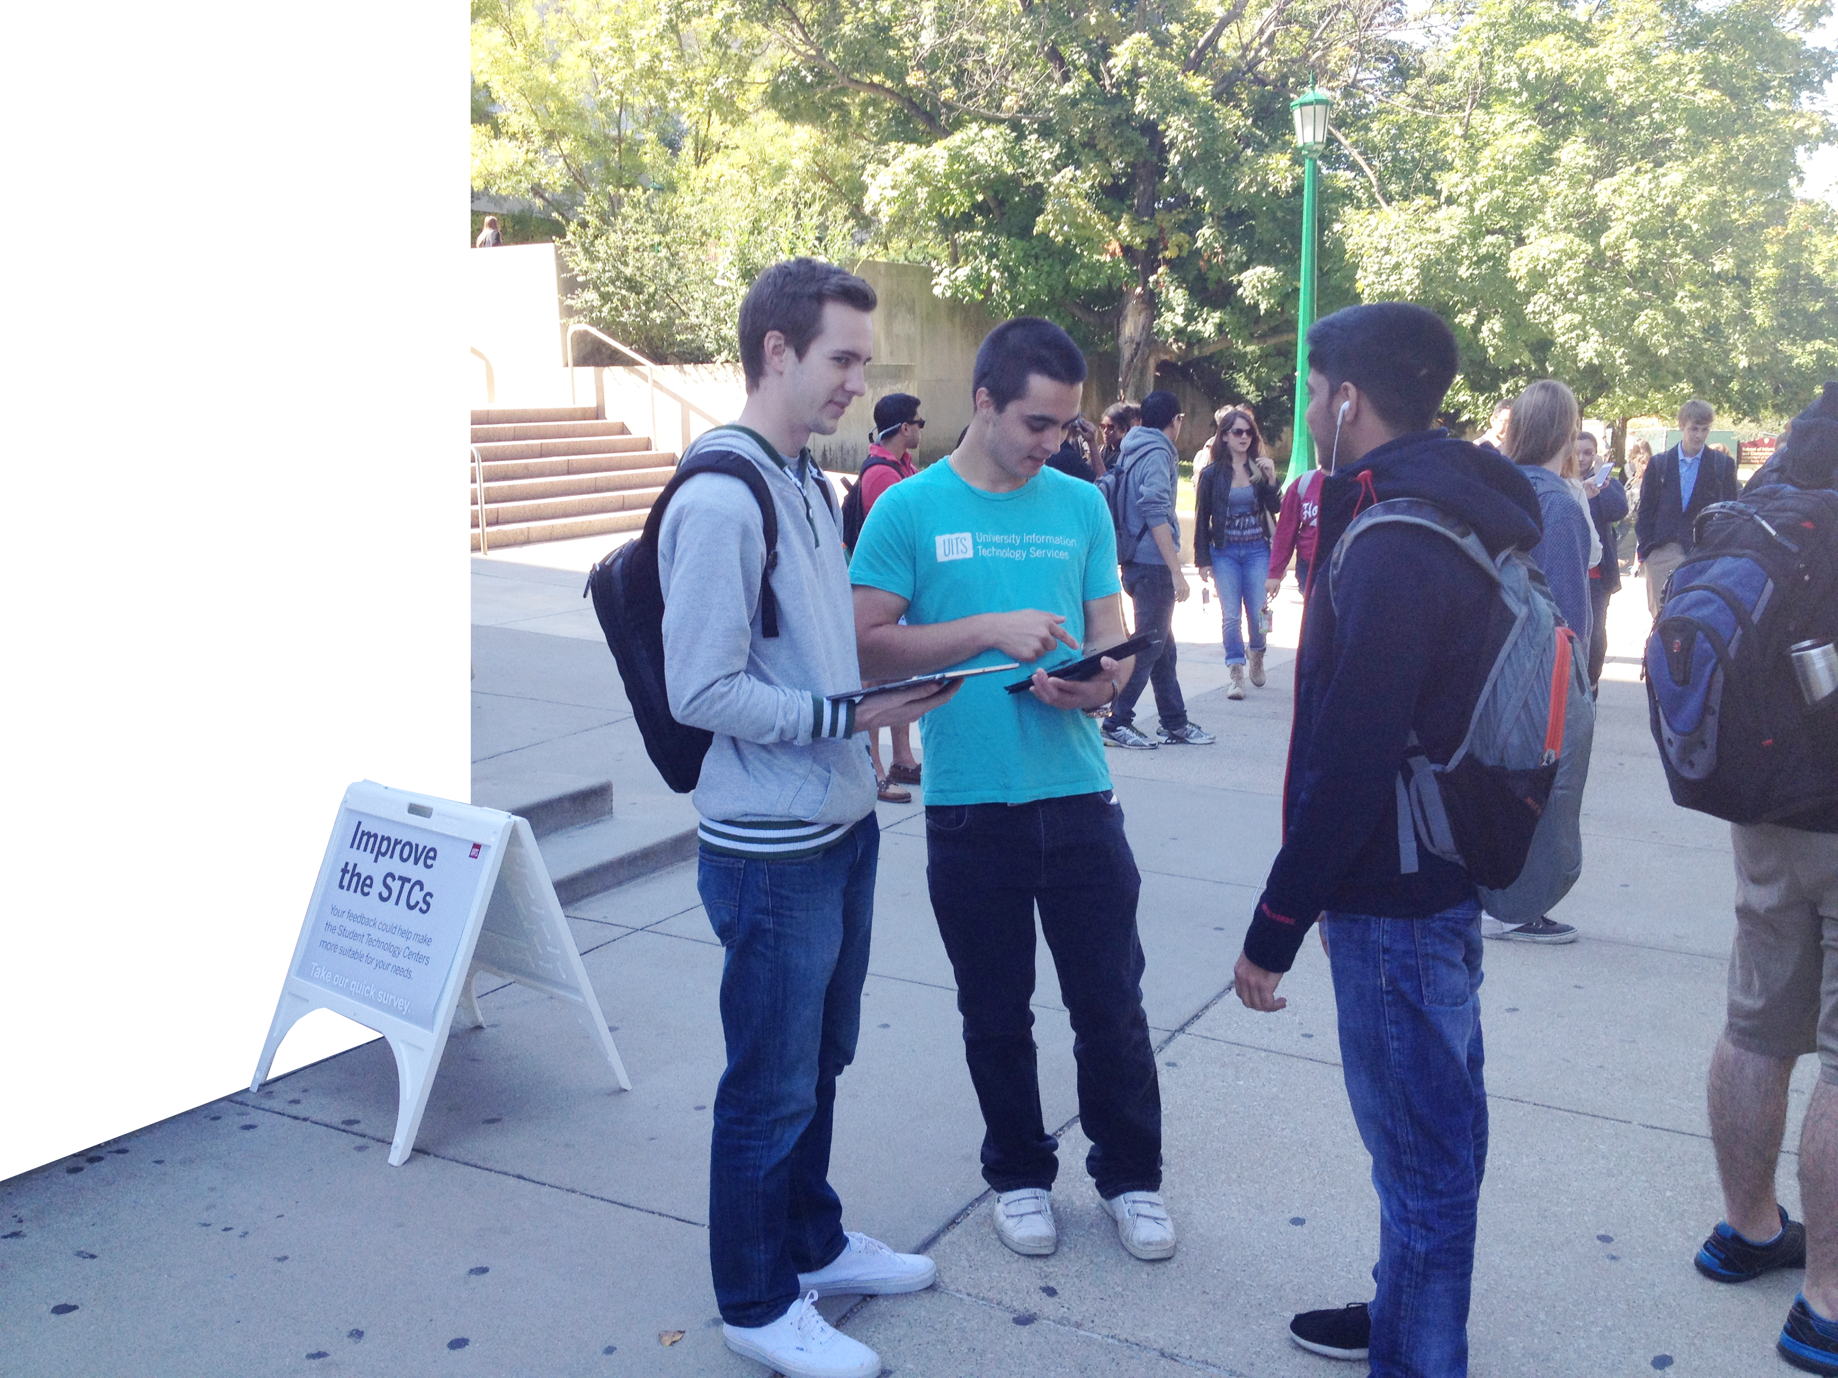
Pilot to PROGRAM
Resource scope
Impacts & new opportunities
Notes:
Michele -2min
The Program is no longer a pilot
New resource scope
Impact to date
Mobile Mondays & the STC survey
Expansion to regionals?
Cathy will end with the Holy Grail/Magic: Story of how we would NEVER get in front of Orientation…
-- note: UITS had a presence at orientation in the past, but the orientation teams changed their schedules. What was left was a spot for a short video as part of a campus resources presentation and an information table during a resource fair

Slide 12
By the numbers…
Fall 2013 | 5, 436
Spring 2014 | 4,911
Summer 2014 | 8,667
Aug. & Sept. 2014 | 8,318
Total: | 27,332
Notes:
Michele – 1 minute

Slide 13
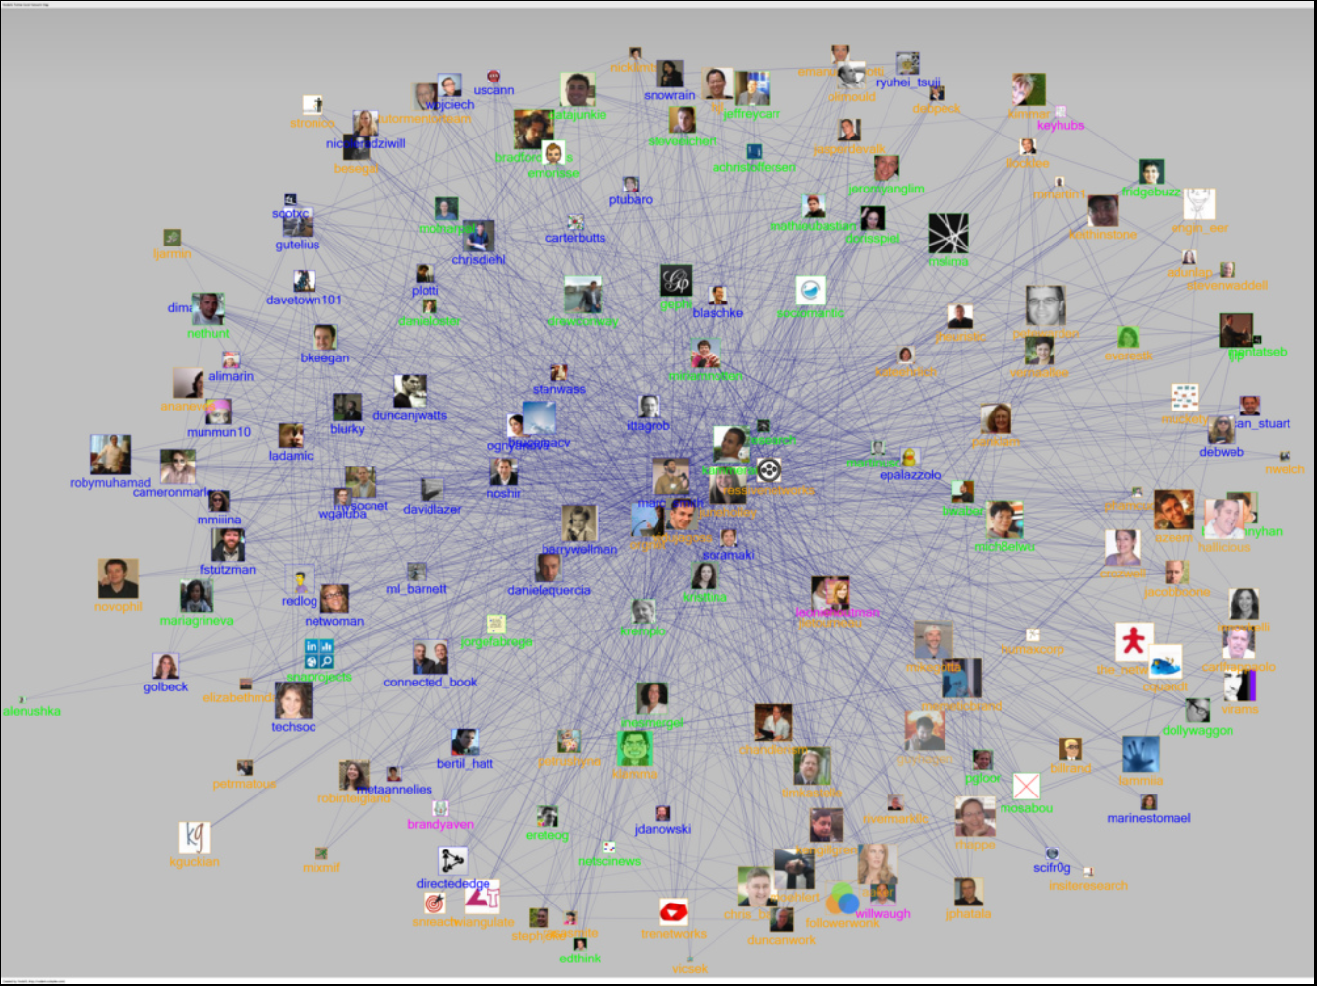
Networking
Photo by Marc_Smith - Creative Commons Attribution License https://www.flickr.com/photos/49503165485@N01
Notes:
Michele – 3min
The real secret is Networking… how you do the magic that you do.
Cold calling potential contacts
Student organizations
Res Life
IT unit leaders / IT Managers Council
Email with IT Training to all faculty on all campuses two weeks before school started
Networking
-- contacts with other student services
-- colleagues inside UITS pass along opportunities that cross their desk
Cathy will cut in at end. BRIEFLY

Slide 14
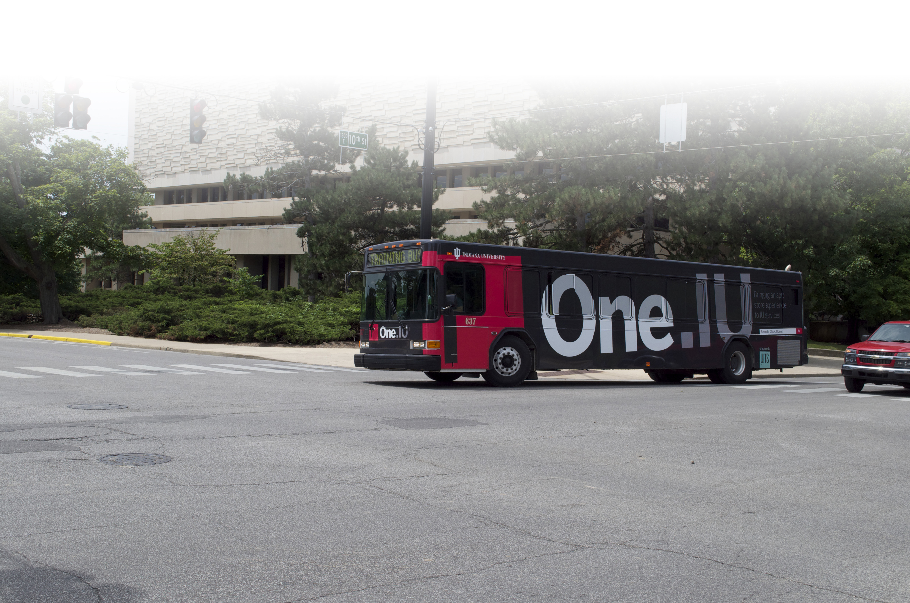
Momentum!
Notes:
Michele – 2min
Networking leads to exponential growth and even unsolicited requests.
Gives us even more opportunity to continue exploring

Slide 15
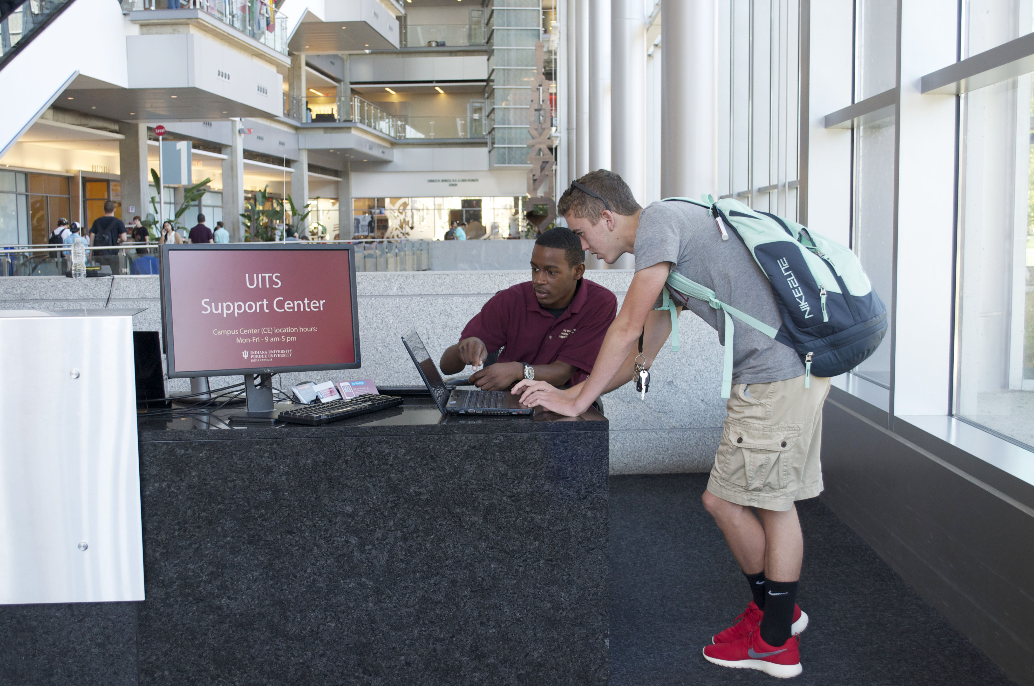
Support Center Synergy
Notes:
Momi – 2min
Traditional support is by nature, reactive.
We wait for someone to come to us with a question and we provide information.
We may collect information for our Tier 2 teams and administrators, but that usually only happens after someone has started the conversation with us.
So how do you get from traditional support to what Michele is doing with her Student Outreach team?
Are you that far off?
What’s the magic formula?
Just like every other magic trick, there is a method to the madness. [next slide]

Slide 16
Evolution of Support
Notes:
So, here’s the secret…
This may be a culture change, but it isn’t magic.
This is a clear evolution of support that, probably, all of us in this room can relate to.
You have to keep moving forward
Keep reinventing support
Change with the times and with the audience to stay relevant
This chart outlines how support has evolved at IU during my tenure.
At IU, we always prided ourselves in being on the cutting edge.
From the start, there was a strong focus on customer support
Answer difficult IT questions in a language that end users could understand
Regardless of the technical answer, always, always, always treat customers with respect. This was at a time when good customer service was not an expectation as it is today… with the exception of the cable tv industry ☺
We had great leadership. When I started, former Hoosiers, Brian Voss and Sue Workman, were the face of support at IU. They were always looking for ways to improve our services and help our customer base.
We had a homegrown KB before knowledge bases were common. And it was written in easy to understand steps
But you cannot rest on your laurels, because at some point you will be asked, “what have you done for me lately?”
Through the years we did
Postering events to raise awareness on hot topics
Tabling events to let students know about our support services.
We created online self-help tools to get ahead of issues.
We started to send people out for f2f assistance high volume issues,
But we did this all with borrowed staff from the help desk or our student technology centers. These assignments were
Short term and fleeting, not a focal point of their jobs
Lacked consistency so we didn’t have history and see trends developing
And, it was still fairly reactive
In our most recent strategic plan, Empowering People
Prioritized the need to ask for and to incorporate feedback from our peers and our constituents.
This also lead to the logical step of having a dedicated team to address this vital need.
Students are ready to receive the message in person now, better than ever before.
Carry their smartphones and tablets with them to the information tables.
Their technology is an extension of their being. They don’t have to remember what you said and take an action later. They do it on the spot.
This is a cultural change for a lot of people, but it’s not magic.
It takes strong leadership and guidance, but it’s not magic. You keep moving forward, change with the times and the audience, in order to stay relevant and to keep growing

Slide 17
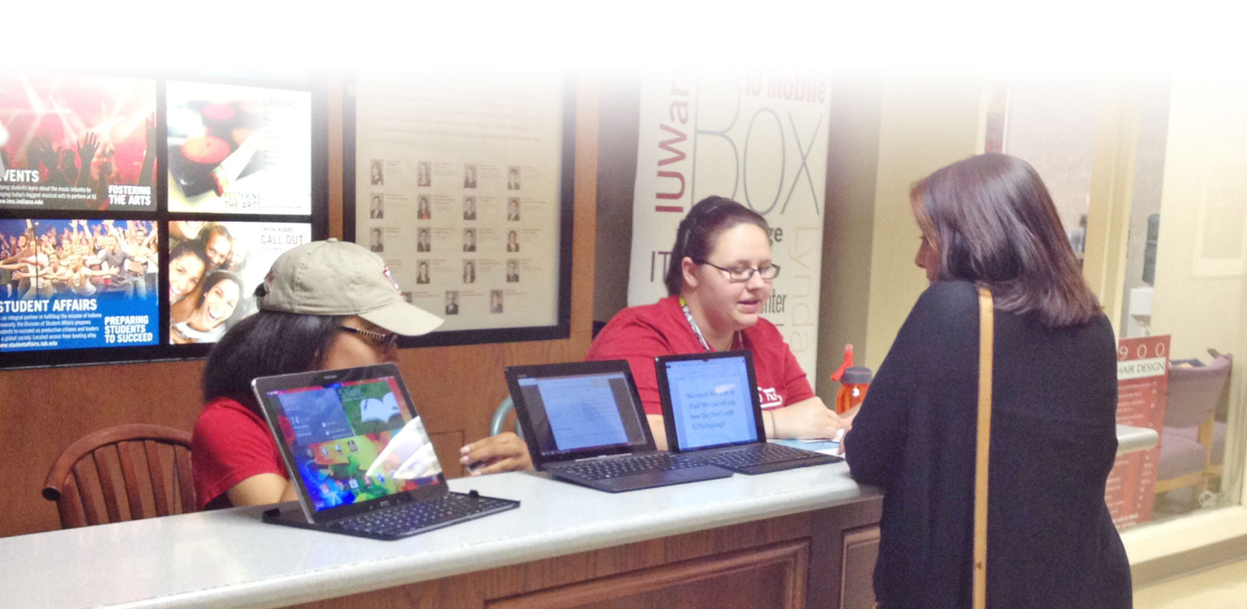
Gartner Field Research 2013
“The game has changed, but most IT organizations are playing by old rules…
Notes:
Cathy – 1 sec
Lots of research on proactive support
The iceberg of traditional support is melting. More importantly, we want to have increased IMPACT and VALUE.

Slide 18
…old sources of IT value…
cost management, maintenance and SUPPORT have been dispersed to external players and users. What is valued is take a step up.
Photo by Werner Kunz - Creative Commons Attribution-NonCommercial-ShareAlike License https://www.flickr.com/photos/35375520@N07
Notes:
Cathy – 1 minute
Ibid
-- is there text missing from this quote?

Slide 19
Questions?
Notes:
Questions (Cathy intro)

Slide 20
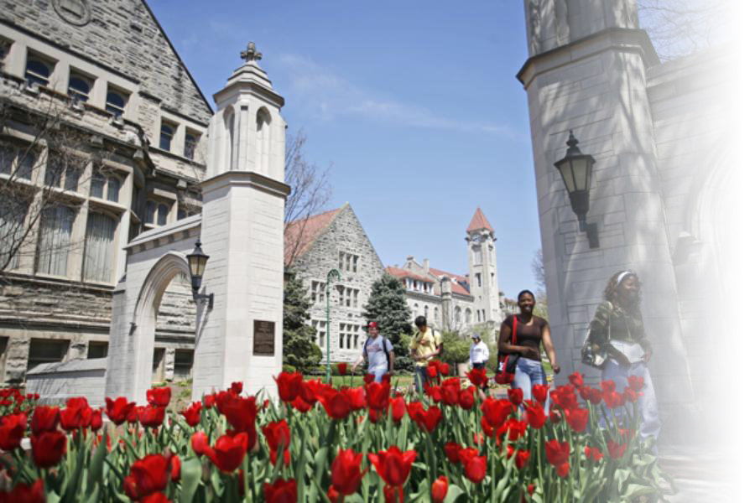
Contact us
Momi Ford Manager, Support Center
moford@iu.edu
Michele Kelmer IT Strategy Business Analyst
mkelmer@iu.edu
Cathy O’Bryan Director of Client Support
caobryan@iu.edu

