Slide 1
Breaking through Bottleneck Courses – California State University’s Proven Course Redesign Program
Kathy Fernandes & Brett Christie
Academic Technology Services
CSU Office of the Chancellor
Notes:
Kathy - 10minutes for Intro, proven, Promising
Brett 20 minutes for QA, ePortfolio, web tour
Kathy - 10 minutes - VL, summary, students, Lessons Learned, Outcomes.
All - 10 minutes discussion

Slide 2
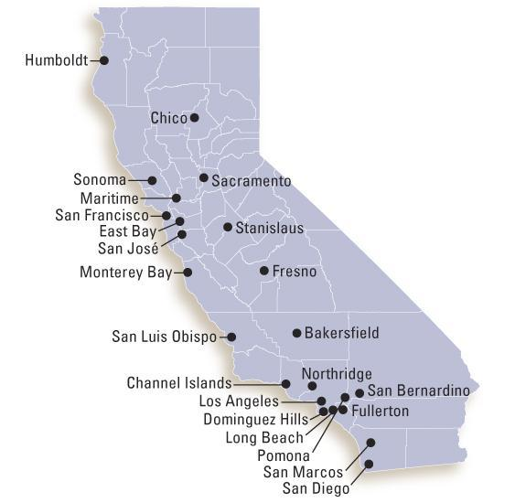
CSU System Demographics
23 campuses
447,000 students
45,000 faculty & staff
Largest university system in the world
Most diverse university system in the U.S.
One of the most affordable universities in the U.S.
Notes:
Kathy

Slide 3
CSU Academics
Offers 1800+ bachelors and masters degrees
Awards half of CA bachelors degrees yearly
Awards one-third of CA masters degrees each year
Graduates ~84,000 students annually into the CA workforce
Notes:
Kathy

Slide 4
Setting the California Context
California Higher Education Context
CSU budget drastically reduced over 30% in the last few years
High demand by students to attend a CSU (23 campuses)
Turning away 20,000+ students
Not good for California’s economy
Notes:
Kathy

Slide 5
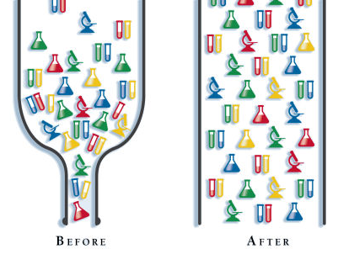
Setting the California Context
Governor willing to reinvest but …
Not interested in “same old way” of increasing # of sections
Interested in changing education
Using today’s technology and innovations
How do we address the 21st Century Learner?
2013-2014 Results
$10M to the CSU for Enrollment Bottleneck Solutions
Notes:
Kathy

Slide 6
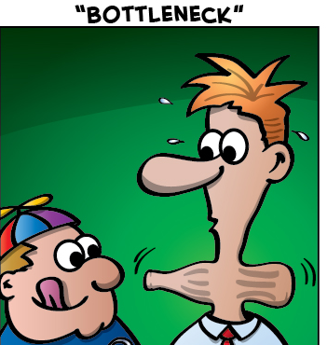
Enrollment Bottleneck Solutions
Bottlenecks = anything that limit students’ ability to make progress toward degrees:
Student Readiness
Students repeating courses – DWF’s
Place-bound
Waiting for required courses to be offered and then getting enrolled
Facilities
Limited number of students who can be in the labs
Advising and Scheduling
Options for completing GE and/or major requirements
Notes:
Kathy

Slide 7
High Enrollment/Low Success
Analyzed 1.4M course sections (all 23 campuses)
Identified 22 areas of high enrollment/low success
Mostly STEM courses
Sciences: Biology, Chemistry, Physics
Also Critical Thinking, Economics, Accounting, Psychology, US History, American Government
Engineering
Mathematics
CSU Internal RFP Created
What courses to be redesigned?
By Who?
How?
Notes:
Kathy

Slide 8
Academic Affairs Team
Ephraim Smith, Executive Vice Chancellor, AA
Gerry Hanley, Assistant Vice Chancellor, ATS
Kathy Fernandes, Director, Learning Design and Technologies
Brett Christie, Program Manager, Course Redesign Services
Leo Cota, Program Manager, Enrollment Bottleneck Solutions
Notes:
Kathy

Slide 9
2013-14 Budget
Promising: 2.5 M
Proven: 1.2 M
CourseMatch: 1 M
eAdvising: 1.5 M
Assessment: 1 M
Quality Assurance
Notes:
Kathy:
This doesn’t add up to 10M. We spent overall about 8.3M for Bottlenecks.
QA didn’t start until 14-15, but I can provide you that info if you would like.

Slide 11
Course Redesign with Technology
Proven Course Redesign
Identify a faculty member who redesigned course
Achieved greater student success
Not grade inflation
More students achieved the learning outcomes
Host an “eAcademy” for the discipline
Create a PLC around course model
Share the pedagogy and technology used to achieve greater success
Share the data and assessment methods used to achieve greater success
Notes:
Kathy

Slide 12
Course Redesign with Technology
Proven Course Redesign
Faculty from other CSUs can choose to adopt and adapt the course model
Letter of Commitment
Participation in the online Professional Learning Community
Funding for assigned time for one course to do the redesign
Stipends for eAcademy and other learning events
Complete 3 stages of a teaching ePortfolio
Notes:
Kathy

Slide 13
CSU Summer 2013 eAcademies
Course Subject | Lead campus(es) | # of CSU Campuses | Enabling Technology / Pedagogy
Engineering | San José | 13 | edX / Flipped Classroom
Physics | Pomona | 5 | smartPhysics / Flipped Classroom
Chemistry | Fullerton | 4 | Online Homework/ Supplemental Instruction
Mathematics | Northridge and Fullerton | 10 | ALEKS / Supplemental Instruction
Critical Thinking | Chico | 9 | Fully Online / LMS
Biology | Los Angeles | 15 | Virtual Labs / SmartScience / Biology Labs Online
Online GE Sciences | Dominguez Hills | 14 | Fully Online / LMS
Total |  | 19 (unique)
Notes:
Kathy

Slide 14
Course Redesign with Technology
Promising Practices
Local Campus Project
Identify faculty and course(s) - high enrollment/low success
Redesign is needed but not proven with data or completed yet
Participation in the online Professional Learning Community
http://courseredesign.csuprojects.org/wp/plc/
Complete 3 stages of a teaching ePortfolio
Notes:
Kthy

Slide 15
Professional Learning Community Webinars
Orientation: Establishing Project Activities and Outcomes
QOLT: Effective Online and Blended Course Development
Data Analytics and Documenting Impact
Lead Faculty Status Updates on Proven Course Redesign
Implementing Successful Supplemental Instruction
Universal Design for Learning
Introduction to ePortfolio Template
ScreenCasting for Enhanced Teaching and Learning
Fostering and Ensuring Academic Integrity in the CSU
Redesign Project Showcase
Cool Tools for Blended/Online Learning
ePortfolio Showcase
Flipping the Classroom: Making the Most of Student Time
CSU Quality Hybrid-Online Course Awardees Showcase
Notes:
Kathy

Slide 16
Teaching ePortfolio Template & Stages
Stage 1
Stage 2
Stage 3
Course Background, Redesign Strategy and Plan
Why redesign?
What changes? Pedagogy? Technology? Engagement?
Why will this redesign lead to better learning?
Redesign Materials and Activities
Redesigned syllabus, course materials?
Redesigned activities?
Redesigned assessments?
Outcomes
Did the redesign gain better SLOs? DWFs?
Lessons Learned?
Student Reactions?
Notes:
Kathy

Slide 17
http://courseredesign.csuprojects.org/wp/eportfolios/
Notes:
Kathy

Slide 18
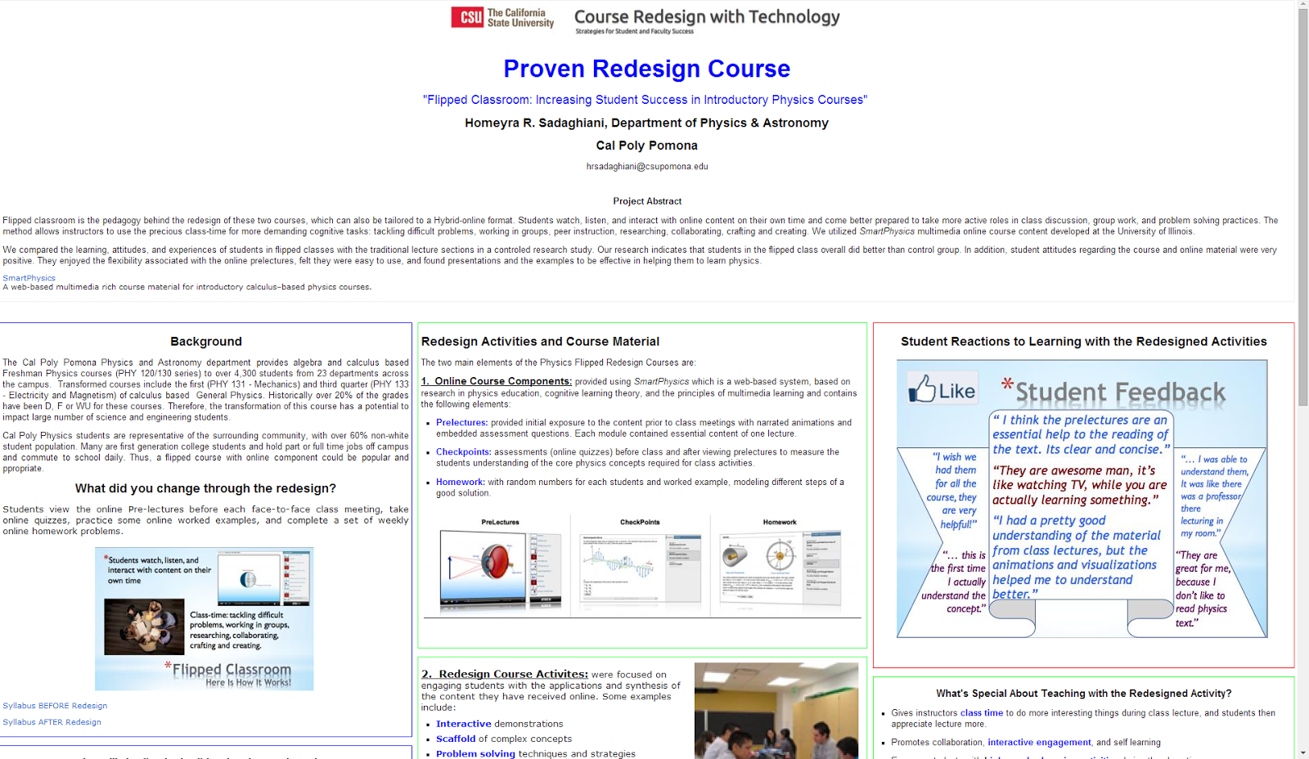
Notes:
Kathy

Slide 19
Quality Assurance
In an effort to increasingly support effective teaching and learning in blended and online course formats, we have developed a well-rounded program of QA training and resources for faculty and staff:
Instructional Quality
Academic Integrity
Universal Design for Learning/Accessibility
Student Readiness
Notes:
Brett

Slide 20
Quality Assurance
In an effort to increasingly support effective teaching and learning in blended and online course formats, we have developed a well-rounded program of QA training and resources for faculty and staff:
Instructional Quality
Academic Integrity
Universal Design for Learning/Accessibility
Student Readiness
Notes:
Brett

Slide 21
Instructional Quality
CSU Academic Technology Services supports faculty and staff training in the following instructional quality programs:
CSU Quality Online Learning & Teaching (QOLT) program
58-item instrument
Addresses prof development for course design and delivery
Includes UDL, accessibility, student readiness, OER, mobile
Available through Creative Commons licensing
Quality Matters (QM) institutional subscription
Addresses course design
Through CSU subscription, campuses pay ½ to ⅓ costs
Training available in online format.
Certifications can be for course, as well as peer-reviewers
Notes:
Brett: How we went from each campus doing their own thing for several years to having common efforts.

Slide 22
Mapping Across 2 Instructional Quality Programs
Notes:
Brett

Slide 23
Began in 2011 to assist CSU faculty, faculty developers, IDs to more effectively design hybrid-online courses.
Developed after review of related research, literature, models:
Rubric for Online Instruction: Assist development and evaluation of online courses while promoting dialog about student learning. CSU Chico, 2003.
Quality Matters: Developed through FIPSE grant from 2003-2006. Faculty-centered, peer-review process to certify quality of online-blended.
Quality Online Course Initiative: Online course rubric and evaluation system in the state of Illinois to help colleges and universities improve accountability.
NSSE: Hundreds of four-year colleges and universities surveyed since 2000 about student participation in programs and activities.
Community of Inquiry: Addresses course quality on three aspects: Social Presence, Teaching Presence, and Cognitive Presence.
Notes:
Brett: Will do a quick scan as a nod to these programs coming first and informing some of QOLT.

Slide 24
Over 200 faculty have completed Q₁. To date, 48 have completed Q₂.
Notes:
Brett

Slide 25
Notes:
Brett

Slide 26
Notes:
Brett

Slide 27
Recognition & Dissemination of Quality Instruction
Since 2010, 500+ CSU faculty have participated in the CSU QOLT Awards Program.
Three levels of evaluation
Self-evaluation: Copy goes to instructor, copy goes to Campus Coordinator
Student ratings: Anonymous. Viewed by peer- reviewer. Instructor views after grades submitted.
Peer-review: Analysis by faculty/staff colleague
Participation letter to all; Recognition letter to campus finalists; Letter, certificate, postings to CSU awardees
Campus and CSU presentations by awardees
Online repository of exemplars by objective
Notes:
Brett

Slide 28
Leveraging QM Institutional Subscription
Teaching Online: An Introduction to Online Delivery- Introduces differences between traditional F2F and online learning, the instructor’s role, importance of engaging students and facilitating discussions. Two weeks long; 8-10 hours per wk
Applying the QM Rubric- This is the first course that most faculty and staff take. Provides an overview of QM, the QM rubric, and the peer-review process. Two weeks; 10-11 hrs per week
Peer Reviewer Course- Prepares experienced online faculty to participate in course reviews. Two weeks long; 8-10 hours per week
Almost 300 CSU faculty and staff have completed QM workshops. Over 50 certified peer-reviewers.
Notes:
Brett

Slide 29
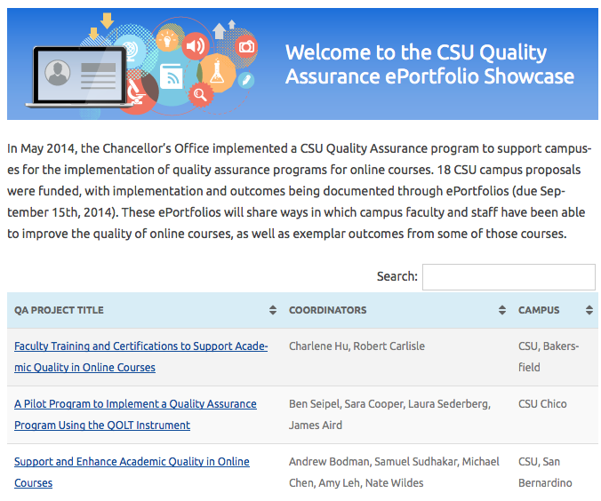
http://courseredesign.csuprojects.org/wp/qa-eportfolios-showcase/
Notes:
Brett

Slide 30
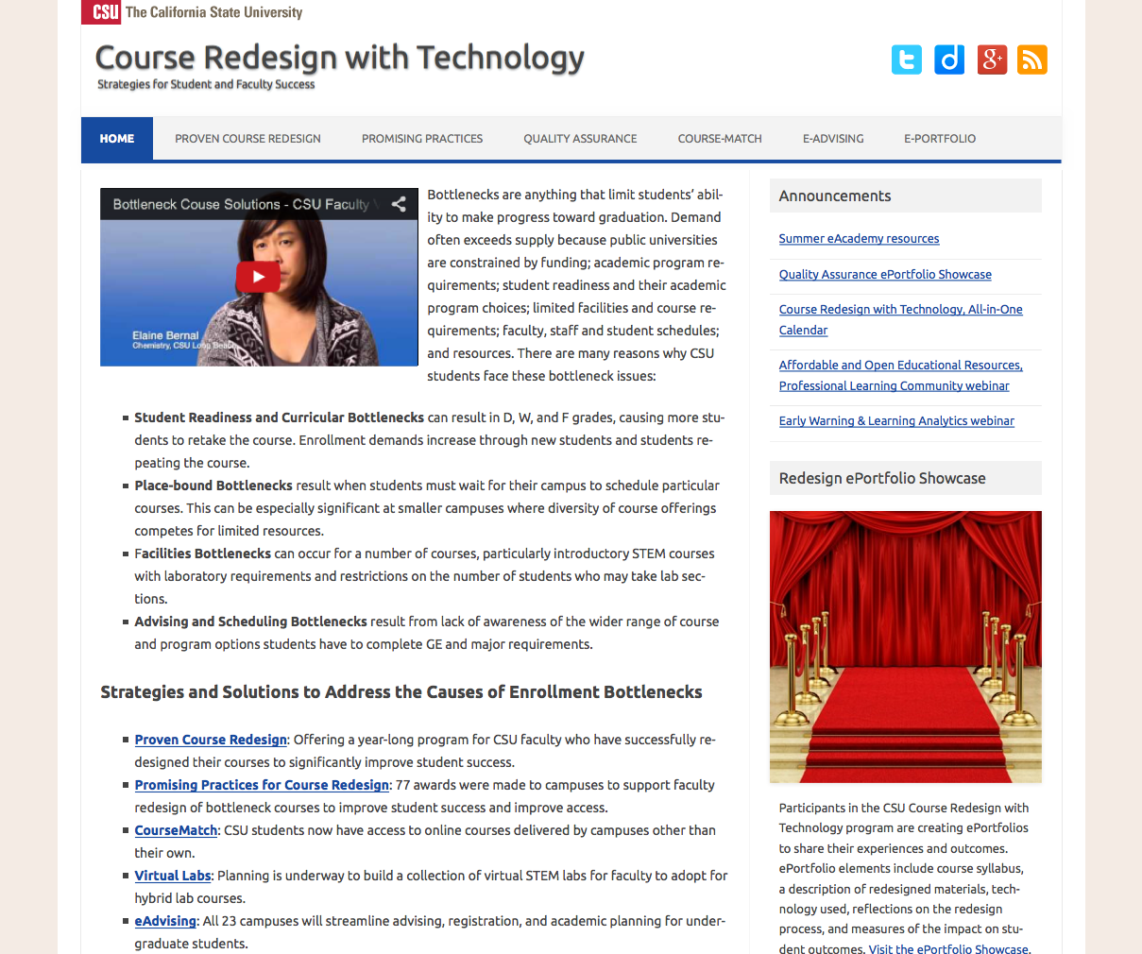
calstate.edu/courseredesign
Notes:
Brett: Close my section with a quick web tour as to where they can find all the information and resources from our programs.

Slide 31
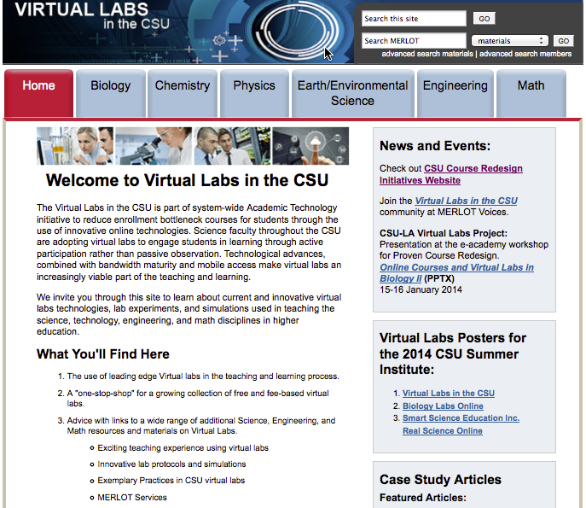
http://teachingcommons.cdl.edu/virtuallabs/
Notes:
Kathy

Slide 32
Course Redesign with Technology
Proven Course Redesign
81 faculty
20 CSU campuses
In 8 disciplines
Promising Course Redesign
76 faculty
Representing 18 campuses
In 25 disciplines
Notes:
Kathy

Slide 33
Course Redesign with Technology Models/Trends
Proven (81 Faculty)
Flipped Classrooms
Supplemental Instruction
Virtual Labs
Promising (76 Faculty)
Supplemental Instruction
Hybrid Courses
Clickers
Notes:
Kathy

Slide 34
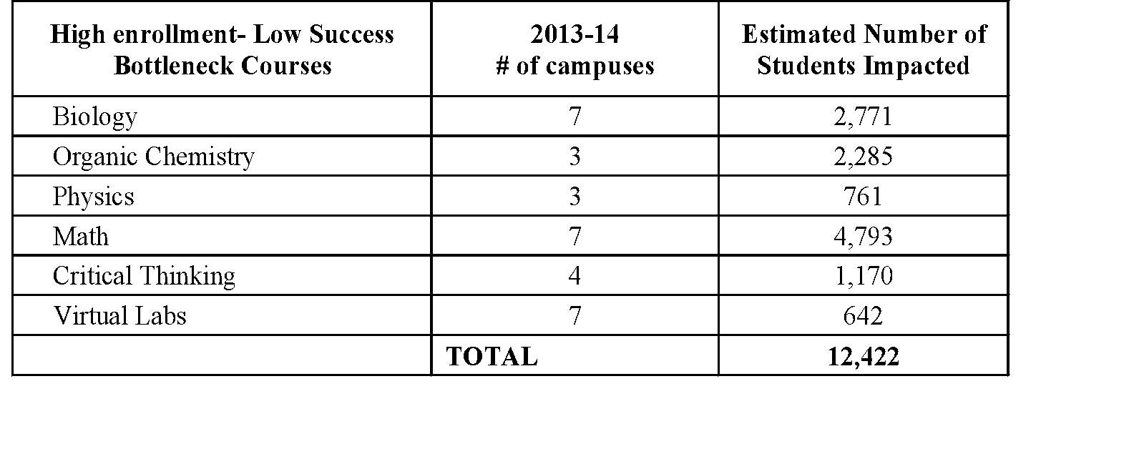
Estimated Student Impact (Proven and Promising Programs)
*Total number of students enrolled in a redesigned course over 2013-2014
Notes:
Kathy

Slide 35
Outcomes/Results
July 7 was the faculty deadline to submit course redesign results to their ePortfolios
Institutional Research data being consolidated from the adopting campuses and analyzed in aggregate
Meanwhile, we have launched Year 2 of the Proven and Promising Course Redesigns
Faculty from Year 1 have consulted faculty in Year 2 at one big CSU Summer Institute (eAcademy)
Notes:
Kathy

Slide 36
Lessons Learned
First Year was “Running with Scissors”
Web sites up
Improve communications and timing of RFP
Improving ePortfolio Submissions Process and Template
PLC -> more discipline-specific webinars
More presentations from faculty participating in the course redesign program
Camtasia presentations vs Live interactive Collaborate presentations
Notes:
Kathy

Slide 37
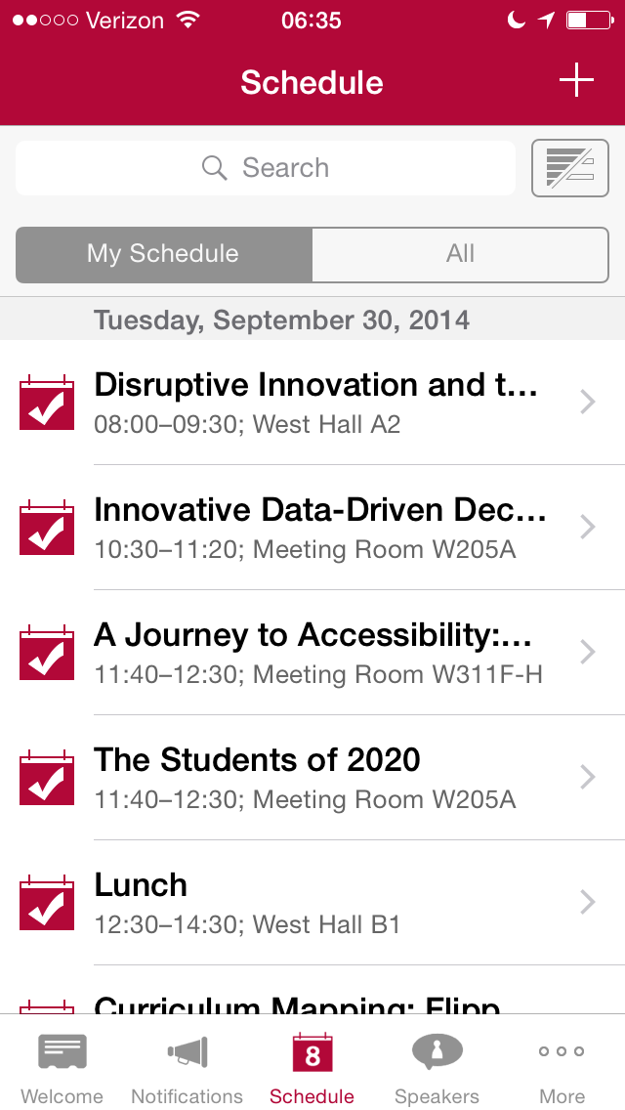
Contact Information
Kathy Fernandes Director of Learning Design and Technologies kfernandes@calstate.edu
Brett Christie Director of Course Redesign Services bchristie@calstate.edu
CSU Course Redesign with Technology website http://calstate.edu/courseredesign
Slides and links available in Educause program
Session evaluation via mobile or online

