Slide 1
A View from the Top: Taking the Mobile Experience to New Heights
Hilary Baker
(VP and CIO, California State University Northridge)
Santhana Naidu
(AVP of Marketing Communications, Indiana State University)
Andrew Yu
(Founder and CTO, Modo Labs)

Slide 2
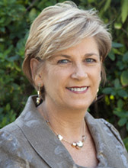
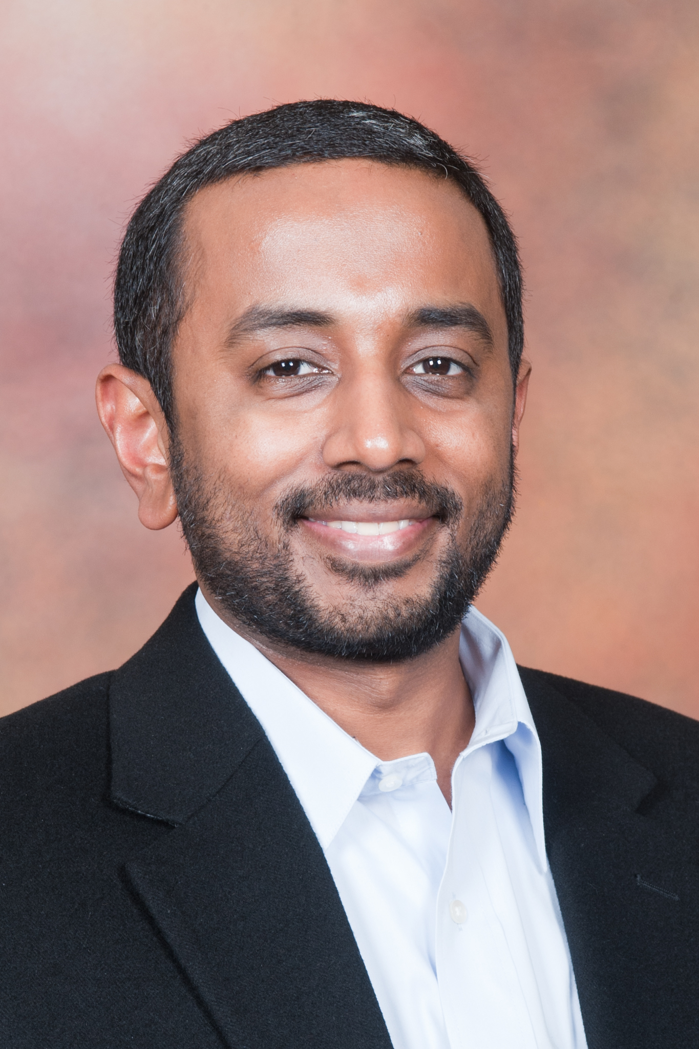

Today’s Presenters
Hilary Baker
Vice President for Information Technology and Chief Information Officer
California State University, Northridge
Santana Naidu
Associate Vice President, Marketing and Communications
Indiana State University

Slide 3





































Modo Labs
Make Mobile Easy and Awesome
Platform + Solution + Source Code
Founded by chief MIT Mobile
Platform Architect
Based in Cambridge

Slide 4
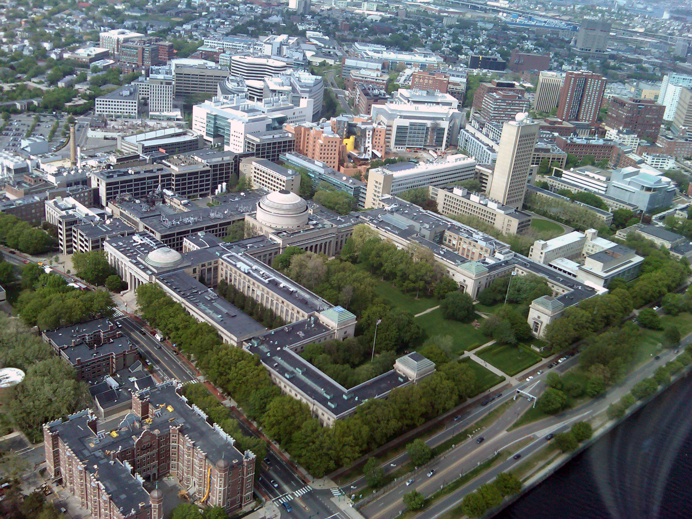
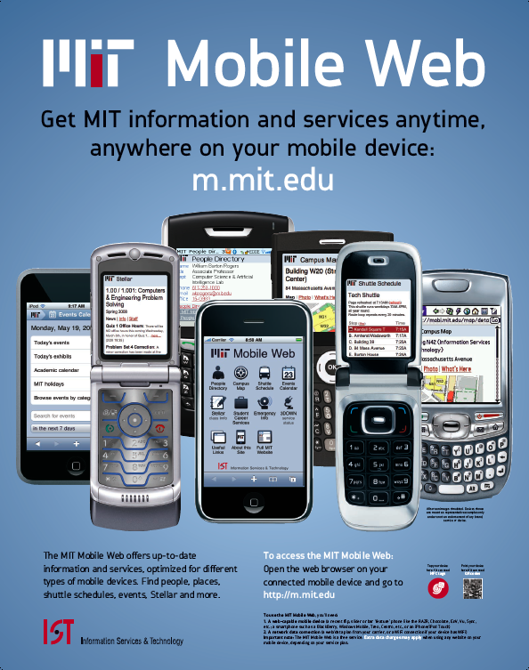
Seven Years Ago at MIT

Slide 5
Mobile Challenge: Leadership Needed!
Prospective Students
New Students
Current Students
Faculty
Staff
Alumni
Parents
Visitors
IT
Marketing/Communications
Admissions
Student Affairs
Registrar
Facilities
Transportation
Alumni Association
Student Government
Dining
Athletics
And Many More!

Slide 6
Why WAS mobile important?

Slide 7
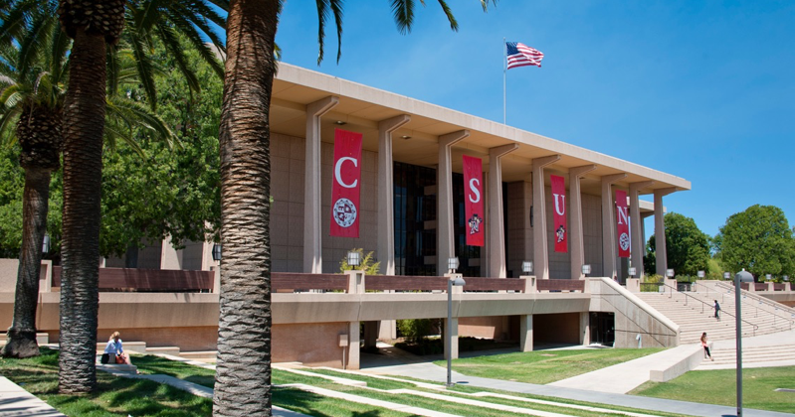
Public and diverse university community of 41,500 students and 4,200 faculty and staff in northwest Los Angeles

Slide 8
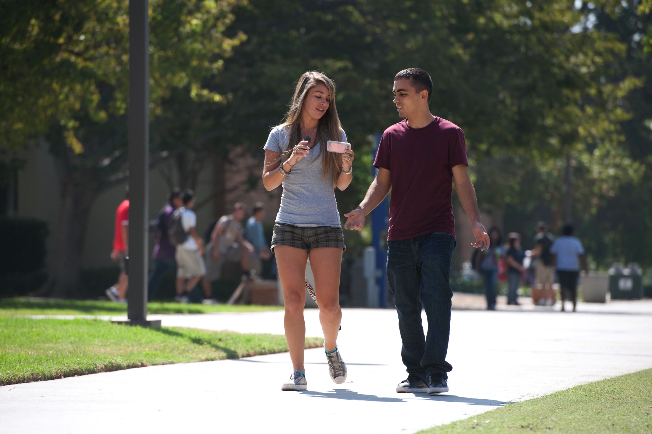
Why Mobile?

Slide 9
Why Mobile?
Campus priority on student success
IT Vision – exemplary service, mobility
One to one iPad initiative
Majority of CSUN students own smartphone
(79% - 2013, 96% - 2014)

Slide 10

Came late to the mobile party!
Needed to develop & launch CSUN app fast
March 2013 - Procurement RFP process
April 2013 - Selected Modo Labs
…….Launched first CSUN app 10 weeks later!

Slide 11
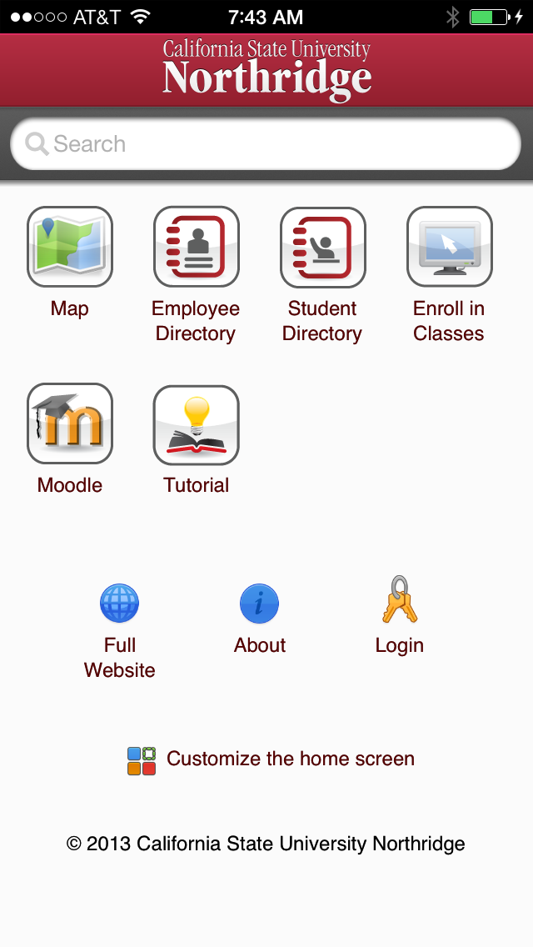
Initial Release
Campus Map
Campus Directories
Enroll in Classes
Link to Moodle
iOS, Android, and mobile web

Slide 12
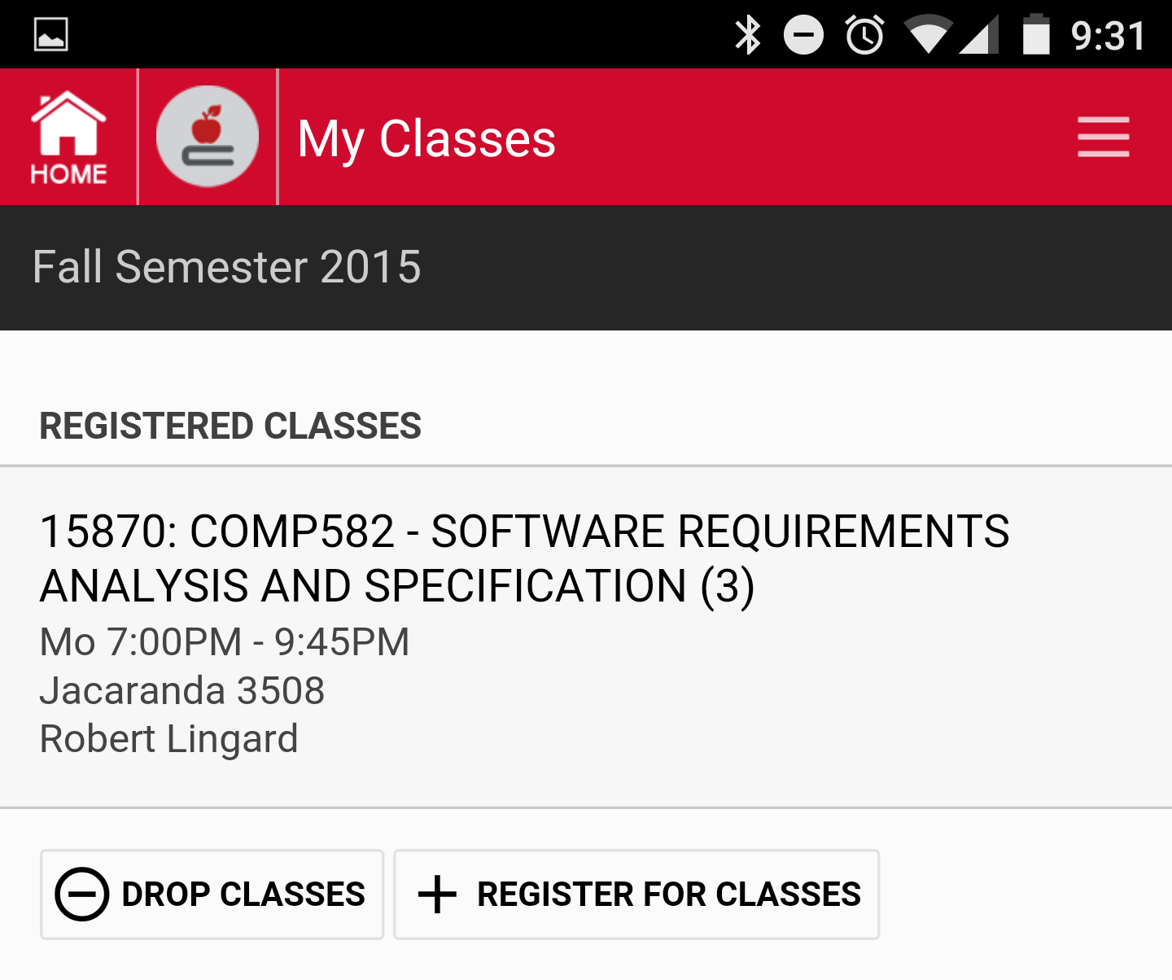
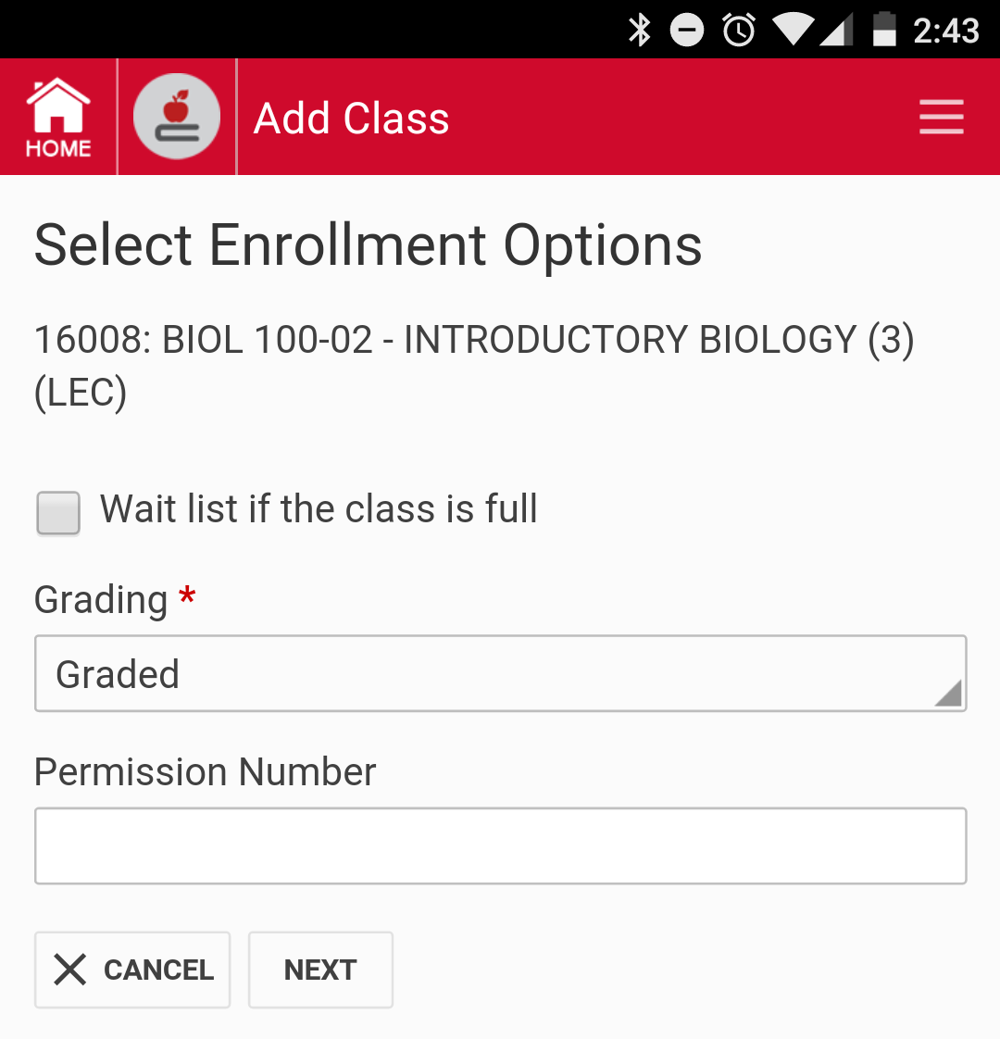
Enroll in Classes
Class Search
View, Drop, Swap Classes
Enroll in Classes
Waitlist

Slide 13
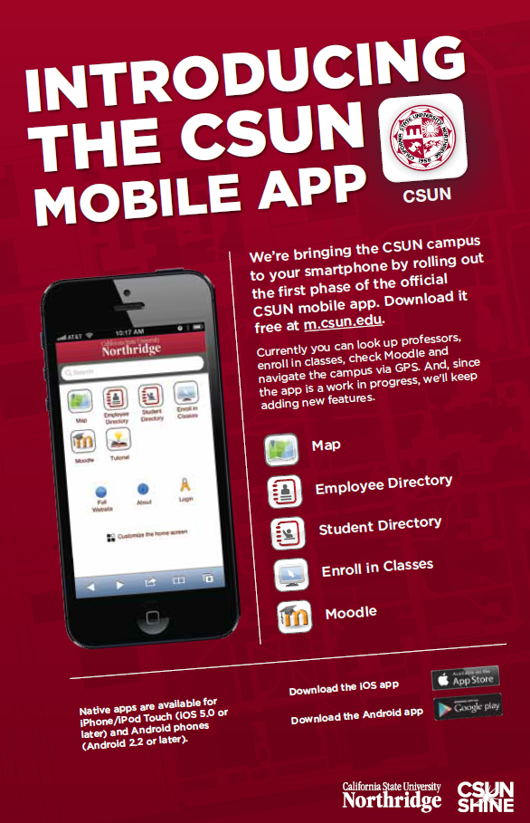
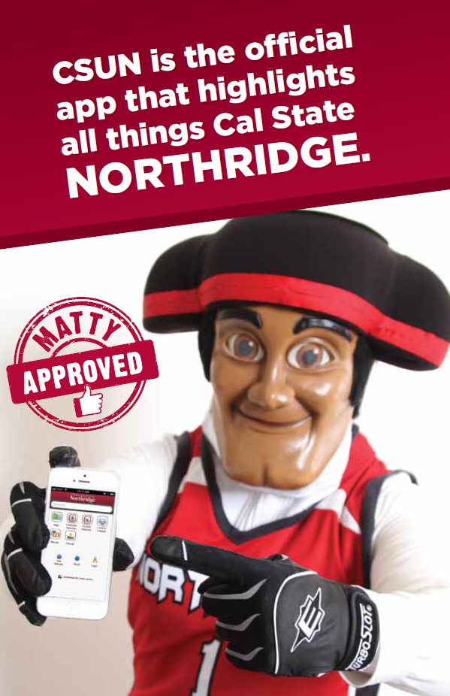
Notes:
Marketing to students was important – postcards, new student orientations, student newspaper
Matty the Matador

Slide 14
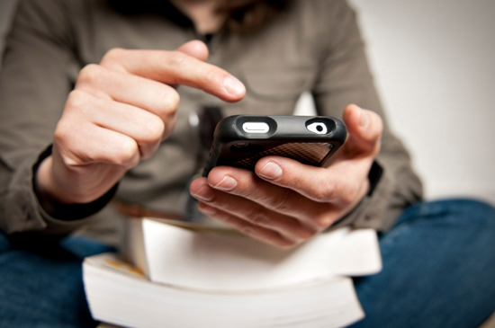
Students started using the app!
Launched a few days before fall semester 2013
Downloads:
1st week: 6,000
2nd week: 9,000
3 months: 17,000
20% usage in first week - Enroll in Classes

Slide 15
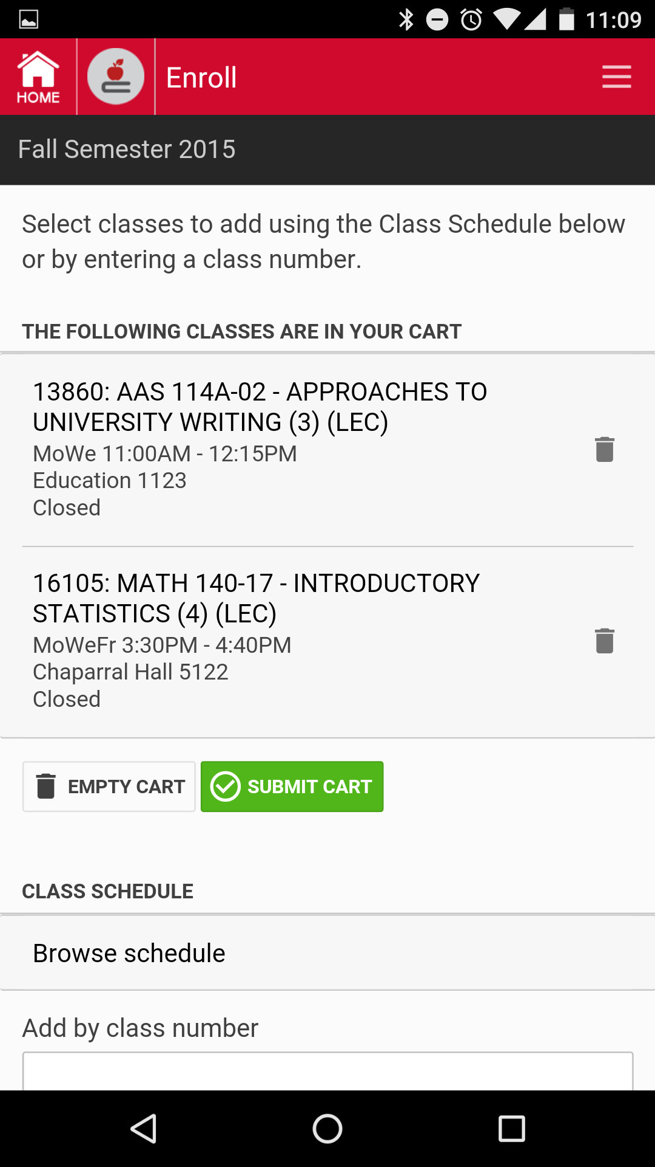
“I love that I can add classes on my phone now.”

Slide 16
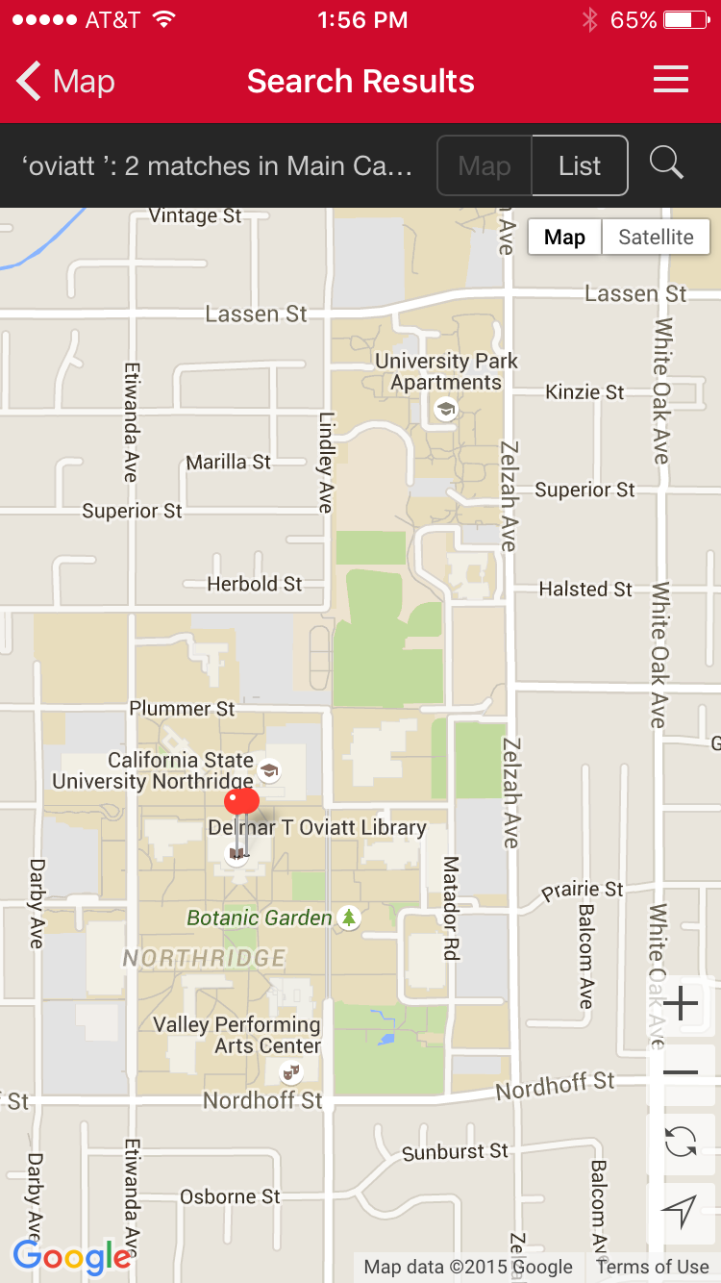
“I'm a new transfer student from overseas and this app is invaluable for navigating around campus.”

Slide 17
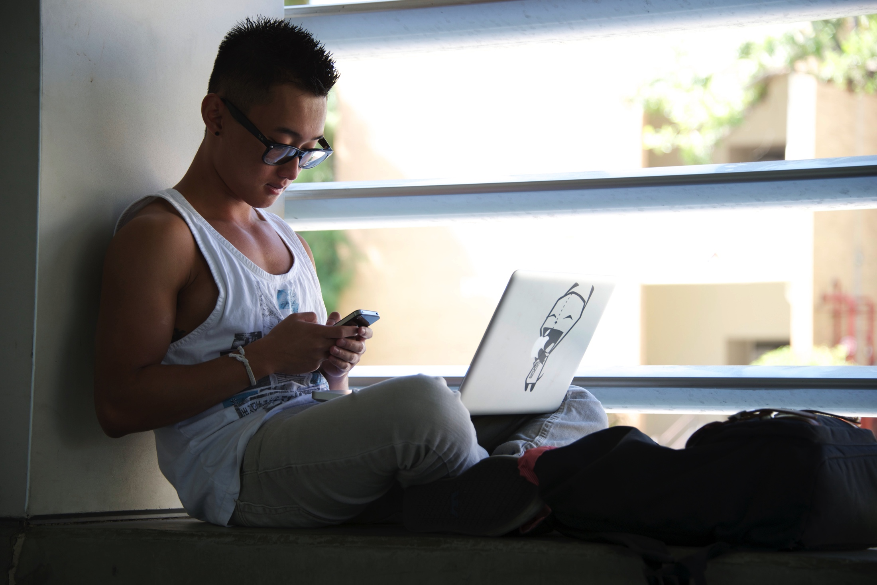
“Love the map, class schedule and directory.
Can't wait for the added features!”

Slide 18

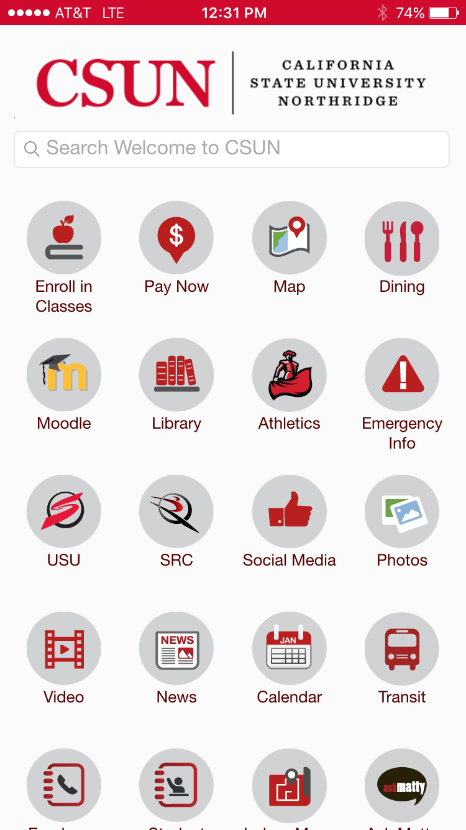
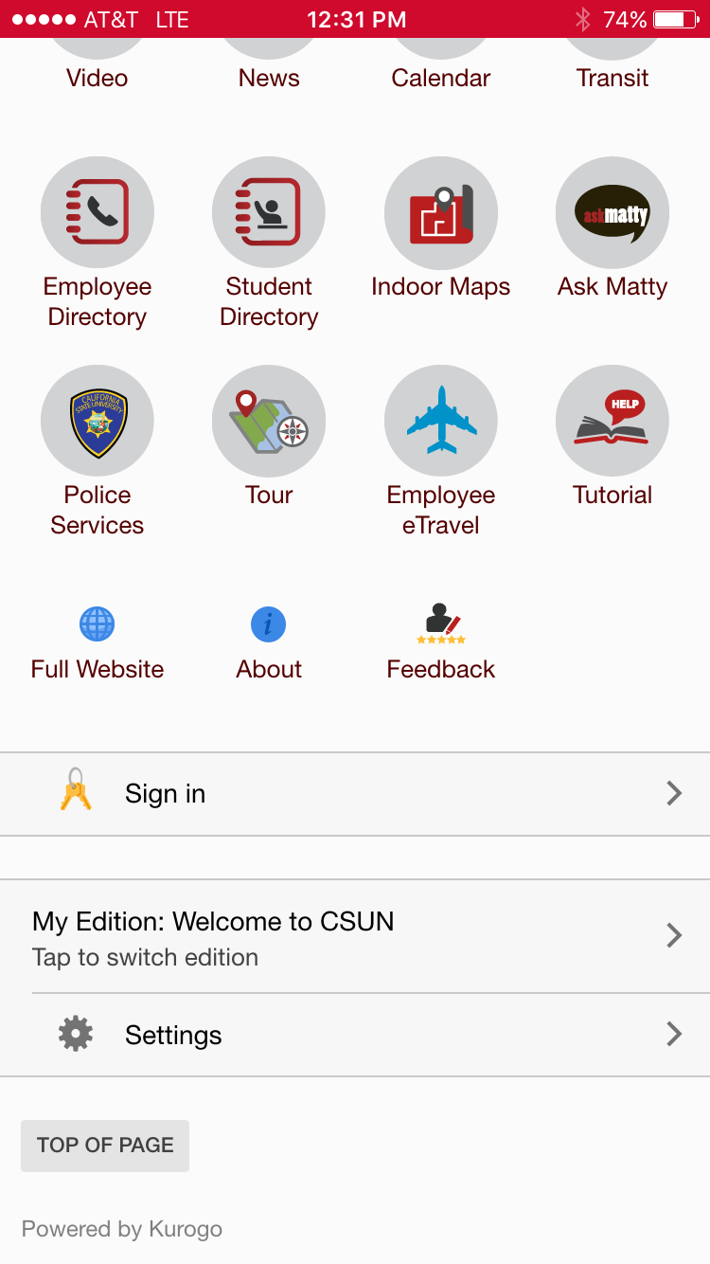
Pay Now
Dining
Library link
Athletics
Emergency Info
Student Union
Student Rec Center
Social Media
Photos
News
Videos
Calendar
Indoor Maps
Ask Matty
Police Services
Tour

Slide 19
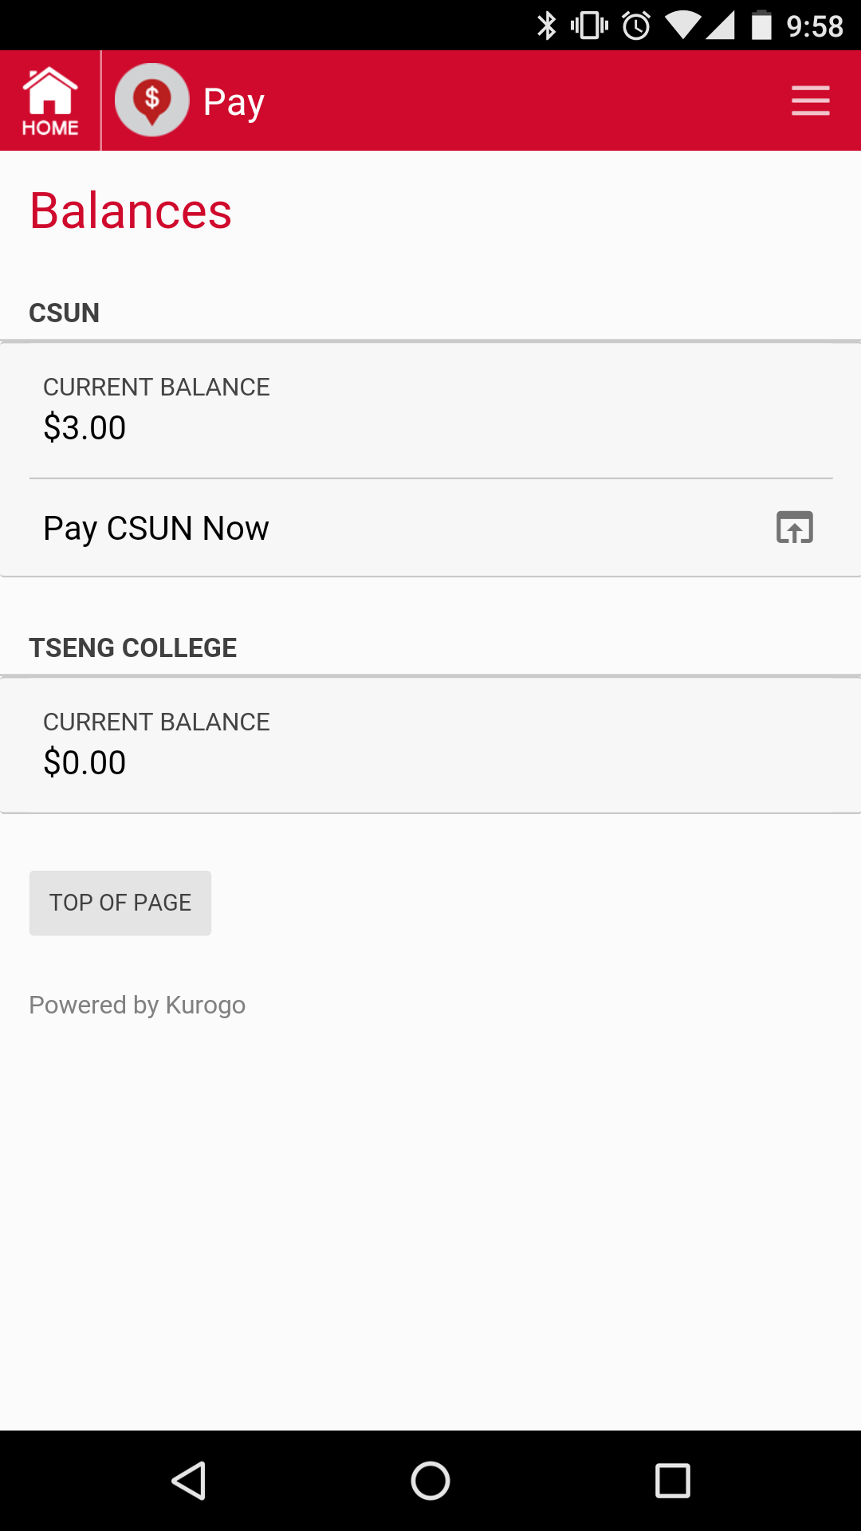

Pay Now

Slide 20
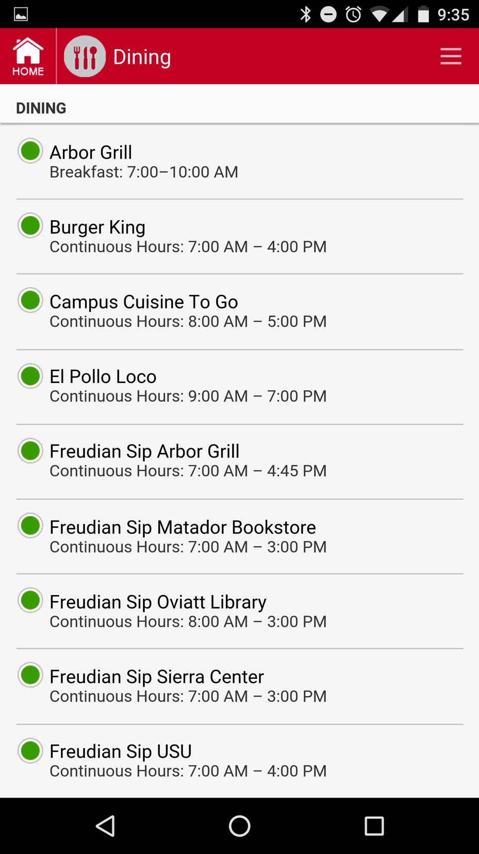
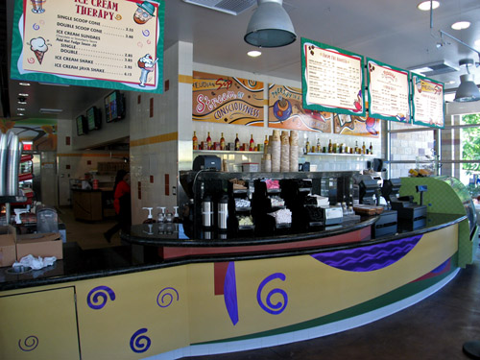
Dining

Slide 21
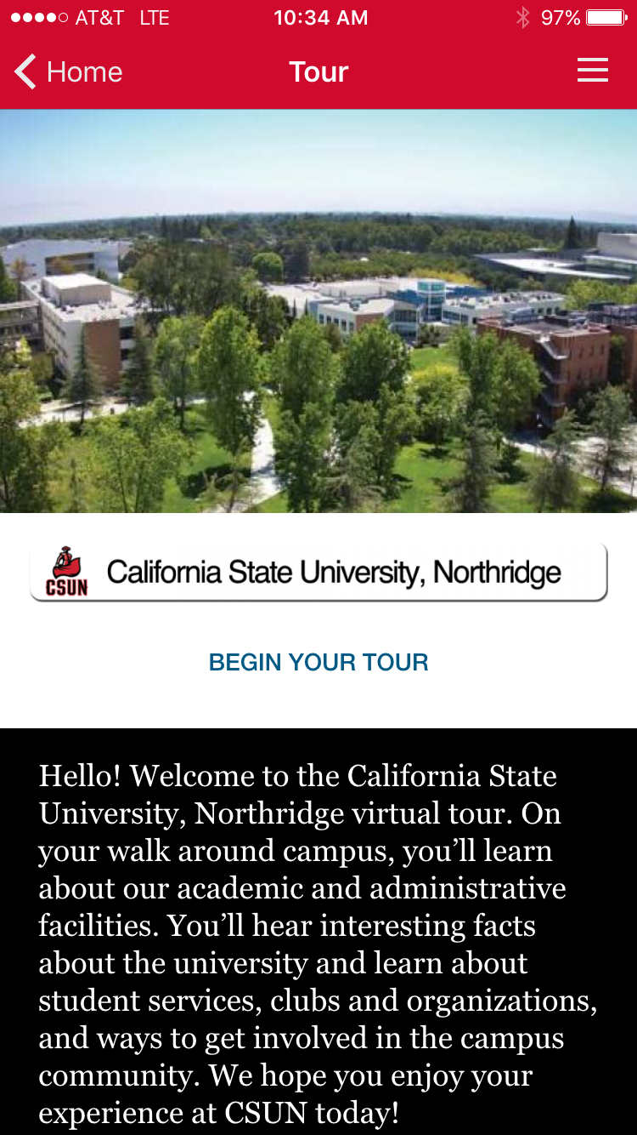
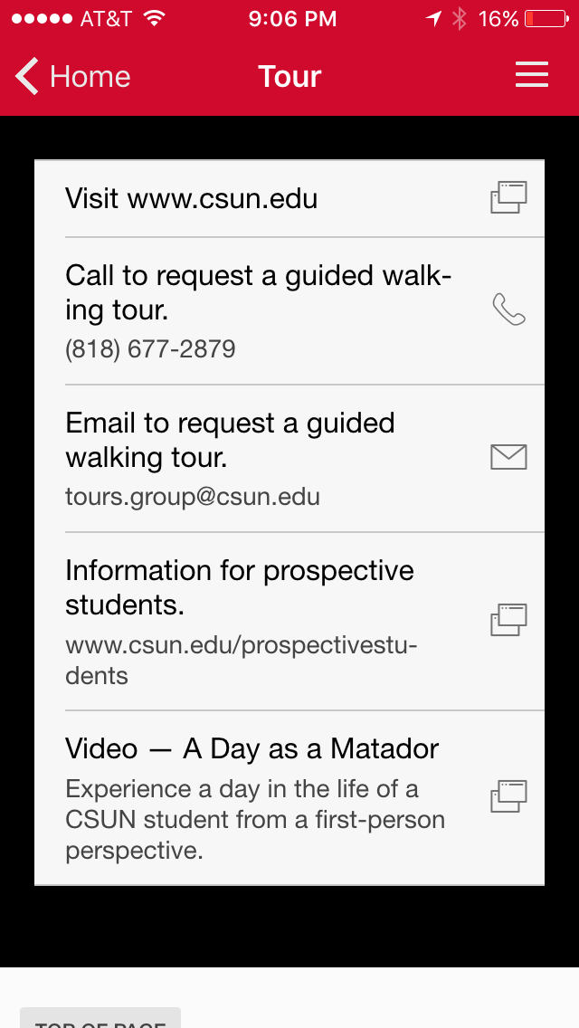
Campus Tours

Slide 22
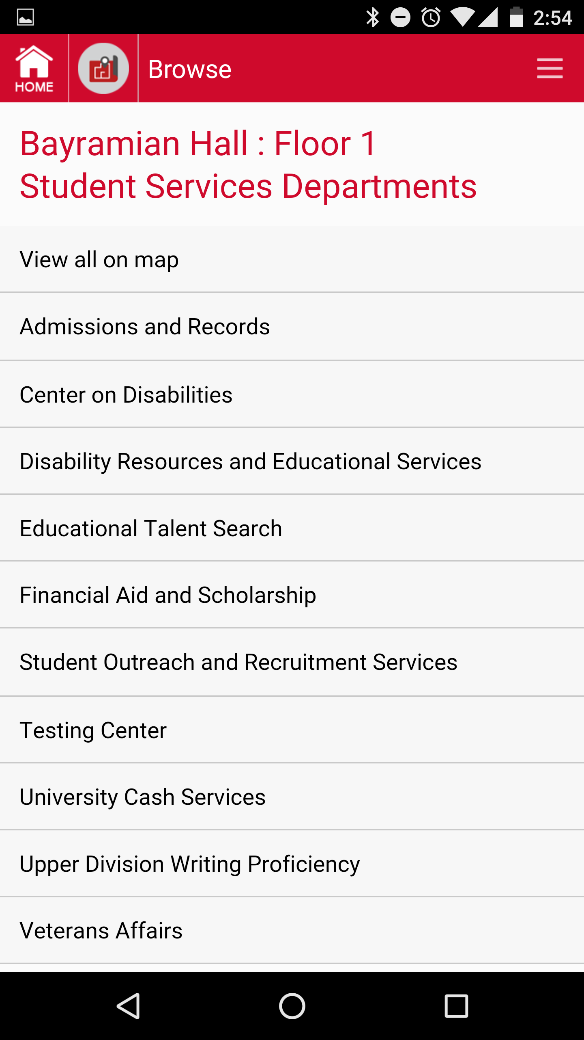
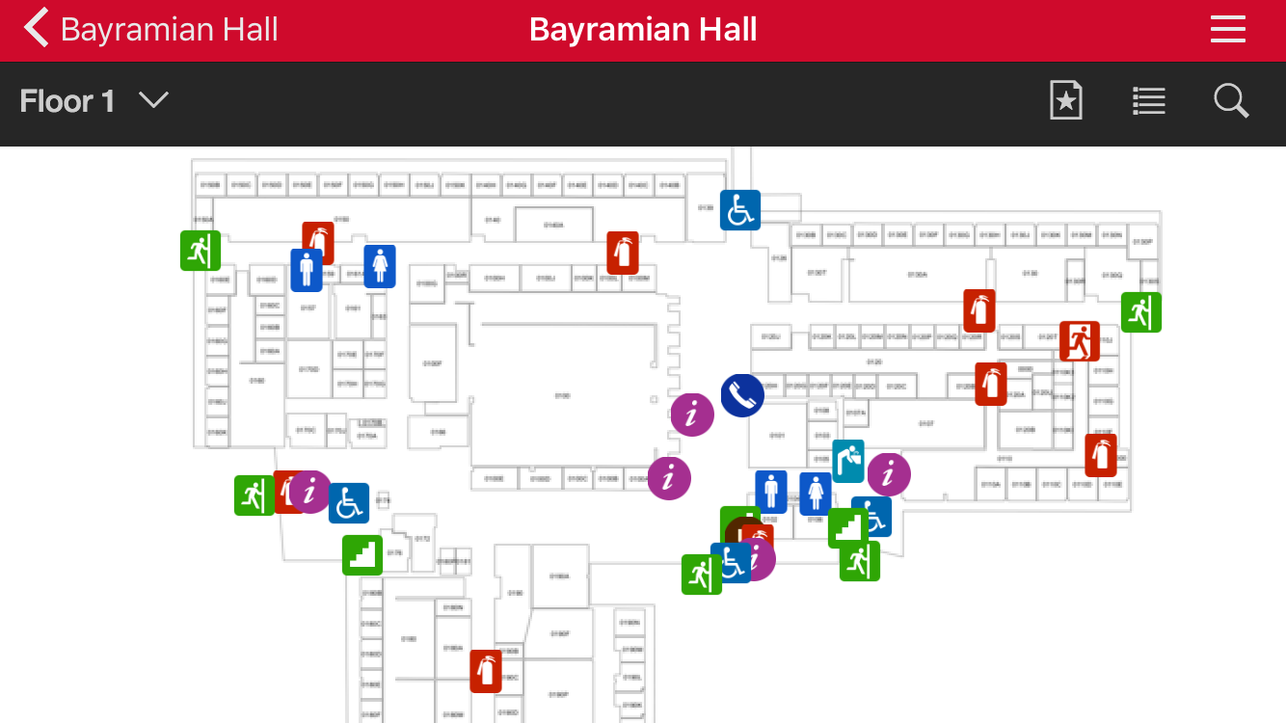
Indoor Floor Plans

Slide 23
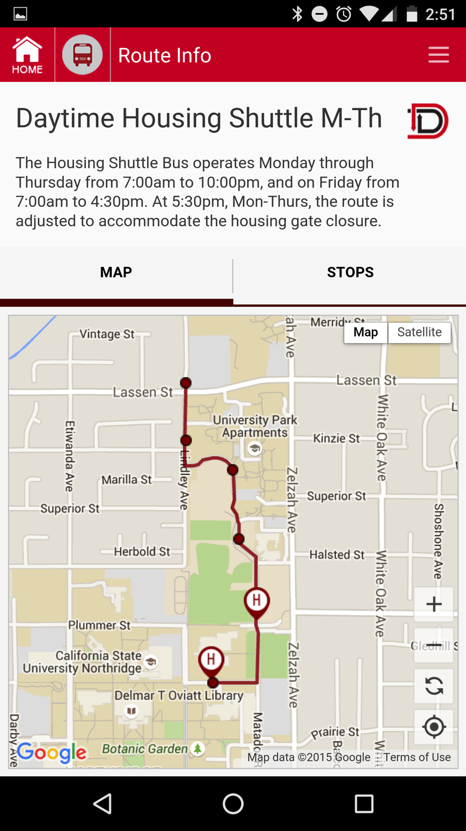
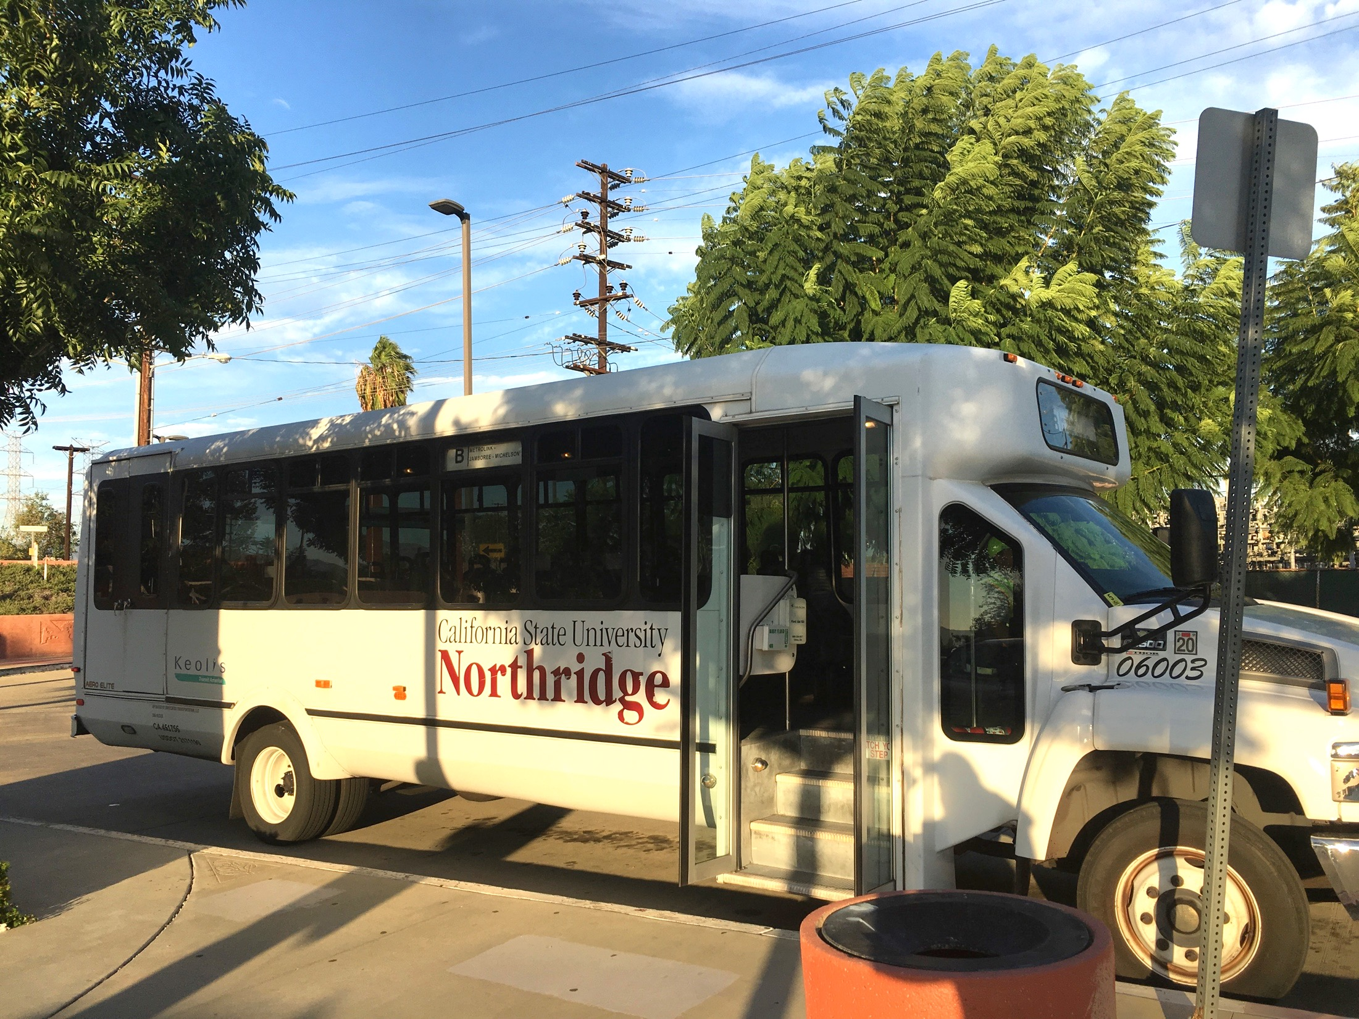
Campus Shuttle and Transportation Services

Slide 24
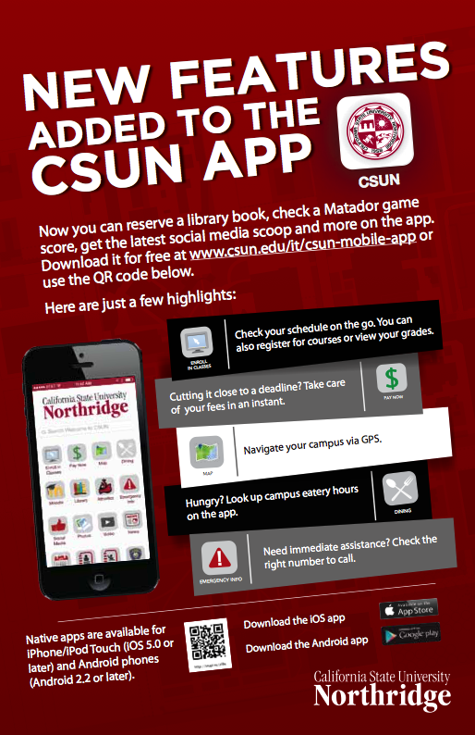
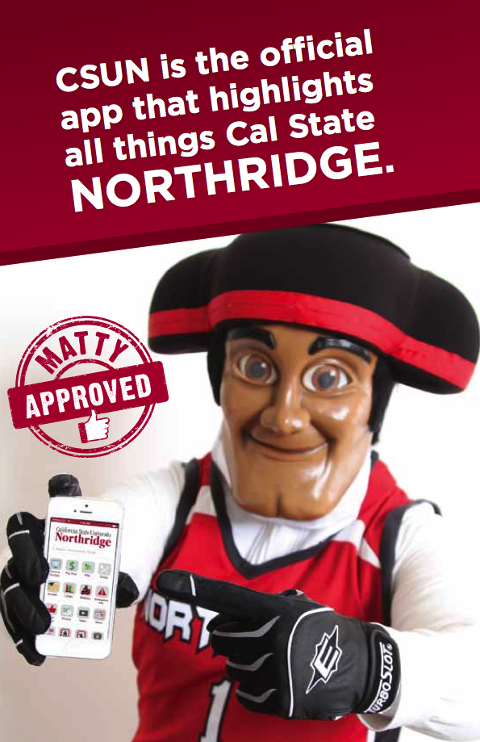

Slide 25
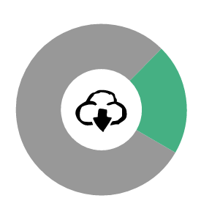
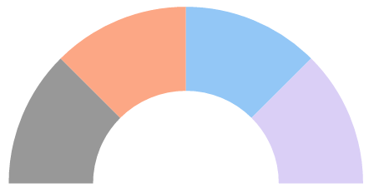




CSUN Mobile App Downloads
Most Used
Features
Campus Map
Class Search
View My Schedule
Add/Drop Class
Start of term
9k+
34k+
Transit
Dining
Middle of term

Slide 26
Why WAS mobile important?

Slide 27
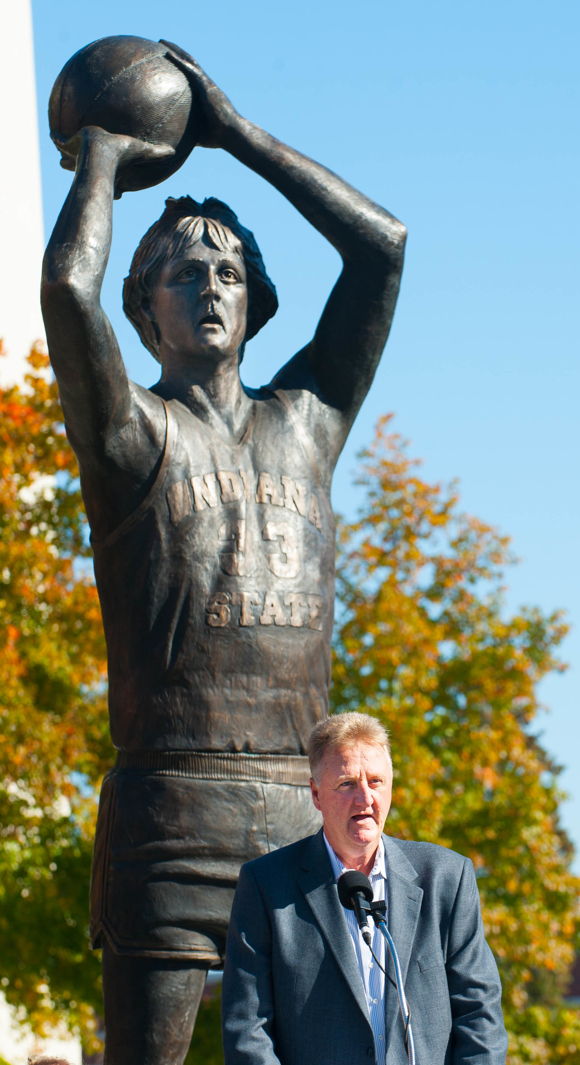
About ISU
Founded in 1865
Located in Terre Haute, IN
Over 13,500 students (campus and online)
Areas of study:
  Bayh College of Education
  College of Arts and Sciences
  College of Health and Human Services
  College of Technology
  Scott College of Business

Slide 28
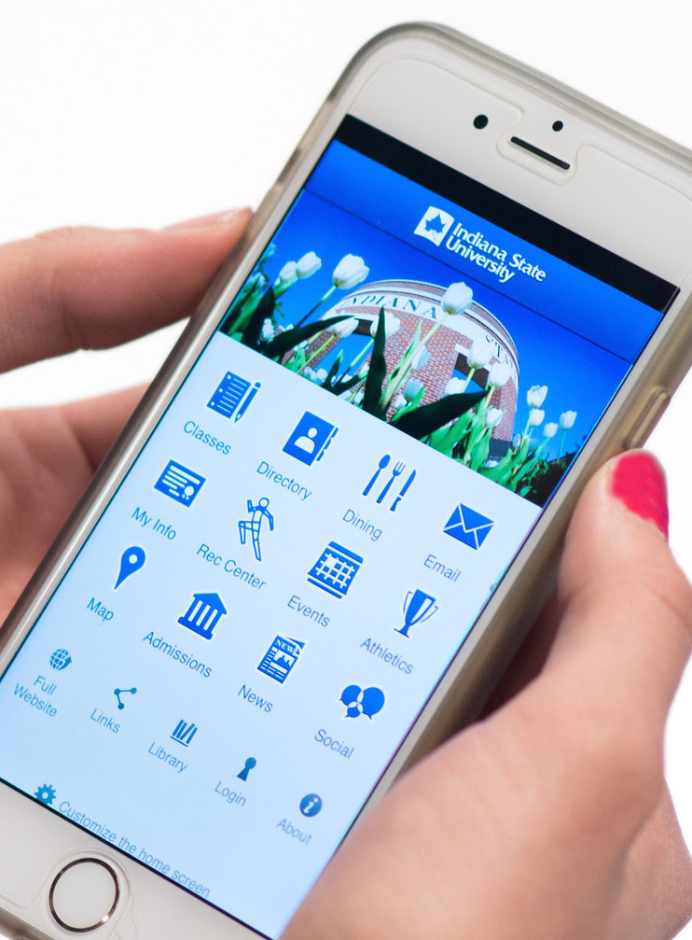
ISU Mobile App
Launched in Fall 2012
Popular modules
  Classes (Blackboard, Banner and Catalog)
  Dining
  Admissions
  Map
  Email
  Athletics

Slide 29
ISU Mobile App

Slide 30

Focus on recruitment
Growth in mobile usage among students
  20% of overall website traffic from mobile (4% in 2012)
  Over 90% of our incoming students carry smartphones
  Over 40% of admissions traffic from mobile
  (5% in 2012)

Slide 31
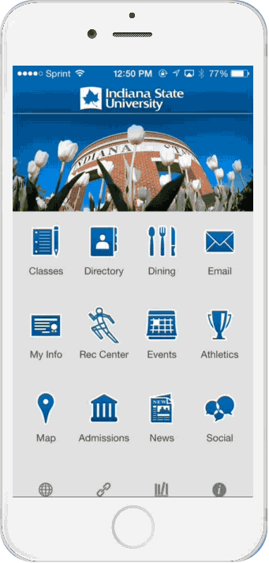
ISU Mobile – Admissions
One of the top 5 most popular modules
What’s available?
  Information about Colleges
  Academic programs
  Videos
  Virtual tour
  Schedule campus visit
  Driving directions
  Apply
Additional content as applicable
(ex. Orientation and Fall Welcome)

Slide 32
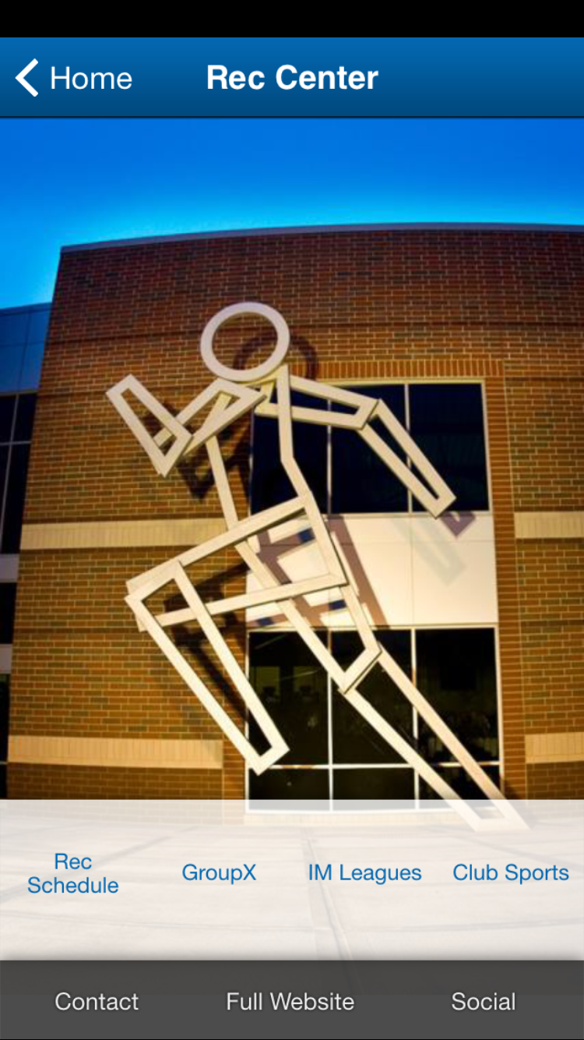
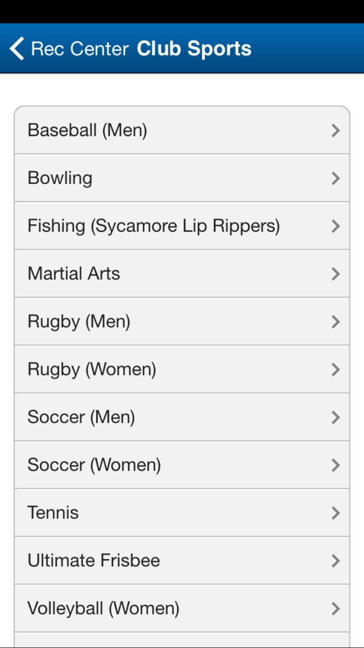
ISU Mobile – Rec Center
Using Publisher for other areas on campus

Slide 33
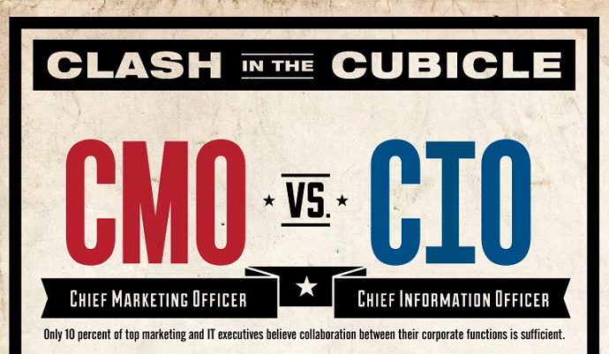
IT - MarCom Partnership

Slide 34

How did we do it?
ISU resources: Project manager (part-time)
  IT and Marketing as needed
Modo helped us with design, programming, app launch, etc.
Content entry through the admin console
  Delegated to some areas

Slide 35
Mobile Trends: Near Future

Slide 36
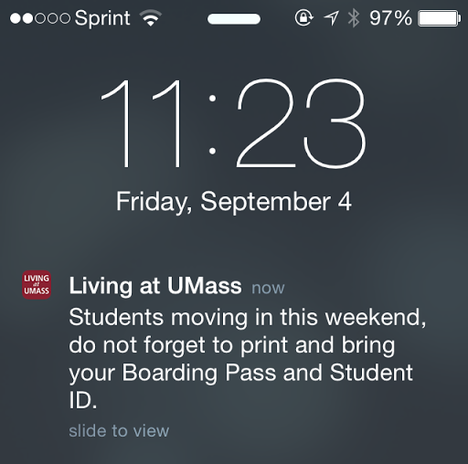
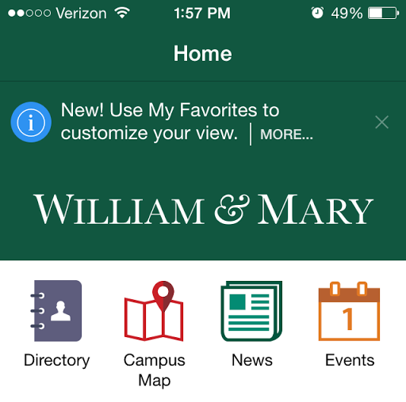
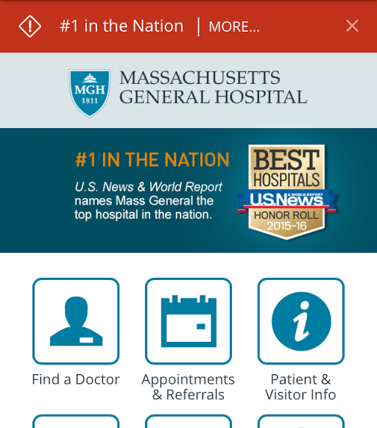
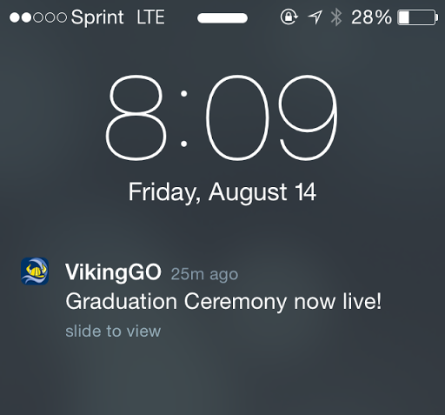
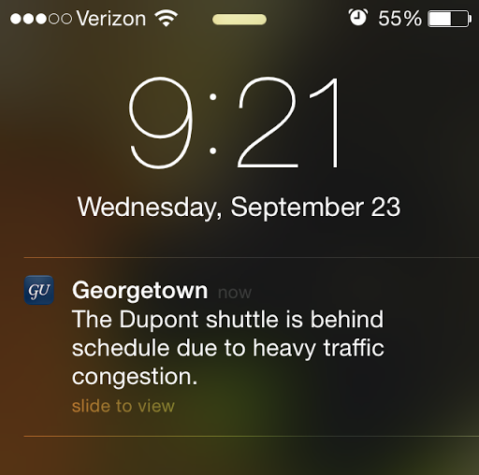
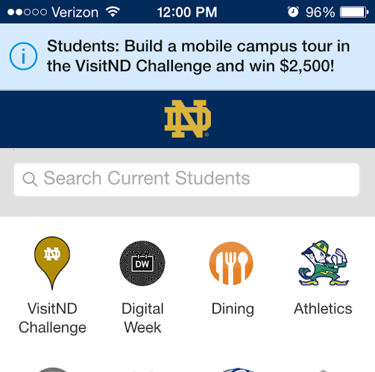
Communication (Messaging)

Slide 37
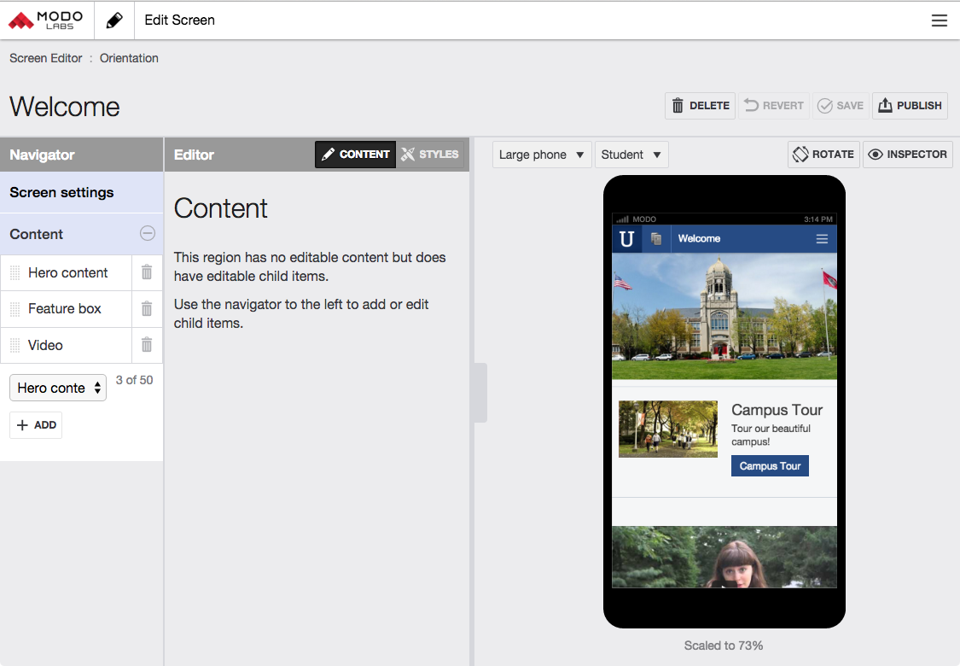
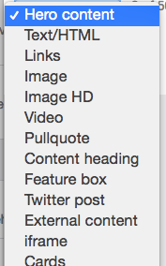
Scaling: Ability to Collaborate

Slide 38

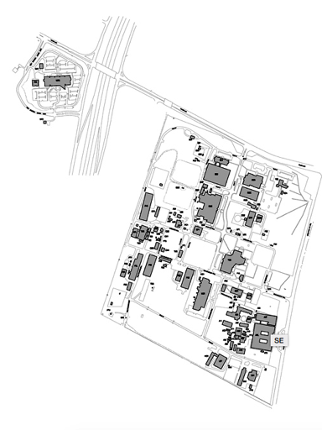
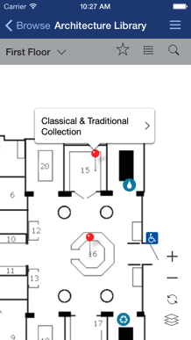
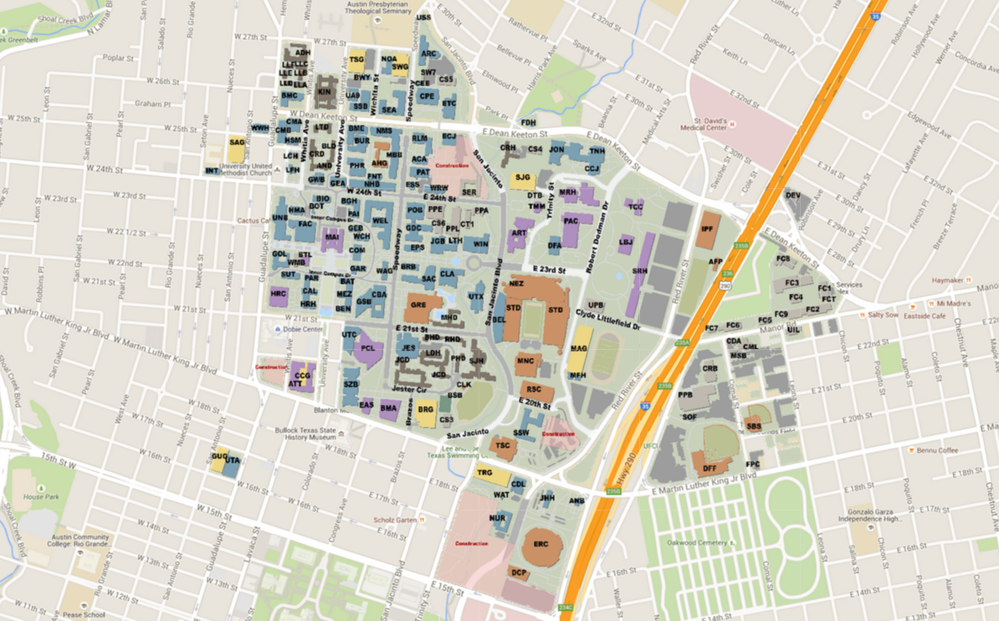
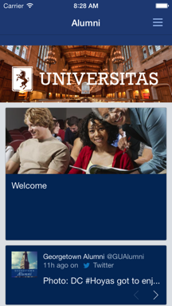
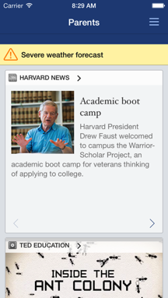
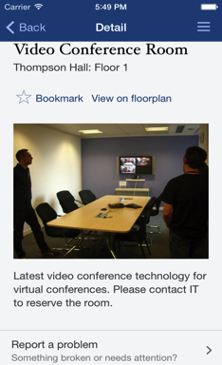











Personalization: Locations, Roles
Pickle
Research Campus

Slide 39




iBeacons, Geofencing, QR Codes

Slide 40
Why IS mobile important?

Slide 41

Coming next to the CSUN App …
PeopleSoft Student Services - GreyHeller/Modo Labs
Parking Space Availability
Indoor-Outdoor Maps Transitioning
Matador Patrol Safety
Notes:
Leverage PeopleSoft functionality directly to the CSUN Mobile app.

Slide 42


Financial Aid Award

Slide 43


Emergency Contact Information

Slide 44

Parking Space App

Slide 45


Seamless Map Integration

Slide 46



Slide 47


Slide 48


Matador Patrol App - Spring, 2016

Slide 49
Why IS mobile important?

Slide 50
Roadmap
Audience based content
Enhancing the campus visit and tour experience using iBeacons
Messaging
  Target messages by categories and groups
  Users can customize how they want to receive notifications
  Message center within the app so that users can refer to the messages
  An easy to use backend interface for the administrator
  Ability for users to opt in or out of certain optional message types
  Promotions

Slide 51


CLASS OF 2036

Slide 52

Thank You!
Download our app
Modo Labs Company Overview
Visit us at Booth #1930
Hear from other Mobile Leaders
  Del Mar College
  Dominican University
  University of Notre Dame
  The George Washington University

