Slide 1
Empowering BYOD Learning Spaces: Lessons Learned from Three Universities

Slide 2
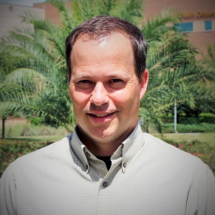

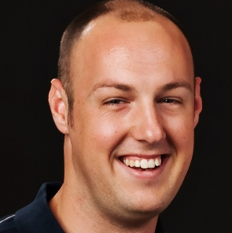
Introductions
Craig Froehlich
Director, Information Technology Student Development and Enrollment Services University of Central Florida
Jason Hair
Interim Director Information Technology University of South Florida
Jameson Johnston
IT Manager, Learning Spaces University of Florida

Slide 3
What you're in for...
What we did:
Implementing Virtual Apps for students (XenApp)
Use Case: Applications essential for coursework available anytime, anywhere, on any device
How we'll tell our stories:
University culture / Deployment timelines
Success Stories
Challenges
Metrics
Next Steps
**Intra-presenter university bashing a distinct possibility

Slide 4
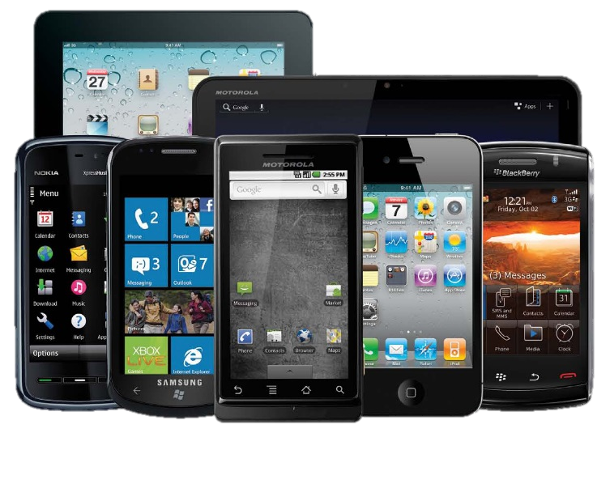
Why Virtualize?
Students need access to university owned software
Students now work 24x7 from anywhere
Cost savings with decreasing physical lab machines
Students use multiple technology devices
“Any time, Anywhere, Any device”

Slide 5





Requirements
Need the ability to leverage existing software licenses
Students need to have a similar experience to working in a physical computer lab
Solution needs to work and provide same user experience on multiple platforms and operating systems (device independent)

Slide 6
Our Soluton – Citrix XenApp
Apps hosted in the datacenter on university owned servers
Clients for Windows, Mac OS, Linux, iOS, Android, Blackberry
Easier than local installs - only the Citrix client software needed
Allows older machines to work just as well as newer ones

Slide 7
Virtual App Deployment Timeline
January 2010
USF Pilot
March 2013
UF Pilot
November 2014
UCF Pilot
USF
UF
UCF
2010
2011
2012
2013
2014
2015
January 2011
USF Production
March 2014
UF Production
January 2015
UCF Production

Slide 8
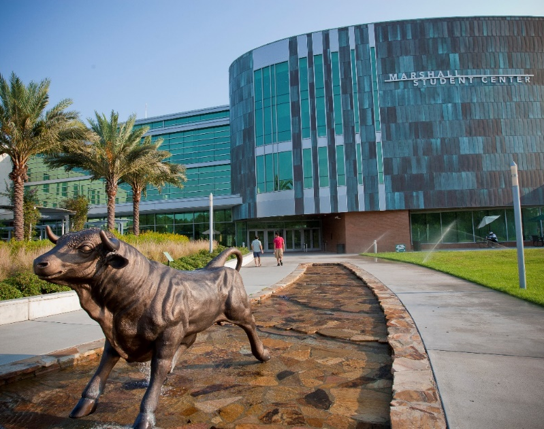
University of South Florida
Among the top 50 universities, public or private, for federal research expenditures
More than 48000 students across USF system – USF Tampa, USF St. Petersburg and USF Sarasota-Manatee
Over 10,000 Faculty and Staff
Centralized IT

Slide 9

Pilot to Production
Student Tech Fee funded (2009)
Dedicates hosts
Shared SAN storage
Implemented “in house”.
Pilot (Jan 2010)
Specific Courses in ENG
10 High-use apps
Quickly added… ENG, CAS, COBA, everything
Production (Jan 2011-)
Entire University System
Over 100 apps
1500 unique users per day, 400 concurrent

Slide 10
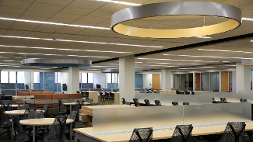
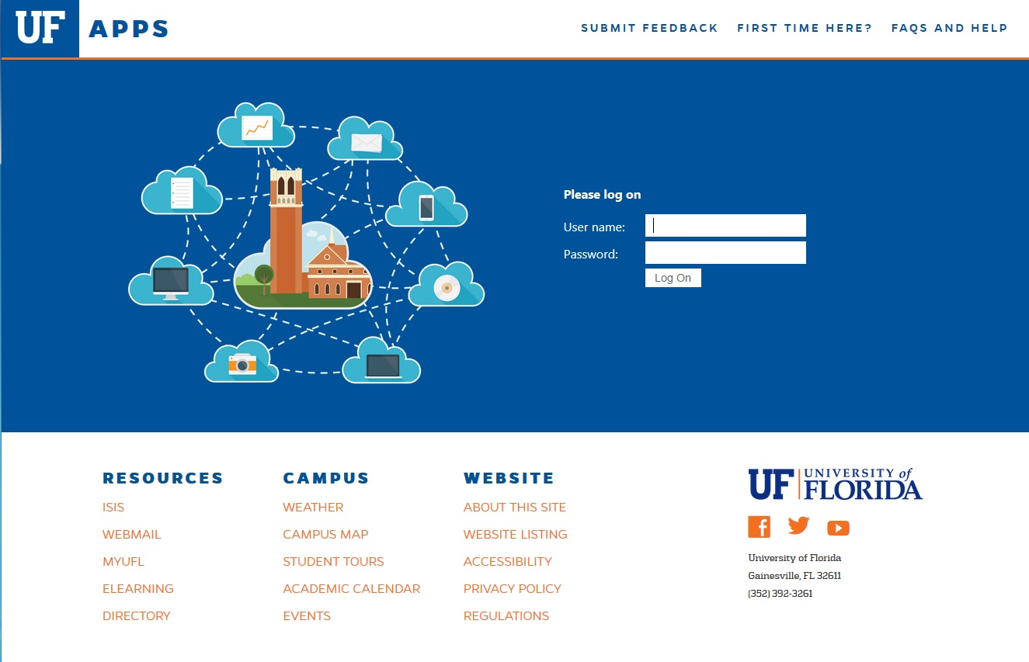
University of Florida
8th Largest Single Campus University
50,000 students
1st Public University with Online only degree program
“Sort of...” centralized IT
30+ National Championships
UFApps: Right Technology. Right Time

Slide 11
UFApps Pilot
UFApps (XenApp for students) initially viewed as “value-add” service
Only available to students
Pilot used existing data center resources
Primary concern: don’t break anything
Secondary concern: don’t run out of licenses

Slide 12
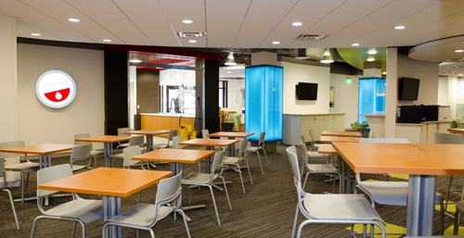
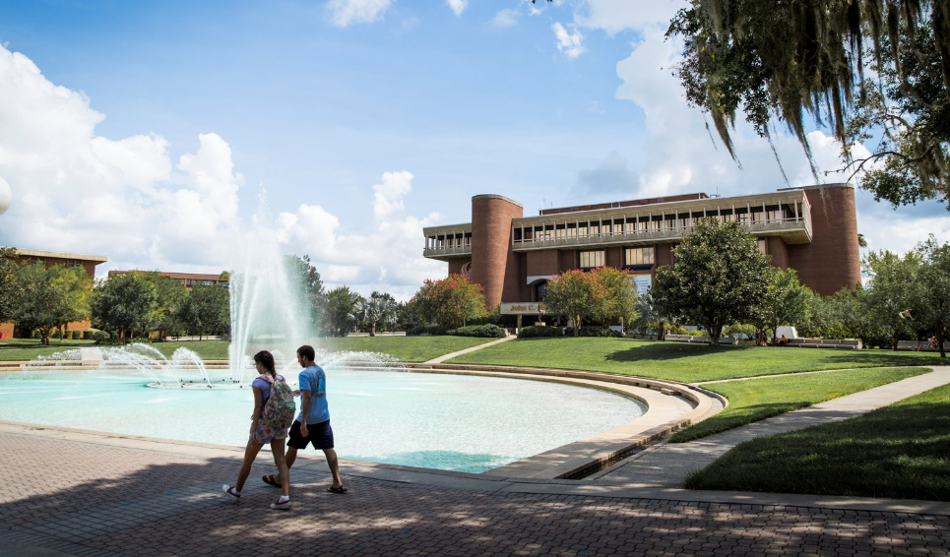
University of Central Florida
Second Largest University in the US
Over 63,000 Students
Over 11,000 Faculty/Staff
Orlando, Florida
Distributed IT
Collaboration Spaces
Technology Commons
UCF Apps: Perfect Compliment

Slide 13
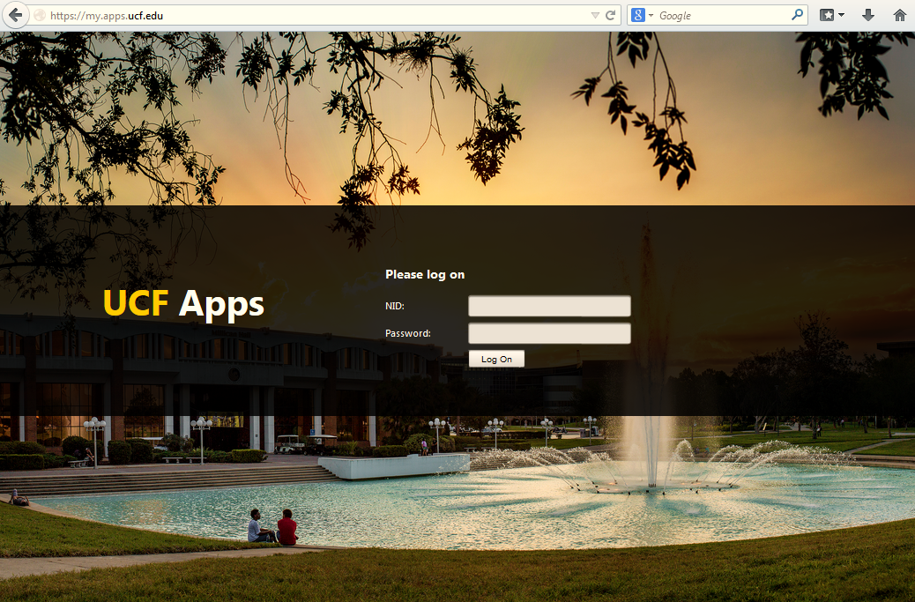
UCF Apps Pilot
Tech Fee $900k
Dedicated Hardware
Software Licensing (Citrix, SPSS)
Implementation resources
9 Colleges/Divisions Participated
20,000 Student Exposure
300 Faculty/Staff
Identified 14 Software Applications
Quickly moved from pilot to production

Slide 14

Success Stories

Slide 15
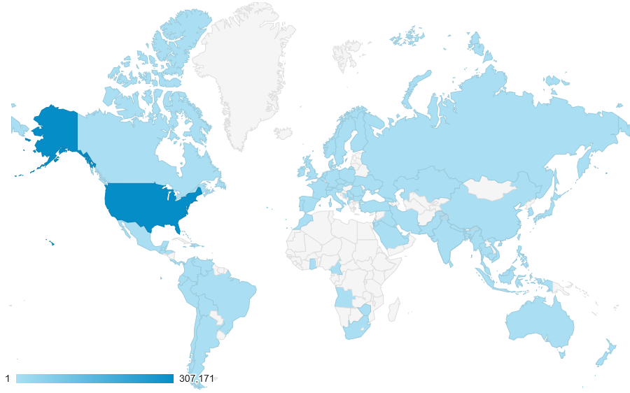
Success: Any device, anytime, anywhere
"The GatorNation is everywhere"​
Aha moment: Application feature request from Jamaica
“I am a Ph.D. student and I am currently in my home country of Jamaica. I would have had to purchase expensive software program to conduct the analysis of my data…UFApps has been a life saver.”

Slide 16
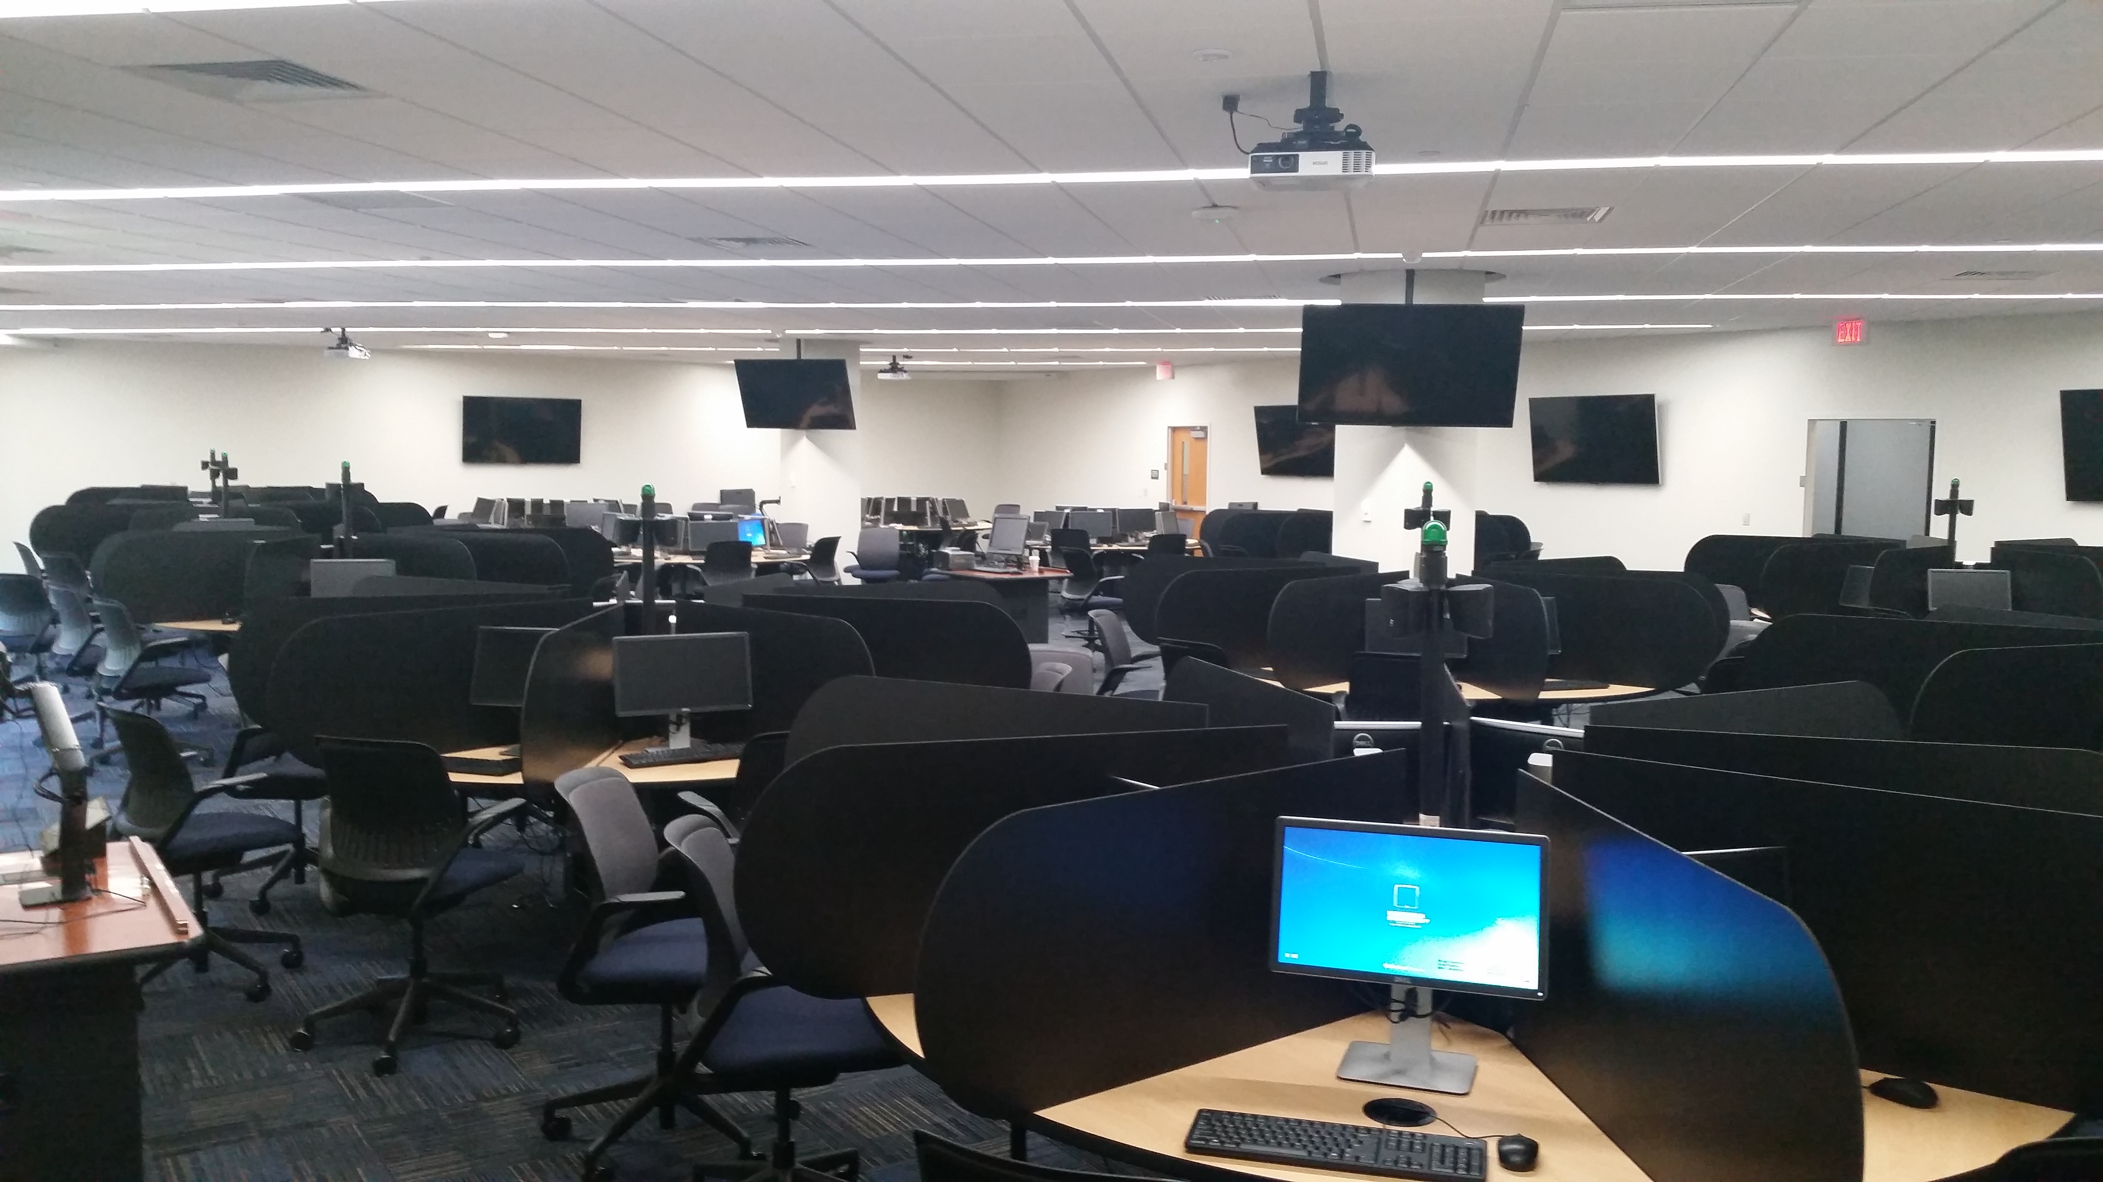
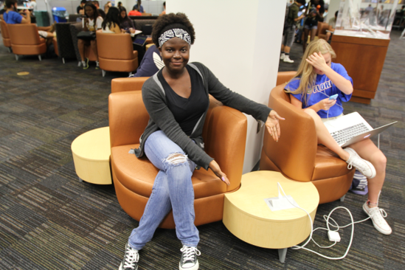
Success: Space Usage
Impact on physical labs
Fold in departmental labs
Repurpose Open Use labs
Remaining labs are purpose built
Better visibility into usage
Centralized support and licensing
Fewer endpoints/assets to manage

Slide 17
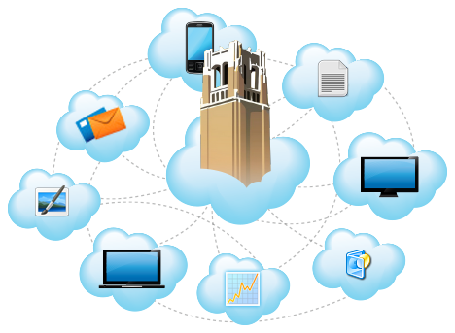
Success: Service Synergy
Services benefiting from UFApps
UF Online and Distance Learning Programs
Physical labs
BYOD spaces
VDI Services
Software licensing services
Course file storage
New services because of UFApps
UFApps for Research
ResShield FISMA/NIST environment for Research
Student file storage
Centralized Render Farm (coming soon)

Slide 18
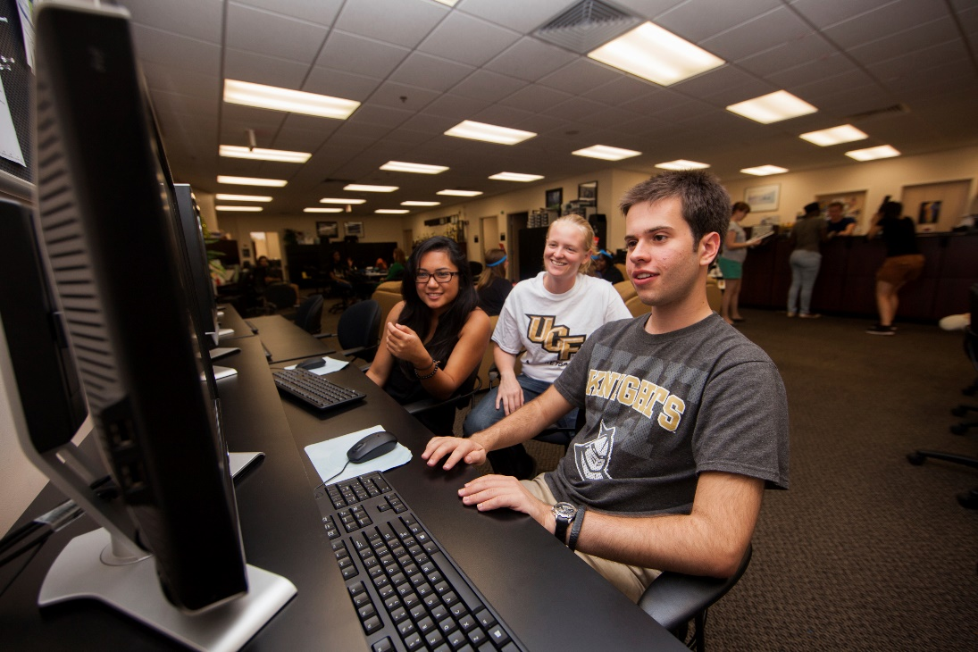
Success: Honors Lab
What did we do?
Used Citrix to deliver Apps to the desktop, without local installs
Created a seamless single sign-on experience for students
How did it help us and students?
Reduced support time for lab computers
Reduced cost on hardware
Provided consistent software versions for students

Slide 19
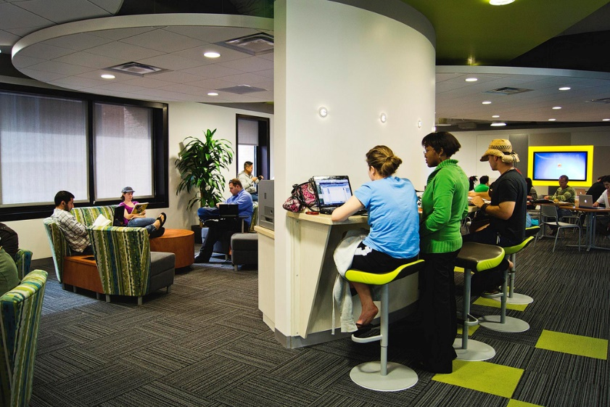
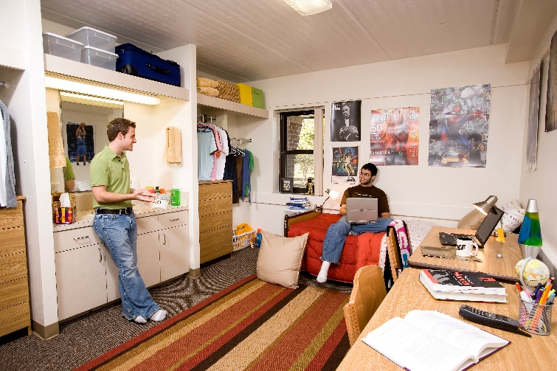
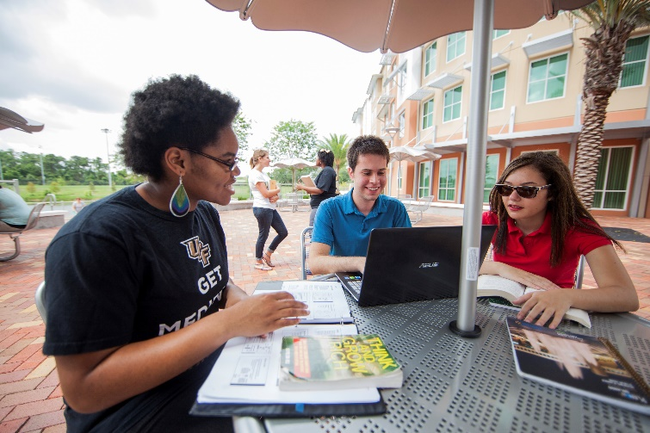
Success: BYOD Spaces
Collaboration spaces vs labs
Provide access to apps where students want to study
On campus
Off campus
Provide access to apps on their platform (Mac, Windows, iOS, Android, etc)

Slide 20

Success: Pilot Use Cases
We have been able to expand UCF Apps reach through pilots to targeted audiences
No need to license software for the entire campus
Ability to vet any issues before reaching all students
Small Successes Keep Us Moving Forward!

Slide 21









Success: Application Licensing
Convert to concurrent use or site licenses
Departments needed fewer licenses
Everyone has access
Consolidate Licenses
Don’t assume all vendors will be happy with their app on XenApp
Metering and reporting

Slide 22
Success: Provisioning Server
OS streaming.
Central, shared vDisk.
Physical of Virtual.
Multiple HW model support on single vDisk
You might already own it!

Slide 23
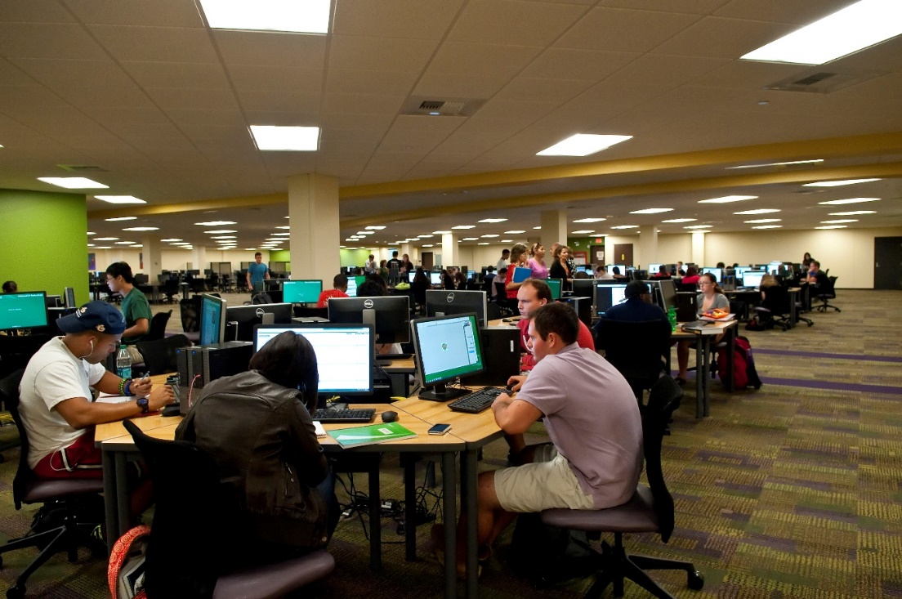
Success: Provisioning Server
USF SMART Lab
350 computers
Shared Space
Open Use
SMART mode
Scheduled Task
Swap vDisk
Warnings to students, timed log off
Reboot machine to new vDisk

Slide 24
Challenges
OOPS!

Slide 25
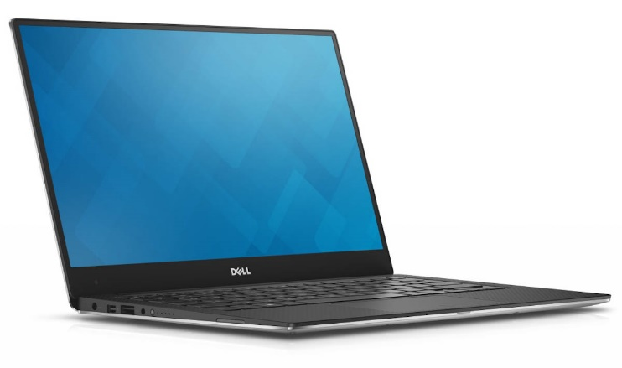
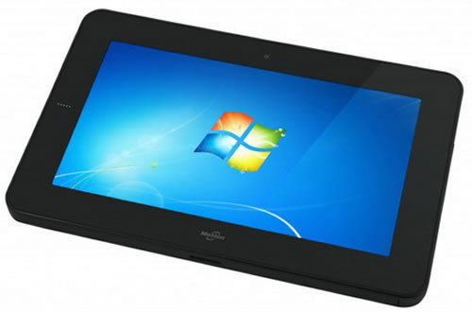

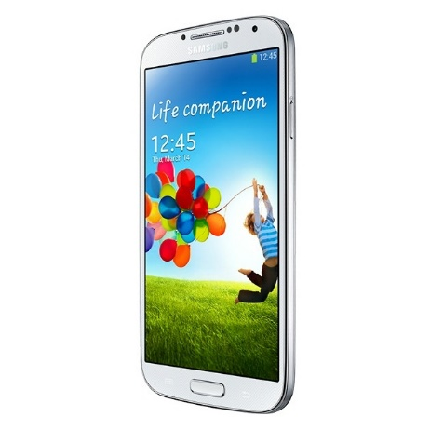
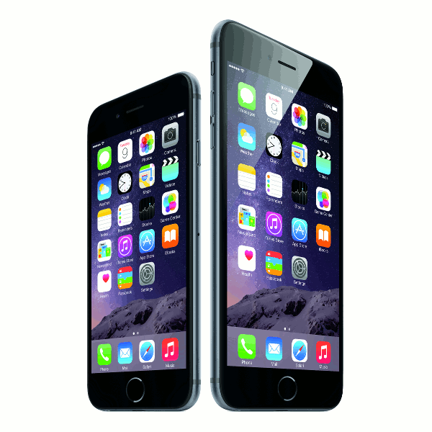
Challenge: The BYOD Ecosystem
Creating documentation for (almost) everything a student could use
Device OS
Browser
Updates out of our control
Web browser updates
New OS versions

Slide 26




Challenge: User Adoption
UCF Apps
Marketing focus to ensure adoption and growth
Worked with Citrix to develop
Video to sell proposal to committee
Video for student onboarding
Print and digital materialsSocial Media
Faculty Champions (integration into syllabi)
Surveys (attention, and feedback)

Slide 27


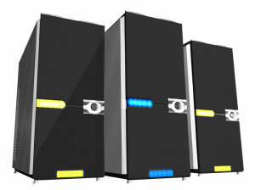

Challenge: User Storage
Storage location confusion
Performance issues
Server Mapped vs Local vs Cloud
Cloud Storage integration
LMS Integration

Slide 28
Challenge: BYOD in the Classroom
Benefits
Reduce cost of computing labs
More flexibility in scheduling
Challenges
BYOD vs Managed devices
Real-time Support Issues
Centralized vs Distributed (failures HURT)
Ex: Industrial Systems (Arena) exams.

Slide 29

Challenge: Application Consistency
How do you provide consistency?
UFApps, Lab PCs, VDI, etc...
Consistent application versions, plugins, toolbars, extensions, etc.
Application groups
Multiple versions of the same App

Slide 30

Challenge: Communication
What have we learned?
Engage Faculty
Identify key stakeholders
Target courses for consistent adoption
Clearly communicate intend use
Clearly communicate limitations
REPEAT

Slide 31

Metrics

Slide 32
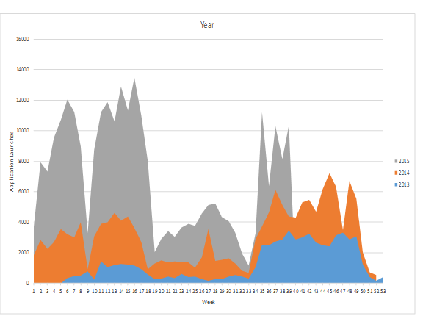
UFApps Adoption
Usage has doubled every year
Over 10,000 application launches per week
Over 21,000 users on 27,000 devices

Slide 33
UCF vs UF First Year

Slide 34
USF Usage Statistics

Slide 35
USF vs UF vs UCF for Spring 2015

Slide 36

Next Steps

Slide 37
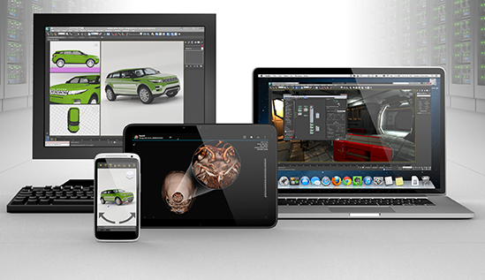
USF Next Steps
Persistent Profile Data
Cloud Storage
GPU
Classrooms and Labs

Slide 38
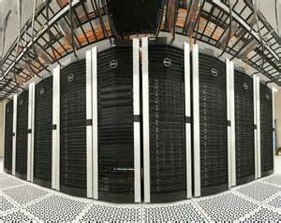
UF Next Steps
Support strategy for in class usage
Revisit student file storage
2 instances of UFApps for Research
Analyze GPU acceleration usage
Render Farm

Slide 39

UCF Next Steps
Kumo
Cloud storage option for students
Citrix Cloud Pilot
Disaster Recovery (management VMs)
Collaboration with College of Medicine
Pilot other use cases (thin desktops)

Slide 40
Thanks/Questions?
Craig Froehlich
craigf@ucf.edu
linkedin.com/in/cfroehlich
Jason Hair
hair@usf.edu
Jameson Johnston
jameson@ufl.edu

