Slide 1
Best Practices in Emergency Mass Notification
Kansas State University • Washington University in St. Louis • Florida State University

Slide 2




Webinar Panelists
Erik Stafford (moderator)
Director of Higher Education Sales
Dave Bujak
Director of
Emergency
Management
Matthew Arthur
Director, Media Services &
Incident Communications
Solutions
Rob Caffey
IT Director

Slide 3
Rob Caffey
IT Director
Location: Manhattan, KS
Campus type: urban
Enrollment: 24,766
Employees: 5,181
Campus size: 668 acres
Notes:
Rob Caffey is the IT Director at Kansas State University. For 13 years he has served in the university’s Office of Medicated Education, which provides innovative and reliable academic technologies solutions for Kansas State University. In 2004, Rob was awarded the C2C Outstanding Online Leadership Award for creating an innovative, technology based student centered learning oriented climate. He was also acknowledged for his promotion of diverse ideas among faculty and students to enhance a culture of technology usage.

Slide 4

K-State Alerts
Multiple modes/single point of access
SMS
Voice
RSS/homepage override
Social Media
Alertus Beacons
Digital Signs
Mobile App
Semiannual tests (spring and fall terms)
Mandatory email enrollment
Voice and SMS optional
Users can add up to 3 lines

Slide 5
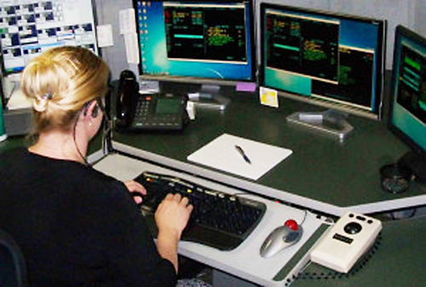
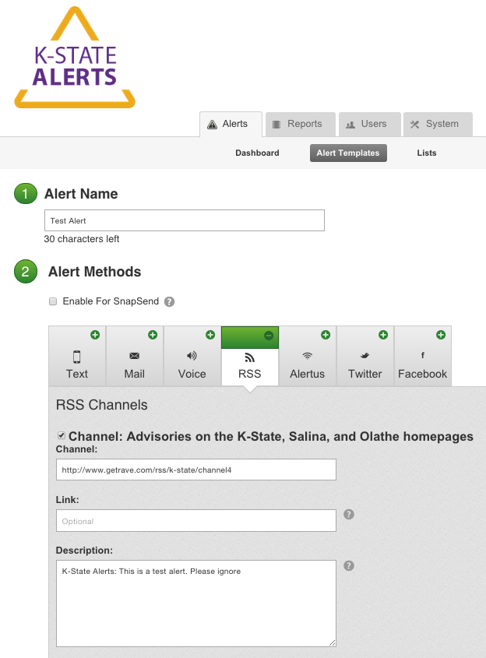

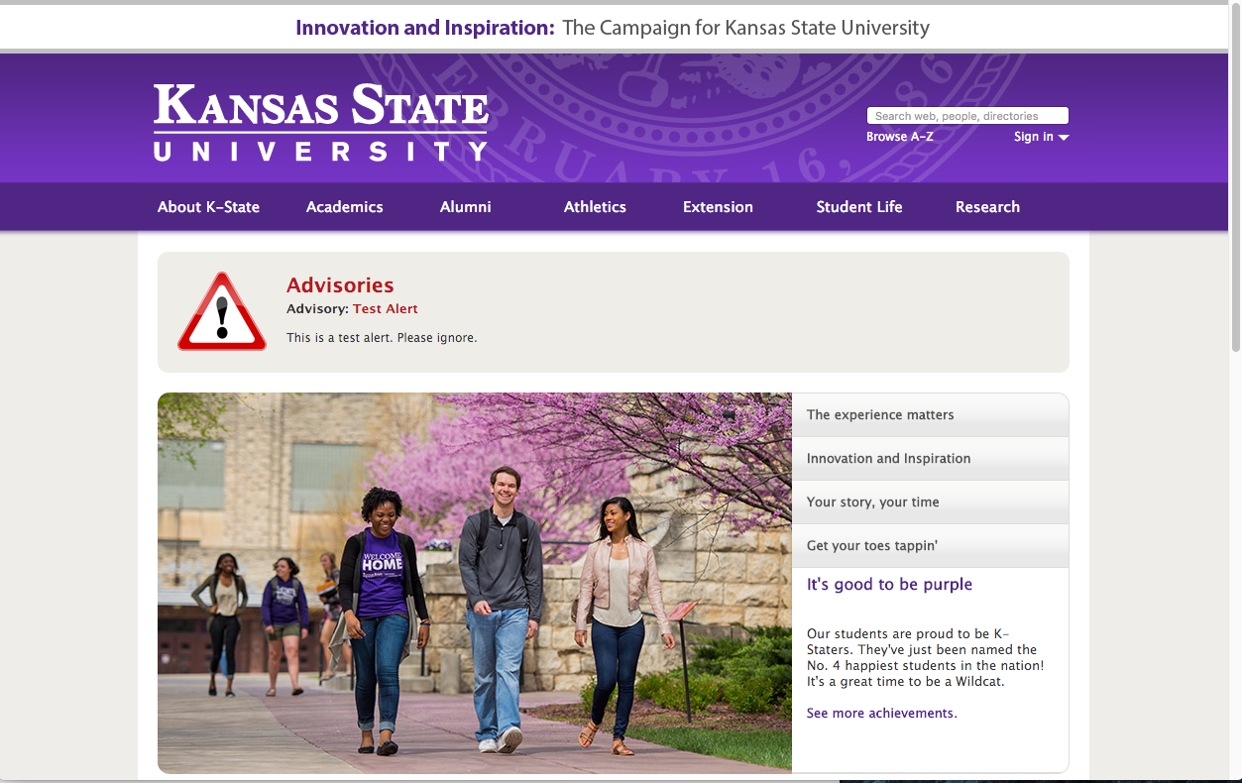





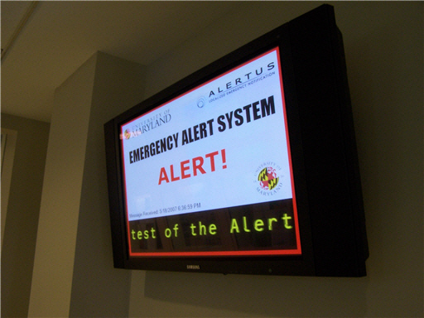
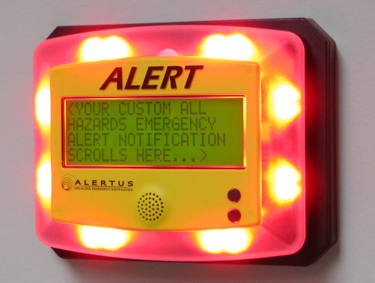
Homepage Advisory

Slide 6
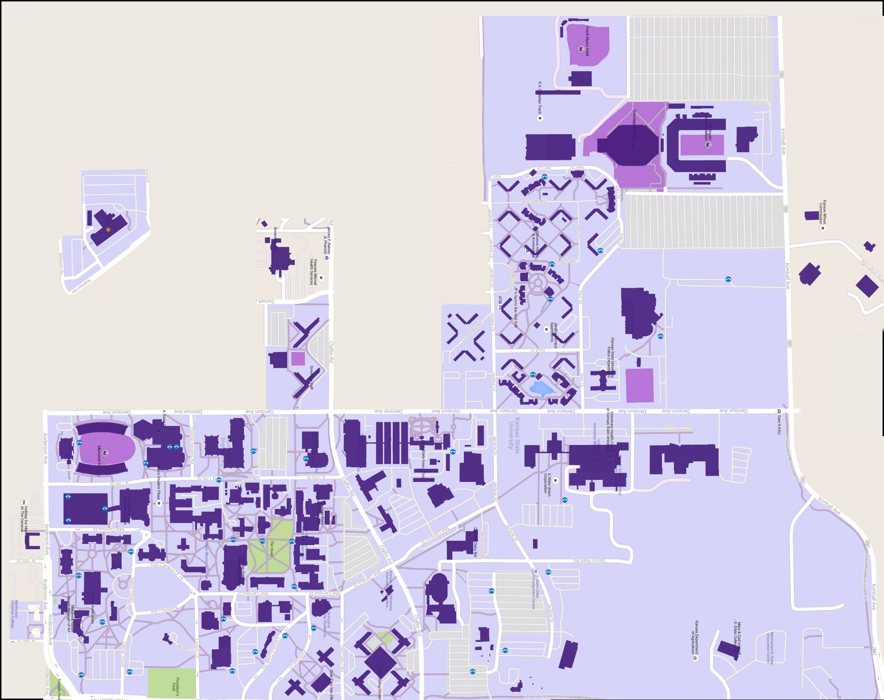
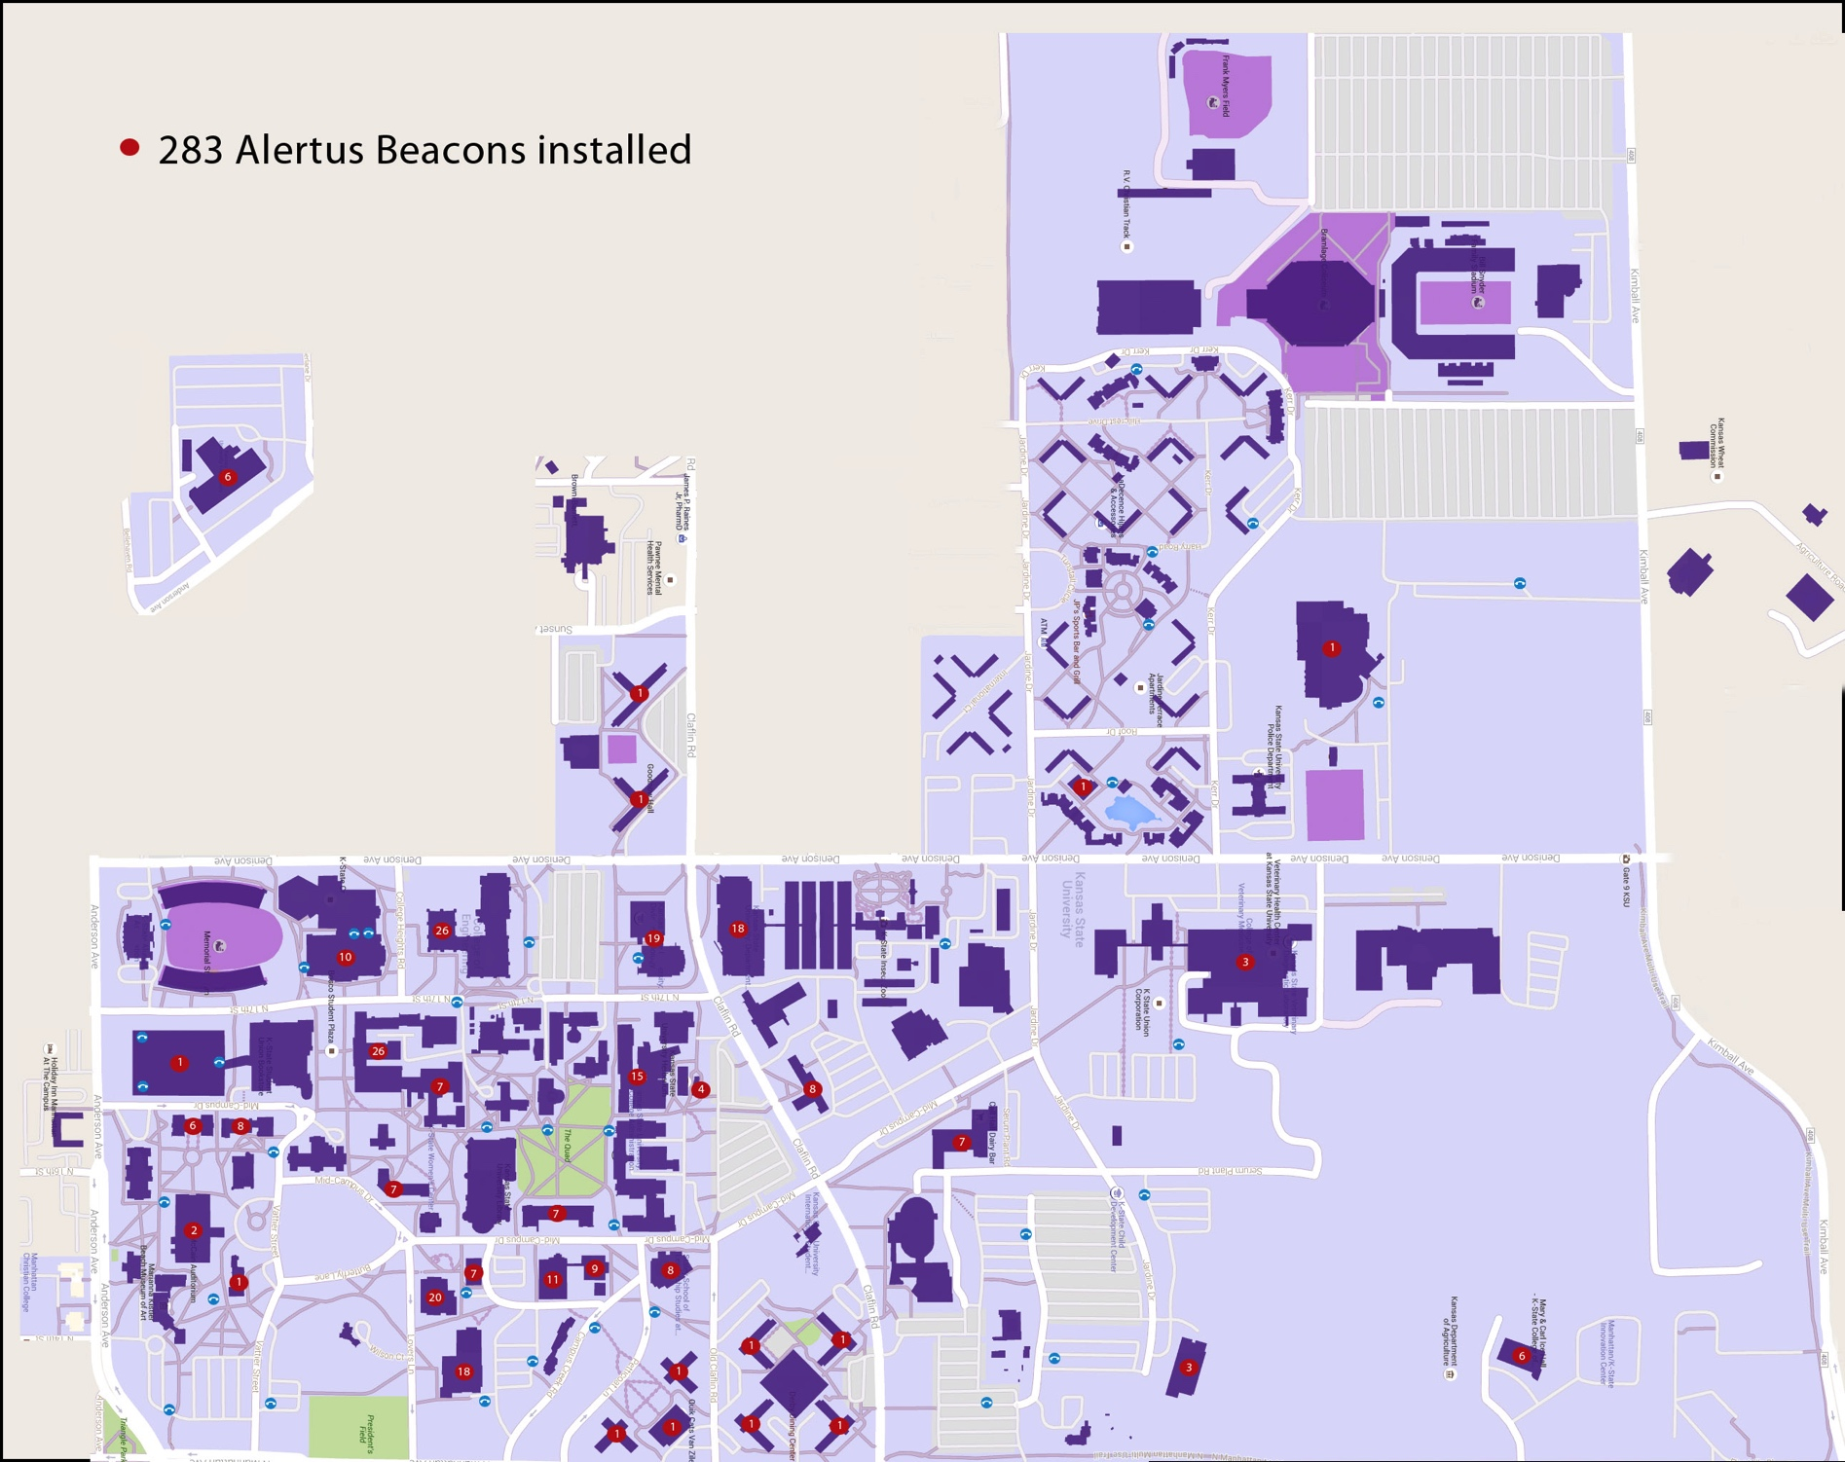
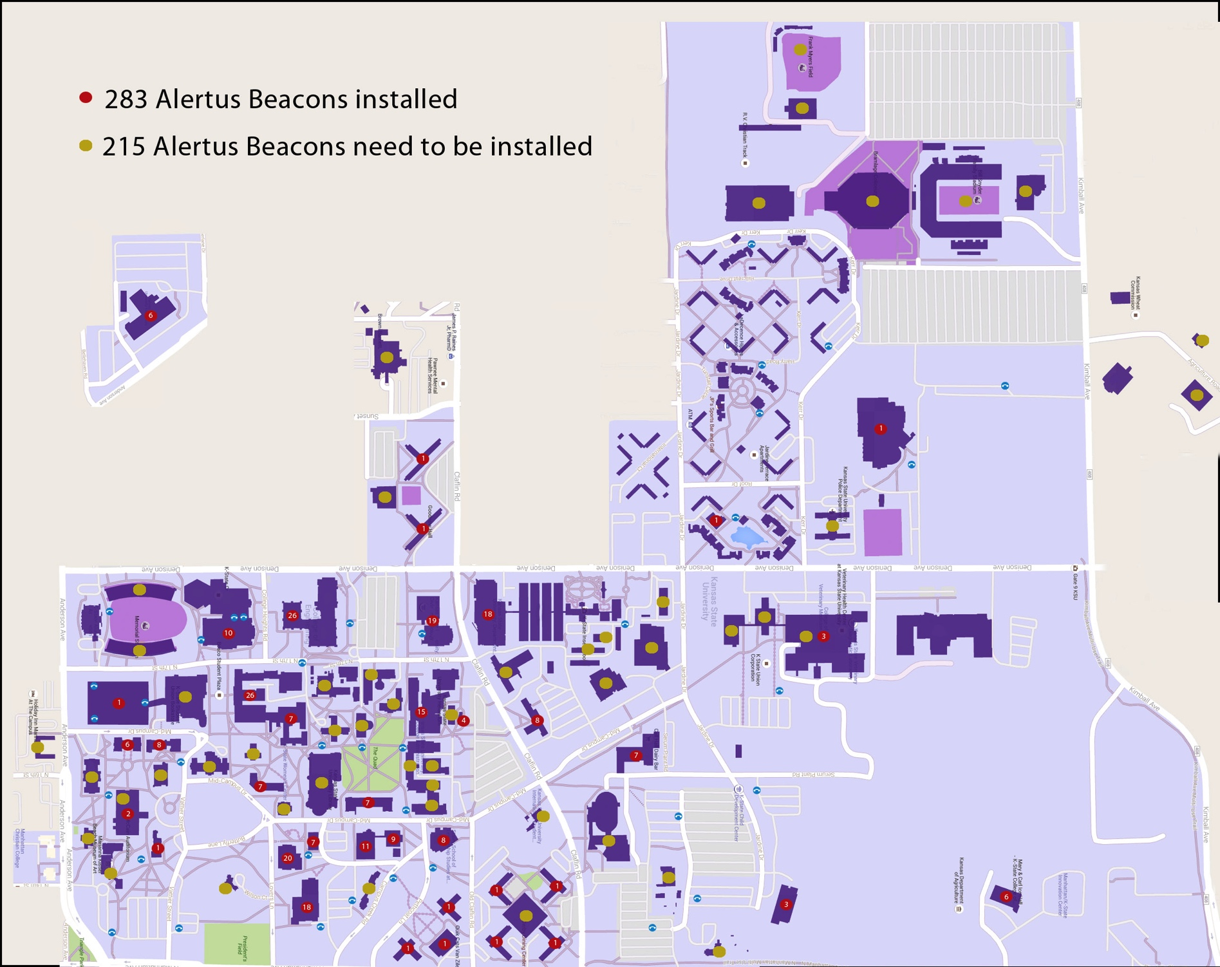

Slide 7
Registered Users: 46,948
Registered Phones: 14,614
People with at least 1 mobile device: 28.3%
Issues:
Alerts for Severe weather?
Alerts for Winter weather?
Opt-in/opt-out?
Mobile App Integration?
Better UI for groups and modes?

Slide 8
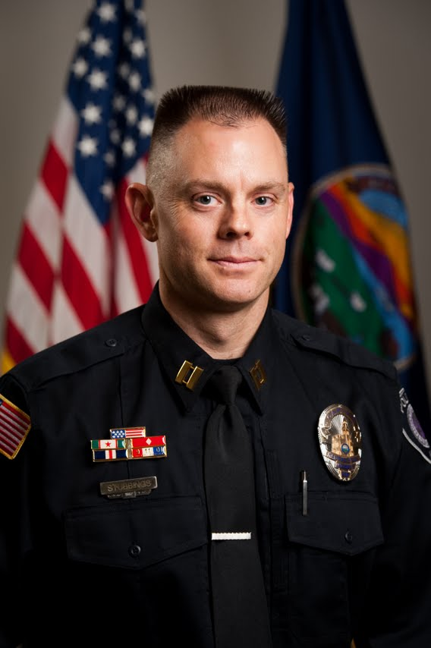
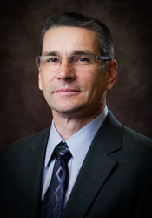
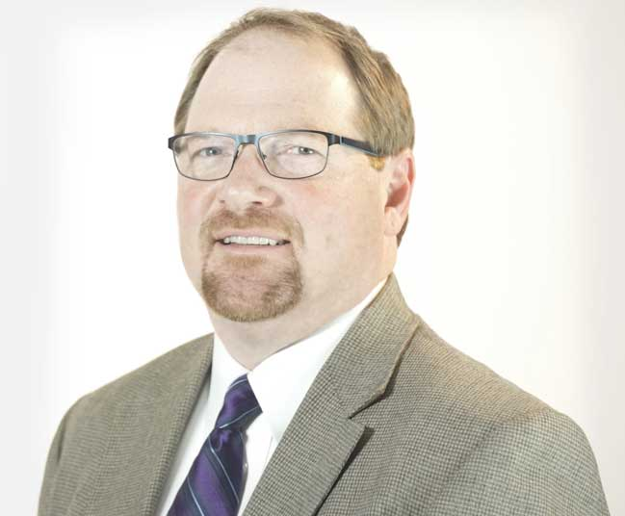
Public Safety/Police Department
Communications & Marketing
Major Don Stubbings
KSU Police
Jeff Morris
VP DCM
Information Technology Services
Rob Caffey
Director ITS

Slide 9
Homepage Advisory

Slide 10
Location: St. Louis, MO
Campus type: urban
Enrollment: 14,500
Employees: 15,000
Campus size: 4,625 acres
Campuses: 6 across county
Matthew Arthur
Director, Media Services &
Incident Communications
Solutions
Notes:
Matthew Arthur is Director of Media Services and Incident Communications Solutions at Washington University in St. Louis. Matt has been in IT for 30 years and at WUSTL for 26 years. In his present position, he collects and interprets functional requirements from multiple organizations and develops an overall technology plan for supporting communications during incidents. Matt is a Certified Information Systems Security Professional.

Slide 11
The Challenge
Flash-to-Bang
Time from visual cue to audio acceptance
How to get from incident to key members of CMT together making coherent decisions moving forward, including sending alerts.

Slide 12
Communication requirements
Save Lives Now - “immediate threat to health or safety of students or staff” like tornado or violence on campus (HEOA requirement)
Emergency – does not involve immediate threats to safety like chemical spill or fire
Informational – non-emergencies that require timely information like food-borne illness or follow-on to tornado

Slide 13
Policy & Needs Assessment Comes First
Develop the need and the policy
Who do you need to reach and how?
Who is authorized to issue a message?
Who has the ability to set off the system?
When will the system be used?
Weather, violence, fire, etc.
Who “owns” the system (e.g., admin rights, upkeep, programming)?
What technology(ies) do you have or want to use/integrate?

Slide 14
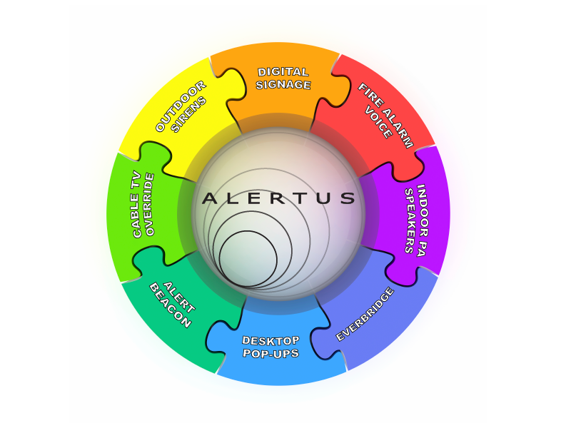

The Solution
Work with our vendor partners to integrate existing system into a centralized dashboard.
Easy Button

Slide 15
How We Did It
Project Timeline
Sep-Oct 2010: RFP published/proposals accepted
March 2011 – Project Approved, Vendor Chosen
April 2011 – Vendor Onsite for engineering & test
August 2011: Server setup & beacons installed
Sept 2011: Alertus and Campus TeleVideo onsite for install and testing
Oct 2011: Administration decides not to launch mid-semester. Launched Jan 17, 2012

Slide 16
Activation
We created 3 “Levels” of user access:
Preset: Dispatchers in our Police/Public Safety Dept. can send pre-scripted messages to pre-determined devices
Customized: Police/Public Safety Managers & 9 University officials can send customized messages to any and all devices
Admin: Administer & maintain the system

Slide 17
Policy/Procedure
For immediate threats to life and safety, Dispatchers have the ability to send select messages.
For tornado warnings for St. Louis City/County from the National Weather Service, the system automatically sends out a message.
Limited university administrators can authorize a message at any time.

Slide 18
Matt’s “Washington University Emergency Communications Alerting” Matrix
Executive Authorization | Chancellor's Letter/MOU
Operational Responsibility | Crisis Management Team
Operational Authority | Authorized Admins (Operations, WUPD, MSPS, PA, AtC, EHS, Emergency, etc…)
Incident Timeline | Incident Happens | CMT Control | Time until Incident 'Ends'
Incident Type | HEOA - 'Save Lives Now' | Emergency | Follow-On / Informational
Incident Examples | "immediate threat to the health or safety of students or staff" | Hazardous Materials Spill, Fire, etc… | Campus Illness (Meningitis episode two years ago), tornado/earth quake follow-on information
Alert Authorization | Pre-Approved as per WUPD/MSPS Protocol | Authorized Admins | CMT - Public Affairs - DCM
Responsible to Send Alert | WUPD/MSPS Dispatch (Alertus Level 1 Training Required) | WUPD/MSPS Officers/Mgmt Bagby / Arthur (Alertus L2) | Digital Content Management (PA) Bagby / Arthur (Alertus L2)
Modes of Communication | All Available (Tornado Warning Sirens provided by STL County) | Alert Affected Campus (All) Inform All Others (eMail/DTPupUp) | As required by situation

Slide 19
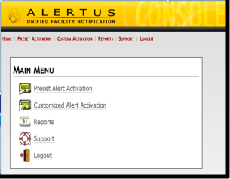



One System to Control all our MNS Components
PERSONAL - Everbridge for SMS, Emails, Phone
OUTDOOR
Whelen Siren System (x3)
INDOOR
-Alert Beacons (95+)
Desktop Popups (>8K)
Cable TV Override
PA Systems (x3 buildings)
Emergency Web Site RSS Feed
Emergency/Fire Alarms
WUSTL App – Spring 2015
Digital Signage Override - 2015
Social
Facebook / Twitter
Manual Activation
Automatic Activation

Slide 20

Dave Bujak
Director of Emergency
Management
Location: Tallahassee, FL
Campus type: urban
Enrollment: 41,773
Employees: 11,797
Campus size: 750 acres
Notes:
Dave Bujak has been the Director of Emergency Management for Florida State University, Tallahassee FL, for more than eight years. He leads university efforts to prepare for, prevent, respond to, recover from and mitigate against the effects of a wide variety of emergencies and disasters that could adversely affect the health, safety, and/or general welfare of students, faculty, staff, visitors, and families. Dave manages the FSU Alert emergency notification and warning system, one of the most advanced in the nation, featuring more than 35 methods of delivery, single-button activation, and end-user delivery in 5 minutes or less.

Slide 21
FSU Background
FSU Campus Safety & Security includes: Police (fully-sworn), E.M., Transportation & Parking, Systems
Predecessor to FSU ALERT established after 9/11.
FSU Emergency Management established December 2006.
FSU ALERT Emergency Notification & Warning System modernized and formalized just before Virginia Tech, 2007.
University conducts semiannual tests, review and needs assessment of FSU ALERT system. Annual gap analysis.
Needs assessment & gap analysis drives funding priorities.

Slide 22

Florida State University uses a number of notification methods to communicate with the campus community in the event of an emergency:
Alerts page
FSU website home
page
Outdoor sirens
Indoor sirens
SMS text messages
Email
Blue light phones
FSU ALERTS hotline
Voice phone calls
Desktop alerts
Alert Beacons
my FSU mobile app
Facebook
Twitter
Tumblr
Reddit
LinkedIn
RSS feeds
Digital displays
Network login portals
Family connection list serve
Two-way radios
Vehicle public address speakers
Electronic card-swipe door access
NOAA weather radios
Television media
Radio media
Newspaper media
Online media
Traffic message boards
Seminole cablevision
Tumblr
YouTube
Pinterest
FSU emergency people locator
Word of mouth

Slide 23
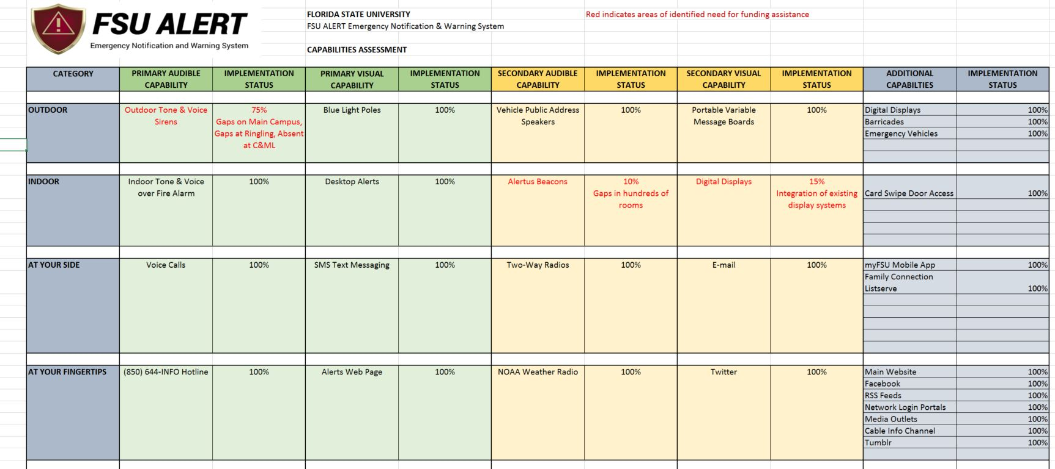
Gap Analysis
Gap Identified: Less than 25% of buildings on campus have “voice capable” fire alarm systems for “Indoor Sirens.” Others are legacy horn / bell systems that are cost-prohibitive to replace.

Slide 24
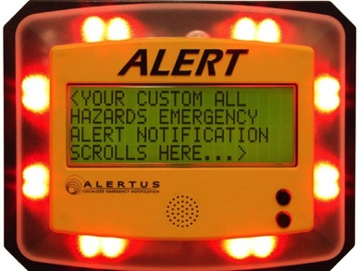
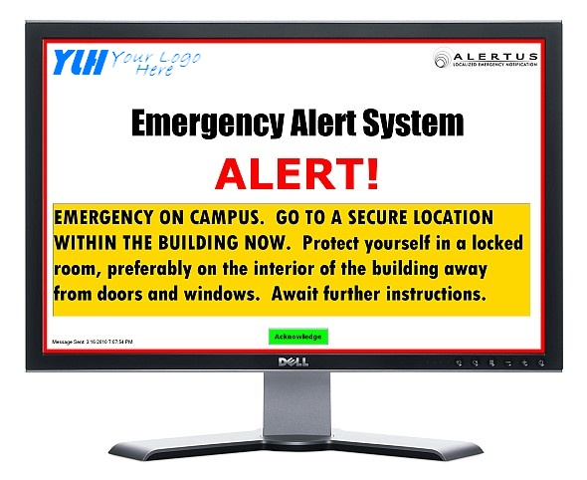
The Solution
Alertus filled the gap.
Identified Alertus Desktop Notifications as a viable alternative for visual notifications in classrooms.
Identified Alertus beacons as a viable alternative for audible notifications in high-concentration areas.
Clearly identified need.
Funding priority.
Grant funding secured.

Slide 25
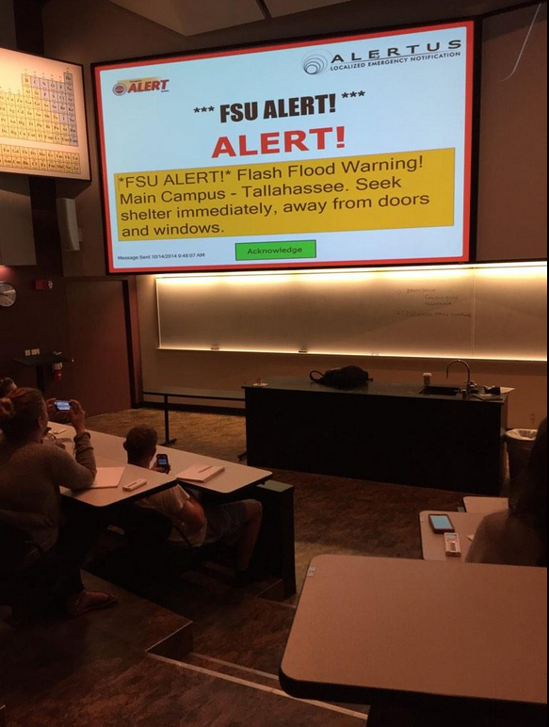
MNS Integration with IT Network
Challenge to integrate MNS into FSU’s decentralized IT structure
Alertus Desktop Notification had to be installed as part of each college’s individual infrastructure
University current has the desktop notification client set up on 1,800 machines
Desktop notification is available to any university-owned or managed computer

Slide 26
MNS Integration with IT Network
Challenge to integrate MNS into FSU’s decentralized IT structure
Alertus Desktop Notification had to be installed as part of each college’s individual infrastructure
University current has the desktop notification client set up on 1,800 machines
Desktop notification is available to any university-owned or managed computer
BREAKING NEWS!
Effective November 1, 2015
Alertus Desktop Client added to enterprise software image.
8,000 new clients coming online within weeks!
Pushing 10,000 desktop clients

Slide 27
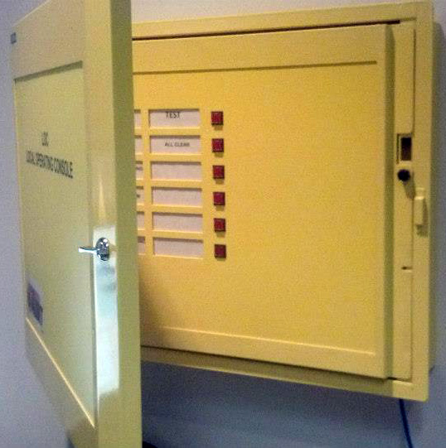
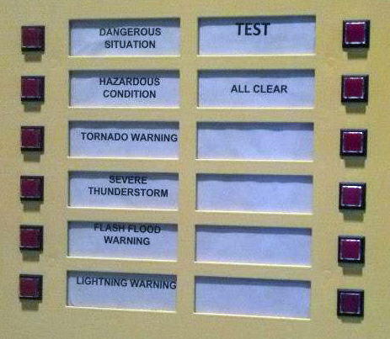
FSU’s “EZ Button” Integration
One button does it all…
8 pre-recorded messages
Split-second activation
Total delivery within 3-5 min
Alertus fully integrated with Siemens technology.

Slide 28
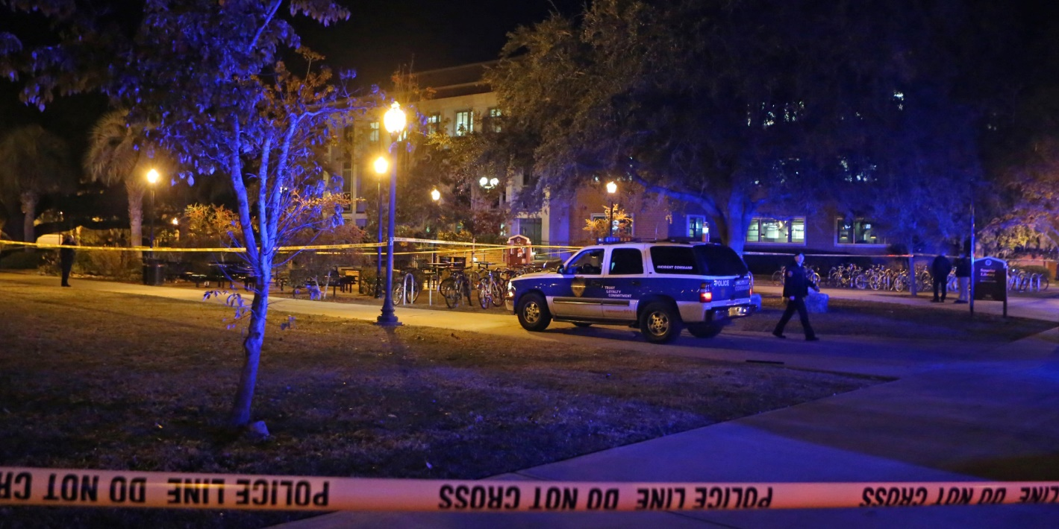
November 20, 2014 – Strozier Library Shooting
10 minutes from first gunshot to full alert – “Dangerous Situation”
Hundreds of Alertus desktop clients throughout Library.

Slide 29
Questions
Erik Stafford (moderator)
Director of Higher Education Sales
Dave Bujak
Director of
Emergency
Management
Matthew Arthur
Director, Media Services &
Incident Communications
Solutions
Rob Caffey
IT Director
Notes:
Problems encountered when implementing the system and establishing emergency communication protocols, and corresponding solutions
Top 3 considerations when selecting an emergency mass notification system
What proactive steps do you take to get the campus community invested in emergency communication efforts?

Slide 30
Help Us Improve and Grow
Thank you for participating
in today’s session.
We’re very interested in your feedback. Please take
a minute to fill out the session evaluation found within
the conference mobile app, or the online agenda.

