Slide 1
Collaborative Innovation Communities:
Bringing the Best Together
Florence D. Hudson
Senior Vice President & Chief Innovation Officer, Internet2

Slide 2
Meeting Objectives
Learn how to build a collaborative innovation community and culture
Gather learnings from collaborative innovation efforts
Learn how to start local and go global with collaborative innovation
Questions & Answers

Slide 3
Internet2 Community Overview: Enabling the Future
Internet2 is a community of U.S. and international leaders in research, academia, industry and government who create and collaborate via innovative technologies…
to develop and deliver new innovations around the internet.
Together, we accelerate research discovery, advance national and global education, and improve the delivery of public services.
Our community touches nearly every major innovation that defines our modern digital lives—and continues to define “what’s next.”

Slide 4
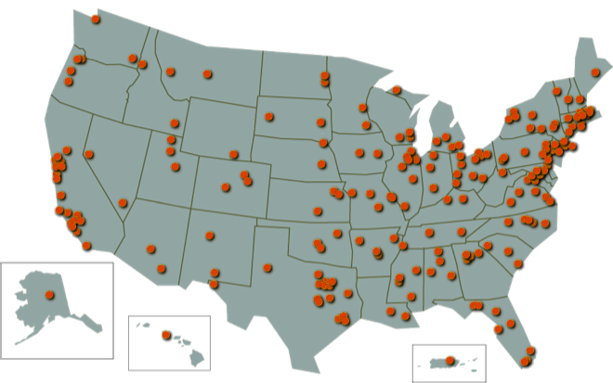
Internet2 includes over 500 Members and Partners
“The idea of being able to collaborate with anybody, anywhere, without constraint…”
—Jim Bottum, CIO, Clemson University
301 Higher Education members
65+ Affiliate members
42 Research & Education Network members
80+ Industry members
65+ International partners reaching over… 100 Nations
93K+ Community anchor institutions

Slide 5
Internet2 provides enabling services & collaboration
Through its four Divisions…
Network Services – 100Gb network for research collaboration
NET+ Services – suite of services from industry partners for universities
Community Engagement – events and membership services
Chief Innovation Office – define and enable collaborative development of new innovations
…Internet2 engages its members in…
Common problem and solution focused initiatives
Facilitating a test bed for innovation

Slide 7
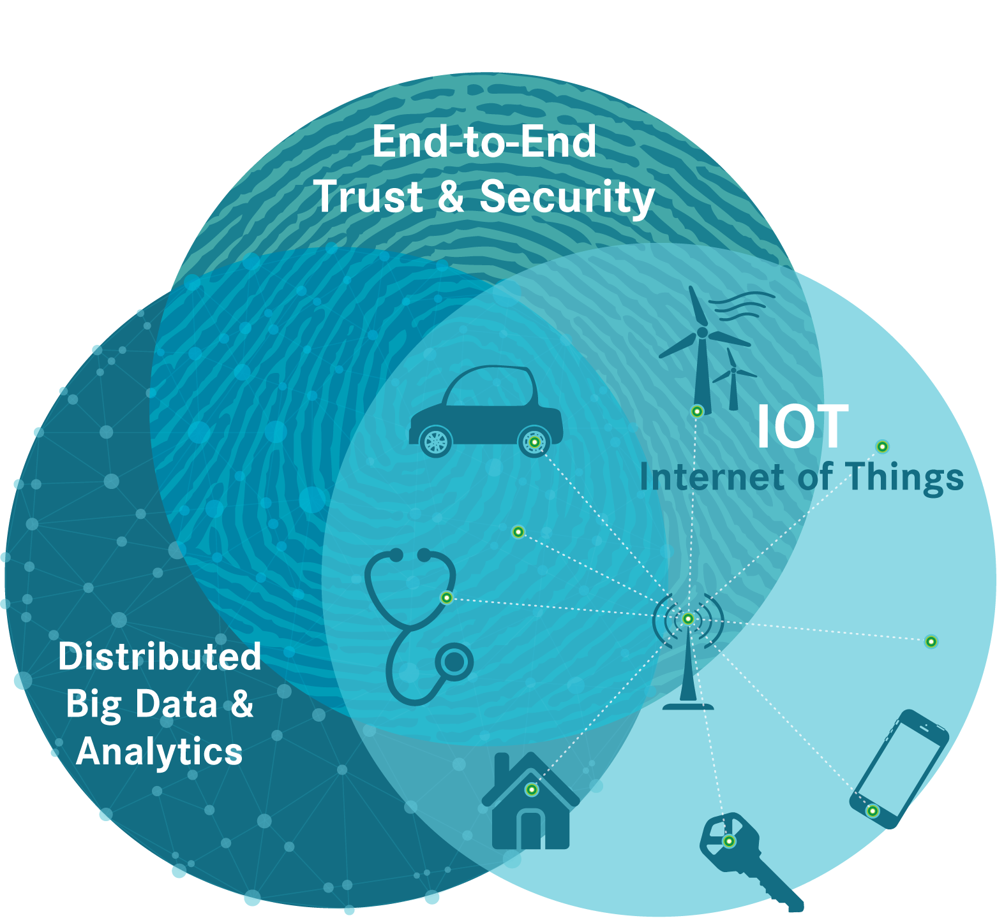
Three new Internet2 Collaborative Innovation Working Groups Created in May 2015
Based on March 2015 Member Survey

Slide 8
Innovation Working Groups Complement Other Internet2 Activities
Each making specific recommendations for innovation initiatives, including scope, value, use cases, actions
Bring tactical and strategic value to members
Positively impact a significant segment of Internet2 membership
Led by member representatives
Three university co-chairs of each working group
Leverage member programs and facilities
Participation encouraged for all Internet2 members – universities, industry, agencies, labs, international partners, regional networks
Working groups operate within a broader Internet2 Collaborative Innovation Community with representatives from all types of member organizations

Slide 9
Innovation Working Groups include University, Industry, Affiliate Members and Partners
Representative sample. As of October 1, 2015.

Slide 10
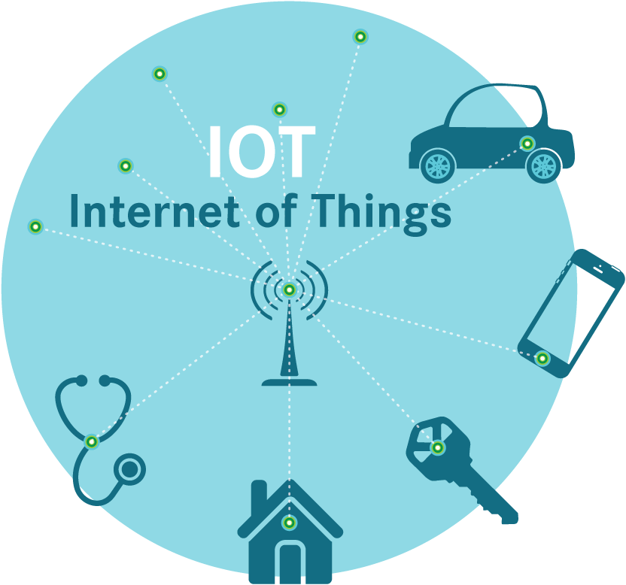
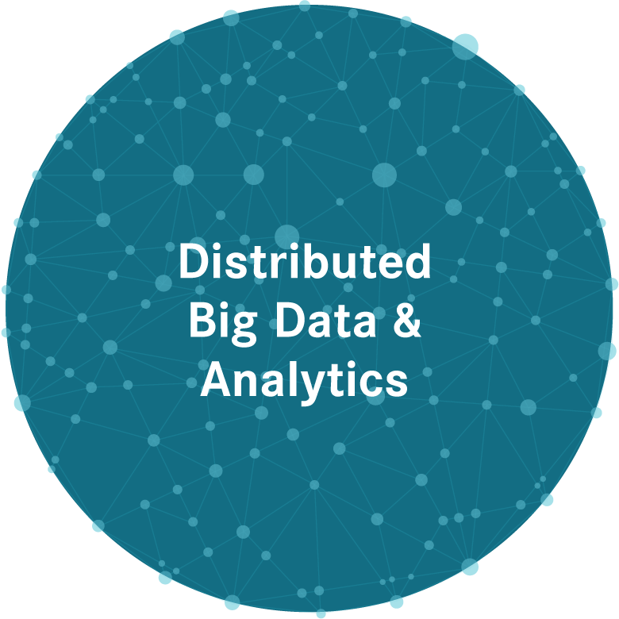
Innovation Working Groups Have Defined Missions
Develop an advanced architectural roadmap and recommended implementation approach to enable future “End-to-End Trust & Security” innovations for the Research & Education community
Leverage existing resources & capabilities including TIER and InCommon
Address trust, identity, privacy, security, compliance, etc.
The IOT will incorporate many physical devices, sensors and facilities into a variety of public and private networks. This possibility presents many opportunities and challenges for our members and the world.
Enable Internet2 members to better manage distributed big data and analytics through partnerships, collaborations, shared services and leveraging of Internet2 capabilities in advanced networking, cloud services, and federated identity.

Slide 11
Innovation Working Groups Have Defined Operations
Each working group co-led by member representatives with support from the Internet2 staff
Regular touch points: monthly meetings with teleconference capabilities – held in various locations
Make maximum feasible use of available prior related work
Working group participants develop draft recommendations for community review, coordinated by the Internet2 CINO team
Operating principles – open membership, open meetings, open source results

Slide 12
Collaborative Innovation Program Current Focus Areas
E2E Trust & Security:
End to End Trust and Security for IOT
TIPS – Trust, Identity, Privacy & Security
SDP (Software Defined Perimeter), Network Segmentation
Distributed Big Data & Analytics:
Genomics
Smarter Cities / Smarter Campuses
Digital Humanities
Internet of Things:
IOT Sandbox
Smarter Cities / Smarter Campuses
Smart Grid Testbed

Slide 13
Creating Collaborative Innovation Program and Working Groups
Considerations for collaborative innovation programs
What could we do that is not being addressed elsewhere?
Why is the Internet2 community the right place for this activity?
What resources would be required and how might we get them?
Recommendations may include establishing a team to create software and/or services, e.g.,
End to end platform/architecture with community-acceptable capabilities for trust, identify, privacy, security
Platform for distributed cyber-physical systems research

Slide 14
Innovation Working Group Timeline
2015 – Startup year
1Q
Member survey on open collaborative innovation ideas

Slide 15
Innovation Working Group Timeline
2015 – Startup year
1Q
Member survey on open collaborative innovation ideas
2Q
Announce working groups based on member survey
Attract co-chairs and members
Working Groups Startup
Monthly meetings
Gather use cases

Slide 16
Innovation Working Group Timeline
2015 – Startup year
1Q
Member survey on open collaborative innovation ideas
2Q
Announce working groups based on member survey
Attract co-chairs and members
Working Groups Startup
Monthly meetings
Gather use cases
3Q
Cross-working group discussions
Develop plans: tactical & strategic
Tactical outcomes
E2ET&S SDP Webinar
IOT Sandbox

Slide 17
Innovation Working Group Timeline
2015 – Startup year
1Q
Member survey on open collaborative innovation ideas
2Q
Announce working groups based on member survey
Attract co-chairs and members
Working Groups Startup
Monthly meetings
Gather use cases
3Q
Cross-working group discussions
Develop plans: tactical & strategic
Tactical outcomes
E2ET&S SDP Webinar
IOT Sandbox
4Q
TechEx in-person meetings to discuss recommendations
Gather new input
Strategic Plans
Smart grid testbed
E2ET&S for IOT
Healthcare/Life Sciences

Slide 18
Innovation Working Group Timeline
2016 – We evolve and grow
1H
E2ET&S for IOT workshop(s)
Smart Grid testbed planning
Smart Campus focus group
Expand IOT Sandbox
Develop Healthcare/Life Sciences (HCLS) strategy with DBDA
Develop DBDA Digital Humanities/Humanists strategy
Increase researcher engagement
Continue education & awareness for new innovation opportunities

Slide 19
Innovation Working Group Timeline
2016 – We evolve and grow
1H
E2ET&S for IOT workshop(s)
Smart Grid testbed planning
Smart Campus focus group
Expand IOT Sandbox
Develop Healthcare/Life Sciences (HCLS) strategy with DBDA
Develop DBDA Digital Humanities/Humanists strategy
Increase researcher engagement
Continue education & awareness for new innovation opportunities
2H
E2ET&S collaboration across extended community
Continued IOT and DBDA strategy development
Smart Grid & HCLS testbeds
Smart Campus enablement
HCLS strategy execution
DBDA Digital Humanities strategy continuation
Assess/extend Sandbox approach
Constant market insight gathering
Innovation input from community
Ongoing Community Input

Slide 20
Developing Market Insights to Inform Strategic Planning
IOT, Healthcare/Life Sciences and Smart Cities could represent $15T in economic value by 2025, supported by $8T-18T in technology enablers
Internet of Things $11.1T
Mobile Internet $4T-10T
Cloud Computing $2T-6T
SW-Defined Anything $1T
3D Printing $200-500B
Cyber Security $170B
Big Data/Analytics $122B
Cognitive Computing $13B
Healthcare & Life Sciences $2.5T
Smart Cities & Smart Grid $2.1T
*Economic value includes revenues, cost reductions & service improvements achieved

Slide 21
Thank You
Questions & Answers…
CINO@Internet2.edu
@FloInternet2

Slide 22
Help Us Improve and Grow
Thank you for participating
in today’s session.
We’re very interested in your feedback. Please take
a minute to fill out the session evaluation found within
the conference mobile app, or the online agenda.

