Slide 1
Reimagined Schools and Next-Gen Tools: What They Mean for Higher Education
Andy Calkins: acalkins@educause.edu @andrewcalkins www.nextgenlearning.org
Tom Vander Ark: tom@gettingsmart.com @tvanderark www.gettingsmart.com

Slide 2
The Field’s Response to a Gradually Clarifying Goal-line
State Standards in ELA, Math
(Content Knowledge)
1983: “Our kids are not being held to the same high standards for achievement!”

Slide 3
THE FIRST ERA
of STANDARDS
DEFINE
Proficiency in ELA, Math
GOALS
State tests
State tests
MEASURE
DESIGN
No Exc
Test-driven
practice
METHODS
IMPLEMENT
ENABLE
PD, TA
ENVIRONMENTS
SCALE
NCLB

Slide 4
The Field’s Response to a Gradually Clarifying Goal-line
State Standards in ELA, Math
(Content Knowledge)
Common Core
(Creative Know How)
2008: “Profiency in ELA and Math content is important but inadequate. Kids need to be able to apply that knowledge to solve problems.”

Slide 5
Attributes of Next Generation Learning from the Student’s Perspective
HOW WE DEFINE NEXT GENERATION LEARNING
I will know it when I see it because it is:
Personalized to the ways I learn best
Flexible so that I can try different ways to learn
Interactive and engaging so that I participate in the learning
Relevant to the life I’d like to lead
Organized around my own progress against goals I understand
Constantly informed by different ways of demonstrating and measuring my progress
Collaborative with teachers and peers, unlimited by proximity
Agile and supportive when I need extra help
Challenging but achievable, with opportunities to become expert in an area of interest
Available to me as much as it is to every other student
Next Generation Learning Challenges, 2012

Slide 6
The Emerging Definition of Success MyWays: Student Competencies for Success in College, Career & Life

Slide 7
A Synthesis of Current Models

Slide 8
The 20 MyWays Competencies

Slide 9
MyWays: a Tool to Map Students’ Current (black) and Future (red) Competencies
A way to visually depict any student’s personalized learning plan

Slide 10
The Field’s Response to a Gradually Clarifying Goal-line
State Standards in ELA, Math
(Content Knowledge)
Common Core
(Creative Know How)
Personal Success Skills
(Agency, Habits of Success, Wayfinding)
2013: “Beyond academic skills, students need agency – the capacity to self-regulate and successfully make their way in the world.”

Slide 11
?
THE CURRENT OPPORTUNITY
DEFINE
Comm
Core
CC Plus
GOALS
MEASURE
DESIGN
METHODS
IMPLEMENT
ENABLE
ENVIRONMENTS
SCALE

Slide 12
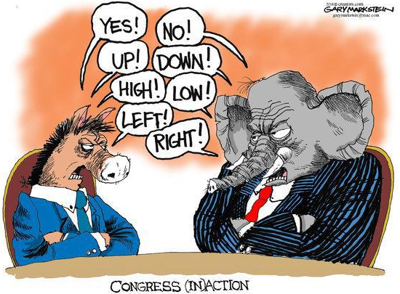

Slide 13
THE CURRENT OPPORTUNITY
DEFINE
Comm
Core
CC Plus
GOALS
MEASURE
DESIGN
NGL Schools
METHODS
IMPLEMENT
ENABLE
ENVIRONMENTS
SCALE

Slide 14
NGLC new-model “Breakthrough” Schools: Personalized, Student-Centered, Competency-based, Blended, Experiential --
all designed to help students meet a deeper/richer goal-line
16
7
10
Wave IV Launch grantees (23)
Wave IV Planning grantees (25)
Wave IIIa Grantees (19)
Regional Funds for Breakthrough Schools (21 opening FL15)
Regional Funds for Breakthrough Schools (43 opening FL16)

Slide 15
THE CURRENT OPPORTUNITY
DEFINE
Comm
Core
CC Plus
GOALS
Constia tests
NGL assessmt
MEASURE
NGL Schools
NGL Ntwks
Research-based
Practice
DESIGN
A rich, productive period of RD&D: exploring, learning, refining
METHODS
IMPLEMENT
Tech tools
ENABLE
NGL acctblity
Res-bsd Supprt
ENVIRONMENTS
ESEA Reauth
SCALE

Slide 16
Making Sense of the “Learning” Labels
STRETCHING PATH AND PACE
QIII
QIV
COMPETENCY-BASED
PERSONALIZED
STUDENT-CENTERED
NEXT GENERATION
BLENDED (DISRUPTIVE)
INDIVIDUALIZED
STRETCHING TIME AND PLACE
DEGREE OF INDIVIDUALIZATION
QI
QII
COHORT-BASED
TRADITIONAL
DIGITAL
ONLINE
BLENDED (SUSTAINING)
LITTLE
EXTENSIVE
TRANSFORMING
USE OF DIGITAL LEARNING STRATEGIES

Slide 17
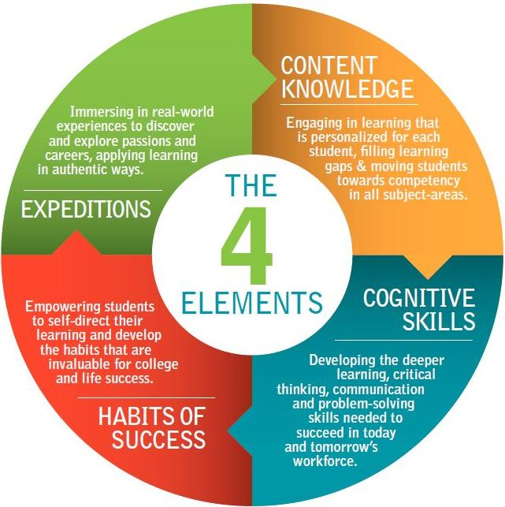
Implications for HigherEd
Preparation variables
1. Better preparation
2. More credit
3. More productive mindsets

Slide 18
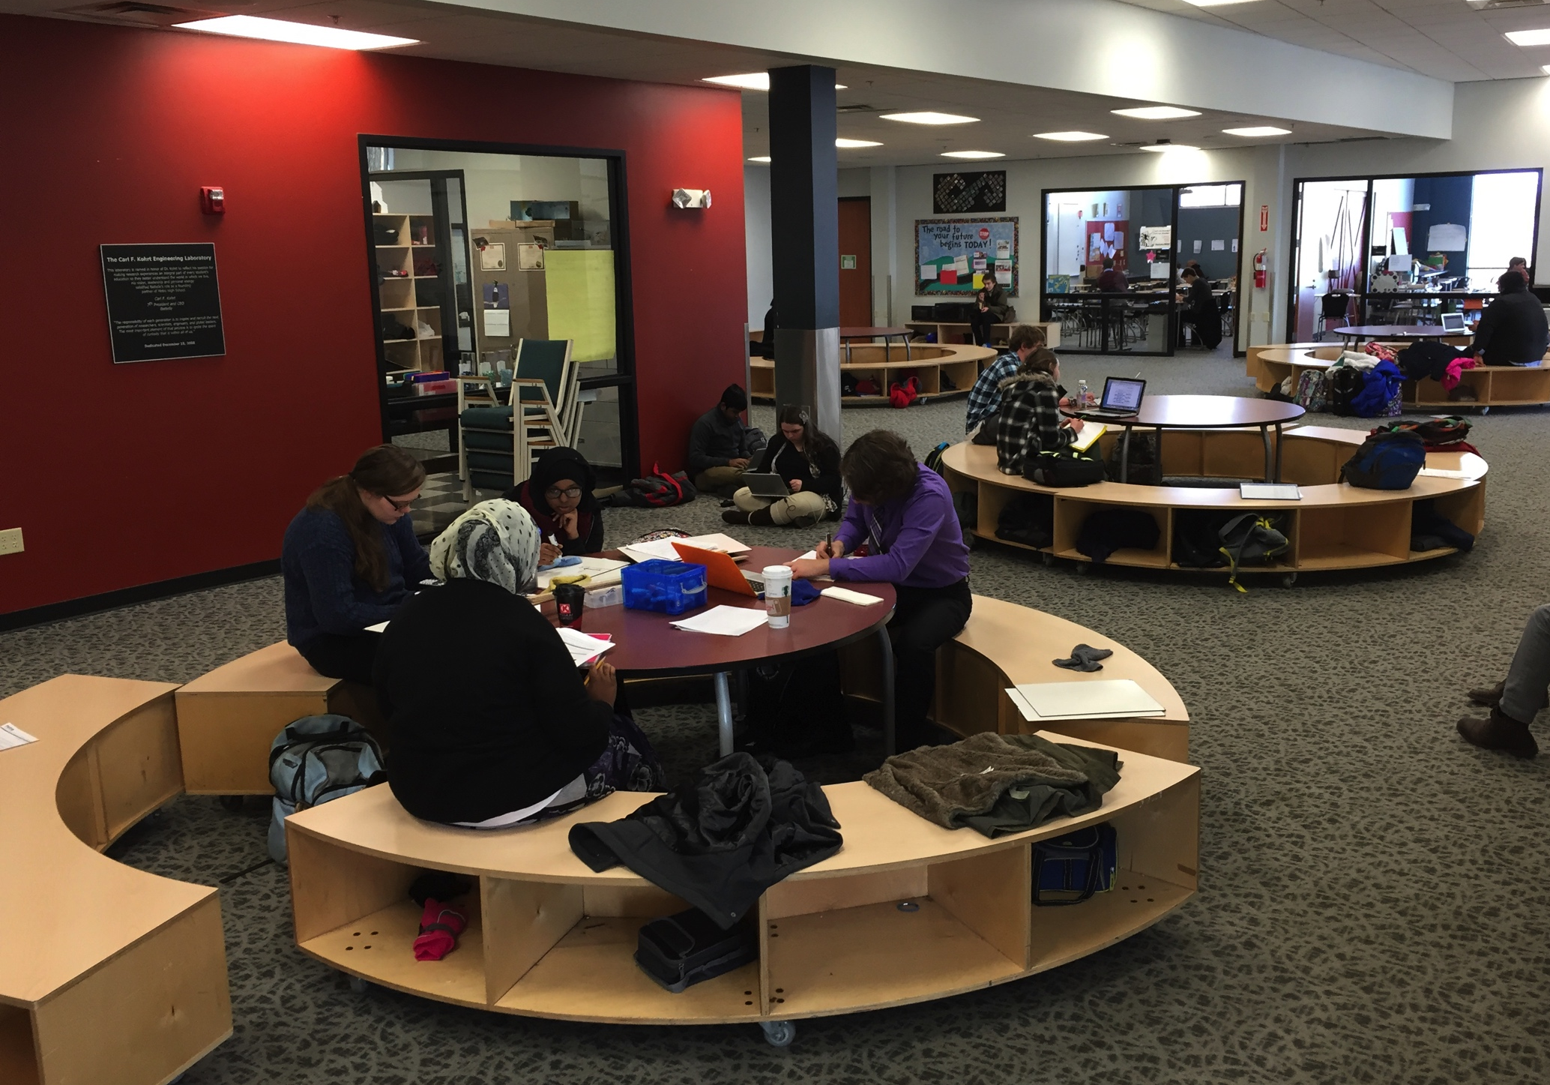
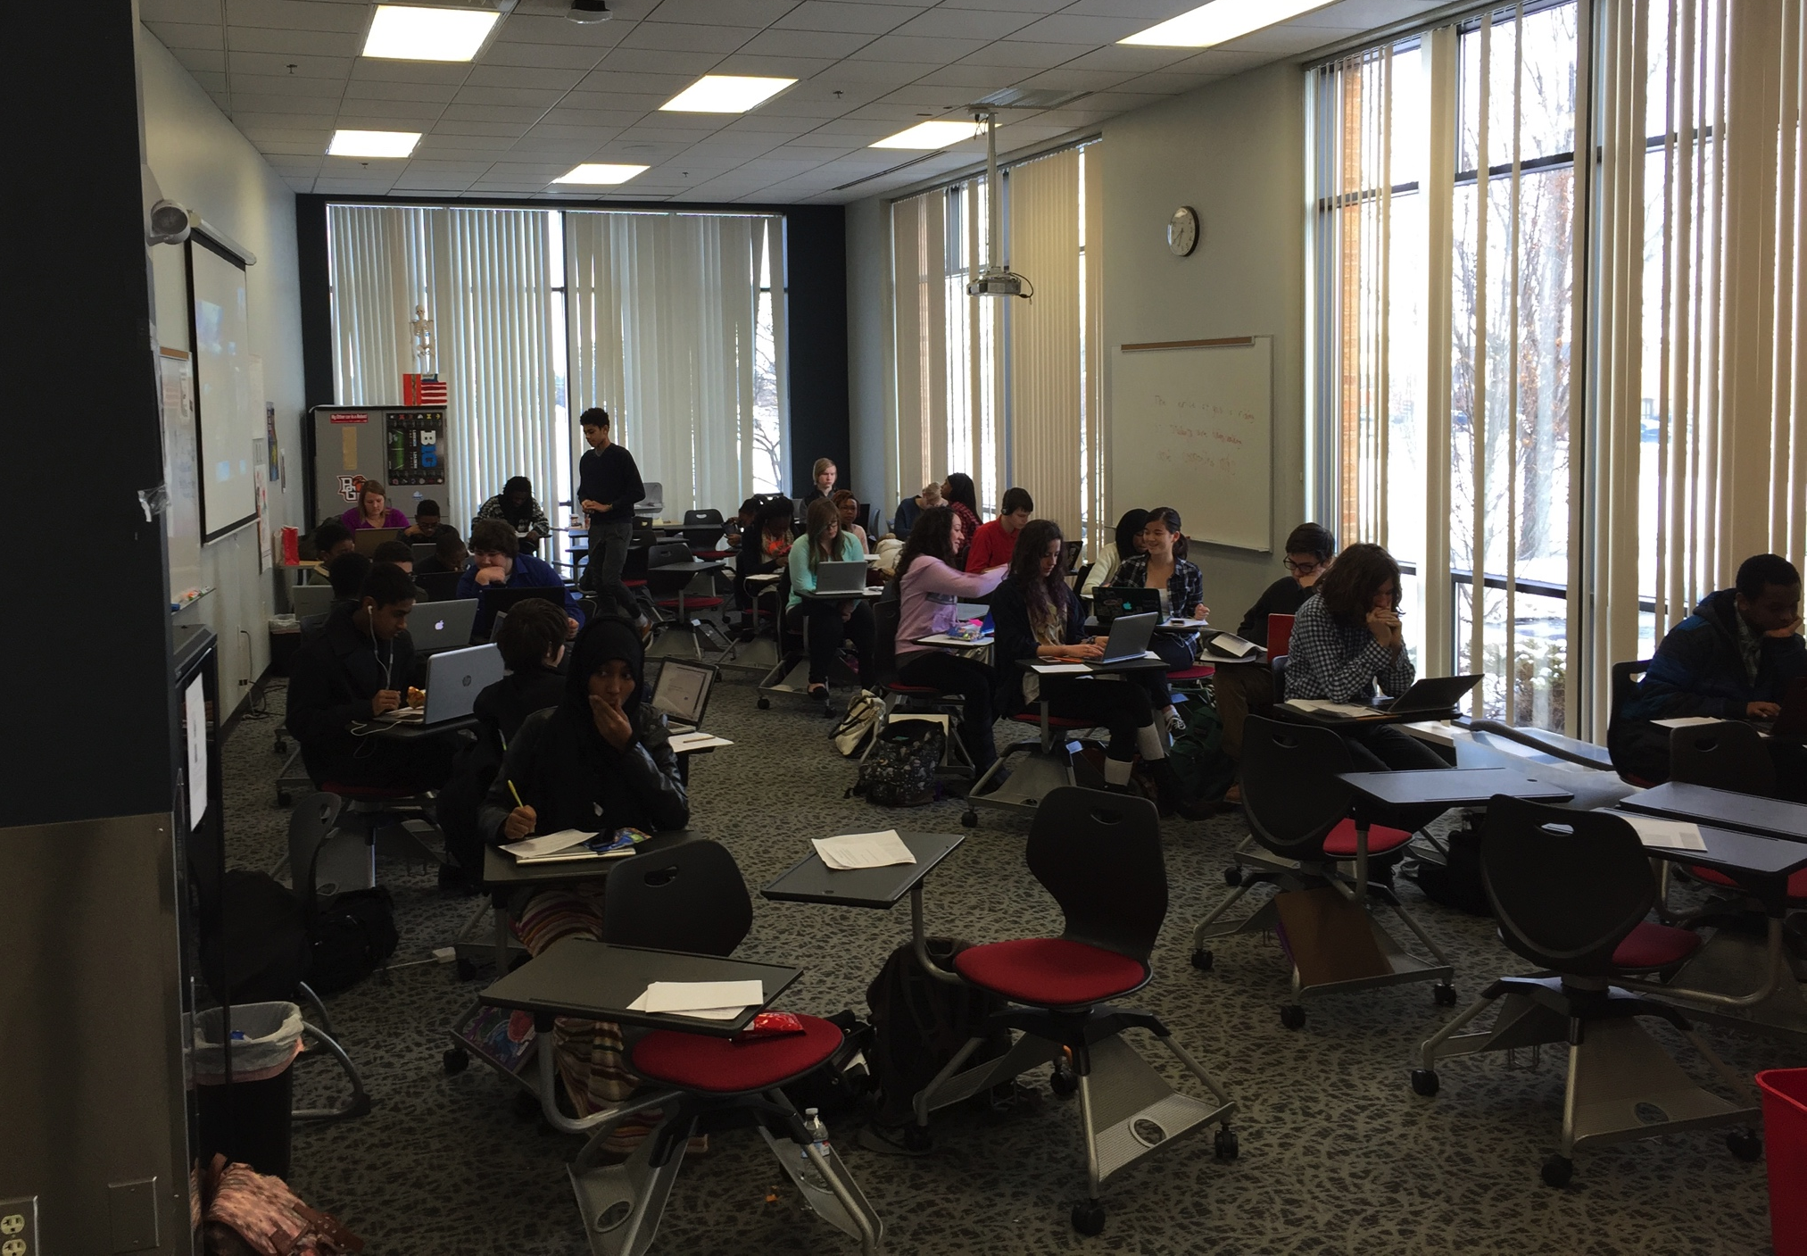
STEM Early College @ OSU
Metro ECHS, Columbus

Slide 19
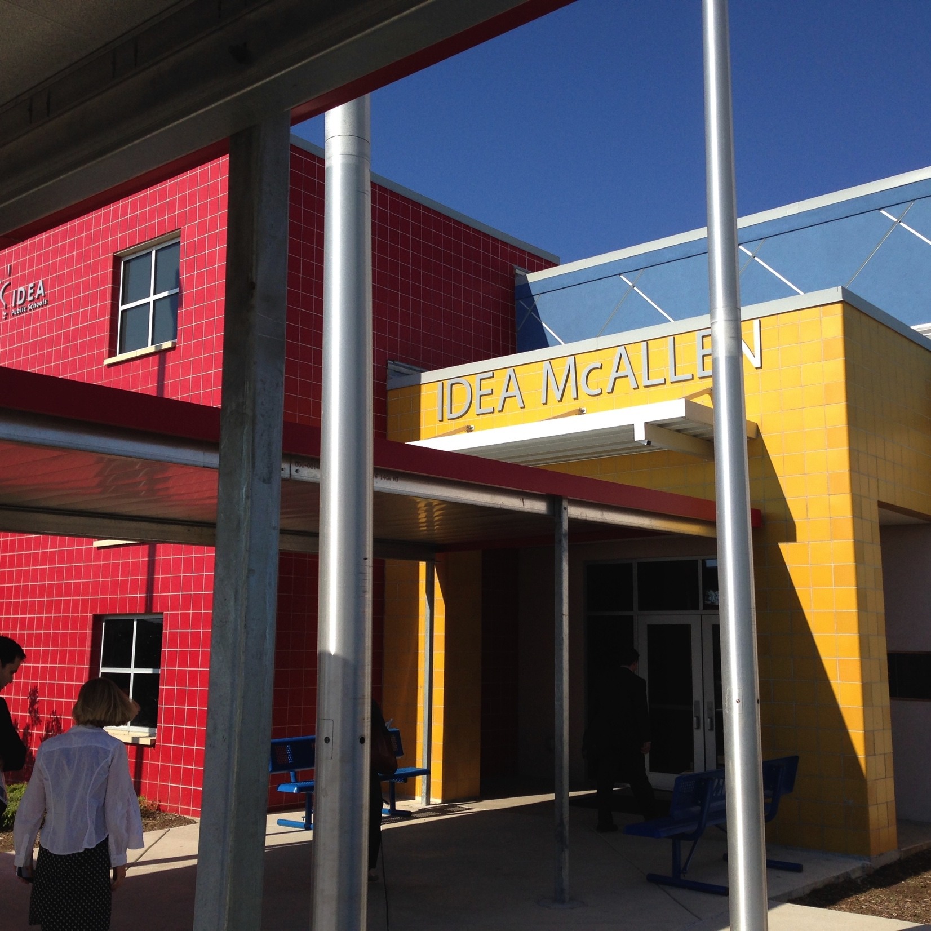
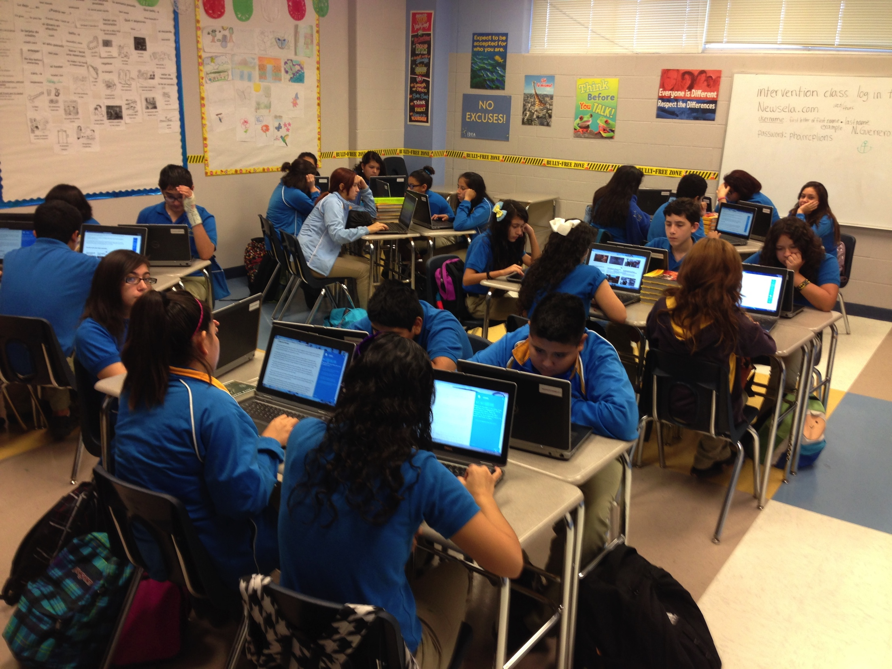
IB & AP for English Language Learners
IDEA Public Schools, TX; all grads go to 4 year colleges

Slide 20
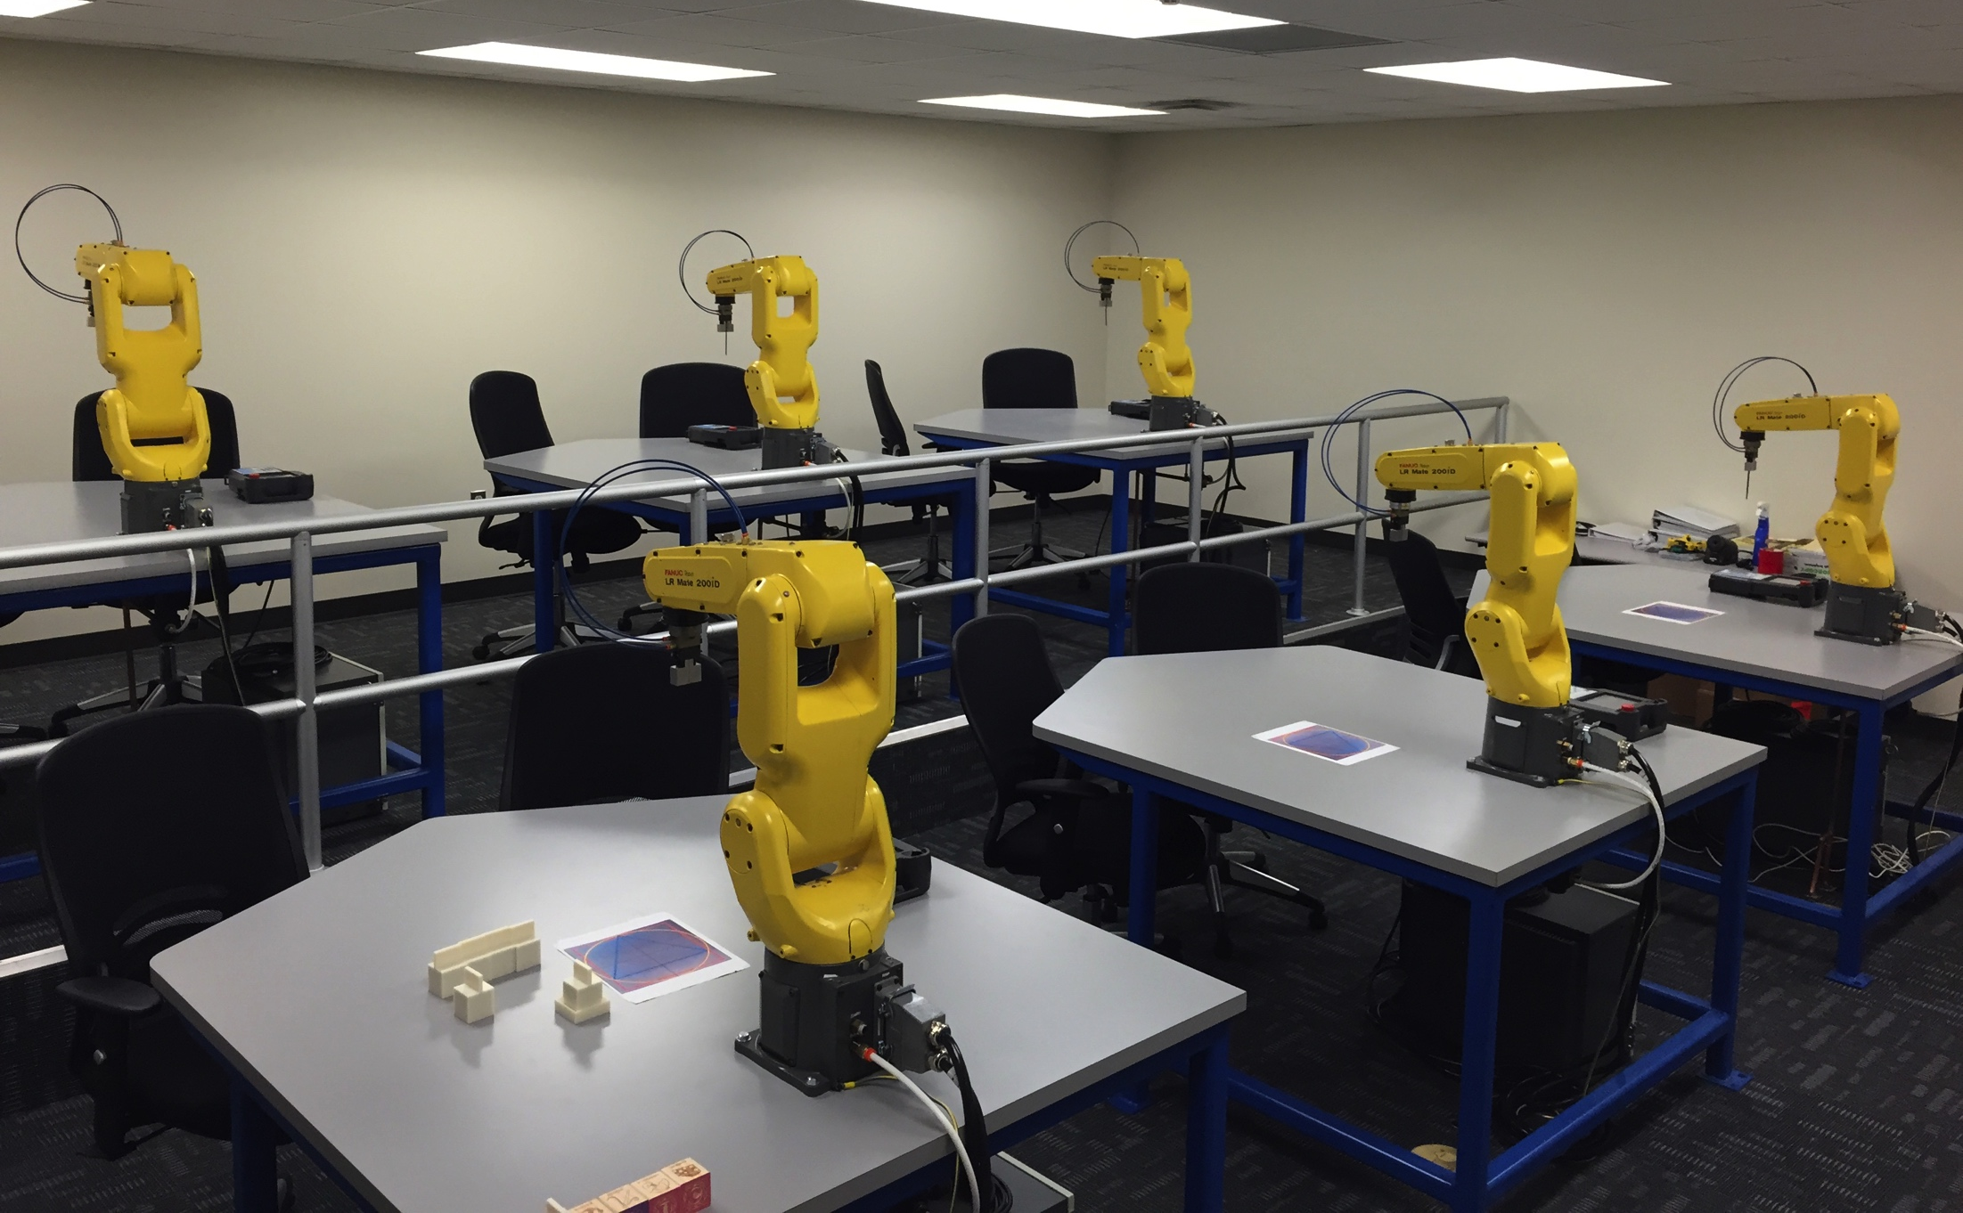
Career Center Robotics
RAMTEC, Marion OH

Slide 21
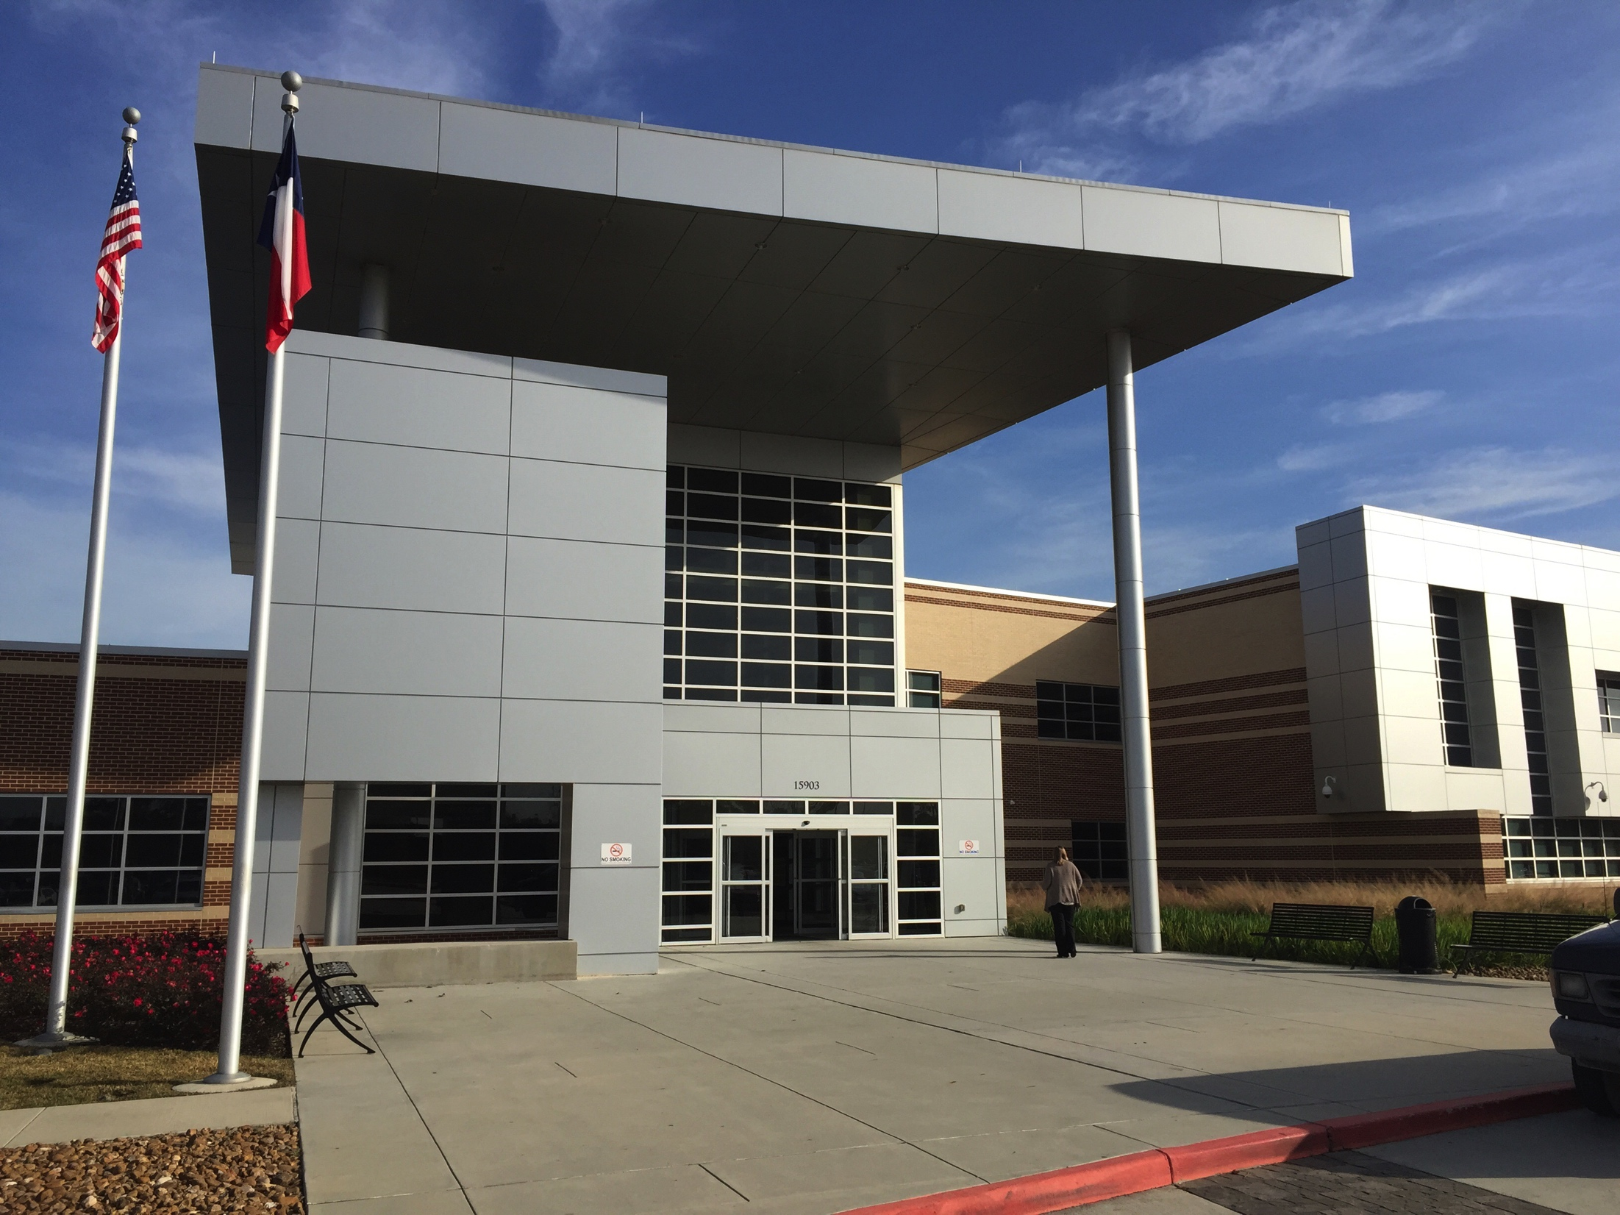
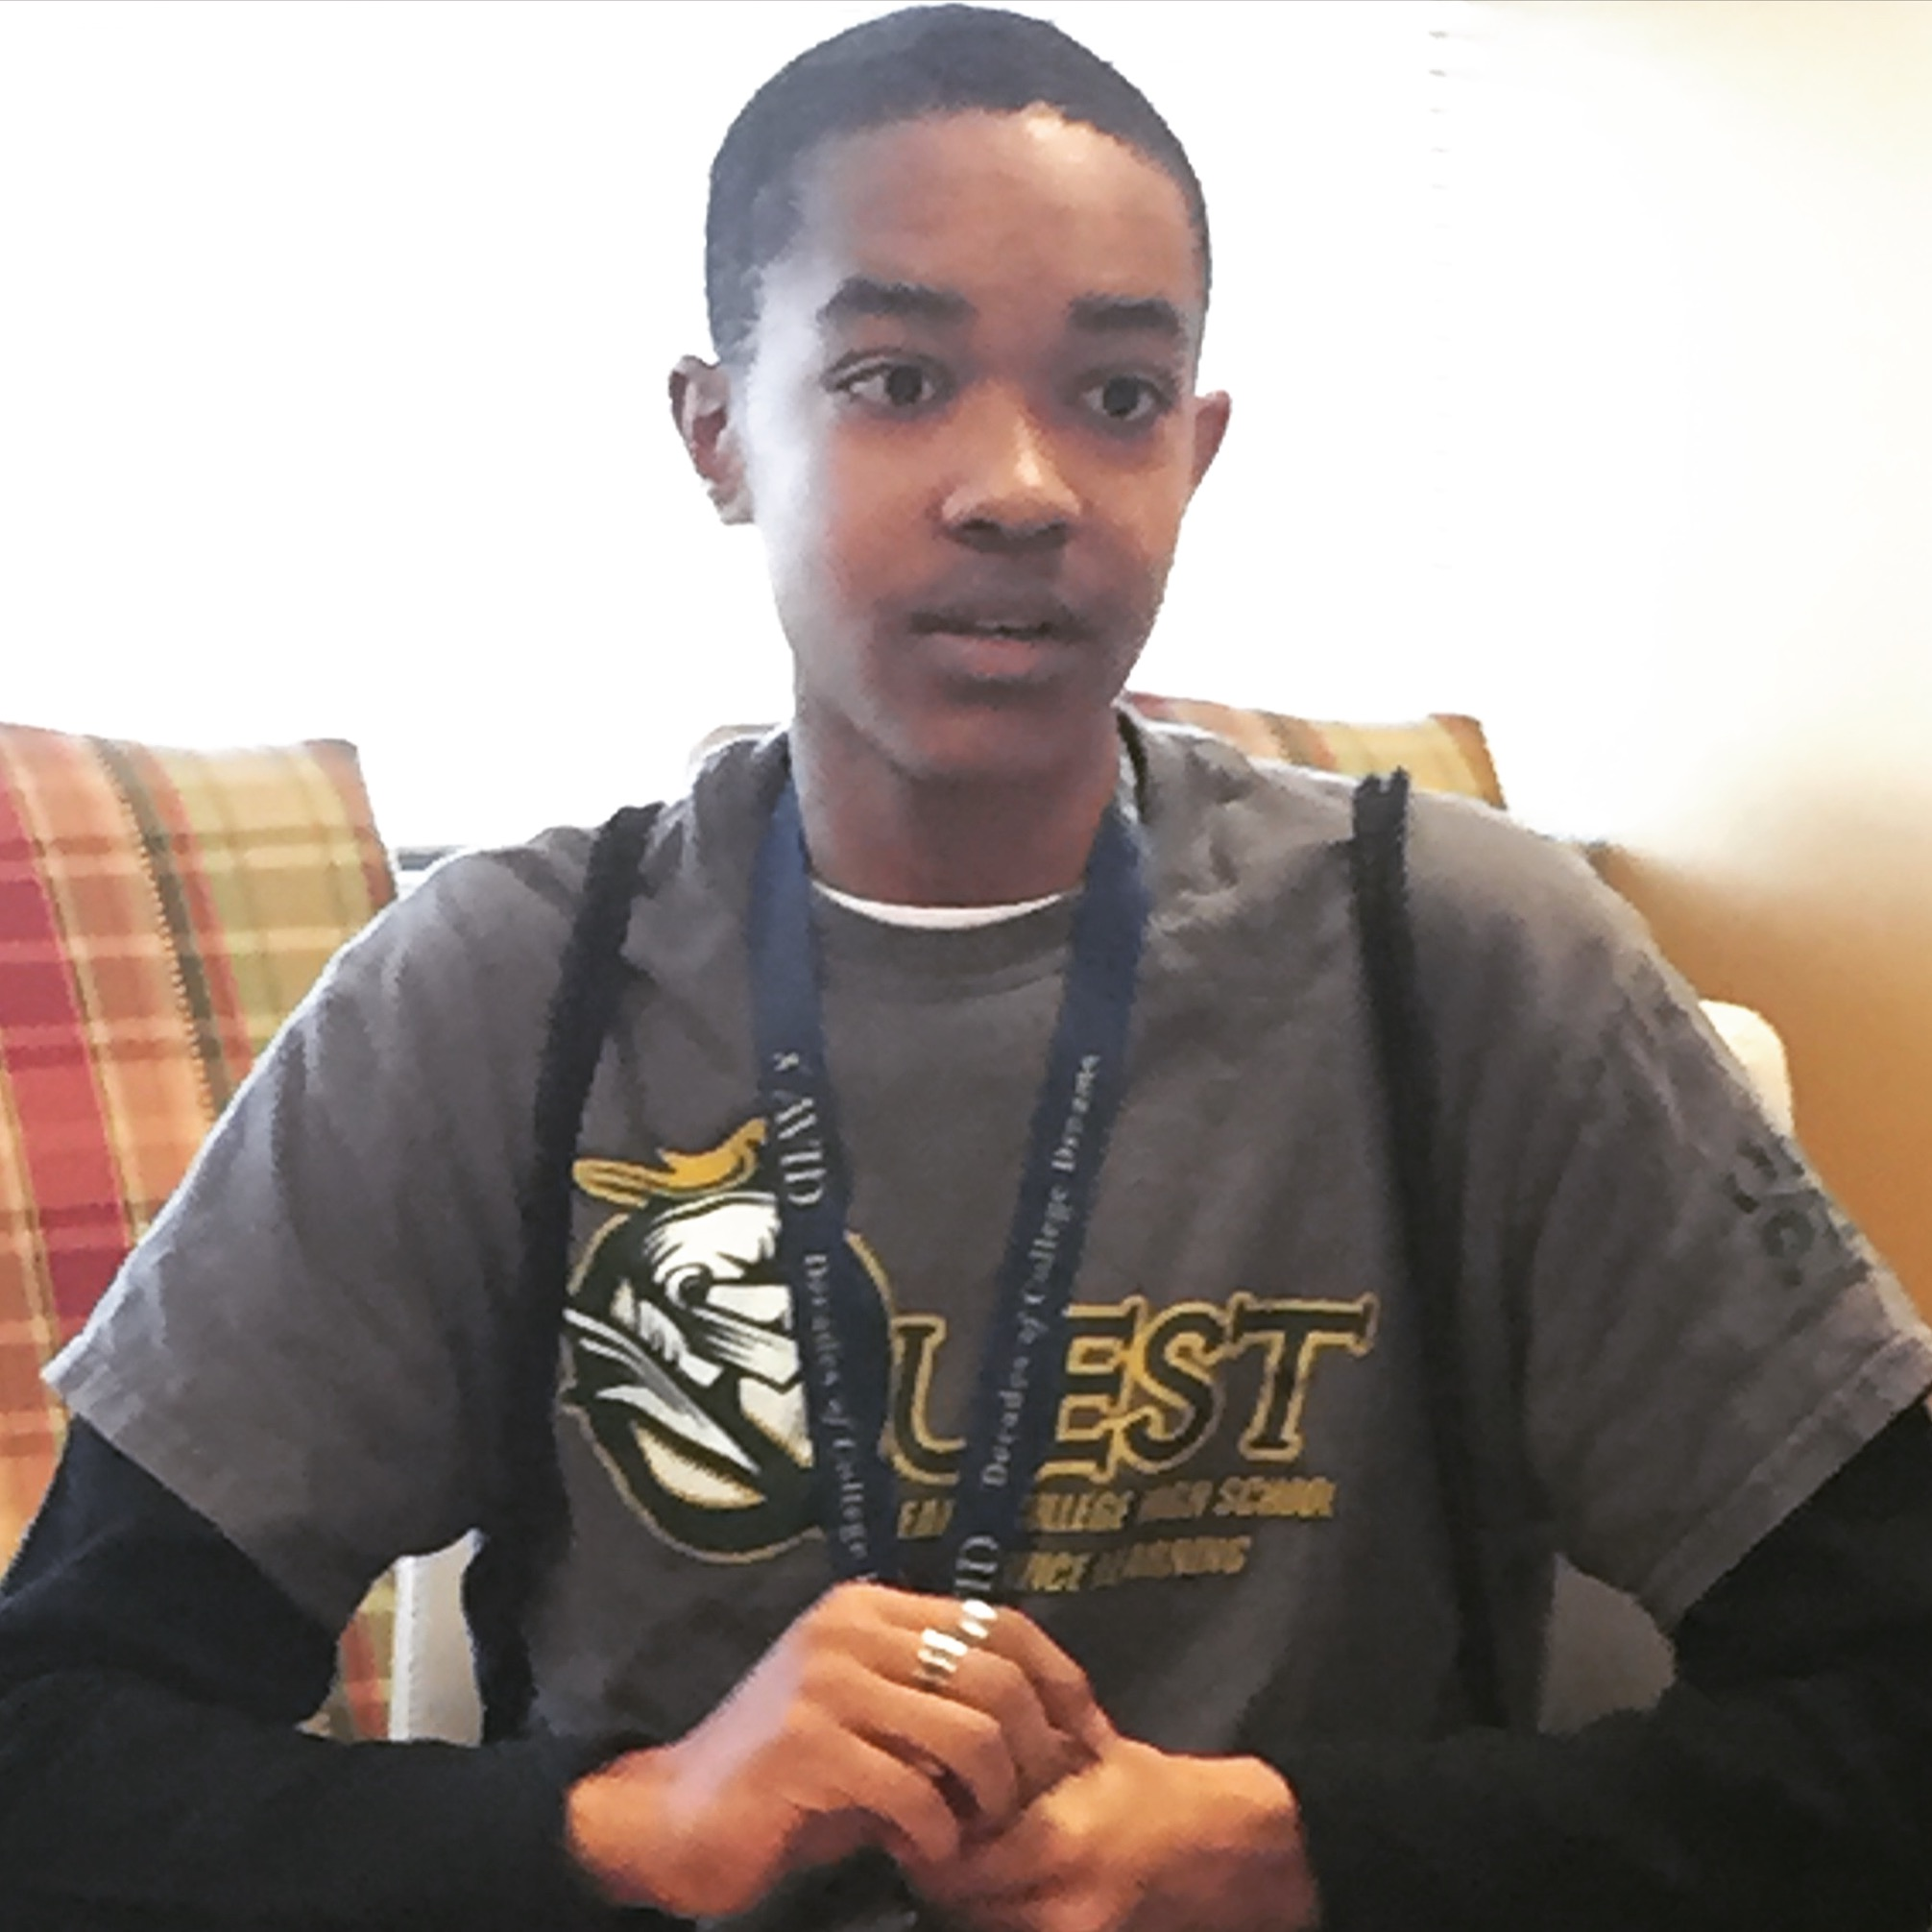
Service Learning Early College
80% of first generation students leave with an AA from Quest ECHS, Humble ISD

Slide 22
Implications for HigherEd
Consumer variables
4. Better employability
5. Better learner experience
6. More competency-based education
7. More unbundling/rebundling

Slide 23
Notes:
Students at e3 Civic High. The space was designed specifically for a personalized learning school.

Slide 25
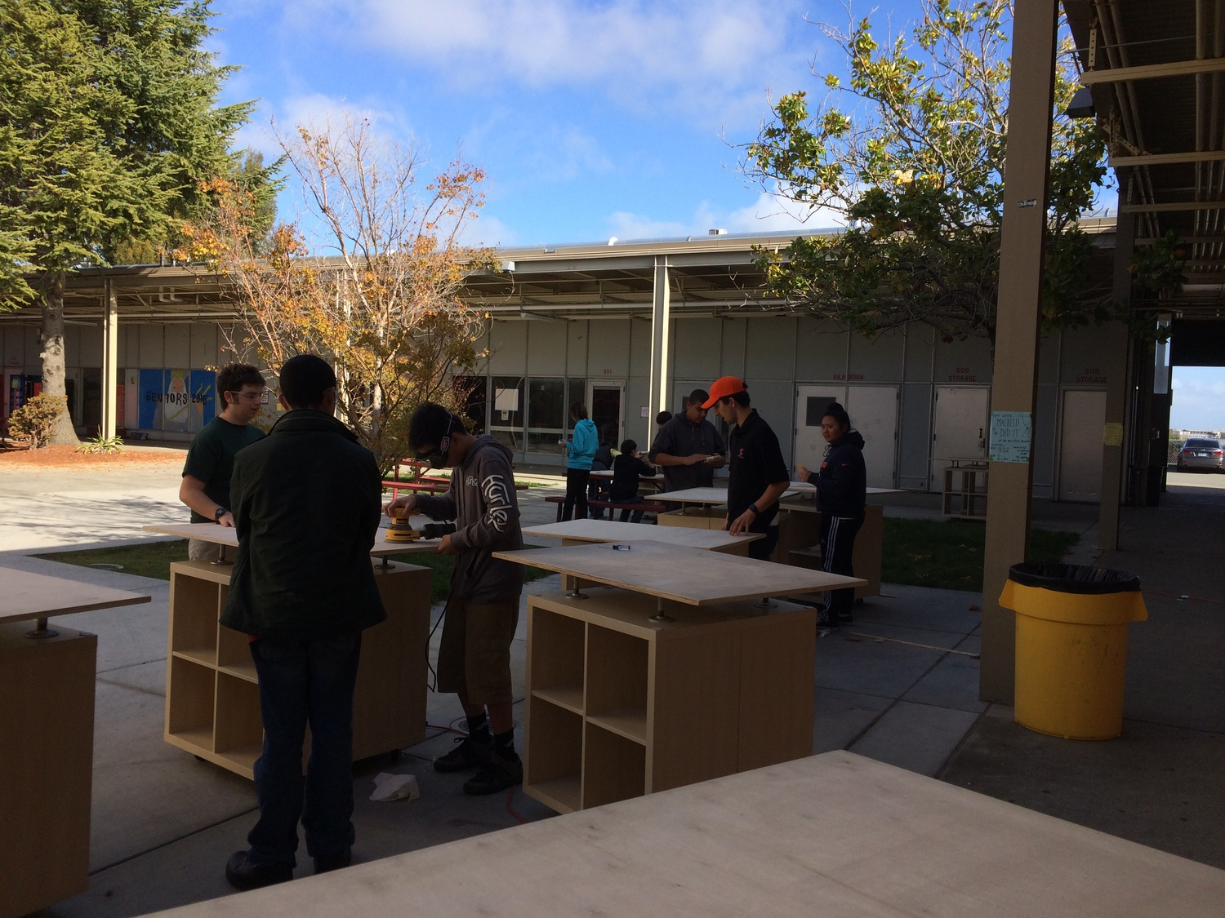

Slide 28
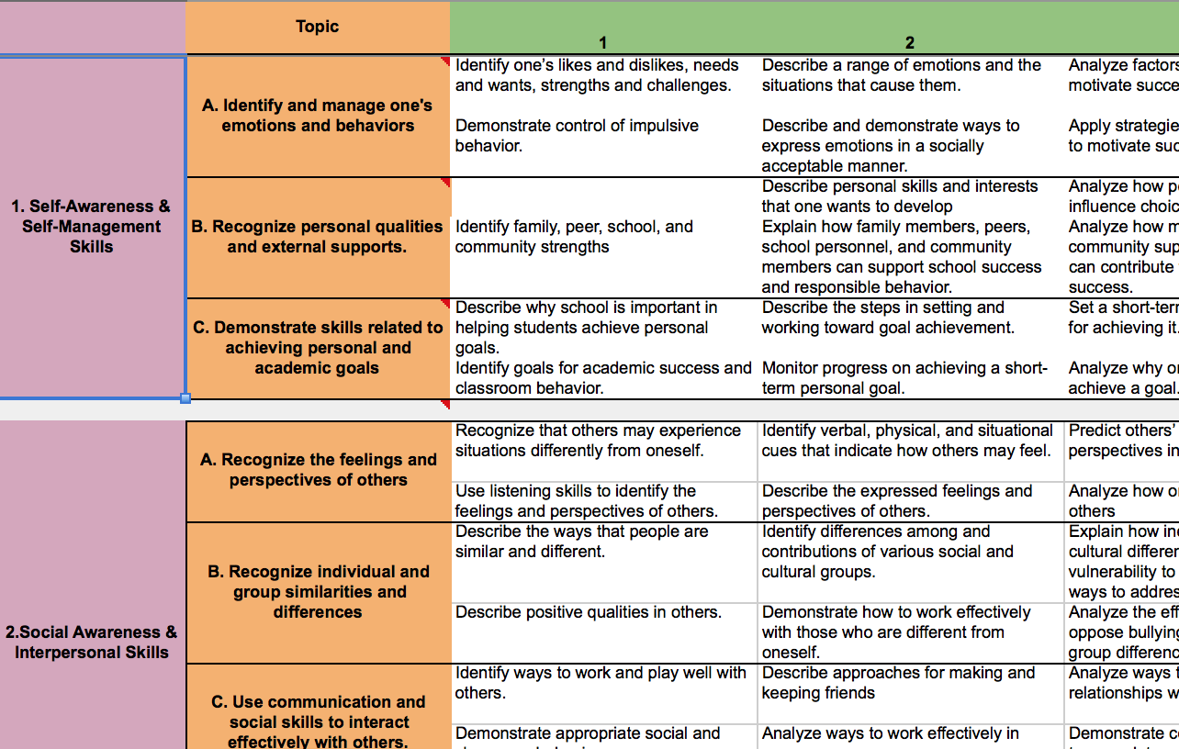
Summit’s Habits of Success Continuum

Slide 29
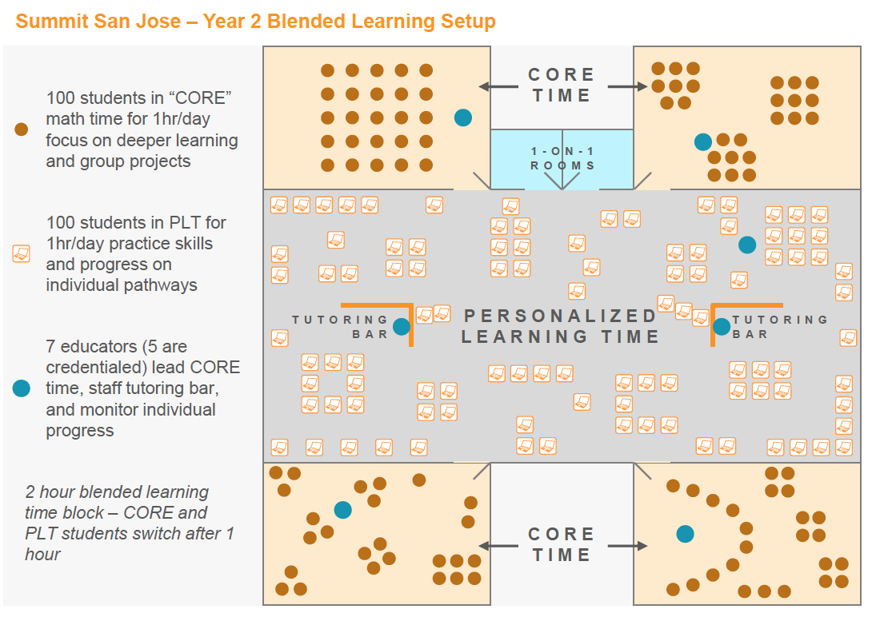
Design for Summit’s NGL Environment

Slide 33
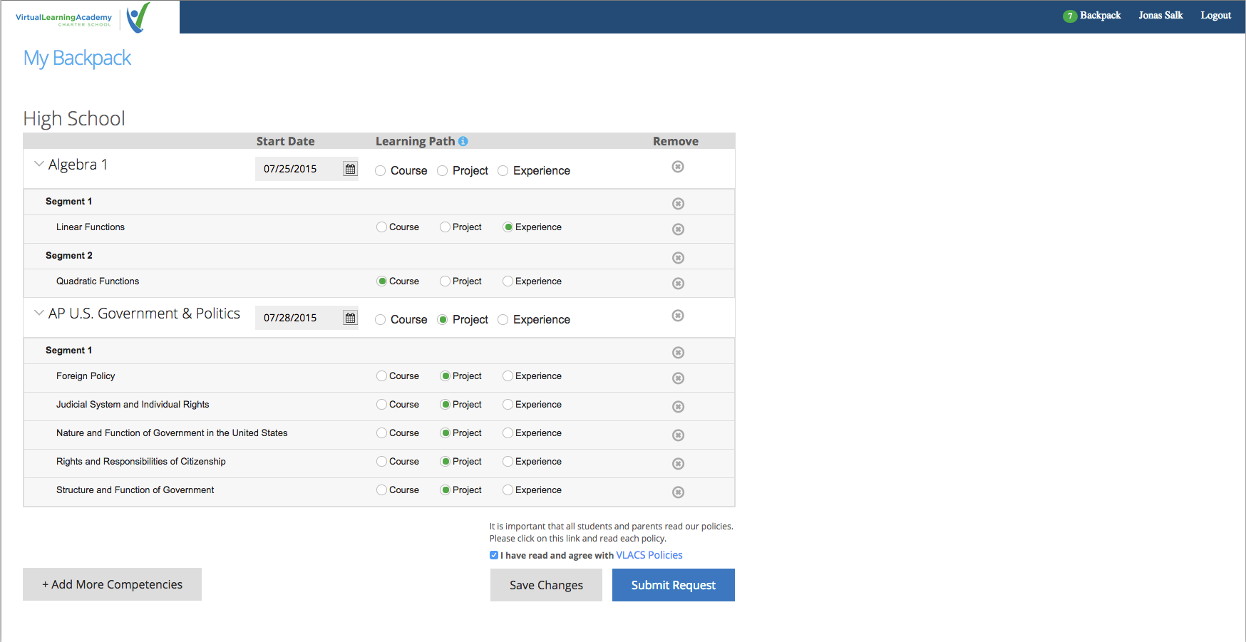

Slide 34
5 “Critical Elements” of mBolden Piedmont (Piedmont, AL)
1 Advanced Mastery
2 Relevance
3 Student Ownership
Goal Time
Class Time
My Time
Blended Learning
Community Partnerships
Piedmont City School District
34

Slide 35
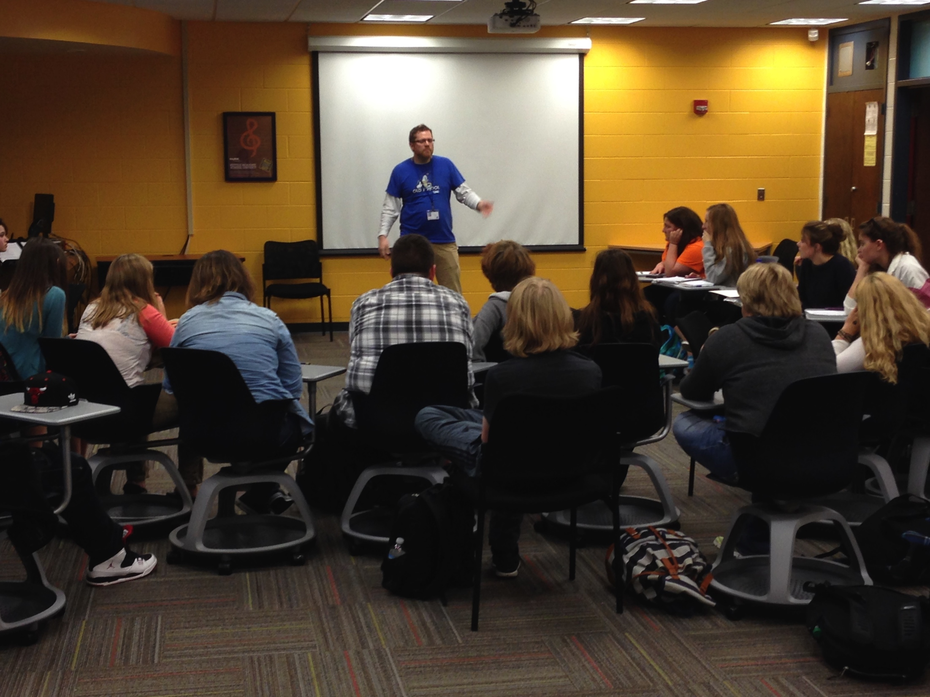
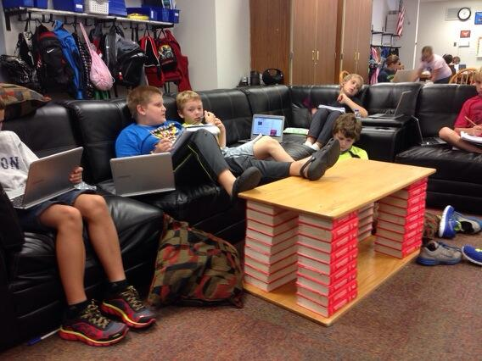
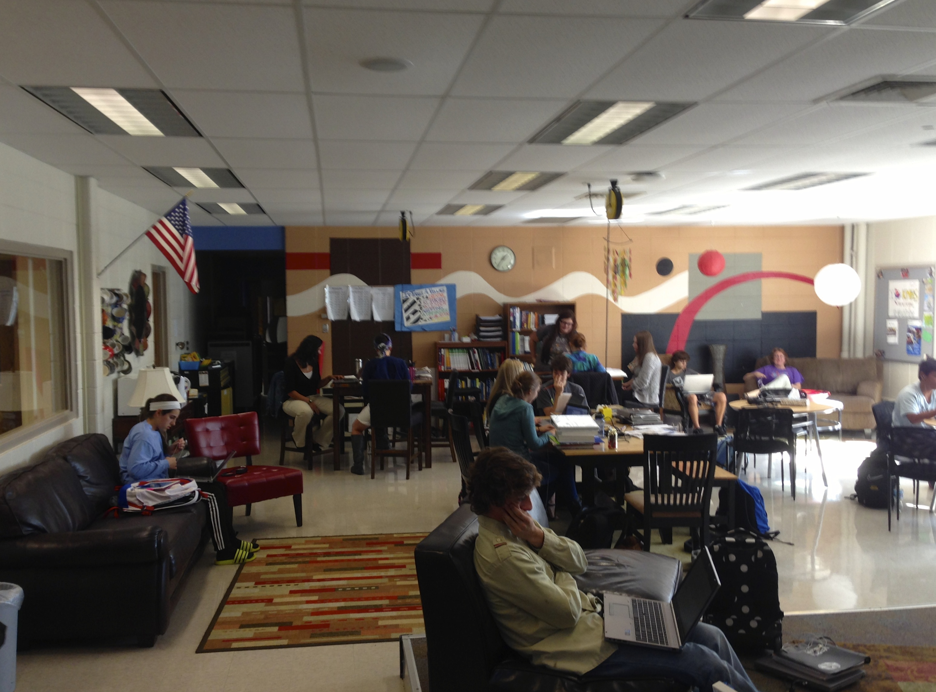
Tiny Flex Schools Reward Leadership, Mitigate Risk
Kettle Moraine, WI

Slide 36
Implications for HigherEd
Infrastructure variables
8. Blended staffing
9. Mobile imperative
10. Integrating LX & IT
LX
-Instructional model
-School model
-Structure
-Schedule
-Staffing
IT
-Access device
-Learning mngt
-Feedback
-Data mngt
-Student Information
-Business systems

Slide 37
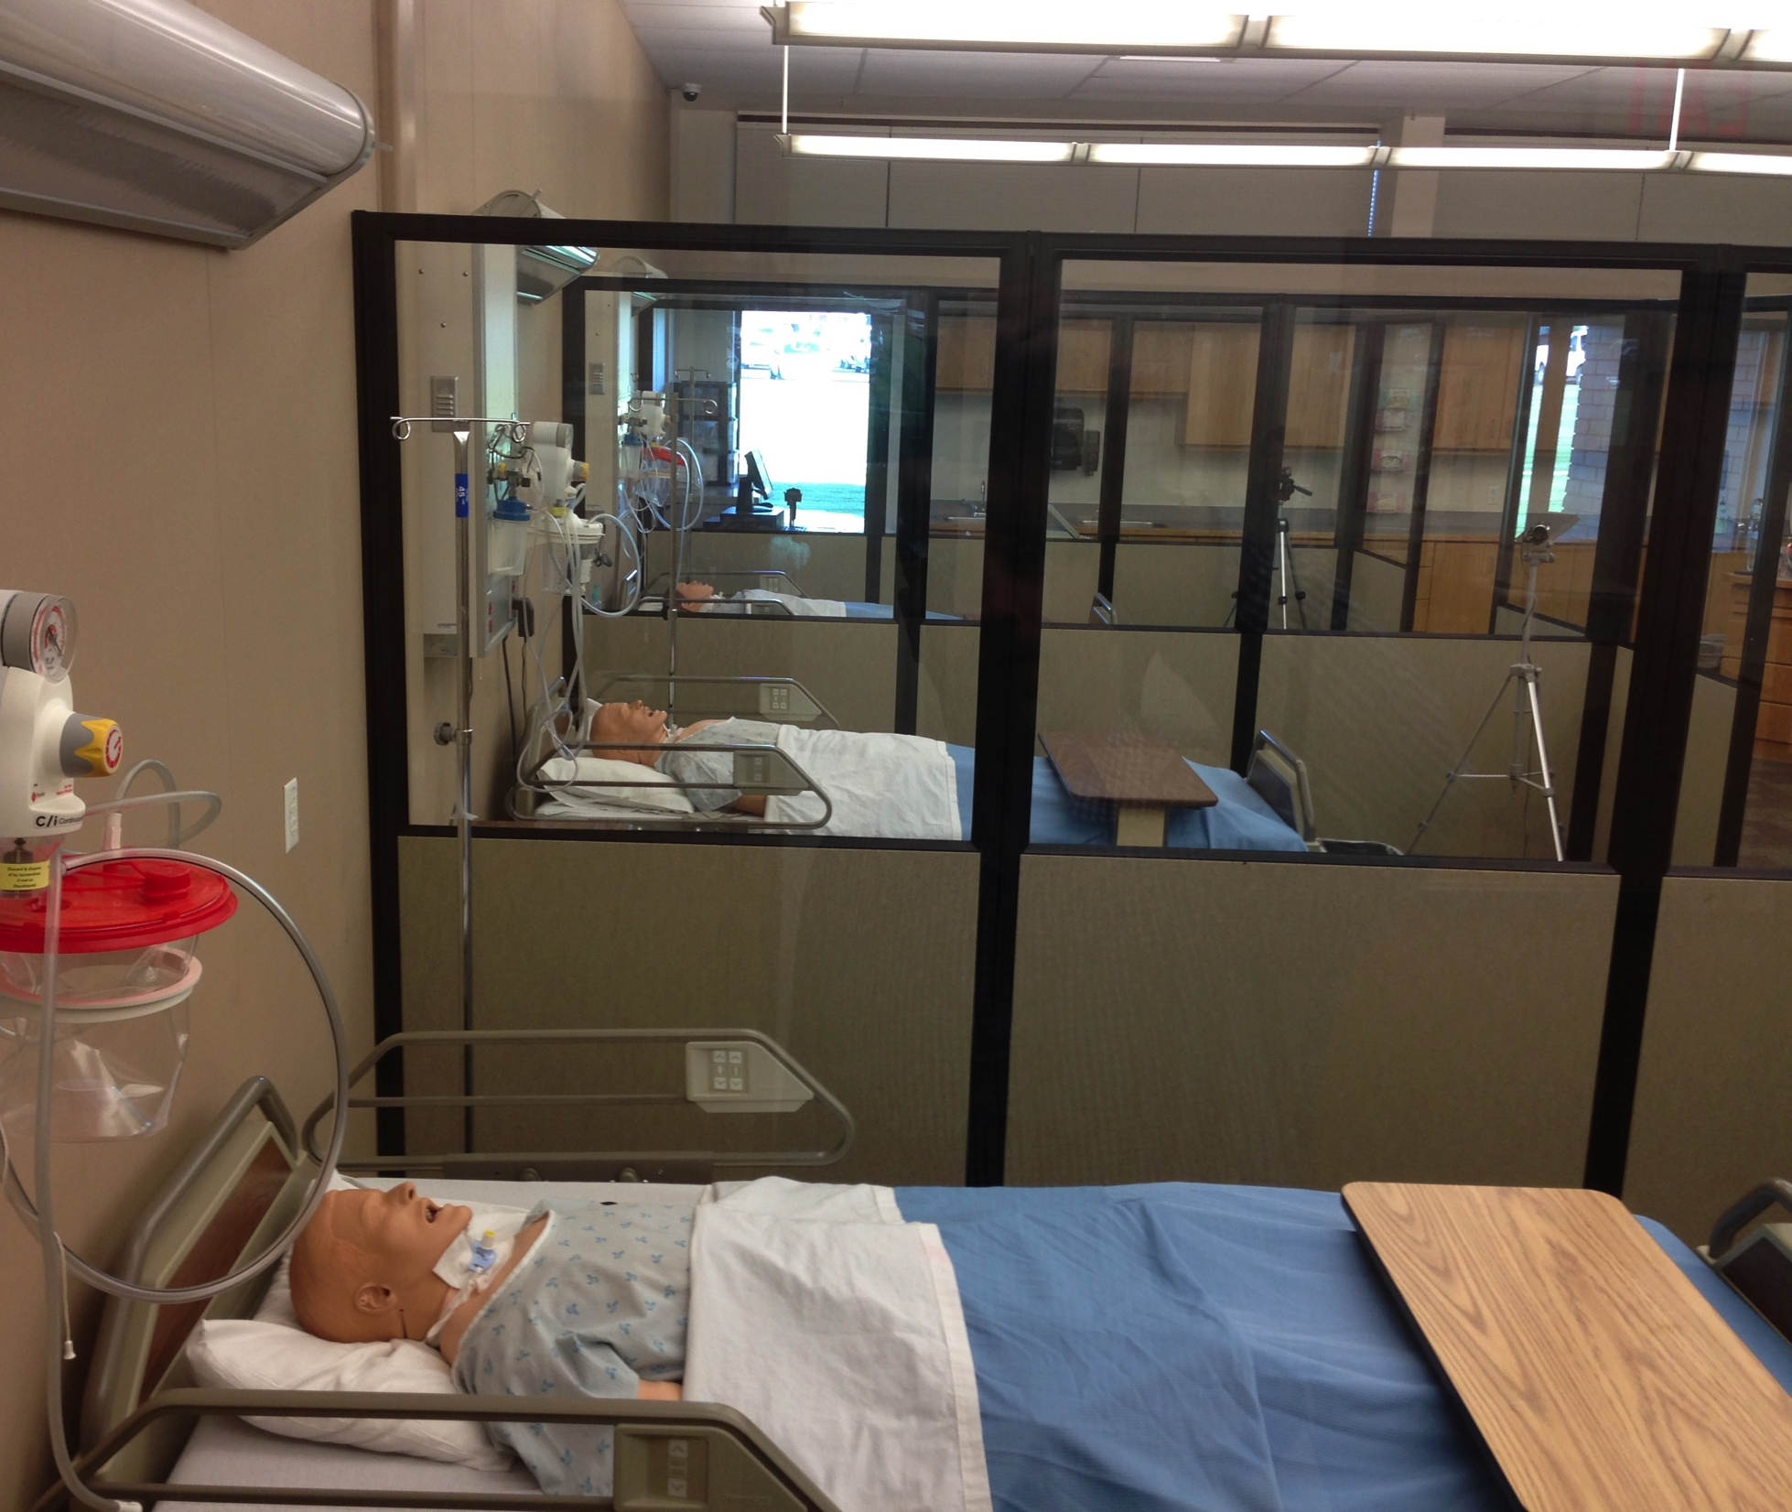
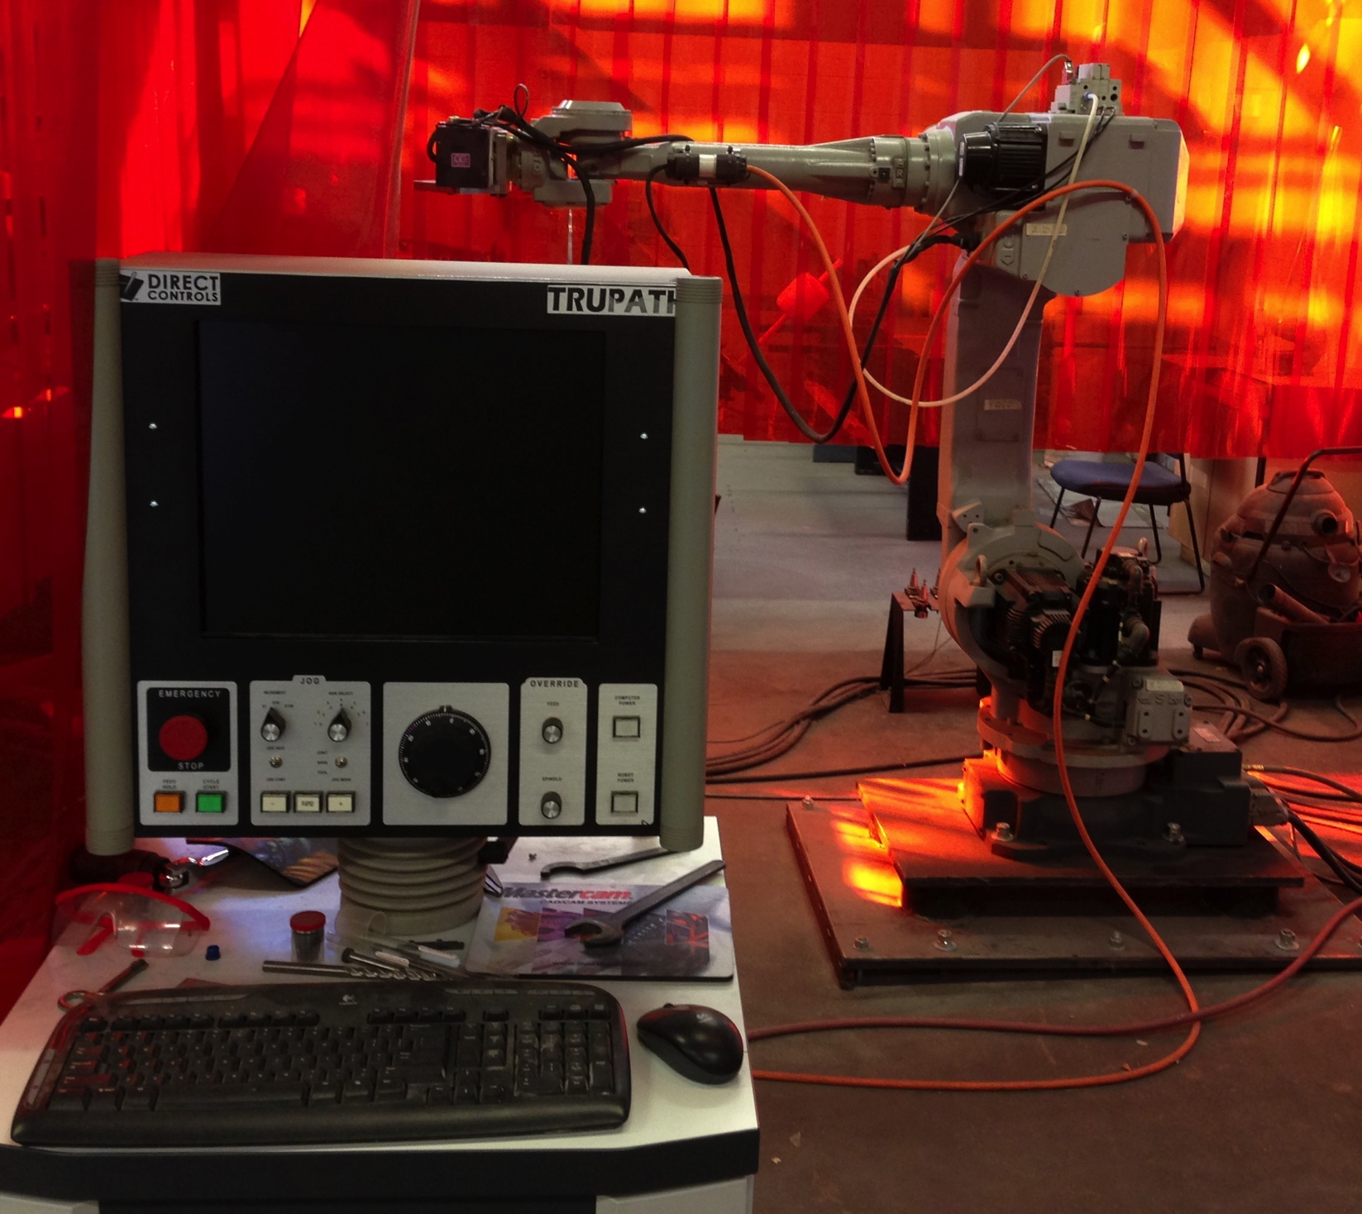
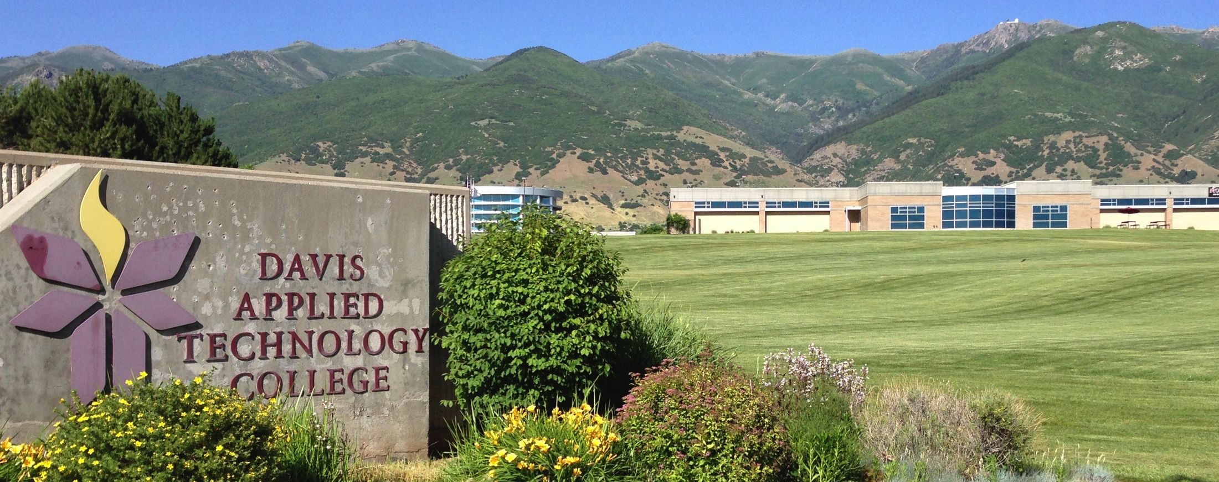
Early College Career Flex
Career Path High, Salt Lake City UT

Slide 38
As featured in Most Likely to Succeed

Slide 39
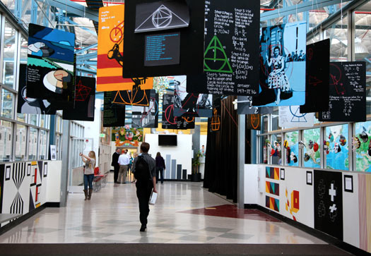

Slide 40
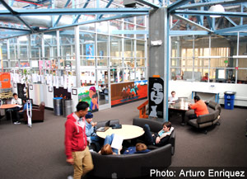
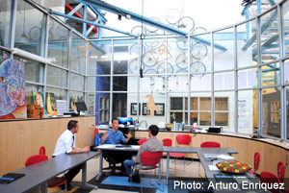

Slide 42
Results for High Tech High since 2000
98% of HTH's graduates have gone on to college, with approximately 75% attending four-year programs
86% of High Tech graduates are either still in or have graduated from college (the national rate is about 59%).
About 35% of HTH graduates are first-generation college students.
Over 30% of HTH alumni enter math or science fields (vs. 17% national rate).
HTH’s African-American students outperform district and statewide peers by a wide margin vis-à-vis test scores, percentage who take chemistry, physics, and advanced math (100%), and college entry (100%).

Slide 43
Reimagined Schools and Next-Gen Tools: What They Mean for Higher Education
Andy Calkins: acalkins@educause.edu @andrewcalkins www.nextgenlearning.org
Tom Vander Ark: tom@gettingsmart.com @tvanderark www.gettingsmart.com

Slide 44
Appendix

Slide 45
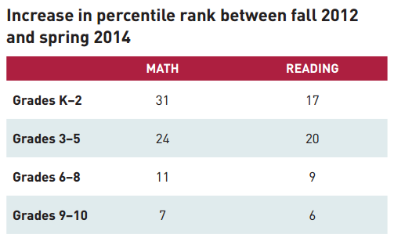
Personalized Learning Is Promising
“Students are making significantly greater gains in math and reading over the last two years than a virtual control group made up of similar students at comparable schools.”
Source: Early Progress on Personalized Learning – Executive Summary
Notes:
The RAND Study—Early Progress on Personalized Learning—found relatively large positive effects in both math and reading.
--2/3 of the 23 schools had statistically significant positive effects.
--across all 23 schools, effect size for math was 0.41; effect size for reading was 0.29. “An effect size of 0.41 is equivalent to moving a student from the 50th percentile to the 66th percentile.
--the 2-yr gains (show in the chart on this slide) show greater gains in the lower grades, but positive effects were ‘statistically significant’ at all grade levels.
DETAILS ABOUT THE STUDY:
RAND study of 23 Personalized Learning Schools funded directly or indirectly by the Gates Foundation (NGLC Breakthrough Schools, Charter School Growth Fund’s Next Gen School Investments, and Gates’ Personalized Learning Pilots).
They are urban schools serving students of color (86%) and low-income students (87% are eligible for free or reduced price meals)
Schools implemented personalized learning at least 2 years and had assessment data covering the 2-yr period.
2 years of data on 5,000 students—these are interim findings—a report next year will include 3 years of data, more schools, and may be able to determine the impact of personalized learning practices on outcomes
RAND collected data on:
MAP assessments in math and reading (with a MAP-provided virtual comparison group of similar students at similar schools with similar starting scores)
10-day teacher logs
Teacher and student surveys
Administrator interviews

Slide 46
Catching Up to National Averages in Math
Source: Early Progress on Personalized Learning – Full Report, p. 17
Notes:
“Students generally ended the school year with both math and reading test scores above or near the national average, after having started the school year generally performing below the national average.” (from Early Progress on Personalized Learning)
This may be an indicator that the schools are closing income and racial achievement gaps, since they’ are urban schools serving predominantly students of color (86%) and predominantly low-income students (87%).
The only exception was high school math—although scores improved, they were still below the national average at the end of 2 years.
The gains in the lower grades—earlier on in students’ academic careers—are much greater than in the upper grades, both in actual improvements of scores and in relation to national averages.

Slide 47
Catching Up to National Averages in Reading
Source: Early Progress on Personalized Learning – Full Report, p. 17
Notes:
See notes on previous slide

