Slide 1

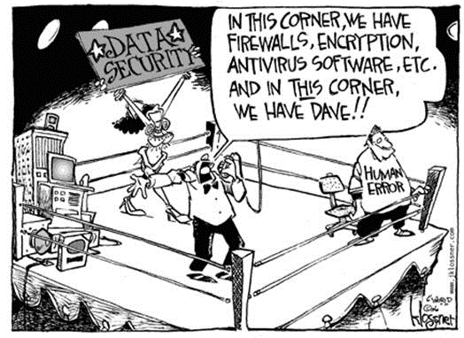
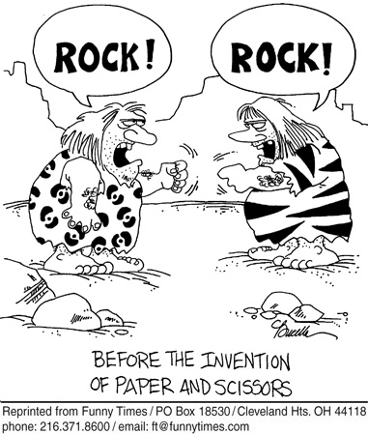
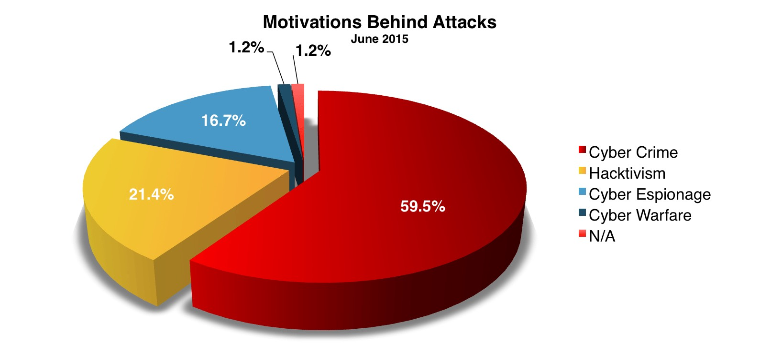
Security Risk Profiles – Tips and Tricks
William Perry and Helen Norris
California State University and Chapman University
A Few (in)Famous Cyber Attacks
Tips and Tricks
Tips and Tricks
Information Security – the Seemingly Impossible Mission
It is a complex & demanding role
Skillset must cover related but disparate domains
Decentralized environments
Organizational Culture
Federated Governance Models
Ever increasing cyber threats
The Morris Worm 1988 – Broke the internet
The MafiaBoy DDoS Attack 2000 - $1.2B in damage
Teen hacks NASA 1999 – NASA stopped emails during shuttle launch
LA Radio Station phone lines blocked to win a Porsche – 1995
Estonian govt. networks attacked by Russians? – 2007
Israel’s Internet Infrastructure attacked (Soviets & Hamas)? – 2009
Stuxnet in Iran 2010 – Malware designed to disrupt weapons program
Canadian govt.’s finance agencies attacked 2011
Office of Personnel Management 2015 – Millions of PII records stolen
Assess Security Controls
Do you have a framework? (SANS, ISO27001, NIST)
Policies, standards, and guidelines aligned to framework?
Perform a gap analysis
Prioritize based on a risk assessment (HIPAA, PCI, etc…)
Develop mitigation plan
Implement & test
Gain Insight from Intelligence!
Utilize information sharing services (e.g. MS-ISAC)
Industry research (e.g. Verizon Data Breach)
Penetration tests & compromise assessments
Analyze your organization’s incidents
Log & user access management
Vulnerability & application scanning
Locate your sensitive data
There was a time when sticks and stones were advanced weapons!
Develop your approach to manage threats – blocking & tackling
  Firewalls & Network Access Control (NAC)
  Physically & logically segregated networks
  APT, Signature based & behavioral based malware protection
  Encryption
  Secure application development practices
  Patch management
  Access management & SoD assessment, 2 Factor Authentication
  Incident & business continuity plans
  Data Loss / Leakage Prevention tools
  Application Whitelisting
Biggest Bang for your buck – train users
  Computer based training
  Information security advisory emails
  Articles in organizations newsletter
  Small groups (It’s Just Lunch)
  Phishing education campaign

