Slide 1
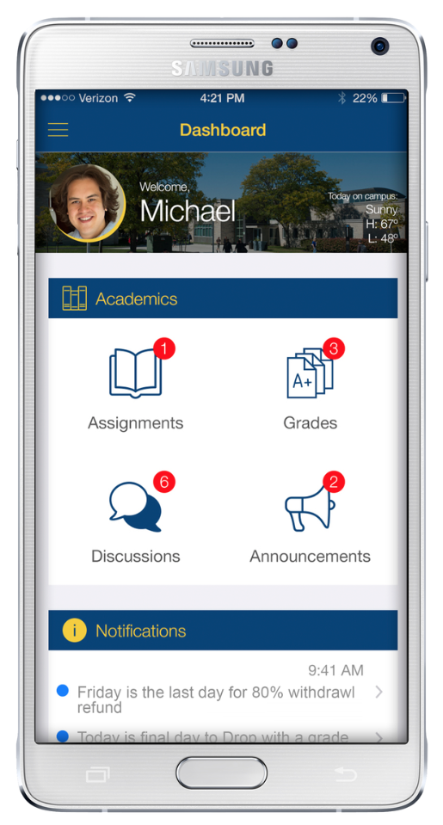
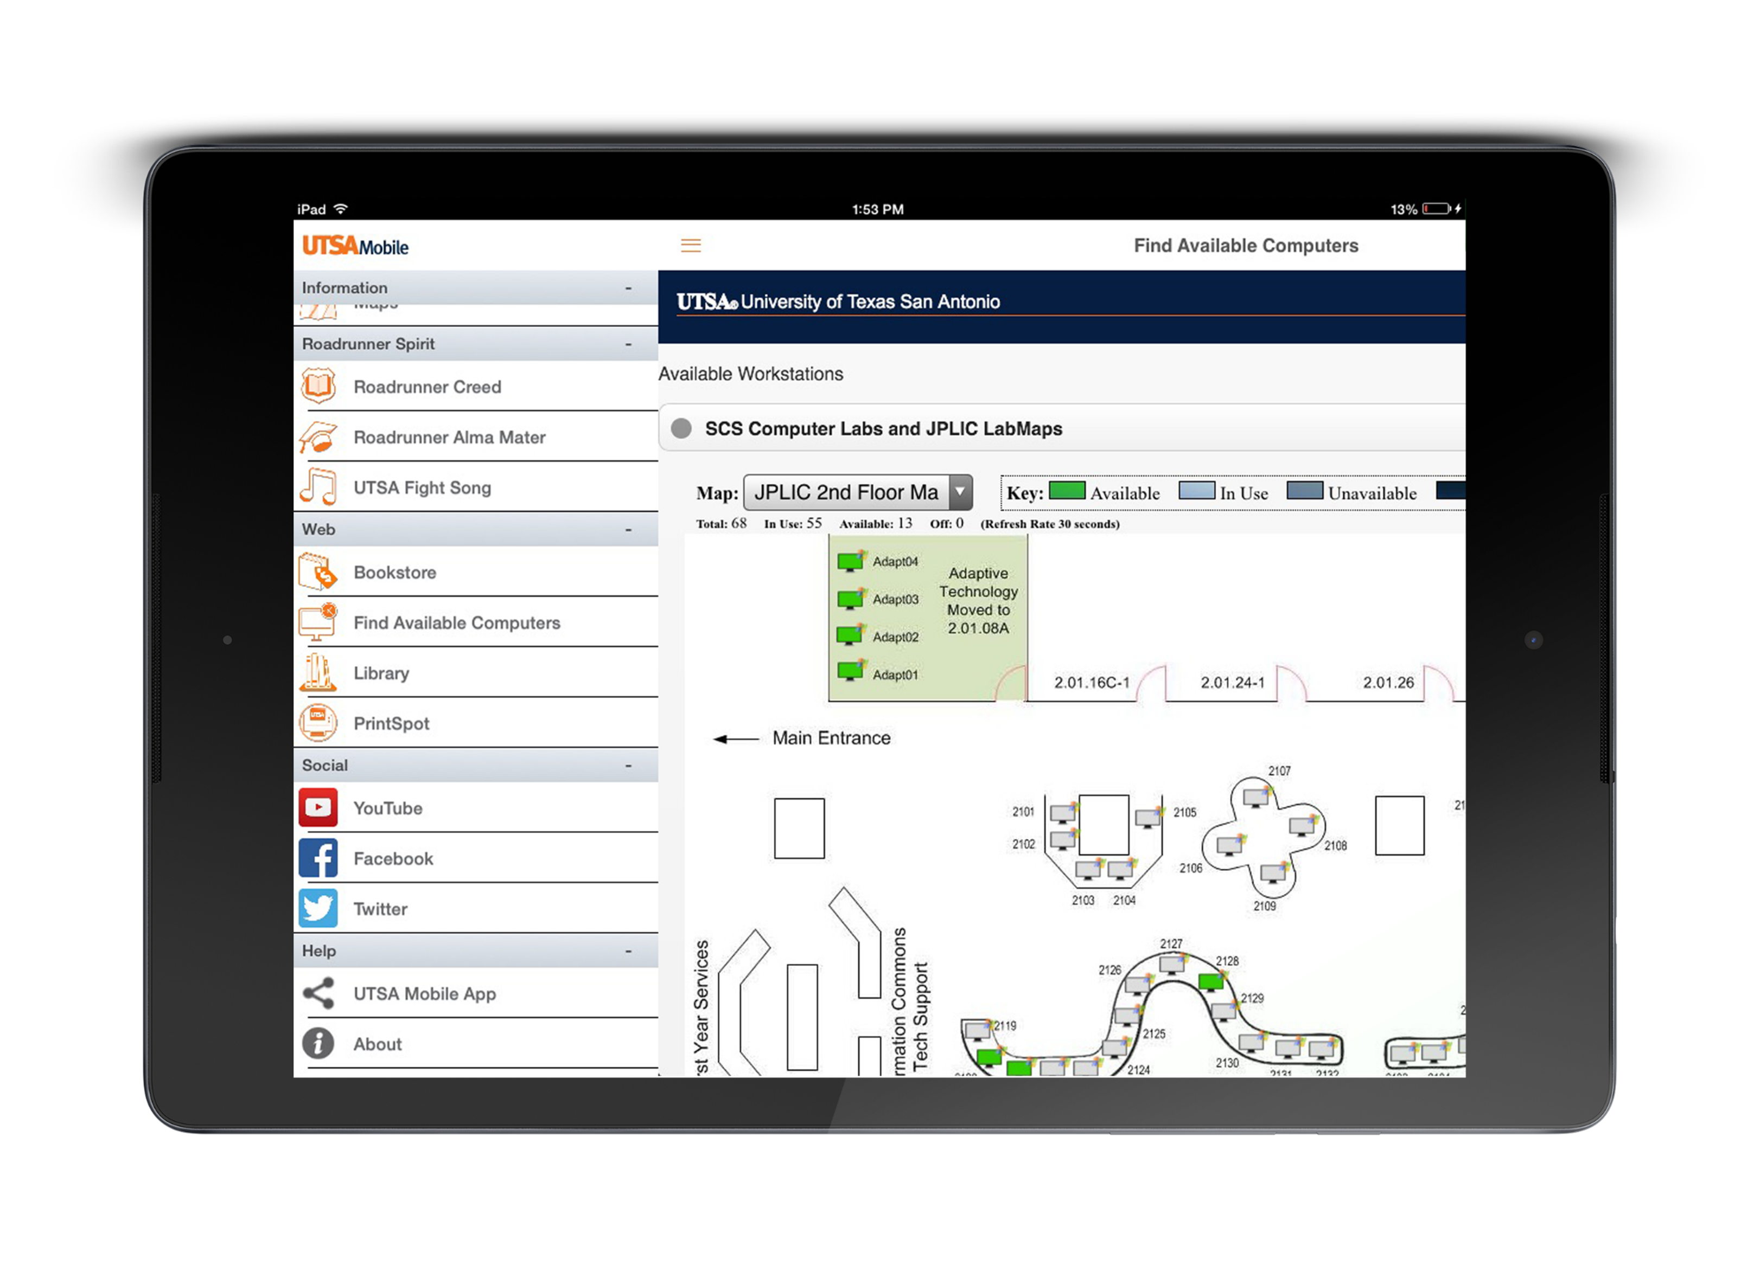
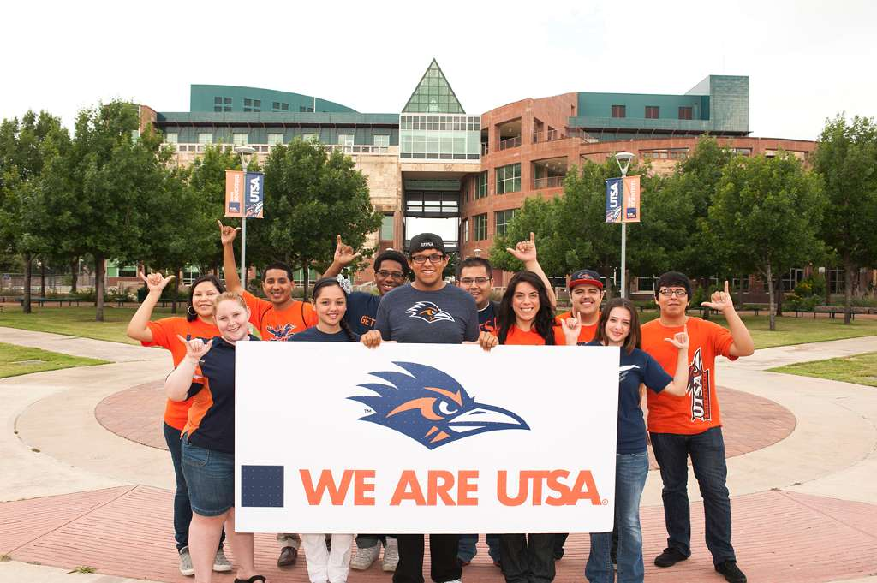

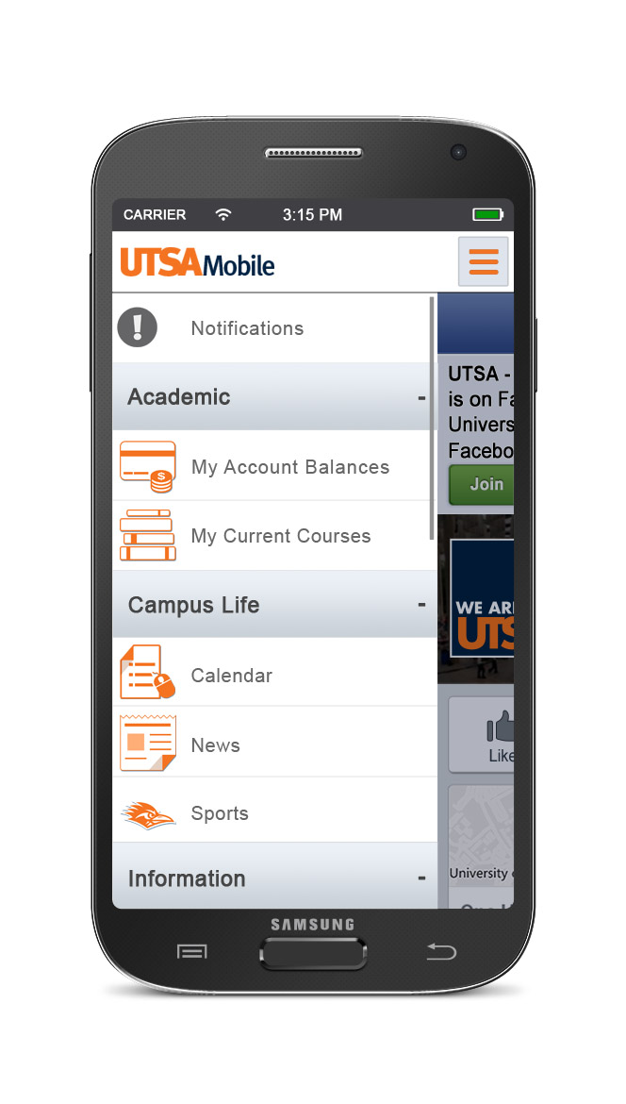
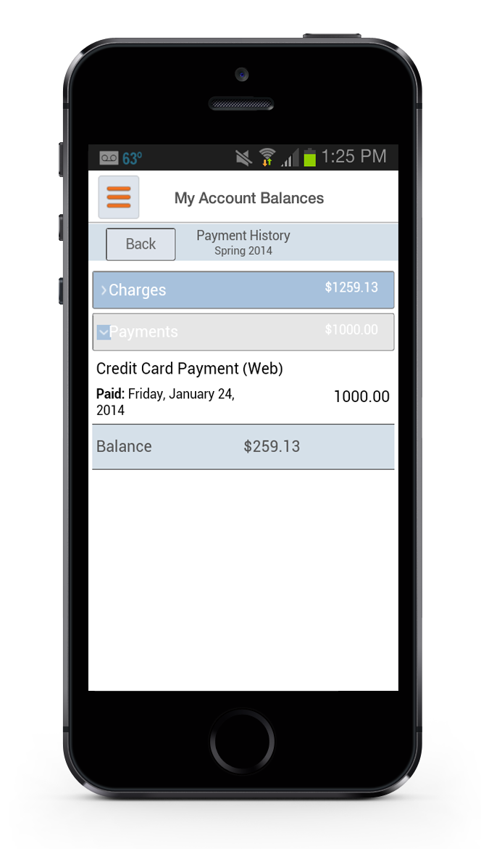
Preparing for the Mobile-First Student: Engaging Students Where They Live
UTSA at a Glance
Road to a building a mobile first strategy
Where we go from here
State research university
Founded in 1969
Nearly 29,000 students
UTSA offers a wide array of academic studies, with 133 undergraduate, 51 graduate and 24 doctoral programs
The Center for World University Rankings placed UTSA among the top universities in the the world in 2014. For the third year in a row, ranked among the world’s top 100 young universities by Times Higher Education
UTSA’s new strategy is to make everything available on the mobile site first, and then ASAP second, with plans to eventually retire the portal altogether. “The goal is to add one feature each month to the mobile app,” says Wilson, who already has a list of about 18 to 20 features to add.
“Students really like that they have one place to go to see what courses they’re registered for, look at their assignments, look at the discussions and find out information about their classes,” says Jayashree Iyengar, Assistant Director for Application Development and Support for OIT at UTSA.
UTSAMobile
Dashboard
Enhanced Advisor functionality:
Expanded Admissions functionality
Emergency Information
Mobile Payments
Keys for Success
Improve upon the current functionality
  Courses (Assignments, Grades)
  Account Balance
  Holds
  Calendar
Improved User Engagement
Launch new feature every month
Solid framework
Ease of managing various upgrades
Apple, Android & Windows native app
Ease of Configuration & customization
Find a outside development partner
Lesson Learned
Create a clear vision for mobility that is student focused
Build uniquely mobile experiences that make the mobile platform an essential part of student life
Engage school stakeholders BUT don’t let “committee mindset” deter you from your mission
Plan on change: In order to keep students engaged, you need to innovate often
Keep the end-game in mind: How can you help students succeed?
Initial Mobile App
We launched initial app with great fanfare in 2012. We had 8,000 downloads within 30 days then download rate decreased. Students were were complaining about the app!
“We received a lot of mixed feedback from our students,” Bryan Wilson, executive director of infrastructure services, says of the bare-bones app that the university got for free from a longtime vendor, “so they stopped using it.”
“The question is, ‘What does it mean to be mobile?’ If it’s just pulling up a website on a mobile device, that’s different than really intending to deliver to mobile,” says Marti Harris, research director at Gartner. “It has to do with increased capabilities, not just mirroring what you would get on a notebook.”
Armed with new insight on what it truly means to shift to a mobile-first mentality, UTSA started again from scratch. The IT team developed a new app that offered most of the services available on UTSA’s Automated Student Access Program (ASAP) self-service portal, including accessing course schedules to checking account balances and their LMS. Wilson’s team launched the new app in May 2014.
“With zero advertising, the new app had 3,000 new downloads, in addition to 8,000 students who received the update to the existing app” at the start of the academic year, Wilson says. But this time, it wasn’t the banners that drew users. Rather, recommendations from the students who had already tried it drew in more downloads. “It’s all word of mouth.”
Mobile Partner Requirements
Student focused
Expanded functionality
Feature-rich
Up-to-date user interface
Streamline navigation
Customized look and feel
Development Team
Jayashree Iyengar, Patricia K. Clark, Wesley Lay
Chris Grishaw, Bradley Christianson
Our Mission
The University of Texas at San Antonio is dedicated to the advancement of knowledge through research and discovery, teaching and learning, community engagement and public service. As an institution of access and excellence, UTSA embraces multicultural traditions and serves as a center for intellectual and creative resources as well as a catalyst for socioeconomic development and the commercialization of intellectual property – for Texas, the nation and the world.

