Slide 1


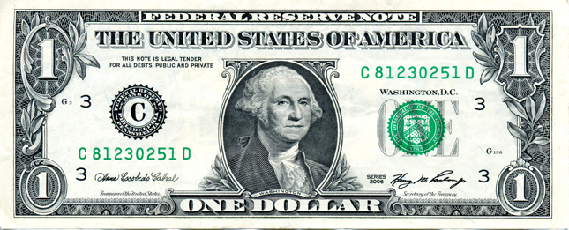

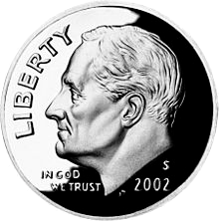








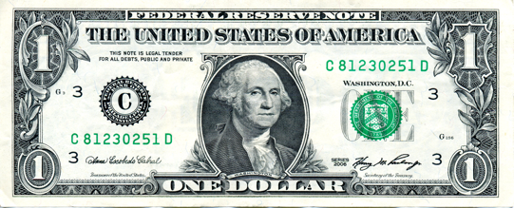
Data Governance - On a Dime… With Minimal Bureaucracy
Scott Flory -
Client Services
Brenda Reeb -
Data Architect
Your Thoughts?
Data Governance is…
an artifact or activity that answers:
  Where is the data?
  What does the data mean?
  Where did this data come from?
  What may I do with this data?
  What is the quality of this data?
Try to solve all problems at once (lineage, quality, access, all reports)
Write definitions as a committee
Build up descriptive metadata as you build reports
Focus on immediate reporting demands
Create new positions
and hire new people
Get everyone’s input and approval before moving forward
Identify existing staff as data stewards in each area
Grant stewards authority to make unilateral decisions in their own domain
Knowledge
Quality
Security
Value →
Establish stewards as a team
Create multi-tiered hierarchical committee structure
Access
Lineage
Promote the attitude that data belongs to us, it takes the debate and indecisiveness out of technical work
Allow stewards to establish standards and escalate issues regarding the management of data
Cost →

