Slide 1
Metrics: Guiding Compass to Creating a Performance-Based Learning Organization
Jerry Yerardi • Michelle Bautista • Paolo Mercado
ACIO • Deputy Director • Metrics & Reporting Analyst
Campus Shared Services, UC Berkeley

Slide 2
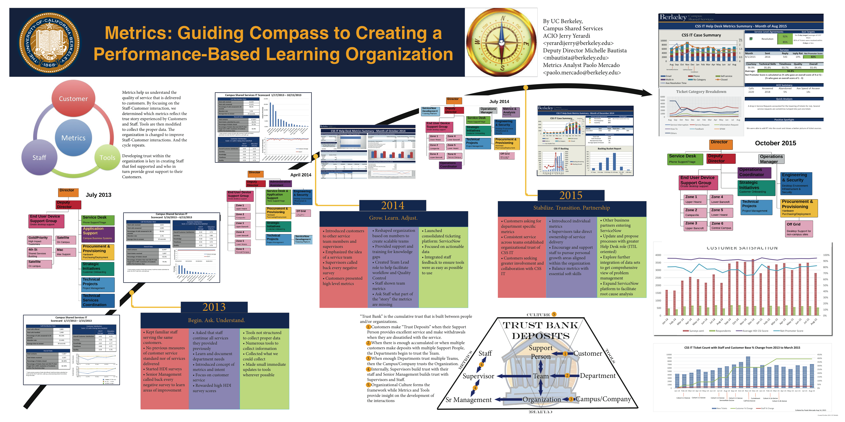

Slide 3
Here’s the story of how we used metrics to guide our path towards creating a learning organization

Slide 4
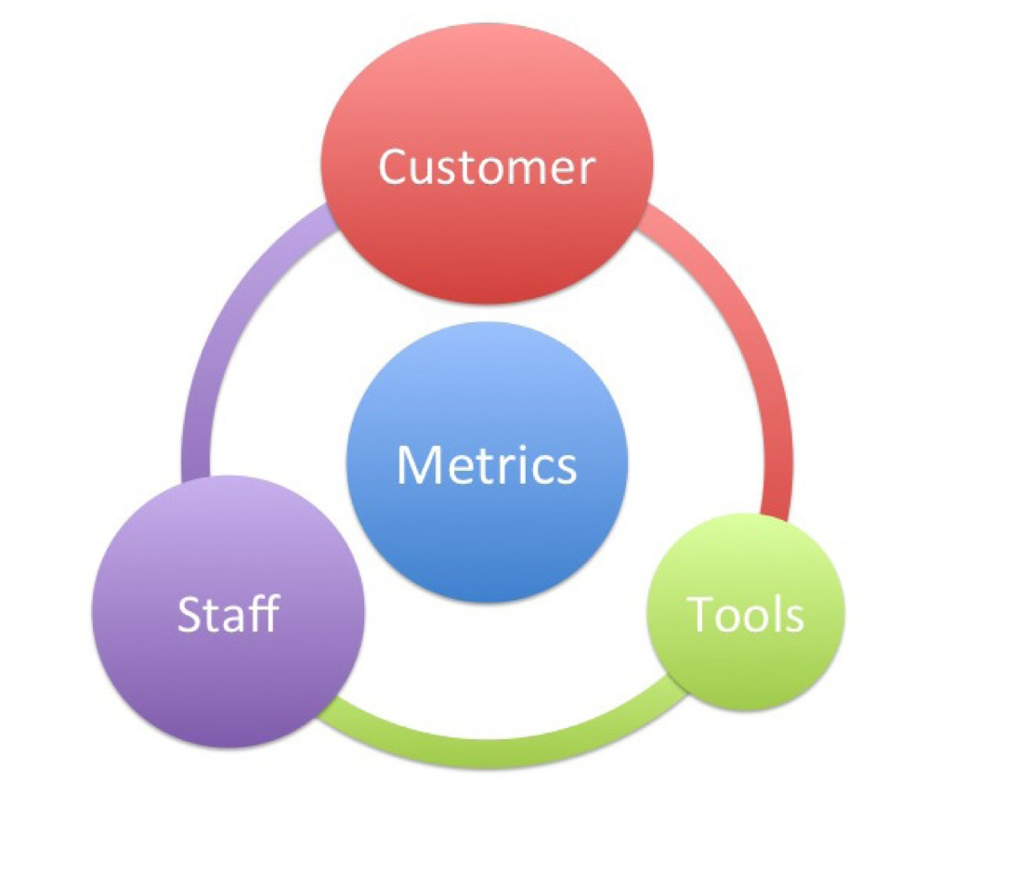
As a customer service organization, it’s all about the Staff - Customer relationship. Metrics are used to understand the “story” so it’s important to work with Staff and Customers to make sure we’re telling the story right.

Slide 5
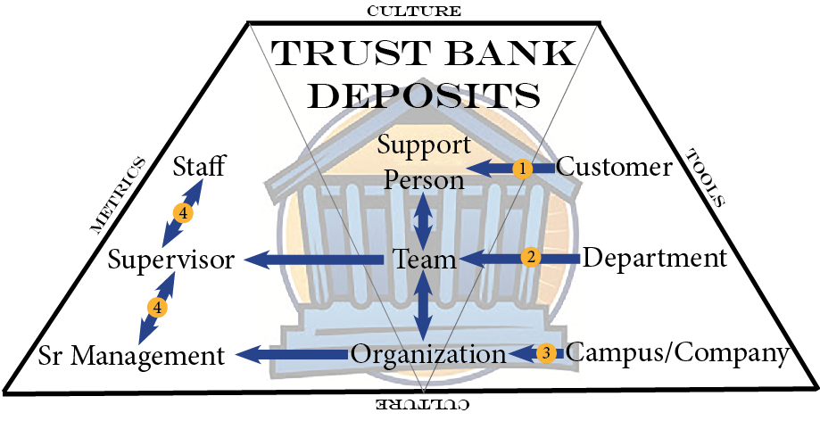
Creating a learning organization that delivers great customer service requires building trust throughout an organization and with customers.

Slide 6
2013
Campus Shared Services IT launches

Slide 7
Begin. Ask. Understand.

Slide 8

We started with reassigned staff who had already built up relationships with their customers
We thought campus would call us by phone and fully staffed a large Service Desk

Slide 9
Customers
Kept familiar reassigned staff serving the same customers.
No previous measures of customer service standard nor of services delivered
^{Started HDI surveys}
Senior Management called back every negative survey to learn areas of improvement

Slide 10
Staff
Asked that staff continue all services they provided previously
Learn and document department needs
Introduced concept of metrics and intent
^{Focus on customer service}
Rewarded high HDI survey scores

Slide 11
Tools
Tools not structured to collect proper data
Numerous tools to collect information
Collected what we could collect
Made small immediate updates to tools wherever possible

Slide 15
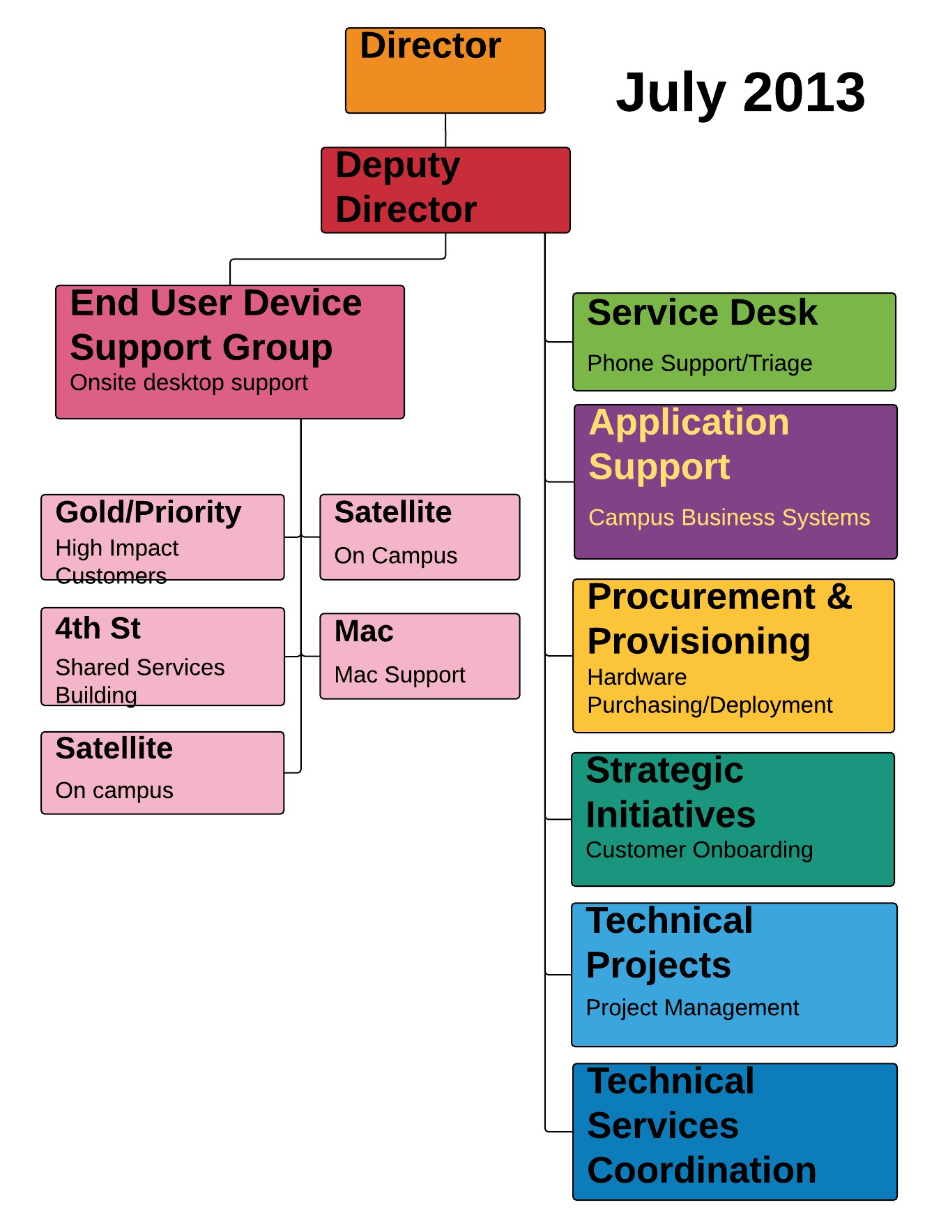

Slide 16
What we learned that year
Customers trusted a person they could see face to face
Staff were used to being on their own without a team to support them
Our teams were not scalable to the growth of customers

Slide 17
2014

Slide 18
Grow. Learn. Adjust.

Slide 19



We had to change our structure to allow Support People be better at Staff-Customer interactions.
We changed our teams and focused on building a supportive team structure at all levels.

Slide 20
Customers
Introduced customers to other service team members and supervisors
Emphasized the idea of a service team
Supervisors called back every negative survey
Customers presented high level metrics

Slide 21
Staff
Reshaped organization based on numbers to create scalable teams
Provided support and training for knowledge gaps
Created Team Lead role to help facilitate workflow and Quality Control
^{Staff shown team metrics}
Ask Staff what part of the “story” the metrics are missing

Slide 22
Tools
Launched consolidated ticketing platform: ServiceNow
^{Focused on actionable data}
Integrated staff feedback to ensure tools were as easy as possible to use

Slide 25
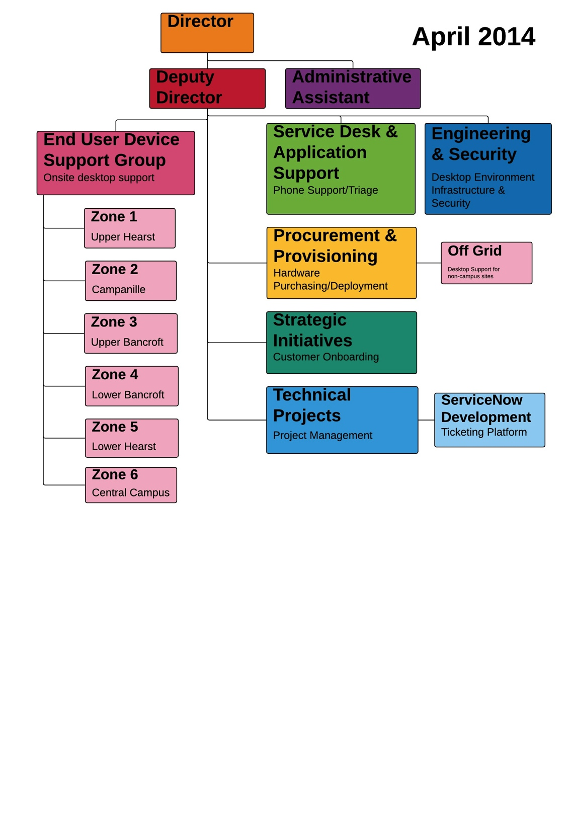

Slide 26
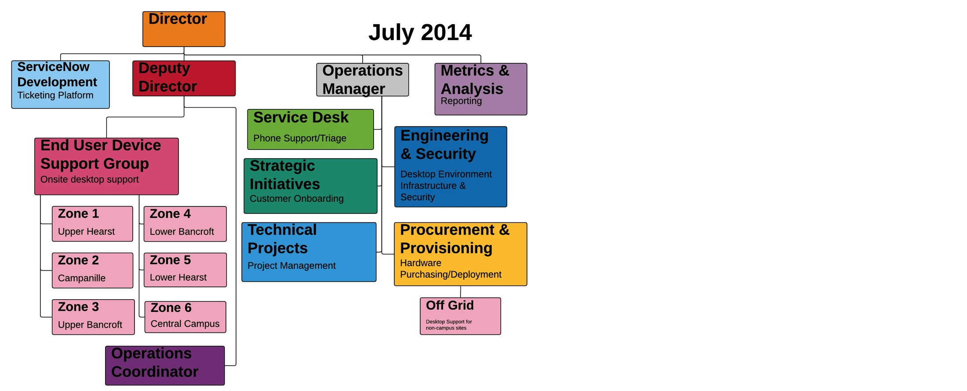

Slide 27
What we learned that year
Open communications between all levels built trust
Ask ourselves what are the numbers telling us? Are they actionable? What are we missing?
Are we measuring what customers and staff really care about?

Slide 28
2015

Slide 29
Stabilize. Transition. Partnership.

Slide 30
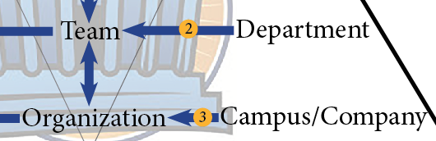
In providing consistent support to our Staff, they in turn provided consistent service to our customers.
Open communications allowed staff to take risks and offer up new and creative ideas.

Slide 31
Customers
Customers asking for department specific metrics
Consistent service across teams established organizational trust of CSS IT
Customers seeking greater involvement and collaboration with CSS IT

Slide 32
Staff
^{Introduced individual metrics}
Supervisors take direct ownership of service delivery
Encourage and support staff to pursue personal growth areas aligned within the organization
Balance metrics with essential soft skills
Have staff think across functions and beyond CSS IT

Slide 33
Tools
Other business partners entering ServiceNow
Update and propose processes with greater Help Desk role (ITIL oriented)
Explore further integration of data sets to get comprehensive view of problem management
Expand ServiceNow platform to facilitate root cause analysis

Slide 34
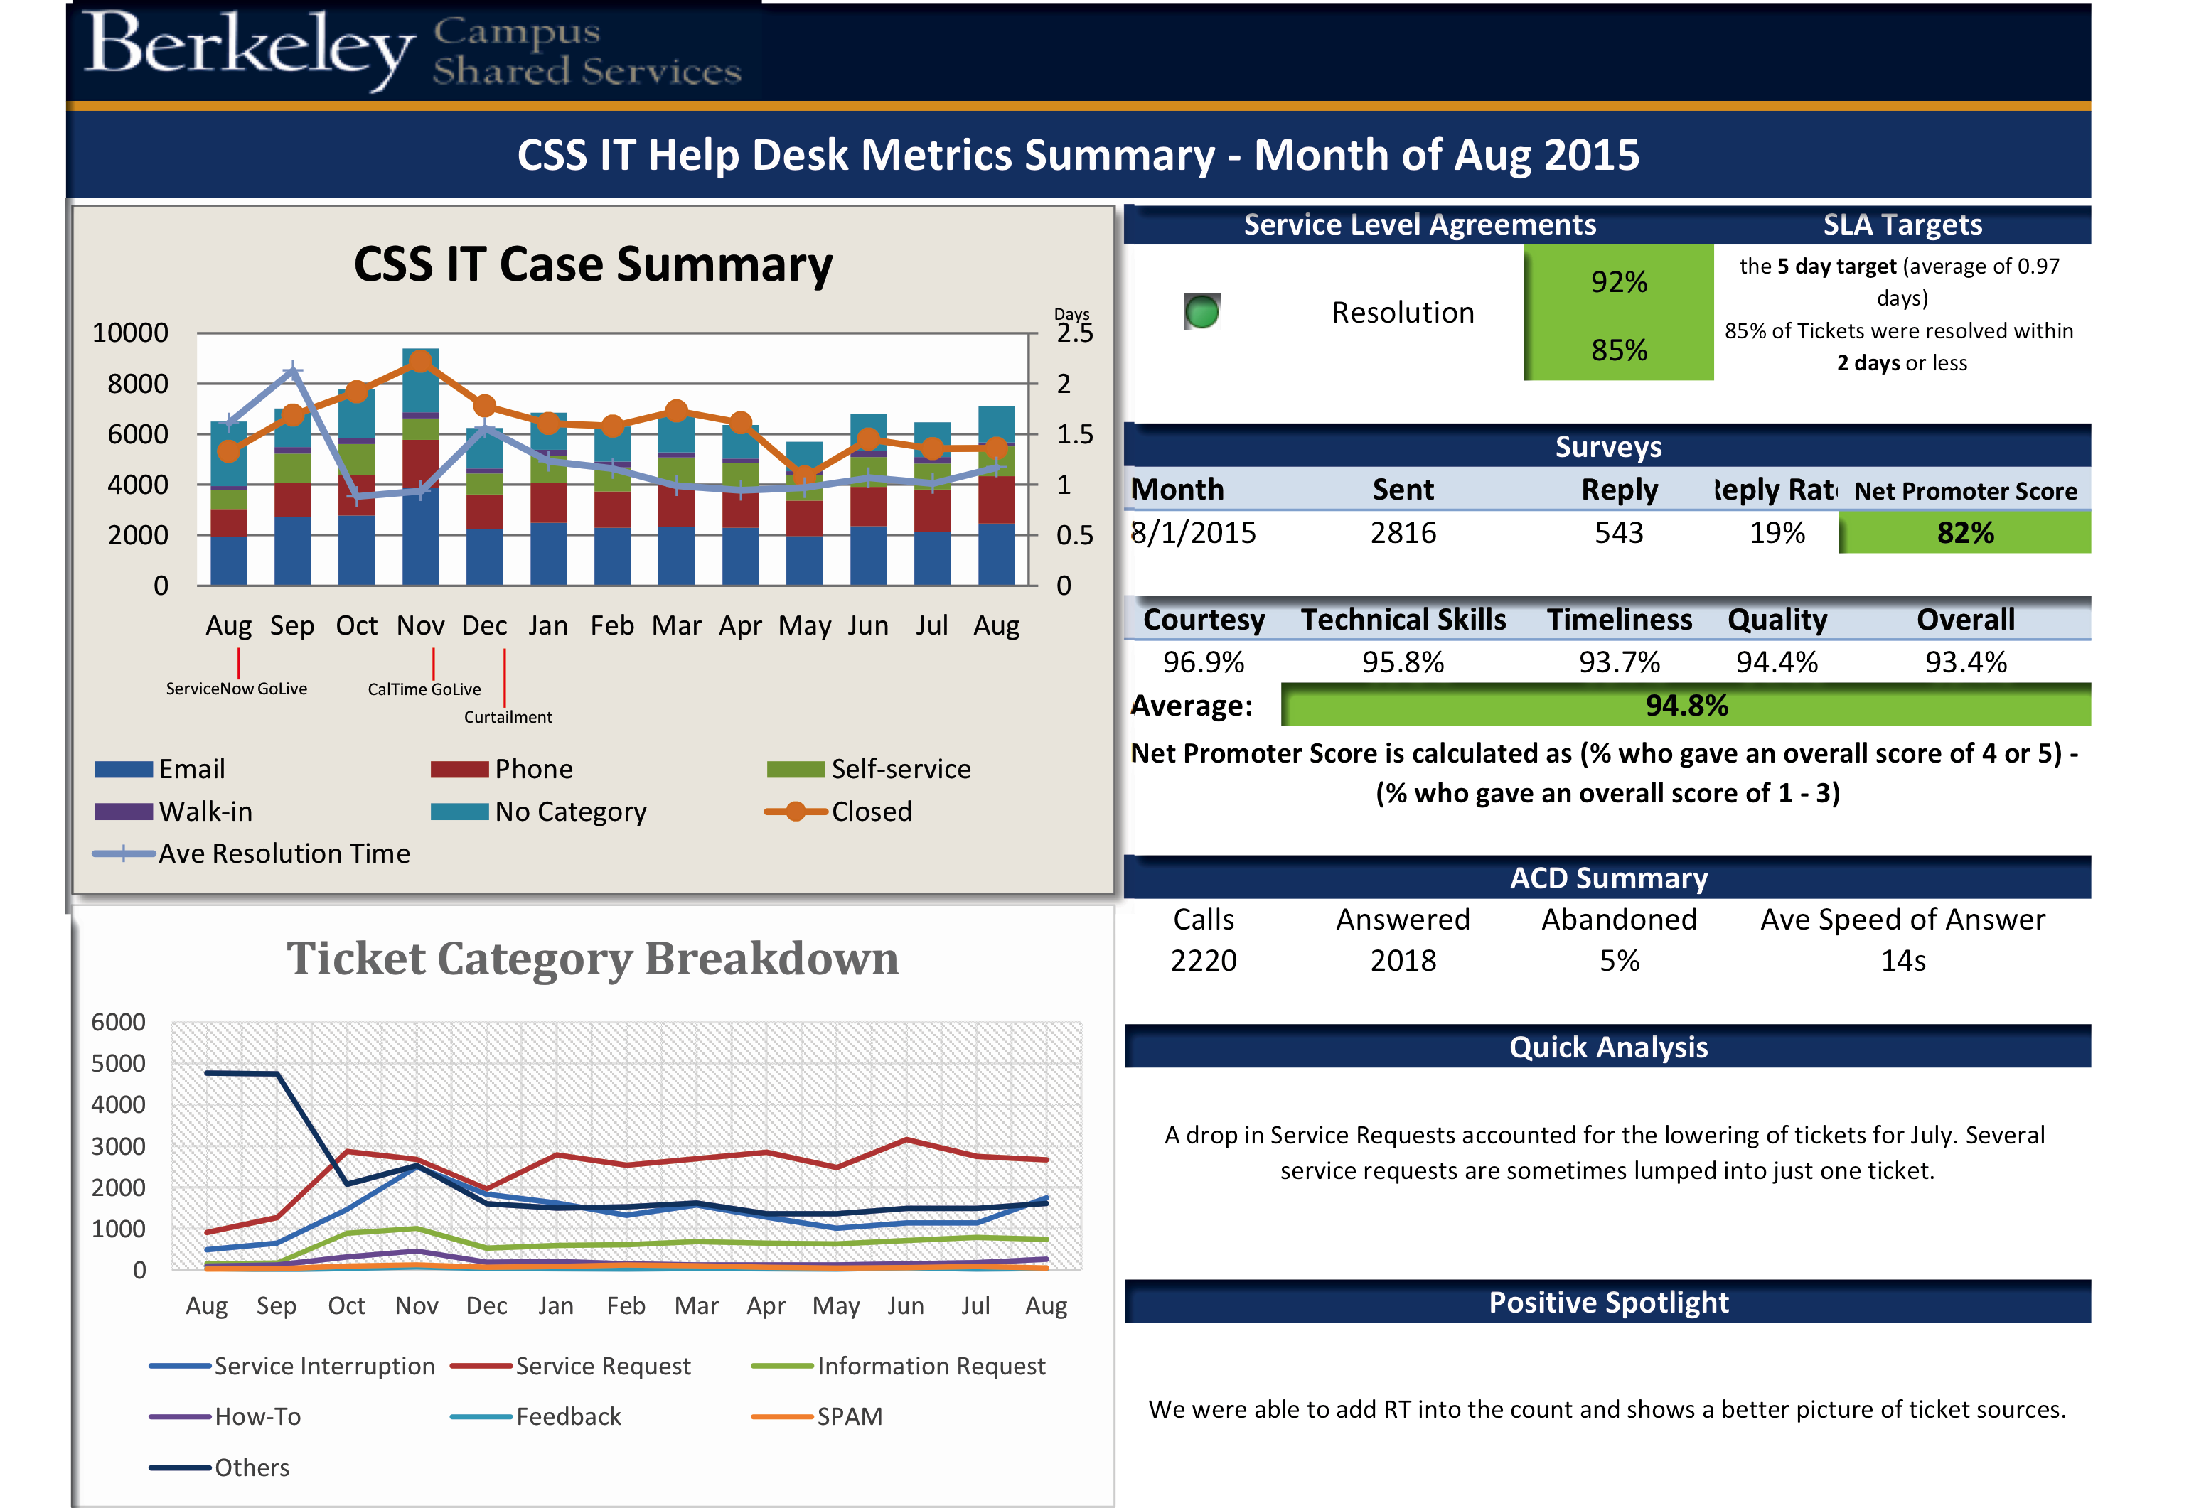

Slide 35
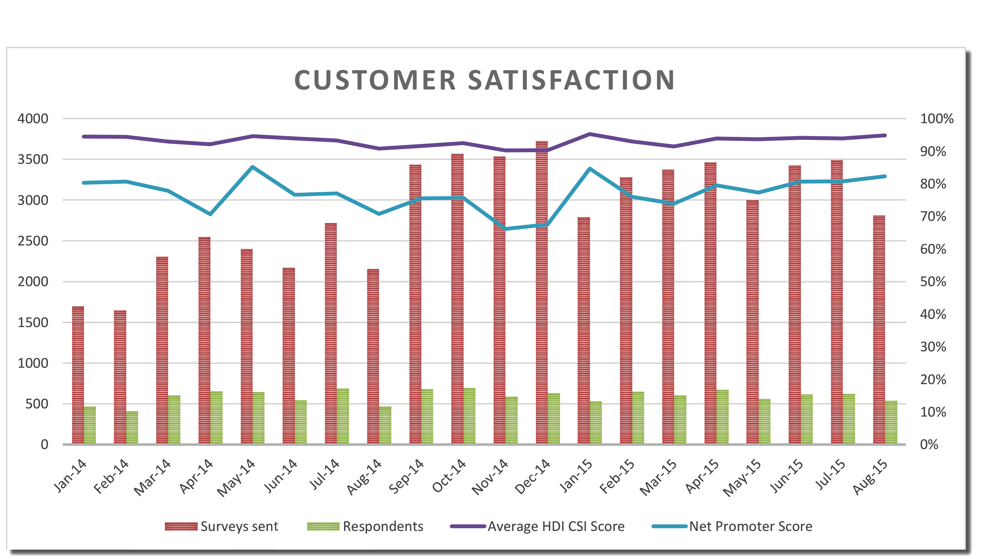

Slide 37
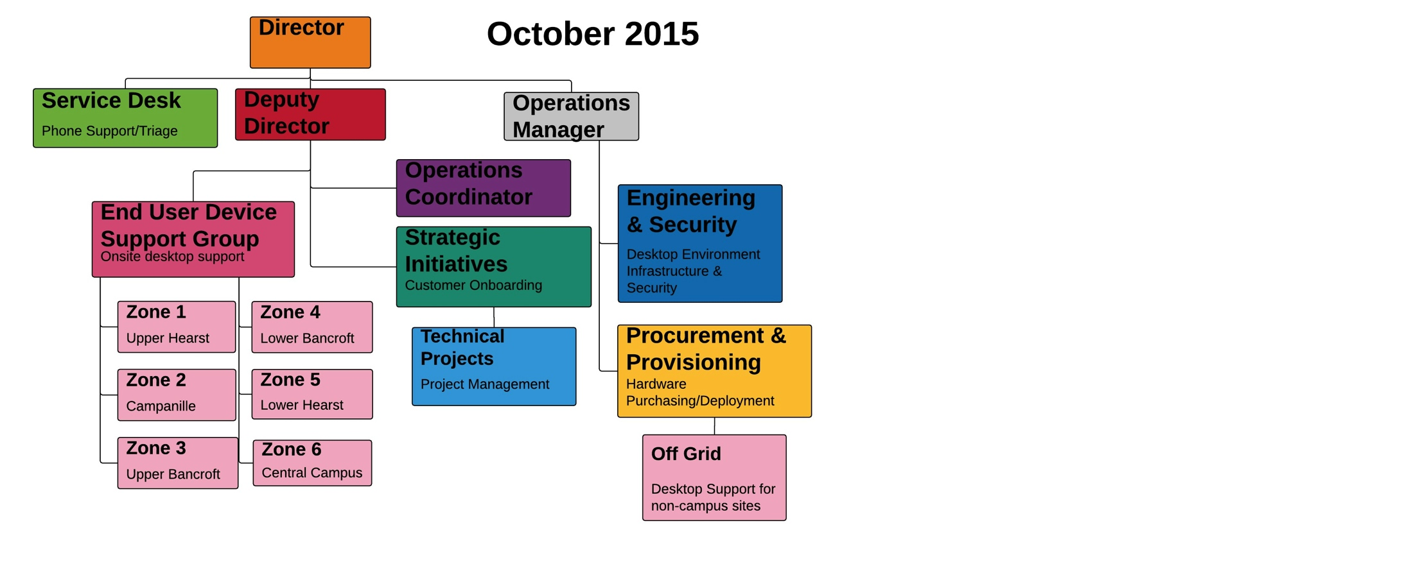

Slide 38
What we learned that year
There is still so much we cannot measure.
Metrics, Organizations, Tools, Culture all evolve together

Slide 39
Metrics help you see where you are and orient the path of your organization. Creating a culture of trust, helps Staff and Customers contribute to the telling of the right story. Combined, they all contribute to creating a performance-based learning organization.

Slide 40
Thanks!
Contact us:
Jerry Yerardi yerardijerry@berkeley.edu
Michelle Bautista
mbautista@berkeley.edu
Paolo Mercado
paolo.mercado@berkeley.edu

Slide 41
Help Us Improve and Grow
Thank you for participating
in today’s session.
We’re very interested in your feedback. Please take
a minute to fill out the session evaluation found within
the conference mobile app, or the online agenda.

