Slide 1

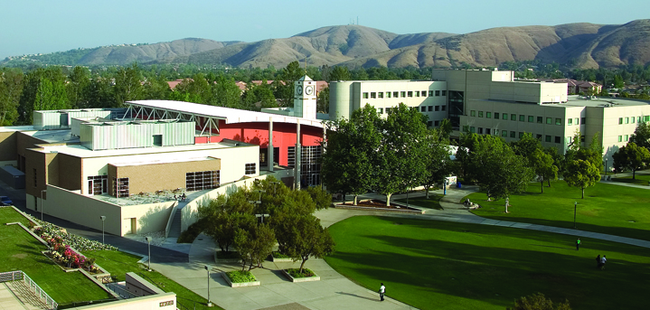
We Are On Your Team
Win-Win Partnership in Faculty Development
Dr. Kim Costino, TRC Director
Dr. Michael Chen, ATI Director/SATO
Dr. Sam Sudhaker, VPIT/CIO

Slide 2
Who Are in the Room?
Faculty
Administrator
Academic support staff
IT support staff

Slide 3
What Are Your Biggest Challenges in Faculty Development?
Type in short phrases

Slide 4
CSUSB Snapshot
One of 23 CSU campuses
19,982 students
1139 full-time and adjunct faculty
Five colleges plus College of Extended Learning
Palm Desert Campus

Slide 5
Information Technology Services
World Class Customer Service
Foster and Support Faculty Led Innovation and Research
Improve Operational Efficiency in all areas of University Operations
Secure, Stable, High Performance Infrastructure
End User Empowerment

Slide 6
We Come to Play on Your Team
Taking partnership to the next level
ITS does not have its own agenda – we provide players for your team
Those who we serve keep the score sheet
Your win is our win

Slide 7
How We Have Delivered
Process Improvements Across Campus - OnBase
Institutional Intelligence – EAB, Institutional Data Team
Renovating learning spaces
  Incubator Classroom (PL015)
  Kinesiology Lab (HP123)
Taking the message to campus
  All College Meetings
  Departmental Meetings
  Faculty Meetings
  Student Gatherings

Slide 8
Faculty Development in Teaching
What was it like before
  Three offices providing support
    Academic Computing and Media (ACM/IT)
    Teaching Resources Center (TRC/Provost Office)
    Office of Distributed Learning (ODL/AVP Academic Programs)
  Overlapping and competing services
  Little collaboration
  Faculty confused

Slide 9
Supporting Faculty Development Now
Newly formed office of Academic Technologies and Innovation (ATI/ITS)
  Moving ODL to IT and merging with ACM
Close partnership with Teaching Resources Center (Provost Office)

Slide 10
Academic Technologies & Innovation
Fostering and Supporting Faculty Led Innovation & Research
Instructional Design
Classroom Technologies
Active learning space design
Distribute and Distance Learning

Slide 11
Teaching Resources Center
Teaching Excellence
Pedagogies
Faculty Grants
Quality Assurance
Course redesign
Community of practice

Slide 12
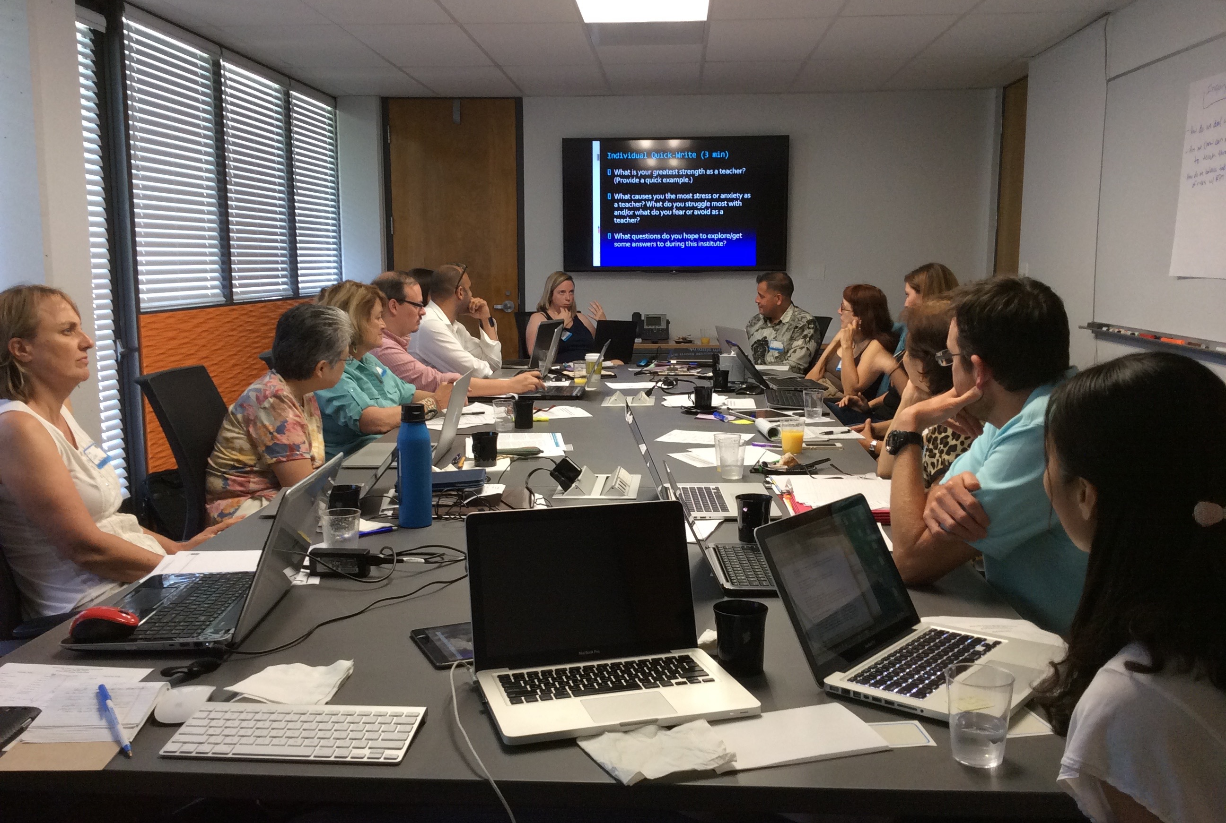
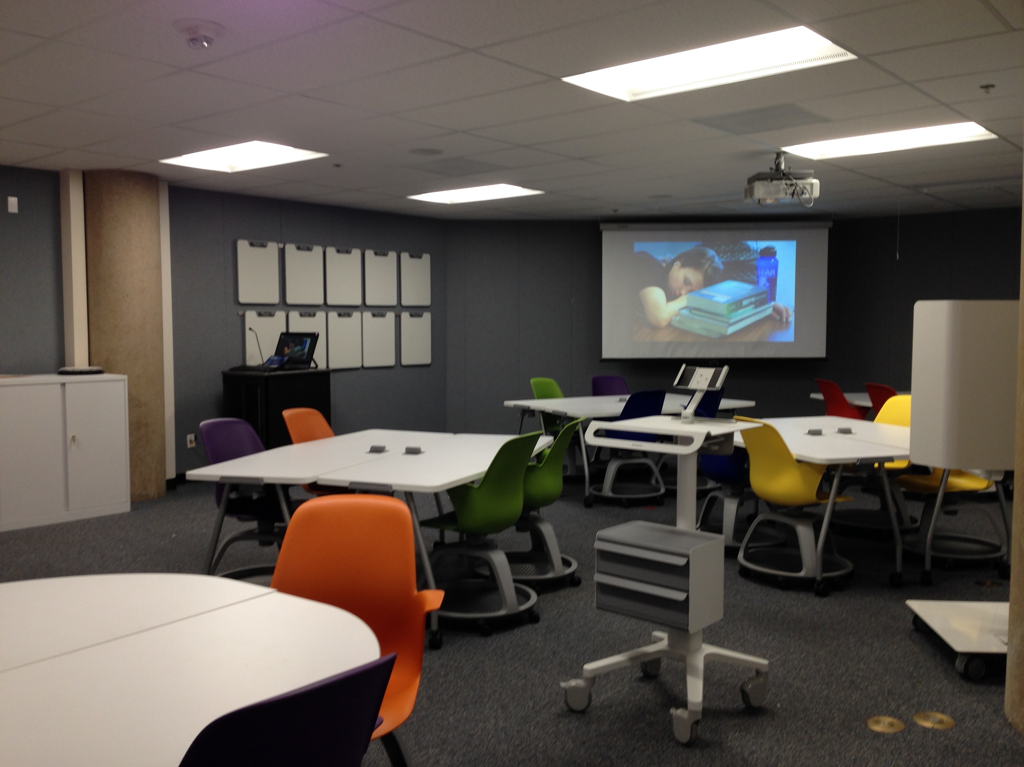
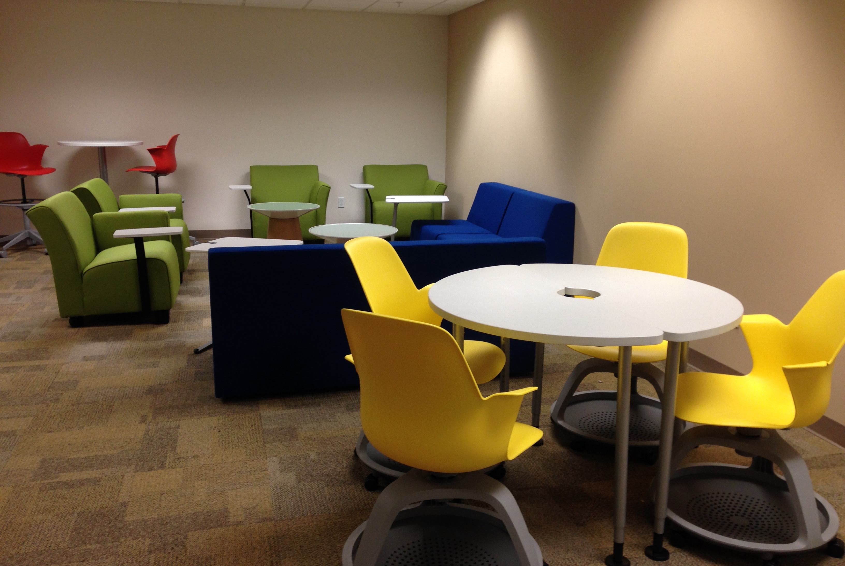
ATI/TRC Collaboration
Faculty Sandbox
Summer Institutes
Faculty Spring Showcase
Faculty Associate in ATI
Technology Mentors
Faculty Travel support
Faculty IDEA Lab
Incubator Classroom

Slide 13
What’s Coming
Faculty Center of Excellence
  Teaching
  Research
  Technology
  Service
Information Commons

Slide 14
Discussion

