Slide 1
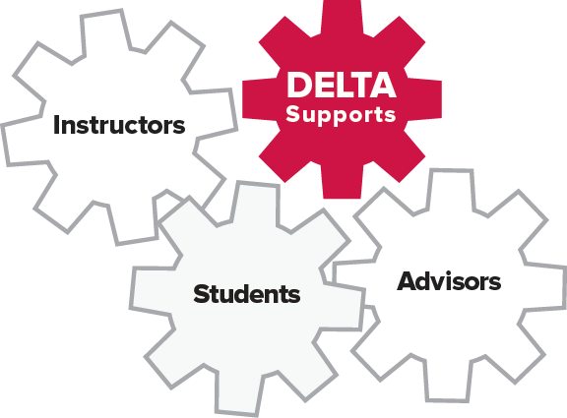
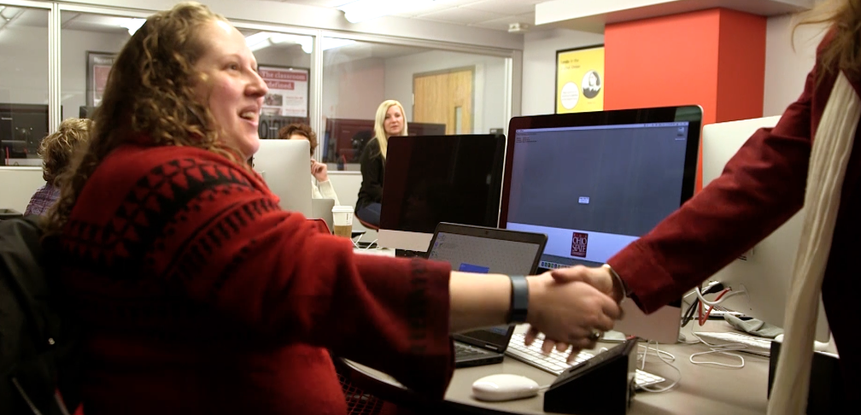
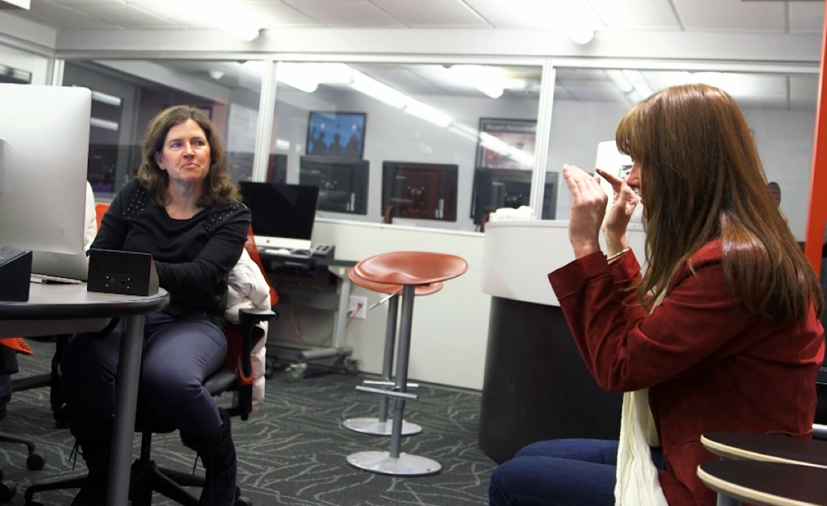
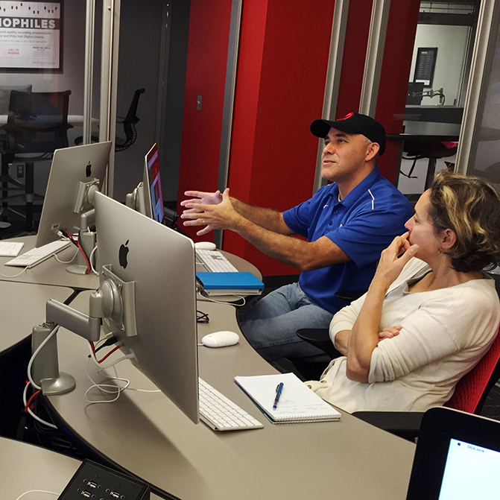
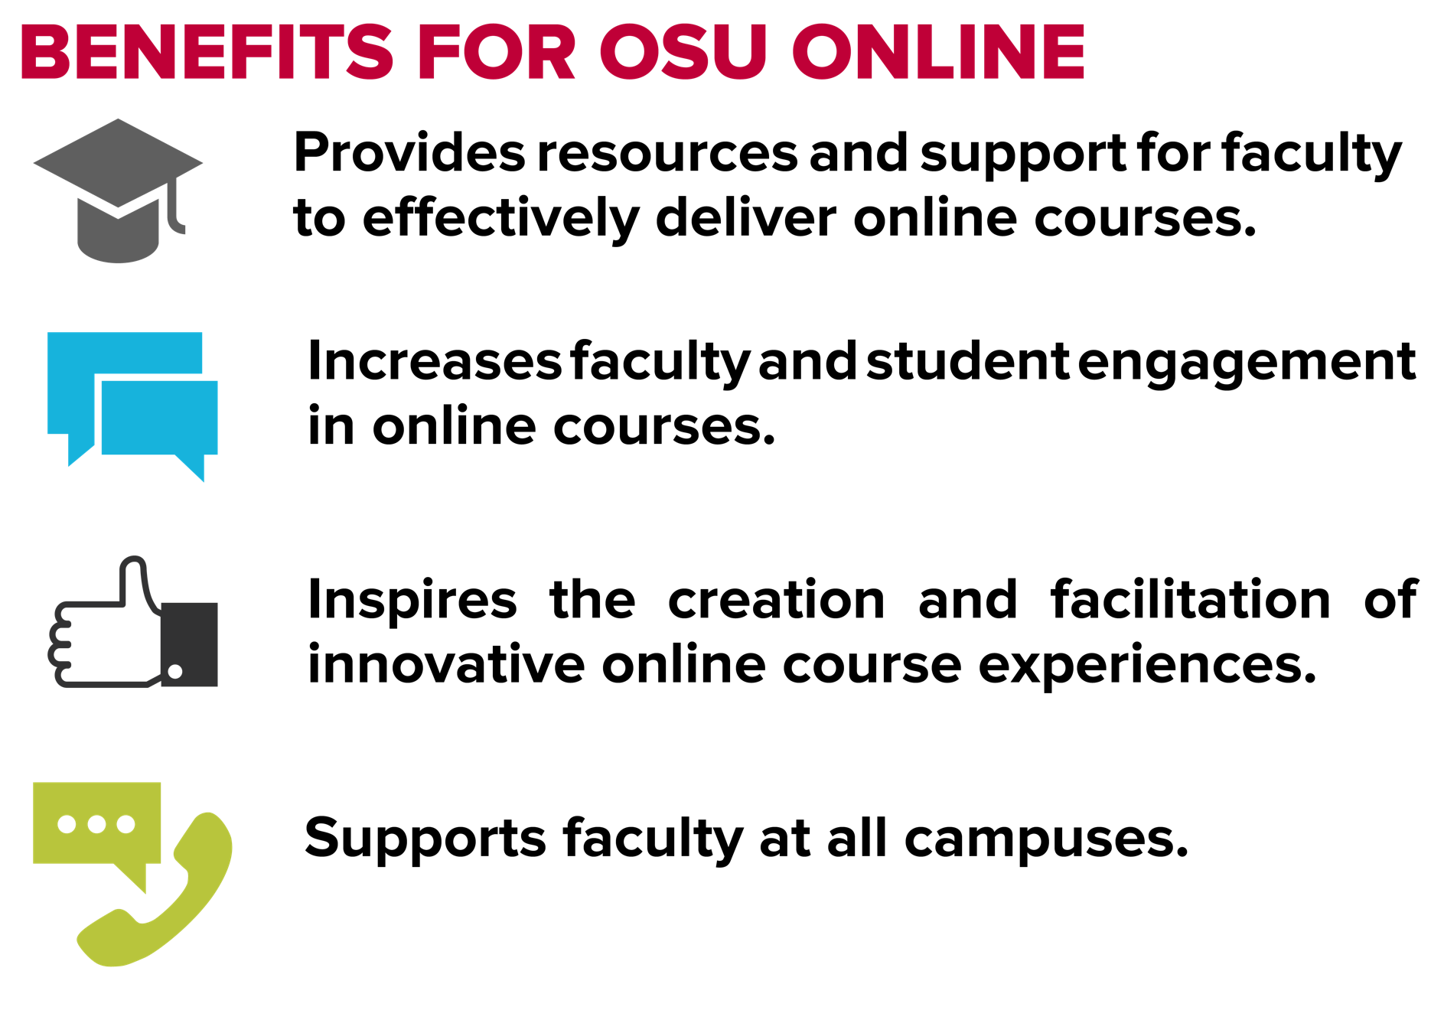
DELTA: A tiered model for online faculty development and support
What Is DELTA?
The Distance Education Learning and Teaching Academy (DELTA) provides high quality learning experiences and support for online instructors across The Ohio State University while fostering a community of learners sharing their experiences and knowledge in a spirit of support and collaboration with one another.
Rationale
OSU has an expected growth rate for fully online programs of 191% and an expected growth rate of students in those programs of 445% by 2020.* In preparation for this growth, the Office of Distance Education and eLearning established DELTA to help support online instructors regardless of their location.
What DELTA Provides
Implementation Strategy
“
Webinars
Regularly scheduled and hosted via CarmenConnect (OSU branded AdobeConnect).
Topics related to online education and teaching online courses.
Needs Assessment
Audience – topic and accessibility needs
Development and facilitation of workshops/trainings
Communications and promotion strategy
Registrations and feedback processes
Plan for scalability
29 years at OSU and 20 working with class design and I still found this class and the information contained new ideas and ways to make the student/instructor experience richer and rewarding.
Creation Studios
Regularly offered in Digital Union spaces for instructors to work with the assistance of instructional designers to create innovative experiences for their online courses.
A “makerspace” to work on solving challenges with online activities through investigation of tools and trial & error.
”
-Tim Bailey
John Glenn College of Public Affairs
“
Rolling out Services
Another great class. I was really challenged to think about the endless possibilities that I can incorporate into my future plans.
Customized Workshops
Tailored to meet the specific needs of a college or program.
Offered face-to-face or virtually.
Creation of a structured plan with room for flexibility as technology and needs change. Follow the QR code to view the DELTA structure as it exists today.
”
-Mitch Wilson
Online Trainings
Facilitated trainings focused on topics relating to teaching and designing online.
On-demand, self-paced modules addressing FAQs.
Office of Academic Affairs
“
Future Plans
Kickstart lives up to its name. I am feeling kicked! The good kind of kicked. Mostly. The week of sampling ideas and tools, goals and outcomes, approaches and best practices is invigorating, overwhelming, challenging. A puzzle of possibilities. I am at the point now where I feel ready, if not fully competent, to piece together a fully-distant course.
Virtual Community
DELTA blog at u.osu.edu/delta where instructors continue learning tips for teaching and designing online.
Q&A forum: faculty questions answered by peers and instructional designers.
DELTA will be rolling out support resources for online students and their advisors. Resources will be supporting on-demand, self-paced needs in the beginning. Students will be directed to additional scheduled and facilitated trainings offered by other on-campus services as recommended by their advisors.
”
Scan QR code to play video.
-Susan Hanson
College of Arts and Sciences
“
­More wonderful and practical information today! Lots of new ideas on how to use the discussion board on Carmen for my class.
Benefits for OSU Online
”
Information & Resources
-Mary Kay Pohlschneider
College of Food, Agriculture, and Environmental Science
Needs Assessment & Planning Strategy
For More Information:
Kickstart Weeks
One week session bringing together course developers and instructional designers to jump start the online course development process.
Use of Digital Union space and resources to generate concepts for innovative online learning experiences following best practices.
Planning Template
DELTA.osu.edu | u.osu.edu/delta
delta@osu.edu | #deltaOSU
Promotional Handouts
Marcia Ham
Senior Instructional Designer,
Faculty Development Coordinator
Ham.73@osu.edu
* Executive Summary Healthcheck: 5-Year Distance Education Program Plans (2015)

