Slide 1
Moving toward
Enterprise Learning Analytics
at NC State
Dr. Donna Petherbridge Lou Harrison
Associate Vice Provost for Director of
Instructional Technology Support and Development Educational Technology Services

Slide 2
Building a vision
How to get everyone moving in the same direction

Slide 3
Socializing a Plan and Vision
Organizational Strategic Planning
Student Success - NC State
Leverage Technology to improve student success - DELTA
Specific Initiatives in Support of Plan
Conversations with peers
Get information to the right people (dashboard?)
Notes:
NC State Goal 1 of Strategic Plan: NC State must ensure students make timely progress toward a degree. NC State must provide educational opportunities that inspire students to lead, to serve, to challenge, to take responsibility, to build problem-solving skills, and to engage with complex problems.
DELTA high level goal:
Helping students make timely progress toward a degree means rethinking how courses are developed, delivered and scheduled, taking advantage of innovative learning technologies to provide flexible delivery methods for easy access to course materials, supporting emerging pedagogies and using technologies that support the university’s Quality Enhancement Plan by engaging students in critical and reflective thinking with a variety of learning materials, and providing excellent and timely support for students and instructors.
DELTA initiative:
Identify and make available learning technology data to support student success and academic decisions. Initiatives/programs in this area include:
Begin conversations with campus peers about the information instructors/advisors would find useful in supporting student success that reside in the learning technology systems
Define and create an enterprise learning technology student success dashboard and/or other appropriate delivery mechanism

Slide 4
Working with our partners
Scheduled series of Lunch & Learn sessions within the LA Space.
Bring people up to speed on what questions to ask
Start thinking about who can generate answers
Notes:
Between October, 2014 and May, 2015, Donna Petherbridge (DELTA) and Michelle Johnson (Registrar’s office) have hosted a series of Student Success Lunch and Learns to bring together partners across campus to discuss various technology platforms and projects that can potentially provide data that can help those working directly with students (advisors/faculty/staff) support student success. We have looked at a range of enterprise projects and our own home-grown internal systems, and have fostered very good cross-campus dialogue around this issue.
Brought in vendors - looked at internal systems both built in house and in pilot.
Marist Visited on Dec. 5, 2014 - Campus stakeholders said yes, this is worth exploring - see if we can do what they are doing with Sakai with our systems (Moodle)

Slide 5
Now, and Next . . .
Division of Academic & Student Affairs has purchased EAB
Concurrently, we are working on LAP
Continued conversations with partners across campus necessary
Notes:
Campus has purchased EAB Student Success Collaborative - view this as a “partnering” thing vs. something that excludes our work with the LAP
We will be interested in how the predictive analytics in these cases overlap/concur regarding students at risk.
Conversation points:
what partners get what data and how and when do they get it?

Slide 6
From Proof to Production
Toward Learning Analytics for the Enterprise
Notes:
And here’s Lou . . . .

Slide 7
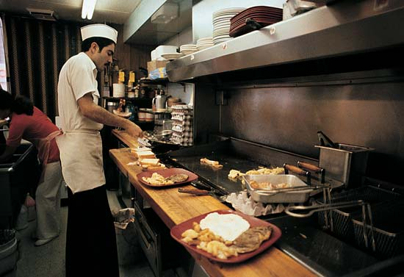
Initial Steps
Small sample sizes
Predictions at ¼, ½, ¾ points in course
Multi-step, manual process

Slide 8
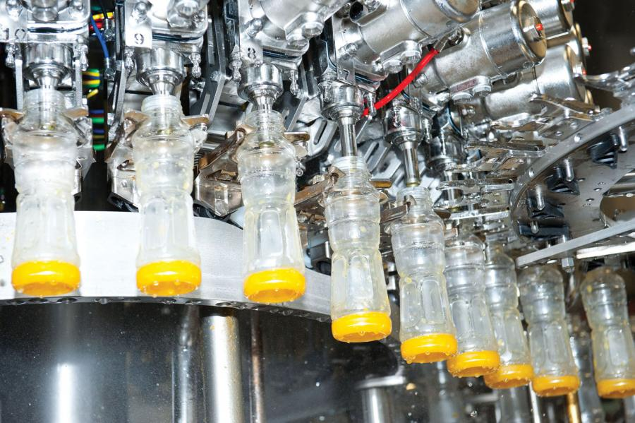
Goal 1: More Enterprise-y
Large sample sizes (all student enrollments)
Frequent early runs (maybe daily)
Automatic, no more than one click

Slide 9
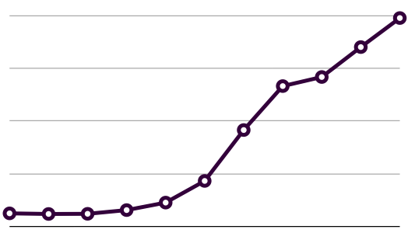
Currently in Progress
Rebuild infrastructure for scale
Daily snapshots of fall semester data
After fall semester ends, look for sweet spot

Slide 10
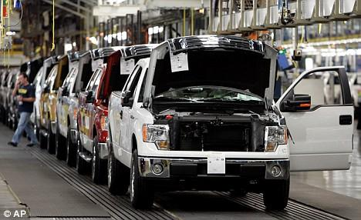
Future Goals
Refine model even more
Segment Model by population
Balance between models and accuracy

Slide 11
Future Goals continued
Refine and improve model(s) over time
Explore ways to track efficacy over time
Once we intervene, can never go back to virgin state

Slide 12
Questions?
donna_petherbridge@ncsu.edu
lou@ncsu.edu

