Slide 1

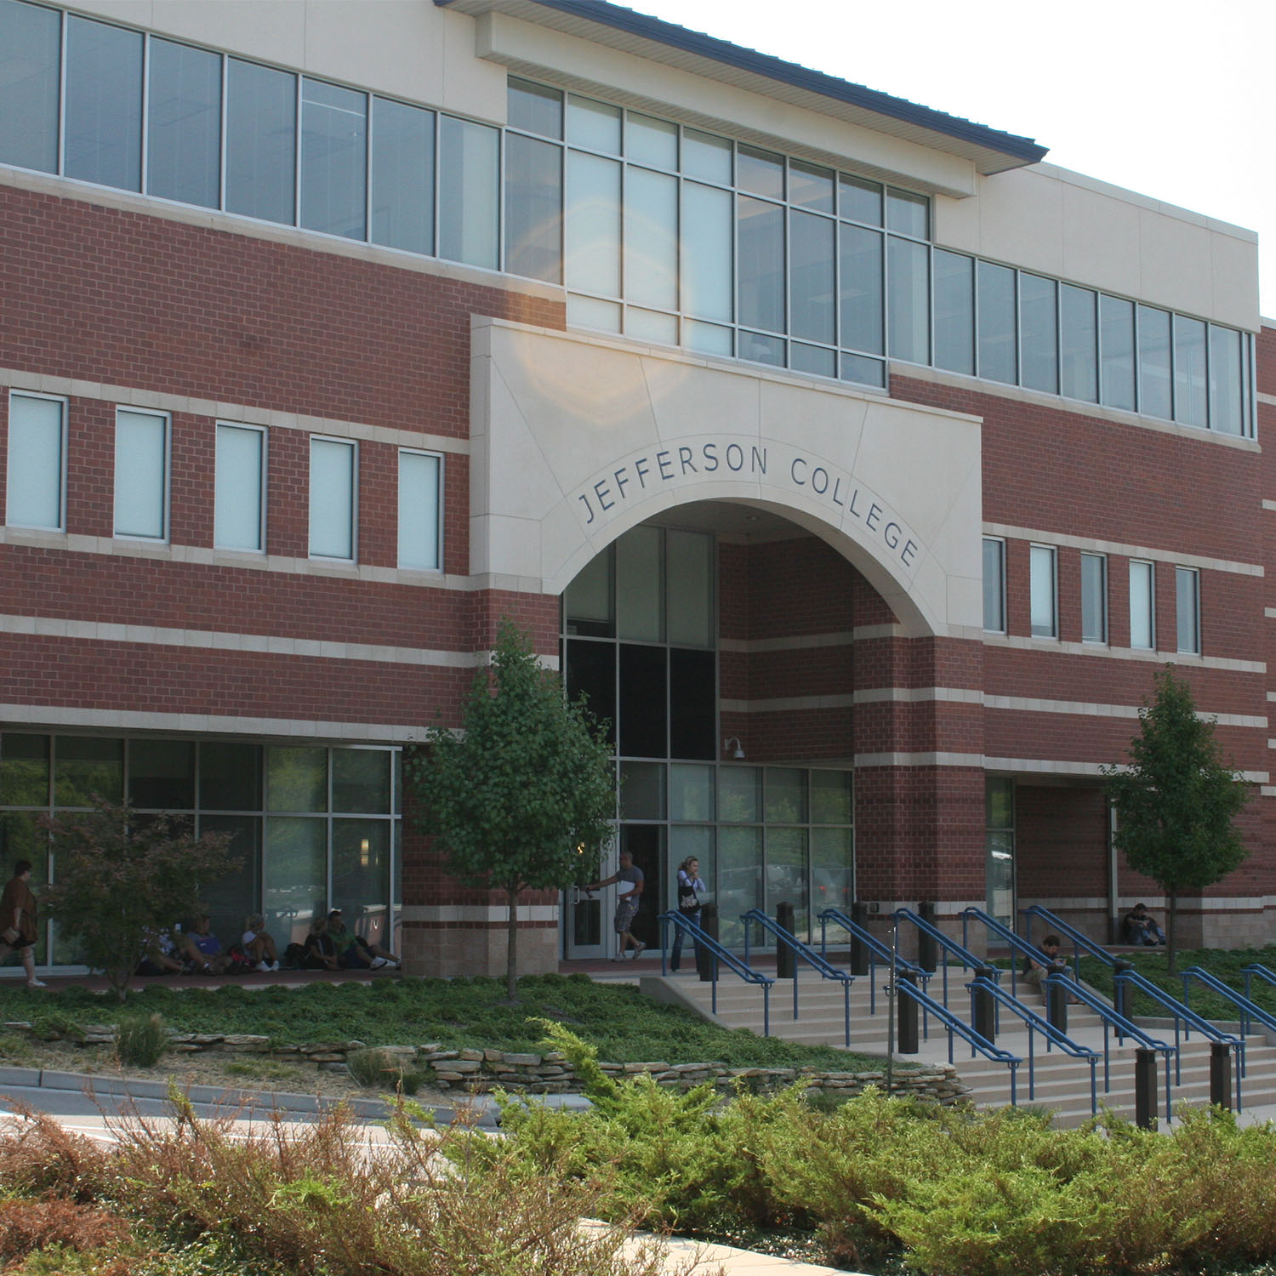




Technology-Enhanced Advising Services
Kenneth Wilson, MHS, PT, CHT, SCS, ATC
Division Chair – Health Occupation Programs
October 28, 2015

Slide 2
Technology-Enhanced Advising Services Brought to You By:
TAACCCT Round IV
Department of Labor

Slide 3

My Particulars:
@JC_DHOP
kwilso20@jeffco.edu
www.jeffco.edu/DHOP

Slide 4

LAP @ JC
Why is JC seeking LAP implementation?
How is LAP implementation going?
What is our future vision of LAP @ JC?

Slide 5
Why LAP:
Jefferson College – AP1 Success Rate
(ABC rate over past 5 years)
First Time AP1 (ABC):
54%
Re-Take Rate:
27%
Non-Persistence Rate (DFW):
37%

Slide 6

Technology-Enhanced Intentional Advising
Tech-Enhanced Intentional Advising with dedicated Navigators.
HP Navigator – Brenna
SSP Re-Branded
OAAI Re-Branded

Slide 7
LAP Comes to Rural Missouri!!!

Slide 8
How is LAP implementation going?

Slide 9
Potential Timeline
Compliance Letter Received
LAP Roll-out
Grant Black Hole
PREP Implement & Roll out
LAP Implement & Roll out
Reporting Activities Only – No Program Work
Year 1
10/01/2014
Year 2
10/01/2015
Year 3
10/01/2016
Year 4
10/01/2017
Year 4 Ends
09/30/2018

Slide 10
LAP Early Alert System Overview
Step #1: Developed model using historical data
Student Aptitude Data
(ACT/COMPASS, current GPA, etc.)
SIS Data
Academic Alert
Report (AAR)
Predictive Model
Scoring
Identifies students “at risk” to not complete course
Student Demographic Data (Age, gender, etc.)
LMS Data
BB Event Log Data
BB Gradebook Data
Model Developed
Using Historical Data
“Creating a Learning Analytics System”
Intervention Deployed
“Awareness” or Tutorial Support Suggested
Notes:
I’ll talk about our intervention strategies in a little more detail a bit later on in the presentation…

Slide 11
LAP Early Alert System Overview
Step #1: Developed model using historical data
Student Aptitude Data
(ACT/COMPASS, current GPA, etc.)
SIS Data
Academic Alert
Report (AAR)
Predictive Model
Scoring
Identifies students “at risk” to not complete course
Student Demographic Data (Age, gender, etc.)
SPS Data
Student Participation System Data
BB Event Log Data
Model Developed
Using Historical Data
“Creating a Learning Analytics System”
Intervention Deployed
“Awareness” or Tutorial Support Suggested
Notes:
I’ll talk about our intervention strategies in a little more detail a bit later on in the presentation…

Slide 12


What is SPS Data?
TITLE IV AUDIT – YOU ARE ATTENDANCE TAKING!!!
Faculty-Reported Attendance System
Student Participation System Database
Raw Activity Data
Nightly Query
Activity Log Information

Slide 13
Why use SPS Data?
Readily available data.
Part of our HLC Quality Initiative.
Less politically charged.
Shown to correlate with student success.
Clear map of data schema.
Data is very robust, more data there than we are presently using.
Data is “complete”.
  Much more complete than our present reality.
  Much less complete than the original LAP design.

Slide 14
What is our future vision of LAP @ JC?

Slide 15
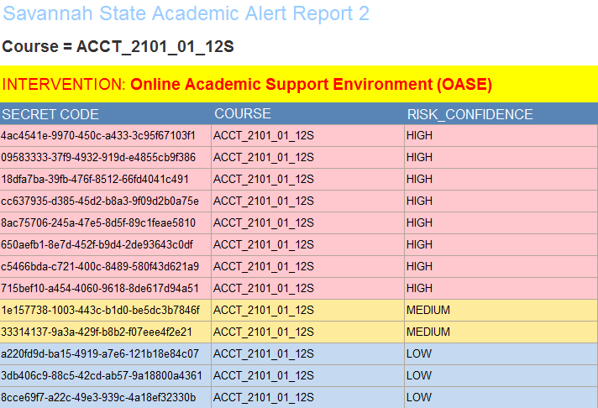
Integrated Approach
Each instructor will receive an Academic Alert Report (AAR) four times during the semester at 0%,25%, 50% and 75% into the semester.

Slide 16

What is our future vision of LAP @ JC?
Program-Level Tracking
Macroscopic Information
Course-Level
Information
Visual Information
Content-Level
Information
Microscopic Information

Slide 17
What is our future vision of LAP @ JC?
BlackBoard Data (LMS)
?
?
?
SPS Data
?
Banner Data (SIS)
Early Alerts from Faculty
Advising

Slide 18
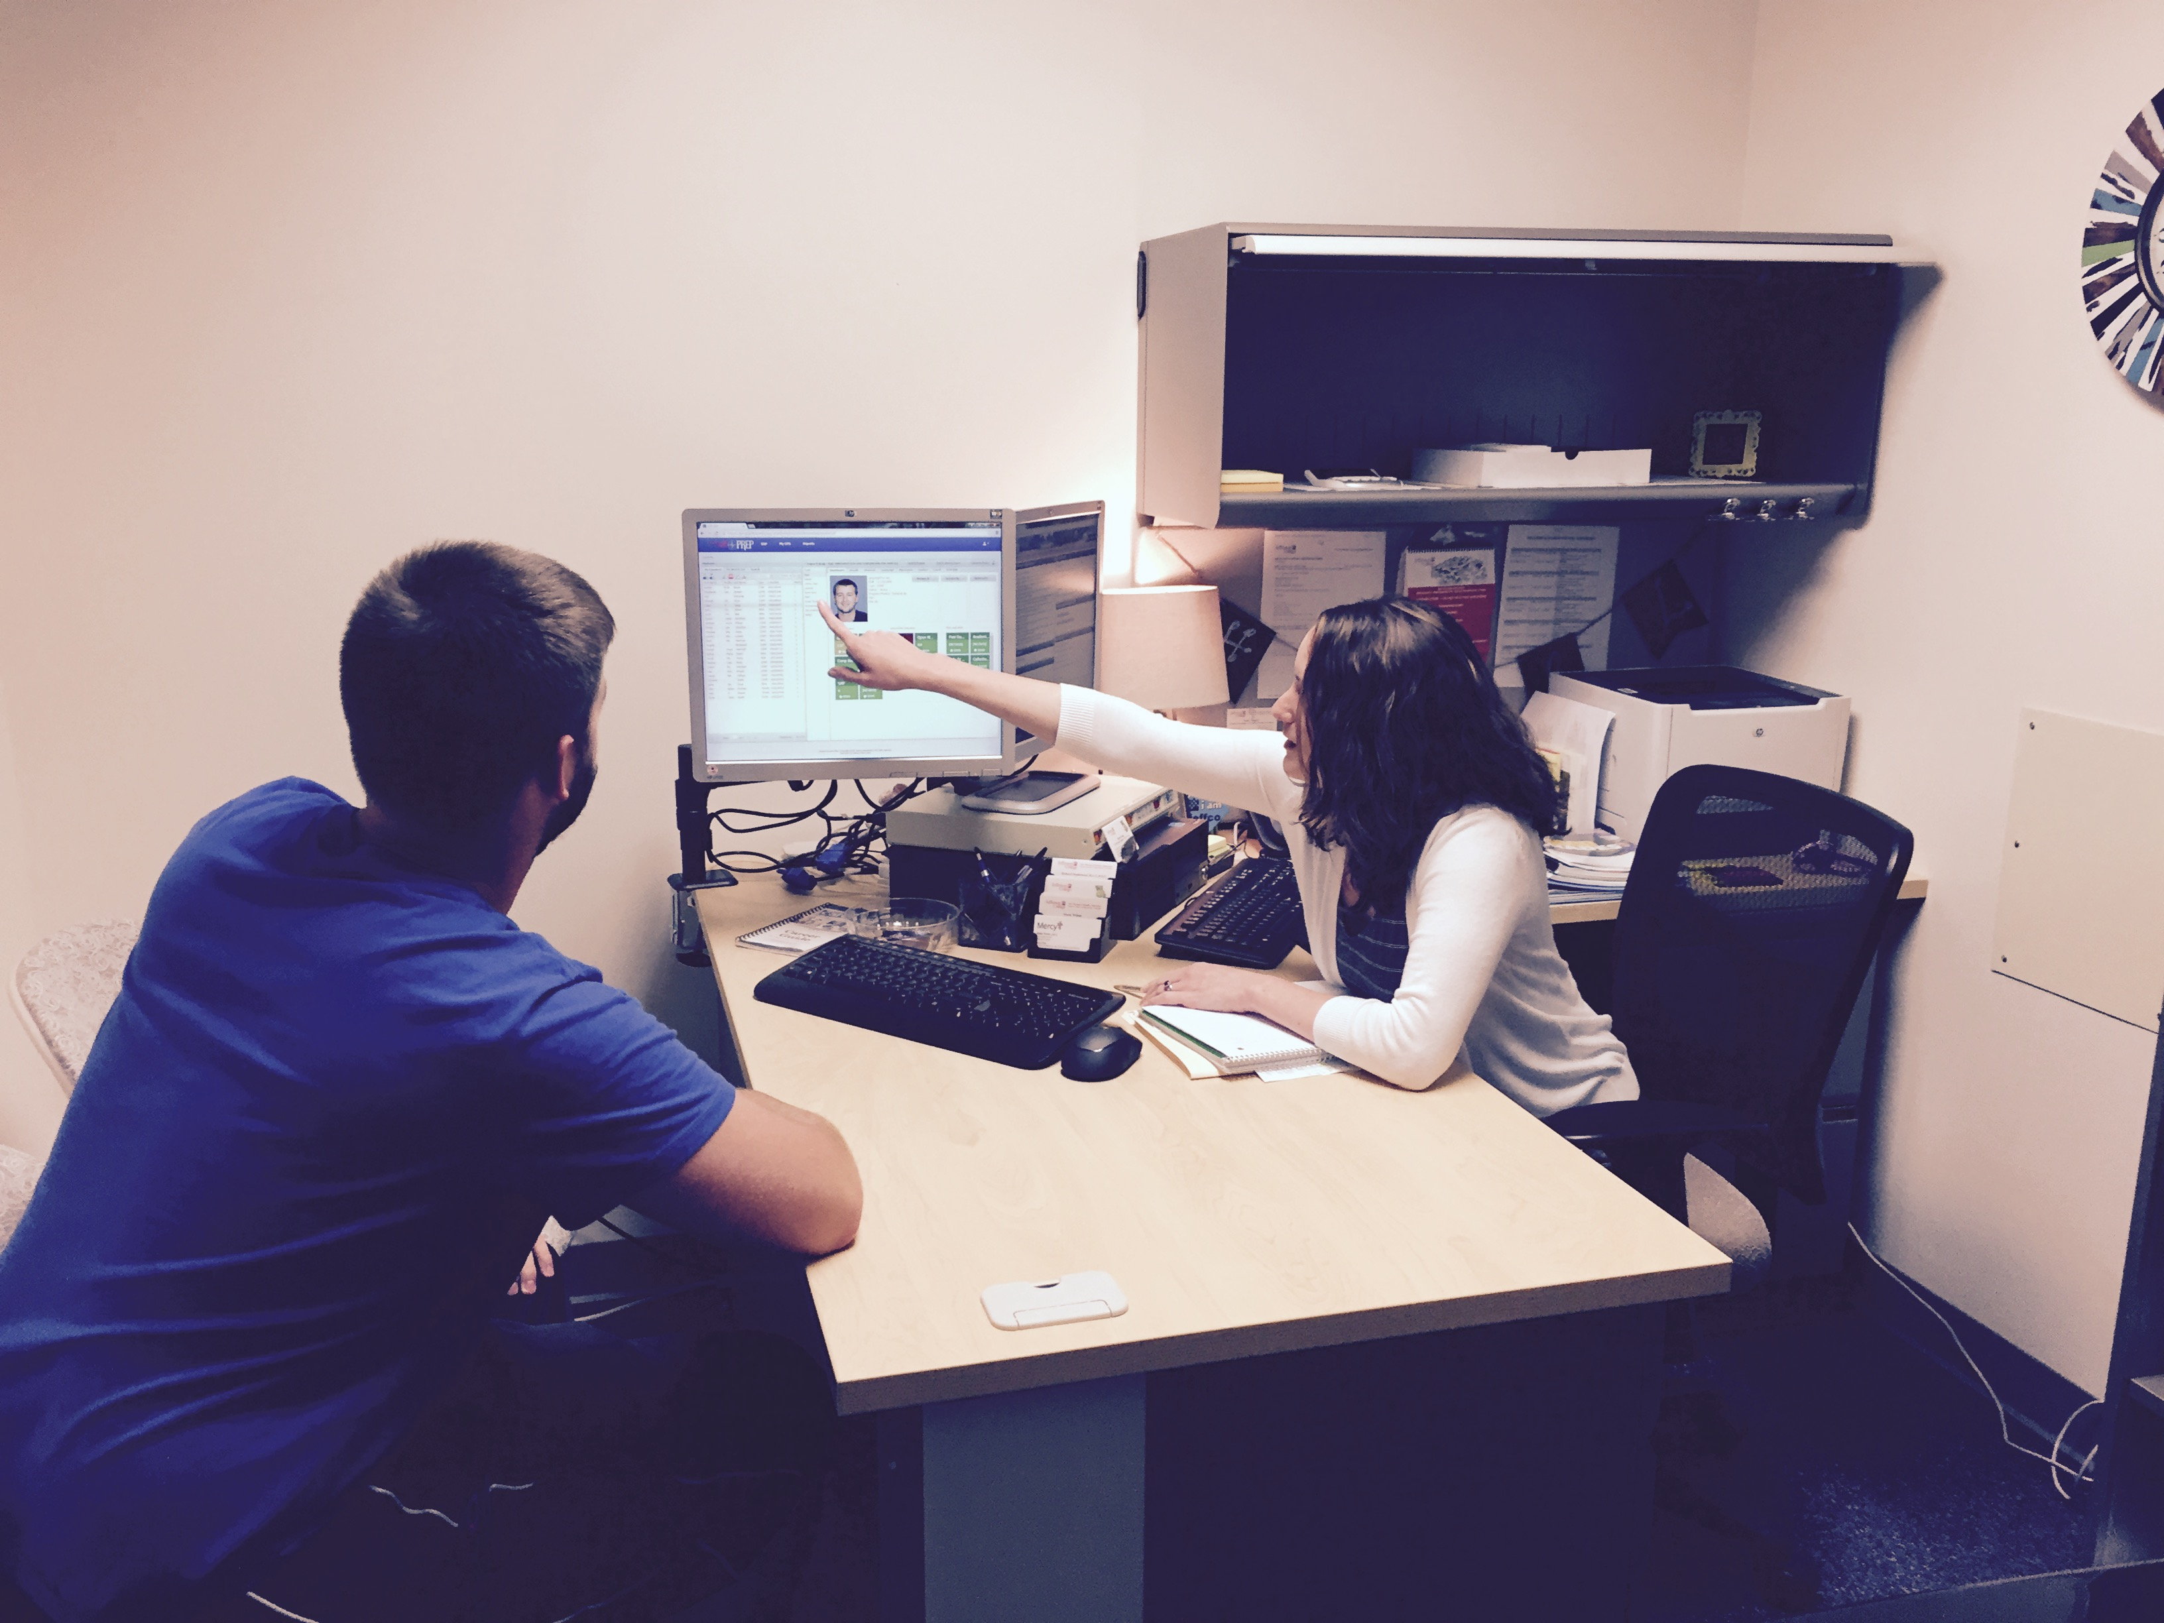
HP Navigator – Brenna Young

Slide 19
Logic Model:

Slide 20
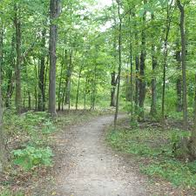
Thank you for your time and attention

