Slide 1
Access, Affordability, Success: NOVA's Digital Open Associate Degree Project
Wm. Preston Davis, Ed.D.
wdavis@nvcc.edu

Slide 2
Cost of Textbooks
Do you know the price students pay for textbooks in courses that you teach?

Slide 3
Open Educational Resources
OER
Open
Course Ware
Online Modules
Open Textbooks
Open Journals
Streaming Videos
Digital Tutorials
Learning Objects

Slide 4
What is an Open License?
Free: Free to access online, free to print
Open: Re-use, Revise, Remix, Redistribute
Creative Commons: free and open allows author to share with others but retain copyright.

Slide 5
Creative Commons Licenses
Some rights reserved - simple, standardized way
to grant copyright permissions
Permission:
Attribute:
http://creativecommons.org

Slide 6
Open Content Repositories
How to Adopt an Open Textbook
Notes:
Difference between Referral Lists and Repositories of Open Textbooks. Curated content and peer reviews and ranking and ratings.

Slide 7
Search Creative Commons

Slide 8
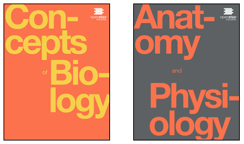
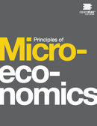
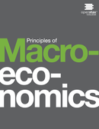
Openstax Catalog
Open Textbooks for top 20 course
Peer reviewed prior to publication
Adapted from David Harrison CCCOER webinar cc-by
Notes:
Open Textbook publisher, 9 available but another 11 are planned

Slide 9
OER Organizations & Resources
ELI OER Resource Site http://bit.ly/ELIOERforFaculty
OER Commons http://www.oercommons.org/
OpenStax http://openstaxcollege.org/
Open Education Consortium http://www.oeconsortium.org/
Open Course Library http://www.opencourselibrary.org/
College Open Textbooks http://www.collegeopentextbooks.org/
Saylor Academy http://www.saylor.org
Howard Hughes http://www.hhmi.org
MERLOT http://www.merlot.org
Open Textbook Library http://open.umn.edu/opentextbooks/
BC Campus http://open.bccampus.ca/
CCCOER http://www.oerconsortium.org/
MIT OCW http://ocw.mit.edu/index.htm
Lumen Learning http://lumenlearning.com/
Creative Commons http://creativecommons.org/
Also see Khan Academy, TedEd, Youtube, Internet Archive, Wikipedia, Google, etc.

Slide 10
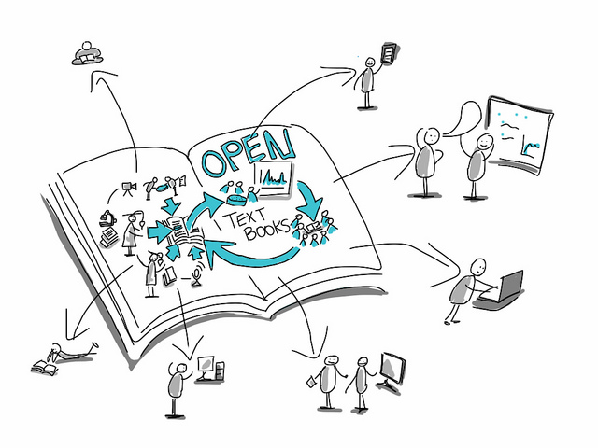
OPEN SEARCH Activity
Please use your device for the following…

Slide 11
Find and Share an Open Resource
http://www.oerconsortium.org/
http://lumenlearning.com/
http://openstaxcollege.org/
http://www.oeconsortium.org/
http://www.opencourselibrary.org/
http://www.collegeopentextbooks.org/
http://open.bccampus.ca/
http://www.saylor.org
http://www.hhmi.org
http://www.oercommons.org/
http://open.umn.edu/opentextbooks/
http://www.morguefile.com/
http://ocw.mit.edu/index.htm
http://creativecommons.org/
http://ed.ted.com/
https://archive.org/
Your faculty is building a module on Cell Biology. Please locate one of the following resources:
OER Adoption Tool Kit
Open Biology textbook
Openly Licensed Image
Free Video on Cells
Tweet your resource with hashtags #EDU15 #ELIOER
Notes:
Open Text – Openstax, Open Course Library, College Open Textbooks, Saylor, UMN, etc.
Image – HHMI, Morguefile, Creative Commons
Free Video – TedEd, HHMI, Internet Archive,

Slide 12
WHAT OER DID YOU FIND
& WHERE?

Slide 13
WHAT LICENSE DOES THE RESOURCE CARRY?

Slide 14
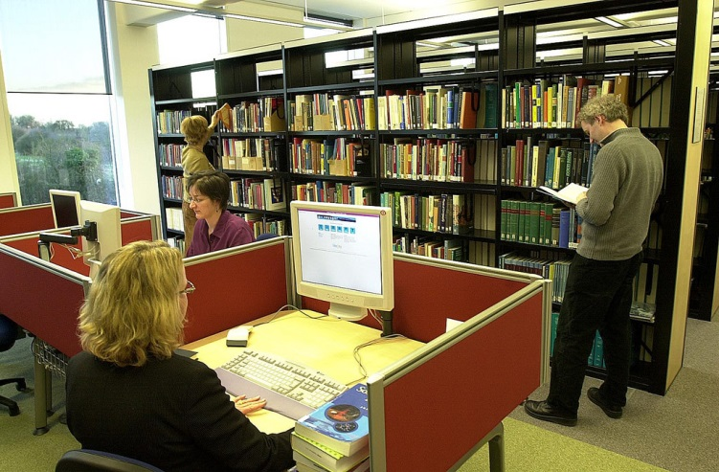
Don’t forget about Library Collections…
Open University, UK

Slide 15
…Or Public Domain Content…

Slide 16
…or that Technology is your Friend!

Slide 17
REMIXING AND ATTRIBUTION, GIVE IT A TRY…

Slide 18
So, Why use OER?
Access – Open Educational Resources allows for all students to have equal access to all course materials
Affordability – Open Educational Resources are free or very low cost, significantly reducing educational expenses
Student Success – Open Educational Resources are high quality educational materials available in a variety of engaging formats for all learners

Slide 19
Outcomes of ELI’s OER Program
Access – Open Educational Resources allows for all students to have equal access to all course materials
Over 8000 NOVA students have completed an OER course
Affordability – Open Educational Resources are free or very low cost, significantly reducing educational expenses
ELI Students have saved $1.5 Million with OER since fall 2013
Student Success – Open Educational Resources are high quality educational materials available in a variety of engaging formats for all learners
Success increased an average of 9% in OER pilot courses

Slide 20
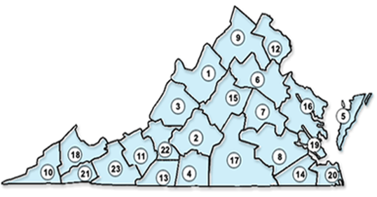
Comprehensive Approach to OER
40 ELI courses using free digital/open material with zero textbook costs, now referred to as zELI courses, provide degree pathways at lower cost to students
General Education Certificate and 2 full OER-based Associate Degree programs online
Students can save $185 per course, $3600 per degree
Ability to share content throughout the VCCS
and to open courses to all institutions through
partnership with Lumen Learning
Notes:
PAUSE Here… video launches automatically on next slide!

Slide 21
Access, Affordability, Success: NOVA's Digital Open Associate Degree Project

Slide 22
What Are Your Thoughts
on Open Education?
Wm. Preston Davis, Ed.D.
wdavis@nvcc.edu
@LazyPhilosopher

Slide 23
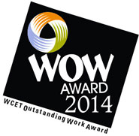
Questions/Comments?
Thank You!
Wm. Preston Davis, Ed.D.
wdavis@nvcc.edu
@LazyPhilosopher

