Slide 1
Creating Academic and Technology Partnerships for Student Success
Kyle Parker – Ball State University

Slide 2
The classroom

Slide 3
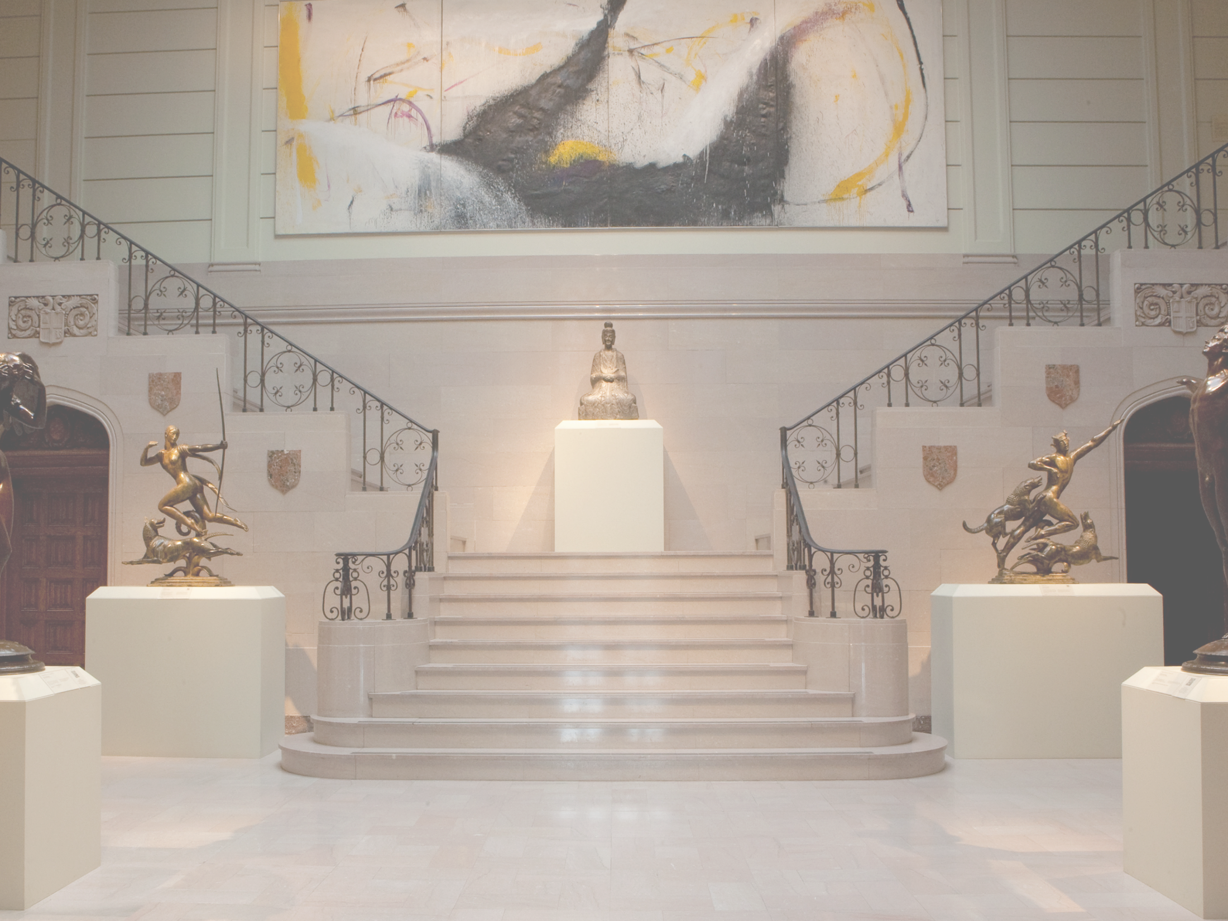
David Owsley Museum of Art
Ball State University
Notes:
Introduce the “classroom” - more than 11,000 works from Ancient Egypt, Greece, and Rome; China and Japan; the Native Americas; Ancient and Modern Africa, Europe, and the United States

Slide 4
Course materials

Slide 5
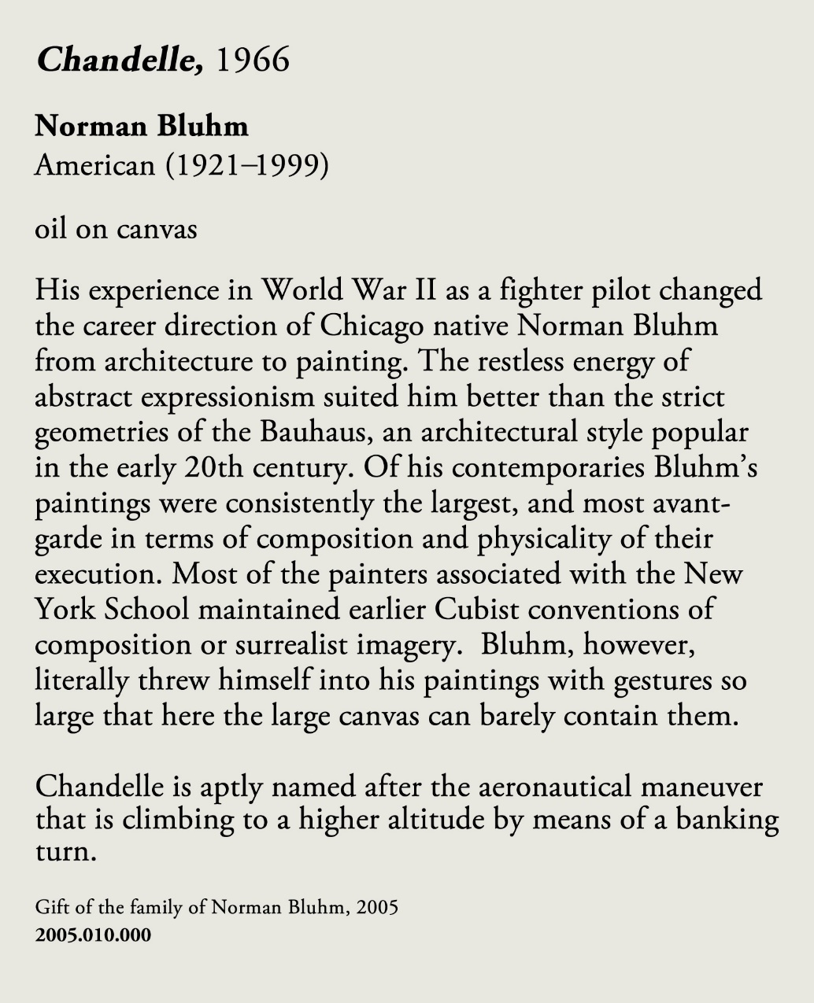
Notes:
Show a couple of examples to highlight the focus of the students’ work

Slide 6
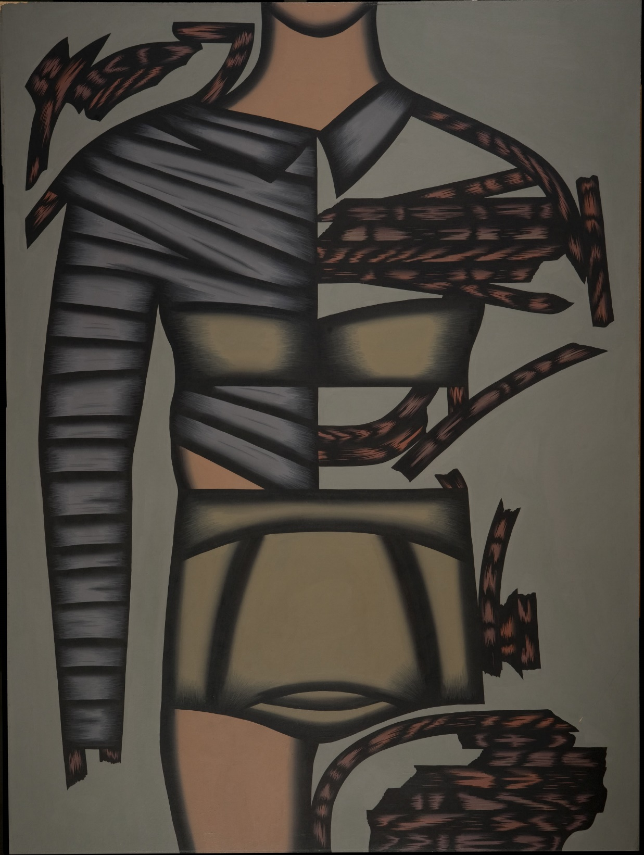
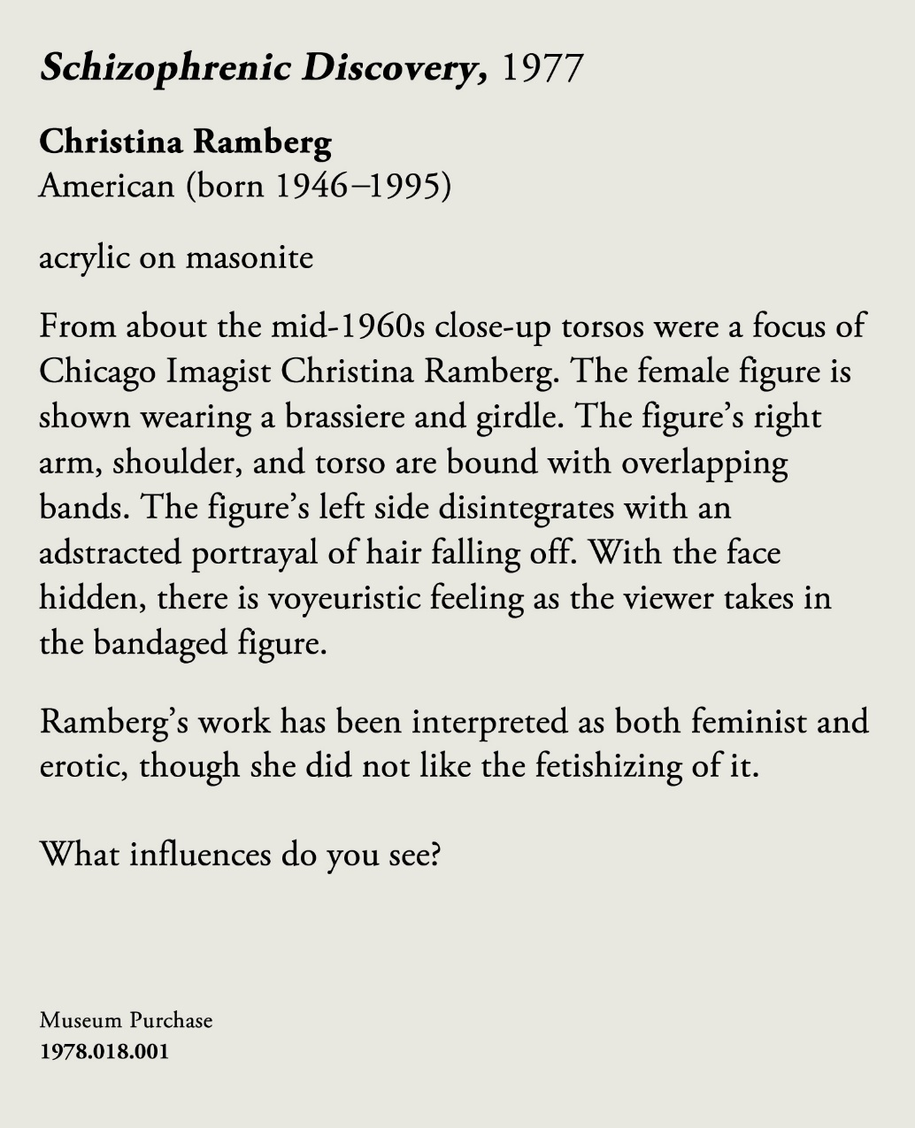

Slide 7
Learning outcomes

Slide 8

Relational
Relevant
Relatable
Information
Notes:
Set foundation for what we’re doing

Slide 9





Create connections between past experiences, memories and the course materials

Slide 10

How do students retain the coursework and learn what the professor is teaching?

Slide 11
“Does the information
make sense?”
and
“Does it have meaning?”
Source: David Sousa, How the Brain Learns.

Slide 12
Our students

Slide 13

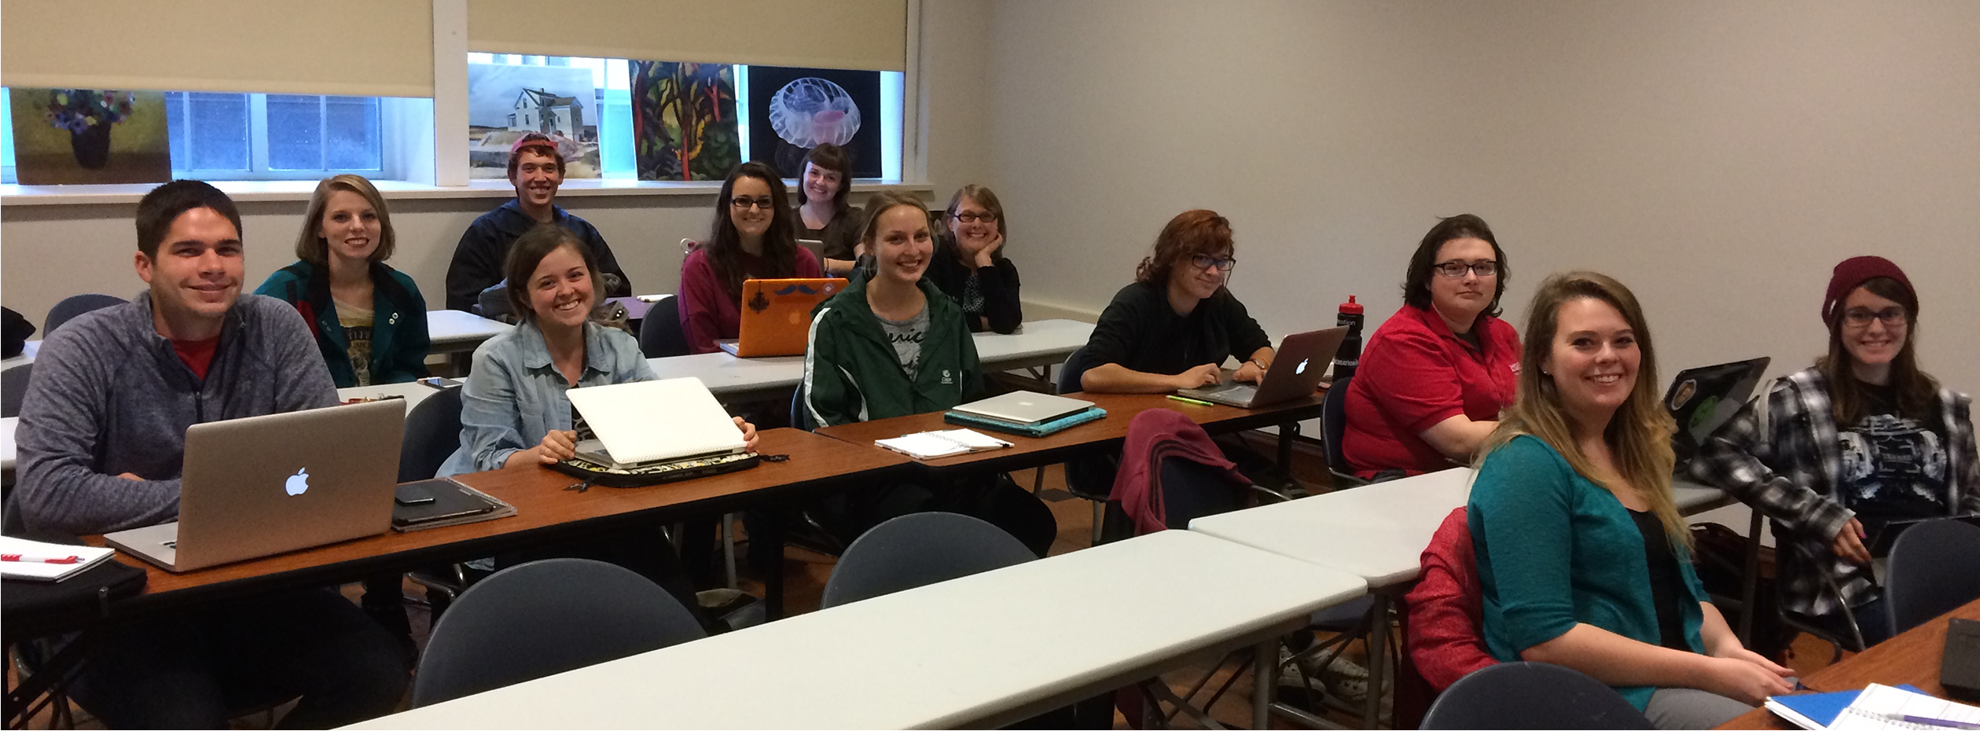
Professor Lara Kuykendall with
students from the
Art Museum Theory and Practice course
Notes:
Introduce the class

Slide 14
Early prototype

Slide 15
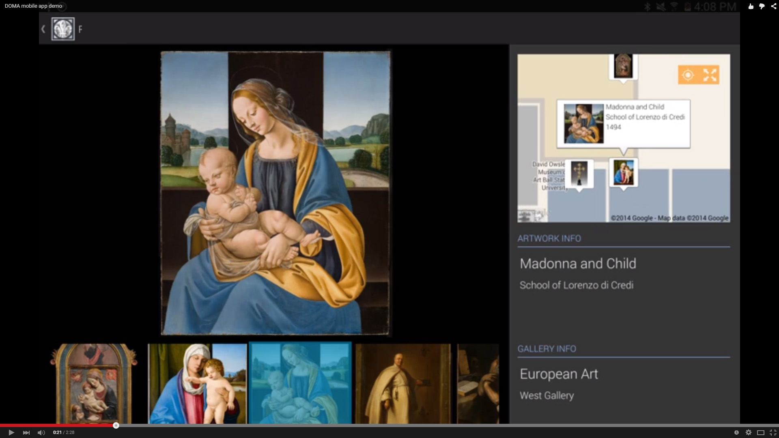

Slide 16
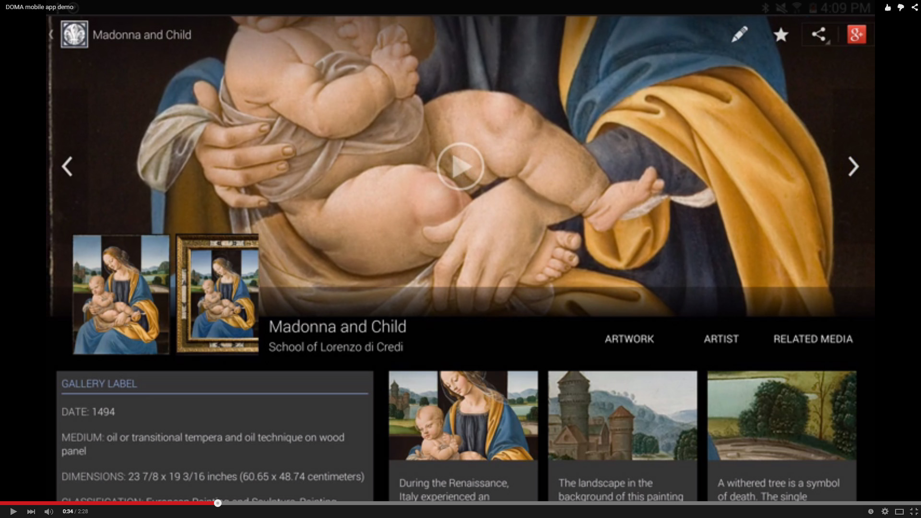

Slide 17
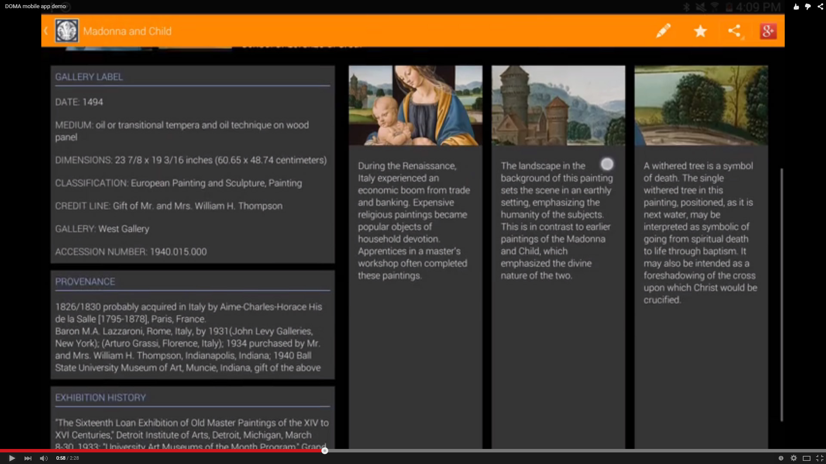

Slide 18
The project
Semester-long project and 40% of their grade!

Slide 19
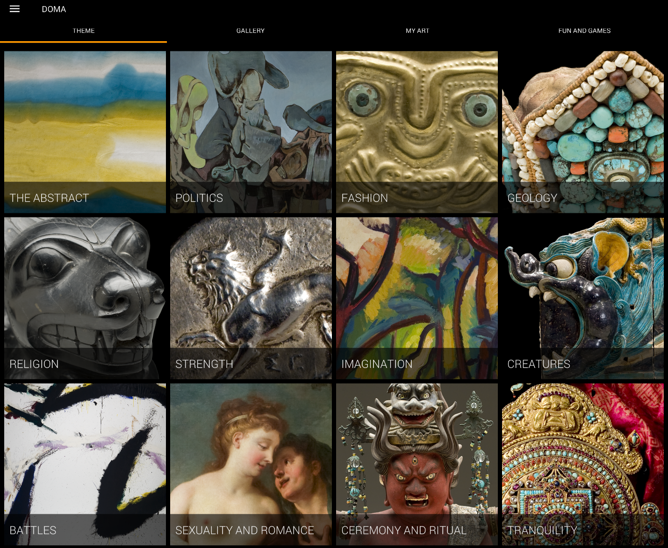
Students were able to create, name, and curate one theme.
Developed an emotion bond with the museum collection and their chosen theme
Took an active interest in the usability of the app.
Notes:
What did they do?

Slide 20
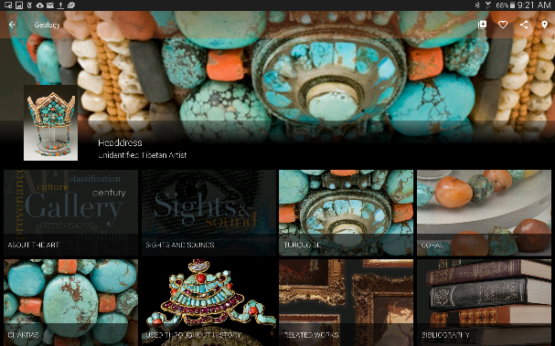
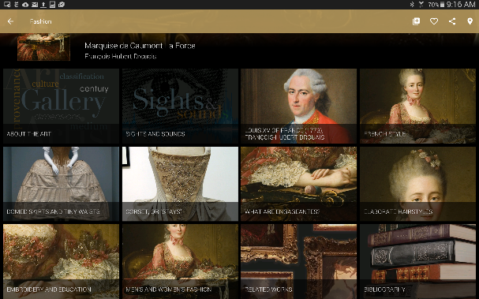
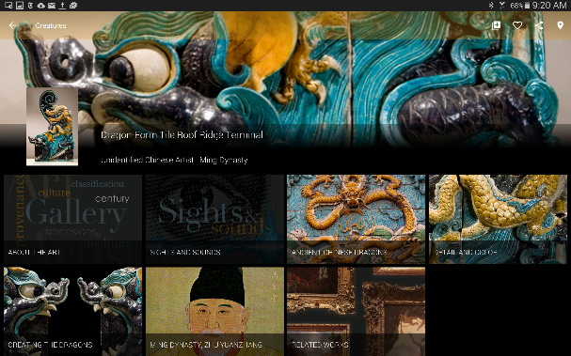
Geology
Fashion
Creatures
Students are more likely to gain greater understanding of and derive greater pleasure from learning when allowed to transform the learning into creative thoughts and products.
Source: David Sousa, How the Brain Learns.

Slide 21
The app

Slide 22
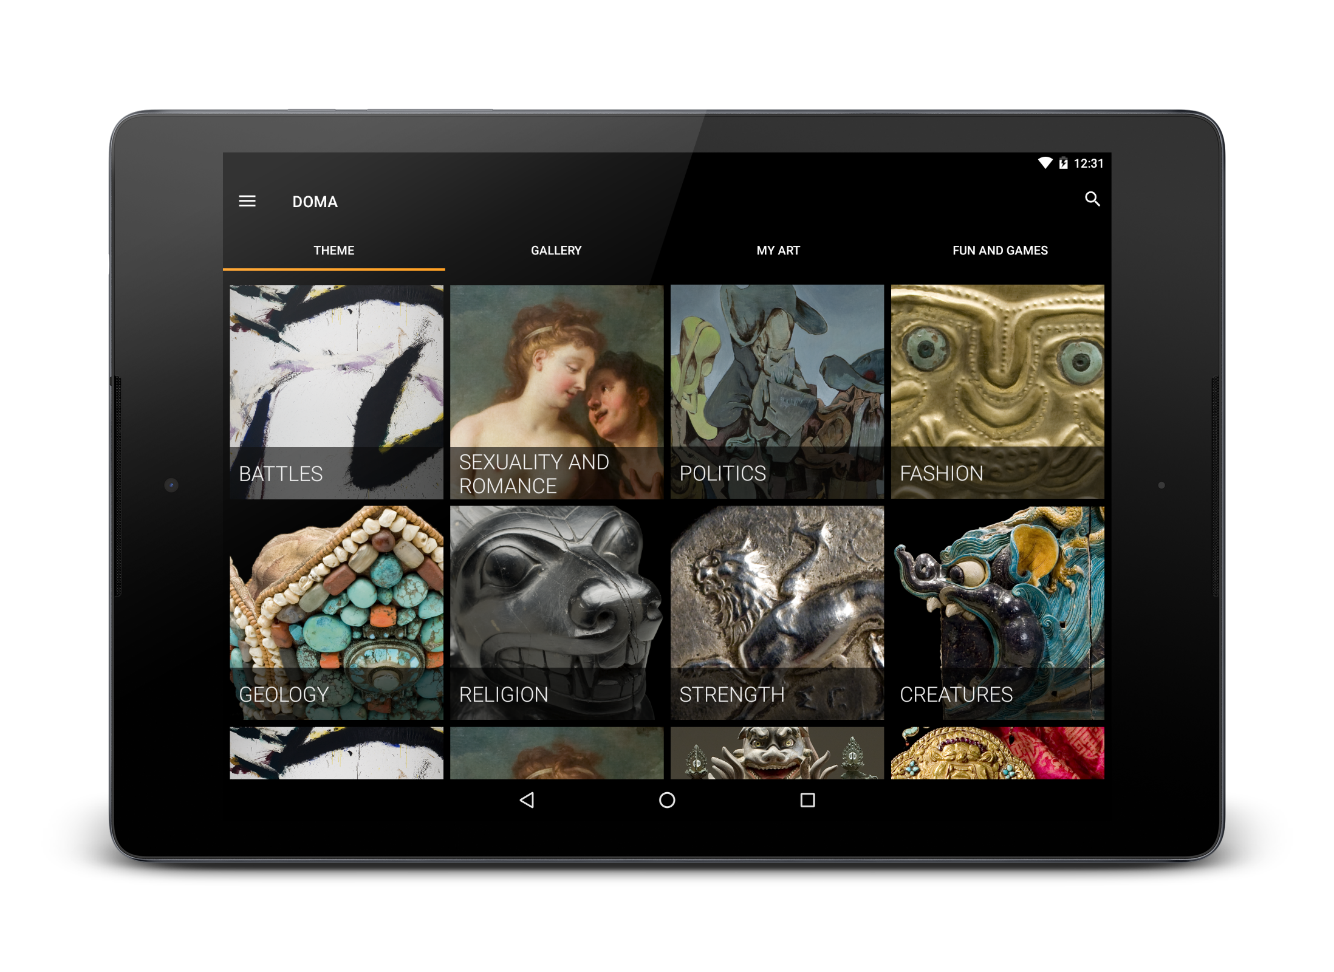


Slide 23
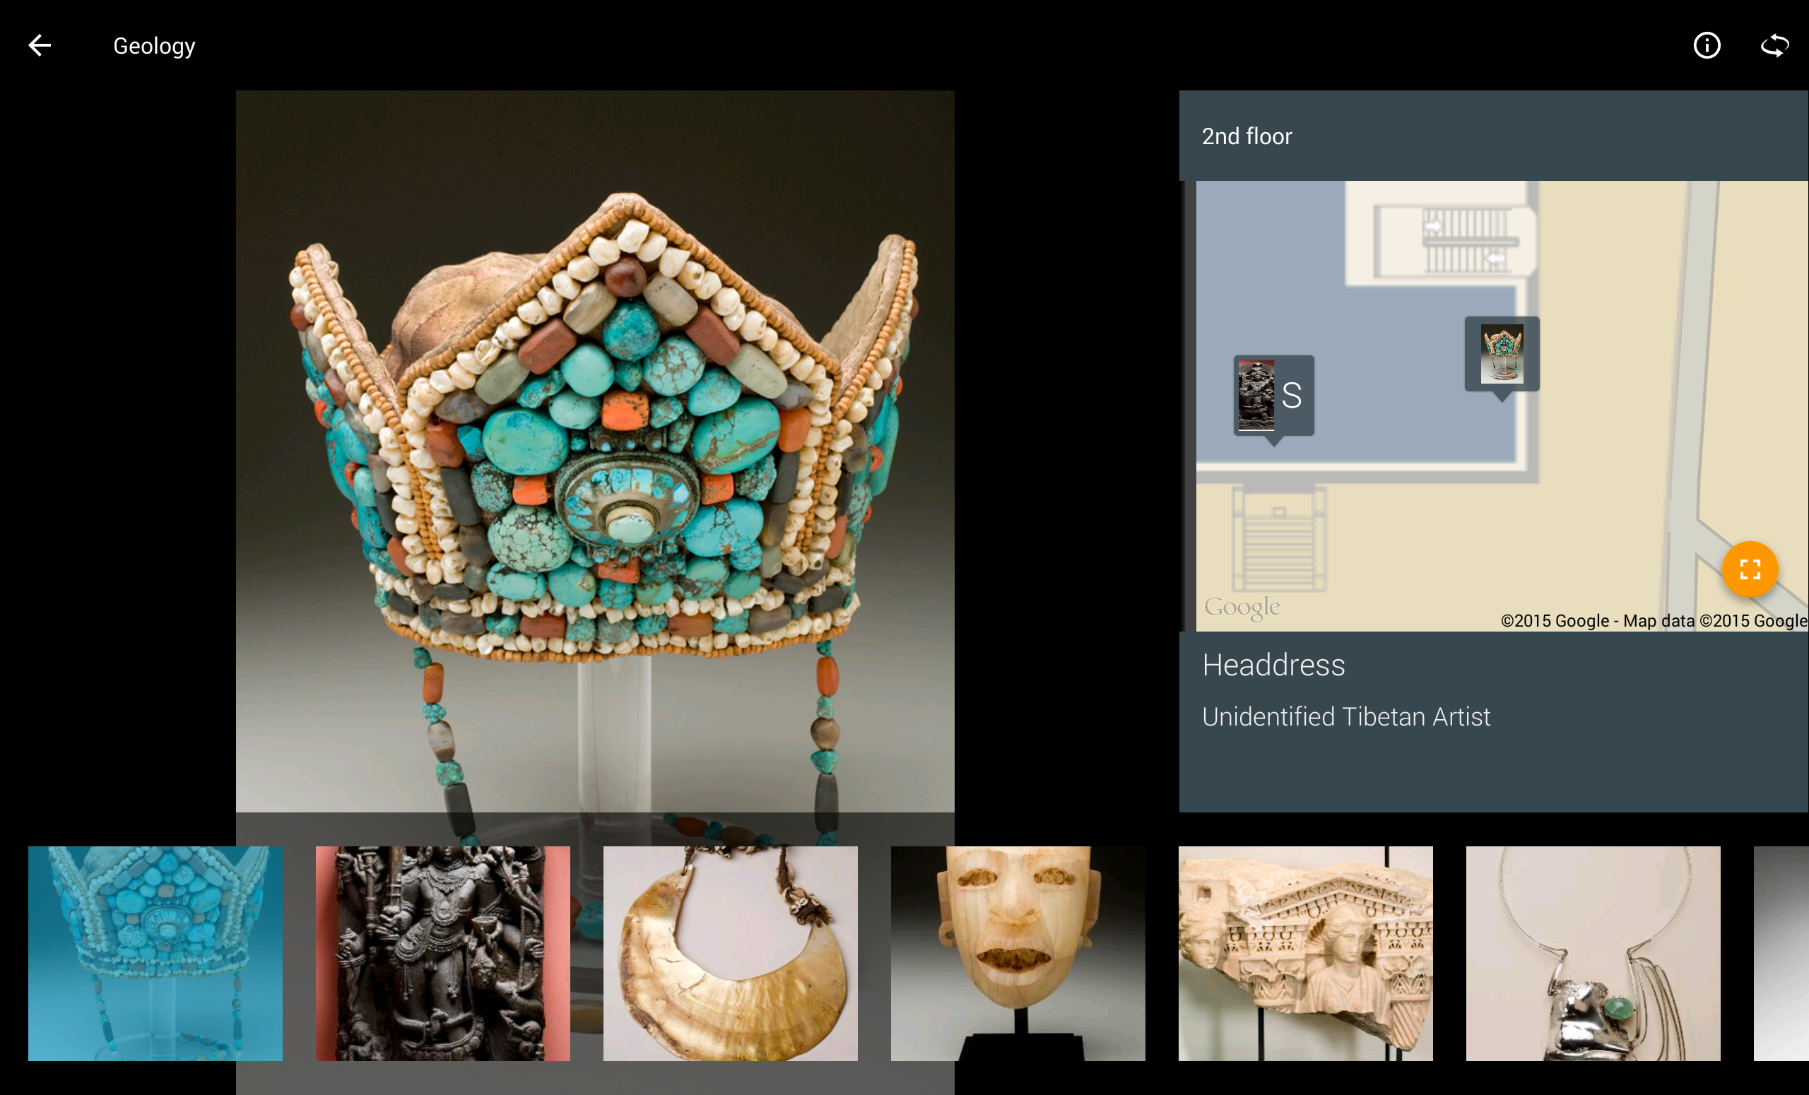


Slide 24
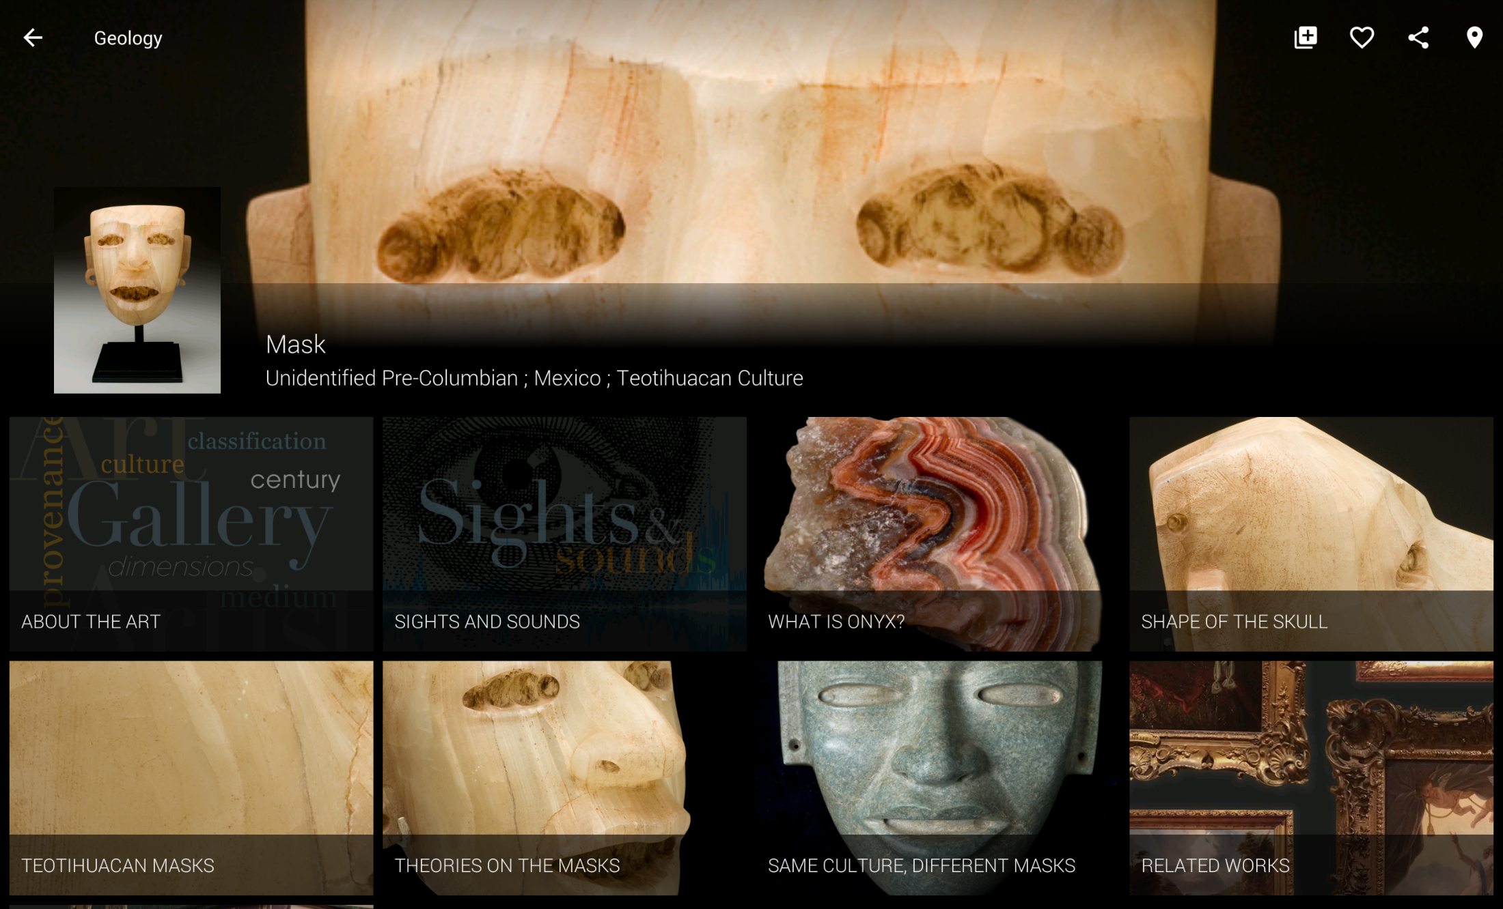
Notes:
Examples of the app – discuss the before/after

Slide 25
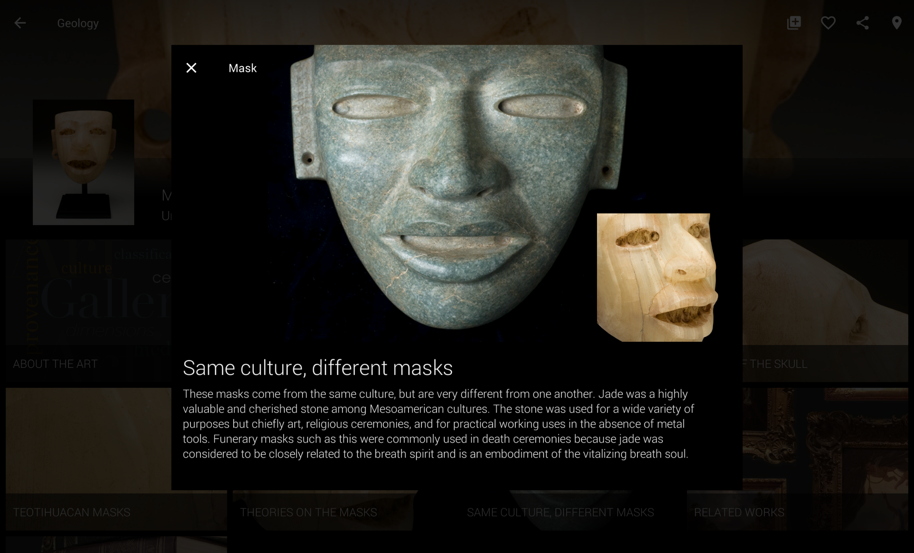

Slide 26
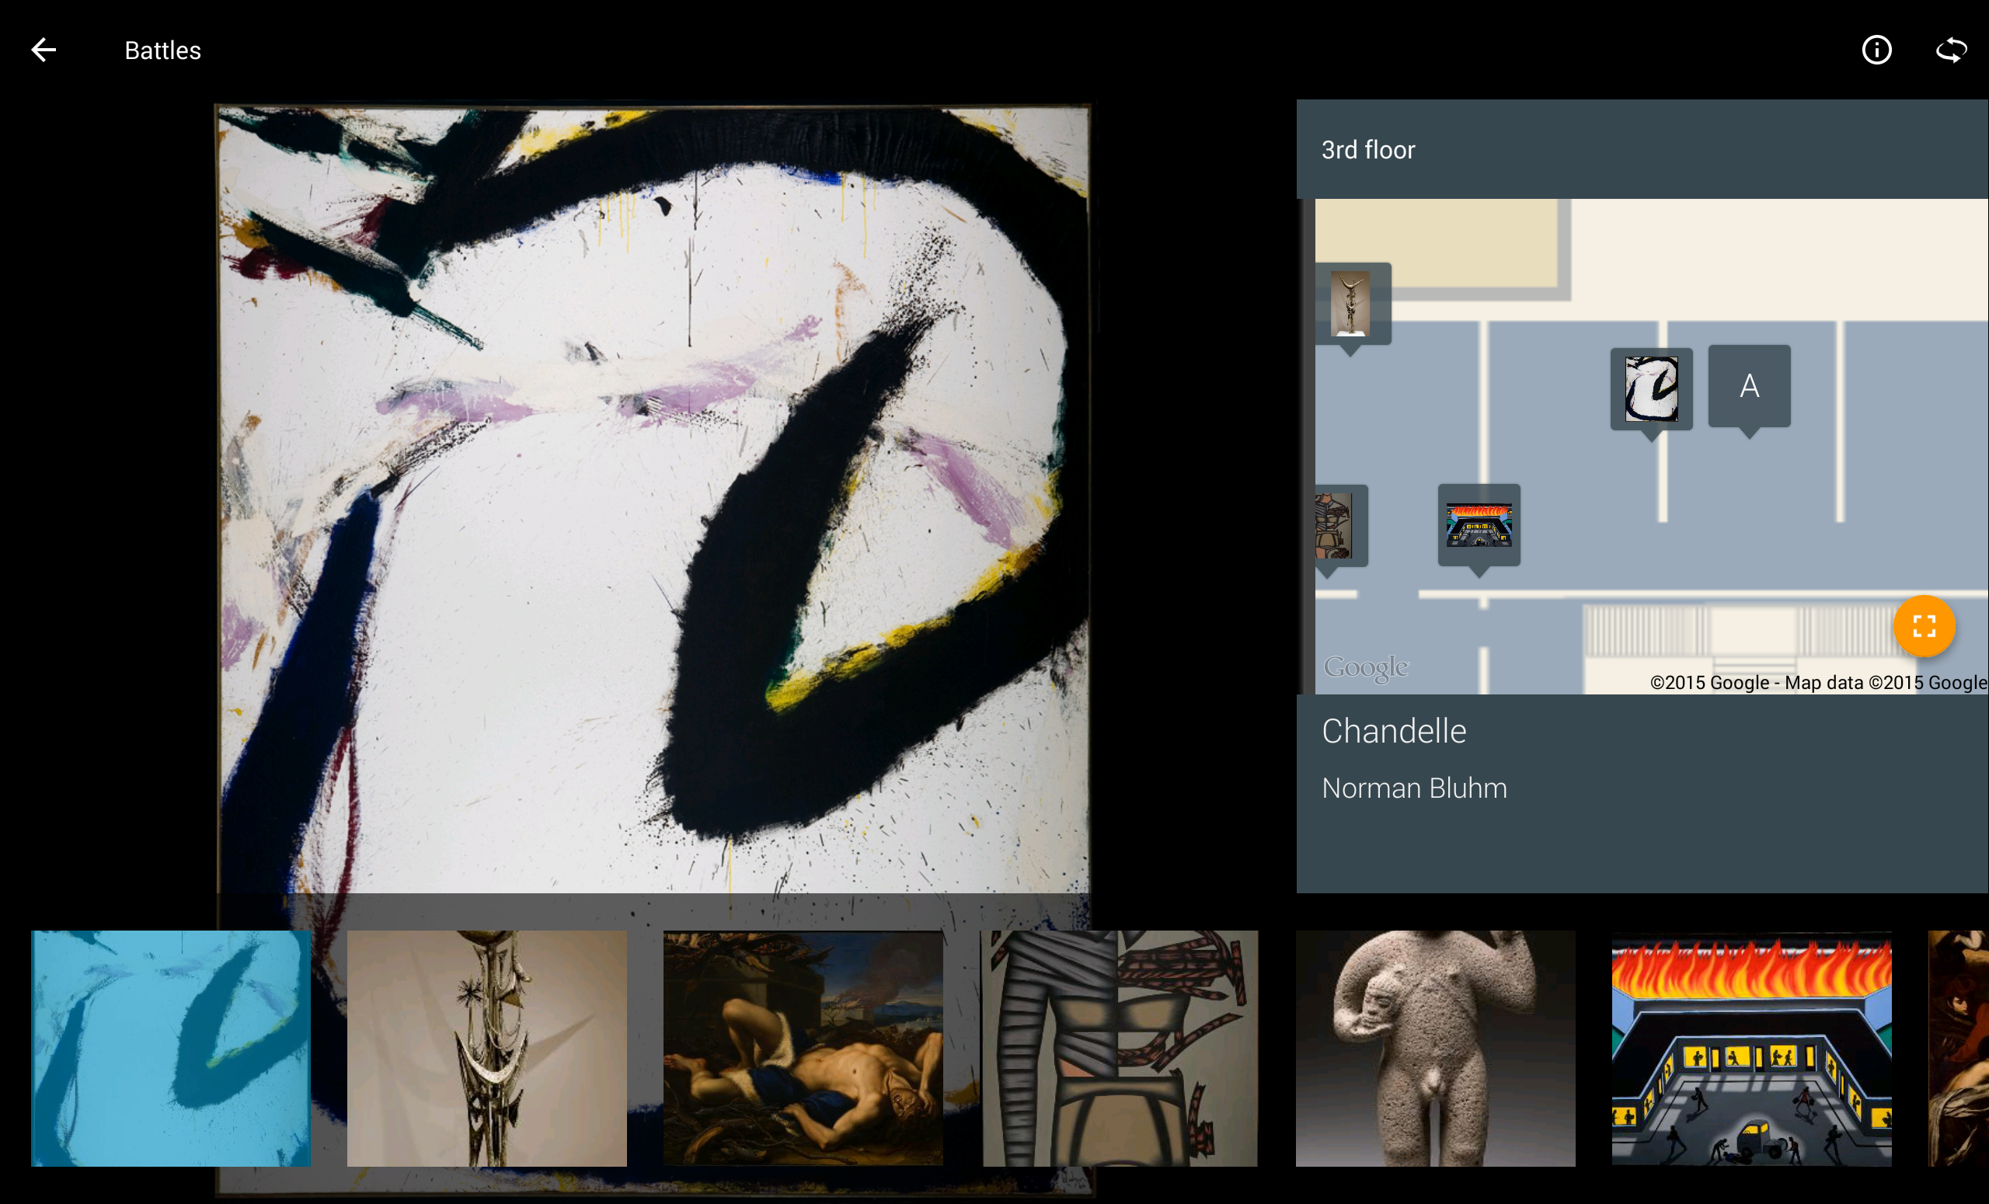
Norman Bluhm’s
Abstract Expressionist painting, Chandelle (1966)
appears in the Battles theme, curated by Samantha Ehrhart.

Slide 27

What do you remember?
. . . the title
. . . the artist
. . . the movement

Slide 28
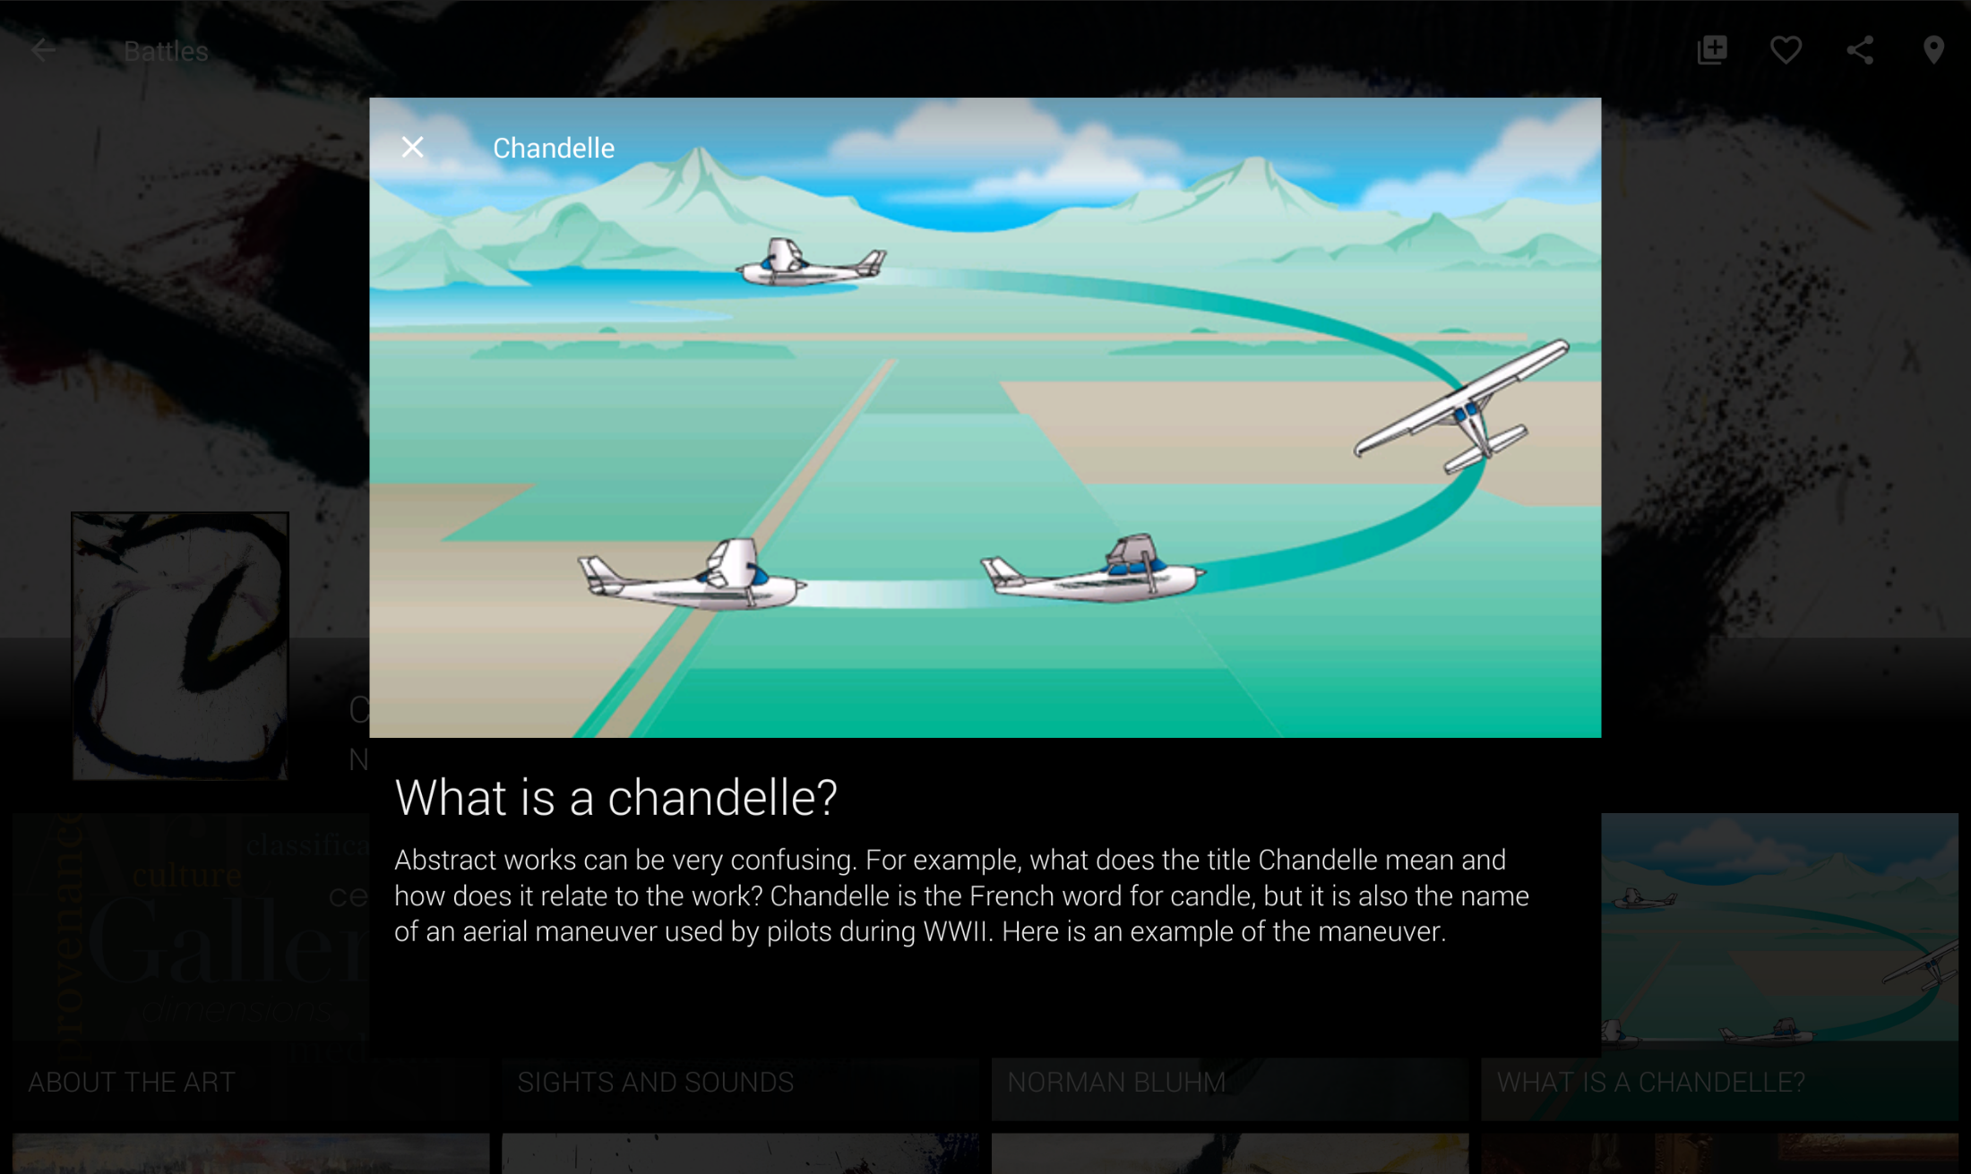
Provides definition and meaning

Slide 29
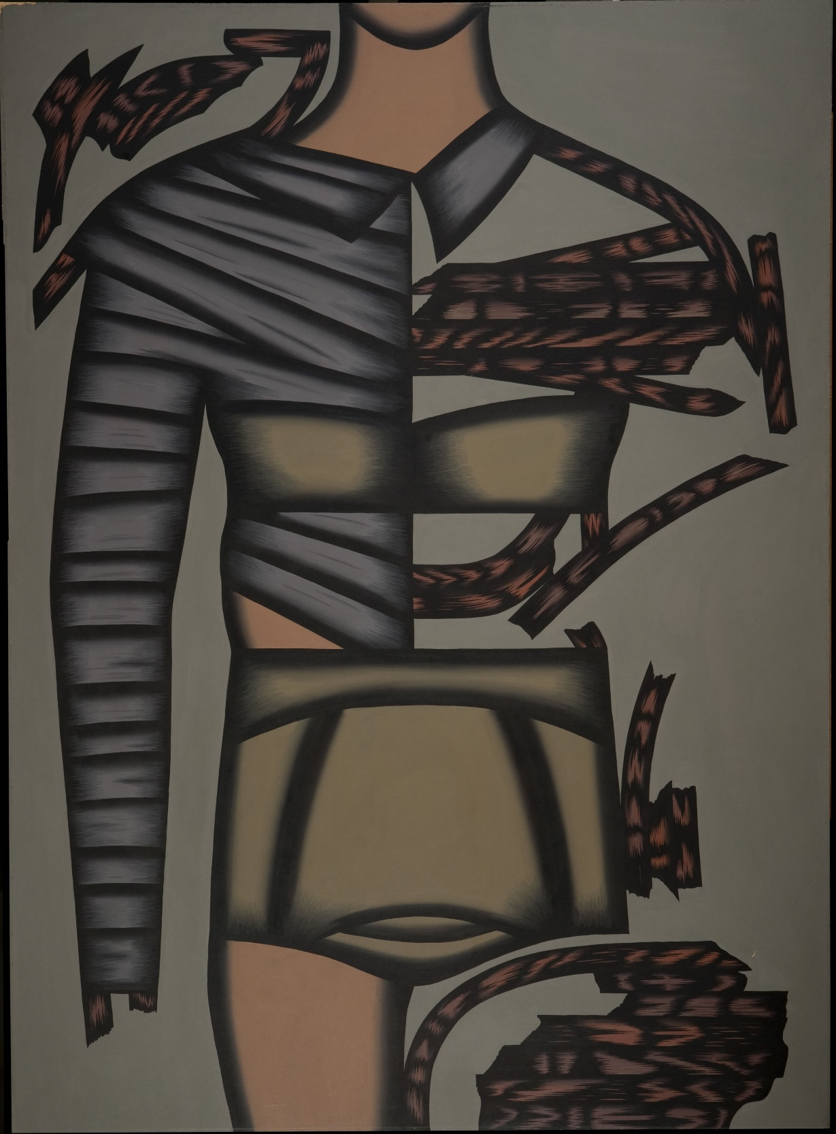
What was
your first
reaction to
this work?
. . . did you like it
. . . want to know more about it
. . . understand it

Slide 30
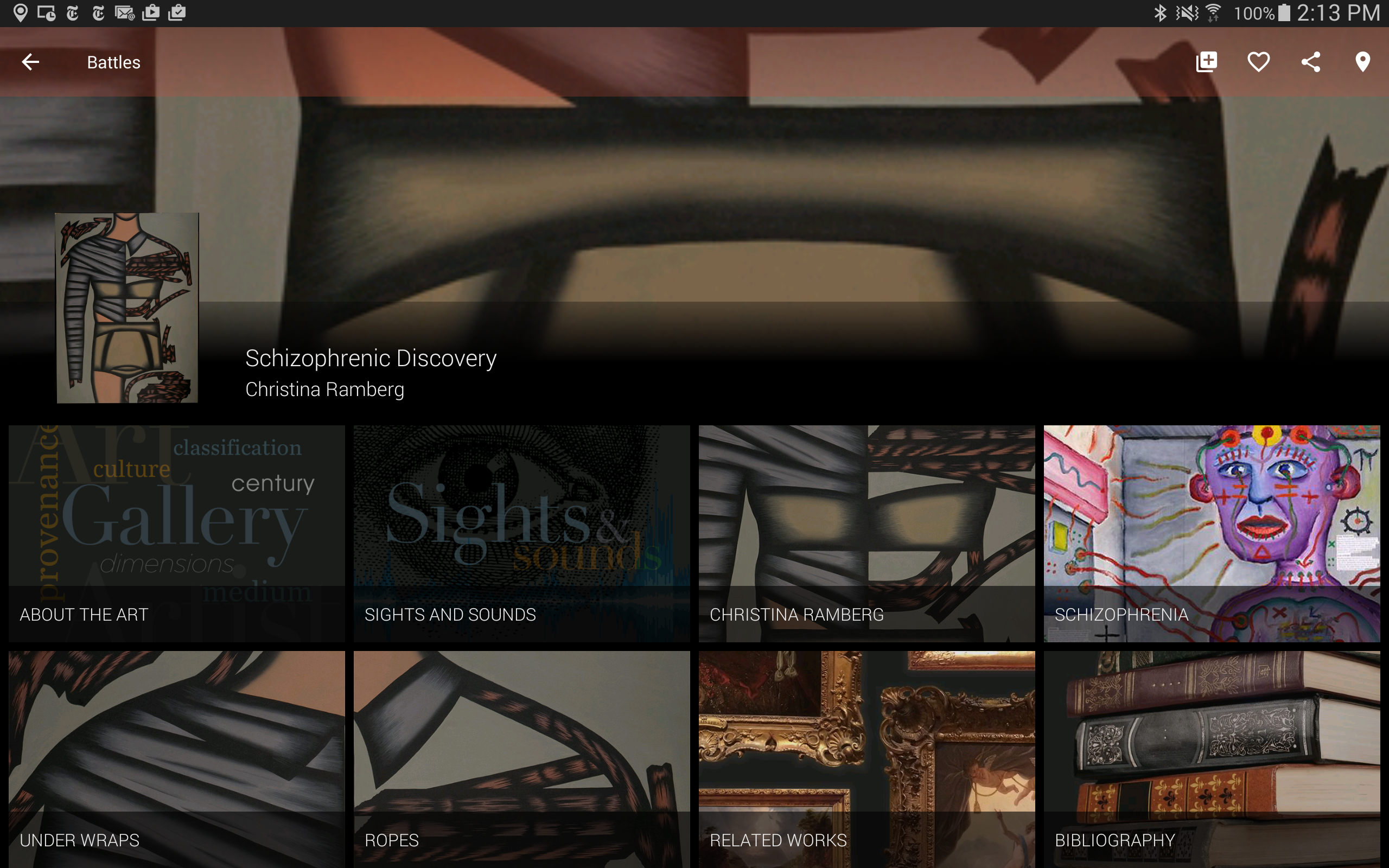

Slide 31
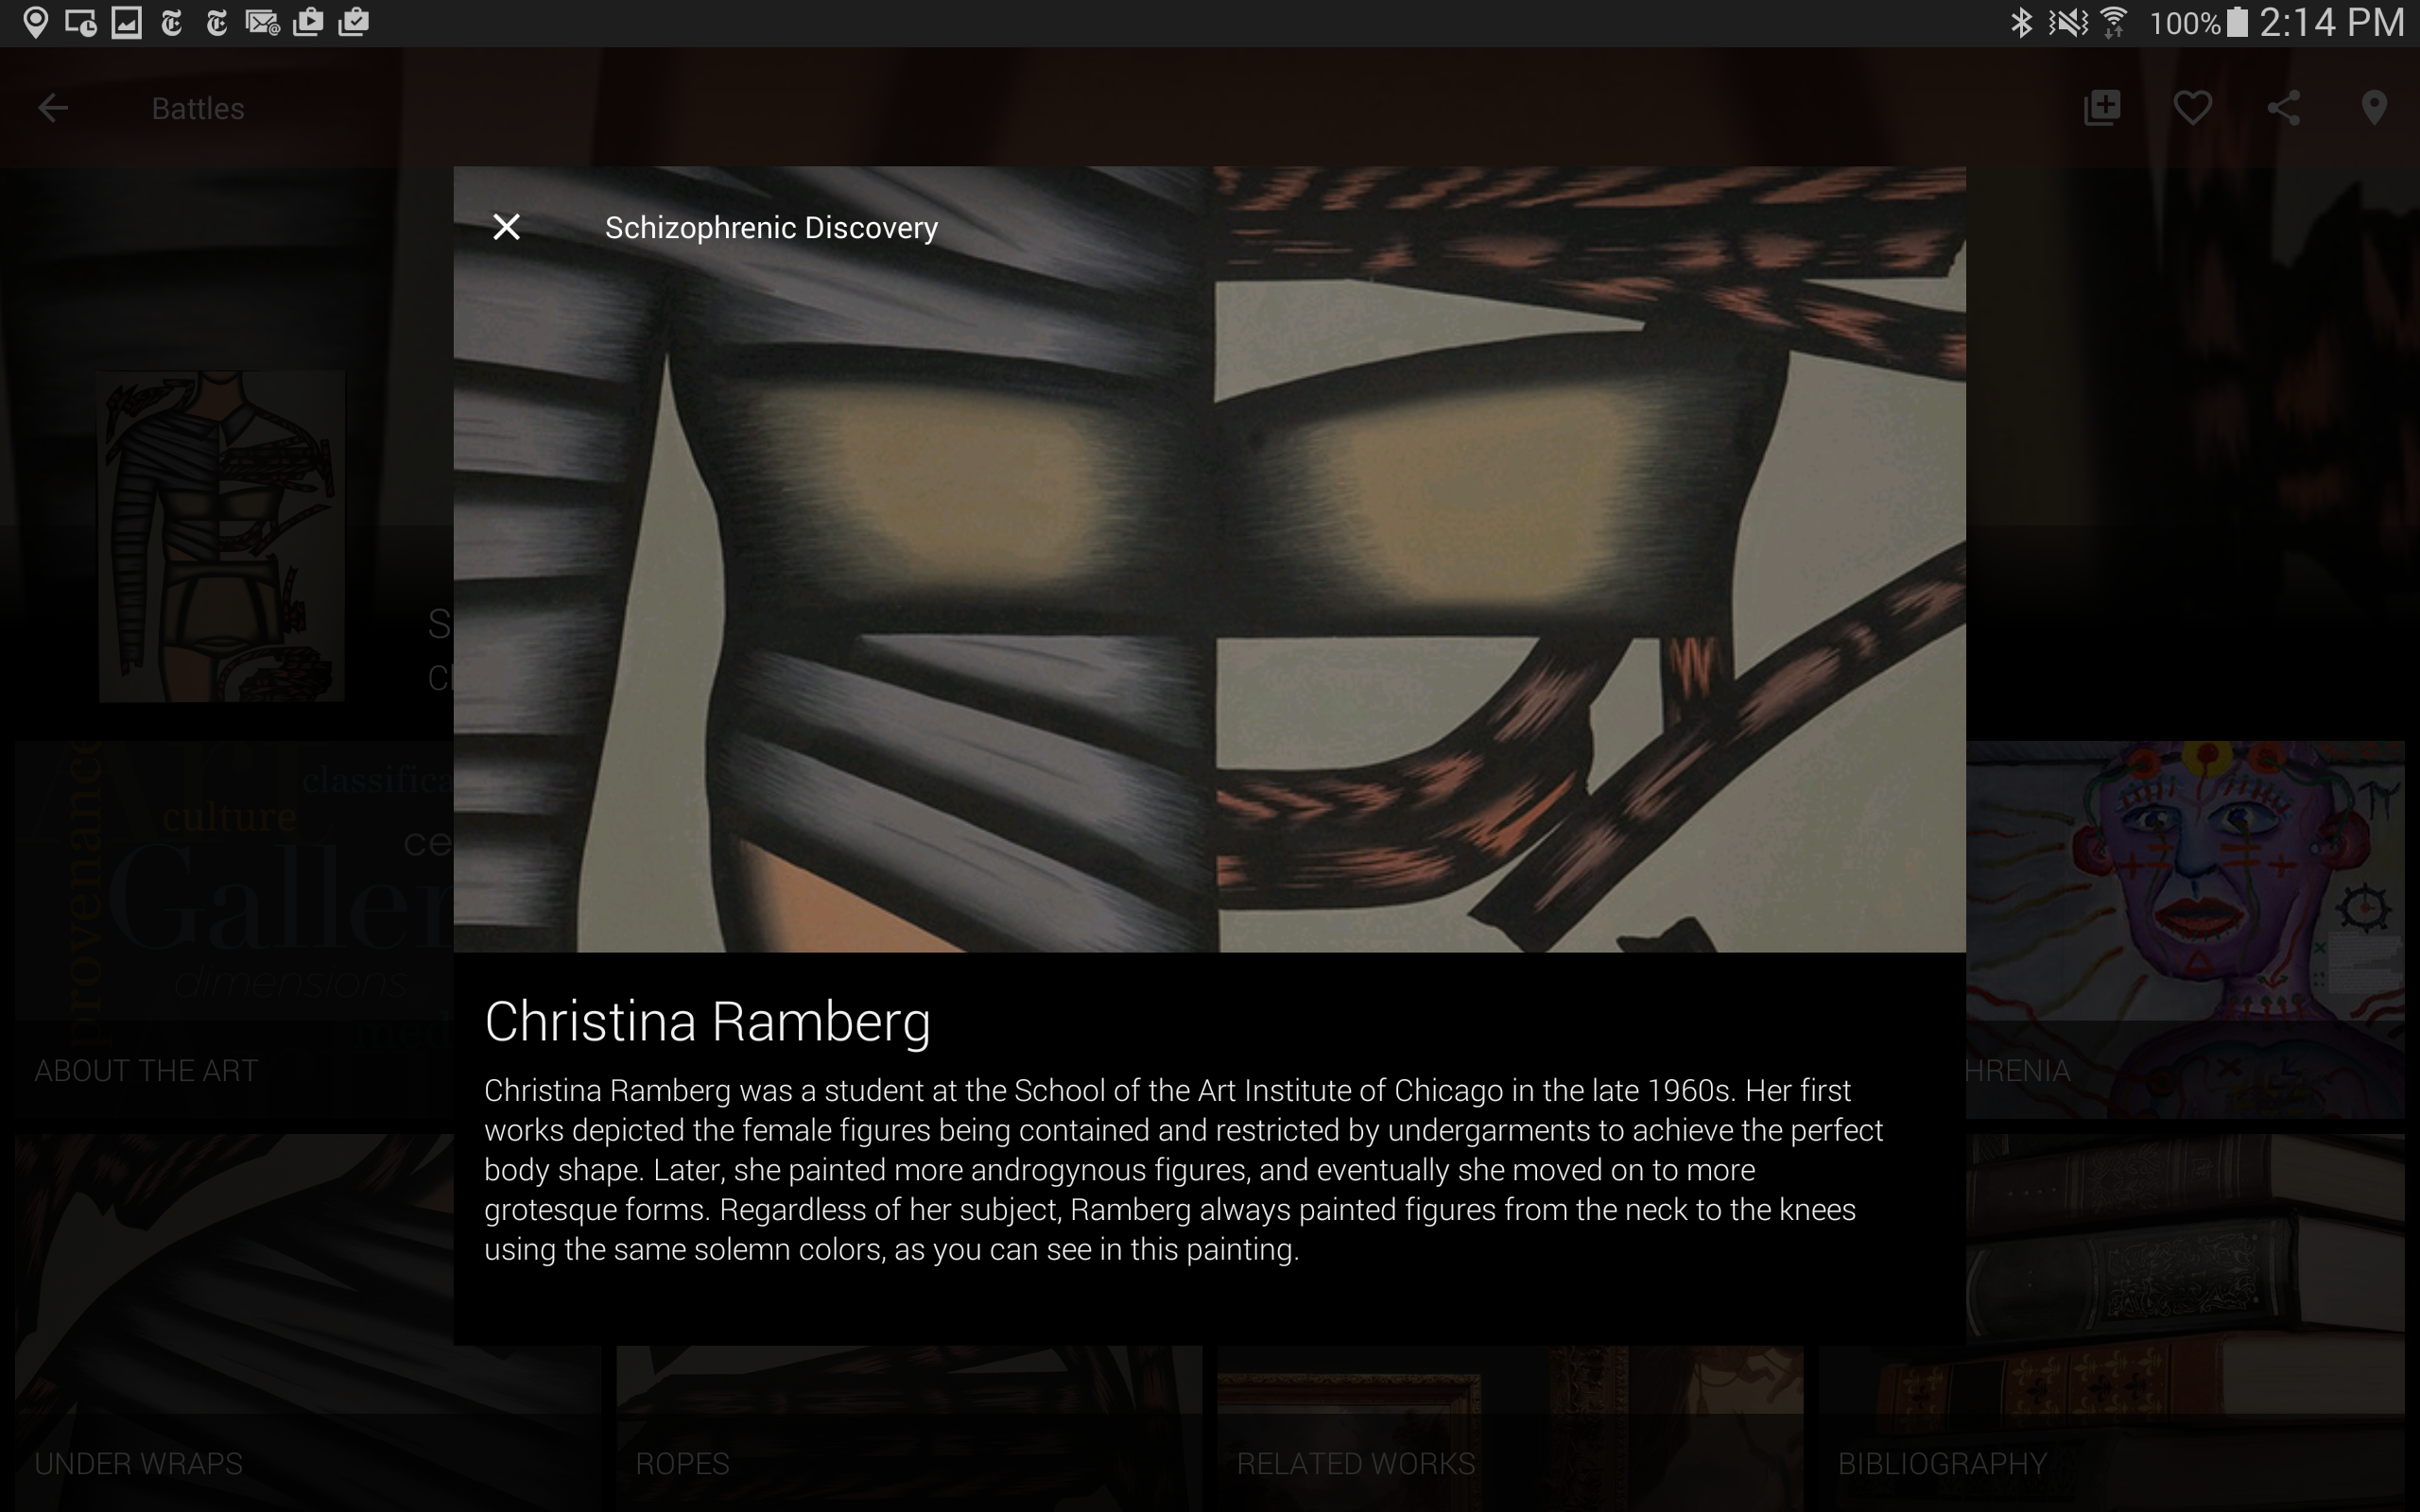
Provides context

Slide 32
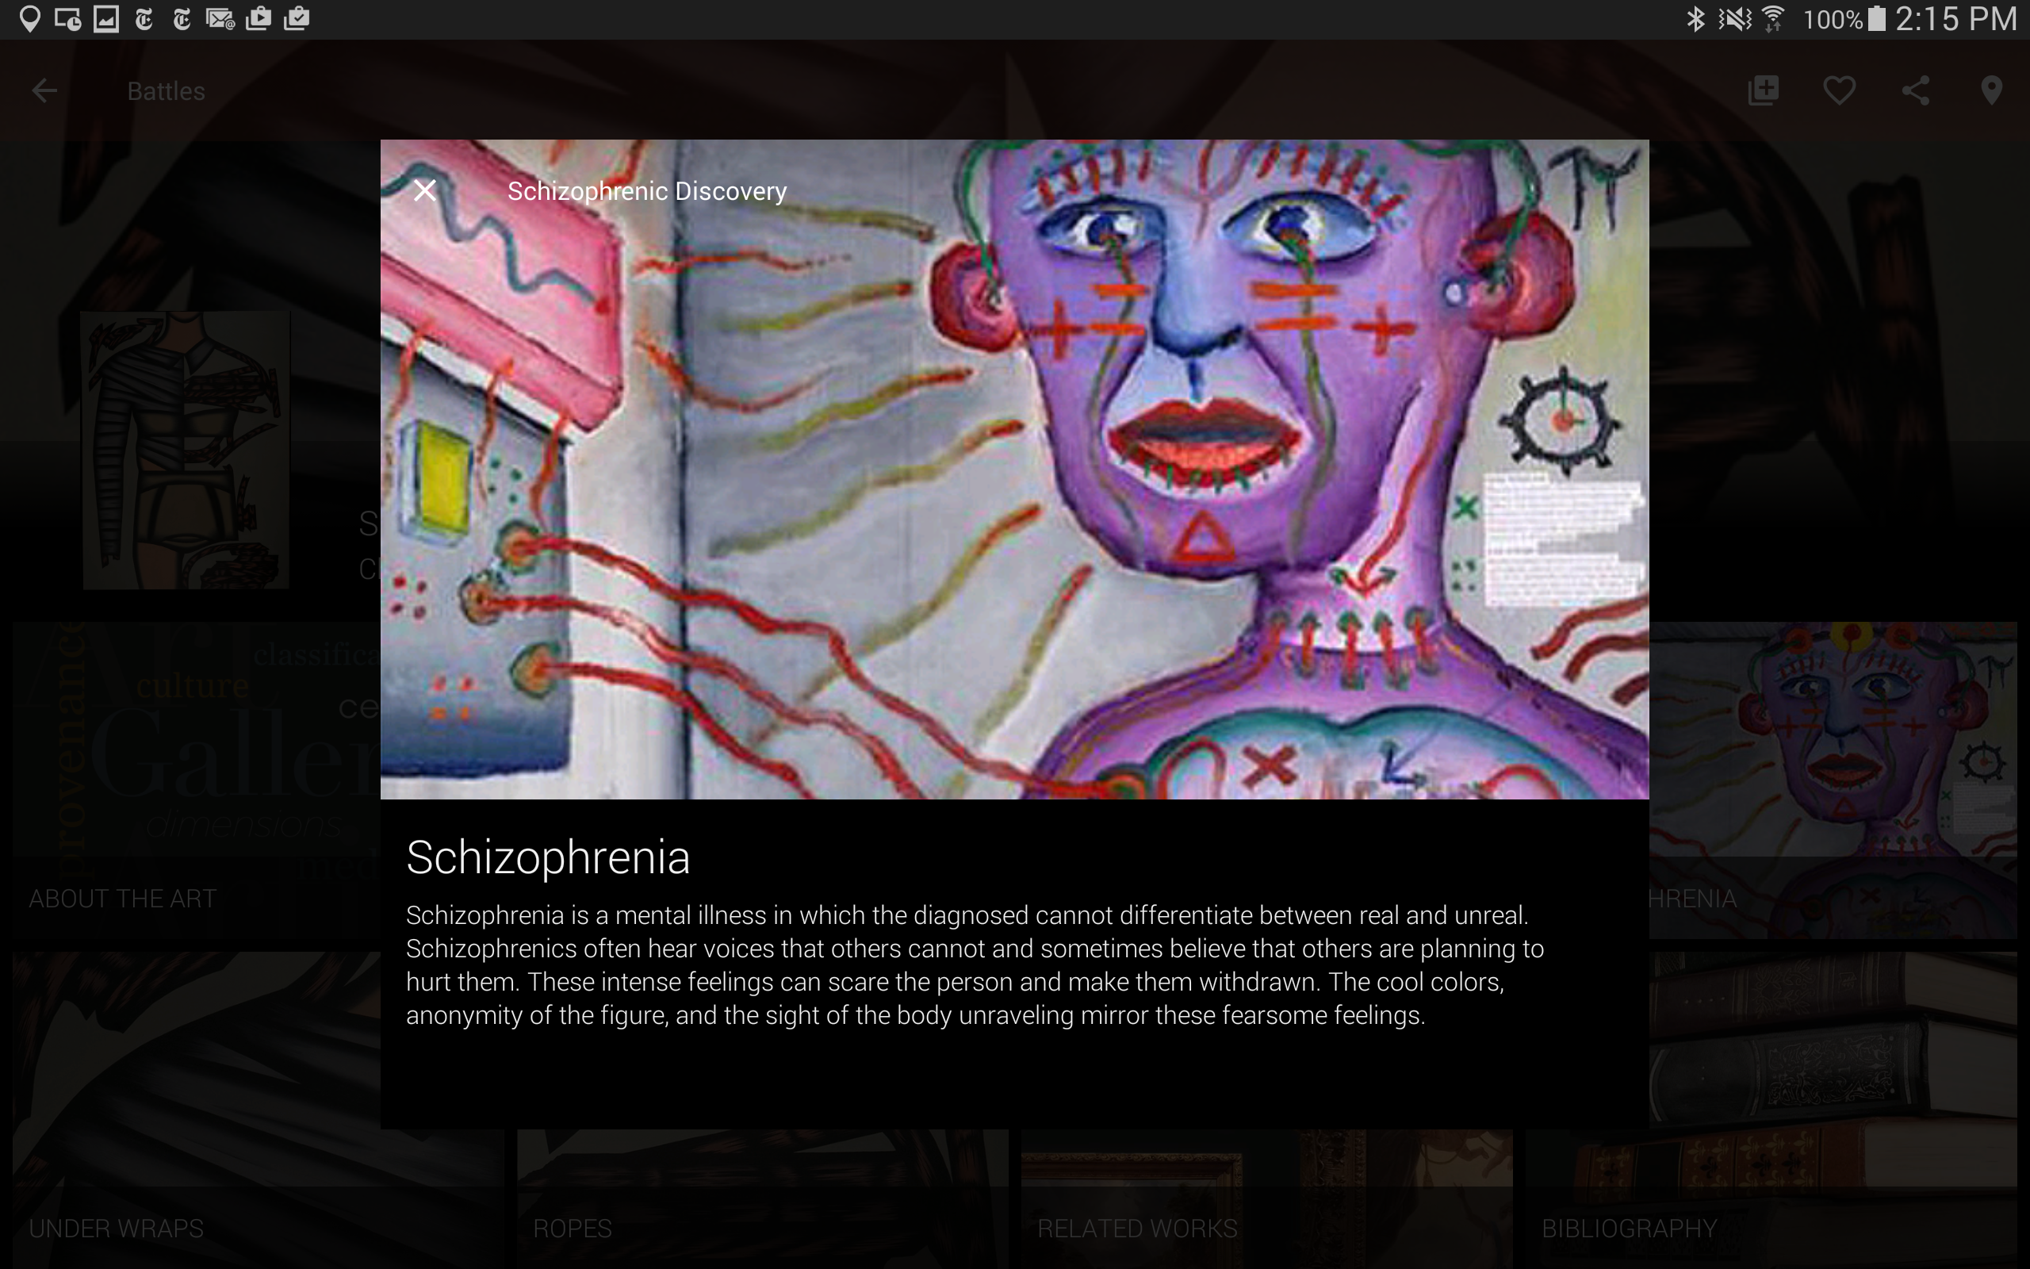
Provides definition

Slide 33
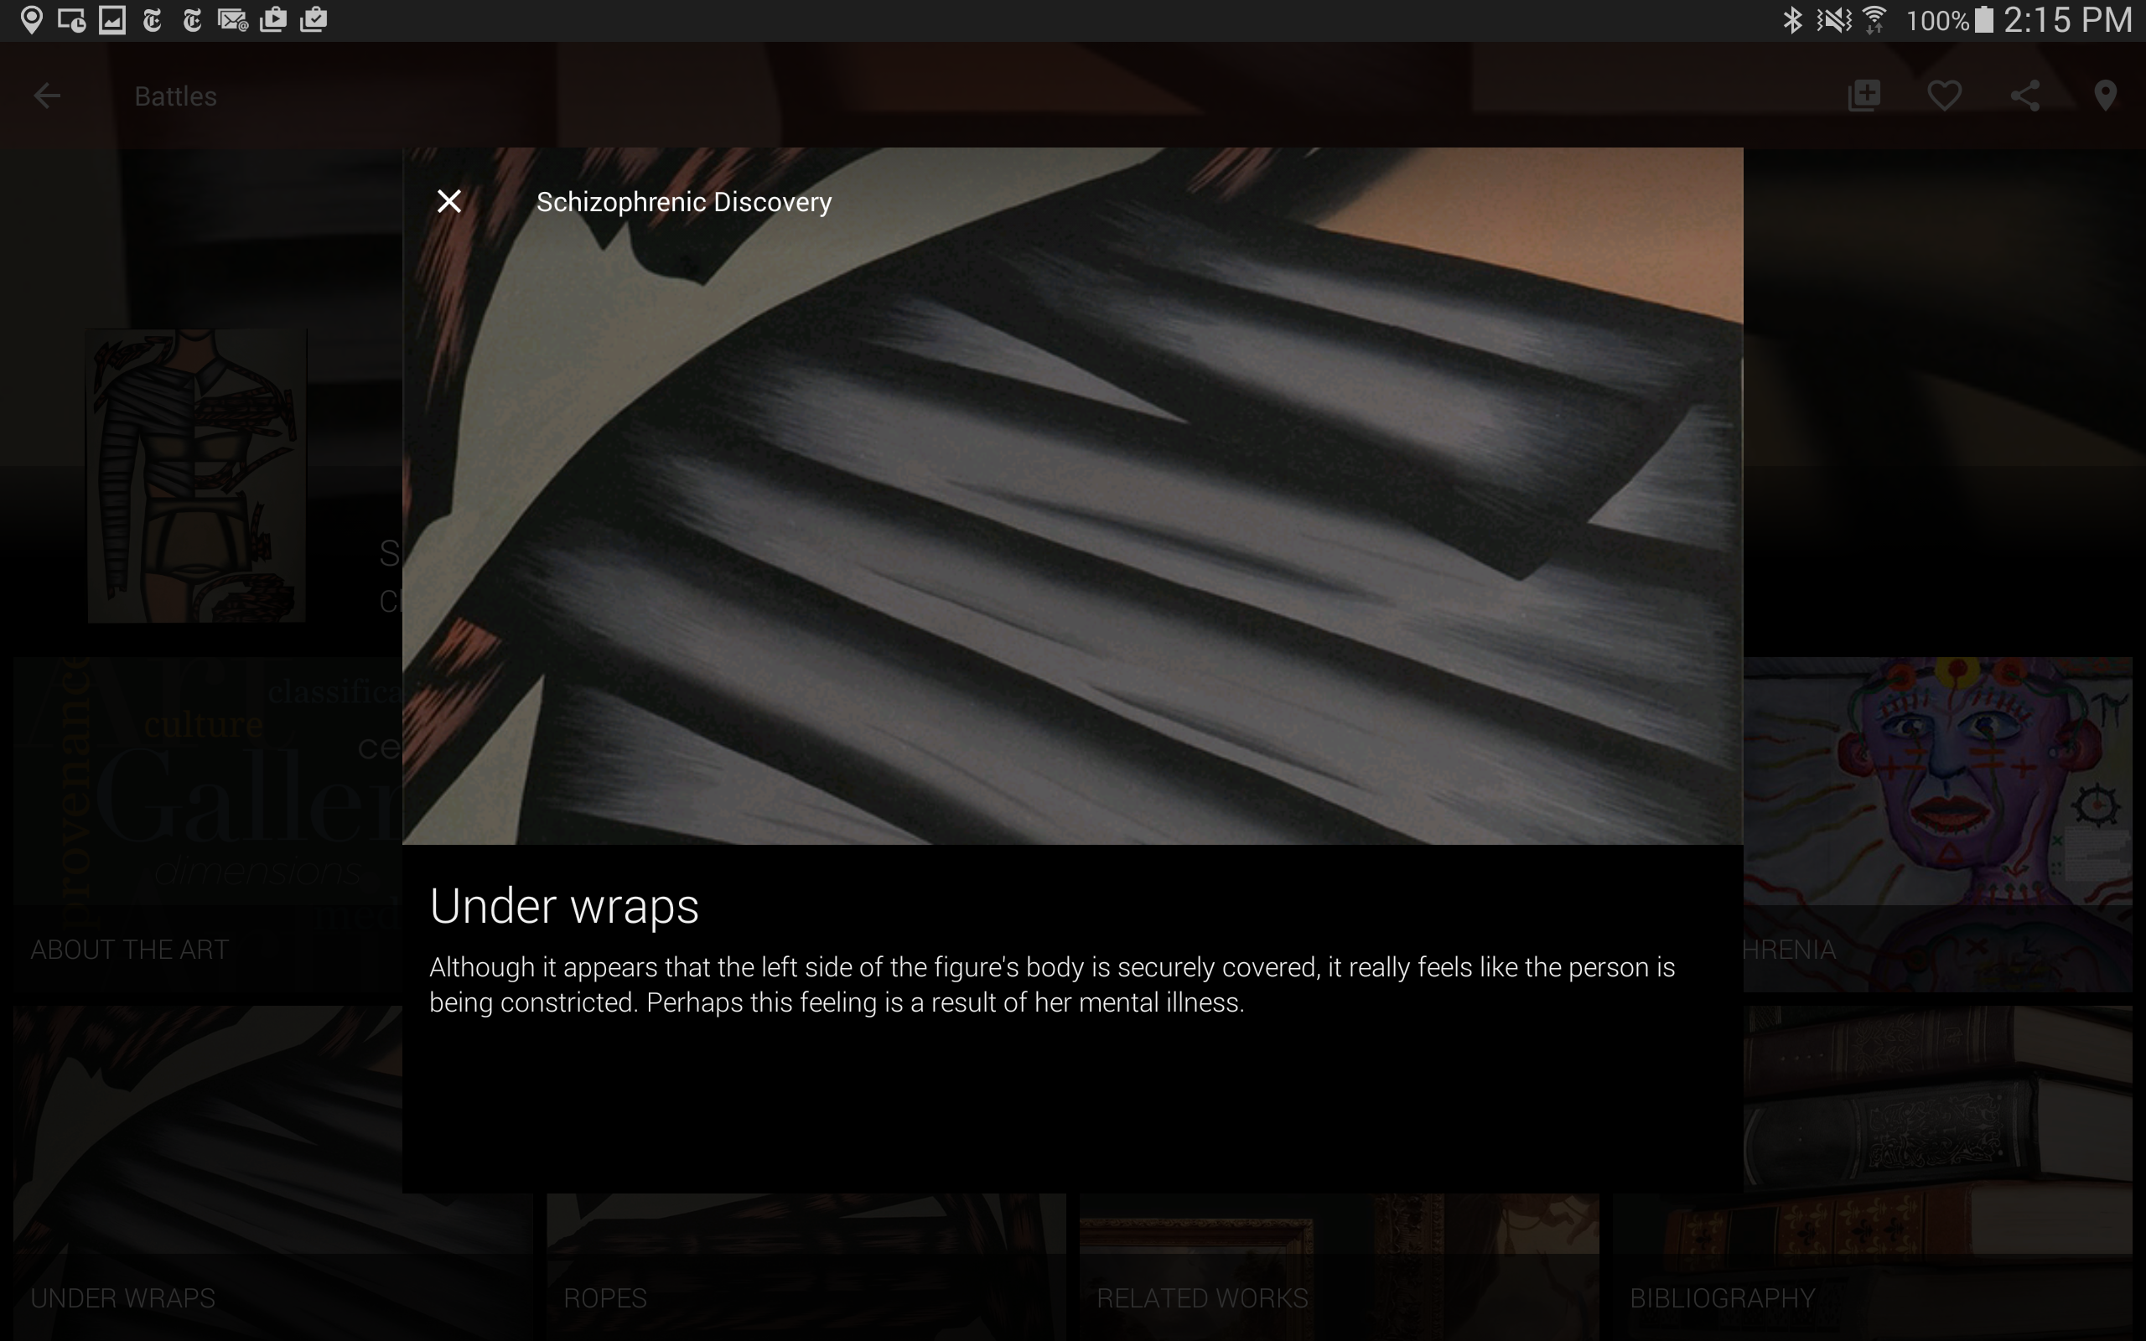
Connects to emotions

Slide 34
Student response

Slide 35
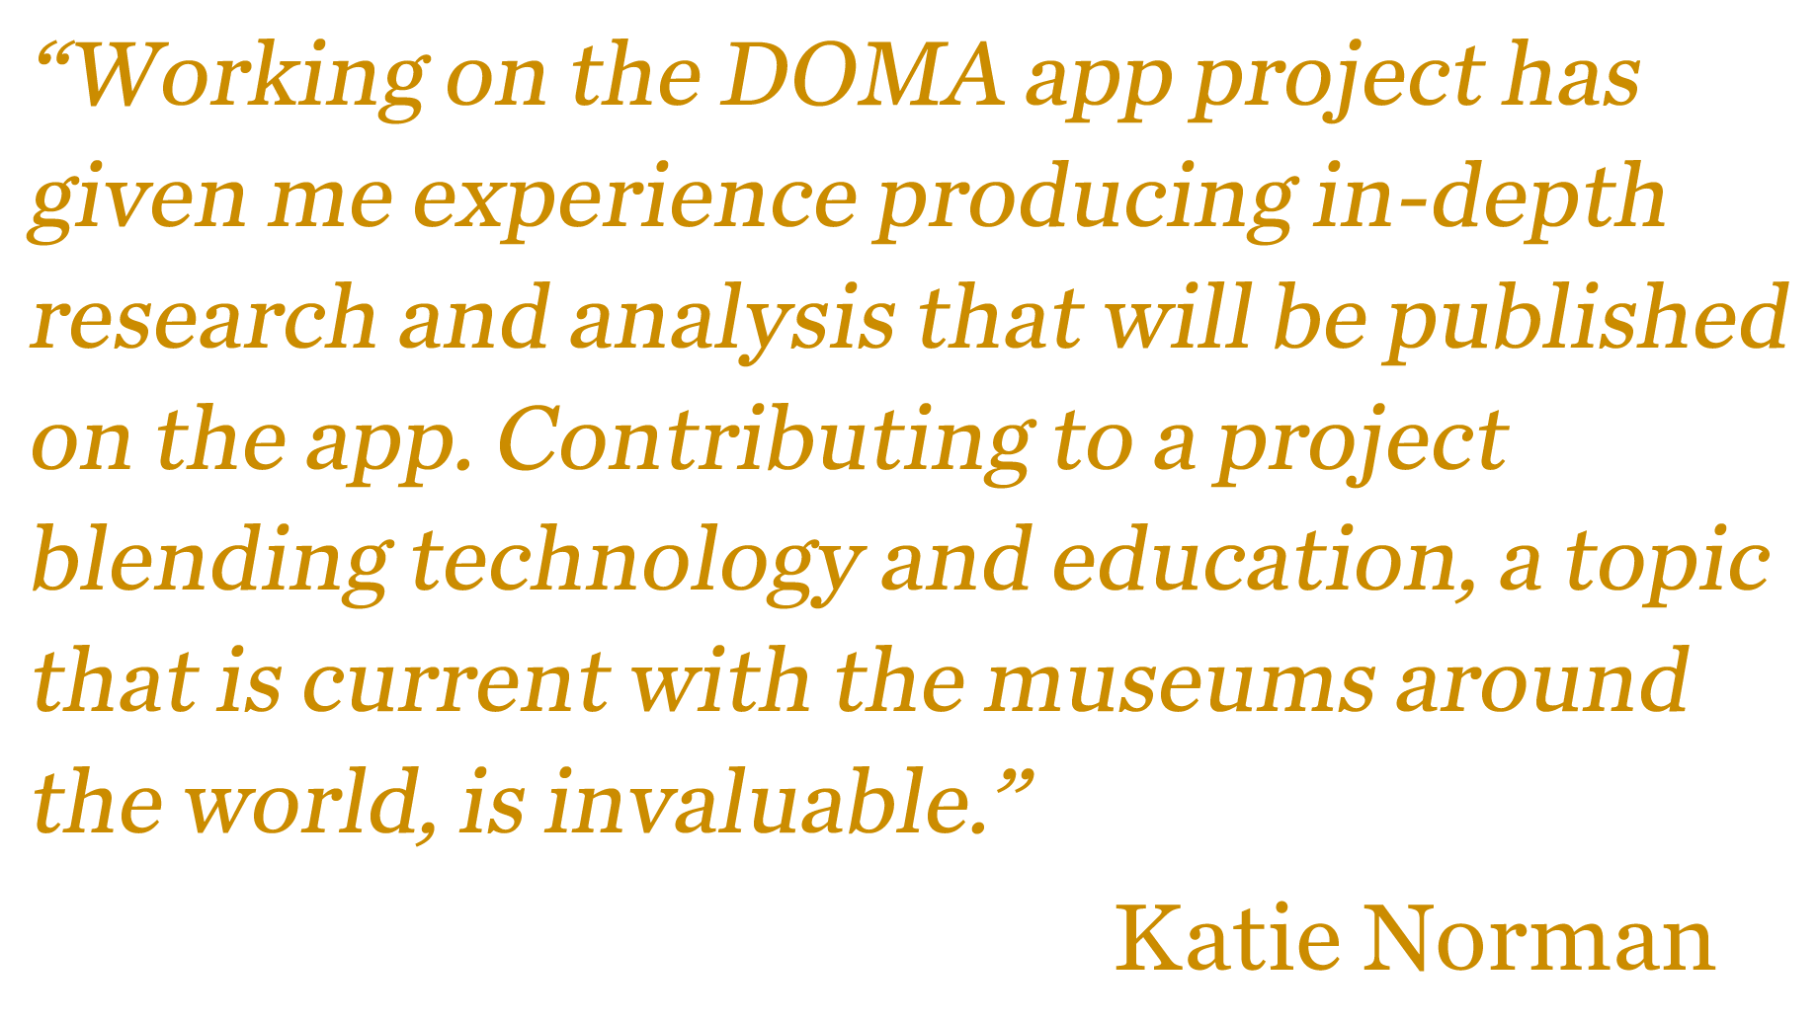

Slide 36
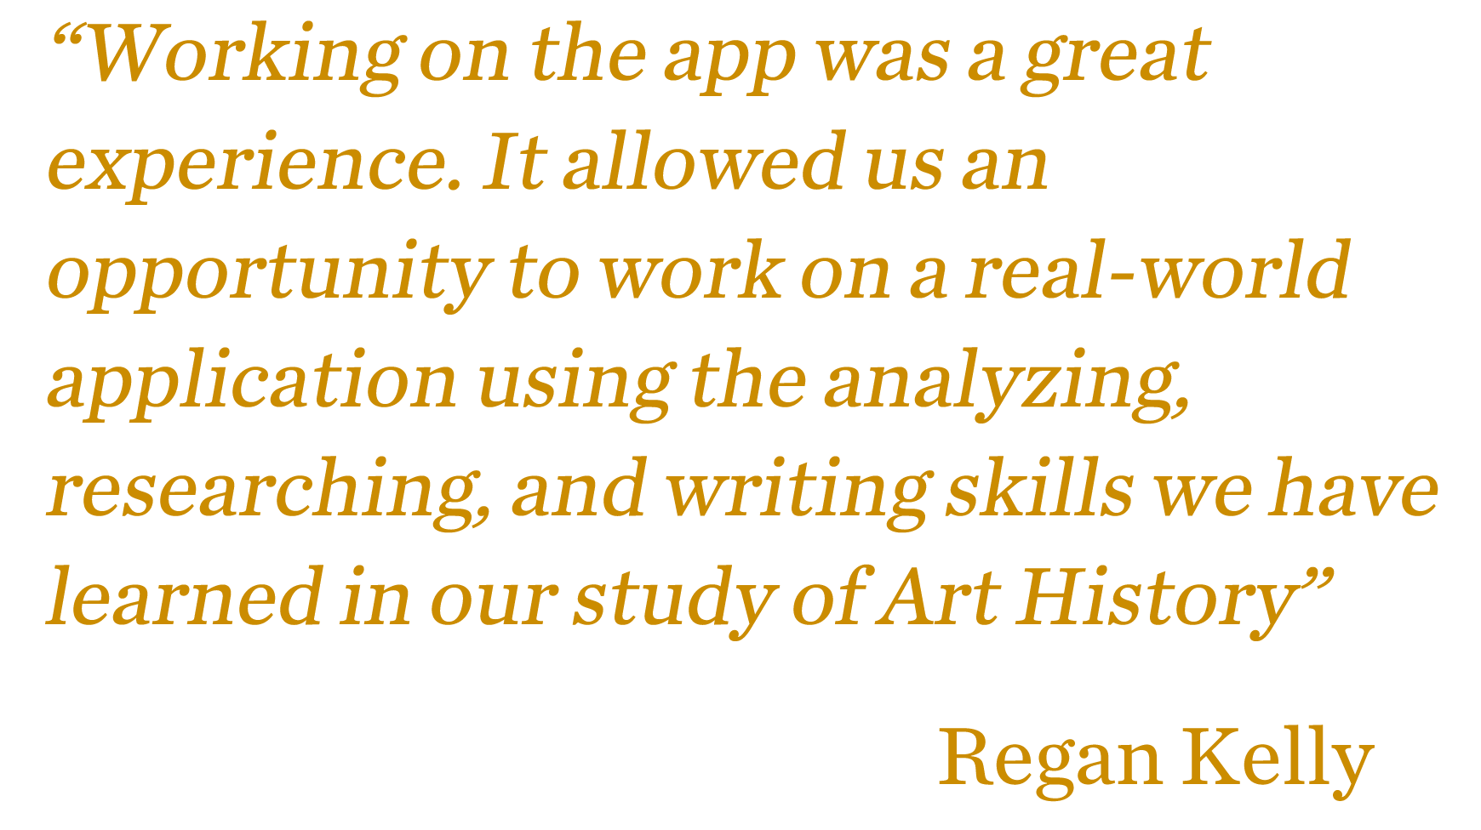

Slide 37
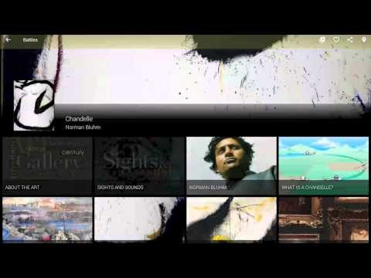

https://www.youtube.com/watch?v=YdL34f8kUak

Slide 38
New semester, new students, new goals

Slide 39
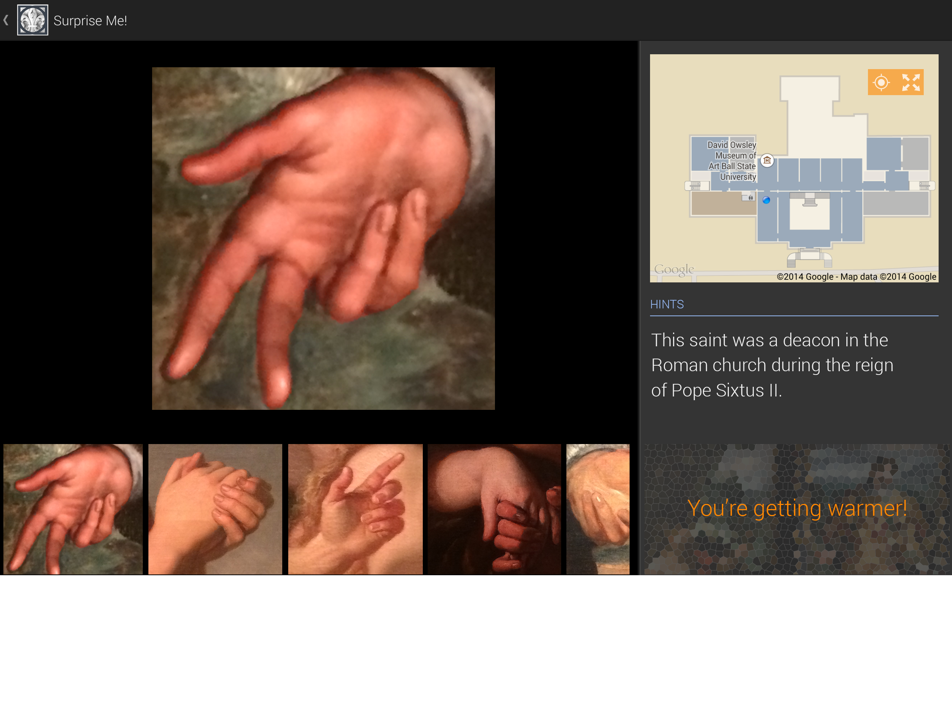
Scavenger hunt, educational games, ways to interact with visitors

Slide 40
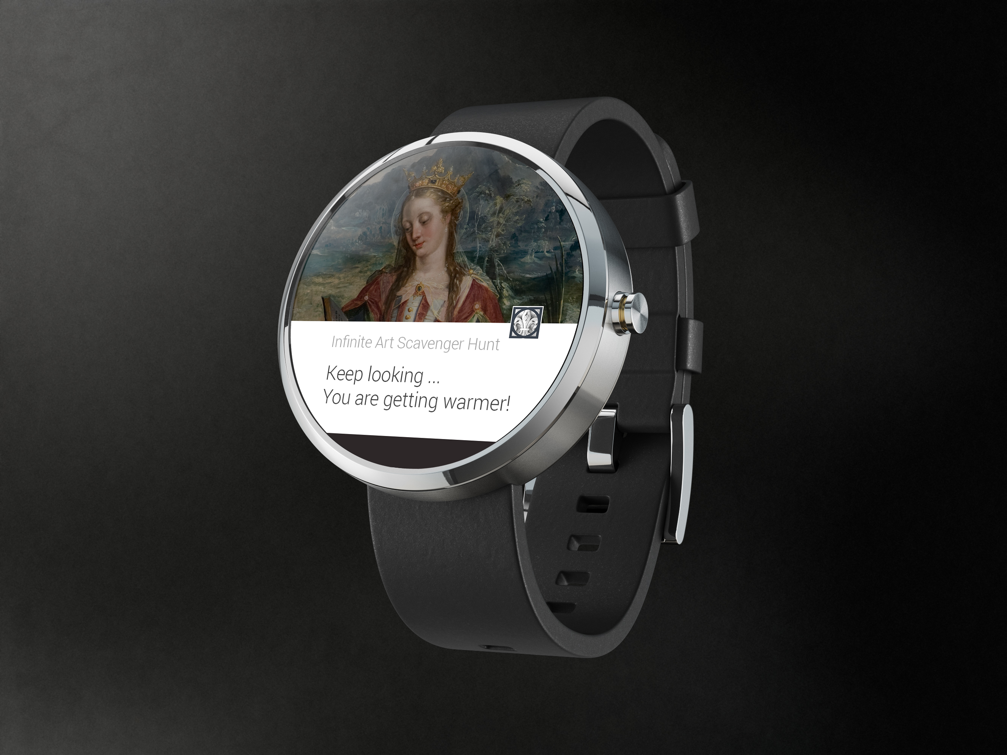
Incorporate companion devices like smartwatches

Slide 41
Kyle Parker
kyleparker@bsu.edu
Lara Kuykendall
lkuykendall@bsu.edu
Denise Jones
djones@bsu.edu

Slide 43
Help Us Improve and Grow
Thank you for participating
in today’s session.
We’re very interested in your feedback. Please take
a minute to fill out the session evaluation found within
the conference mobile app, or the online agenda.

