Slide 1
Aligning IT Organization Structures to Academic and Business Needs
Kyle Johnson, Keith McIntosh, Joseph Moreau, Jennifer Sparrow

Slide 2
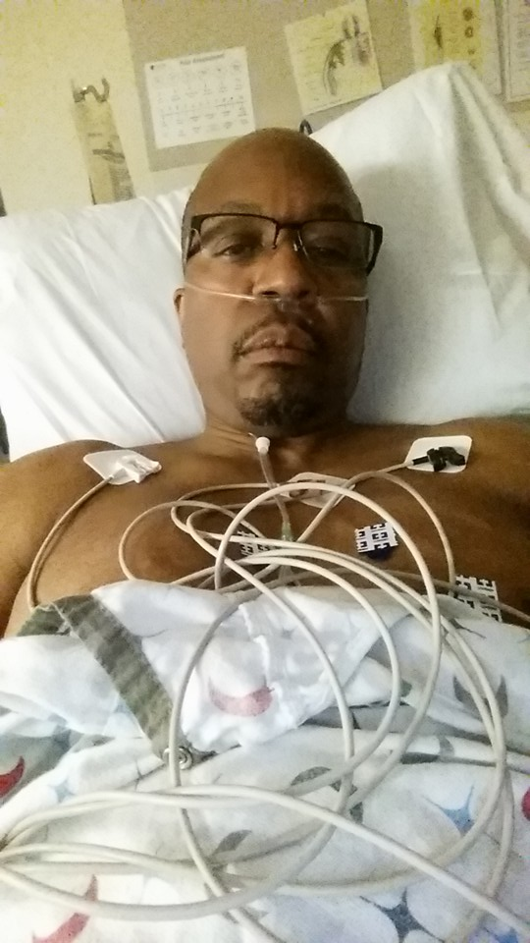
Get well Mac!

Slide 3
The Big Picture
Technology is changing substantially and rapidly
Cloud-based applications and services
Virtualization
Modularized applications – “Apps”
Mobile devices
Software is “rented” versus owned

Slide 4
New Options
End users have new & different options for technology solutions
Services only available from traditional IT are now available as commodities
Hosted services often require less involvement of traditional IT
Functional users can go far down the path with a solution provider before IT is even aware a project is happening

Slide 5
New Options
Consortial services may need little or no involvement from traditional IT
Shadow systems persist – both locally and cloud, SaaS, etc.

Slide 6
Remaining Relevant
How does a college’s IT organization remain a relevant and vital contributor to the strategic capabilities of the college?
Traditional organizations developed to align with technology or the nature of IT work (IT centric)
New structures should be reflective of the needs and priorities of institutional stakeholders (customer centric)
Notes:
Question: How does a college’s IT organization remain a relevant and vital contributor to the strategic capabilities of the college?

Slide 7
Remaining Relevant
Linked to core mission of teaching and learning (strategic partnership vs. utility)
Data to support solutions and services

Slide 8
Traditional Structures
What are some of the traditional IT organizational structures in higher ed and other industries?
Hardware/software
Administrative computing/academic computing
Product/department structure
Hybrid – internal/contract Out
Size of college key to structure
Notes:
Question:

Slide 9
Traditional Structures
Learning technologies/academic technologies
Notes:
Question:

Slide 10
New Structures
What are some of the newer IT organizational structures in higher ed and other industries?
Operations/project management
Development/operations (Dev/Ops)
Enterprise systems/desktop Systems
Functional/PM/Ops
Hybrid – internal/outsource
Notes:
Question:

Slide 11
New Structures
Centers for teaching and learning/learning spaces
Notes:
Question:

Slide 12
Barriers To Change
What might be some of the barriers to moving from a traditional IT organizational structure to a newer structure?
Staff entrenchment and/or entitlement
Management entrenchment
Organization entrenchment
Collective bargaining limitations
Human Resources restrictions
Notes:
Question:

Slide 13
Barriers to Change
Fear of change and job security
Availability of skilled staff (internal/external)
Cultural feasibility
Unclear processes

Slide 14
Overcoming Barriers
What might be some of the strategies to overcome the barriers to IT organizational change?
Engage all stakeholders
Address concerns directly
Develop a clear transition plan
Articulate the benefits, large and small, to all stakeholders, the IT organization, and the college as a whole
Notes:
Question:

Slide 15
Overcoming Barriers
Employ a formal change management methodology
Utilize an external assessment of current IT organization
Ensure training and education process for skills enhancements
Ensure executive support
Consistent communications

Slide 16
Overcoming Barriers
Explain how new strategy with make their jobs better\easier
Find power users to be champions
Share the alternatives

Slide 17
Conclusions
Change is inevitable. Resistance is futile.
Funding is being linked to efficiency and results – adapt or perish
Employ efficient technology solutions to offset manpower loss

Slide 18
Conclusions
Our IT personnel will be turning over substantially in the next few years mostly due to retirements
Successful recruitment and retention of new IT staff will be affected by the nature and vitality of our IT organization

Slide 19
Conclusions
Regardless of new options and services available to end users, a vital IT organization is still essential to the success of a college/district
Identify and continually develop a link to the core mission of teaching and learning of your institution

Slide 20
Contact Information
Kyle Johnson
kyle.johnson@chaminade.edu
Keith McIntosh
kmcintosh@ithaca.edu
Joseph Moreau
moreaujoseph#@fhda.edu
Jennifer Sparrow
jennifer.sparrow@psu.edu

Slide 21
Help Us Improve and Grow
Thank you for participating
in today’s session.
We’re very interested in your feedback. Please take
a minute to fill out the session evaluation found within
the conference mobile app, or the online agenda.

