Slide 1
Partnership-Powered IT Change
Rhian Davies • Craig Henderson • Mark Ritchie
Notes:
<Mark>
Thanks for coming to our presentation this morning on partnership-powered IT Change
We’re from Edinburgh University in Scotland
We’ve come a long way, and not just geographically, to be able to present this to you!
There may be some challenges with accents and terminology
We’ll do our best to speak more slowly but please forgive us if we get over-excited
Establishing effective partnerships is always a challenge for IT and even more so within complex and highly devolved organisations such as Universities.
Its clear that finding ways to work across campus that produce better outcomes for our students and staff is high on everyone’s agenda.
We think that partnership for IT is an idea whose time has come – a recent Gartner paper “The Politics of Powerful Partnerships” certainly suggest so.
Our presentation is based on work done within Information Services at the University of Edinburgh going back more than 10 years.
We hope that you find ideas in our presentation that will help you.
We’ll leave time for questions at the end but we’re more than happy to stay around afterwards.
<Next Slide Mark>

Slide 2
Partnership Powered IT – Outcomes
Understand importance of partnership in delivering IT change
Identify key behaviours for building trust
Describe how changing your language can change your relationship
Notes:
<Mark>
Reads points from slide
<Next Slide Mark>

Slide 3
Mark Ritchie
Team of 20+ project managers and business analysts
IT and business change projects
Responsible for ~13000 IT project days last year
Delivering projects at the University for 20+ years
Head of Project Services Information Services
Mark.Ritchie@ed.ac.uk
Influencing the world since 1583
Notes:
<Mark>
Before we get started a few introductions are in order.
I’m Head of Project Services in Information Services
I’ve worked at the University for more than 20 years in various IT roles
I’m responsible for a team of >20 Project Managers and Business Analysts
We deliver IT and business change projects
Approximately 13000 IT days (70 person years) last year
<Pause>
I’m delighted my colleagues Rhian Davies and Craig Henderson are with me today
Rhian, my Deputy, has been the architect of much of our work on partnership and at the heart of Project Services for more than 10 years
Craig has been a colleague and friend for almost 20 years
Between the three of us we’ve worked over half a century at the University!
<Next Slide Rhian>

Slide 4
Rhian Davies
Deputy Head of Project Services since 2012
Portfolio Manager for Corporate Services
Delivering projects and business change for 10+ years at the University
Deputy Head of Project Services Information Services
Rhian.Davies@ed.ac.uk
Influencing the world since 1583
Notes:
<Rhian>
I’m Deputy Head of Project Services
I’m also Portfolio Manager for Corporate Services
A key element of my role is to maintain effective relationships which deliver benefits for the University
As part of this work I’ve played a leading role in developing our partnership model
<Pause>
Craig Henderson from our Procurement (Purchasing) Team is one of my partners in Corporate Services
Craig is a genuine business person and absolutely not an IT professional – be gentle with him!
<Next Slide Craig>

Slide 5
Craig Henderson
Responsible for eCommerce and efficiency
Award winning procurement team
Sponsoring and leading business change projects at University for 20+ years
Member Scottish Government eCommerce Forum
Assistant Director of Procurement
Corporate Services
Craig.Henderson@ed.ac.uk
Influencing the world since 1583
Notes:
<Craig>
I’m Assistant Director of Procurement
I’m responsible for eCommerce systems including eSourcing, eTendering and eOrdering
Our Procurement team has been consistently recognised as one of the most effective in Scotland
I’ve worked in project and service delivery at the University for more than 20 years, in both Finance and Procurement
I’m also a Member of the Scottish Government eCommerce Strategic Forum – this gives me the opportunity to influence strategic direction and policy at government level.
My background in Finance– started in management accounting – definitely not an IT professional!
<Next Slide Craig>

Slide 6
Procurement Spend at the University
Notes:
<Craig>
The University places in excess of 110,000 orders per year and spends over $300million annually on goods and services.
This represents a growth of over 20% since 2011
Typically our staffing resources have not grown in line with external spending, so we need to be as efficient as possible.
<Next Slide is Mark>

Slide 7
35,000+ students
$1bn + turnover
$450m research income
13,000+ staff
3 Colleges 22 Schools
World Top 50 university
Influencing the world since 1583
Notes:
<Mark> Thanks Craig
An overview of the University will be helpful to place our presentation in context.
The University is based in Edinburgh in Scotland
Sixth oldest in the English speaking world – but only the fourth oldest in Scotland!
This gives some idea of the historical strength of education in Scotland!
We have 35000 students mainly on campus around Edinburgh
We also have a strong research focus
Consistently rated in the top 50 universities in the world – something we’re very proud of
We have many beautiful historical buildings across campus
This is Old College at the heart of the University
<Next Slide Mark>

Slide 8
Influencing the world since 1583
Notes:
<Mark>
In the midst of all of this history and romance it’s easy to forget that Universities are large and complex businesses.
Businesses which operate in an increasingly dynamic environment and require effective management of business and IT change. The University of Edinburgh is no different.
This is the high level organisation chart for the University showing our three Colleges and three Support Groups. We’ll come back to these Colleges and Support Groups later in the context of our project portfolios.
<Next Slide Mark>

Slide 9
Our Message
Working Together
Building Trust
Transforming Relationships to Partnerships
Improved Delivery of IT Change
It takes time and effort but it’s worth it!
Notes:
<Mark>
We believe partnership is, by some distance, the most effective way to deliver change in Higher Education
The typical University is a highly devolved organisation with many centres of power and influence.
IT solutions which fail to take into account the impact on people or business processes are even more likely to fail in a University environment.
Only by working in close harmony with colleagues across the campus will IT start to build the trust essential for building partnerships and improving the delivery of change.
We’ve learned this the hard way – we have the scars to prove it!
Partnership takes time and effort – but we believe that your investment will be repaid many times over
<Next Slide Mark>

Slide 10
What is Partnership?
A business entity in which two or more co-owners contribute resources, share in profits and losses, and are individually liable for the entity's actions
A relationship between individuals or groups that is characterized by mutual cooperation and responsibility, as for the achievement of a specified goal
Source: The Free Dictionary http://www.thefreedictionary.com/partnership
Notes:
<Mark>
In an effective partnership each partner:
Takes ownership
Contributes resources
Works together positively
Takes responsibility for and shares in the outcomes – both good or bad
Sadly this is not the most common model for delivering IT change in Higher Education. Instead we more commonly encounter:
unclear objectives
disputed ownership
organisation silos
under-resourcing
a pervasive blame culture which makes it better to try to avoid all responsibility for change
It’s tough!
<Next Slide Mark>

Slide 11
So what’s the problem?
Notes:
<Mark>
IT cannot deliver change on its own and must work effectively across the campus. This demands different skills of empathy and communication that take us far outside our comfort zone.
On a major project it was said to me that IT was from Mars and our business partner, in this case our Research Office, was from Venus. We simply didn’t understand or communicate well with each other.
I was advised that we had to work harder to build this relationship if the project was to succeed.
This turned out to be very good advice!
In truth I haven’t yet read John Gray’s book but maybe I should!
<Next Slide Mark>

Slide 12
Partners can have very different
Backgrounds and Experience
Skills and Talents
Approaches to Problem Solving
Views
Notes:
<Mark>
So how can we build effective partnerships?
Perhaps the first thing we need to do is accept that successful partnership does not require “group think”
Our colleagues across campus probably don’t see things exactly the same way as we do
But these differences are an essential part of understanding each other and enable us to work together more effectively
We need to recognise that our differences are often in fact our essential professional contributions to the partnership
For IT these professional contributions might include:
Structured approaches in areas such as project management
Technology skills
Specialist knowledge
Experience of similar work done previously
Great partnerships leverage their differences so that the whole is greater than the sum of the parts.
<Next Slide Mark>

Slide 13
A Great Partnership - Laurel and Hardy
Notes:
<Mark>
If we’re looking for some evidence of constructive differences in a partnership let’s consider these two – Laurel and Hardy
The greatest comedy double act ever!
This partnership didn’t just have differences – it celebrated them!
The contrast in physical appearance
The different ties
The hats – one too small one too large
The too tight and too loose jackets
All of these can be seen in any photograph – a compelling study of difference
But what they did - they did together - and didn’t they do it well!
An unlikely model perhaps but we hope an inspiring one for IT and our colleagues across campus
<Next Slide Mark>

Slide 14
Where we started
Notes:
<Mark>
Sadly however this peak of effective partnership represented by Laurel and Hardy is not exactly where we were in 2005
Craig – how was it for you back then?
<Next Slide Craig>

Slide 15
Project Delivery in 2005 – Business View
It was difficult to work with IT
IT chose the projects but didn’t understand our business
IT provided technology we had to do the rest
Every project seemed to be managed differently
It was difficult to find out about project status
Projects often stalled, took longer and cost more
We blamed IT!
Notes:
<Craig>
Not great to be honest.
Up to 2005 - IT projects were very difficult to work on
We felt that IT largely chose the projects and set the priorities
IT gave us some hardware, put the software on it, and largely left us to it. To be honest, we were quite happy with that.
We felt that IT knew little about our business and preferred to do as much as we could ourselves, so when they offered us a project manager or business analyst, we were sceptical and usually declined .
Similarly, we knew what the real end users wanted - sometimes because we’d asked them, but not always!
Partnership wasn’t something that we were actively seeking
Together we were inefficient, ineffective and ultimately infamous, offering endless opportunities for finger-pointing and blame
<Next Slide Craig>

Slide 16
Project Delivery Headlines
Reporting Tool Five Years to Complete!
System Withdrawn Following Complaints from Students
Student Records Project In Trouble!
Fall Guy! – Business Lead Knew Nothing About Project
Notes:
I don’t think anyone’s going to thank me for sharing this, but here are few examples to illustrate…
A reporting project that took 5 years to complete - it was poorly defined and inaccurately estimated, due to a lack of trust
A new system was withdrawn for re-design after go-live due to complaints from students. It didn’t do what they needed and no-one had asked them.
A Student Records project entirely staffed by Student Administration staff needed to be recovered by IT after running over budget and missing several major deadlines
A business lead turned up for a meeting to discuss the scope of a project - but he hadn’t been told what the project was about!
<Next Slide Mark>

Slide 17
How was it in 2005 for IT?
We didn’t work well as a team
Roles/responsibilities poorly understood
Projects not well defined
We struggled to engage effectively with non IT colleagues – misunderstanding and lack of trust
Not consulted on decisions with IT implications
Projects often stalled, took longer and cost more
We felt undervalued and misunderstood!
Notes:
<Mark>
Ouch! Thanks Craig – I’m glad you got that off your chest!
To be fair to Craig though he’s right and it was scarcely any better for IT
All out projects managers were doing things differently
IT roles and responsibilities were not clearly defined
We struggled to engage effectively with our colleagues like Craig
Projects, and particularly benefits, were not well understood
There were misunderstandings and a general lack of trust
We needed to improve our delivery and find ways to establish more effective relationships
Thankfully we had Rhian!
<Next Slide Rhian>

Slide 18
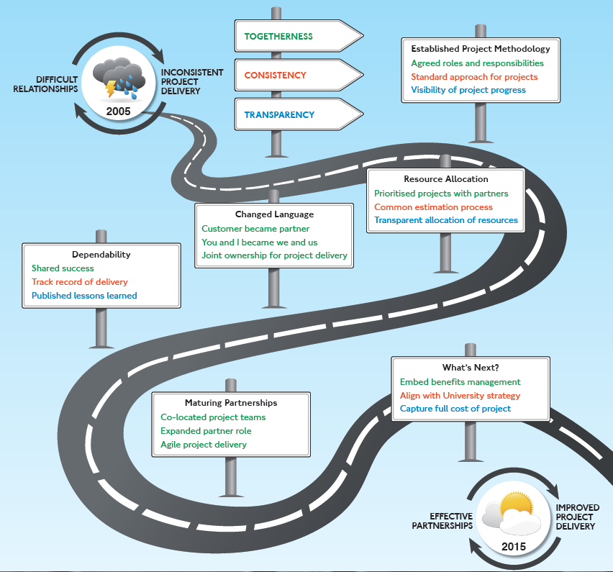
Our Journey
Notes:
<Rhian>
I realised that better relationships would enable us to more consistently deliver successful solutions for the University.
How would we achieve this? This was the start of our journey.
Rhian highlights “Partnership Powered IT Change Card”
<Next Slide Rhian>

Slide 19
Starting to Tackle the Problems
Build Trust
Improve Delivery
Notes:
<Rhian>
We started to progress under what we subsequently recognised as these three main themes:
Togetherness – the basic elements of working together and communication
Consistency – adopting standard approaches which were easier to understand and engage with
Transparency – sharing and openness about projects - no hidden information
We’ll use these signposts for the remainder of the presentation.
<Next Slide Mark>

Slide 20
Established Project Methodology
Notes:
<Mark>
Thanks Rhian. This is the first milestone in our journey.
We recognised that the lack of standardisation in our project processes was a significant barrier to progress.
Thankfully however it was something that we could do something about
A number of our staff had good experience of project methodologies gained in their previous roles. Others had certification in things like PRINCE a projects management methodology developed originally in the UK
So we decided to introduce a project methodology
<Next Slide Rhian>

Slide 21
Standard Approach for Projects
Notes:
<Rhian>
A project methodology is a roadmap for your project and it helped us in a number of ways.
It meant that we now had a standard approach to how we delivered our projects, so if Craig was working with 3 different project managers they would all be working in the same way.
Our roadmap introduced standard checkpoints across the life of the project for ourselves and our partners, and other standards which together had a demonstrable improvement on the quality of what we were doing.
Once you have a roadmap for your project you can see how your project is progressing, making it much easier for our colleagues to see what was happening– warts and all!
<Next Slide Rhian>

Slide 22
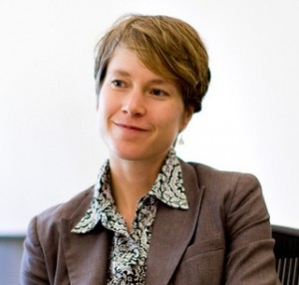
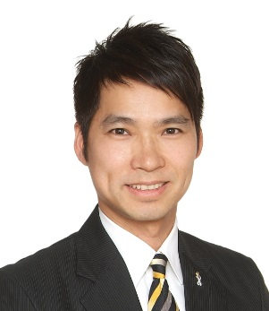
Agreed Roles and Responsibilities
Owns the business case
Accountable for the success or failure of the project
Project Sponsor
Day to day responsibility for running the project
Responsible for ensuring that project produces the required deliverables
Project Manager
Notes:
<Rhian>
Agreeing roles and responsibilities for us and our colleagues helped everyone to understand what was expected
This didn’t mean that they did it – but it was a start!
It began to bring in a sense of shared responsibility for project delivery
<Next Slide Rhian>

Slide 23
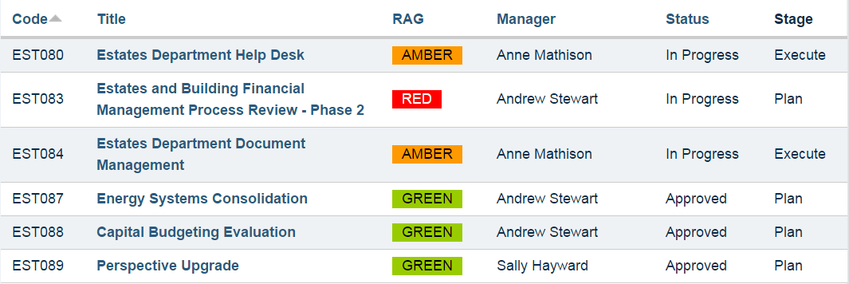
Visibility of Project Progress
Notes:
<Rhian>
We organised our projects into programmes – largely organisational based
The example used here is for Estates and Buildings
These programme made it easier for IT and project stakeholders to view project status
This change also encouraged project ownership at the organisational level
Use of Red Amber Green (RAG) status also helped us focus on what projects were going well and what projects needed our attention
Project status information was shared at least monthly with stakeholders
<Next Slide Mark>

Slide 24
Resource Allocation
Notes:
<Mark>
Thanks Rhian. This is our second milestone.
The Project Methodology introduced previously was starting to make a real difference
However we still needed to bring a greater sense of reality to our project delivery
We didn’t have unlimited resources and needed to ensure that there was a greater engagement with project prioritisation and resource management
We’d introduced Time Tracking for IT staff in 1999
Time Tracking would prove an incredibly valuable enabler for our next steps
<Next Slide Mark>

Slide 25
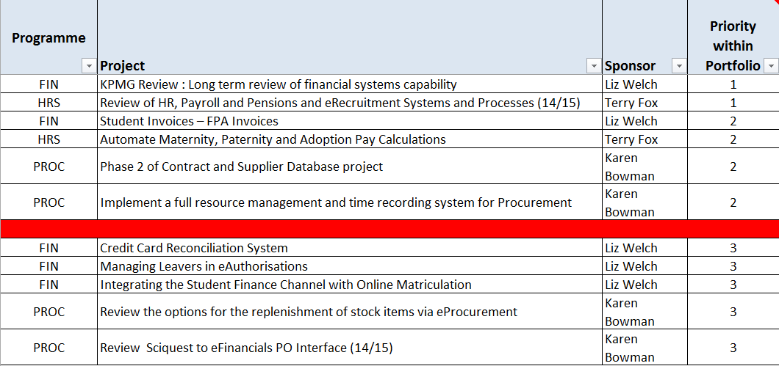
Prioritised Projects Together
Notes:
<Rhian>
We have an annual planning process where our partners submit project proposals, they are prioritised, and a red line is drawn when all the resources are allocated – if your project is below that line it will not happen.
Craig said he felt IT prioritised the projects
Finding a way to do this together was a key element of building trust.
We did it by establishing portfolios for each of major areas of activity i.e. Corporate Services, the Colleges and our other Support Groups.
Each portfolio had a clear owner – before that we just had a large list of project proposals and no overall ownership
The Portfolio Owner was a senior person in administration within the area
Working with our Portfolio Owners we were able to prioritise projects based on the needs of the portfolio, a much more successful approach!
<Next Slide Rhian>

Slide 26
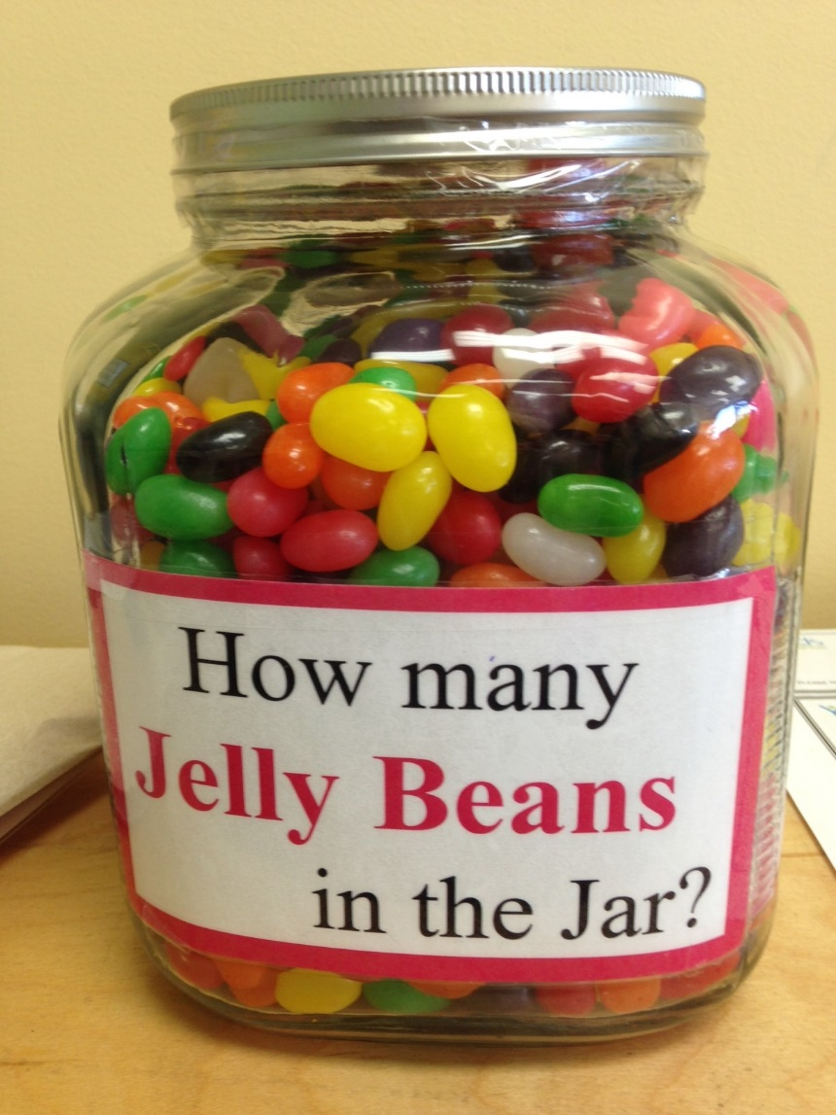
Common Estimation Process
Notes:
<Rhian>
During the planning process, we had very limited information about each proposal.
It made estimating how much of our effort would be required difficult, we did the best we could but often ended up with very exact sounding estimates like 158 days or 203 days.
Such an exact figure gave our partners the impression that we really understood what was required.
Once the project started, the estimate would quickly change as we found out more and our partners would feel frustrated and assume we had just got it wrong.
We needed to find a way of communicating that it was not an exact science.
<Next Slide Rhian>

Slide 27
Common Estimation Process
SMALL
MEDIUM
LARGE
Notes:
<Rhian>
We decided to create a scale – small, medium, and large.
0-50 = Small (50 days in plan), 50-100 = Medium (100 days in plan) 100-200 = Large (200 days in plan) >200 = Need a more detailed estimate
This made it easier to understand that it was a ballpark figure and ensured a sensible number of days was included in the plan!
We could also compare the project to something we had done before, and that really helped us to agree on size
We now ask our partners to estimate their time on the same scale.
<Next Slide Rhian>

Slide 28
Transparent Allocation of IT Resource
Budgets at programme level
Allocated budgets to Programme Owners not IT
Owners could decide where IT effort was used
Owners could trade within and between programmes
Programme owners better understood costs and were empowered to make decisions about their projects
Notes:
<Mark>
We decided to build on the programmes introduced earlier
Each project had always had an estimate and the improved estimation techniques meant that these were now more reliable
We decided to use these estimates to create a programme level budget
For example if a programme had three projects each with a 100 day estimate then we’d allocate a 300 budget for the programme
We allocated these budget to the Programme Owners
Programme Owners could then decide where to use the available IT effort within the programme e.g. to add scope to one project and reduce IT effort in another
Programme Owners could also get together to trade IT effort between programmes
This had the benefit of highlighting costs and empowering programme owners
Where scope increases were previously the norm we started to have more informed conversations about the costs and value of change
<Next Slide Mark>

Slide 29
Changed Language
Notes:
<Mark> This is our third milestone.
By now we’d made a lot of progress on project delivery
But IT was not yet an equal player and this was affecting both our internal relationships and our project outcomes
So we made a conscious decision to change our language
<Next Slide Rhian>

Slide 30
Changed Language
Customer
Partner
I and You
We and Us
Sorry
Because
Notes:
<Rhian>
We typically referred to colleagues that we worked with as our customers, but this was reinforcing our dysfunctional relationships.
As a customer you are seen as having higher status in relationships – we often hear people say the customer is always right.
Our colleagues were not even the customer – the actual customer was the end user who could have been staff, student, or alumni.
What was actually happening was that we were partnering with our colleagues to deliver services for these end users, so we stopped calling them our customers and started calling them our partners.
We stopped apologising and started explaining.
We started talking about we and us.
These might seem like small changes, but it is actually a pretty significant shift, not least in our minds and our approach.
<Next Slide Mark>

Slide 31
Dependability
Notes:
<Mark>
Thanks Rhian. This is our fourth milestone.
By now our positive progress had started to increase trust in IT
Increasing confidence in IT led to us being asked to lead a major University wide procurement project – eProcurement Scotland
We worked closely with Craig on this project so he can tell us more about it.
<Next Slide Craig>

Slide 32
Shared Success
eProcurement Scotland – implement a country-wide eProcurement system at UoE
Scottish Government, UoE, consultants and supplier all part of on-site team
Anything other than an effective partnership would have been a disaster
Full time project manager from IT
Co-location in a single team office
Project was delivered successfully, and has continued to develop and grow
Notes:
<Craig>
In 2007 the University took the decision to implement a new eProcurement system, as part of a Scottish Government initiative to deliver a country-wide, public sector eProcurement system.
This was a high-profile, politically sensitive project - “Failure was not an option”
An on-site team was put together including representatives from the Scottish government, the supplier, management consultants and the University. Many different perspectives, with different drivers, but all sharing the same ultimate goal. It was decided that a dedicated, full-time project manager was essential for the success of the project, and that the newly developed project methodology should be followed.
Rhian was the project manager appointed to the project, and was seconded to the team full time.
The whole project team was located in one office, and remained consistent throughout the project. This allowed us to build cohesion and trust.
There were some competing priorities within the group, but the project structure - user group, project board, consistent reporting of risks and issues – helped ensure that successful delivery of the project wasn’t compromised.
Together, we delivered a successful project which still continues to deliver significant benefits to the University.
And just in case anyone has forgotten about my finance credentials, here are some more numbers.
<Next Slide Craig>

Slide 33
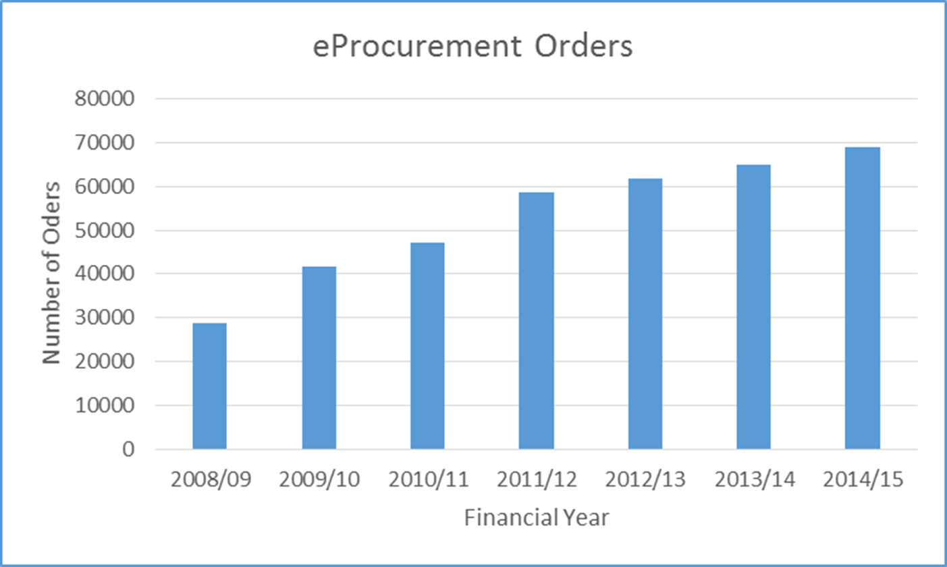
Shared Success
Notes:
<Craig>
Project was delivered successfully, and the service has continued to develop and grow
Since completion of our project in 2008 volumes of eProcurement orders have grown significantly year on year
Saving approximately $11 per order in process costs for a fully electronic purchase order, this represents an important annual efficiency benefit to the University of around $700K
<Next Slide Mark>

Slide 34
Track Record of Delivery
Notes:
<Mark>
Thanks Craig.
Alongside successful delivery of individual projects it was important that we were successful right across our programmes and portfolios
This chart shows the growth in project days delivered between 2005 and 2015 – a greater than 100% increase across this period!
These days are funded either by the University of directly by Project Sponsors
Increased days reflects the University growing confidence in our delivery and increased trust
<Next Slide Mark>

Slide 35
Maturing Partnerships
Notes:
<Mark>
This is our final milestone and brings us up to where we are today.
We really are starting to see the benefits
Partners trust us more and want us to help them with other challenges
Our increased confidence in delivery also means that we are much more likely to suggest new collaborative approaches
Let’s have a look at some of these
<Next Slide Mark>

Slide 36
Co-located Project Teams
Student Systems Partnership
University Web Site Programme
Notes:
<Mark>
We now have several teams co-located with our partners in different parts of the University.
We have 10 staff working as part of our partner led Student Systems Team. This is a semi-permanent arrangement. Where once our Student Systems partner would have hired their own IT staff they now work closely with us
We also have 5 staff co-located in our Web Team delivering a new University web site based on the Drupal Web Content Management System
<Next Slide Mark>

Slide 37
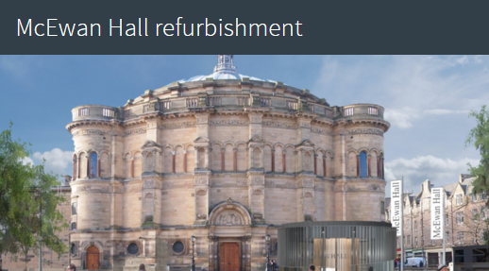
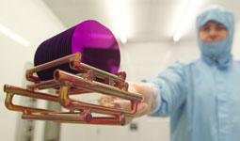
Expanded Partner Role
Embedded Programme Managers
Estates and Buildings (also Human Resources and IT Infrastructure)
Multi Year University Projects
Research Administration (also Scheduling and University Website CMS)
Notes:
<Mark>
Partners increasingly recognise the value of project management and have requested that we provide staff to help them deliver their programmes of IT and non IT projects
In Estates
All IT activities not just projects
Supplier/vendor management
Developing an IT strategy
In HR supporting mainly non IT projects
In ITI providing a framework to enable them to mange and deliver their own projects
We’ve led several multi-year projects in areas like Scheduling and Research Administration
For Scheduling the University wide Project Board worked together successfully for more than three years to implement an effective solution
Over the last few years we’ve also successfully adopted agile methodologies but I’ll let Craig tell you more about that.
<Next Slide Craig>

Slide 38
Agile Project Delivery
Searchable contract and supplier database “Buy@Ed”
Short space of time, small budget, to deliver but big impact
Partnership with HE sector partner
End user requirements sessions – they were delighted to be asked!
Successful project – partnership in action!
Notes:
<Craig>
As the ultimate step in partnership in practice, we now undertake some projects using the agile project methodology.
In 2013 we undertook a project to deliver a simple, easy-to-use searchable database of all of our current contracts and suppliers.
Perfect for agile delivery - it needed to be delivered quickly, within a very limited budget, but would have a big impact for the rest of the University.
We worked in partnership with an HE representative body who held most of the data we needed, and we set out to seek the end-user requirements at an early stage.
The users were keen to participate, and delighted to have been asked what they thought.
The solution – Buy@Ed – has been well received and used, and allows us to deliver an improved service with limited resources.
This project is typical of one which would have been too small, and deemed to unimportant to have been given priority under our old working practices.
<Next Slide Mark>

Slide 39
Where are we now?
Notes:
<Mark>
Thanks Craig.
We’re reaching the end of the presentation but not the end of our journey.
So where have we got to now? Rhian what’s your view.
<Next Slide Rhian>

Slide 40
2015 – An IT Perspective
Working together to prioritise projects
Well understood methods of delivery
Confidence in delivery
Ability to have difficult conversations – and move forward positively
Asked for help and advice – not just with technology!
Working together to improve e.g. benefits management
Notes:
<Rhian>
Our trust relationship has allowed us to completely change how we work together.
We now prioritise projects together based on what the university needs.
We have confidence in our ability to deliver projects and we all understand and respect the processes that we have in place to do so.
When things go wrong or become difficult, we can talk about it.
That doesn't mean it's always easy, but the big difference is that we now decide what to do together.
Our partners value our knowledge and experience, involving us in early discussions and seeking our support with non IT change.
They support our ongoing improvement activities. For example, last month we invited our partners to attend a seminar with us on benefits realisation. People like Craig were keen to attend - a complete shift from 2005 when they didn't even want to talk about benefits.
It really does feel like partnership!
<Next Slide Craig>

Slide 41
2015 – A Partner Perspective
It’s no longer them and us
Buy-in/ownership/trust - honesty
I don’t buy a service, we deliver projects together
End users have become our partners too
Our solutions and services are better
Empowered by change to programme budgets
It’s more fun than it used to be!
Notes:
<Craig>
I can only agree!
Gone is the them and us approach where we had established a way of anticipating failure and apportioning blame before we even started. It’s been replaced by a trust relationship which allows honest, if sometimes difficult, conversations to be had, making problem solving much easier.
The partnership approach has helped improve the service that my business support team provide to our end users. Having been involved in partnership powered projects, and seen the successful outcomes, they naturally adopt that approach.
We work better with other programme owners too! The simple change to programme budgets has opened up the option to discuss redistribution of budgets based on need, thus encouraging even more communication and sharing of resources.
We encourage the rest of the Procurement department to take this active, partnership approach on procurement projects to buy goods and services. This has led to improvements in both engagement and compliance.
We all enjoy the inclusive nature, and are happy and proud to be part of successful projects.
<Next Slide Mark>

Slide 42
2015 - Project Delivery Headlines
Agile project delivers hazardous materials solution
Library Management System delivered on time and to budget – students like it too!
Student Systems Partnership goes from strength to strength
University to present on Partnership at EDUCAUSE
Notes:
<Mark>
The headlines have improved too! Here are some examples.
All in all we’ve made real and sustained progress.
We’re far from perfect but we’ve made a difference across campus
Something that we’re really proud of
<Next Slide Mark>

Slide 43
Conclusions
Notes:
<Mark>
This has been a long journey. I’d like to leave you with some quick takeaways
<Next Slide Mark>

Slide 44
Build Trust to Improve Delivery
to build trust and improve delivery
Focus on
Notes:
<Mark>
Building trust will encourage partnership and improve your delivery – perhaps more than any single other process or technology change.
Focus on Togetherness, Consistency and Transparency
<Mark>

Slide 45
Build Trust - Togetherness
Agree roles and responsibilities
Prioritise projects together
Change language and take joint ownership for delivery
Share your successes (and your problems)
Co-locate your project teams
Identify opportunities to expand your partner relationships
Notes:
<Mark>
Here are our suggestions for improving TOGETHERNESS.
<Next Slide Mark>

Slide 46
Build Trust – Consistency
Introduce standard approach for projects
Sort out estimation and consider how to manage resources – do you need Time Tracking?
Establish a track record for delivery
Notes:
<Mark>
Here are our suggestions for improving CONSISTENCY.
<Next Slide Mark>

Slide 47
Build Trust – Transparency
Agree rules for RAG reporting
Ensure project status visible to all stakeholders
Consider developing a Projects Web Site
Introduce transparent allocation of resources
Publish (and act on) lessons learned
Notes:
<Mark>
Here are our suggestions for improving TRANSPARENCY
<Next Slide Mark>

Slide 48
Leverage your differences
Notes:
<Mark>
Remember Laurel and Hardy!
Differences are good and a basis for successful partnership
Our differences should be signs of professional competence not a source of partnership problems
<Next Slide Mark>

Slide 49
Changing your language can make a big difference!
Customer
Partner
Notes:
<Mark>
Your unconscious language may be revealing more than you realise
Changing it could make all the difference!
<Next Slide Mark>

Slide 50
Partnership will power IT change
We do it together!
Notes:
<Mark>
This last one is easy!
IT in HE is challenging - but we have great people – possibly the best in the world
It will be much easier and so much more successful if we work together
<Next Slide Mark>

Slide 51
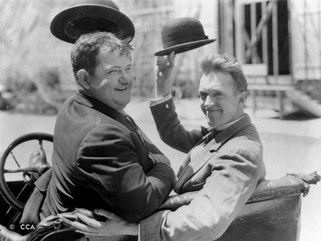
Any Questions?
www.projects.ed.ac.uk
pmo@ed.ac.uk
@uoe_isapps
@uoe_pmo
Notes:
<Mark>
<Next Slide Mark>

Slide 52
Help Us Improve and Grow
Thank you for participating
in today’s session!
We’re very interested in your feedback. Please take
a minute to fill out the session evaluation found within the conference mobile app, or the online agenda
Notes:
<Mark>

